Slide 1
AOSP Apps Investigations
Part 3: Investigating calendar services
Notes:
https://digitalcorpora.s3.amazonaws.com/corpora/mobile/android_10/Non-Cellebrite%20Extraction/Pixel%203.zip

Slide 2
Calendar services

Slide 3
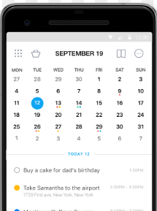
What are calendar services?
Calendar Provider is Android’s central service for calendar data.
Apps and sync adapters access it through CalendarContract / ContentResolver APIs.
It stores and synchronizes calendars, events, attendees, reminders, and event instances.
Pre-installed and third-party calendar apps display data through this provider.

Slide 4
Potential evidence from calendar services
Event titles, descriptions, and locations.
Start/end times, time zones, all-day flags, and recurrence rules.
Attendees, organizers, reminders, and response status.
Account ownership and synchronization indicators.
Note: in this sample extraction, the relevant tables may have no user rows; still document the schema and absence of evidence.

Slide 5
Forensic questions for calendar evidence
When was the event scheduled to occur?
Where was the event supposed to happen?
Who organized the event and who was invited?
Was the event recurring, deleted, modified, or synced from an account?
Does the calendar record corroborate or contradict other evidence?

Slide 6
Investigate calendar services

Slide 7
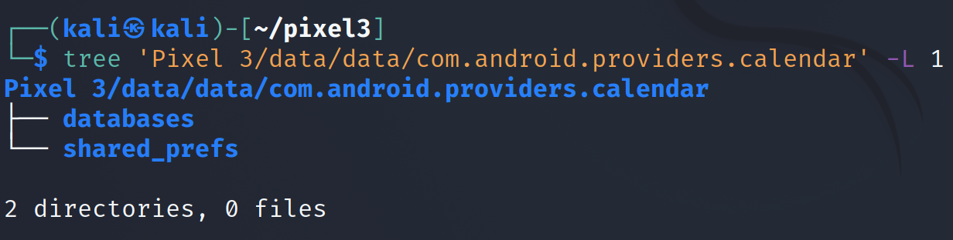
Calendar services folder structure
Notes:
Cmd: tree 'Pixel 3/data/data/com.android.providers.calendar' -L 1

Slide 8
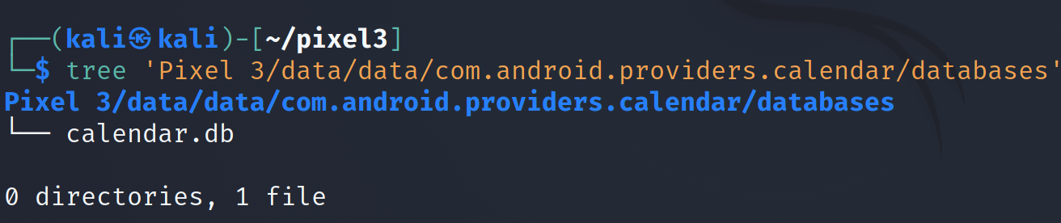
calendar.db location
Notes:
Cmd: tree 'Pixel 3/data/data/com.android.providers.calendar/databases'

Slide 9
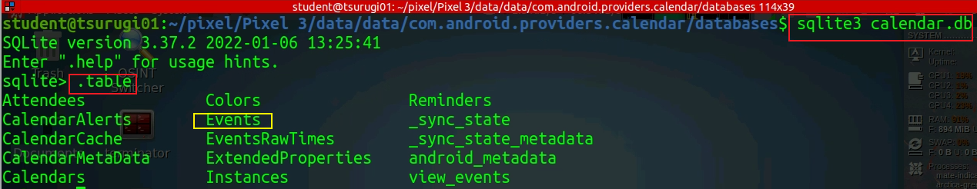
Examine calendar.db
Focus tables: calendars, events, attendees, reminders, instances.
Notes:
Cmd: sqlitebrowser 'Pixel 3/data/data/com.android.providers.calendar/databases/calendar.db'

Slide 10
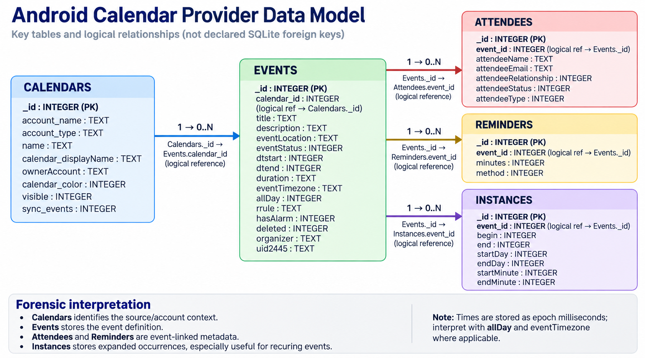

Slide 11
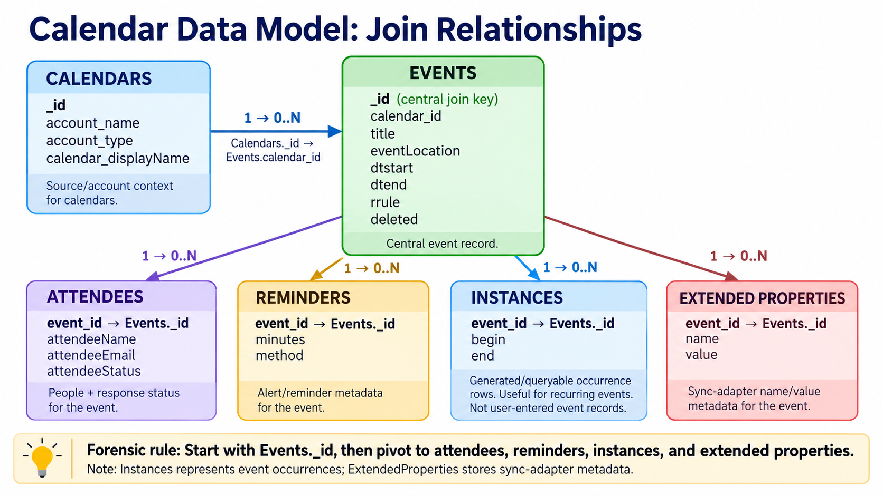

Slide 12
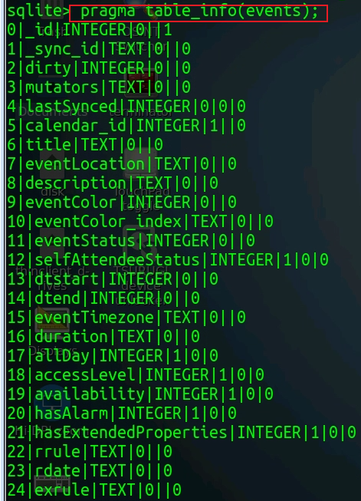
Column | Type | Description
_id | INTEGER | Primary key for the event.
calendar_id | INTEGER | Foreign key linking to Calendars._id.
title | TEXT | Event title.
description | TEXT | Event description.
eventLocation | TEXT | Location of the event.
eventStatus | INTEGER | Status (e.g., tentative=0, confirmed=1, canceled=2).
dtstart | INTEGER | Start time in UTC (milliseconds since epoch).
dtend | INTEGER | End time in UTC (milliseconds since epoch).
duration | TEXT | Duration if dtend is not set (e.g., “PT1H”).
eventTimezone | TEXT | Time zone for the event start.
eventEndTimezone | TEXT | Time zone for the event end (Android ≥7.0).
allDay | INTEGER | 1 if all-day event, else 0.
rrule | TEXT | Recurrence rule (RFC 5545 format, e.g., “FREQ=WEEKLY;COUNT=10”).
rdate | TEXT | Recurrence dates.
exrule | TEXT | Exclusion rule.
exdate | TEXT | Exclusion dates.
original_id | INTEGER | _id of the original recurring event (for exceptions).
original_sync_id | TEXT | Legacy sync ID for recurring exceptions.
originalInstanceTime | INTEGER | Start time of the original recurring instance.
originalAllDay | INTEGER | Whether the original event was all-day.
lastDate | INTEGER | Last date this event repeats on (UTC ms).
hasAlarm | INTEGER | 1 if event has a reminder.
hasExtendedProperties | INTEGER | 1 if event has extended properties.
accessLevel | INTEGER | Access level (default=0, owner=700, etc.).
availability | INTEGER | Availability (busy=0, free=1, tentative=2).
guestsCanModify | INTEGER | Whether guests can modify the event.
guestsCanInviteOthers | INTEGER | Whether guests can invite others.
guestsCanSeeGuests | INTEGER | Whether guests can see other guests.
organizer | TEXT | Organizer’s email or identifier.
isOrganizer | INTEGER | 1 if the user is the organizer.
selfAttendeeStatus | INTEGER | Attendance status for the current user.
sync_data1–sync_data5 | TEXT | Reserved for sync adapters.
customAppPackage | TEXT | Custom app package that created the event.
customAppUri | TEXT | URI for the custom app.
uid2445 | TEXT | Globally unique ID (iCalendar UID).
lastSynced | INTEGER | Last sync timestamp (ms).
dirty | INTEGER | Whether record has unsynced local changes (1=yes).
deleted | INTEGER | Whether event is deleted (soft delete flag).

Slide 13
Interpreting calendar time evidence
Raw event time
dtstart and dtend define event boundaries; duration may be used for recurring events.
Time zone context
Use eventTimezone / eventEndTimezone before converting values to local time.
All-day flag
allDay = 1 means date-level evidence; avoid interpreting it as a precise local hour.
Recurrence rules
rrule, rdate, exrule, exdate, and instances determine repeated or excluded occurrences.
Reporting standard: show the raw database value, conversion method/time zone, and interpreted human-readable time.

Slide 14
Why the Events table matters
Timeline: dtstart, dtend, duration, recurrence, and deleted flags help reconstruct planned activity.
Location and intent: title, description, and eventLocation may reveal plans or context.
Relationships: organizer and attendee joins identify people connected to the event.
Account provenance: calendar_id links the event to a calendar/account owner.
Corroboration: compare calendar records with messages, calls, GPS, browser history, and cloud artifacts.

Slide 15
Example investigation scenario
Question: Was there a scheduled meeting around a relevant date/time?
Find candidate rows in events using dtstart/dtend or recurrence instances.
Join events to calendars to identify the owning account/calendar.
Join events to attendees and reminders to identify people and notification behavior.
Report raw database values first, then explain the interpretation and uncertainty.

Slide 16
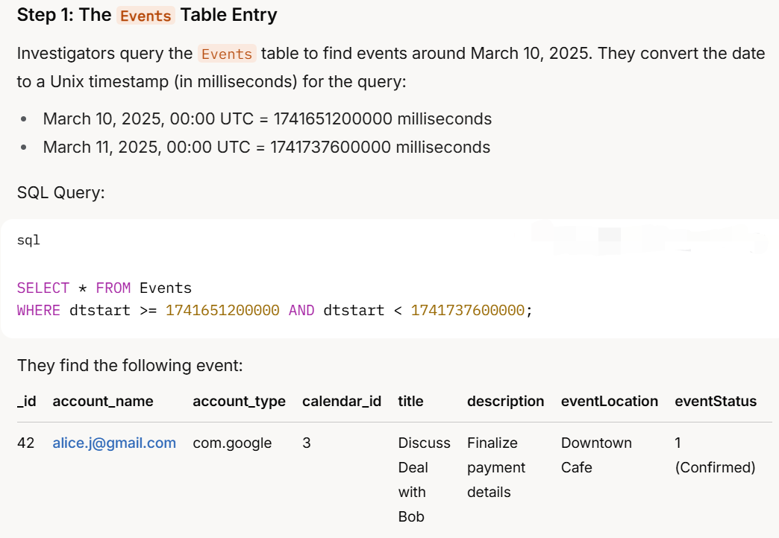
in calendars table

Slide 17
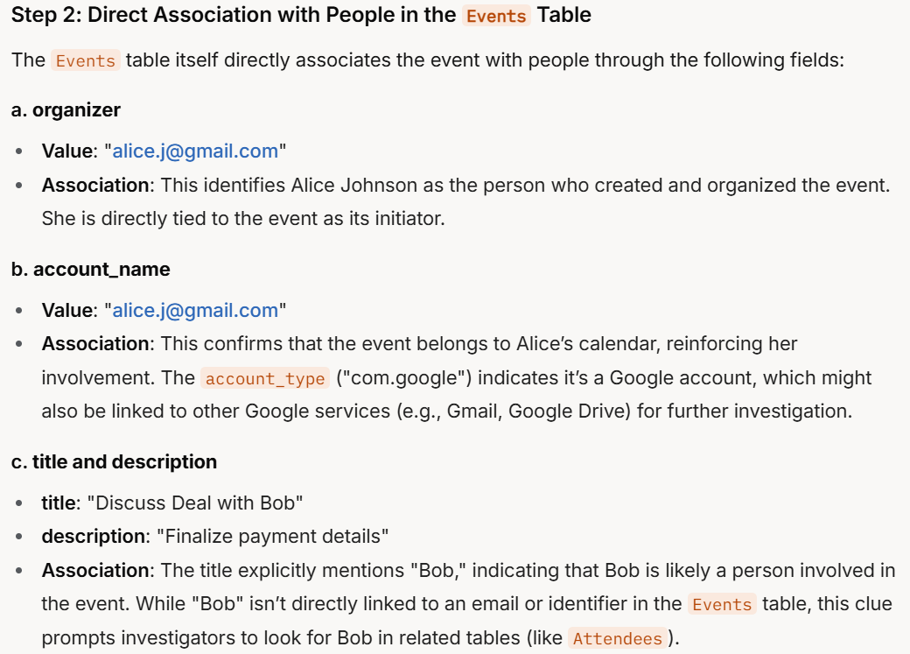

Slide 18
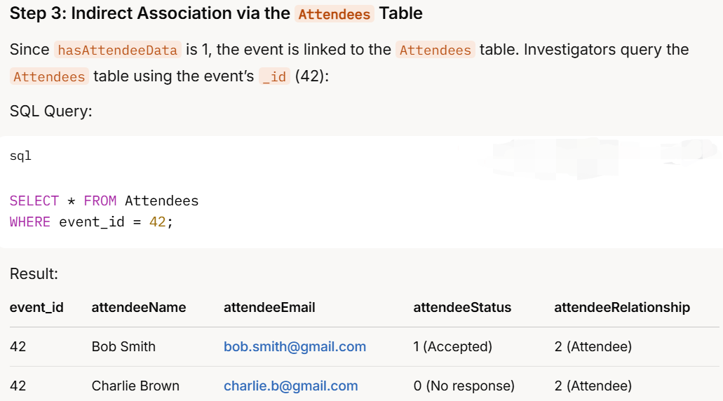

Slide 19
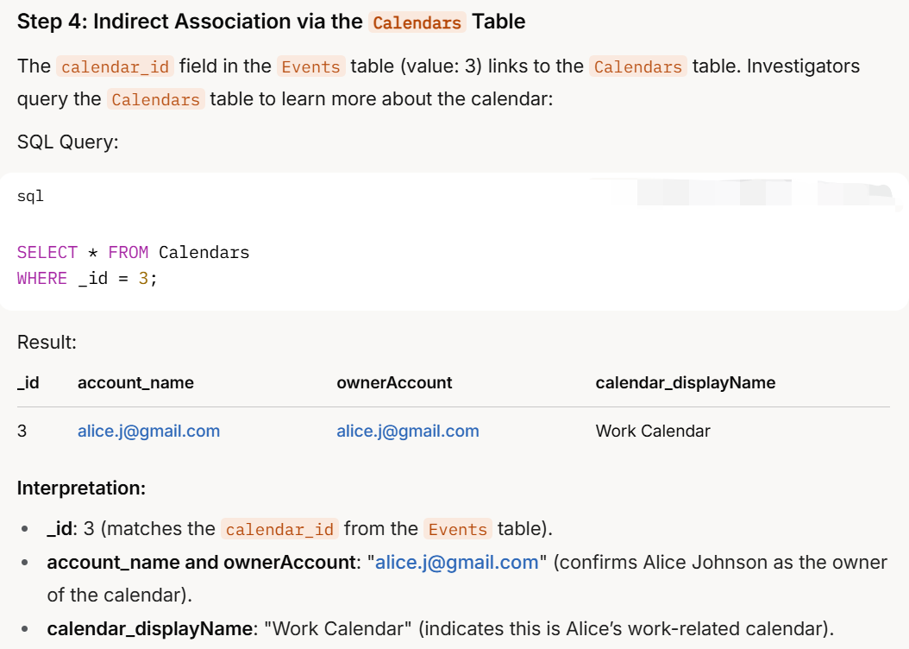

Slide 20
Summary: calendar services in Android forensics
Calendar Provider centralizes calendar data in `com.android.providers.calendar` and exposes it through CalendarContract.
Start with `calendar.db`: focus on calendars, events, attendees, reminders, and instances.
Use joins to add context: calendars identify account ownership; attendees identify people; reminders show alert behavior; instances resolve occurrences.
Interpret time carefully: raw timestamps, time zones, all-day flags, and recurrence rules can change the meaning of an event.
Forensic takeaway: calendar artifacts are evidence of scheduled or synchronized activity; corroborate before treating them as proof that an activity occurred.

Slide 21
Calendar investigation workflow
1
2
3
4
5
6
Locate
calendar.db
Inventory
core tables
Query
events
Join
calendar_id / event_id
Interpret
time + recurrence
Corroborate
other artifacts
If events are absent: do not invent findings. Report that no event rows were recovered and document the acquisition scope and tables checked.

