Slide 1
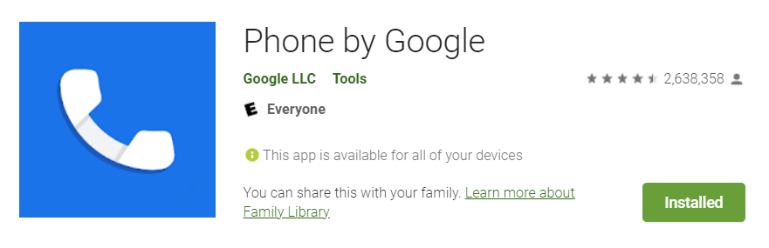
GMS Apps Investigations
Part 2: GMS Google Phone Dialer App

Slide 2
Phone Dialer App?

Slide 3
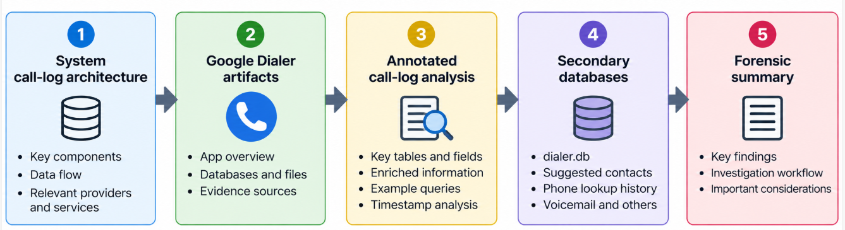
Roadmap

Slide 4
What is Phone Dialer App?
Google Phone is the default dialer on Pixel devices and some other Android phones.
Primary evidence functions:
  place and receive calls
  display call history
  resolve numbers through contacts/caller ID
  support spam filtering, visual voicemail, and call screening when enabled
Package: com.google.android.dialer

Slide 5
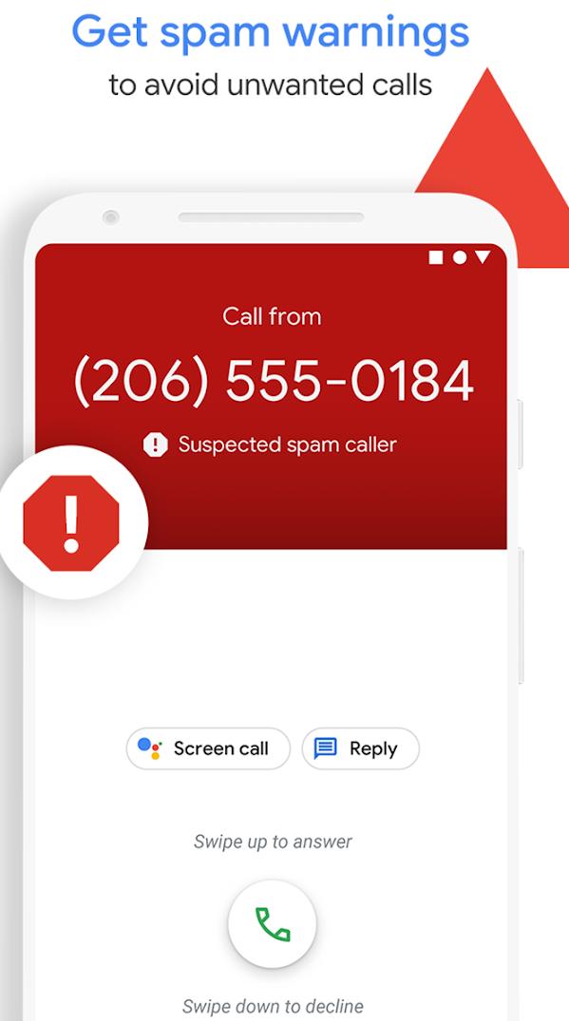
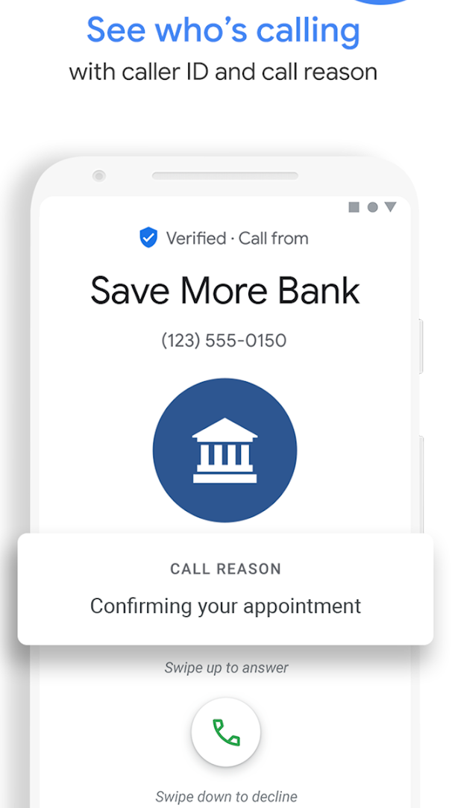
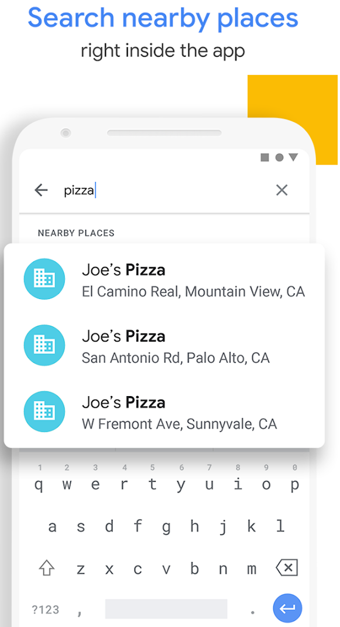
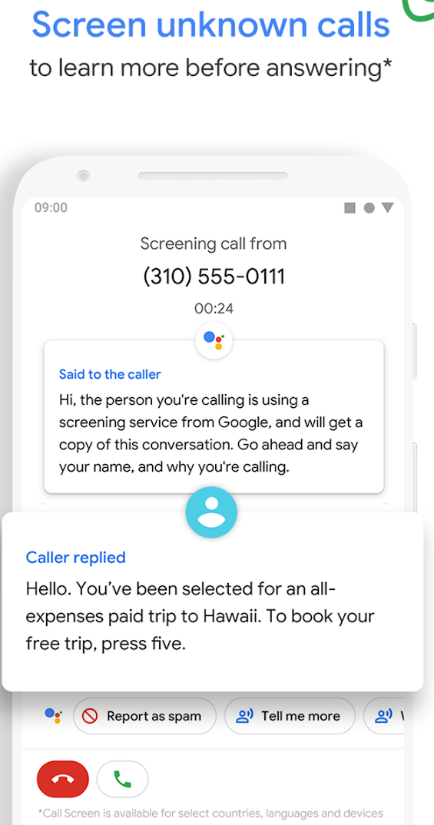

Slide 6
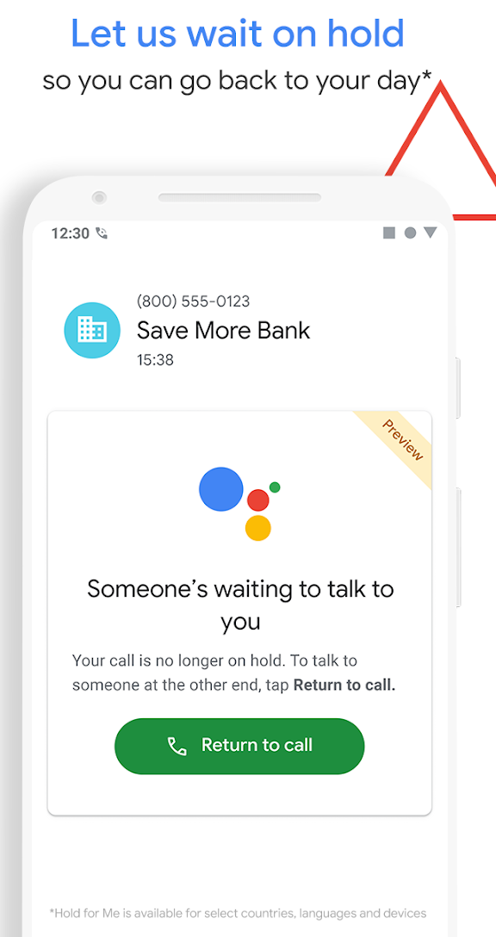
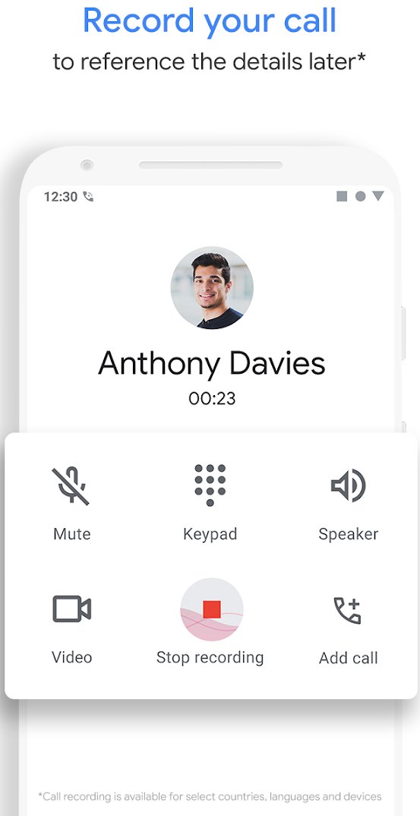
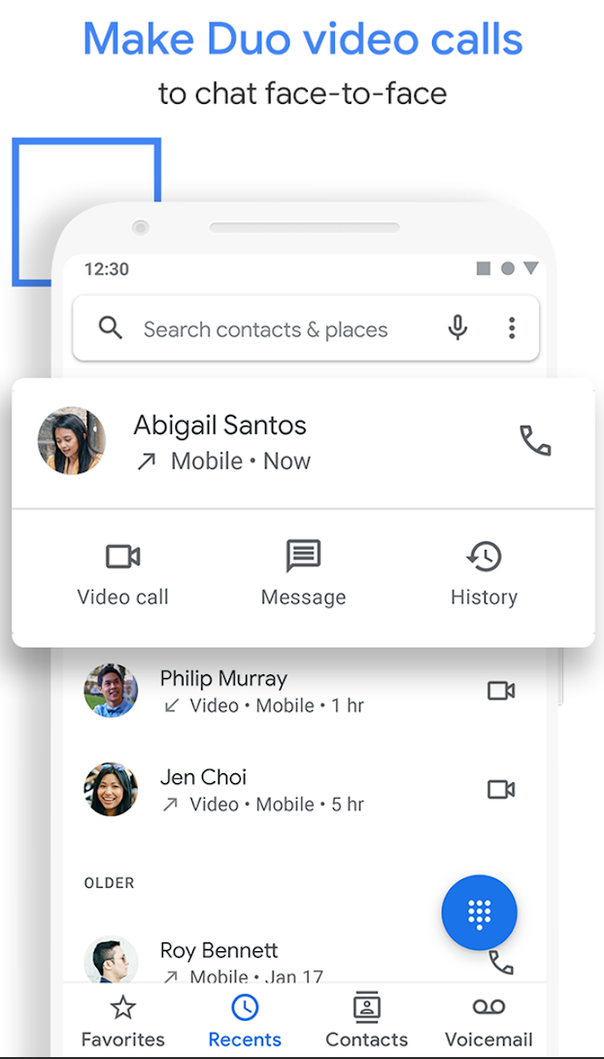
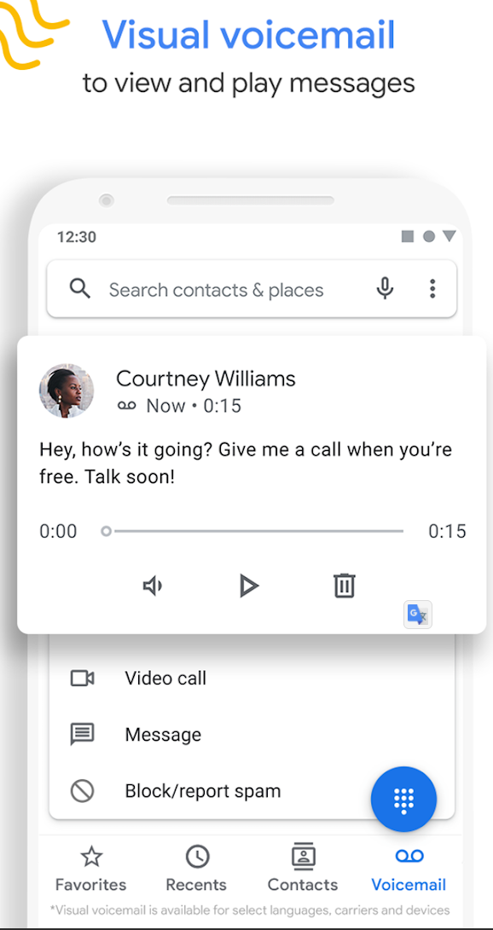

Slide 7
Android call-log architecture
Separate the user-facing Dialer app from system call-log storage
Google Phone
User-facing app
Package: com.google.android.dialer
Android Telecom
Manages call lifecycle
and phone accounts
Call Log Provider
Authority: call_log
API: CallLog.Calls
calllog.db
System call-history
backing SQLite DB
Key distinction
The Dialer does not own the authoritative system call log. It queries and manages call-history records through Android APIs/providers.
Forensic rule
Start with system calllog.db for call events. Then use Google Dialer databases to enrich and corroborate caller ID, spam, voicemail, and screening context.

Slide 8
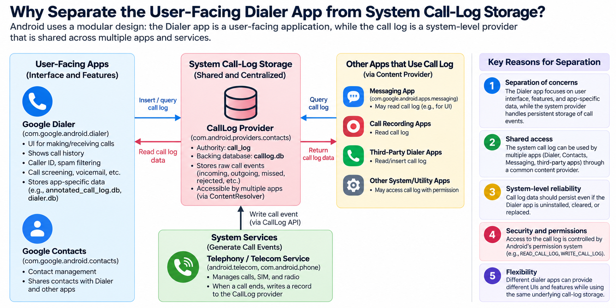

Slide 9
Three layers of Call-Log Architecture
App Layer — User-Facing
  contains applications the user directly interacts with.
Content Provider Layer — Shared Data Access
  Android's standardized interface for accessing structured data shared between apps and the operating system.
System Service Layer — Call Processing
  Android OS services that perform the actual low-level phone and communication operations.

Slide 10
Google Dialer and Android Call-Log Architecture
Google Dialer is the user-facing interface for making calls, viewing call history, caller ID, spam filtering, screening, and voicemail.
  Apps access shared Android data through Content Providers rather than directly manipulating system databases.
CallLogProvider uses the authority call_log and exposes call history through content://call_log/calls.
  Thinks of authority as the unique name Android uses to identify a Content Provider.
Android Telecom records completed call events through the CallLog API/CallLogManager.
  The system call history is stored in calllog.db, separate from Google Dialer’s app-private databases.
Google Dialer uses Android Telecom to make/manage calls, but uses CallLogProvider to access call history. When a call completes, Android Telecom writes the call event through CallLogProvider into calllog.db.

Slide 11
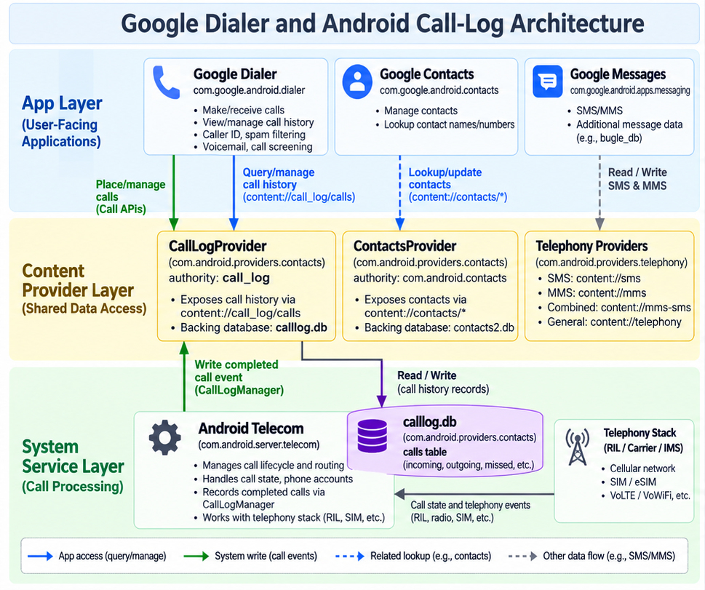

Slide 12
Sample Service Providers at System Service Layer
Provider | Authority | Backing Package | Notes
Contacts Provider | com.android.contacts | com.android.providers.contacts | Manages contacts, raw contacts, data rows (emails, phones, etc.)
CallLog Provider | call_log | com.android.providers.contacts | Exposes call-history records through content://call_log/calls; backing SQLite database is calllog.db.
IMS Service |  | com.google.android.ims | Supports VoLTE/VoWiFi and other IMS features; exact artifacts are device and version dependent.
Telephony Service |  | com.android.phone | System telephony stack for SIM/radio state, call routing, and related phone services.
Notes:
digraph GoogleDialerArchitecture {
rankdir=TB;
node [shape=box, style=filled, fillcolor=white];
subgraph cluster_app {
label="App Layer (User-Facing)";
color=lightblue;
GoogleDialer [label="Google Dialer\n(com.google.android.dialer)\n- dialer.db\n- annotated_call_log.db\n- Spam, Caller ID, Screening"];
ContactsApp [label="Google Contacts\n(com.google.android.contacts)\n- contacts2.db"];
Messaging [label="Google Messages\n(com.google.android.apps.messaging)\n- bugle_db"];
}
subgraph cluster_provider {
label="Content Provider Layer";
color=lightyellow;
ContactsProvider [label="Contacts Provider\n(com.android.providers.contacts)\n- contacts2.db, calllog.db\n- exposes contacts & call log URIs"];
CallLogProvider [label="CallLog Provider\n(content://call_log/calls)\n(sub-provider of ContactsProvider)"];
TelephonyProvider [label="Telephony Provider\n(com.android.providers.telephony)\n- content://sms, content://mms"];
}
subgraph cluster_system {
label="System Service Layer";
color=lightgray;
TelephonyService [label="Telephony Service\n(android.telephony)\n- SIM, radio, call & SMS routing"];
IMSService [label="IMS / Carrier Service\n(com.google.android.ims)\n- VoLTE, VoWiFi, RCS\n- rcs.db"];
}
// App → Provider relationships
GoogleDialer -> CallLogProvider [label="Query / Insert Calls", color=blue];
GoogleDialer -> ContactsProvider [label="Lookup / Update Contacts", color=blue];
ContactsApp -> ContactsProvider [label="CRUD via ContentResolver", color=blue];
Messaging -> TelephonyProvider [label="Read / Write SMS & MMS", color=blue];
// Provider → System Services
CallLogProvider -> TelephonyService [label="Retrieve call state", color=gray];
TelephonyService -> IMSService [label="Forward to IMS (VoLTE/RCS)", color=gray, style=dashed];
// Provider hierarchy
ContactsProvider -> CallLogProvider [label="same package\n(com.android.providers.contacts)", style=dotted, color=gray];
// Shared RCS linkage
IMSService -> Messaging [label="rcs.db ↔ bugle_db (RCS transport)", color=darkgreen, style=dotted];
}

Slide 13
Section 1 — Google dialer vs. system call-log overview
what is app-private cache/enrichment.

Slide 14
Google Dialer Evidence Sources and Databases
calllog.db is the primary system source for call events: number, call type, time, duration, and phone-account information.
annotated_call_log.db contains Google Dialer–specific enrichment such as caller labels, spam information, and other annotations when available.
dialer.db and related Dialer databases provide secondary evidence such as Smart Dial, lookup, and app-specific state.
contacts2.db helps resolve phone numbers to contacts and account/source information.
bugle_db belongs to Google Messages and should be treated only as a cross-app corroboration source, not as a Dialer database.
Google app-private schemas are version-dependent, so always inspect the extracted schema before interpreting fields.

Slide 15
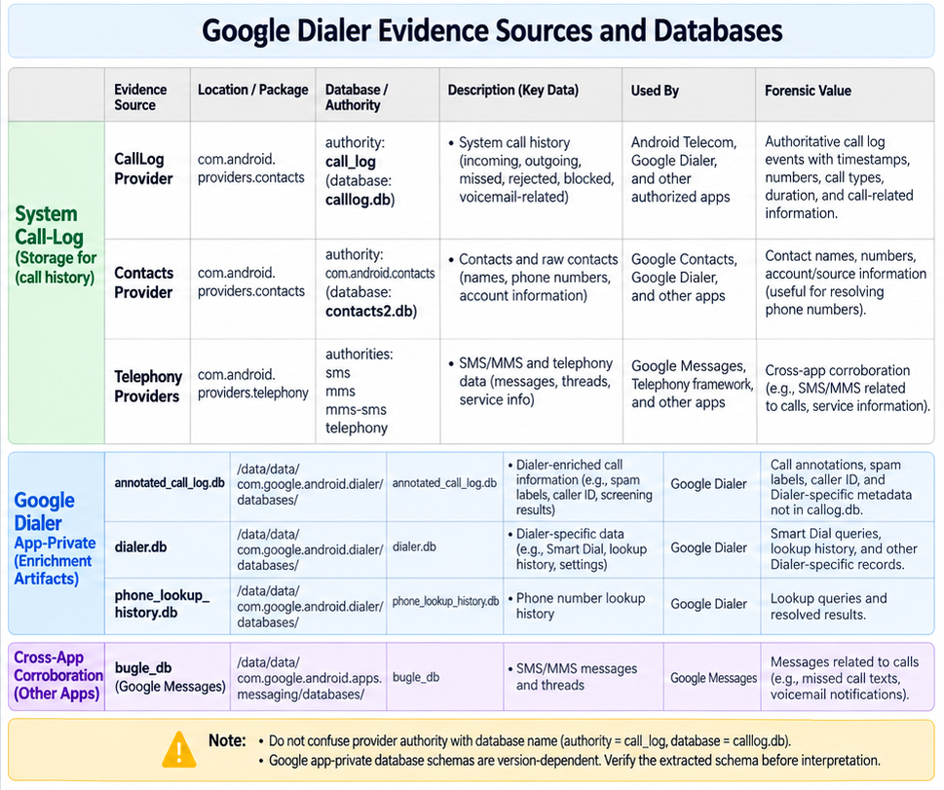

Slide 16
Concept | calllog.db.calls (📁 com.android.providers.contacts) | annotated_call_log.db.annotatedcalllog (📁 com.google.android.dialer)
Origin | Contacts Provider (system-level) - authoritative call log | Google Dialer app — app-level cache / enriched view for UI display
Link key | _id | Correlation key must be verified from extracted schema; do not assume a database-enforced foreign key.
Data type | Raw call event (date, number, type, duration, SIM info) | Enriched/cache record: caller ID labels, spam/screening metadata, voicemail/call-screening fields when present
Sync direction | Contacts Provider → Dialer (read-only copy) | Updated by Google Dialer application logic or observers; not a two-way database sync
Persistence | System-persistent (survives app resets) | App-private; may be lost if Google Dialer app data is cleared
Extra fields | — | is_spam, label, business_name, call_screening_status, transcription

Slide 17
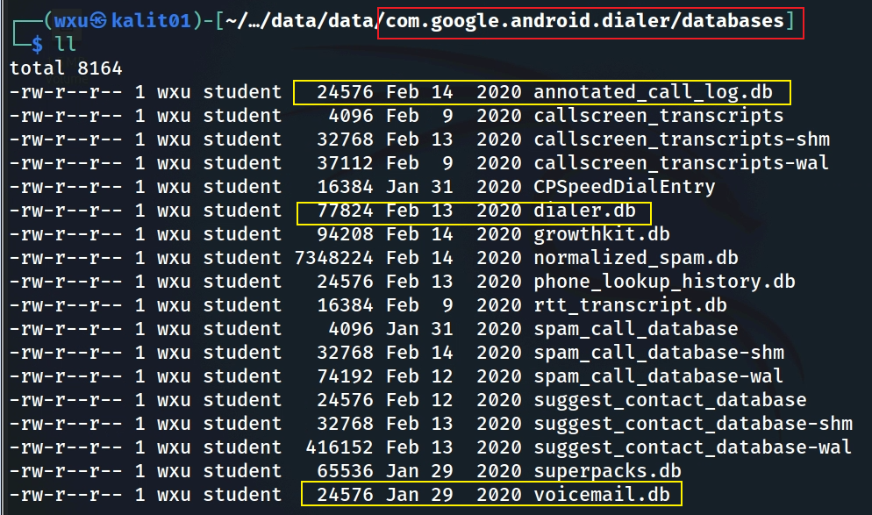
Phone Dialer Databases
Notes:
tree 'Pixel 3/data/data/com.google.android.dialer/databases/'

Slide 18
Section 2 — High-value Google Dialer artifacts
Identify which databases can enrich or corroborate system call logs.

Slide 19
High-Value Google Dialer Artifacts
annotated_call_log.db
Why? App-level enriched call-log cache used by Google Dialer UI. It can contain caller ID labels, spam/screening annotations, voicemail-related fields, and cached display data.
Use case: Enrich system call-log records; do not treat it as the authoritative call source.
dialer.db
Why? Stores Google Dialer app data such as smart-dial/search support, contact-association caches, and filtering/blocking-related data.
Use case: Corroborate numbers and contact relationships; not a replacement for system calllog.db.
suggest_contact_database
Why? Supports contact suggestions and ranking used by Google apps/features. It may reflect frequent or recent interaction patterns.
Use case: Identify high-priority contacts and possible residual interaction traces. Interpret scores as app-generated ranking values, not direct counts.

Slide 20
High-Value Google Dialer Artifacts (2)
voicemail.db
Why? May contain voicemail metadata, greetings, transcriptions, or references to voicemail content depending on carrier, device, and app configuration.
Use case: Determine whether voicemail artifacts exist and correlate them with call-log records.
phone_lookup_history.db
Why? Caches phone-number lookup results used for caller ID/spam/caller information.
Use case: Corroborate unknown-number identification and cached lookup metadata.

Slide 21
High-Value Google Dialer Artifacts (3)
rtt_transcript.db
Why? May preserve Real-Time Text call transcripts if RTT was used and supported.
Use case: Recover text exchanged during calls; correlate with call-log timestamps and numbers.
callscreen_transcripts
Why? May contain Google Call Screen interaction text and metadata.
Use case: Examine interactions with unknown or suspicious callers when call screening was used.

Slide 22
Section 3 — Annotated call-log workflow
Interpret timestamps, numbers, call type, phone-account fields, voicemail, and caller-ID metadata.

Slide 23
annotated_call_log.db

Slide 24
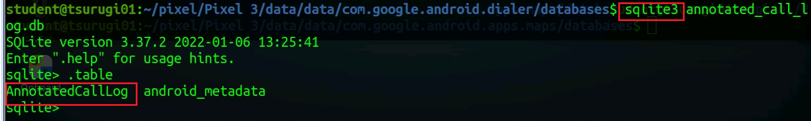

Slide 25
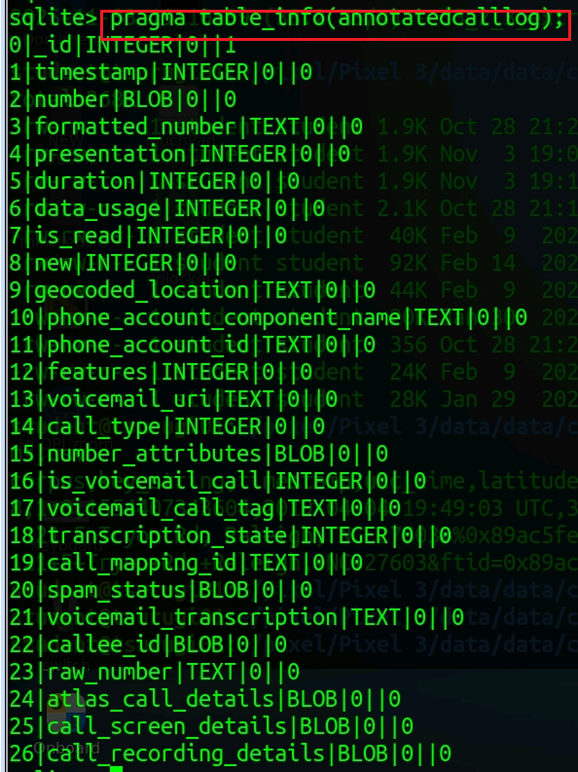

Slide 26
Column (AnnotatedCallLog) | Type | Description
_id | PRIMARY KEY | Local unique identifier for the cached call entry in this table (not necessarily equal to _id in calllog.db).
timestamp | INTEGER | UNIX epoch time (milliseconds) when the call occurred (maps to date in system call log).
number | TEXT | Raw phone number as stored from the system call log (Calls.NUMBER).
formatted_number | TEXT | Human-readable formatted version (with country code and spacing). Derived using Google’s libphonenumber.
presentation | INTEGER | How the number was presented: 1 = allowed, 2 = restricted, 3 = unknown, 4 = payphone (see CallLog.Calls.PRESENTATION_*).
duration | INTEGER | Length of call in seconds.
data_usage | INTEGER | Bytes used for data-based calls (VoIP, RCS, Duo, etc.). Often 0 for normal cellular calls.
is_read | INTEGER (0/1) | Whether the user has viewed this call entry (affects “new call” badge in the Dialer).
new | INTEGER (0/1) | Same logic as in system log – 1 if the call is new/unread, 0 otherwise.
geocoded_location | TEXT | Location string inferred from number prefix (e.g., “Maryland, USA”). Added by Dialer’s number lookup service.
phone_account_component_name | TEXT | Component name of the telephony account (e.g., SIM or VoIP package). Helps distinguish SIM1 vs SIM2 vs Wi-Fi call.
phone_account_id | TEXT | Identifier of the phone account (e.g., IMSI or account tag).
features | INTEGER | Bitmask flags for call features (e.g., video call, Wi-Fi call, RTT, etc.) matching CallLog.Calls.FEATURES_*.
voicemail_uri | TEXT | URI to the voicemail content if this was a voicemail entry (content://voicemail/…).
call_type | INTEGER | Type of call: 1=INCOMING, 2=OUTGOING, 3=MISSED, 4=VOICEMAIL, 5=REJECTED, 6=BLOCKED, 7=ANSWERED_EXTERNALLY.
number_attributes | INTEGER | Encoded attributes such as IS_BUSINESS, IS_EMERGENCY, IS_TOLL_FREE. Used for UI badges.
is_voicemail_call | INTEGER (0/1) | Flag indicating if this call is a voicemail entry.
voicemail_call_tag | TEXT | Optional tag describing voicemail call source or type.
transcription_state | INTEGER | State of voicemail transcription: 0=none, 1=pending, 2=complete, 3=failed.
call_mapping_id | INTEGER | Mapping key linking this annotated entry to the corresponding calls._id in calllog.db.
spam_status | INTEGER | Spam evaluation result: 0=not spam, 1=suspected spam, 2=confirmed spam.
voicemail_transcription | TEXT | Full text transcription of a voicemail, if available.
callee_id | TEXT | Cached display name or lookup key (e.g., contact name, business name, or Google caller ID).
raw_number | TEXT | Unformatted original dialed number before normalization.
atlas_call_details | TEXT (JSON) | Internal JSON field used for analytics and metrics (“Atlas” is Google’s internal dialer analytics module).
call_screen_details | TEXT (JSON) | JSON-encoded metadata for Google’s Call Screen feature (e.g., transcript, reason, outcome).
call_recording_details | TEXT (JSON) | Metadata for recorded calls (if supported in that region). Contains file path, duration, mime type, etc.

Slide 27
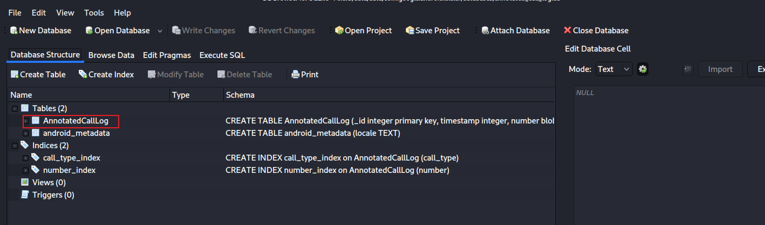
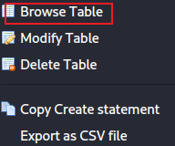
AnnotatedCallLog table content
Notes:
sqlitebrowser 'Pixel 3/data/data/com.google.android.dialer/databases/annotated_call_log.db'

Slide 28
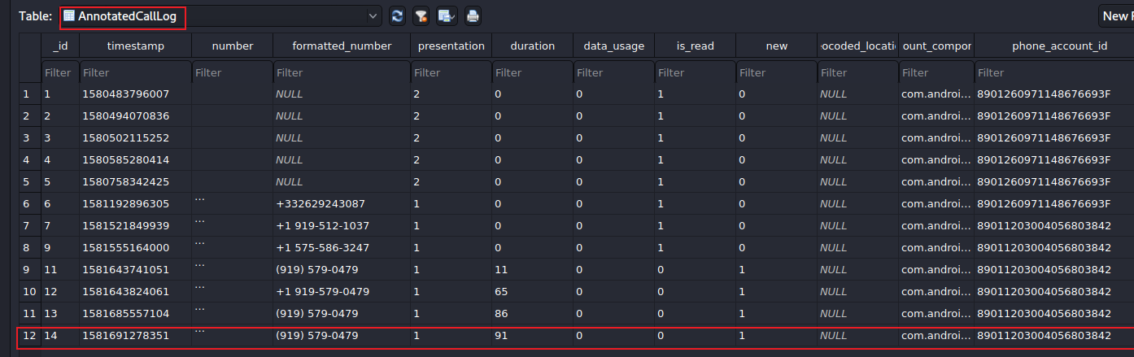

phone_account_component_name
(com.android.phone / TelephonyConnectionService)
Call timestamp
(epoch ms; divide by 1000 for date -d @seconds)
Stored number
(raw caller/callee value)
Duration
91 seconds
New/read flags
0/1 values
Phone account ID
Account identifier; do not assume IMSI without corroboration.
Number presentation
1 = allowed
2 = restricted/private
3 = unknown
4 = payphone
Phone account component: Identifies the service/component that handled the call.
Notes:
date -d '@1581691278’ –u
https://developer.android.com/reference/android/provider/CallLog.Calls

Slide 29
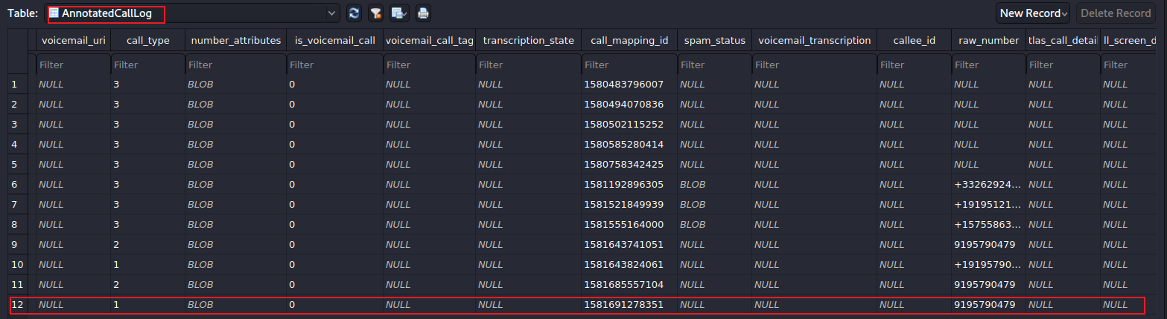
Call type
1 = incoming
2 = outgoing
3 = missed
4 = voicemail
5 = rejected
6 = blocked
7 = answered externally
voicemail_uri
Pointer to voicemail content/metadata when present.
Voicemail indicator
Use with call_type and voicemail_uri.
Voicemail transcription state
Interpret as app/provider-specific status for transcription processing.
Notes:
https://developer.android.com/reference/android/provider/CallLog.Calls.html#TYPE
https://android.googlesource.com/platform/packages/apps/Dialer/+/5d01ebb84a25c097a58ea8a3e1b4a521456e6f17/java/com/android/dialer/calllogutils/PhoneCallDetails.java

Slide 30

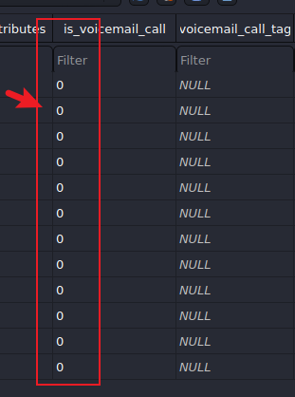
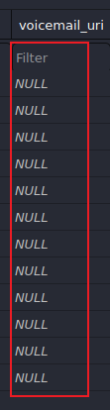
Sample Questions
List all incoming calls
  2
Did any callers leave voice mails?
  none

Slide 31
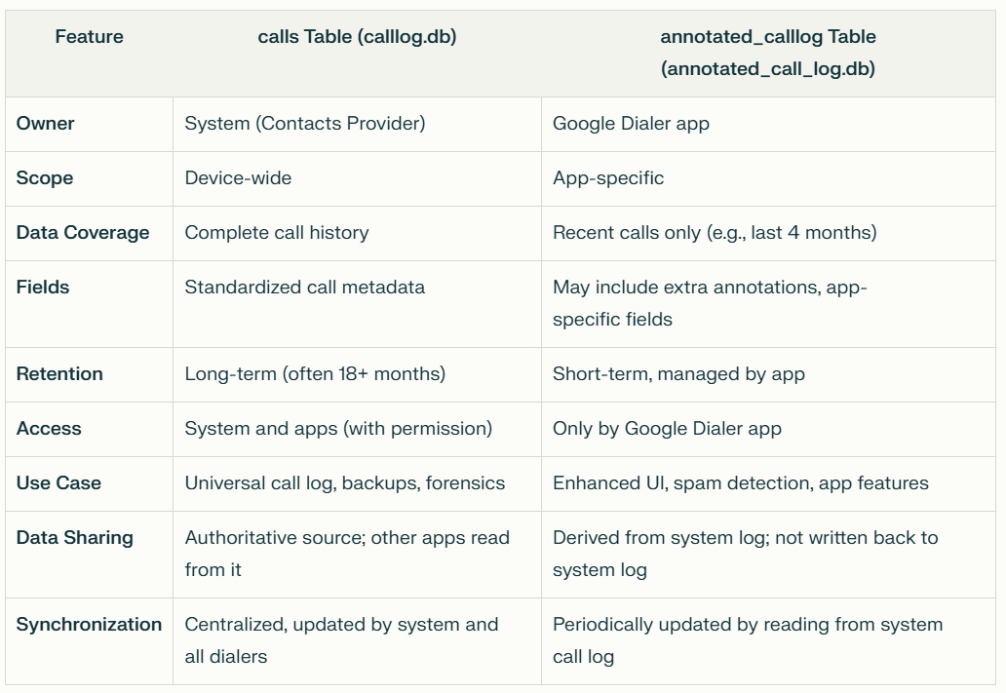

Slide 32
System call log vs. Google Dialer annotated cache
Key distinction:
calllog.db.calls is the system-level call-history source.
annotated_call_log.db is a Google Dialer app-private cache/enrichment layer.
Correlation:
Do not assume a database-enforced foreign key between the two databases.
Verify the extracted schema and use timestamps, numbers, call type, phone account fields, and app-specific mapping columns when present.
Forensic rule:
Start with the system call event, then use Dialer artifacts to enrich and corroborate it.
Treat caches as supporting evidence unless independently verified.

Slide 33
Deleted call-log recovery: forensic caveats
Question: Can a deleted call-log record still be recovered?
Answer:
  Possibly — but there is no fixed recovery window. Recovery depends on SQLite state, WAL/journal files, free pages, backups, and subsequent writes.
  Do not rely on Google Dialer caches alone; correlate system calllog.db, -wal/-journal, annotated_call_log.db, voicemail, lookup history, and contact artifacts.
Question | Answer
Does deleting a call in Google Dialer remove it from calllog.db? | Often yes — if the deletion is performed through the Dialer UI, it normally propagates through Android APIs to the system call log.
Can it be recovered later? | Possibly. Deleted rows may remain in WAL/journal/free pages or correlated caches, but later writes can overwrite them.
Where to focus in forensics? | Prioritize calllog.db and its WAL/journal, then corroborate with Google Dialer caches, voicemail, lookup history, and contacts.

Slide 34
Section 4 — Smart Dial and suggested contacts
Use ranking and suggestion artifacts as supporting evidence, not direct call counts.

Slide 35
dialer.db

Slide 36
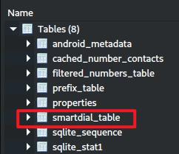
smart_dial_table
Smart Dial supports fast contact/number search as the user types.
Forensic value:
can link numbers to cached contact identifiers
may reflect frequently used or important contacts
should be interpreted as a Dialer app artifact, not a complete call log
Corroborate with contacts2.db, calllog.db, and annotated_call_log.db.

Slide 37
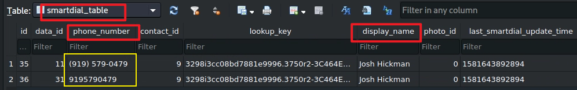
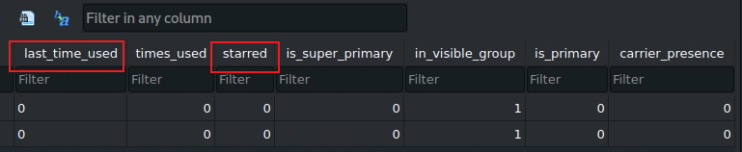
Two phone numbers are found

Slide 38
suggest_contact_database

Slide 39
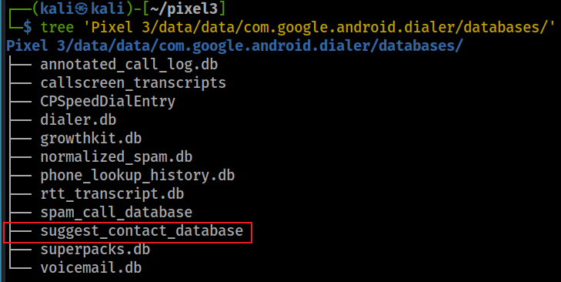
Understand user’s interactions with contacts, not just dialing
Suggested-contact artifacts may reflect app-generated ranking used for contact suggestions, sharing targets, or communication shortcuts.
Forensic interpretation:
useful for identifying contacts that may be important to the user
not a direct count of calls or messages
ranking logic is app/version dependent and should be described cautiously

Slide 40
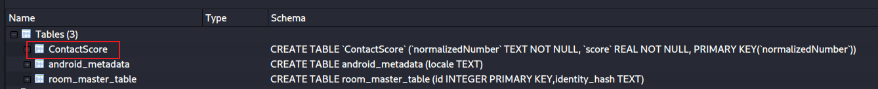
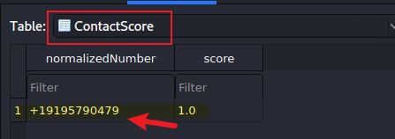
Open suggest_contact_database
Find frequently suggested / ranked phone numbers
Field | Type | Description
Normalized Number | TEXT | The phone number in normalized E.164 format (for example +13015551234). Acts as the primary key.
score | REAL (float) | A computed weight representing how “important” or “frequently used” the number is to the user.

Slide 41
score in ContactScore table
normalizedNumber | score
+13015551234 | 0.94
+12405550000 | 0.78
+18005550123 | 0.45
How should the score be interpreted?
Score is an app-generated ranking/weight, not a direct event count.
Higher values may suggest greater contact importance or interaction frequency/recency.
The exact algorithm is app-version dependent.
Forensic value
Can corroborate communication patterns even when individual call-log rows are missing.
Treat as supporting evidence and compare with call logs, contacts, and messages.

Slide 42
phone_lookup_history.db

Slide 43
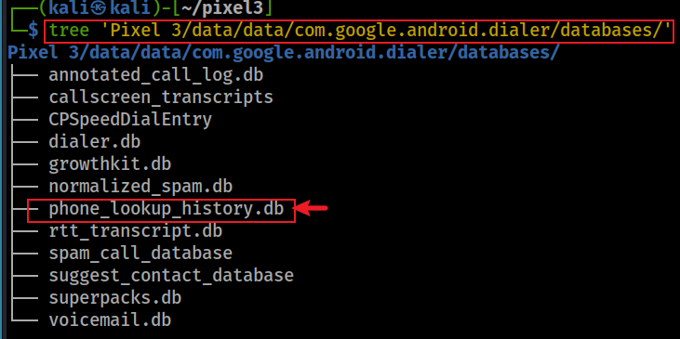
What is the phone lookup function?
Phone lookup supports caller ID, spam labeling, and enriched number display.
Google Dialer may cache lookup results locally in phone_lookup_history.db so repeated calls can be resolved quickly.
Forensic interpretation:
a cached lookup can show that the app had lookup information for a number
the cache does not, by itself, prove the user manually searched for the number
lookup sources and formats are app/version dependent

Slide 44
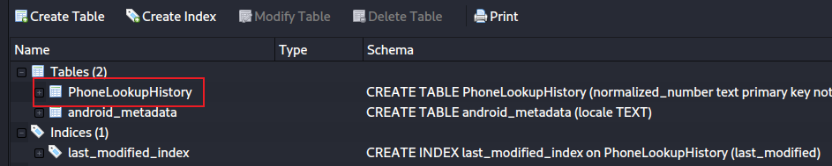
Open phone_lookup_history.db

Slide 45
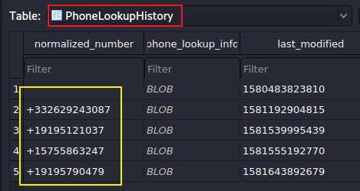
PhoneLookupHistory table
normalized_number: standardized phone number, usually in normalized/E.164-like form.
phone_lookup_info: serialized lookup payload stored as a BLOB.
Interpretation rule:
do not assume JSON; the payload may use Protocol Buffers or another serialized format.
export the BLOB and identify its structure before interpreting names, labels, or confidence values.

Slide 46
Section 5 — Lookup, voicemail, and other app-private artifacts
Inspect serialized lookup payloads, voicemail artifacts, screening data, RTT, and spam/blocking records.

Slide 47
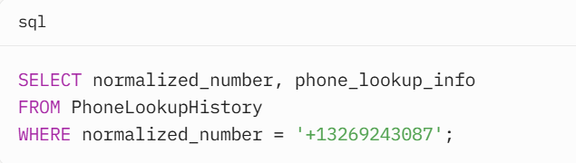
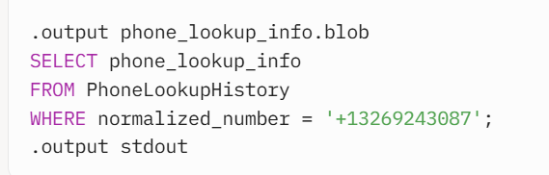
Access the BLOB
Notes:
import sqlite3
# Connect to the database
conn = sqlite3.connect('phone_lookup_history.db')
cursor = conn.cursor()
# Query the BLOB data
cursor.execute("SELECT normalized_number, phone_lookup_info FROM PhoneLookupHistory WHERE normalized_number = '+13269243087'")
row = cursor.fetchone()
if row:
normalized_number, blob_data = row
print(f"Phone Number: {normalized_number}")
# Save the BLOB to a file for further processing
with open('phone_lookup_info.blob', 'wb') as f:
f.write(blob_data)
# Close the connection
conn.close()

Slide 48
voicemail.db

Slide 49
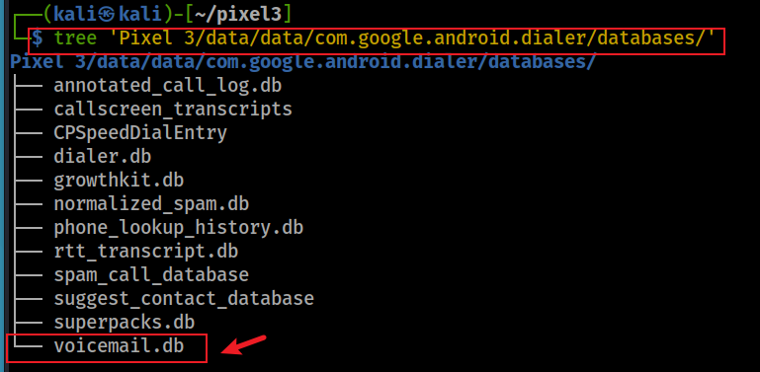
What is the greeting message?
Voicemail artifacts may include greeting metadata, voicemail entries, transcription state, and content references.
Question to ask: Did the user configure or store a custom voicemail greeting, and can it be correlated with voicemail/call-log records?

Slide 50
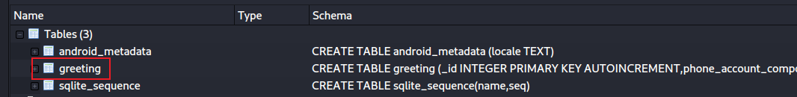
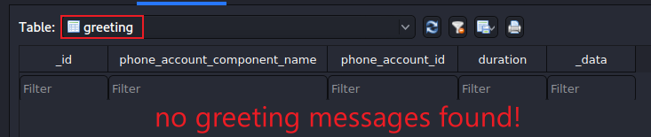
Open voicemail.db
Open voicemail.db: Inspect greeting and voicemail-related tables

Slide 51
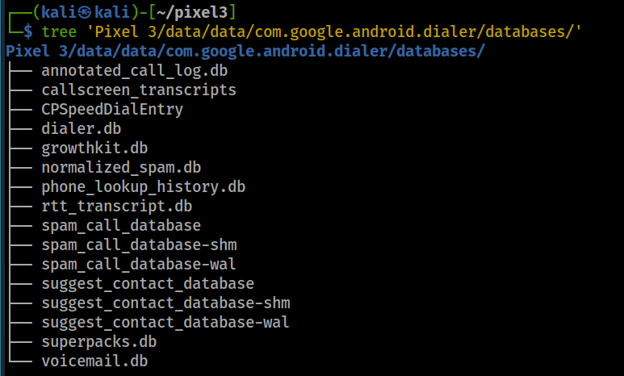
Other valuable information in databases
Other artifacts to check
• speed-dial entries
• spam/blocking databases
• call-screen transcripts
• RTT transcripts
• voicemail references and transcriptions
Use these as corroborating artifacts, not replacements for the system call log.

Slide 52
Summary: Google Dialer forensic workflow
Core concepts
• System calllog.db is the authoritative call-history source.
• Google Dialer databases enrich/corroborate call events.
• App-private caches are schema- and version-dependent.
• Distinguish observed database values from forensic interpretation.
Investigation sequence
1. Start with calllog.db.calls.
2. Correlate with annotated_call_log.db.
3. Check phone account/component fields.
4. Inspect voicemail, lookup, smart-dial, and call-screen artifacts.
5. Report source and limitations.
Forensic takeaway
Do not treat system call-log records and Google Dialer caches as interchangeable. Use app-private databases to enrich, corroborate, and explain the system call event.

