Slide 1
AOSP App Investigations
Part 1: Messaging Service Provider (SMS/MMS)
Notes:
https://digitalcorpora.s3.amazonaws.com/corpora/mobile/android_10/Non-Cellebrite%20Extraction/Pixel%203.zip

Slide 2
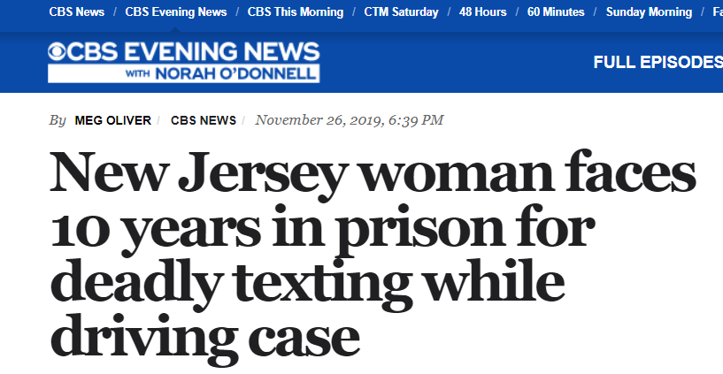
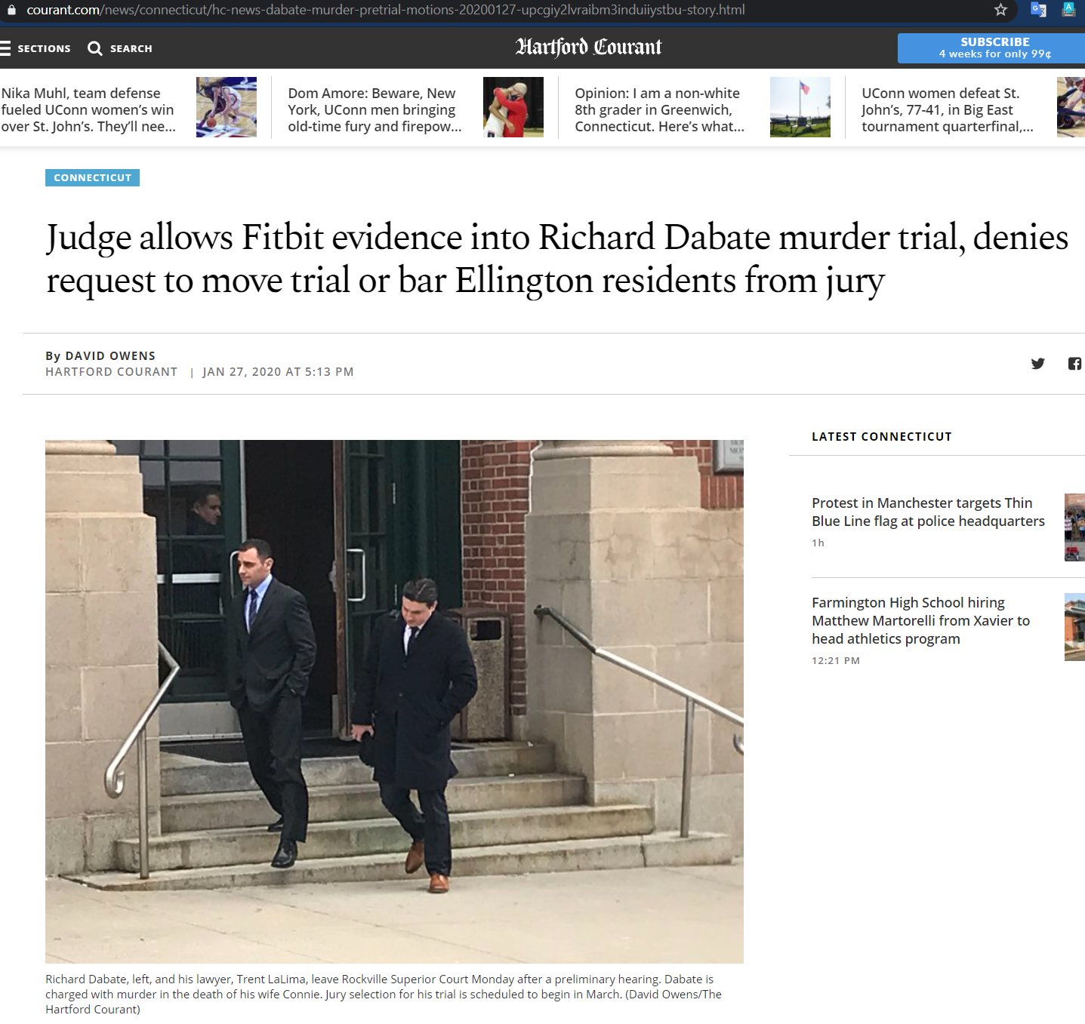
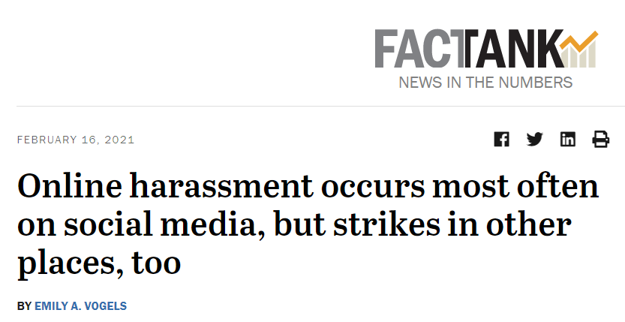
Why phone messaging matters in investigations
Notes:
https://www.cbsnews.com/news/new-jersey-woman-faces-10-years-in-prison-for-deadly-texting-while-driving-case-2019-11-26/
https://www.courant.com/news/connecticut/hc-news-dabate-murder-pretrial-motions-20200127-upcgiy2lvraibm3induiiystbu-story.html

Slide 3
AOSP Application/Services

Slide 4
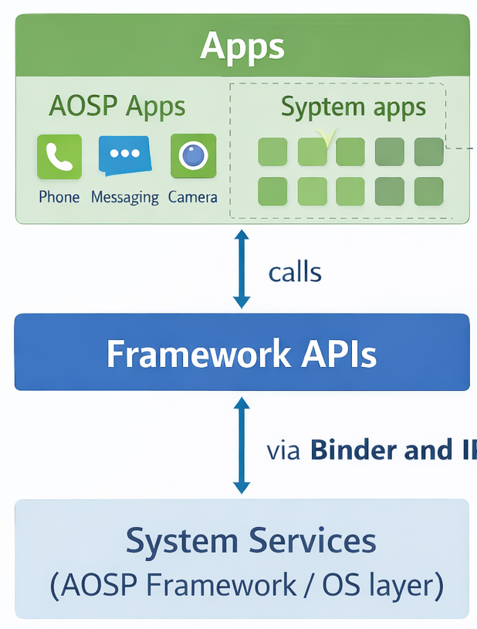
What is an AOSP application or service?
Android Open Source Project (AOSP) apps and services provide baseline phone functionality.
They also expose standard APIs that other apps can use.
Forensics value: app-service data may persist even when the visible app is not obvious.
Key examples: messaging, contacts, calendar, downloads, media, NFC, MTP, and user dictionary.
Notes:
https://android-developers.googleblog.com/2019/03/aosp-application-updates.html

Slide 5

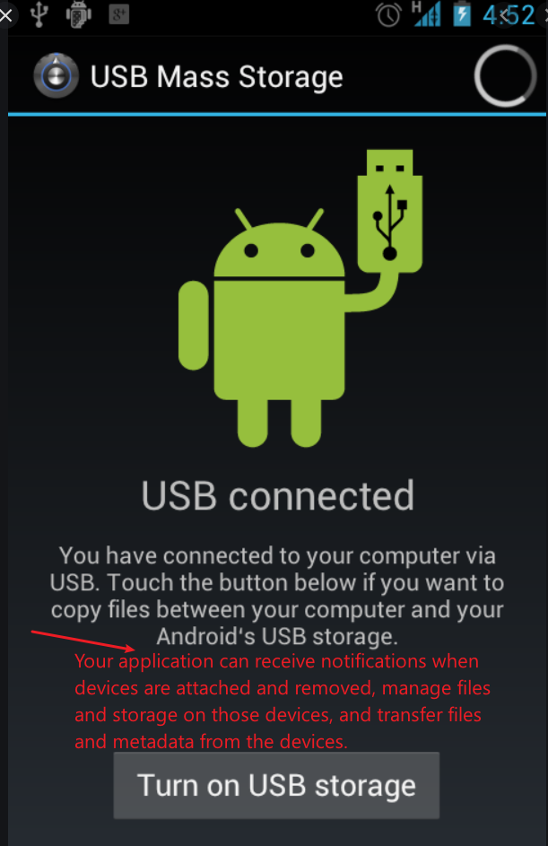
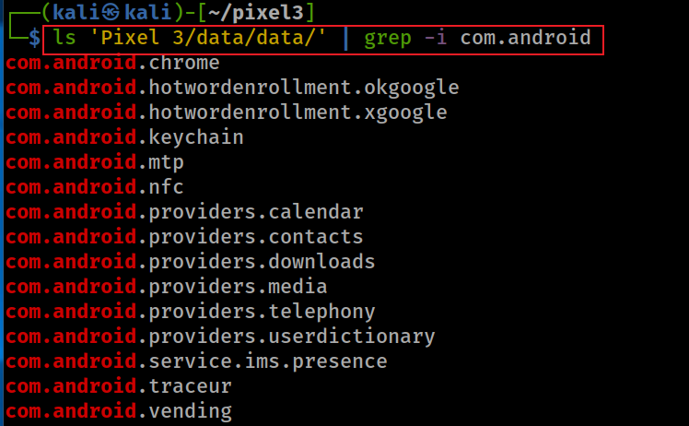
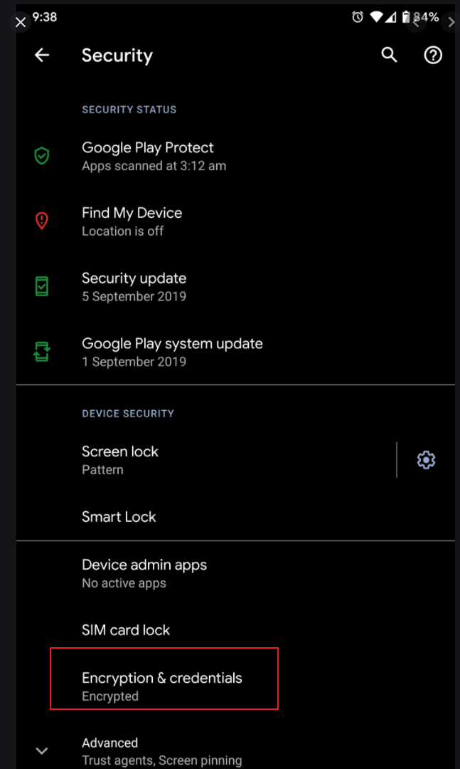
AOSP Apps/Services: com.android.*
Different front-end apps may use shared back-end services and credentials.
Telephony provider data can include SMS/MMS, APN/MMSC settings, and service-state artifacts.
IMS supports IP-based multimedia communication services.
System tracing records short-term device activity and performance behavior.
Notes:
ls 'Pixel 3/data/data/' | grep -i com.android
https://developer.android.com/reference/android/provider/UserDictionary
https://developer.android.com/reference/android/mtp/package-summary
https://developer.android.com/topic/performance/tracing
com.android.chrome
com.android.hotwordenrollment.okgoogle
com.android.hotwordenrollment.xgoogle
com.android.keychain
com.android.mtp
com.android.nfc
com.android.providers.calendar
com.android.providers.contacts
com.android.providers.downloads
com.android.providers.media
com.android.providers.telephony
com.android.providers.userdictionary
com.android.service.ims.presence
com.android.traceur
com.android.vending

Slide 6
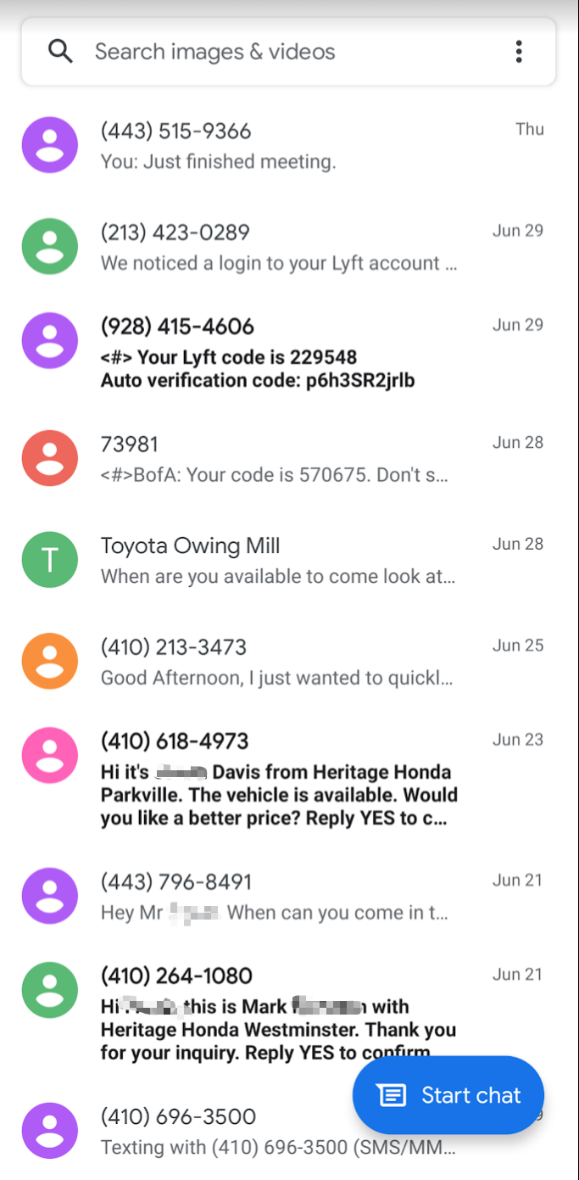
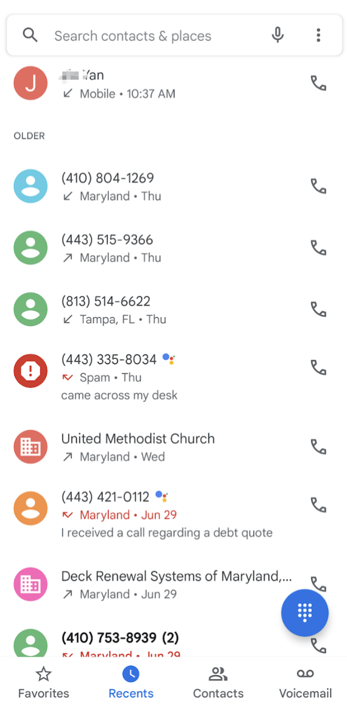
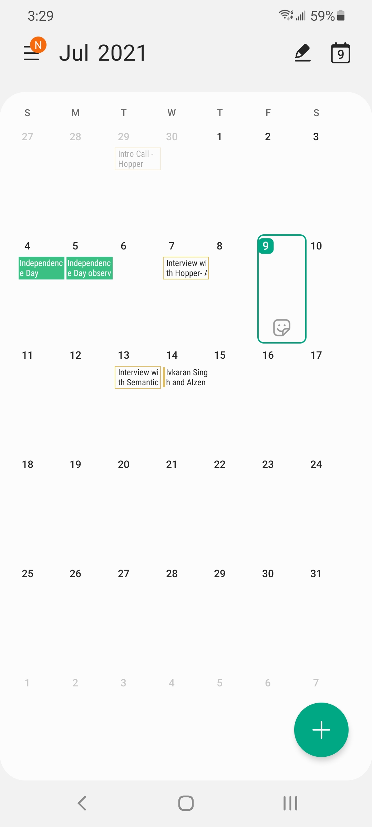
Core AOSP services to investigate
Messaging service: SMS/MMS
  Package: com.android.providers.telephony
Contacts service: contacts and call log
  Package: com.android.providers.contacts
Calendar service: events and reminders
  Package: com.android.providers.calendar

Slide 7

Messaging services
SMS and MMS evidence sources

Slide 8
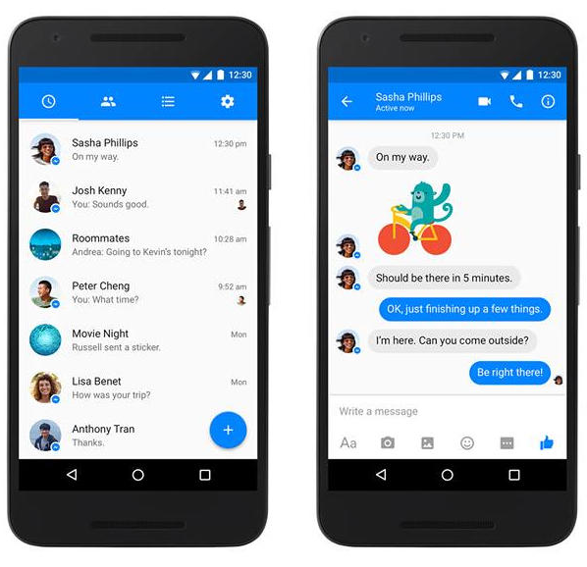
Messaging service is a core AOSP evidence source
SMS: Short Message Service; text messages and related metadata.
MMS: Multimedia Messaging Service; text plus media such as images, audio, and video.
Provider role: stores message content, status, timestamps, participants, and attachment references.
Example: third-party messaging apps may interact with Android messaging services.

Slide 9
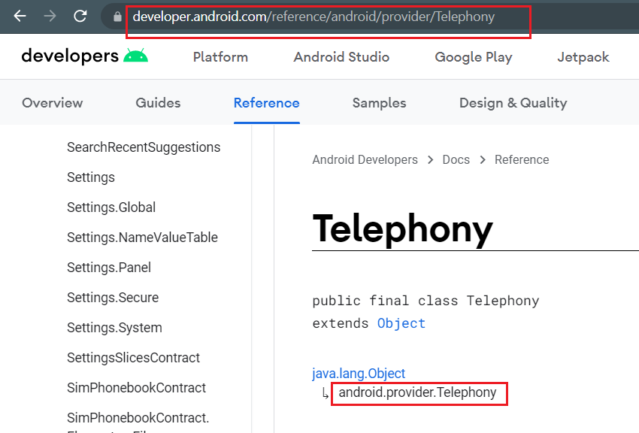
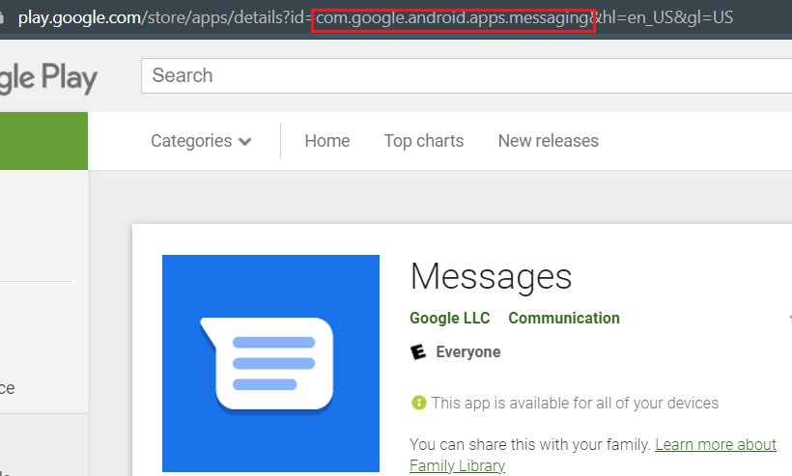
Messaging service implementation
Can be used by third-party applications through Android APIs.
Notes:
https://developer.android.com/reference/android/provider/Telephony
https://android.googlesource.com/platform/frameworks/base/+/refs/heads/master/core/java/android/provider/Telephony.java

Slide 10
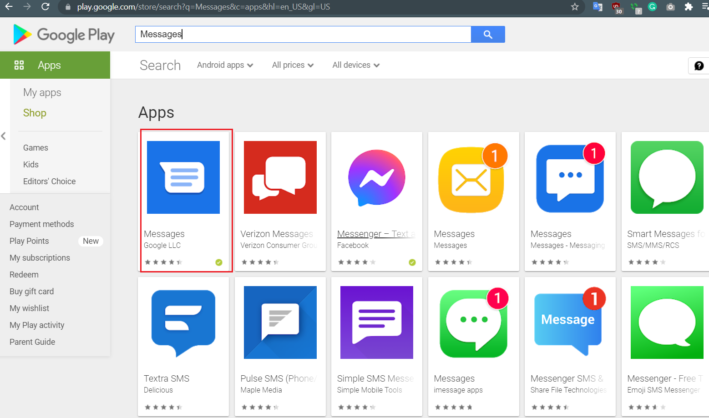
Messaging service can be used by other apps

Slide 11
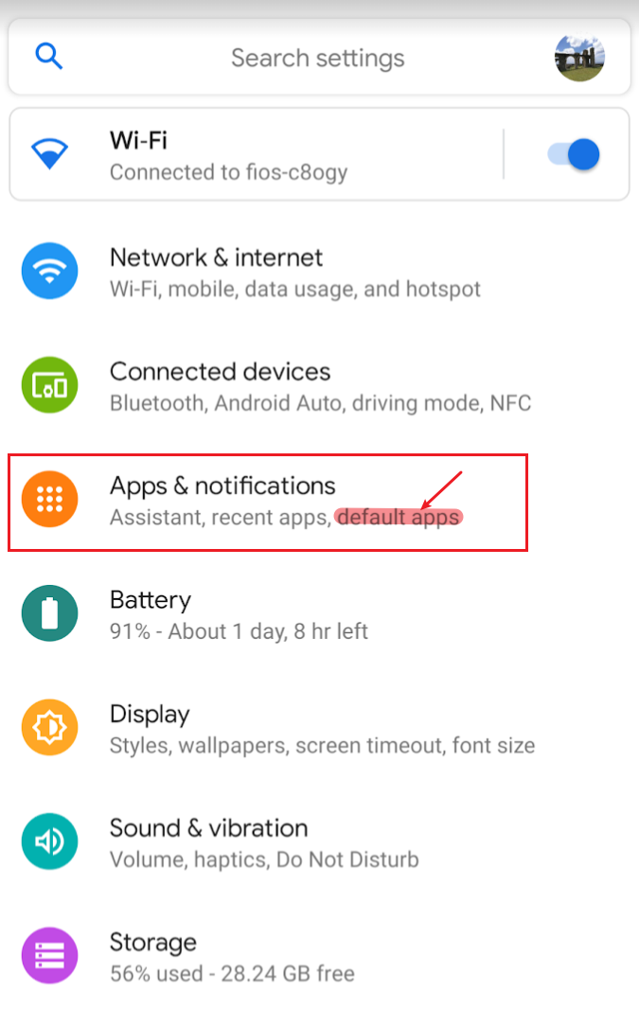
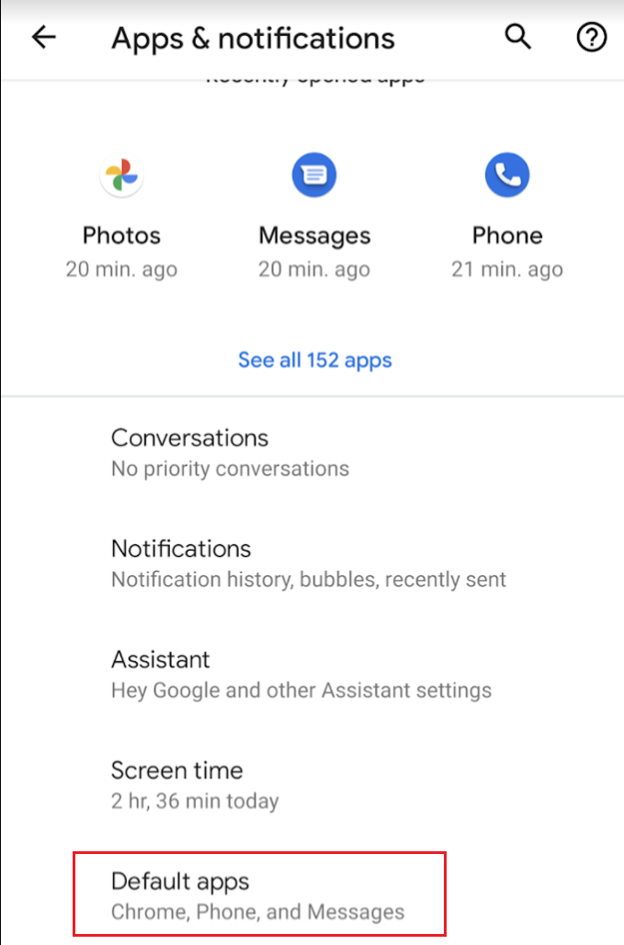
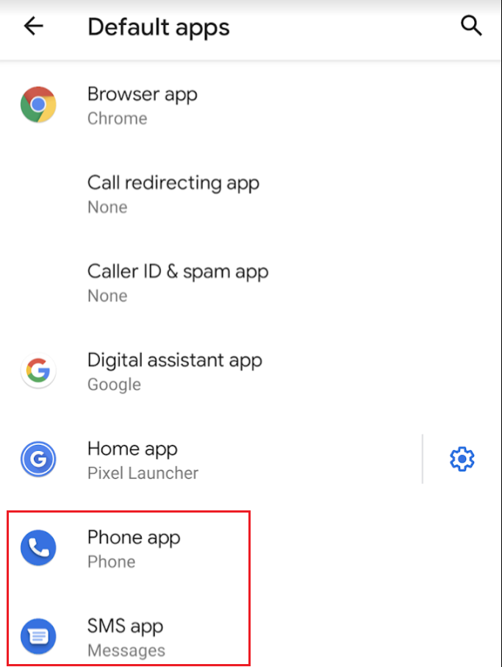
Check which apps use messaging services

Slide 12
Messaging services in digital forensics

Slide 13
Why messaging services matter
Messaging is a common source of user activity.
SMS/MMS records can reveal content, participants, timestamps, read status, and attachments.
Provider databases may preserve artifacts beyond what a single app UI displays.
Carrier-related fields can help explain message delivery and retrieval behavior.

Slide 14
Sample forensic questions
Who sent or received the message?
What was the message content?
Was there an attachment or other multimedia component?
When was the message sent, received, or downloaded?
Was the message read, seen, failed, queued, or deleted?
Which app or service inserted the record?

Slide 15




Strategy: move from service to storage
Identify the application or service package.
Inspect its private data directory.
Locate structured stores such as SQLite databases, XML preferences, and text files.
Correlate database records with file-system artifacts and timestamps.
Forensic workflow: package → directory → database → tables → records

Slide 16
Forensic workflow: AOSP messaging evidence
Extraction
Pixel 3 data
Package
com.android.providers.telephony
Database
mmssms.db
Tables
sms / pdu / part / addr / threads
Findings
who / what / when / status
Raw app folders
Service-private evidence
SQLite structured store
Records and relationships
Defensible interpretation
Teaching point: students should move from app-service context to database evidence, then translate database records into investigative answers.

Slide 17
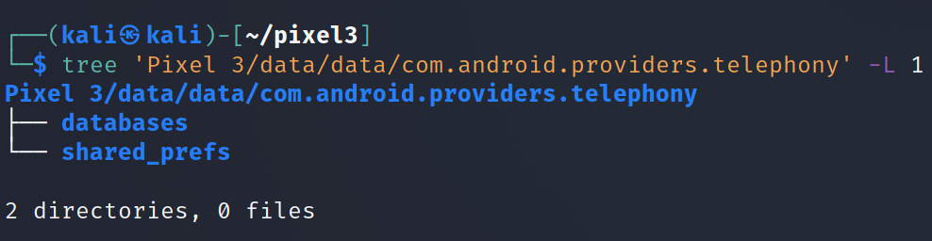
Messaging service folder structure
tree -L 1 shows only the first directory level.
Notes:
Cmd: tree 'Pixel 3/data/data/com.android.providers.telephony' -L 1

Slide 18
Investigating mmssms.db

Slide 19
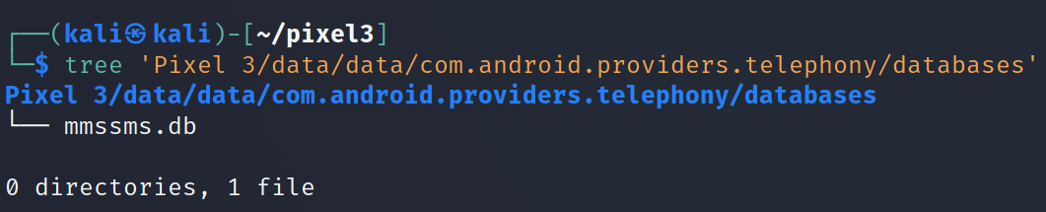
Locate mmssms.db
mmssms.db is the primary SQLite database for SMS/MMS artifacts. It stores message content, participant references, timestamps, message status, conversation grouping, and MMS metadata or attachment references.
Notes:
Cmd: tree 'Pixel 3/data/data/com.android.providers.telephony/databases'

Slide 20
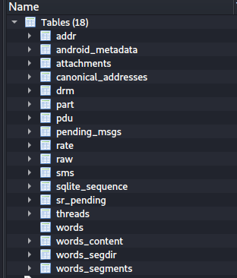
Most valuable mmssms.db tables
sms: SMS message content and metadata
pdu: MMS message-level metadata
part: MMS components such as text, SMIL, images, audio, and video
threads: conversation grouping
addr: MMS sender/recipient records
canonical_addresses: normalized address identifiers
attachments: attachment metadata
pending_msgs: queued or unsent messages
Notes:
Cmd: sqlitebrowser 'Pixel 3/data/data/com.android.providers.telephony/databases/mmssms.db’
https://android.googlesource.com/platform/packages/providers/TelephonyProvider/+/refs/heads/master/src/com/android/providers/telephony/SmsProvider.java
https://titanwolf.org/Network/Articles/Article?AID=297a97cf-1b71-4167-a5b3-5f3616e170db#gsc.tab=0

Slide 21
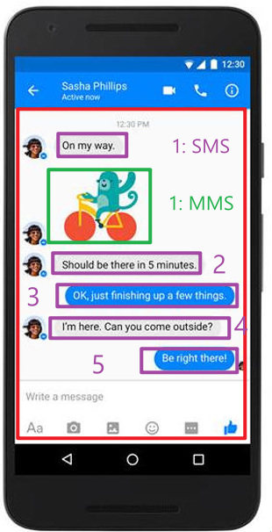
Key concept: reconstruct conversations from linked tables
thread: one conversation grouping
sms: individual SMS records
pdu: one MMS message record
part: one-to-many MMS components
addr: sender and recipient records
canonical_addresses: normalized phone-number IDs

Slide 22
Evidence map: mmssms.db tables
pdu
MMS message metadata
sms
SMS text + metadata
part
MMS body + media parts
mmssms.db
SQLite database
threads
Conversation grouping
addr
MMS sender/receiver
canonical_addresses
Normalized phone numbers
Core reconstruction: SMS usually starts in sms; MMS usually requires joining pdu + part + addr.

Slide 23
sms table
Stores individual SMS records.
Key fields: address, date, type, read, seen, body, service_center, creator.
Forensics value: reconstructs who communicated, when, message direction, content, and read/seen status.
Notes:
The `mmssms.db` database contains several tables, but not all are equally valuable depending on the use case. Since this database is primarily used to store SMS and MMS data on an Android device, the "most valuable" tables are those that directly contain or link to message content, conversation details, and associated metadata. These are often the focus in scenarios like digital forensics, data recovery, or app development. Below is a list of the most valuable tables from the schema you provided, along with why they are significant:
---
### Most Valuable Tables in `mmssms.db`
1. **sms**
- **Why It’s Valuable**: This table is the core storage for SMS messages. It contains the actual text messages, including the message body, sender/receiver phone numbers, timestamps, message type (sent, received, draft), and status (read, unread).
- **Use Case**: Essential for recovering or analyzing SMS communication history, such as in forensic investigations or for apps that need to display a user’s text messages.
2. **pdu**
- **Why It’s Valuable**: The `pdu` table stores the raw Protocol Data Unit (PDU) data for both SMS and MMS messages. PDUs are the encoded format of messages as they are sent over the network, so this table holds the full, unparsed message data. For MMS, it’s a starting point before the message is broken into parts.
- **Use Case**: Critical for reconstructing MMS messages or analyzing low-level message data, especially in forensics or when debugging messaging issues.
3. **part**
- **Why It’s Valuable**: This table stores individual parts of MMS messages, such as text, images, videos, or audio. Each MMS message is multipart, and this table includes details like the content type (e.g., image/jpeg), file path, and the actual data or reference to the attachment.
- **Use Case**: Key for accessing MMS content, such as retrieving multimedia attachments in forensics or displaying MMS messages in an app.
4. **threads**
- **Why It’s Valuable**: The `threads` table groups messages into conversations. It links SMS and MMS messages to a specific thread (conversation) with a contact or group of contacts. It includes metadata like the thread ID, recipient IDs, and the timestamp of the last message in the thread.
- **Use Case**: Essential for organizing messages into conversations, which is how most messaging apps display data. It’s also useful for analyzing communication patterns with specific contacts.
5. **canonical_addresses**
- **Why It’s Valuable**: This table maps phone numbers to unique IDs, normalizing them (e.g., removing country codes or formatting differences). Other tables like `sms` and `threads` reference these IDs instead of raw phone numbers, ensuring consistency.
- **Use Case**: Crucial for linking messages to contacts accurately, especially when phone numbers might be stored in different formats. It’s often used in forensics to identify who a message was sent to or received from.
6. **attachments**
- **Why It’s Valuable**: This table stores metadata about MMS attachments, such as file paths, MIME types, and sizes of media files (e.g., images, videos). It complements the `part` table by providing additional details about multimedia content.
- **Use Case**: Important for retrieving or analyzing MMS attachments, such as in data recovery or forensic analysis of multimedia messages.
7. **pending_msgs**
- **Why It’s Valuable**: This table stores messages that are queued for sending but not yet delivered (e.g., due to lack of network connectivity). It includes details like the message content, recipient, and status.
- **Use Case**: Useful for troubleshooting failed message deliveries or recovering messages that were never sent, especially in forensics or app development.
---
### Why Other Tables Are Less Valuable
While the above tables are the most directly tied to message content and conversations, the remaining tables in the schema serve more specialized or supporting roles:
- **addr**: Useful for MMS address details, but less critical than `canonical_addresses` for general use.
- **android_metadata**: Contains device metadata (e.g., locale), which is not directly related to messages.
- **drm**: Relevant only for DRM-protected media, which is rare in modern messaging.
- **rate**: Likely used for tracking message sending rates, which is more of a carrier or system concern.
- **raw**: Stores unprocessed MMS data, but `pdu` and `part` are more useful for accessing parsed content.
- **sqlite_sequence**: A system table for managing auto-incremented IDs, not directly related to message data.
- **sr_pending**: Similar to `pending_msgs`, but likely more niche (e.g., for specific send-receive operations).
- **words**, **words_content**, **words_segdir**, **words_segments**: These are part of the full-text search (FTS) system for messages. They’re valuable for search functionality but not for directly accessing message content.
---
### Summary of Most Valuable Tables
The most valuable tables in `mmssms.db` for accessing and analyzing SMS and MMS data are:
- `sms`: Core SMS message data.
- `pdu`: Raw SMS/MMS message data.
- `part`: MMS message parts (e.g., text, media).
- `threads`: Conversation grouping.
- `canonical_addresses`: Phone number normalization.
- `attachments`: MMS attachment metadata.
- `pending_msgs`: Queued messages.
These tables provide the most direct access to message content, conversation structure, and associated metadata, making them the most useful for most practical purposes. If you have a specific use case in mind (e.g., forensics, app development).

Slide 24
pdu table
Stores one row per MMS message at the message level.
Key fields: thread_id, date, msg_box, m_type, read, seen, sub_id, creator.
To reconstruct content, join pdu with part and addr.
Notes:
The `mmssms.db` database contains several tables, but not all are equally valuable depending on the use case. Since this database is primarily used to store SMS and MMS data on an Android device, the "most valuable" tables are those that directly contain or link to message content, conversation details, and associated metadata. These are often the focus in scenarios like digital forensics, data recovery, or app development. Below is a list of the most valuable tables from the schema you provided, along with why they are significant:
---
### Most Valuable Tables in `mmssms.db`
1. **sms**
- **Why It’s Valuable**: This table is the core storage for SMS messages. It contains the actual text messages, including the message body, sender/receiver phone numbers, timestamps, message type (sent, received, draft), and status (read, unread).
- **Use Case**: Essential for recovering or analyzing SMS communication history, such as in forensic investigations or for apps that need to display a user’s text messages.
2. **pdu**
- **Why It’s Valuable**: The `pdu` table stores the raw Protocol Data Unit (PDU) data for both SMS and MMS messages. PDUs are the encoded format of messages as they are sent over the network, so this table holds the full, unparsed message data. For MMS, it’s a starting point before the message is broken into parts.
- **Use Case**: Critical for reconstructing MMS messages or analyzing low-level message data, especially in forensics or when debugging messaging issues.
3. **part**
- **Why It’s Valuable**: This table stores individual parts of MMS messages, such as text, images, videos, or audio. Each MMS message is multipart, and this table includes details like the content type (e.g., image/jpeg), file path, and the actual data or reference to the attachment.
- **Use Case**: Key for accessing MMS content, such as retrieving multimedia attachments in forensics or displaying MMS messages in an app.
4. **threads**
- **Why It’s Valuable**: The `threads` table groups messages into conversations. It links SMS and MMS messages to a specific thread (conversation) with a contact or group of contacts. It includes metadata like the thread ID, recipient IDs, and the timestamp of the last message in the thread.
- **Use Case**: Essential for organizing messages into conversations, which is how most messaging apps display data. It’s also useful for analyzing communication patterns with specific contacts.
5. **canonical_addresses**
- **Why It’s Valuable**: This table maps phone numbers to unique IDs, normalizing them (e.g., removing country codes or formatting differences). Other tables like `sms` and `threads` reference these IDs instead of raw phone numbers, ensuring consistency.
- **Use Case**: Crucial for linking messages to contacts accurately, especially when phone numbers might be stored in different formats. It’s often used in forensics to identify who a message was sent to or received from.
6. **attachments**
- **Why It’s Valuable**: This table stores metadata about MMS attachments, such as file paths, MIME types, and sizes of media files (e.g., images, videos). It complements the `part` table by providing additional details about multimedia content.
- **Use Case**: Important for retrieving or analyzing MMS attachments, such as in data recovery or forensic analysis of multimedia messages.
7. **pending_msgs**
- **Why It’s Valuable**: This table stores messages that are queued for sending but not yet delivered (e.g., due to lack of network connectivity). It includes details like the message content, recipient, and status.
- **Use Case**: Useful for troubleshooting failed message deliveries or recovering messages that were never sent, especially in forensics or app development.
---
### Why Other Tables Are Less Valuable
While the above tables are the most directly tied to message content and conversations, the remaining tables in the schema serve more specialized or supporting roles:
- **addr**: Useful for MMS address details, but less critical than `canonical_addresses` for general use.
- **android_metadata**: Contains device metadata (e.g., locale), which is not directly related to messages.
- **drm**: Relevant only for DRM-protected media, which is rare in modern messaging.
- **rate**: Likely used for tracking message sending rates, which is more of a carrier or system concern.
- **raw**: Stores unprocessed MMS data, but `pdu` and `part` are more useful for accessing parsed content.
- **sqlite_sequence**: A system table for managing auto-incremented IDs, not directly related to message data.
- **sr_pending**: Similar to `pending_msgs`, but likely more niche (e.g., for specific send-receive operations).
- **words**, **words_content**, **words_segdir**, **words_segments**: These are part of the full-text search (FTS) system for messages. They’re valuable for search functionality but not for directly accessing message content.
---
### Summary of Most Valuable Tables
The most valuable tables in `mmssms.db` for accessing and analyzing SMS and MMS data are:
- `sms`: Core SMS message data.
- `pdu`: Raw SMS/MMS message data.
- `part`: MMS message parts (e.g., text, media).
- `threads`: Conversation grouping.
- `canonical_addresses`: Phone number normalization.
- `attachments`: MMS attachment metadata.
- `pending_msgs`: Queued messages.
These tables provide the most direct access to message content, conversation structure, and associated metadata, making them the most useful for most practical purposes. If you have a specific use case in mind (e.g., forensics, app development).

Slide 25
part table
Stores the individual components of an MMS message.
Examples: text/plain, SMIL layout, image/jpeg, audio, or video.
Forensics value: identifies the actual MMS body and media components.
Notes:
The `mmssms.db` database contains several tables, but not all are equally valuable depending on the use case. Since this database is primarily used to store SMS and MMS data on an Android device, the "most valuable" tables are those that directly contain or link to message content, conversation details, and associated metadata. These are often the focus in scenarios like digital forensics, data recovery, or app development. Below is a list of the most valuable tables from the schema you provided, along with why they are significant:
---
### Most Valuable Tables in `mmssms.db`
1. **sms**
- **Why It’s Valuable**: This table is the core storage for SMS messages. It contains the actual text messages, including the message body, sender/receiver phone numbers, timestamps, message type (sent, received, draft), and status (read, unread).
- **Use Case**: Essential for recovering or analyzing SMS communication history, such as in forensic investigations or for apps that need to display a user’s text messages.
2. **pdu**
- **Why It’s Valuable**: The `pdu` table stores the raw Protocol Data Unit (PDU) data for both SMS and MMS messages. PDUs are the encoded format of messages as they are sent over the network, so this table holds the full, unparsed message data. For MMS, it’s a starting point before the message is broken into parts.
- **Use Case**: Critical for reconstructing MMS messages or analyzing low-level message data, especially in forensics or when debugging messaging issues.
3. **part**
- **Why It’s Valuable**: This table stores individual parts of MMS messages, such as text, images, videos, or audio. Each MMS message is multipart, and this table includes details like the content type (e.g., image/jpeg), file path, and the actual data or reference to the attachment.
- **Use Case**: Key for accessing MMS content, such as retrieving multimedia attachments in forensics or displaying MMS messages in an app.
4. **threads**
- **Why It’s Valuable**: The `threads` table groups messages into conversations. It links SMS and MMS messages to a specific thread (conversation) with a contact or group of contacts. It includes metadata like the thread ID, recipient IDs, and the timestamp of the last message in the thread.
- **Use Case**: Essential for organizing messages into conversations, which is how most messaging apps display data. It’s also useful for analyzing communication patterns with specific contacts.
5. **canonical_addresses**
- **Why It’s Valuable**: This table maps phone numbers to unique IDs, normalizing them (e.g., removing country codes or formatting differences). Other tables like `sms` and `threads` reference these IDs instead of raw phone numbers, ensuring consistency.
- **Use Case**: Crucial for linking messages to contacts accurately, especially when phone numbers might be stored in different formats. It’s often used in forensics to identify who a message was sent to or received from.
6. **attachments**
- **Why It’s Valuable**: This table stores metadata about MMS attachments, such as file paths, MIME types, and sizes of media files (e.g., images, videos). It complements the `part` table by providing additional details about multimedia content.
- **Use Case**: Important for retrieving or analyzing MMS attachments, such as in data recovery or forensic analysis of multimedia messages.
7. **pending_msgs**
- **Why It’s Valuable**: This table stores messages that are queued for sending but not yet delivered (e.g., due to lack of network connectivity). It includes details like the message content, recipient, and status.
- **Use Case**: Useful for troubleshooting failed message deliveries or recovering messages that were never sent, especially in forensics or app development.
---
### Why Other Tables Are Less Valuable
While the above tables are the most directly tied to message content and conversations, the remaining tables in the schema serve more specialized or supporting roles:
- **addr**: Useful for MMS address details, but less critical than `canonical_addresses` for general use.
- **android_metadata**: Contains device metadata (e.g., locale), which is not directly related to messages.
- **drm**: Relevant only for DRM-protected media, which is rare in modern messaging.
- **rate**: Likely used for tracking message sending rates, which is more of a carrier or system concern.
- **raw**: Stores unprocessed MMS data, but `pdu` and `part` are more useful for accessing parsed content.
- **sqlite_sequence**: A system table for managing auto-incremented IDs, not directly related to message data.
- **sr_pending**: Similar to `pending_msgs`, but likely more niche (e.g., for specific send-receive operations).
- **words**, **words_content**, **words_segdir**, **words_segments**: These are part of the full-text search (FTS) system for messages. They’re valuable for search functionality but not for directly accessing message content.
---
### Summary of Most Valuable Tables
The most valuable tables in `mmssms.db` for accessing and analyzing SMS and MMS data are:
- `sms`: Core SMS message data.
- `pdu`: Raw SMS/MMS message data.
- `part`: MMS message parts (e.g., text, media).
- `threads`: Conversation grouping.
- `canonical_addresses`: Phone number normalization.
- `attachments`: MMS attachment metadata.
- `pending_msgs`: Queued messages.
These tables provide the most direct access to message content, conversation structure, and associated metadata, making them the most useful for most practical purposes. If you have a specific use case in mind (e.g., forensics, app development).

Slide 26
attachments table
Stores metadata about MMS attachments, such as file paths, MIME types, and sizes.
Forensics value: helps locate and interpret multimedia evidence associated with MMS messages.
Notes:
The `mmssms.db` database contains several tables, but not all are equally valuable depending on the use case. Since this database is primarily used to store SMS and MMS data on an Android device, the "most valuable" tables are those that directly contain or link to message content, conversation details, and associated metadata. These are often the focus in scenarios like digital forensics, data recovery, or app development. Below is a list of the most valuable tables from the schema you provided, along with why they are significant:
---
### Most Valuable Tables in `mmssms.db`
1. **sms**
- **Why It’s Valuable**: This table is the core storage for SMS messages. It contains the actual text messages, including the message body, sender/receiver phone numbers, timestamps, message type (sent, received, draft), and status (read, unread).
- **Use Case**: Essential for recovering or analyzing SMS communication history, such as in forensic investigations or for apps that need to display a user’s text messages.
2. **pdu**
- **Why It’s Valuable**: The `pdu` table stores the raw Protocol Data Unit (PDU) data for both SMS and MMS messages. PDUs are the encoded format of messages as they are sent over the network, so this table holds the full, unparsed message data. For MMS, it’s a starting point before the message is broken into parts.
- **Use Case**: Critical for reconstructing MMS messages or analyzing low-level message data, especially in forensics or when debugging messaging issues.
3. **part**
- **Why It’s Valuable**: This table stores individual parts of MMS messages, such as text, images, videos, or audio. Each MMS message is multipart, and this table includes details like the content type (e.g., image/jpeg), file path, and the actual data or reference to the attachment.
- **Use Case**: Key for accessing MMS content, such as retrieving multimedia attachments in forensics or displaying MMS messages in an app.
4. **threads**
- **Why It’s Valuable**: The `threads` table groups messages into conversations. It links SMS and MMS messages to a specific thread (conversation) with a contact or group of contacts. It includes metadata like the thread ID, recipient IDs, and the timestamp of the last message in the thread.
- **Use Case**: Essential for organizing messages into conversations, which is how most messaging apps display data. It’s also useful for analyzing communication patterns with specific contacts.
5. **canonical_addresses**
- **Why It’s Valuable**: This table maps phone numbers to unique IDs, normalizing them (e.g., removing country codes or formatting differences). Other tables like `sms` and `threads` reference these IDs instead of raw phone numbers, ensuring consistency.
- **Use Case**: Crucial for linking messages to contacts accurately, especially when phone numbers might be stored in different formats. It’s often used in forensics to identify who a message was sent to or received from.
6. **attachments**
- **Why It’s Valuable**: This table stores metadata about MMS attachments, such as file paths, MIME types, and sizes of media files (e.g., images, videos). It complements the `part` table by providing additional details about multimedia content.
- **Use Case**: Important for retrieving or analyzing MMS attachments, such as in data recovery or forensic analysis of multimedia messages.
7. **pending_msgs**
- **Why It’s Valuable**: This table stores messages that are queued for sending but not yet delivered (e.g., due to lack of network connectivity). It includes details like the message content, recipient, and status.
- **Use Case**: Useful for troubleshooting failed message deliveries or recovering messages that were never sent, especially in forensics or app development.
---
### Why Other Tables Are Less Valuable
While the above tables are the most directly tied to message content and conversations, the remaining tables in the schema serve more specialized or supporting roles:
- **addr**: Useful for MMS address details, but less critical than `canonical_addresses` for general use.
- **android_metadata**: Contains device metadata (e.g., locale), which is not directly related to messages.
- **drm**: Relevant only for DRM-protected media, which is rare in modern messaging.
- **rate**: Likely used for tracking message sending rates, which is more of a carrier or system concern.
- **raw**: Stores unprocessed MMS data, but `pdu` and `part` are more useful for accessing parsed content.
- **sqlite_sequence**: A system table for managing auto-incremented IDs, not directly related to message data.
- **sr_pending**: Similar to `pending_msgs`, but likely more niche (e.g., for specific send-receive operations).
- **words**, **words_content**, **words_segdir**, **words_segments**: These are part of the full-text search (FTS) system for messages. They’re valuable for search functionality but not for directly accessing message content.
---
### Summary of Most Valuable Tables
The most valuable tables in `mmssms.db` for accessing and analyzing SMS and MMS data are:
- `sms`: Core SMS message data.
- `pdu`: Raw SMS/MMS message data.
- `part`: MMS message parts (e.g., text, media).
- `threads`: Conversation grouping.
- `canonical_addresses`: Phone number normalization.
- `attachments`: MMS attachment metadata.
- `pending_msgs`: Queued messages.
These tables provide the most direct access to message content, conversation structure, and associated metadata, making them the most useful for most practical purposes. If you have a specific use case in mind (e.g., forensics, app development).

Slide 27
threads table
Groups SMS/MMS messages into conversations.
Key fields may include thread ID, recipient IDs, message count, date, snippet, and read flag.
Forensics value: supports conversation-level reconstruction and communication-pattern analysis.
Notes:
The `mmssms.db` database contains several tables, but not all are equally valuable depending on the use case. Since this database is primarily used to store SMS and MMS data on an Android device, the "most valuable" tables are those that directly contain or link to message content, conversation details, and associated metadata. These are often the focus in scenarios like digital forensics, data recovery, or app development. Below is a list of the most valuable tables from the schema you provided, along with why they are significant:
---
### Most Valuable Tables in `mmssms.db`
1. **sms**
- **Why It’s Valuable**: This table is the core storage for SMS messages. It contains the actual text messages, including the message body, sender/receiver phone numbers, timestamps, message type (sent, received, draft), and status (read, unread).
- **Use Case**: Essential for recovering or analyzing SMS communication history, such as in forensic investigations or for apps that need to display a user’s text messages.
2. **pdu**
- **Why It’s Valuable**: The `pdu` table stores the raw Protocol Data Unit (PDU) data for both SMS and MMS messages. PDUs are the encoded format of messages as they are sent over the network, so this table holds the full, unparsed message data. For MMS, it’s a starting point before the message is broken into parts.
- **Use Case**: Critical for reconstructing MMS messages or analyzing low-level message data, especially in forensics or when debugging messaging issues.
3. **part**
- **Why It’s Valuable**: This table stores individual parts of MMS messages, such as text, images, videos, or audio. Each MMS message is multipart, and this table includes details like the content type (e.g., image/jpeg), file path, and the actual data or reference to the attachment.
- **Use Case**: Key for accessing MMS content, such as retrieving multimedia attachments in forensics or displaying MMS messages in an app.
4. **threads**
- **Why It’s Valuable**: The `threads` table groups messages into conversations. It links SMS and MMS messages to a specific thread (conversation) with a contact or group of contacts. It includes metadata like the thread ID, recipient IDs, and the timestamp of the last message in the thread.
- **Use Case**: Essential for organizing messages into conversations, which is how most messaging apps display data. It’s also useful for analyzing communication patterns with specific contacts.
5. **canonical_addresses**
- **Why It’s Valuable**: This table maps phone numbers to unique IDs, normalizing them (e.g., removing country codes or formatting differences). Other tables like `sms` and `threads` reference these IDs instead of raw phone numbers, ensuring consistency.
- **Use Case**: Crucial for linking messages to contacts accurately, especially when phone numbers might be stored in different formats. It’s often used in forensics to identify who a message was sent to or received from.
6. **attachments**
- **Why It’s Valuable**: This table stores metadata about MMS attachments, such as file paths, MIME types, and sizes of media files (e.g., images, videos). It complements the `part` table by providing additional details about multimedia content.
- **Use Case**: Important for retrieving or analyzing MMS attachments, such as in data recovery or forensic analysis of multimedia messages.
7. **pending_msgs**
- **Why It’s Valuable**: This table stores messages that are queued for sending but not yet delivered (e.g., due to lack of network connectivity). It includes details like the message content, recipient, and status.
- **Use Case**: Useful for troubleshooting failed message deliveries or recovering messages that were never sent, especially in forensics or app development.
---
### Why Other Tables Are Less Valuable
While the above tables are the most directly tied to message content and conversations, the remaining tables in the schema serve more specialized or supporting roles:
- **addr**: Useful for MMS address details, but less critical than `canonical_addresses` for general use.
- **android_metadata**: Contains device metadata (e.g., locale), which is not directly related to messages.
- **drm**: Relevant only for DRM-protected media, which is rare in modern messaging.
- **rate**: Likely used for tracking message sending rates, which is more of a carrier or system concern.
- **raw**: Stores unprocessed MMS data, but `pdu` and `part` are more useful for accessing parsed content.
- **sqlite_sequence**: A system table for managing auto-incremented IDs, not directly related to message data.
- **sr_pending**: Similar to `pending_msgs`, but likely more niche (e.g., for specific send-receive operations).
- **words**, **words_content**, **words_segdir**, **words_segments**: These are part of the full-text search (FTS) system for messages. They’re valuable for search functionality but not for directly accessing message content.
---
### Summary of Most Valuable Tables
The most valuable tables in `mmssms.db` for accessing and analyzing SMS and MMS data are:
- `sms`: Core SMS message data.
- `pdu`: Raw SMS/MMS message data.
- `part`: MMS message parts (e.g., text, media).
- `threads`: Conversation grouping.
- `canonical_addresses`: Phone number normalization.
- `attachments`: MMS attachment metadata.
- `pending_msgs`: Queued messages.
These tables provide the most direct access to message content, conversation structure, and associated metadata, making them the most useful for most practical purposes. If you have a specific use case in mind (e.g., forensics, app development).

Slide 28
canonical_addresses table
Normalizes phone numbers and maps them to stable address IDs.
Other tables reference these IDs rather than repeating raw phone numbers.
Forensics value: links messages to participants even when number formats vary.
Notes:
The `mmssms.db` database contains several tables, but not all are equally valuable depending on the use case. Since this database is primarily used to store SMS and MMS data on an Android device, the "most valuable" tables are those that directly contain or link to message content, conversation details, and associated metadata. These are often the focus in scenarios like digital forensics, data recovery, or app development. Below is a list of the most valuable tables from the schema you provided, along with why they are significant:
---
### Most Valuable Tables in `mmssms.db`
1. **sms**
- **Why It’s Valuable**: This table is the core storage for SMS messages. It contains the actual text messages, including the message body, sender/receiver phone numbers, timestamps, message type (sent, received, draft), and status (read, unread).
- **Use Case**: Essential for recovering or analyzing SMS communication history, such as in forensic investigations or for apps that need to display a user’s text messages.
2. **pdu**
- **Why It’s Valuable**: The `pdu` table stores the raw Protocol Data Unit (PDU) data for both SMS and MMS messages. PDUs are the encoded format of messages as they are sent over the network, so this table holds the full, unparsed message data. For MMS, it’s a starting point before the message is broken into parts.
- **Use Case**: Critical for reconstructing MMS messages or analyzing low-level message data, especially in forensics or when debugging messaging issues.
3. **part**
- **Why It’s Valuable**: This table stores individual parts of MMS messages, such as text, images, videos, or audio. Each MMS message is multipart, and this table includes details like the content type (e.g., image/jpeg), file path, and the actual data or reference to the attachment.
- **Use Case**: Key for accessing MMS content, such as retrieving multimedia attachments in forensics or displaying MMS messages in an app.
4. **threads**
- **Why It’s Valuable**: The `threads` table groups messages into conversations. It links SMS and MMS messages to a specific thread (conversation) with a contact or group of contacts. It includes metadata like the thread ID, recipient IDs, and the timestamp of the last message in the thread.
- **Use Case**: Essential for organizing messages into conversations, which is how most messaging apps display data. It’s also useful for analyzing communication patterns with specific contacts.
5. **canonical_addresses**
- **Why It’s Valuable**: This table maps phone numbers to unique IDs, normalizing them (e.g., removing country codes or formatting differences). Other tables like `sms` and `threads` reference these IDs instead of raw phone numbers, ensuring consistency.
- **Use Case**: Crucial for linking messages to contacts accurately, especially when phone numbers might be stored in different formats. It’s often used in forensics to identify who a message was sent to or received from.
6. **attachments**
- **Why It’s Valuable**: This table stores metadata about MMS attachments, such as file paths, MIME types, and sizes of media files (e.g., images, videos). It complements the `part` table by providing additional details about multimedia content.
- **Use Case**: Important for retrieving or analyzing MMS attachments, such as in data recovery or forensic analysis of multimedia messages.
7. **pending_msgs**
- **Why It’s Valuable**: This table stores messages that are queued for sending but not yet delivered (e.g., due to lack of network connectivity). It includes details like the message content, recipient, and status.
- **Use Case**: Useful for troubleshooting failed message deliveries or recovering messages that were never sent, especially in forensics or app development.
---
### Why Other Tables Are Less Valuable
While the above tables are the most directly tied to message content and conversations, the remaining tables in the schema serve more specialized or supporting roles:
- **addr**: Useful for MMS address details, but less critical than `canonical_addresses` for general use.
- **android_metadata**: Contains device metadata (e.g., locale), which is not directly related to messages.
- **drm**: Relevant only for DRM-protected media, which is rare in modern messaging.
- **rate**: Likely used for tracking message sending rates, which is more of a carrier or system concern.
- **raw**: Stores unprocessed MMS data, but `pdu` and `part` are more useful for accessing parsed content.
- **sqlite_sequence**: A system table for managing auto-incremented IDs, not directly related to message data.
- **sr_pending**: Similar to `pending_msgs`, but likely more niche (e.g., for specific send-receive operations).
- **words**, **words_content**, **words_segdir**, **words_segments**: These are part of the full-text search (FTS) system for messages. They’re valuable for search functionality but not for directly accessing message content.
---
### Summary of Most Valuable Tables
The most valuable tables in `mmssms.db` for accessing and analyzing SMS and MMS data are:
- `sms`: Core SMS message data.
- `pdu`: Raw SMS/MMS message data.
- `part`: MMS message parts (e.g., text, media).
- `threads`: Conversation grouping.
- `canonical_addresses`: Phone number normalization.
- `attachments`: MMS attachment metadata.
- `pending_msgs`: Queued messages.
These tables provide the most direct access to message content, conversation structure, and associated metadata, making them the most useful for most practical purposes. If you have a specific use case in mind (e.g., forensics, app development).

Slide 29
pending_msgs table
Stores messages queued for sending or delivery processing.
Forensics value: may reveal attempted communication, failed delivery, or messages not visible in the normal conversation view.
Notes:
The `mmssms.db` database contains several tables, but not all are equally valuable depending on the use case. Since this database is primarily used to store SMS and MMS data on an Android device, the "most valuable" tables are those that directly contain or link to message content, conversation details, and associated metadata. These are often the focus in scenarios like digital forensics, data recovery, or app development. Below is a list of the most valuable tables from the schema you provided, along with why they are significant:
---
### Most Valuable Tables in `mmssms.db`
1. **sms**
- **Why It’s Valuable**: This table is the core storage for SMS messages. It contains the actual text messages, including the message body, sender/receiver phone numbers, timestamps, message type (sent, received, draft), and status (read, unread).
- **Use Case**: Essential for recovering or analyzing SMS communication history, such as in forensic investigations or for apps that need to display a user’s text messages.
2. **pdu**
- **Why It’s Valuable**: The `pdu` table stores the raw Protocol Data Unit (PDU) data for both SMS and MMS messages. PDUs are the encoded format of messages as they are sent over the network, so this table holds the full, unparsed message data. For MMS, it’s a starting point before the message is broken into parts.
- **Use Case**: Critical for reconstructing MMS messages or analyzing low-level message data, especially in forensics or when debugging messaging issues.
3. **part**
- **Why It’s Valuable**: This table stores individual parts of MMS messages, such as text, images, videos, or audio. Each MMS message is multipart, and this table includes details like the content type (e.g., image/jpeg), file path, and the actual data or reference to the attachment.
- **Use Case**: Key for accessing MMS content, such as retrieving multimedia attachments in forensics or displaying MMS messages in an app.
4. **threads**
- **Why It’s Valuable**: The `threads` table groups messages into conversations. It links SMS and MMS messages to a specific thread (conversation) with a contact or group of contacts. It includes metadata like the thread ID, recipient IDs, and the timestamp of the last message in the thread.
- **Use Case**: Essential for organizing messages into conversations, which is how most messaging apps display data. It’s also useful for analyzing communication patterns with specific contacts.
5. **canonical_addresses**
- **Why It’s Valuable**: This table maps phone numbers to unique IDs, normalizing them (e.g., removing country codes or formatting differences). Other tables like `sms` and `threads` reference these IDs instead of raw phone numbers, ensuring consistency.
- **Use Case**: Crucial for linking messages to contacts accurately, especially when phone numbers might be stored in different formats. It’s often used in forensics to identify who a message was sent to or received from.
6. **attachments**
- **Why It’s Valuable**: This table stores metadata about MMS attachments, such as file paths, MIME types, and sizes of media files (e.g., images, videos). It complements the `part` table by providing additional details about multimedia content.
- **Use Case**: Important for retrieving or analyzing MMS attachments, such as in data recovery or forensic analysis of multimedia messages.
7. **pending_msgs**
- **Why It’s Valuable**: This table stores messages that are queued for sending but not yet delivered (e.g., due to lack of network connectivity). It includes details like the message content, recipient, and status.
- **Use Case**: Useful for troubleshooting failed message deliveries or recovering messages that were never sent, especially in forensics or app development.
---
### Why Other Tables Are Less Valuable
While the above tables are the most directly tied to message content and conversations, the remaining tables in the schema serve more specialized or supporting roles:
- **addr**: Useful for MMS address details, but less critical than `canonical_addresses` for general use.
- **android_metadata**: Contains device metadata (e.g., locale), which is not directly related to messages.
- **drm**: Relevant only for DRM-protected media, which is rare in modern messaging.
- **rate**: Likely used for tracking message sending rates, which is more of a carrier or system concern.
- **raw**: Stores unprocessed MMS data, but `pdu` and `part` are more useful for accessing parsed content.
- **sqlite_sequence**: A system table for managing auto-incremented IDs, not directly related to message data.
- **sr_pending**: Similar to `pending_msgs`, but likely more niche (e.g., for specific send-receive operations).
- **words**, **words_content**, **words_segdir**, **words_segments**: These are part of the full-text search (FTS) system for messages. They’re valuable for search functionality but not for directly accessing message content.
---
### Summary of Most Valuable Tables
The most valuable tables in `mmssms.db` for accessing and analyzing SMS and MMS data are:
- `sms`: Core SMS message data.
- `pdu`: Raw SMS/MMS message data.
- `part`: MMS message parts (e.g., text, media).
- `threads`: Conversation grouping.
- `canonical_addresses`: Phone number normalization.
- `attachments`: MMS attachment metadata.
- `pending_msgs`: Queued messages.
These tables provide the most direct access to message content, conversation structure, and associated metadata, making them the most useful for most practical purposes. If you have a specific use case in mind (e.g., forensics, app development).

Slide 30
Investigate the sms table

Slide 31
Timestamp and direction fields: avoid common mistakes
Artifact
Key field
Meaning
Forensic caution
SMS
sms.date
Milliseconds since Unix epoch
Convert carefully; verify timezone used by the tool
SMS
sms.type
1=inbox, 2=sent, 3=draft, 4=outbox, 5=failed, 6=queued
Do not infer “sent” or “received” from address alone
MMS
pdu.date
Seconds since Unix epoch
Different unit than sms.date in this dataset
MMS
pdu.msg_box
1=inbox, 2=sent, 3=draft, 4=outbox
Use with addr.type to identify sender and recipient
Read state
read / seen
User interaction flags
Read and seen are related but not always identical
Ask students to show the original value, conversion method, timezone assumption, and final human-readable time.

Slide 32
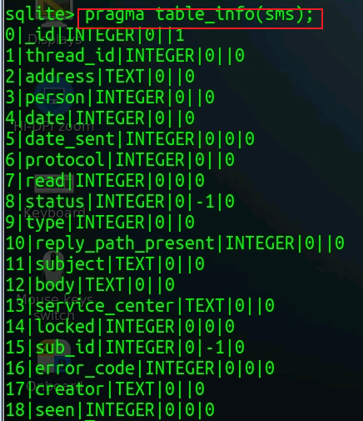
Column Name | Description | Example / Notes
_id | Primary key | 123
thread_id | Links to conversation in threads table | 7
address | Phone number of other party (sender or recipient) | "+14155551234"
person | Contact ID (deprecated) | NULL or 42
date | Timestamp (ms since Unix epoch, UTC) | 1697571600000
date_sent | Timestamp message was sent (ms since epoch) | 1697571500000
protocol | Protocol used (e.g., SMS=0, MMS=1) | 0
read | 1 = read, 0 = unread | 1
status | Delivery status: 0 = none, 32 = pending, 64 = failed | 0
type | Message type (direction) 1 = inbox (received) 2 = sent 3 = draft 4 = outbox 5 = failed 6 = queued | 1
reply_path_present | Indicates presence of reply path | 0 or 1
subject | Message subject (rarely used in SMS) | NULL
body | Text content of message | "See you soon!"
service_center | SMS service center address | "+12063130004"
locked | 1 if locked (protected from deletion) | 0
error_code | Error code if failed | 0
seen | 1 = seen in UI, 0 = unseen | 1
creator | App package that created the message | "com.android.messaging"

Slide 33
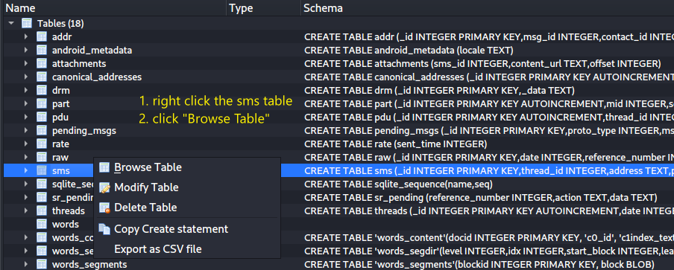

Slide 34
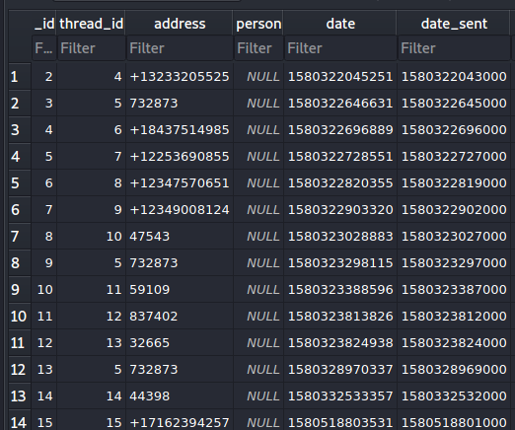
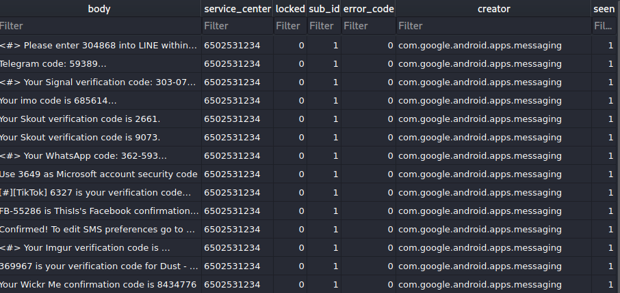
thread_id: links this SMS to a conversation in threads.
body: the SMS text content.
read flag:
0 = unread
1 = read
service_center: carrier SMSC used to route the message.
address: phone number of the other party.
date/date_sent: message timing fields.
creator: app package that inserted the SMS.

Slide 35


How SMS messages are sent and received
SMSC routes outgoing/incoming SMS through the carrier network.
SMS Service Center Number 9811236789
SMS Service Center (SMSC) Number often is associated with your carrier

Slide 36
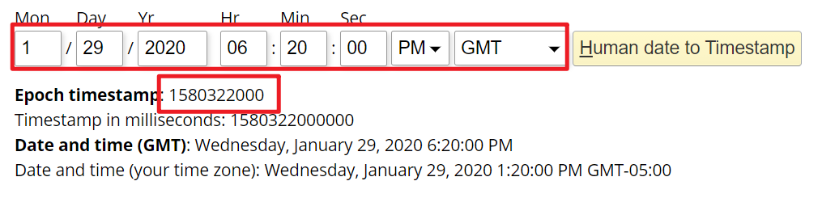
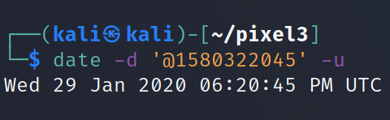
Exercise: identify the message received around Jan. 29, 2020, 6:20 PM
Convert Unix timestamps to local time, then compare rows.
Next question: who sent it?

Slide 37
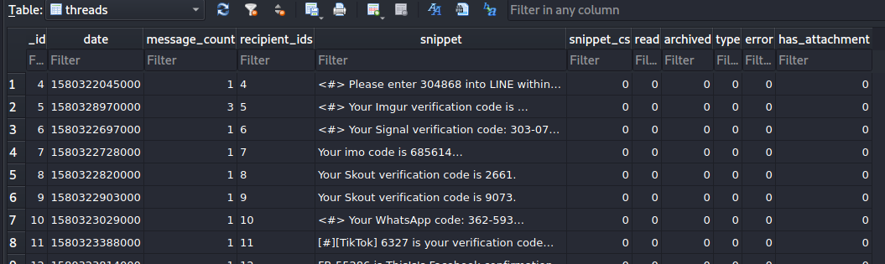
What table describes conversations?
message_count: number of messages in the thread
thread _id: conversation ID
snippet: preview of the most recent SMS/MMS content
read flag:
0 = unread
1 = read
date: last activity time for the thread

Slide 38
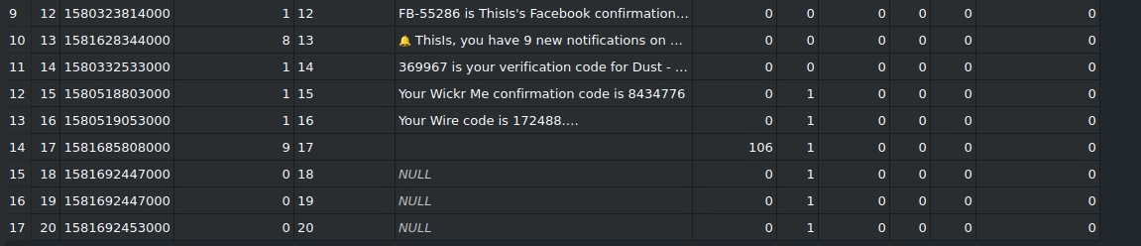
Review the remaining rows in the threads table

Slide 39
Investigate the pdu table
Each row represents one MMS message record.

Slide 40
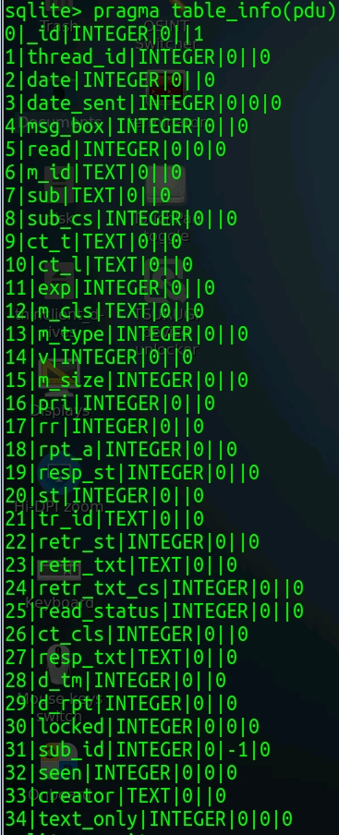
Column | Description | Example / Notes
_id | Primary key for each MMS message | 123
thread_id | Conversation ID (links to threads table) | 7
date | Time message was received (seconds since epoch) | 1697571600
date_ms_part | Millisecond offset (for more precise timing) | 823
msg_box | Message box type:1 = inbox (received)2 = sent3 = draft4 = outbox | 1
read | 1 = read, 0 = unread | 1
m_id | Message-ID from MMS headers | <abc123@carrier.com>
sub | Subject (encoded, may be null) | “Photo”
sub_cs | Character set for subject | 106
ct_t | Content type (MIME type of whole MMS) | “application/vnd.wap.multipart.related”
ct_l | Content location | “mms1234.dat”
exp | Expiry time (in seconds since epoch) | 1698000000
m_cls | Message class | “personal”, “advertisement”, etc.
m_type | Message type:128 = send request 132 = retrieve confirmation 130 = delivery indication134 = notification indication, etc. | 132
v | MMS version | 18
m_size | Total message size (bytes) | 10240
pri | Priority: 129 = low, 130 = normal, 131 = high | 130
rr | Read report requested (1=yes) | 0
rpt_a | Report allowed | 1
resp_st | Response status | 128
st | Message sending status | 128
tr_id | Transaction ID (carrier ID) | “T123456789”
retr_st | Retrieval status | 128
retr_txt | Retrieval text | “Download message”
retr_txt_cs | Char set for retrieval text | 106
d_tm | Delivery time (sec since epoch) | 1697571700
d_rpt | Delivery report requested (1=yes) | 0
locked | 1 = locked (protected) | 0
seen | 1 = seen, 0 = unseen | 1
creator | App that created message | “com.android.mms”
text_only | 1 = text-only message | 1
sub_id | SIM card ID | 1
msg_id | Internal message ID | “123456”

Slide 41
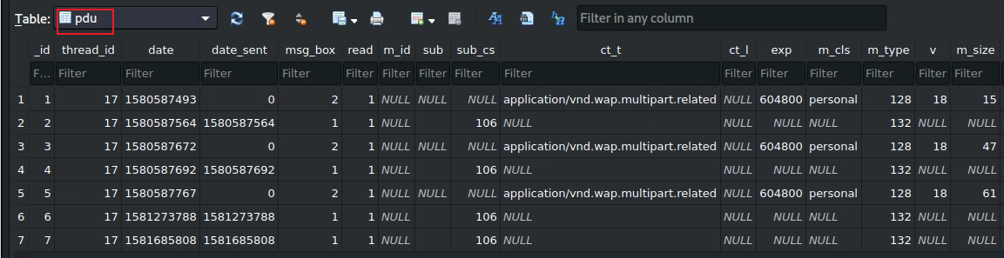






thread_id: links MMS messages to the same conversation.
msg_box: 1 = incoming; 2 = sent.
m_type: 132 = retrieved MMS message.
retrieved MMS
Conclusion: the inbox contains four retrieved MMS messages: 2, 4, 6, and 7.
Notes:
The `pdu` table in the `mmssms.db` database is a critical component for storing raw SMS and MMS message data on an Android device. The table contains Protocol Data Units (PDUs), which are the encoded format of messages as they are sent over the network. The columns in the `pdu` table provide metadata and details about these messages. Let’s break down each column in the table based on the screenshot you provided:
---
### Columns of the `pdu` Table
1. **_id**
- **Description**: A unique identifier for each row in the `pdu` table. This is an auto-incremented primary key used to reference specific messages.
- **Example Values**: 1, 2, 3, ..., 7 (as seen in the screenshot).
- **Purpose**: Used to uniquely identify a message in the database and link it to other tables (e.g., `part` for MMS messages).
2. **thread_id**
- **Description**: The ID of the conversation thread this message belongs to. It links the message to a specific thread in the `threads` table, which groups messages with the same contact or group of contacts.
- **Example Values**: 17 (consistent across all rows in the screenshot).
- **Purpose**: Organizes messages into conversations. For example, all messages with `thread_id` 17 belong to the same conversation.
3. **date**
- **Description**: The timestamp when the message was sent or received, stored as a Unix epoch time (in milliseconds).
- **Example Values**: 1580587493, 1580587564, 1580587672, etc.
- **Purpose**: Indicates when the message was processed. For example, 1580587493 converts to approximately February 1, 2020, 20:44:53 UTC.
- **Note**: This timestamp may differ from `date_sent` if there’s a delay in receiving the message.
4. **date_sent**
- **Description**: The timestamp when the message was originally sent by the sender, also in Unix epoch time (milliseconds). This is often set by the sender’s device or network.
- **Example Values**: 0 (for rows 1, 3, 5), 1580587564 (for row 2), 1580587692 (for row 4), etc.
- **Purpose**: Shows the actual time the message was sent, which can differ from `date` if the message was delayed. A value of 0 typically means the message was sent locally (e.g., an outgoing message) and the `date` field is used instead.
5. **msg_box**
- **Description**: Indicates the message’s status or "box" (e.g., inbox, sent, draft). It’s an integer that maps to a specific state:
- 1 = Inbox (received message).
- 2 = Sent (outgoing message).
- 3 = Draft.
- 4 = Outbox (queued for sending).
- **Example Values**: 2 (for rows 1, 3, 5), 1 (for rows 2, 4, 6, 7).
- **Purpose**: Shows whether the message was sent or received. In the screenshot, rows with `msg_box` 1 are incoming MMS messages, and those with `msg_box` 2 are outgoing MMS messages.
6. **read**
- **Description**: Indicates whether the message has been read by the user.
- 0 = Unread.
- 1 = Read.
- **Example Values**: 1 (all messages in the screenshot).
- **Purpose**: Tracks the read status of the message, useful for displaying unread message notifications in a messaging app.
7. **m_id**
- **Description**: The message ID assigned by the network or carrier for MMS messages. This is a unique identifier for the MMS message on the network.
- **Example Values**: NULL (all rows in the screenshot).
- **Purpose**: Used to track MMS messages across the network, though it’s often NULL for SMS or if the carrier doesn’t provide this ID.
8. **sub**
- **Description**: The subject of the MMS message, if any. SMS messages typically don’t have a subject, so this is usually relevant for MMS.
- **Example Values**: NULL (for rows 1, 3, 5), 106 (for rows 2, 4, 6, 7).
- **Purpose**: Stores the subject line of an MMS message. The value 106 might be a placeholder or encoded value, but typically, this would be a string if a subject exists.
9. **sub_cs**
- **Description**: The character set (charset) used for the `sub` (subject) field, such as UTF-8 or another encoding standard.
- **Example Values**: NULL (all rows in the screenshot).
- **Purpose**: Specifies the encoding of the subject, but it’s often NULL if there’s no subject or if the default encoding is assumed.
10. **ct_t**
- **Description**: The content type of the message, typically for MMS messages. This indicates the MIME type of the message’s primary content.
- **Example Values**: `application/vnd.wap.multipart.related` (for rows 1, 3, 5), NULL (for rows 2, 4, 6, 7).
- **Purpose**: Specifies the format of the MMS message. `application/vnd.wap.multipart.related` indicates a multipart MMS message (e.g., containing text and media). NULL values might indicate SMS messages or messages without a specified content type.
11. **ct_l**
- **Description**: The content location, often a URL or reference to where the MMS content can be retrieved (e.g., from a carrier’s server).
- **Example Values**: NULL (all rows in the screenshot).
- **Purpose**: Used for MMS messages to point to external content, but it’s often NULL if the content is stored locally in the `part` table.
12. **exp**
- **Description**: The expiration time of the MMS message, set by the network or sender, in Unix epoch time (milliseconds). After this time, the message may no longer be available for retrieval.
- **Example Values**: 604800 (for rows 1, 3, 5), NULL (for rows 2, 4, 6, 7).
- **Purpose**: Indicates how long the MMS message is valid. 604800 milliseconds = 7 days, a common expiration period for MMS messages on a carrier’s server.
13. **m_cls**
- **Description**: The message class, which categorizes the type of MMS message. Common values include:
- "personal" = A standard MMS message.
- "advertisement" = An ad message.
- "informational" = A notification or alert.
- **Example Values**: "personal" (for rows 1, 3, 5), NULL (for rows 2, 4, 6, 7).
- **Purpose**: Classifies the MMS message’s purpose. In the screenshot, rows 1, 3, and 5 are personal MMS messages.
14. **m_type**
- **Description**: The MMS message type, represented as an integer. Common values include:
- 128 = MMS notification (indicating an MMS is available to download).
- 130 = MMS delivery report.
- 132 = MMS message (the actual message).
- **Example Values**: 128 (for rows 1, 3, 5), 132 (for rows 2, 4, 6, 7).
- **Purpose**: Specifies the type of MMS message. In the screenshot, rows 1, 3, and 5 are notifications (128), meaning they indicate an MMS is available to download, while rows 2, 4, 6, and 7 are actual MMS messages (132).
15. **v**
- **Description**: The MMS protocol version, typically a number indicating the MMS standard used (e.g., 1.0, 1.1).
- **Example Values**: 18 (for rows 1, 3, 5), NULL (for rows 2, 4, 6, 7).
- **Purpose**: Indicates the MMS protocol version for compatibility. The value 18 likely corresponds to a specific MMS version (e.g., 1.8).
16. **m_size**
- **Description**: The size of the MMS message in bytes, as reported by the network.
- **Example Values**: 15, 47, 61 (for rows 1, 3, 5), NULL (for rows 2, 4, 6, 7).
- **Purpose**: Indicates the size of the MMS message, useful for knowing how much data needs to be downloaded. NULL values might indicate SMS messages or messages already downloaded.
---
### Observations from the Screenshot
- **Message Types**: The `pdu` table contains both MMS notifications (`m_type` = 128) and actual MMS messages (`m_type` = 132). Rows 1, 3, and 5 are notifications (likely indicating MMS messages available to download), while rows 2, 4, 6, and 7 are the actual MMS messages.
- **Thread Consistency**: All messages belong to the same thread (`thread_id` = 17), meaning they are part of the same conversation.
- **Timestamps**: The `date` and `date_sent` columns show the messages were sent/received around February 1, 2020. The `date_sent` being 0 for some rows suggests those are outgoing messages.
- **Read Status**: All messages have been read (`read` = 1).
- **MMS Details**: Rows 1, 3, and 5 have MMS-specific metadata like `ct_t`, `exp`, `m_cls`, `m_type`, `v`, and `m_size`, indicating they are MMS notifications. Rows 2, 4, 6, and 7 lack these details, suggesting they might be the downloaded MMS messages or SMS messages.
---
### Summary
The `pdu` table’s columns collectively store metadata and raw data for SMS and MMS messages. Key columns like `_id`, `thread_id`, `date`, `msg_box`, and `m_type` provide the core information about the message’s identity, conversation, timing, status, and type. MMS-specific columns like `ct_t`, `exp`, `m_cls`, and `m_size` add details for multimedia messages, while columns like `sub` and `ct_l` are often unused or NULL for most messages. This structure allows the Android system to manage and display messages efficiently while providing enough data for forensic analysis or app development.
The first part of the table included columns like `_id`, `thread_id`, `date`, `date_sent`, `msg_box`, `read`, `m_id`, `sub`, `sub_cs`, `ct_t`, `ct_l`, `exp`, `m_cls`, `m_type`, `v`, and `m_size`. The screenshot shows additional columns for the same rows (1 through 7). Let’s analyze these new columns and explain their purpose.
---
### Columns of the `pdu` Table (Second Part)
Based on the screenshot, the columns visible are:
1. **pri**
- **Description**: The priority of the MMS message, as set by the sender or network. Common values include:
- 129 = Low priority.
- 130 = Normal priority (default).
- 131 = High priority.
- **Example Values**: 130 (for rows 1, 3, 5), NULL (for rows 2, 4, 6, 7).
- **Purpose**: Indicates the urgency of the MMS message. In the screenshot, rows 1, 3, and 5 (MMS notifications) have a normal priority (130), while the other rows (actual MMS messages) have no priority specified (NULL), which is typical for downloaded messages or SMS.
2. **rr**
- **Description**: The read report request flag for MMS messages. It indicates whether the sender requested a read receipt (a notification that the recipient has read the message).
- 128 = Read report requested.
- NULL or other values = No read report requested.
- **Example Values**: NULL (all rows in the screenshot).
- **Purpose**: Shows if the sender asked for a read receipt. In this case, no read reports were requested for any of the messages.
3. **rpt_a**
- **Description**: The report allowed flag for MMS messages. It indicates whether the recipient’s device is allowed to send delivery or read reports back to the sender.
- 129 = Reports allowed.
- NULL or other values = Reports not allowed or not specified.
- **Example Values**: NULL (all rows in the screenshot).
- **Purpose**: Controls whether the device can send delivery/read reports. Since all values are NULL, this feature is either not used or not supported for these messages.
4. **resp_st**
- **Description**: The response status for MMS messages, typically used in delivery or read reports to indicate the status of the message (e.g., successfully delivered, failed).
- Common values depend on the MMS standard, but examples include:
- 128 = OK (successful).
- Other values for errors (e.g., 192 = Error: Unspecified).
- **Example Values**: NULL (all rows in the screenshot).
- **Purpose**: Stores the status of a delivery or read report. Since all values are NULL, no such reports are associated with these messages.
5. **st**
- **Description**: The status of the MMS message, often used for MMS notifications to indicate the retrieval status.
- Common values include:
- 128 = Retrieved (message successfully downloaded).
- 130 = Deferred (message retrieval deferred).
- 132 = Unrecognized (e.g., unsupported content).
- **Example Values**: NULL (all rows in the screenshot).
- **Purpose**: Indicates the retrieval status of an MMS message. Since all values are NULL, this field isn’t being used here, possibly because the messages are already downloaded or are SMS.
6. **tr_id**
- **Description**: The transaction ID for MMS messages, a unique identifier assigned by the network to track the MMS transaction (e.g., sending, retrieving).
- **Example Values**: Strings like "T5e2c2f5c2a2b2e2", "T5e2c2f5c2a2b2e4", etc. (for rows 1, 3, 5), NULL (for rows 2, 4, 6, 7).
- **Purpose**: Used to correlate MMS messages with network transactions, such as matching a notification with its retrieval. Rows 1, 3, and 5 (MMS notifications) have transaction IDs, while the actual MMS messages (rows 2, 4, 6, 7) do not, as they are already retrieved.
7. **retr_st**
- **Description**: The retrieval status of the MMS message, indicating whether the message was successfully retrieved from the server.
- 128 = Retrieved successfully.
- Other values for errors (e.g., 192 = Error: Unspecified).
- **Example Values**: NULL (all rows in the screenshot).
- **Purpose**: Tracks whether the MMS content was successfully downloaded. Since all values are NULL, this field isn’t populated, possibly because the retrieval status is tracked elsewhere (e.g., in the `st` column or another table).
8. **retr_txt**
- **Description**: The retrieval text, a human-readable message associated with the retrieval status (e.g., an error message if retrieval failed).
- **Example Values**: NULL (all rows in the screenshot).
- **Purpose**: Provides additional details about the retrieval status. Since all values are NULL, no retrieval errors or messages are recorded here.
9. **retr_txt_cs**
- **Description**: The character set (charset) used for the `retr_txt` field, such as UTF-8 or another encoding standard.
- **Example Values**: NULL (all rows in the screenshot).
- **Purpose**: Specifies the encoding of the `retr_txt` field. Since `retr_txt` is NULL, this field is also NULL.
10. **read_status**
- **Description**: The read status for MMS messages, specifically for read reports.
- 128 = Read.
- 130 = Not read.
- NULL = No read report requested or available.
- **Example Values**: NULL (all rows in the screenshot).
- **Purpose**: Indicates whether the recipient has read the MMS message, as part of a read report. Since all values are NULL, no read reports are associated with these messages.
11. **d_tm**
- **Description**: The delivery time of the MMS message, in Unix epoch time (milliseconds). This is the time when the message was delivered to the recipient’s device.
- **Example Values**: NULL (all rows in the screenshot).
- **Purpose**: Tracks when the MMS message was delivered. Since all values are NULL, this field isn’t used here, possibly because delivery times are tracked elsewhere (e.g., in the `date` column).
12. **d_rpt**
- **Description**: The delivery report request flag for MMS messages. It indicates whether the sender requested a delivery report (a notification that the message was delivered).
- 129 = Delivery report requested.
- NULL or other values = No delivery report requested.
- **Example Values**: 129 (for rows 1, 3, 5), NULL (for rows 2, 4, 6, 7).
- **Purpose**: Shows if the sender requested a delivery report. Rows 1, 3, and 5 (MMS notifications) have delivery reports requested, while the other rows do not.
13. **locked**
- **Description**: Indicates whether the message is locked by the user, preventing it from being deleted (e.g., in the messaging app).
- 0 = Not locked.
- 1 = Locked.
- **Example Values**: 0 (all rows in the screenshot).
- **Purpose**: Protects important messages from being deleted. In this case, none of the messages are locked.
14. **sub_id**
- **Description**: The subscription ID, which identifies the SIM card or subscription used for this message (useful for dual-SIM devices).
- **Example Values**: 1 (all rows in the screenshot).
- **Purpose**: Associates the message with a specific SIM card or subscription. A value of 1 indicates the message was sent/received using the primary SIM.
15. **seen**
- **Description**: Indicates whether the message has been seen by the user (e.g., displayed in the messaging app).
- 0 = Not seen.
- 1 = Seen.
- **Example Values**: 1 (all rows in the screenshot).
- **Purpose**: Tracks whether the message has been viewed, which can differ from `read` (e.g., a message might be seen in a notification but not marked as read). All messages here have been seen.
16. **creator**
- **Description**: The package name of the app that created or inserted this message into the database.
- **Example Values**: NULL (all rows in the screenshot).
- **Purpose**: Identifies the app responsible for the message (e.g., the default messaging app). Since all values are NULL, this field isn’t populated, possibly because the default system app was used.
17. **text_only**
- **Description**: Indicates whether the MMS message contains only text (no multimedia).
- 0 = Contains multimedia (e.g., images, videos).
- 1 = Text only.
- **Example Values**: 0 (all rows in the screenshot).
- **Purpose**: Helps the system quickly determine if the MMS message is text-only or includes media. All messages here include multimedia (likely because they are MMS messages).
---
### Observations from the Screenshot
- **MMS Notifications vs. Actual Messages**: As seen in the first part of the table, rows 1, 3, and 5 are MMS notifications (`m_type` = 128), and rows 2, 4, 6, and 7 are actual MMS messages (`m_type` = 132). This is reflected in the second part:
- Rows 1, 3, and 5 have MMS-specific fields populated, like `pri` (130), `tr_id` (transaction IDs), and `d_rpt` (129).
- Rows 2, 4, 6, and 7 have mostly NULL values for MMS-specific fields, as they are likely the downloaded messages.
- **Delivery Reports**: Rows 1, 3, and 5 have `d_rpt` set to 129, meaning the sender requested delivery reports for these MMS messages.
- **No Read Reports**: Fields like `rr`, `read_status`, and `rpt_a` are all NULL, indicating no read reports were requested or sent.
- **Message Status**: All messages are unlocked (`locked` = 0), seen (`seen` = 1), and associated with the primary SIM (`sub_id` = 1).
- **Multimedia Content**: The `text_only` field is 0 for all rows, confirming that these MMS messages contain multimedia (e.g., images, videos), which aligns with their `m_type` and `ct_t` values from the first part.
---
### Summary
The second part of the `pdu` table provides additional metadata for MMS messages, focusing on message priority, delivery/read report settings, transaction tracking, and user interaction flags. Key columns like `pri`, `tr_id`, and `d_rpt` are relevant for MMS notifications (rows 1, 3, 5), while columns like `locked`, `seen`, `sub_id`, and `text_only` provide general metadata for all messages. Most MMS-specific fields (e.g., `rr`, `retr_st`, `d_tm`) are NULL, indicating they aren’t used in this dataset, possibly because the messages are already downloaded or no reports were requested. This structure helps the Android system manage MMS message workflows while providing enough data for forensic analysis or app development. If you’d like to explore a specific row or column further, let me know!

Slide 42
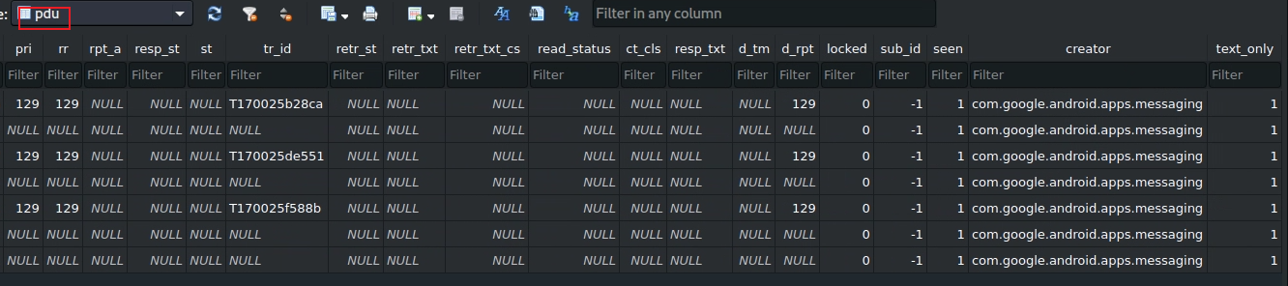


text_only indicates whether an MMS contains only text.
0 = contains multimedia or non-text parts.
1 = text-only MMS.
Notes:
The `pdu` table in the `mmssms.db` database is a critical component for storing raw SMS and MMS message data on an Android device. The table contains Protocol Data Units (PDUs), which are the encoded format of messages as they are sent over the network. The columns in the `pdu` table provide metadata and details about these messages. Let’s break down each column in the table based on the screenshot you provided:
---
### Columns of the `pdu` Table
1. **_id**
- **Description**: A unique identifier for each row in the `pdu` table. This is an auto-incremented primary key used to reference specific messages.
- **Example Values**: 1, 2, 3, ..., 7 (as seen in the screenshot).
- **Purpose**: Used to uniquely identify a message in the database and link it to other tables (e.g., `part` for MMS messages).
2. **thread_id**
- **Description**: The ID of the conversation thread this message belongs to. It links the message to a specific thread in the `threads` table, which groups messages with the same contact or group of contacts.
- **Example Values**: 17 (consistent across all rows in the screenshot).
- **Purpose**: Organizes messages into conversations. For example, all messages with `thread_id` 17 belong to the same conversation.
3. **date**
- **Description**: The timestamp when the message was sent or received, stored as a Unix epoch time (in milliseconds).
- **Example Values**: 1580587493, 1580587564, 1580587672, etc.
- **Purpose**: Indicates when the message was processed. For example, 1580587493 converts to approximately February 1, 2020, 20:44:53 UTC.
- **Note**: This timestamp may differ from `date_sent` if there’s a delay in receiving the message.
4. **date_sent**
- **Description**: The timestamp when the message was originally sent by the sender, also in Unix epoch time (milliseconds). This is often set by the sender’s device or network.
- **Example Values**: 0 (for rows 1, 3, 5), 1580587564 (for row 2), 1580587692 (for row 4), etc.
- **Purpose**: Shows the actual time the message was sent, which can differ from `date` if the message was delayed. A value of 0 typically means the message was sent locally (e.g., an outgoing message) and the `date` field is used instead.
5. **msg_box**
- **Description**: Indicates the message’s status or "box" (e.g., inbox, sent, draft). It’s an integer that maps to a specific state:
- 1 = Inbox (received message).
- 2 = Sent (outgoing message).
- 3 = Draft.
- 4 = Outbox (queued for sending).
- **Example Values**: 2 (for rows 1, 3, 5), 1 (for rows 2, 4, 6, 7).
- **Purpose**: Shows whether the message was sent or received. In the screenshot, rows with `msg_box` 1 are incoming MMS messages, and those with `msg_box` 2 are outgoing MMS messages.
6. **read**
- **Description**: Indicates whether the message has been read by the user.
- 0 = Unread.
- 1 = Read.
- **Example Values**: 1 (all messages in the screenshot).
- **Purpose**: Tracks the read status of the message, useful for displaying unread message notifications in a messaging app.
7. **m_id**
- **Description**: The message ID assigned by the network or carrier for MMS messages. This is a unique identifier for the MMS message on the network.
- **Example Values**: NULL (all rows in the screenshot).
- **Purpose**: Used to track MMS messages across the network, though it’s often NULL for SMS or if the carrier doesn’t provide this ID.
8. **sub**
- **Description**: The subject of the MMS message, if any. SMS messages typically don’t have a subject, so this is usually relevant for MMS.
- **Example Values**: NULL (for rows 1, 3, 5), 106 (for rows 2, 4, 6, 7).
- **Purpose**: Stores the subject line of an MMS message. The value 106 might be a placeholder or encoded value, but typically, this would be a string if a subject exists.
9. **sub_cs**
- **Description**: The character set (charset) used for the `sub` (subject) field, such as UTF-8 or another encoding standard.
- **Example Values**: NULL (all rows in the screenshot).
- **Purpose**: Specifies the encoding of the subject, but it’s often NULL if there’s no subject or if the default encoding is assumed.
10. **ct_t**
- **Description**: The content type of the message, typically for MMS messages. This indicates the MIME type of the message’s primary content.
- **Example Values**: `application/vnd.wap.multipart.related` (for rows 1, 3, 5), NULL (for rows 2, 4, 6, 7).
- **Purpose**: Specifies the format of the MMS message. `application/vnd.wap.multipart.related` indicates a multipart MMS message (e.g., containing text and media). NULL values might indicate SMS messages or messages without a specified content type.
11. **ct_l**
- **Description**: The content location, often a URL or reference to where the MMS content can be retrieved (e.g., from a carrier’s server).
- **Example Values**: NULL (all rows in the screenshot).
- **Purpose**: Used for MMS messages to point to external content, but it’s often NULL if the content is stored locally in the `part` table.
12. **exp**
- **Description**: The expiration time of the MMS message, set by the network or sender, in Unix epoch time (milliseconds). After this time, the message may no longer be available for retrieval.
- **Example Values**: 604800 (for rows 1, 3, 5), NULL (for rows 2, 4, 6, 7).
- **Purpose**: Indicates how long the MMS message is valid. 604800 milliseconds = 7 days, a common expiration period for MMS messages on a carrier’s server.
13. **m_cls**
- **Description**: The message class, which categorizes the type of MMS message. Common values include:
- "personal" = A standard MMS message.
- "advertisement" = An ad message.
- "informational" = A notification or alert.
- **Example Values**: "personal" (for rows 1, 3, 5), NULL (for rows 2, 4, 6, 7).
- **Purpose**: Classifies the MMS message’s purpose. In the screenshot, rows 1, 3, and 5 are personal MMS messages.
14. **m_type**
- **Description**: The MMS message type, represented as an integer. Common values include:
- 128 = MMS notification (indicating an MMS is available to download).
- 130 = MMS delivery report.
- 132 = MMS message (the actual message).
- **Example Values**: 128 (for rows 1, 3, 5), 132 (for rows 2, 4, 6, 7).
- **Purpose**: Specifies the type of MMS message. In the screenshot, rows 1, 3, and 5 are notifications (128), meaning they indicate an MMS is available to download, while rows 2, 4, 6, and 7 are actual MMS messages (132).
15. **v**
- **Description**: The MMS protocol version, typically a number indicating the MMS standard used (e.g., 1.0, 1.1).
- **Example Values**: 18 (for rows 1, 3, 5), NULL (for rows 2, 4, 6, 7).
- **Purpose**: Indicates the MMS protocol version for compatibility. The value 18 likely corresponds to a specific MMS version (e.g., 1.8).
16. **m_size**
- **Description**: The size of the MMS message in bytes, as reported by the network.
- **Example Values**: 15, 47, 61 (for rows 1, 3, 5), NULL (for rows 2, 4, 6, 7).
- **Purpose**: Indicates the size of the MMS message, useful for knowing how much data needs to be downloaded. NULL values might indicate SMS messages or messages already downloaded.
---
### Observations from the Screenshot
- **Message Types**: The `pdu` table contains both MMS notifications (`m_type` = 128) and actual MMS messages (`m_type` = 132). Rows 1, 3, and 5 are notifications (likely indicating MMS messages available to download), while rows 2, 4, 6, and 7 are the actual MMS messages.
- **Thread Consistency**: All messages belong to the same thread (`thread_id` = 17), meaning they are part of the same conversation.
- **Timestamps**: The `date` and `date_sent` columns show the messages were sent/received around February 1, 2020. The `date_sent` being 0 for some rows suggests those are outgoing messages.
- **Read Status**: All messages have been read (`read` = 1).
- **MMS Details**: Rows 1, 3, and 5 have MMS-specific metadata like `ct_t`, `exp`, `m_cls`, `m_type`, `v`, and `m_size`, indicating they are MMS notifications. Rows 2, 4, 6, and 7 lack these details, suggesting they might be the downloaded MMS messages or SMS messages.
---
### Summary
The `pdu` table’s columns collectively store metadata and raw data for SMS and MMS messages. Key columns like `_id`, `thread_id`, `date`, `msg_box`, and `m_type` provide the core information about the message’s identity, conversation, timing, status, and type. MMS-specific columns like `ct_t`, `exp`, `m_cls`, and `m_size` add details for multimedia messages, while columns like `sub` and `ct_l` are often unused or NULL for most messages. This structure allows the Android system to manage and display messages efficiently while providing enough data for forensic analysis or app development.
The first part of the table included columns like `_id`, `thread_id`, `date`, `date_sent`, `msg_box`, `read`, `m_id`, `sub`, `sub_cs`, `ct_t`, `ct_l`, `exp`, `m_cls`, `m_type`, `v`, and `m_size`. The screenshot shows additional columns for the same rows (1 through 7). Let’s analyze these new columns and explain their purpose.
---
### Columns of the `pdu` Table (Second Part)
Based on the screenshot, the columns visible are:
1. **pri**
- **Description**: The priority of the MMS message, as set by the sender or network. Common values include:
- 129 = Low priority.
- 130 = Normal priority (default).
- 131 = High priority.
- **Example Values**: 130 (for rows 1, 3, 5), NULL (for rows 2, 4, 6, 7).
- **Purpose**: Indicates the urgency of the MMS message. In the screenshot, rows 1, 3, and 5 (MMS notifications) have a normal priority (130), while the other rows (actual MMS messages) have no priority specified (NULL), which is typical for downloaded messages or SMS.
2. **rr**
- **Description**: The read report request flag for MMS messages. It indicates whether the sender requested a read receipt (a notification that the recipient has read the message).
- 128 = Read report requested.
- NULL or other values = No read report requested.
- **Example Values**: NULL (all rows in the screenshot).
- **Purpose**: Shows if the sender asked for a read receipt. In this case, no read reports were requested for any of the messages.
3. **rpt_a**
- **Description**: The report allowed flag for MMS messages. It indicates whether the recipient’s device is allowed to send delivery or read reports back to the sender.
- 129 = Reports allowed.
- NULL or other values = Reports not allowed or not specified.
- **Example Values**: NULL (all rows in the screenshot).
- **Purpose**: Controls whether the device can send delivery/read reports. Since all values are NULL, this feature is either not used or not supported for these messages.
4. **resp_st**
- **Description**: The response status for MMS messages, typically used in delivery or read reports to indicate the status of the message (e.g., successfully delivered, failed).
- Common values depend on the MMS standard, but examples include:
- 128 = OK (successful).
- Other values for errors (e.g., 192 = Error: Unspecified).
- **Example Values**: NULL (all rows in the screenshot).
- **Purpose**: Stores the status of a delivery or read report. Since all values are NULL, no such reports are associated with these messages.
5. **st**
- **Description**: The status of the MMS message, often used for MMS notifications to indicate the retrieval status.
- Common values include:
- 128 = Retrieved (message successfully downloaded).
- 130 = Deferred (message retrieval deferred).
- 132 = Unrecognized (e.g., unsupported content).
- **Example Values**: NULL (all rows in the screenshot).
- **Purpose**: Indicates the retrieval status of an MMS message. Since all values are NULL, this field isn’t being used here, possibly because the messages are already downloaded or are SMS.
6. **tr_id**
- **Description**: The transaction ID for MMS messages, a unique identifier assigned by the network to track the MMS transaction (e.g., sending, retrieving).
- **Example Values**: Strings like "T5e2c2f5c2a2b2e2", "T5e2c2f5c2a2b2e4", etc. (for rows 1, 3, 5), NULL (for rows 2, 4, 6, 7).
- **Purpose**: Used to correlate MMS messages with network transactions, such as matching a notification with its retrieval. Rows 1, 3, and 5 (MMS notifications) have transaction IDs, while the actual MMS messages (rows 2, 4, 6, 7) do not, as they are already retrieved.
7. **retr_st**
- **Description**: The retrieval status of the MMS message, indicating whether the message was successfully retrieved from the server.
- 128 = Retrieved successfully.
- Other values for errors (e.g., 192 = Error: Unspecified).
- **Example Values**: NULL (all rows in the screenshot).
- **Purpose**: Tracks whether the MMS content was successfully downloaded. Since all values are NULL, this field isn’t populated, possibly because the retrieval status is tracked elsewhere (e.g., in the `st` column or another table).
8. **retr_txt**
- **Description**: The retrieval text, a human-readable message associated with the retrieval status (e.g., an error message if retrieval failed).
- **Example Values**: NULL (all rows in the screenshot).
- **Purpose**: Provides additional details about the retrieval status. Since all values are NULL, no retrieval errors or messages are recorded here.
9. **retr_txt_cs**
- **Description**: The character set (charset) used for the `retr_txt` field, such as UTF-8 or another encoding standard.
- **Example Values**: NULL (all rows in the screenshot).
- **Purpose**: Specifies the encoding of the `retr_txt` field. Since `retr_txt` is NULL, this field is also NULL.
10. **read_status**
- **Description**: The read status for MMS messages, specifically for read reports.
- 128 = Read.
- 130 = Not read.
- NULL = No read report requested or available.
- **Example Values**: NULL (all rows in the screenshot).
- **Purpose**: Indicates whether the recipient has read the MMS message, as part of a read report. Since all values are NULL, no read reports are associated with these messages.
11. **d_tm**
- **Description**: The delivery time of the MMS message, in Unix epoch time (milliseconds). This is the time when the message was delivered to the recipient’s device.
- **Example Values**: NULL (all rows in the screenshot).
- **Purpose**: Tracks when the MMS message was delivered. Since all values are NULL, this field isn’t used here, possibly because delivery times are tracked elsewhere (e.g., in the `date` column).
12. **d_rpt**
- **Description**: The delivery report request flag for MMS messages. It indicates whether the sender requested a delivery report (a notification that the message was delivered).
- 129 = Delivery report requested.
- NULL or other values = No delivery report requested.
- **Example Values**: 129 (for rows 1, 3, 5), NULL (for rows 2, 4, 6, 7).
- **Purpose**: Shows if the sender requested a delivery report. Rows 1, 3, and 5 (MMS notifications) have delivery reports requested, while the other rows do not.
13. **locked**
- **Description**: Indicates whether the message is locked by the user, preventing it from being deleted (e.g., in the messaging app).
- 0 = Not locked.
- 1 = Locked.
- **Example Values**: 0 (all rows in the screenshot).
- **Purpose**: Protects important messages from being deleted. In this case, none of the messages are locked.
14. **sub_id**
- **Description**: The subscription ID, which identifies the SIM card or subscription used for this message (useful for dual-SIM devices).
- **Example Values**: 1 (all rows in the screenshot).
- **Purpose**: Associates the message with a specific SIM card or subscription. A value of 1 indicates the message was sent/received using the primary SIM.
15. **seen**
- **Description**: Indicates whether the message has been seen by the user (e.g., displayed in the messaging app).
- 0 = Not seen.
- 1 = Seen.
- **Example Values**: 1 (all rows in the screenshot).
- **Purpose**: Tracks whether the message has been viewed, which can differ from `read` (e.g., a message might be seen in a notification but not marked as read). All messages here have been seen.
16. **creator**
- **Description**: The package name of the app that created or inserted this message into the database.
- **Example Values**: NULL (all rows in the screenshot).
- **Purpose**: Identifies the app responsible for the message (e.g., the default messaging app). Since all values are NULL, this field isn’t populated, possibly because the default system app was used.
17. **text_only**
- **Description**: Indicates whether the MMS message contains only text (no multimedia).
- 0 = Contains multimedia (e.g., images, videos).
- 1 = Text only.
- **Example Values**: 0 (all rows in the screenshot).
- **Purpose**: Helps the system quickly determine if the MMS message is text-only or includes media. All messages here include multimedia (likely because they are MMS messages).
---
### Observations from the Screenshot
- **MMS Notifications vs. Actual Messages**: As seen in the first part of the table, rows 1, 3, and 5 are MMS notifications (`m_type` = 128), and rows 2, 4, 6, and 7 are actual MMS messages (`m_type` = 132). This is reflected in the second part:
- Rows 1, 3, and 5 have MMS-specific fields populated, like `pri` (130), `tr_id` (transaction IDs), and `d_rpt` (129).
- Rows 2, 4, 6, and 7 have mostly NULL values for MMS-specific fields, as they are likely the downloaded messages.
- **Delivery Reports**: Rows 1, 3, and 5 have `d_rpt` set to 129, meaning the sender requested delivery reports for these MMS messages.
- **No Read Reports**: Fields like `rr`, `read_status`, and `rpt_a` are all NULL, indicating no read reports were requested or sent.
- **Message Status**: All messages are unlocked (`locked` = 0), seen (`seen` = 1), and associated with the primary SIM (`sub_id` = 1).
- **Multimedia Content**: The `text_only` field is 0 for all rows, confirming that these MMS messages contain multimedia (e.g., images, videos), which aligns with their `m_type` and `ct_t` values from the first part.
---
### Summary
The second part of the `pdu` table provides additional metadata for MMS messages, focusing on message priority, delivery/read report settings, transaction tracking, and user interaction flags. Key columns like `pri`, `tr_id`, and `d_rpt` are relevant for MMS notifications (rows 1, 3, 5), while columns like `locked`, `seen`, `sub_id`, and `text_only` provide general metadata for all messages. Most MMS-specific fields (e.g., `rr`, `retr_st`, `d_tm`) are NULL, indicating they aren’t used in this dataset, possibly because the messages are already downloaded or no reports were requested. This structure helps the Android system manage MMS message workflows while providing enough data for forensic analysis or app development. If you’d like to explore a specific row or column further, let me know!

Slide 43
Investigate the part table
The part table stores actual MMS components.

Slide 44
Example: one MMS, multiple parts
Example MMS: one message, one photo, and one video.
pdu: one row represents the MMS message.
part: multiple rows represent each component.
Row 1: text/plain → message body
Row 2: image/jpeg → image attachment path/data
Row 3: video/mp4 → video attachment path/data

Slide 45
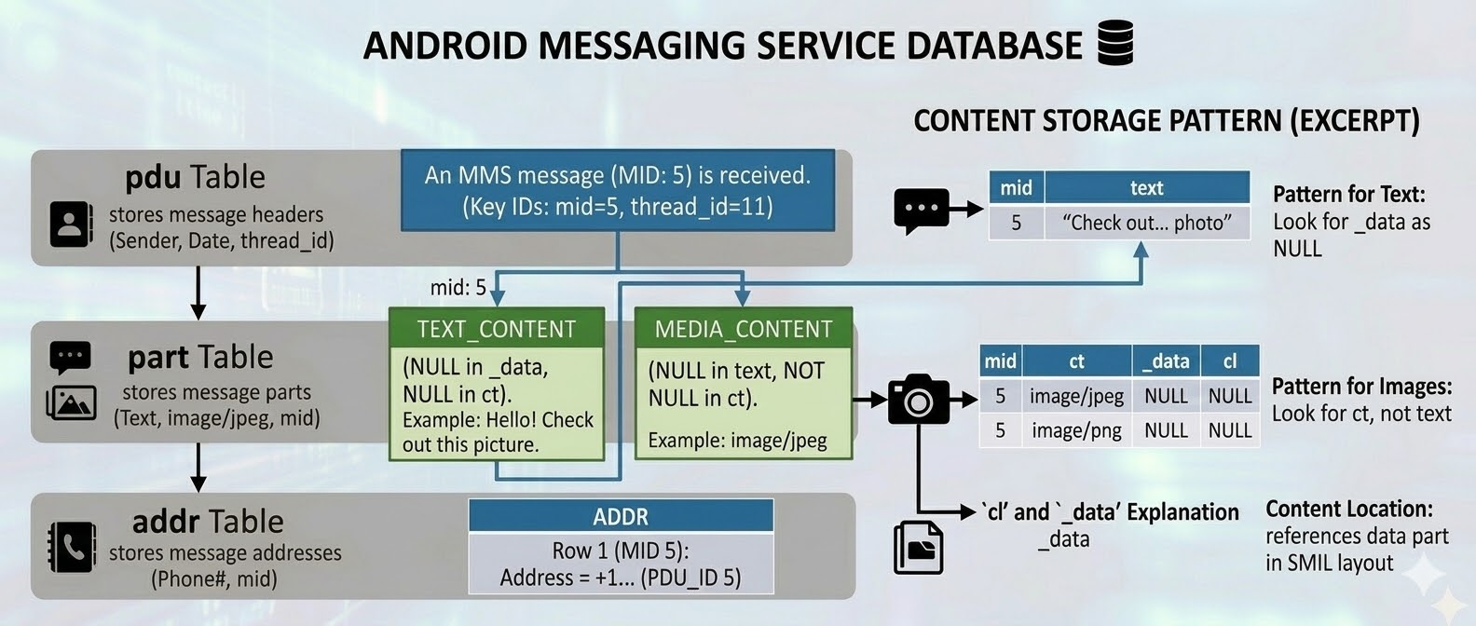

Slide 46
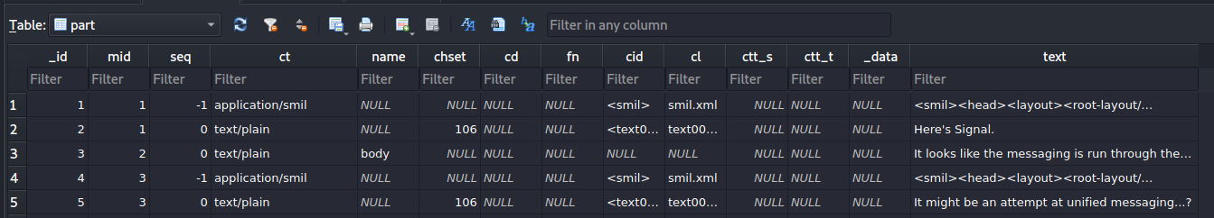






The part table contains MMS components
part.mid links to pdu._id
If an MMS contains text, a layout file, and media, the part table stores separate rows for those components.
Important columns:
  _id: unique component record
  mid: MMS message ID that links back to pdu._id
  ct: content type, such as text/plain or image/jpeg
  cl: content-location name, such as image01.jpg or smil.xml
  text or _data: the body text or media location

Slide 47
Reconstruct an MMS message using pdu, part, and addr

Slide 48
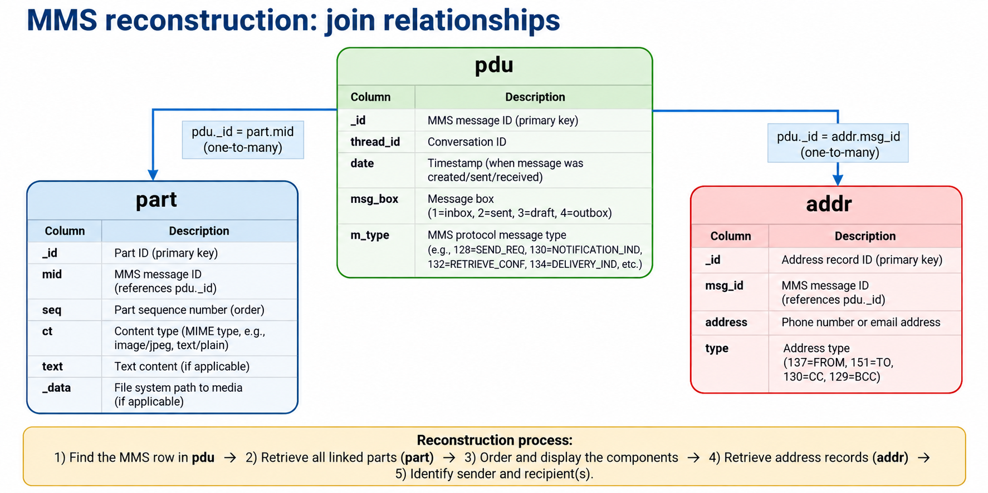

Slide 49
MMS reconstruction logic
pdu stores message-level metadata: time, direction, type, and status.
part stores the components of the MMS: text, SMIL layout, and media.
addr stores sender and recipient records.
The key join is pdu._id = part.mid, and pdu._id = addr.msg_id.

Slide 50
MMS reconstruction steps
Select the MMS message in pdu.
Join pdu._id to part.mid.
Use part.seq to order the parts.
Use part.ct to interpret each component.
Use part.text or part._data to retrieve content.
Join addr to identify sender and recipient(s).

Slide 51
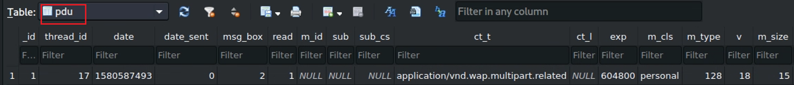
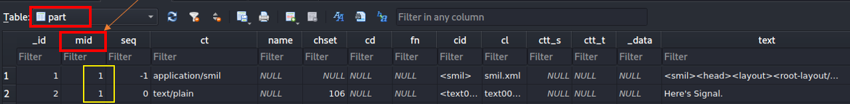

Example: MMS message _id = 1
pdu._id = 1 has two linked rows in part: a SMIL layout row and a text row.
A messaging app uses the SMIL layout to display the content correctly.
seq = -1 → layout/control metadata.
seq ≥ 0 → actual message components in display order.

Slide 52
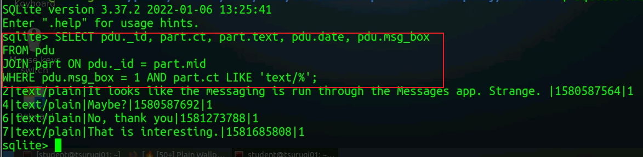
Retrieve text bodies of received MMS messages using SQL
JOIN defaults to INNER JOIN.
Conclusion: text content is available for the four inbox MMS records: 2, 4, 6, and 7.
Notes:
SELECT pdu._id, part.ct, part.text, pdu.date, pdu.msg_box
FROM pdu
JOIN part ON pdu._id = part.mid
WHERE pdu.msg_box = 1 AND part.ct LIKE 'text/%';

Slide 53
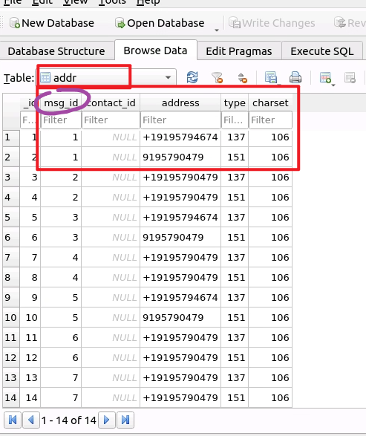


Identify MMS sender and receiver(s)
Use the addr table to identify MMS participants.
Join key: addr.msg_id = pdu._id.
addr.type codes:
137 → FROM (sender)
151 → TO (primary recipient)
130 → CC
129 → BCC

Slide 54
SQL scaffold: include MMS participants
SELECT pdu._id, pdu.date, pdu.msg_box, part.ct, part.text,
addr.address, addr.type
FROM pdu
JOIN part ON pdu._id = part.mid
JOIN addr ON pdu._id = addr.msg_id
WHERE pdu.msg_box = 1
AND part.ct LIKE 'text/%';
addr.type codes
• 137 = FROM
• 151 = TO
• 130 = CC
• 129 = BCC
Instructor note: students can extend this by using CASE expressions to label sender/receiver roles and by converting timestamps.

Slide 55
Summary: AOSP messaging forensic workflow
Start with the service: com.android.providers.telephony.
Locate the data path: data/data/.../databases/mmssms.db.
Use sms and threads to analyze SMS conversations.
Use pdu, part, and addr to reconstruct MMS messages.
Interpret timestamps, direction fields, read/seen flags, and creator fields.
Correlate database records with attachments and file-system artifacts.

Slide 56
Investigator checklist: turn records into evidence
What to document
What to avoid
• Identify source path and database name
• Document table and row identifiers
• Convert timestamps with timezone stated
• Separate SMS from MMS logic
• Join pdu, part, and addr for MMS
• Preserve original values before interpretation
• Do not treat NULL as “not important”
• Do not assume one MMS has one row only
• Do not confuse read and seen flags
• Do not infer sender/receiver without addr.type
• Validate with screenshots or exported artifacts
• Report uncertainty when fields conflict
Forensic takeaway: an artifact is strongest when the database row, table relationship, timestamp conversion, and user-facing meaning are all explained.

Slide 57
Assignment
Update the SQL query to include sender and receiver phone numbers. Use pdu, part, and addr; clearly explain each join condition and each selected field.

