Slide 1
P2P Data Leakage
(Lab Setup)
Malcolm Hayward
University of Baltimore
Forensic Science – Cyber Investigations

Slide 2



Case Background
Beat Step is a company that produces sound effects for popular tv shows and movies.
Two of Beat Step’s music files were stolen from the company and distributed over the Internet.
  One is a copyrighted file that was going to be used in an upcoming movie.
  The other is not copyrighted, but it was to be kept confidential.
Beat Step hired you to determine who was responsible for taking the files and how they were able to do it.

Slide 3
Case Background
Beat Step gave you (cyber investigation team of XXX) the following information when discussing the case:
  The file ‘Contraband.mp3’ has a binary signature and is the copyrighted file. This file was planned to be included in the upcoming movie ‘Fate With Money’.
  The file ‘Sample-1.mp3’ does not have a binary signature and is not the copyrighted file. However, the file was planned to be presented in a meeting. They want to know if the file was leaked by an employee.
  The MD5 and SHA1 hash of the .mp3 files were provided.
Two possible suspects
  Kamryn Allen and Willis Gibbs

Slide 4
Case Background
You have sized one suspect’s PC
  Kamryn Allen
Your goals:
  Prove or disprove that Kamryn downloaded the .mp3 files.
  If copyrighted material is found, prove or disprove that it originated from the company.
  Determine how Kamryn acquired the copyrighted material if any are found.
  Look for any instances where Kamryn downloaded/shared the file(s) with someone else.
  Determine if there are other suspects that may have the file.

Slide 5
Case Background
The title indicates the data leakage case is associated with P2P
  however, we have to assume the investigate did not know the suspect uses P2P to transfer data when starts investigation. The investigator needs to figure it out.
P2P is a type of Peer-to-Peer communication protocol
  used primarily for the distribution of digital media files.
  In a peer-to-peer network each computer acts as both a server and a client—supplying and receiving files—with bandwidth and processing distributed among all members of the network.

Slide 6
Objectives
Install VirtualBox or other Hypervisor
Install Kali Linux or other Linux Distribution
Create Lab Folder
Download Case Materials
Record Hash Information
Install Needed Software
Implement Optional Configurations

Slide 7
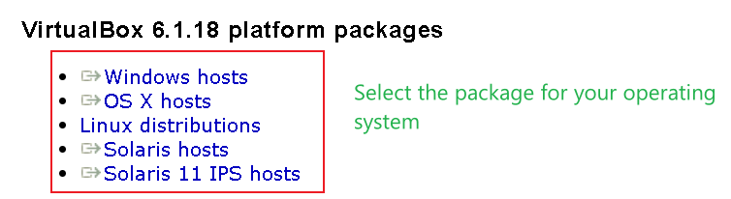
Install VirtualBox
Download VirtualBox from https://www.virtualbox.org/wiki/Downloads

Slide 8
Other Recommendations
VirtualBox will be used for this lab demonstration, but there are other hypervisors to consider:
  VMWare - https://www.vmware.com/products/workstation-player/workstation-player-evaluation.html
  Windows Subsystem for Linux (WSL) - https://docs.microsoft.com/en-us/windows/wsl/install-win10

Slide 9
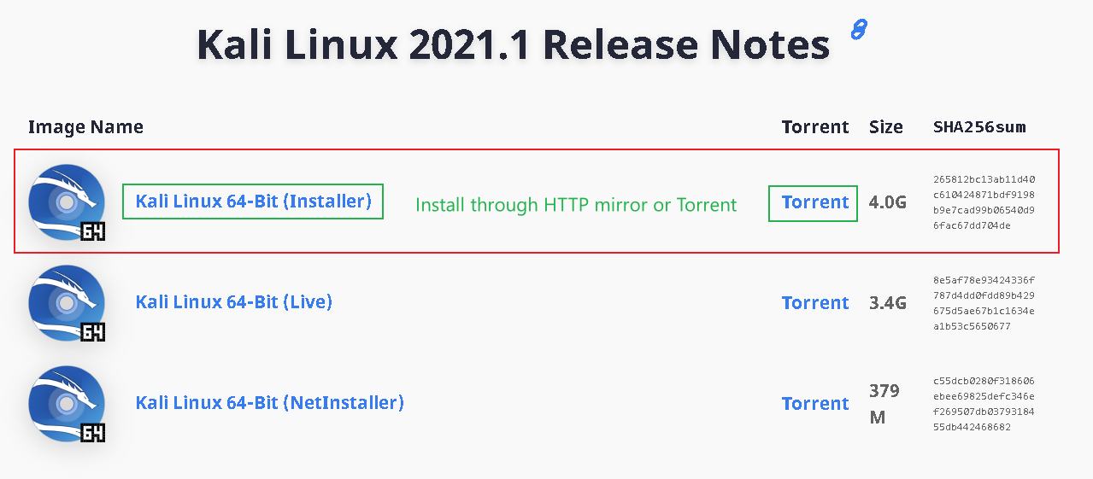
Install Kali Linux or Other Linux Distribution
Option 1: Download Kali Linux from https://www.kali.org/downloads/

Slide 10
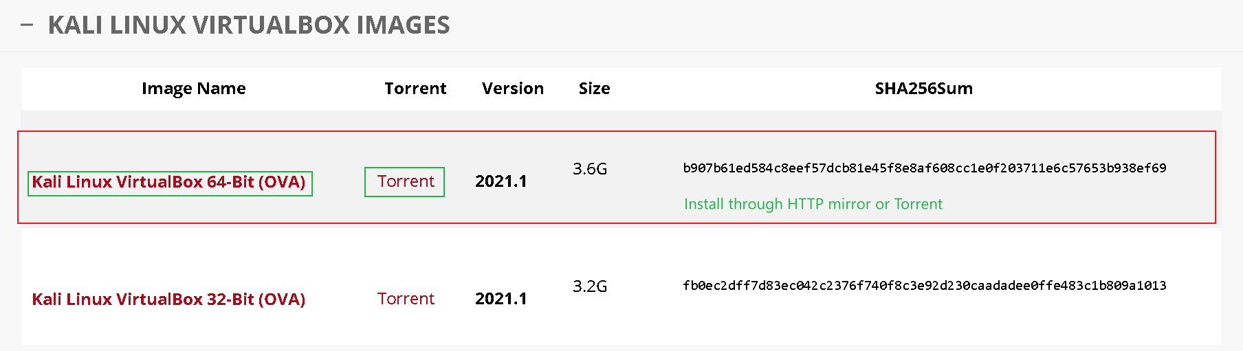
Install Kali Linux or Other Linux Distribution
Option 2: Download Kali Linux from https://www.offensive-security.com/kali-linux-vm-vmware-virtualbox-image-download/

Slide 11
Install Kali Linux or Other Linux Distribution
Difference between ‘Installer’ and ‘OVA’:
  ‘OVA’ is a preconfigured virtual machine. Once you download the ‘OVA’ and start the VM, you will boot right into the desktop. You will not have to go through an installation process for the operating system.
    Easier install, but not recommended if you need to control how much disk space the VM uses. The ‘OVA’ will have a preset amount of space it comes with.
  The ‘Installer’ is the operating system’s ISO file. You will need to install the operating system on the virtual hard drive for the VM.
    Recommended if you want to control how much disk space the VM uses, what desktop environment you want, and what applications you want on the system at the start.

Slide 12
Other Recommendations
Kali Linux will be used for the lab demonstration, but there are other operating systems to consider:
  Parrot OS - https://parrotsec.org/download/
  Backbox Linux - https://www.backbox.org/download/
  SIFT Workstation - https://digital-forensics.sans.org/community/downloads
  Fedora Security – https://labs.fedoraproject.org/security/download/index.html
  BlackArch Linux - https://www.blackarch.org/downloads.html
    Recommend you install BlackArch as a repository on Arch systems since the ISO for BlackArch is large and comes with more tools than you need.
You can use whichever distribution you want and get the same results.

Slide 13
Open a Terminal
This lab demonstration will be done through the terminal (command line). Because of this, many of the tools will be cli-based.
  GUI tools will be suggested in case you prefer to use software with GUIs (if applicable).
Linux distributions come with terminal emulators by default, so you do not need to install anything.
A common shortcut for opening a terminal is the key combination ‘ctrl+alt+t’. Alternatively, you can find a terminal launcher in the panel/toolbar, or through an application/start menu.

Slide 14
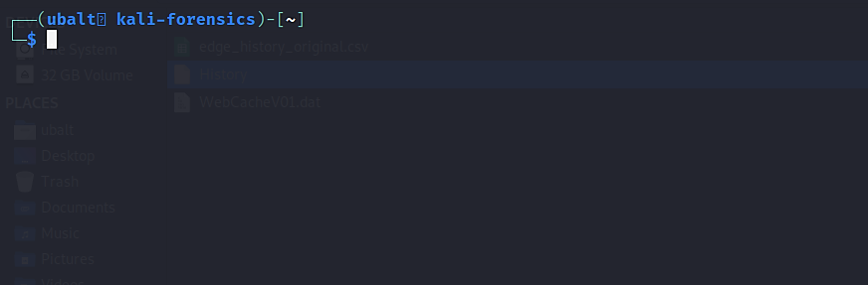
Open a Terminal
Tip: The key combination ‘ctrl alt t’ will open a terminal.

Slide 15
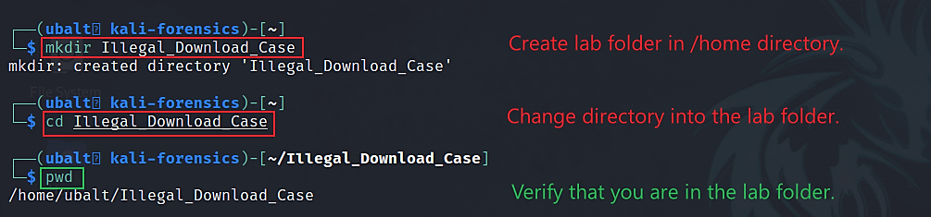
Create Lab Folder

Slide 16
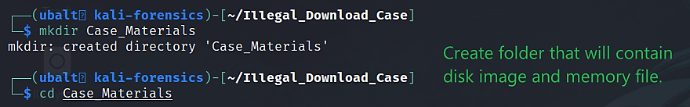
Download Case Materials

Slide 17
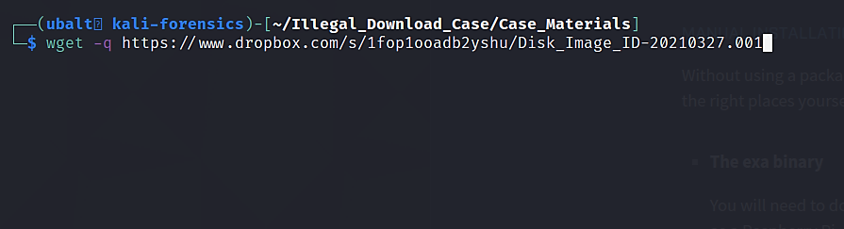
Use wget to download disk image.
Try https://drive.google.com/drive/folders/16UdO-QXIg1RTNsRJ595U24VG6WI-RSgx?usp=sharing if the above link is blocked
Notes:
https://www.dropbox.com/s/0rxqi65v62njd6v/Memory_Dump_ID-20210327.raw
https://www.dropbox.com/s/1fop1ooadb2yshu/Disk_Image_ID-20210327.001

Slide 18
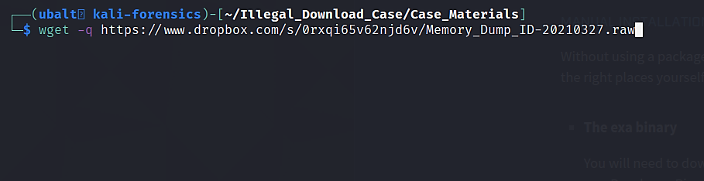
Use wget to download memory file (optional)
if you want to investigate memory
Notes:
https://www.dropbox.com/s/0rxqi65v62njd6v/Memory_Dump_ID-20210327.raw
https://www.dropbox.com/s/1fop1ooadb2yshu/Disk_Image_ID-20210327.001

Slide 19

Record Hash Information
Open a text file using the text editor Nano:
When you execute this command, you will be brought to an empty text file in the terminal.

Slide 20
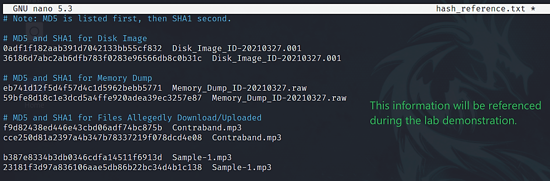
Input this information in your new text file:
Notes:
0ADF1F182AAB391D7042133BB55CF832 Disk_Image_ID-20210327.001
36186D7ABC2AB6DFB783F0283E96566DB8C0B31C Disk_Image_ID-20210327.001
EB741D12F5D4F57D4C1D5962BEBB5771 Memory_Dump_ID-20210327.raw
59BFE8D18C1E3DCD5A4FFE920ADEA39EC3257E87 Memory_Dump_ID-20210327.raw
F9D82438ED446E43CBD06ADF74BC875B Contraband.mp3
CCE250D81A2397A4B347B78337219F078DCD4E08 Contraband.mp3
B387E8334B3DB0346CDFA14511F6913D Sample-1.mp3
23181F3D97A836106AAE5DB86B22BC34D4B1C138 Sample-1.mp3

Slide 21
Install Necessary Software
For this lab, you will need:
  AnalyzeMFT
  Exiftool
  Git
  Hashdeep
  Liblnk-utils
  LibreOffice
  Mutt
  Python 2 & 3
  Regripper
  Sleuthkit
  Sqlite3
  Torrent File Editor
  USN Journal Parser
  USN Record Carver
  Volatility
  Wine

Slide 22
Installation Script
Download the p2p_lab_tool_install.bash at /Scripts folder
To run the script, either:
  Run the script via the bash command:
    bash p2p_lab_tool_install.bash
  Run the script as an executable:
    sudo chmod +x p2p_lab_tool_install.bash
    ./p2p_lab_tool_install.bash

Slide 23
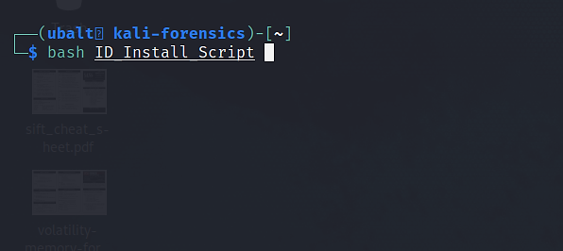
(Option 1) Use the bash command to run the script.

Slide 24
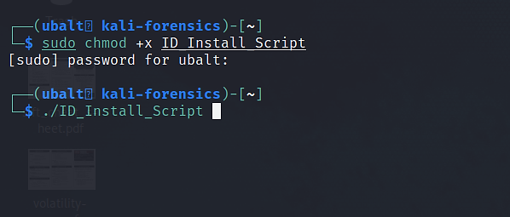
(Option 2) Use chmod to make the script executable, then run it.

Slide 25
(Alternatively) Install Software Manually
Type in the following commands in the terminal.
Most tools are available in your distribution’s repository via your package manager.
  If using a distribution that does not use apt as its package manager, change your commands to use your respective package manager.
Some tools are installed from Github. You will need to have git installed to install them.
  Install the git package: sudo apt install git

Slide 26
Install software manually
Tool | Command
Exiftool | sudo apt install libimage-exiftool-perl
Git | sudo apt install git
Hashdeep | sudo apt install hashdeep
Liblnk-utils | sudo apt install liblnk-utils
Libre Office | sudo apt install libreoffice
Mutt | sudo apt install mutt
Python 2 | sudo apt install python2
Python 3 | sudo apt install python3
Sleuthkit | sudo apt install sleuthkit
Sqlite3 | sudo apt install sqlite3
Wine | sudo apt install wine64
Notes:
Note: Libre Office fails to install on zSecurity’s Kali Linux. I suggest avoiding it completely.

Slide 27
Install software manually
Tool | Command
AnalyzeMFT | git clone https://github.com/dkovar/analyzeMFT.git
Regripper | wget https://raw.githubusercontent.com/dfir-scripts/installers/main/RegRipper30-apt-git-Install.sh
Torrent File Editor | wget https://github.com/torrent-file-editor/torrent-file-editor/releases/download/v0.3.17/torrent-file-editor-0.3.17-x64.exe
USN Journal Parser | git clone https://github.com/PoorBillionaire/USN-Journal-Parser.git
USN Record Carver | git clone https://github.com/PoorBillionaire/USN-Record-Carver.git
Volatility 2 | git clone https://github.com/volatilityfoundation/volatility.git
Volatility 3 | git clone https://github.com/volatilityfoundation/volatility3.git

Slide 28
Installing Regripper
The command on the previous slide downloads the installation script.
To start the download for Regripper, either:
  Use the bash command.
    sudo bash RegRipper30-apt-git-Install.sh
  Make it executable, then run it.
    sudo chmod +x RegRipper30-apt-git-Install.sh
    ./RegRipper30-apt-git-Install.sh

Slide 29
Running Torrent-File-Editor
This program is an executable file. You will need to use Wine to run it on Linux.
To run this program, either:
  Run Wine and then point the program to the Torrent-File-Editor’s file path.
    For example (assuming that Torrent-File-Editor is in my Downloads folder):
      wine /home/<user>/Downloads/torrent-file-editor-0.3.17-x64.exe
      Replace ‘<user>’ with your username.
  Create an alias
    alias torrent-file-editor=‘wine /home/<user>/Downloads/torrent-file-editor-0.3.17-x64.exe’
    Tutorial on how to create an alias.

Slide 30
Optional Configurations
Aliases
Use ‘exa’ instead of the ‘ls’ command
While these are optional, they will help you a lot and are highly recommended.

Slide 31
Aliases
Aliases are shortcuts for executing commands.
  If you wanted to install software with the APT package manager, you would type ‘sudo apt install’.
  Type: alias install=‘sudo apt install’
  You just created a new alias called ‘install’. Now, if you type ‘install’ in the terminal, it will recognize the alias ‘install’ as the command ‘sudo apt install’.
You use aliases in the terminal all the time.
  ‘ls’ is an alias for ‘ls –color=auto’.
  ‘grep’ is an alias for ‘grep –color=auto’.
If this is your first time being exposed to aliases, let’s create one.

Slide 32
Creating your first alias
To create an alias, type this in the terminal:
  alias first=“echo ‘Hello World’”
Now when you type in first, it will execute the echo command that you set it to.
Let’s try it out!

Slide 33
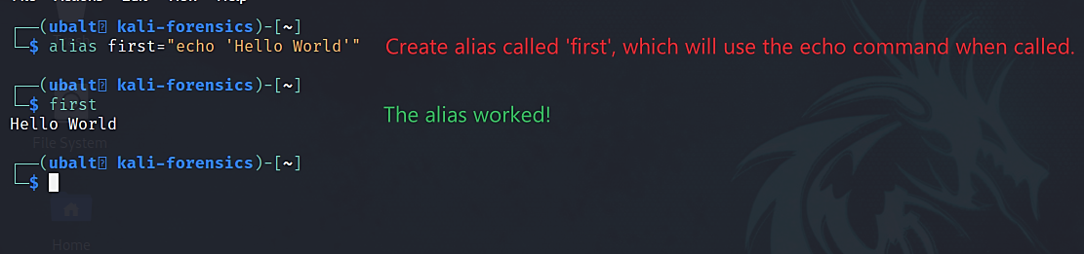
Creating your first alias
Note: Aliases created this way are temporary. Once you close that tab/window, the alias will be gone. The next few slides will show you how to make your aliases persist.

Slide 34
Make aliases persist
Aliases disappear if you close the terminal
To make aliases persist
  the alias must be placed in the shell’s configuration file
    it allows for the aliases to be executed when the terminal is started.
If you are using Kali Linux, the shell should be zsh by default. The configuration file will be located at ~/.zshrc, or /home/$USER/.zshrc.
  $USER = your username
  Tip: The ~ symbol is the same as /home/$USER. You are in this directory by default whenever you first open the terminal.
Notes:
Note: If you have a bash shell, then your configuration file is ~/.bashrc. For any other shells like Fish, your method of creating aliases may be different or your config will be called something different and/or may be in different locations.
Alternatively, you can place your aliases into a different file, and then have the configuration file read the aliases from that file. We will use this option.

Slide 35
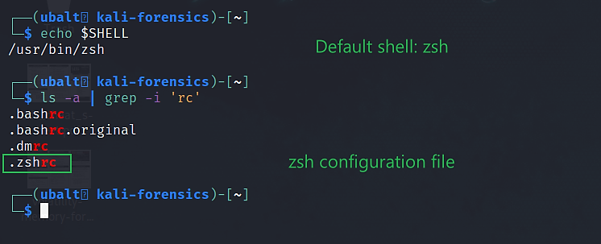
Check your default shell and where the configuration file is.

Slide 36

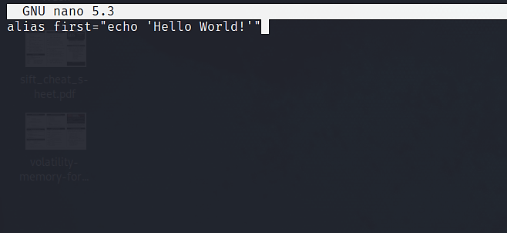
Make Aliases Persist
Note: On Linux, files with a ‘.’ in front of it is a hidden file.

Slide 37


Make Aliases Persist
Note: On systems with different shells (i.e., bash), the config file will have a different name (i.e., .bashrc).
Place anywhere in the config file

Slide 38
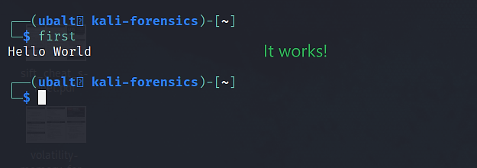
Close and reopen the terminal. Type your new alias.

Slide 39
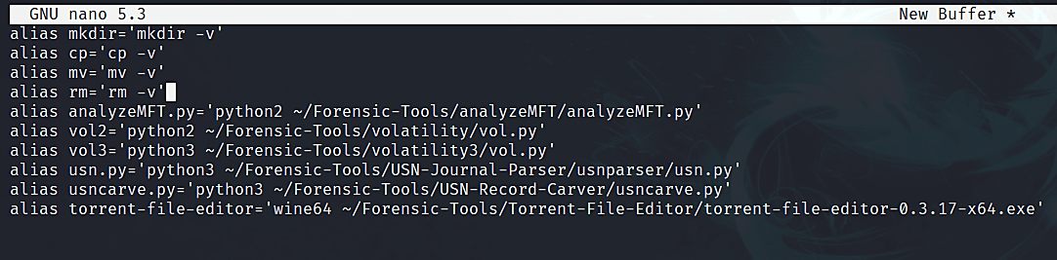
Place these aliases into your .zsh_aliases file.
Note: The ‘Forensic-Tools’ file path is interchangeable depending on where you want to place your tools. These are the default locations for the people who use the installation script.

Slide 40
Use exa Instead of ‘ls’
exa is an alternative to ‘ls’. It colorizes the output to make it easier to read.
Install:
  Through package manager:
    sudo apt install exa
  Through website (if the program is not in the repository):
    https://the.exa.website/#installation

Slide 41
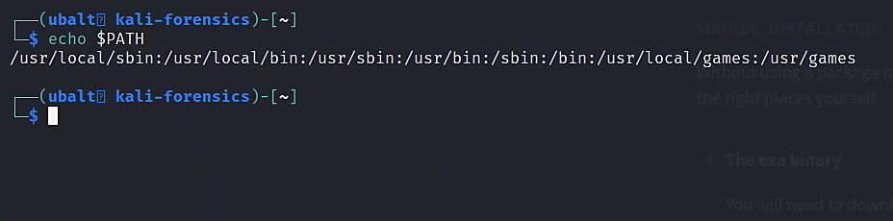
How Linux Executes Programs
The operating system looks in these directories for the commands you type in.
  If the command does not point to a program in these directories, it will not execute.
Note: The path ‘/usr/bin’ is within the PATH variable.
  The reason why we moved exa here is so that when we type ‘exa’ in the terminal, the OS knows where to execute the program from.

Slide 42
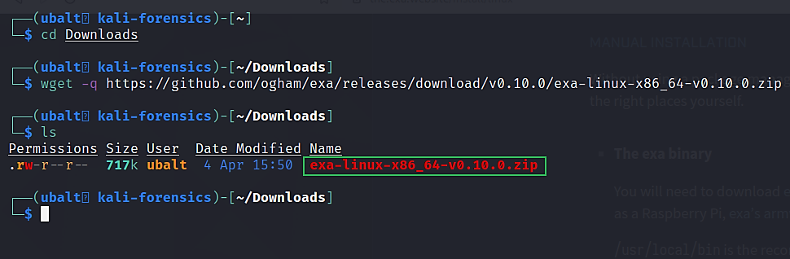
Installing exa Through Website (if the program is not in the repository)

Slide 43
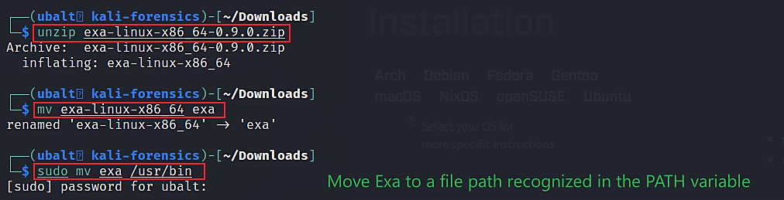
Unzip the program, rename the program to ‘exa’, then move to /usr/bin:

Slide 44
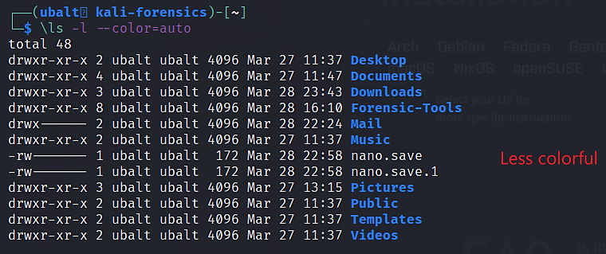
Comparison
‘ls’ command

Slide 45
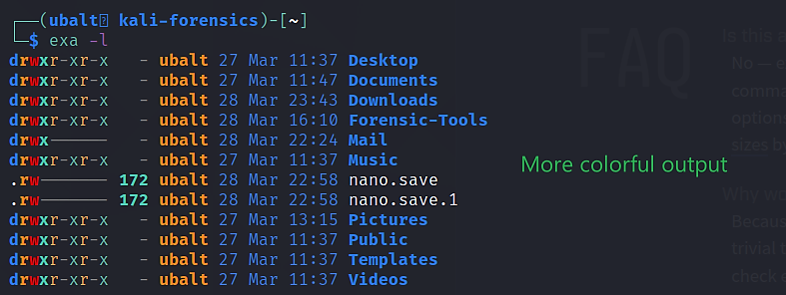
Comparison
Exa command

Slide 46
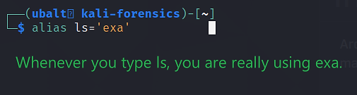
Make exa Into an Alias
Like with your ‘first’ alias, you will always use the exa program whenever you type in ls.
Place this alias in the configuration file or the aliases file if you want it to persist.

Slide 47
Here are the presentations related to this case:
1. Disk Image and Partitions
2. Registry and File Directories
3. MFT Timeline
4. USN Journal Timeline
5. uTorrent Log File
6. File Signature
7. Emails
8. Web History
9. Website Analysis
It is recommended that you view these presentations in order.

