Slide 1
Tracking Android Apps Through Their Life Cycle
Installed, Running, Background, Deleted

Slide 2
Android App Lifecycle Analysis
1 Identify Apps
2 Examine Metadata
3 Reconstruct Usage
4 Interpret Lifecycle
What apps are/were associated?
What do we know about each app?
When and how was it used?
What can we conclude?
→
→
→
Play Store records
App data directories
Package list
Package name + UID
Installer + version
Install/update time
Foreground/background
Activity events
Usage timeline
Installed/used/removed
Reset/restore signals
Corroborated timeline
Evidence sources
App properties
Events over time
Forensic answer
Output: a defensible app-activity timeline with source path, field name, decoded time, and confidence level.
Notes:
find 'Pixel 3' -iname 'package*'

Slide 3
1: Identify Apps
Question: What apps are or were associated with the device or Google account?
Sources: Play Store records • app directories • package lists

Slide 4
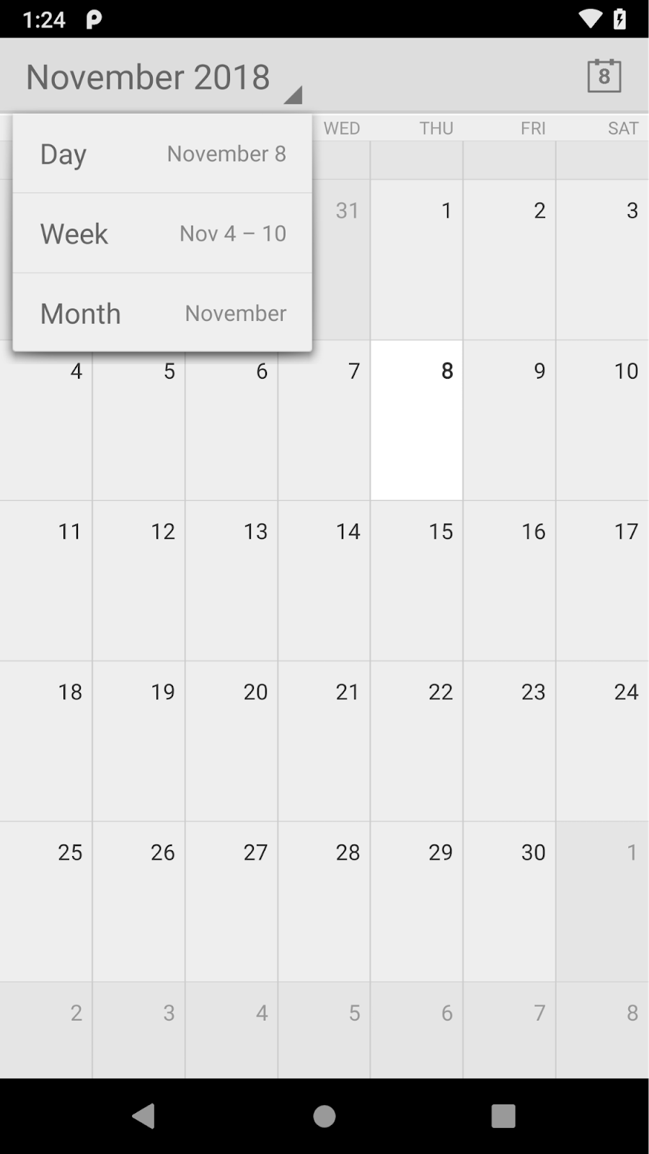
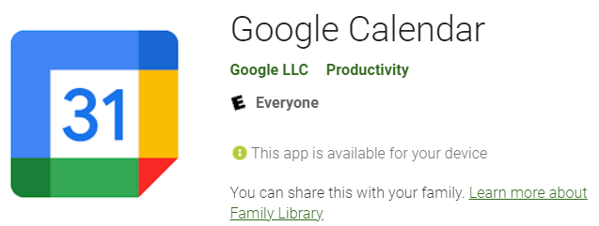
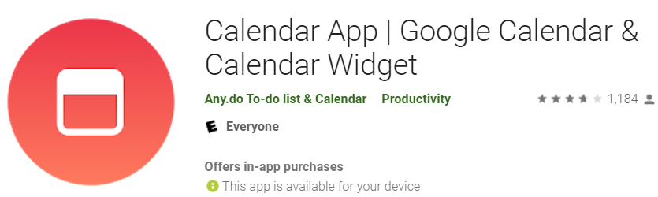
Classify Identified App Packages
AOSP Applications: com.android.calendar
Google GMS: com.google.android.calculator
3rd Party Apps: com.sec.android.app.popupcalculator
Notes:
https://android.googlesource.com/platform/packages/apps/
https://android-developers.googleblog.com/2019/03/aosp-application-updates.html

Slide 5
Identify Apps Overview
Find Apps in Play Store database
Exam purchase record/ownership in Play Store
Find Apps in data directories

Slide 6
I. Find Apps in Play Store database
App record, title, account, first_download_ms

Slide 7
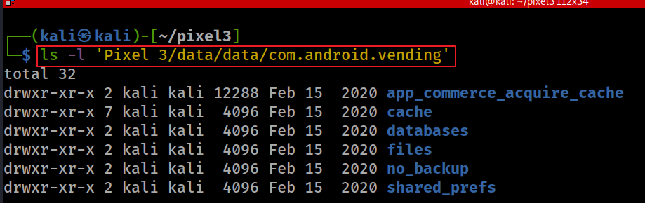
Google Play Store App Data
The Play Store package can maintain installation/acquisition state in its app-private databases.
Play store app: /data/data/com.android.vending
Notes:
ls -l 'Pixel 3/data/data/com.android.vending’
https://gossipfunda.com/com-android-vending/

Slide 8
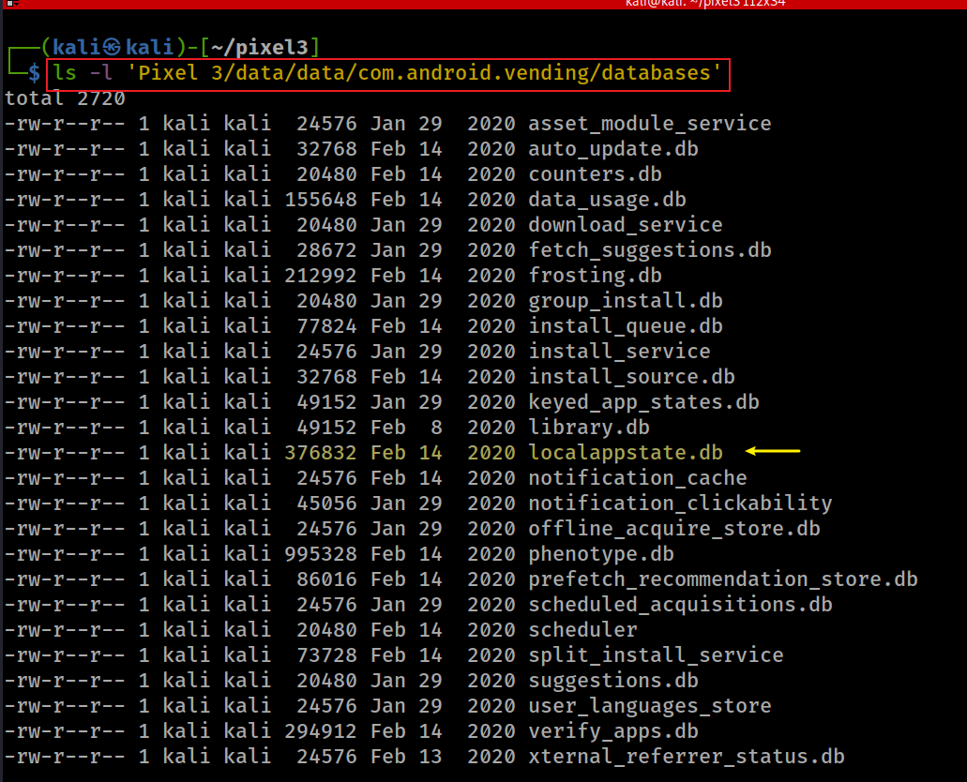
Locate Play Store Databases
Notes:
ls -l 'Pixel 3/data/data/com.android.vending/databases'

Slide 9
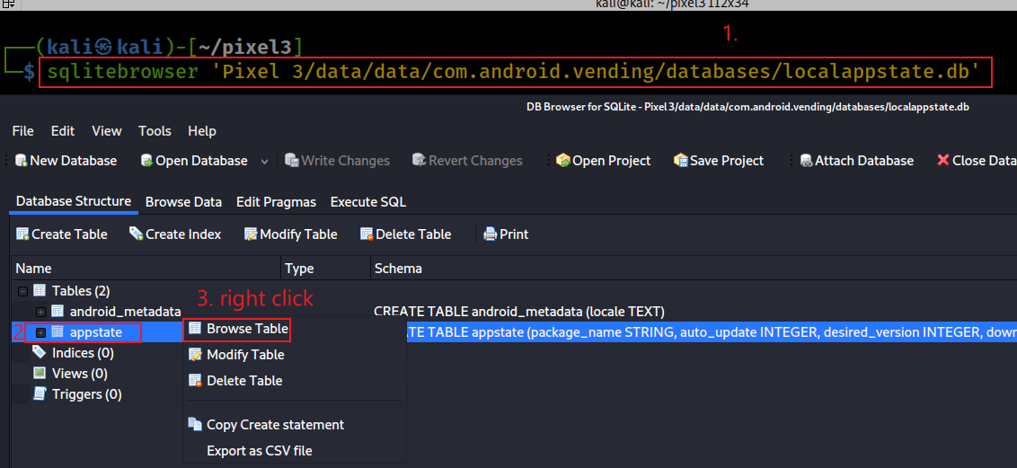
Open localappstate.db
Browse the appstate table to inspect package names, titles, accounts, and download timestamps.
Notes:
sqlitebrowser 'Pixel 3/data/data/com.android.vending/databases/localappstate.db'

Slide 10
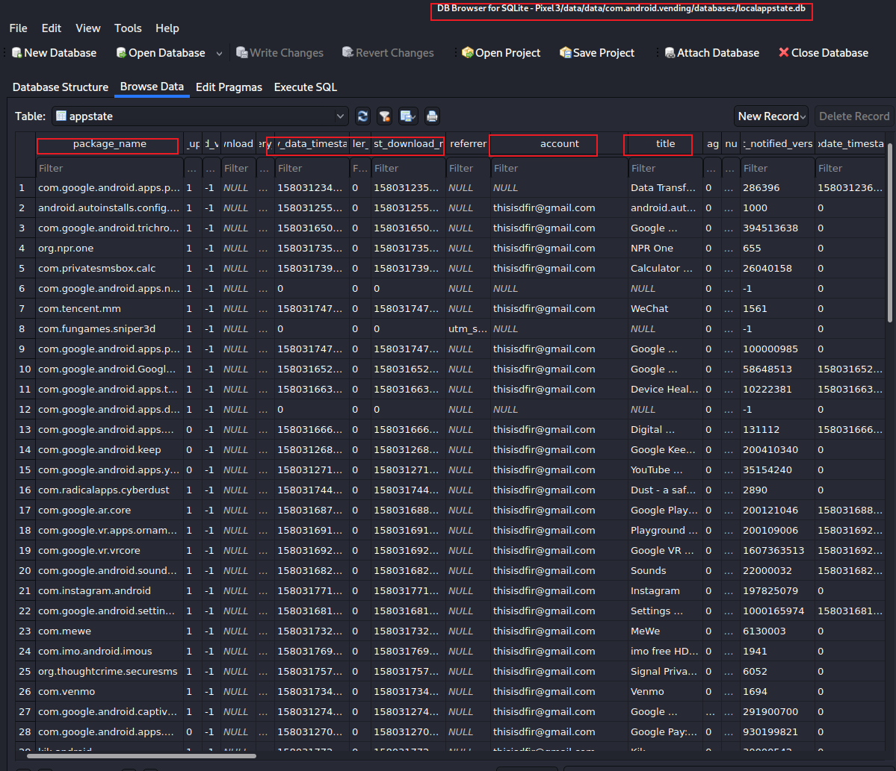

Slide 11
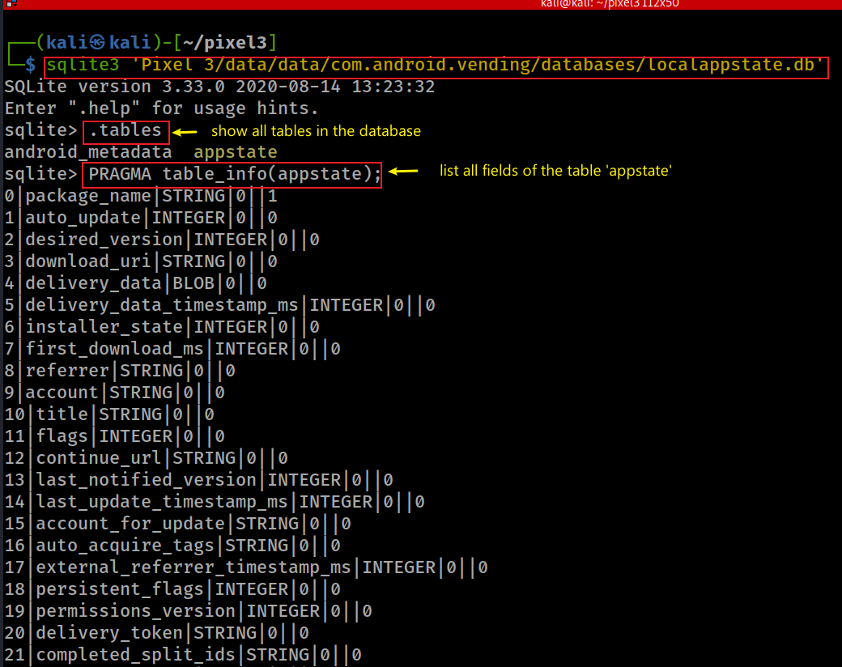
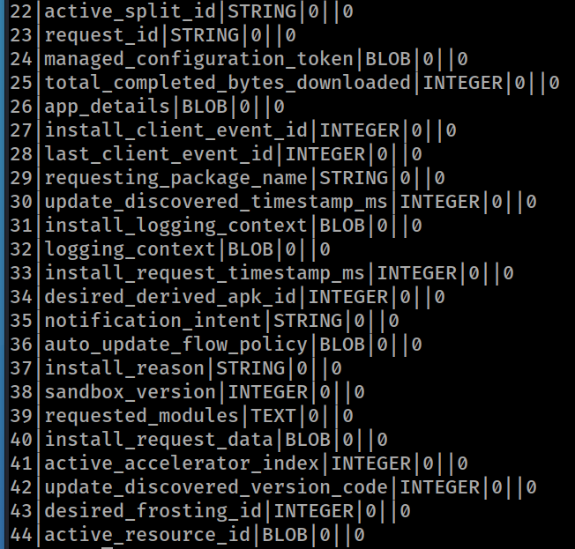
Exam appstate Table fields
.open anotherdatabase.db
Notes:
sqlite3 'Pixel 3/data/data/com.android.vending/databases/localappstate.db’
.tables
PRAGMA table_info(appstate);

Slide 12
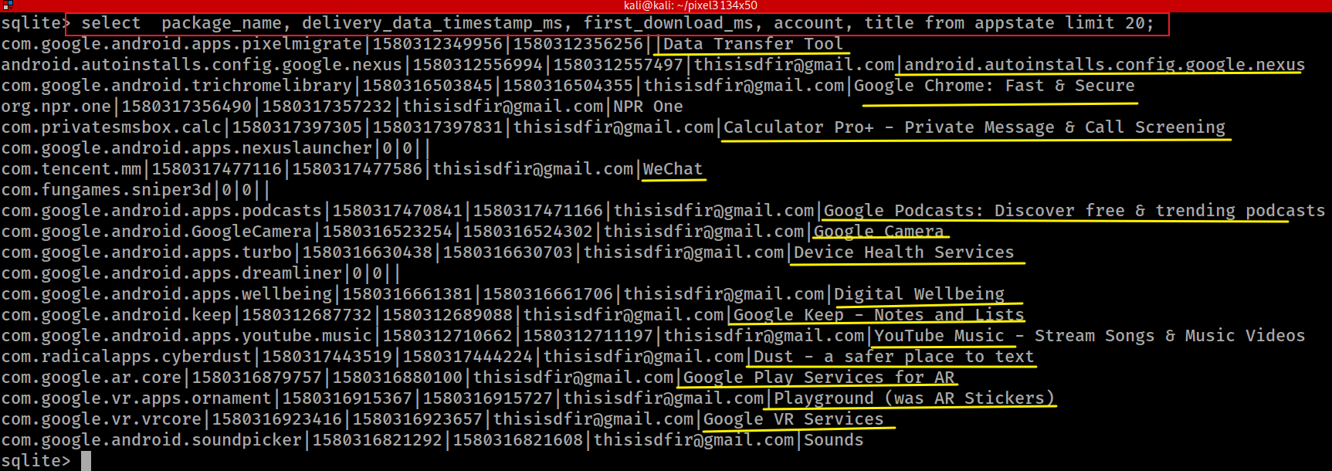
List Installed or Downloaded App Records
Notes:
select package_name, delivery_data_timestamp_ms, first_download_ms, account, title from appstate limit 20;

Slide 13

Was WeChat Downloaded?
WeChat is a Chinese multi-purpose messaging, social media and mobile payment app
Developed by Tencent
First released in 2011
The world's largest standalone mobile app in 2018
over 1 billion monthly active users.
WeChat has been described as China's "app for everything"
because of its wide range of functions.
Key functions
text messaging, hold-to-talk voice messaging, broadcast (one-to-many) messaging, video conferencing, video games, sharing of photographs and videos, and location sharing.

Slide 14
Investigation Focus
Forensic question: does Play Store data show a WeChat record?
Look for package, title, account, and download timestamp
Then corroborate with directories and package metadata

Slide 15
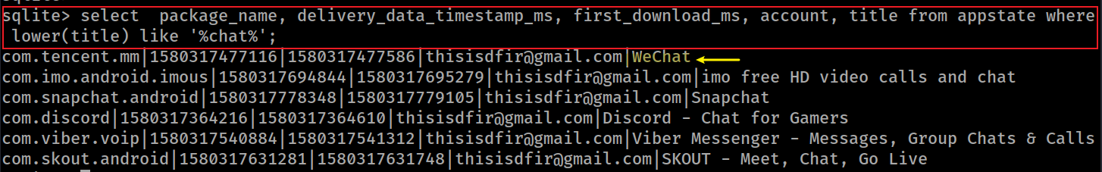
Search App Records with SQL
Search by title keyword, then verify the package name and associated account/timestamps
lower(title): convert title string to lower case
%chat%: match any title with ‘chat’ keyword
Search title with like
Notes:
select package_name, delivery_data_timestamp_ms, first_download_ms, account, title from appstate where lower(title) like '%chat%';

Slide 16
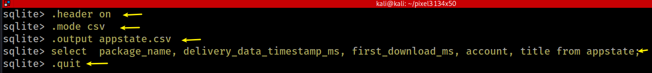
Alternative: Export appstate to CSV.
CSV export is useful for grep/filtering, but document the exact query and fields exported
keep output column name when export to .csv
change to .cvs mode
ready to export to appstate.csv
export specified columns
quit sqlite3
Notes:
sqlite> .header on
sqlite> .mode csv
sqlite> .output appstate.csv
sqlite> select package_name, delivery_data_timestamp_ms, first_download_ms, account, title from appstate;
sqlite> .quit

Slide 17
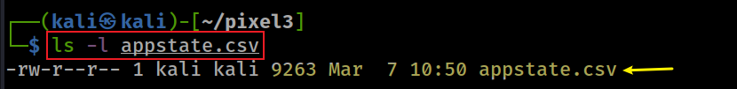
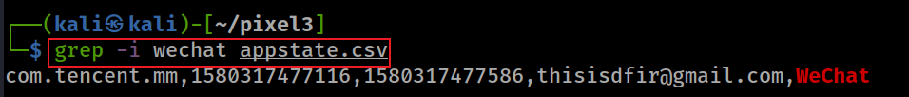
Verify CSV Output and Locate WeChat
After exporting, confirm the record and preserve the output file as derived evidence.
verify the output file
Search for wechat app
Notes:
sqlite> .header on
sqlite> .mode csv
sqlite> .output appstate.csv
sqlite> select package_name, delivery_data_timestamp_ms, first_download_ms, account, title from appstate;
sqlite> .quit

Slide 18
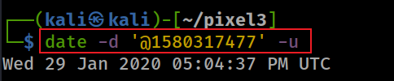
WeChat Account and First Download Time
The result links WeChat to an account and a first_download_ms value in appstate.
Found that thisisdfir@gmail.com is associated with WeChat
Convert integer to downloaded time
Notes:
date -d '@1580317477' -u

Slide 19
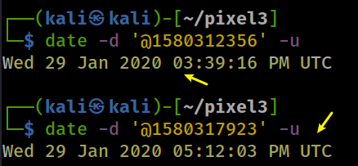
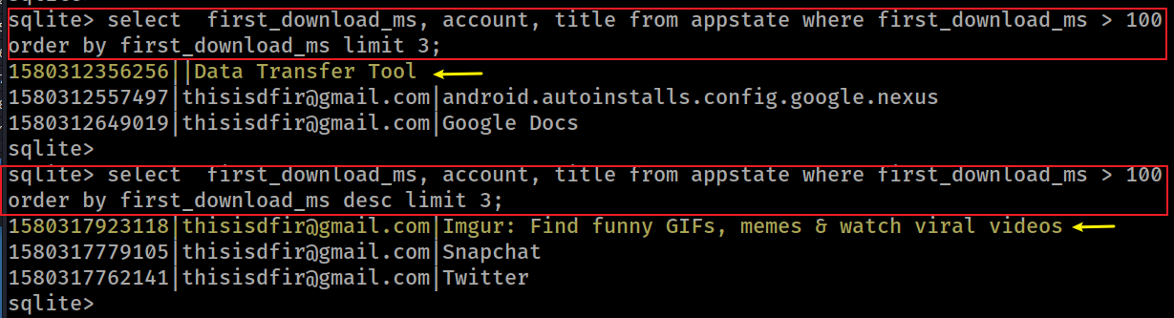
App Download Window
What is the time between the first and last app downloaded (less than 2 hours)?
Find the time of the app downloaded and the last app downloaded
Millisecond (ms):One millisecond is equal to one-thousandth (1/1000) of a second.
Microsecond (µs):One microsecond is equal to one-millionth (1/1,000,000) of a second
Notes:
sqlite> select first_download_ms, account, title from appstate where first_download_ms > 100 order by first_download_ms limit 3;
1580312356256||Data Transfer Tool
1580312557497|thisisdfir@gmail.com|android.autoinstalls.config.google.nexus
1580312649019|thisisdfir@gmail.com|Google Docs
sqlite>
sqlite> select first_download_ms, account, title from appstate where first_download_ms > 100 order by first_download_ms desc limit 3;
1580317923118|thisisdfir@gmail.com|Imgur: Find funny GIFs, memes & watch viral videos
1580317779105|thisisdfir@gmail.com|Snapchat
1580317762141|thisisdfir@gmail.com|Twitter

Slide 20
II. Exam purchase record/ownership in Play Store
Use Play Store ownership records as account-level acquisition evidence.

Slide 21
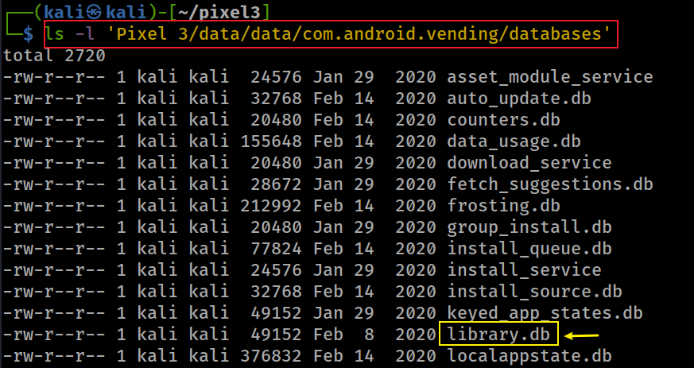
Play Store Ownership Records: library.db
Show location of database (library.db)
2. Find purchase time in the ownership table based on app name:
account
doc-id (package name)
doc hash
purchase time
1. find app name

Slide 22
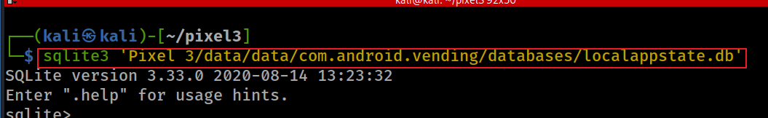
Case Study: When was WhatsApp purchased?
A: Use localappstate.db first to identify the package name and current-device download time.
1. Show location of database (localappstate.db) where we can find package name of whatsapp
2. Find package name of whatsapp
first_download_ms Wed 29 Jan 2020 05:09:04 PM UTC
Notes:
sqlite3 'Pixel 3/data/data/com.android.vending/databases/localappstate.db’
select package_name, delivery_data_timestamp_ms, first_download_ms, account, title from appstate where lower(title) like '%whatsapp%';

Slide 23
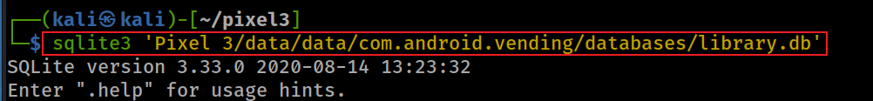

WhatsApp: Query Purchase/Acquisition Time
B. Use library.db ownership records to retrieve the acquisition timestamp.
3. Open the database where whatsapp purchase time is stored
4. Find the purchase time
5. Convert the purchase time to a human readable format
Notes:
sqlite3 'Pixel 3/data/data/com.android.vending/databases/library.db’
select doc_id, document_hash, purchase_time from ownership where doc_id like '%whatsapp%';
com.whatsapp|-2208265135048976340| 1543518467665
Thu 29 Nov 2018 07:07:47 PM UTC

Slide 24
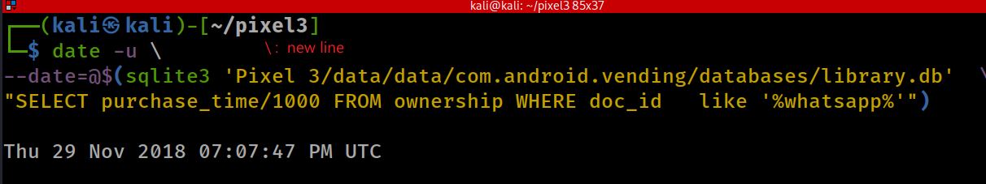
Combine SQLite Query and Time Conversion
A compact command is convenient, but retain the expanded steps for auditability.
Combine step 1 – 5 in one command
The command in the braces of $() is executed in a subshell and the output is then placed in the original command.
Notes:
date -u \
--date=@$(sqlite3 'Pixel 3/data/data/com.android.vending/databases/library.db' \
"SELECT purchase_time/1000 FROM ownership WHERE doc_id like '%whatsapp%'")

Slide 25
Interpret Purchase Time vs Download Time
WhatsApp time
purchased: Thu 29 Nov 2018 07:07:47 PM UTC
downloaded: Wed 29 Jan 2020 05:09:04 PM UTC
A time gap is an observation; the cause must be corroborated with other artifacts.
Why there is over one year gap?
the phone has been reset
the purchased time is the last time that a removed/un-installed app was installed
the phone is the user’s second Android device.
the purchased time is the user’s previous Android device
A free app is also considered purchased

Slide 26
III. App data directories
Use package folders to identify apps with local app-private data.

Slide 27
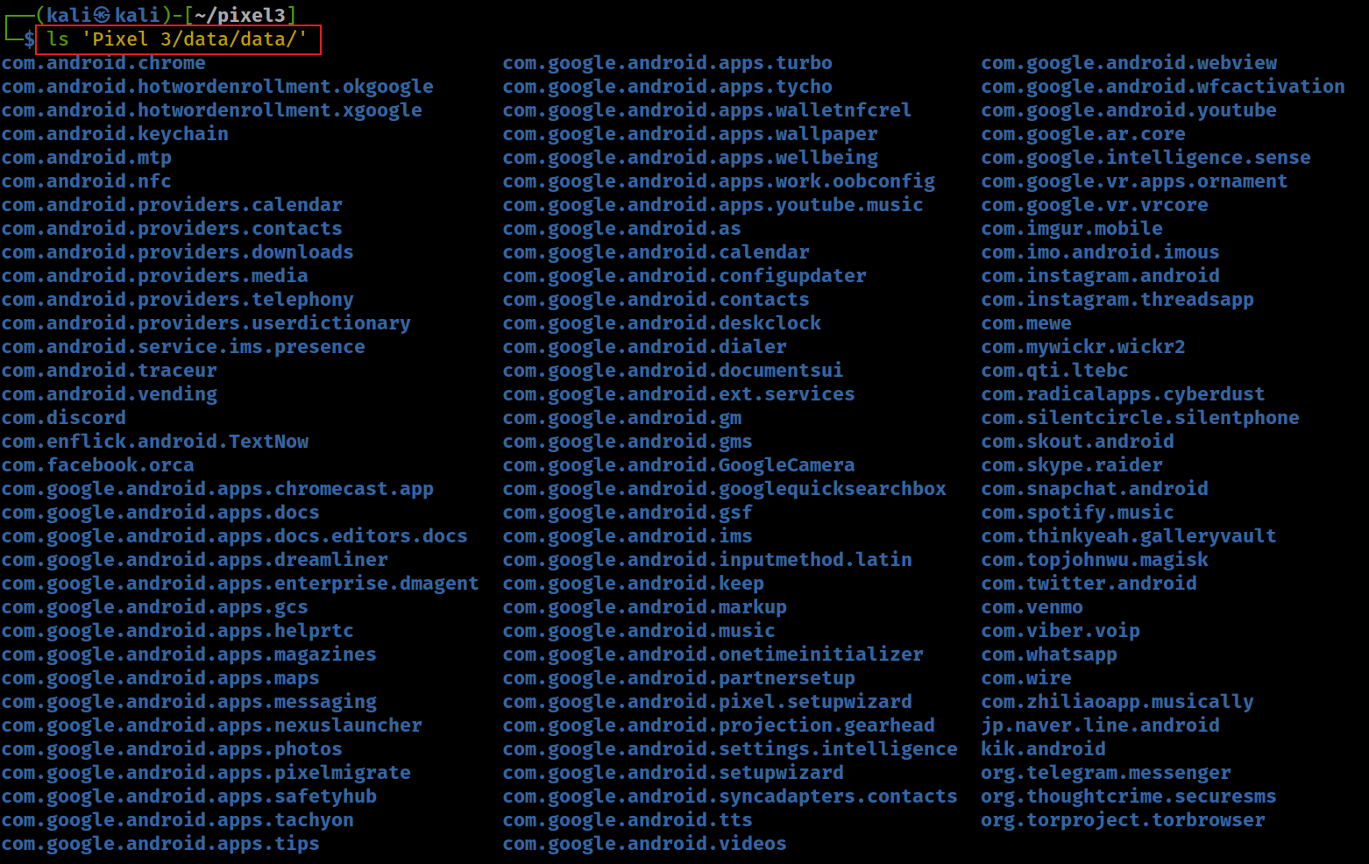
Show all packages under the folder /data/data/
For user 0, /data/data/<package> is the compatibility path for /data/user/0/<package>.
Recall: We categorize them into groups:
google apps: com.google.*
android apps: com.andriod.*
3rd-party apps
Notes:
ls 'Pixel 3/data/data/'

Slide 28
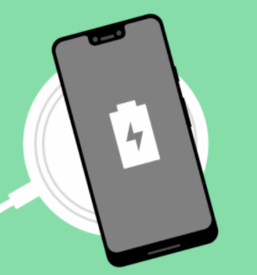
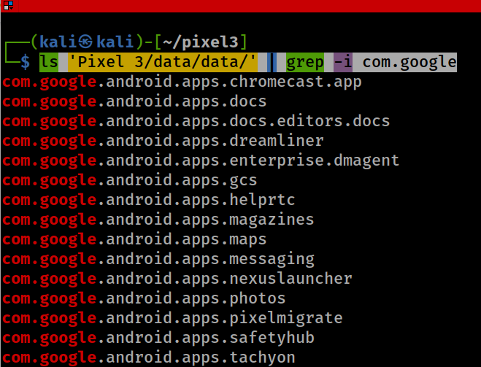
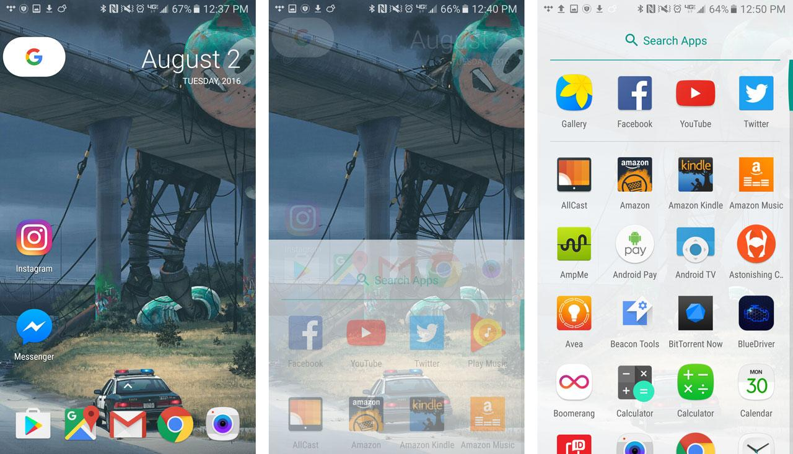
Group 1: Google Apps: com.google.*
‘dreamliner’ wireless charging widget support
Notes:
ls 'Pixel 3/data/data/' | grep -i com.google

Slide 29
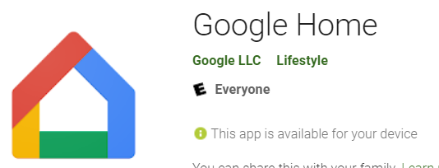

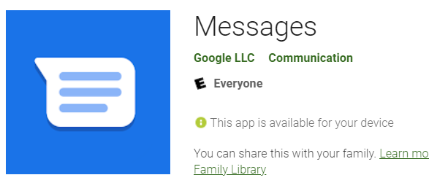
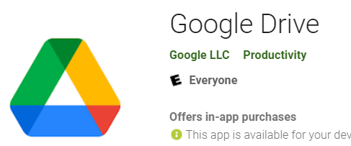
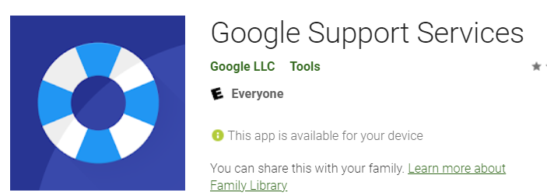
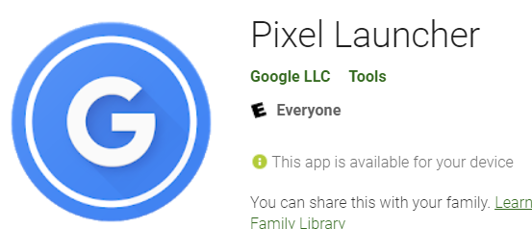
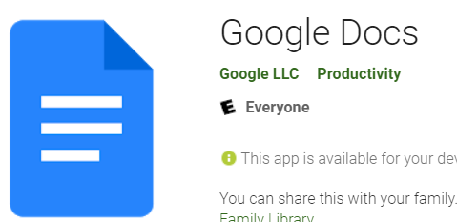
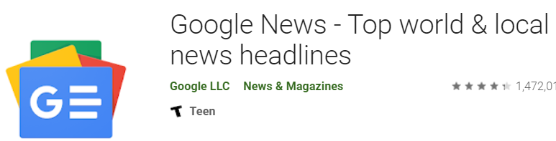
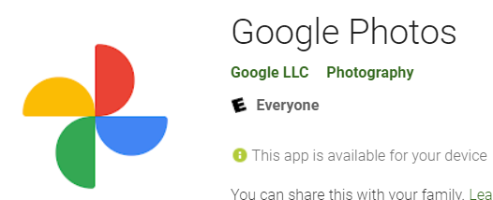
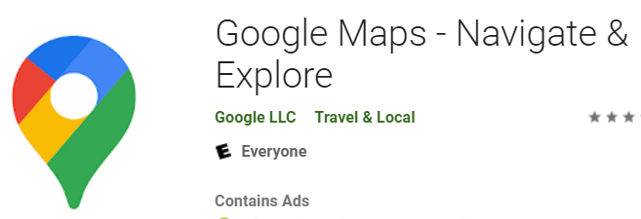
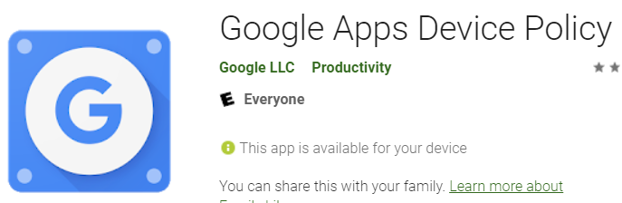
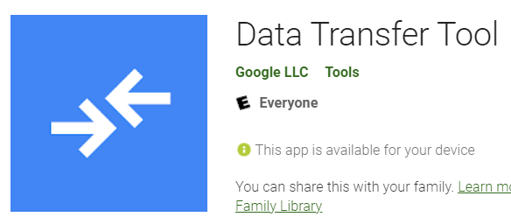
Notes:
com.google.android.apps.chromecast.app
com.google.android.apps.docs
com.google.android.apps.docs.editors.docs
com.google.android.apps.dreamliner
com.google.android.apps.enterprise.dmagent
com.google.android.apps.gcs
com.google.android.apps.helprtc
com.google.android.apps.magazines
com.google.android.apps.maps
com.google.android.apps.messaging
com.google.android.apps.nexuslauncher
com.google.android.apps.photos
com.google.android.apps.pixelmigrate

Slide 30
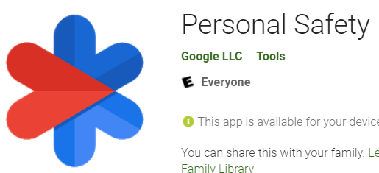
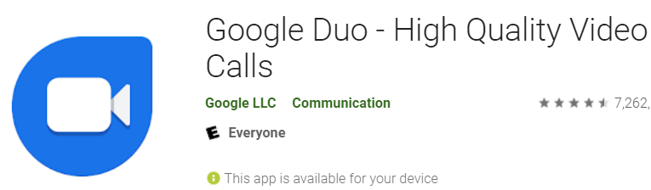
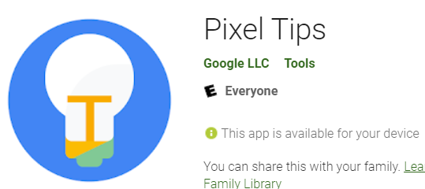
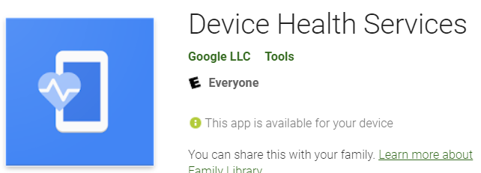
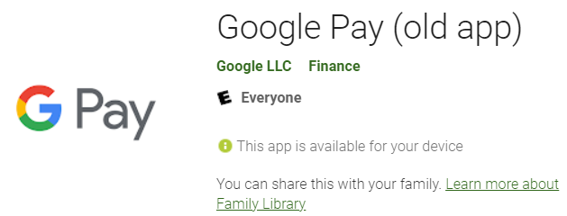
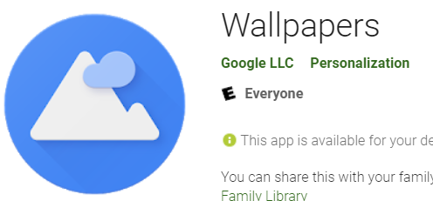
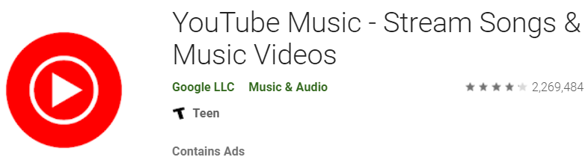
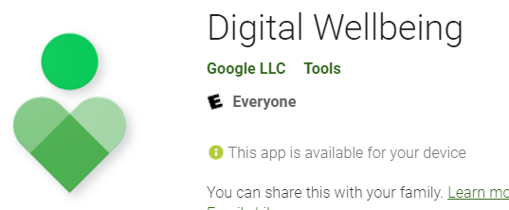
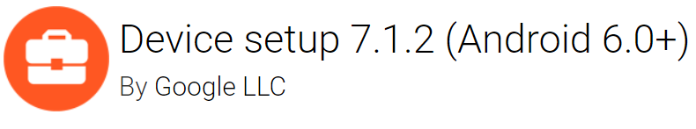
Notes:
com.google.android.apps.safetyhub
com.google.android.apps.tachyon
com.google.android.apps.tips
com.google.android.apps.turbo
com.google.android.apps.tycho
com.google.android.apps.walletnfcrel
com.google.android.apps.wallpaper
com.google.android.apps.wellbeing
com.google.android.apps.work.oobconfig
com.google.android.apps.youtube.music

Slide 31
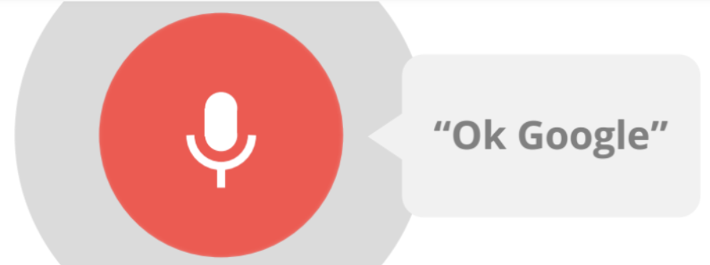
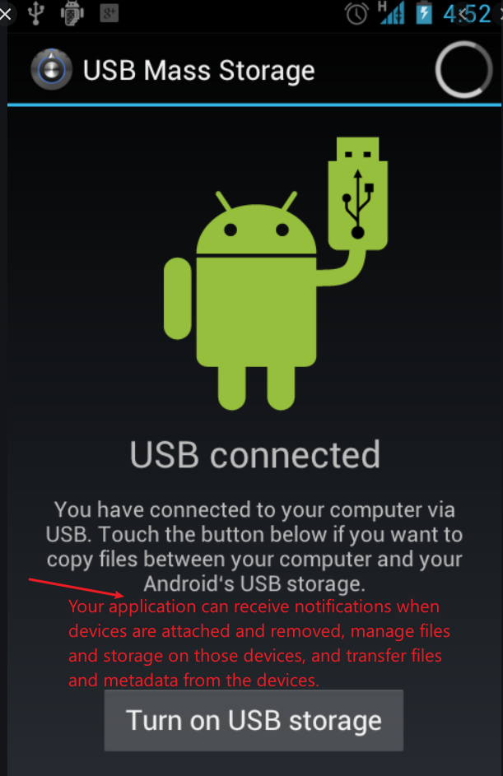
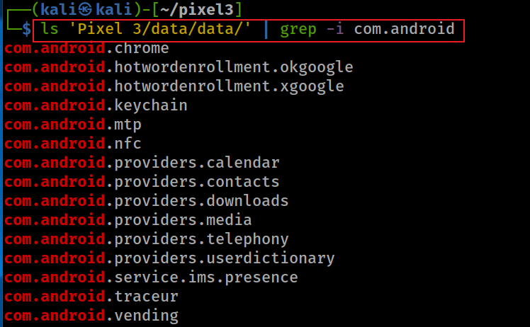
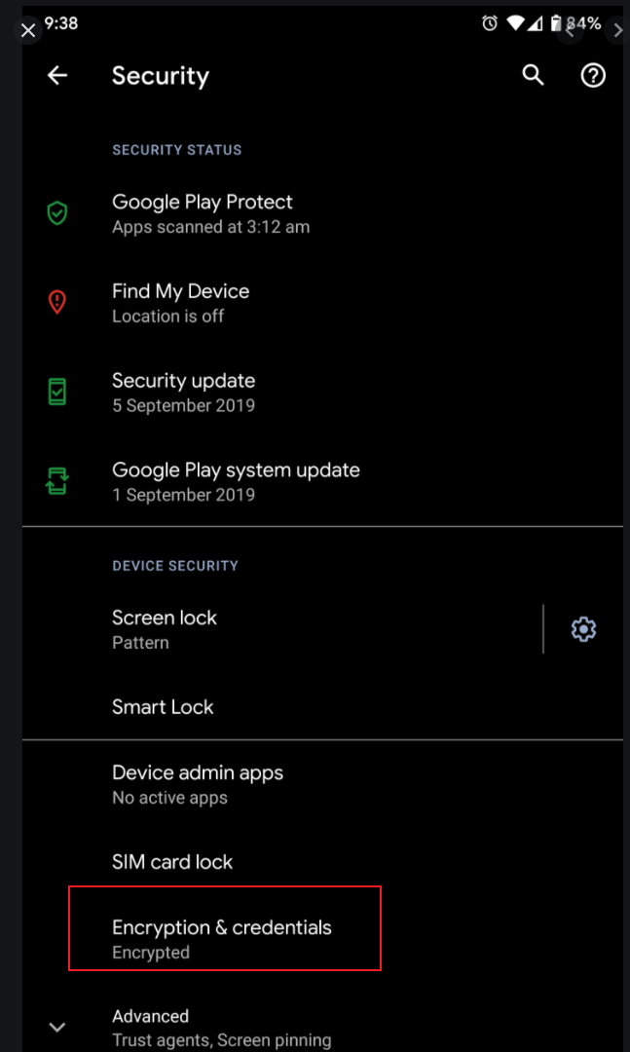
Group 2: AOSP Apps: com.andriod.*
Show apps start with com.android
you have an email app and a browser app which talk to the same backend server with the same set of credentials.
contains data related to phone operation, specifically SMS and MMS messages, access to the APN list, including the MMSC to use, and the service state.
delivering IP multimedia services (text, video..)
Recording device activity over a short period of time is known as system tracing (research project?)
Notes:
ls 'Pixel 3/data/data/' | grep -i com.android
https://developer.android.com/reference/android/provider/UserDictionary
https://developer.android.com/reference/android/mtp/package-summary
https://developer.android.com/topic/performance/tracing
com.android.chrome
com.android.hotwordenrollment.okgoogle
com.android.hotwordenrollment.xgoogle
com.android.keychain
com.android.mtp
com.android.nfc
com.android.providers.calendar
com.android.providers.contacts
com.android.providers.downloads
com.android.providers.media
com.android.providers.telephony
com.android.providers.userdictionary
com.android.service.ims.presence
com.android.traceur
com.android.vending

Slide 32
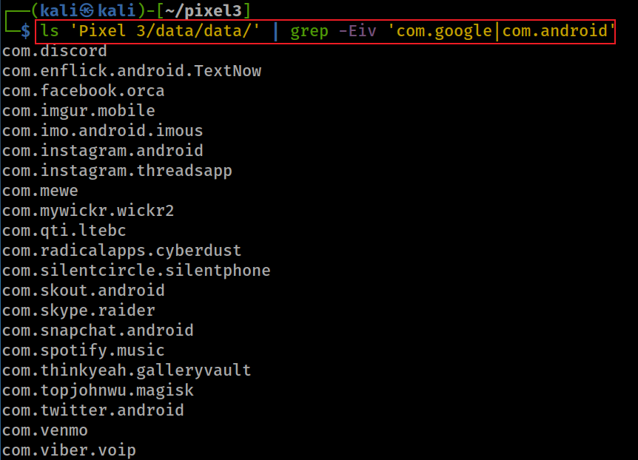
Group 3: 3rd-party apps
-v, --invert-match select non-matching lines
Notes:
ls 'Pixel 3/data/data/' | grep -Eiv 'com.google|com.android’
com.discord
com.enflick.android.TextNow
com.facebook.orca
com.imgur.mobile
com.imo.android.imous
com.instagram.android
com.instagram.threadsapp
com.mewe
com.mywickr.wickr2
com.qti.ltebc
com.radicalapps.cyberdust
com.silentcircle.silentphone
com.skout.android
com.skype.raider
com.snapchat.android
com.spotify.music
com.thinkyeah.galleryvault
com.topjohnwu.magisk
com.twitter.android
com.venmo
com.viber.voip
com.whatsapp
com.wire
com.zhiliaoapp.musically
jp.naver.line.android
kik.android
org.telegram.messenger
org.thoughtcrime.securesms
org.torproject.torbrowser

Slide 33
















Slide 34














Slide 35
Step 1 Summary: Identify Apps
Play Store appstate
App record, title, account, first_download_ms
Play Store ownership
Account-level acquisition/purchase record
App data directories
Local evidence that app-private data existed
Forensic rule: identify the app first, then state what the artifact actually proves.

Slide 36
2: Examine App Metadata
Question: What package-manager properties describe each app?
Sources: packages.xml • packages.list • PackageManager fields

Slide 37
What App Metadata Does Android Store?
Android’s Package Manager maintains metadata about installed applications, primarily under
/data/system/
Examples of app metadata:
Package name — e.g., com.google.android.gms
UID assigned to the application
Version information
APK / code path
Native library path
Installer package — e.g., com.android.vending
Installation timestamp
Last-update timestamp

Slide 38

Locate Metadata Files
Look under /data/system/package* for packages.xml, packages.list, usage, and restriction files
Notes:
find 'Pixel 3' -iname 'package*'

Slide 39

packages.list: UID and Data Directory
packages.list maps package names to UID and data-path information.
UID is the Linux user ID assigned to the app sandbox; do not confuse UID with Android user/profile ID.
The UID isolates apps from each other and protects apps and the system from malicious apps.
Only list .gm packages (Gmail and gms) in system/packages.list
Notes:
cat 'Pixel 3/data/system/packages.list' | grep -Ei '\.gm’
https://source.android.com/security/app-sandbox#:~:text=This%20isolates%20apps%20from%20each,a%20kernel%2Dlevel%20Application%20Sandbox.

Slide 40
packages.xml: Installed-App Metadata
packages.xml stores PackageManager state, such as
code path
library path
installation and update timestamp
installer
Used by the PackageManager
backup & restore, analytics, app management, system integrity
Notes:
grep -in 'package name="com.google.android.gm' 'Pixel 3/data/system/packages.xml’
3962: <package name="com.google.android.gm" codePath="/data/app/com.google.android.gm--QTglY_VBwLxA5dDcCqrCw==" nativeLibraryPath="/data/app/com.google.android.gm--QTglY_VBwLxA5dDcCqrCw==/lib" publicFlags="944488133" privateFlags="524288" ft="16ff237b230" it="11e8f7d4c00" ut="16ff237b83e" version="62049238" userId="10187" installer="com.android.vending" isOrphaned="true" categoryHint="4">
6405: <package name="com.google.android.gms" codePath="/data/app/com.google.android.gms-ZpkWIkavN2y4dNnqJLme0g==" nativeLibraryPath="/data/app/com.google.android.gms-ZpkWIkavN2y4dNnqJLme0g==/lib" primaryCpuAbi="arm64-v8a" secondaryCpuAbi="armeabi-v7a" publicFlags="-1605714235" privateFlags="524296" ft="17043c42548" it="11e8f7d4c00" ut="17043c42752" version="200414037" sharedUserId="10141" installer="com.android.vending" isOrphaned="true" categoryHint="7">
9310: <package name="com.google.android.gms.location.history" codePath="/product/app/LocationHistoryPrebuilt" nativeLibraryPath="/product/app/LocationHistoryPrebuilt/lib" publicFlags="810040901" privateFlags="524288" ft="11e8f7d4c00" it="11e8f7d4c00" ut="11e8f7d4c00" version="1" userId="10191" isOrphaned="true">
10408: <updated-package name="com.google.android.gm" codePath="/product/app/PrebuiltGmail" ft="11e8f7d4c00" it="11e8f7d4c00" ut="11e8f7d4c00" version="61499782" nativeLibraryPath="/product/app/PrebuiltGmail/lib" userId="10187">
10733: <updated-package name="com.google.android.gms" codePath="/product/priv-app/PrebuiltGmsCore" ft="11e8f7d4c00" it="11e8f7d4c00" ut="11e8f7d4c00" version="17786048" nativeLibraryPath="/product/priv-app/PrebuiltGmsCore/lib" primaryCpuAbi="arm64-v8a" secondaryCpuAbi="armeabi-v7a" sharedUserId="10141" />

Slide 41

packages.xml Example: Gmail and GMS Records
it: initial download
ft: first installation
up: update time
Notes:
grep -in 'package name="com.google.android.gm' 'Pixel 3/data/system/packages.xml’
3962: <package name="com.google.android.gm" codePath="/data/app/com.google.android.gm--QTglY_VBwLxA5dDcCqrCw==" nativeLibraryPath="/data/app/com.google.android.gm--QTglY_VBwLxA5dDcCqrCw==/lib" publicFlags="944488133" privateFlags="524288" ft="16ff237b230" it="11e8f7d4c00" ut="16ff237b83e" version="62049238" userId="10187" installer="com.android.vending" isOrphaned="true" categoryHint="4">
6405: <package name="com.google.android.gms" codePath="/data/app/com.google.android.gms-ZpkWIkavN2y4dNnqJLme0g==" nativeLibraryPath="/data/app/com.google.android.gms-ZpkWIkavN2y4dNnqJLme0g==/lib" primaryCpuAbi="arm64-v8a" secondaryCpuAbi="armeabi-v7a" publicFlags="-1605714235" privateFlags="524296" ft="17043c42548" it="11e8f7d4c00" ut="17043c42752" version="200414037" sharedUserId="10141" installer="com.android.vending" isOrphaned="true" categoryHint="7">
9310: <package name="com.google.android.gms.location.history" codePath="/product/app/LocationHistoryPrebuilt" nativeLibraryPath="/product/app/LocationHistoryPrebuilt/lib" publicFlags="810040901" privateFlags="524288" ft="11e8f7d4c00" it="11e8f7d4c00" ut="11e8f7d4c00" version="1" userId="10191" isOrphaned="true">
10408: <updated-package name="com.google.android.gm" codePath="/product/app/PrebuiltGmail" ft="11e8f7d4c00" it="11e8f7d4c00" ut="11e8f7d4c00" version="61499782" nativeLibraryPath="/product/app/PrebuiltGmail/lib" userId="10187">
10733: <updated-package name="com.google.android.gms" codePath="/product/priv-app/PrebuiltGmsCore" ft="11e8f7d4c00" it="11e8f7d4c00" ut="11e8f7d4c00" version="17786048" nativeLibraryPath="/product/priv-app/PrebuiltGmsCore/lib" primaryCpuAbi="arm64-v8a" secondaryCpuAbi="armeabi-v7a" sharedUserId="10141" />

Slide 42
 | Attribute Name | Description
1 | name | package name
2 | codePath | APK file installation location (/system/app/ or /data/app/)
3 | nativeLibraryPath | native library (*.so file) default path is /data/data/<package name>/lib/
4 | flag | Store ApplicationInfo Flags [http://developer.android.com/reference/android/content/pm/ApplicationInfo.html]
5 | ft | timestamp in hex format of first time installation (milliseconds Unix epoch time)
6 | it | timestamp in hex format of initial download? (online notes are conflict with ft)
7 | ut | timestamp in hex format of last update
8 | version | Version Code from AndroidManifest.xml file [http://developer.android.com/guide/topics/manifest/manifest-element.html#vcode]
9 | sharedUserId | The name of Linux user ID that will be shared with other applications, It is same parameter which we define in AndroidManifest.xml [http://developer.android.com/guide/topics/manifest/manifest-element.html#uid]
10 | userId | The name of a Linux user ID (important to find the owner of apps)
Notes:
https://dzone.com/articles/depth-android-package-manager

Slide 43

Decode PackageManager Timestamps
Convert hex millisecond timestamps to UTC and document both raw and decoded values.
Exam timestamps of .gm
Type | Hex | Integer | Epoch
ft | 16ff237b230 | 1580316734000 | Wednesday, January 29, 2020 4:52:14 PM
it | 11e8f7d4c00 | 1230768000000 | Thursday, January 1, 2009 12:00:00 AM
ut | 16ff237b83e | 1580316735550 | Wednesday, January 29, 2020 4:52:15.550 PM
Notes:
https://www.epochconverter.com/

Slide 44
Step 2 Summary: App Metadata
Package name
Primary identifier, e.g., com.google.android.gms
UID / data path
Sandbox owner and storage location
Installer / version
Source and app build context
ft / it / ut timestamps
Raw package-manager times; decode and validate
Report both raw values and decoded times; avoid unsupported certainty.

Slide 45
3: Reconstruct App Usage
Question: When and how did apps move through foreground/background and activity states?
Sources: package-usage.list • /data/system/usagestats/<userID>/

Slide 46
Usage Analysis Questions
Use usage artifacts to answer last-used time, foreground/background transitions, and activity-level behavior.
Last time a package was used
Foreground/background and activity events
User behavior inferred from UsageStats

Slide 47
package-usage.list: Last Usage Indicators
This source gives compact usage indicators; verify field meanings for the Android version/build.
Saturday, February 1, 2020 1:07:29.465 AM
Saturday, February 1, 2020 2:19:40.618 AM
Friday, January 31, 2020 7:08:52.035 PM
Saturday, February 1, 2020 2:19:40.614 AM
Saturday, February 1, 2020 2:19:34.402 AM
the last 8 execution timestamps? need to verify
Notes:
grep -Ei '\.gm' 'Pixel 3’/data/system/package-usage.list
com.google.android.gm 1580519249465 1580523580618 1580497732035 1580523580614 1580523574402 0 0 0
com.google.android.gms 1580523599326 1580529895520 1580395544983 1580529394178 1580526326157 0 1580529874202 0
http://freeandroidforensics.blogspot.com/2014/11/some-artifacts-in-datasystem-directory.html

Slide 48
Usage events in system/usagestats
Usage Events include screen/keyguard, foreground/background, activity, interaction, and configuration events.
Device startup/shutdown
Keyguard Show/off
Move to background/foreground
Screen interactive screen turned on for full user interaction, not ambient display or other non-interactive state
Screen not interactive
completely turned off or turned on only in a non-interactive state like ambient display
Activity paused/resumed/stopped
User interaction
An event type denoting that a package was interacted with in some way by the user
Configuration Change
https://developer.android.com/reference/android/app/usage/UsageEvents.Event#SCREEN_INTERACTIVE
Notes:
https://abrignoni.blogspot.com/2019/02/android-usagestats-xml-parser.html
https://developer.android.com/reference/android/app/usage/UsageEvents.Event
https://www.youtube.com/watch?v=ZI_vzeKA_Zg&list=PLfouvuAjspTo6pWGP7otkE6SZ3QQ0b-RD

Slide 49


Android Activity and Usage Events
An Activity = one focused UI task
Activities are presented to the user as
full-screen windows,
floating windows
Multi-Window mode
Activities generate events and save event info in system/usagestats

Slide 50

Activity Lifecycle Diagram
An Android Activity Lifecycle Diagram is a flowchart
It maps the states a single app screen (an Activity) moves through from creation to destruction, along with the callback methods triggered at each transition.
When users launch, background, or close an app, the Android system navigates through these states to manage system resources and memory efficiently.

Slide 51
Core Lifecycle Callbacks
onCreate(): Screen created; set up UI and layouts (setContentView).
onStart(): Screen becomes visible to the user.
onResume(): Screen enters foreground and becomes interactive.
onPause(): Screen partially obscured (dialogs/calls); pause heavy tasks.
onStop(): Screen completely hidden (user navigated away).
onDestroy(): Screen destroyed and cleared from memory.
onRestart(): Stopped screen brought back; runs right before onStart().

Slide 52


Slide 53



Read UsageStats Event Logs
Show usagestats folder structure
Fri 14 Feb 2020 04:00:01 PM UTC
interval Type: system collects and aggregates the data over 4 different intervals
Only can retrieve app usage data for up to 7 days for interval daily, up to 4 weeks for interval weekly, up to 6 months for monthly and finally up to 2 years for yearly.
Notes:
tree 'Pixel 3/data/system/usagestats/' -L 2
tree 'Pixel 3/data/system/usagestats/0' -L 2
date -d '@1580917965671' -u
1580917965671
1581004373881
1581090879070
1581177279272
1581263873464
1581350284755
1581436707859
1581523178051
1581609587089
1581696001773
https://medium.com/@quiro91/show-app-usage-with-usagestatsmanager-d47294537dab

Slide 54
How to read activity event log files?
Activity event logs are saved in /usagestats folder
in Protocol Buffers format
Protocol buffers are for serializing structured data
Google's language-neutral, platform-neutral, extensible mechanism
like XML, but smaller, faster, and simpler.
Parse information in /usagestats folder
Analyze parsed results
Notes:
https://abrignoni.blogspot.com/2019/02/android-usagestats-xml-parser.html
https://www.swiftforensics.com/2020/01/usagestats-on-android-10-q.html
https://developers.google.com/protocol-buffers

Slide 55



1. Protocol Buffers Format
Protocol Buffers serialize structured data compactly; a parser is needed for analyst-friendly output.
Notes:
https://martin.kleppmann.com/2012/12/05/schema-evolution-in-avro-protocol-buffers-thrift.html

Slide 56


2. Prepare tool and data
Download usagestates parsing tool
works with both old android (before 10) XML based usagestats as well as the newer (10+) Protocol buffer
Copy the whole usagestats folder to the tool folder (required by tool)
cp -avr <source_folder> <destination_folder>
-a: preserve all
-r: copy directories recursively
-v: explain what is being done
Notes:
git clone https://github.com/abrignoni/Android-Usagestats-XML-Protobuf.git
cp -avr 'Pixel 3/data/system/usagestats/' Android-Usagestats-XML-Protobuf
https://github.com/abrignoni/Android-Usagestats-XML-Protobuf

Slide 57


3. Parse usagestats into a SQLite Database
parsing and results are saved in usagestates.db
Verify the parsed results are saved in usagestates.db
sudo apt-get update
sudo apt-get install python3-protobuf
Notes:
python3 Android-Usagestats-XML-Protobuf/usagestats_conv.py

Slide 58

4. Understand Parsed UsageStats Columns
Fullatt example
font_scale: 1.0
mcc: 310
mnc: 120
screen_layout: 268435810
color_mode: 10
touchscreen: 3
keyboard: 1
keyboard_hidden: 1
hard_keyboard_hidden: 2
navigation: 1
navigation_hidden: 2
orientation: 1
ui_mode: 19
screen_width_dp: 392
screen_height_dp: 713
smallest_screen_width_dp: 392
density_dpi: 440
window_configuration {
app_bounds {
right: 1080
bottom: 2028
}
windowing_mode: 1
bounds {
right: 1080
bottom: 2160
}
}
locale_list: "en-US"
Usage_type: Can be event-log, configuration, and packages.
Lastime: last active or a configuration took place.
Time_active: Certain events keep track of their length in milliseconds.
Types: Activity types as integer values. These represent activity like move to background or move to foreground.
Classs: Application name and corresponding modules in use.
Source: daily, weekly, monthly, and yearly.
Fullatt: Contains the full attributes for the XML event /all the data for the event in JSON format. With the data in this field the analyst can easily select any key:value pair and make it its own column in a SQL query by the use of JSON_Extract. see example
https://abrignoni.blogspot.com/2018/09/finding-slack-messages-in-android-and.html
https://abrignoni.blogspot.com/2019/02/android-usagestats-xml-parser.html
Notes:
sqlite3 'usagestats.db’
.tables
pragma table_info(data);

Slide 59
5. Query Parsed UsageStats Events
SELECT
usage_type,
datetime(lastime/1000, 'UNIXEPOCH', 'localtime') as lasttimeactive,
timeactive as time_Active_in_msecs,
timeactive/1000 as timeactive_in_secs,
package,
CASE types
WHEN '1' THEN 'MOVE_TO_FOREGROUND'
WHEN '2' THEN 'MOVE_TO_BACKGROUND'
WHEN '5' THEN 'CONFIGURATION_CHANGE'
WHEN '7' THEN 'USER_INTERACTION'
WHEN '8' THEN 'SHORTCUT_INVOCATION’
WHEN ‘23' THEN 'ACTIVITY_STOPPED'
ELSE types
END types,
classs,
source,
fullatt
FROM data
ORDER BY lasttimeactive DESC
Note:
data is the table in usagestats.db
the timestamp is converted from UTC to 'localtime’ of your computer
You can remove it or change it to UTC
https://abrignoni.blogspot.com/2019/02/android-usagestats-xml-parser.html

Slide 60


6. Review Parsed UsageStats Report

Slide 61
Step 3 Summary: Reconstruct Usage
package-usage.list
Compact last-usage indicators
UsageStats intervals
daily / weekly / monthly / yearly sources
Event types
foreground, background, activity stopped, interaction
Parsed database
Derived analysis format, not original evidence
Build a time-ordered session timeline from multiple event records.

Slide 62
4: Interpret App Lifecycle
Question: What does the combined evidence support—and what remains uncertain?
Sources: all previous artifacts correlated into a timeline

Slide 63
Case Question: When Was Location Shared in LINE?
Identify the LINE package name
Find activity events related to location sharing
Correlate event time with surrounding app behavior

Slide 64

Find the LINE Package Name
Verify the correct package: jp.naver.line.android.
Notes:
sqlite3
.open 'Pixel 3/data/data/com.android.vending/databases/localappstate.db'
select package_name, first_download_ms, account, title from appstate where package_name like '%line%' ;

Slide 65

Search for LINE Activity Events
Filter by package and event-log records before looking for specific activity classes.
Notes:
.open 'usagestats.db'
SELECT
usage_type,
datetime(lastime/1000, 'UNIXEPOCH') as lasttimeactive,
timeactive as time_Active_in_msecs,
timeactive/1000 as timeactive_in_secs,
package,
CASE types
WHEN '1' THEN 'MOVE_TO_FOREGROUND'
WHEN '2' THEN 'MOVE_TO_BACKGROUND'
WHEN '5' THEN 'CONFIGURATION_CHANGE'
WHEN '7' THEN 'USER_INTERACTION'
WHEN '8' THEN 'SHORTCUT_INVOCATION'
WHEN '23' THEN 'ACTIVITY_STOPPED'
ELSE types
END types,
classs,
source
FROM data
where package = 'jp.naver.line.android' and usage_type ='event-log'
ORDER BY lasttimeactive ;

Slide 66

Candidate Location-Sharing Activity Events
location service
MOVE_TO_FOREGROUND: the user was using the app and in a specific activity
MOVE_TO_BACKGROUND: the user moved away from the activity

Slide 67

Determine the LINE Usage Time Window
Use ordered events to reconstruct a session rather than relying on one timestamp.
Events we are interested in
LINE
Notes:
SELECT
usage_type,
lastime,
datetime(lastime/1000, 'UNIXEPOCH') as lasttimeactive,
timeactive as time_Active_in_msecs,
timeactive/1000 as timeactive_in_secs,
package,
CASE types
WHEN '1' THEN 'MOVE_TO_FOREGROUND'
WHEN '2' THEN 'MOVE_TO_BACKGROUND'
WHEN '5' THEN 'CONFIGURATION_CHANGE'
WHEN '7' THEN 'USER_INTERACTION'
WHEN '8' THEN 'SHORTCUT_INVOCATION'
WHEN '23' THEN 'ACTIVITY_STOPPED'
ELSE types
END types,
classs,
source
FROM data
where package = 'jp.naver.line.android' and usage_type ='event-log'
ORDER BY lasttimeactive ;

Slide 68

timestamp of sharing location

Slide 69

Next Activity After Location Sharing
Show all events after 1581271520730, which is the timestamp of sharing location
Notes:
SELECT
usage_type,
lastime,
datetime(lastime/1000, 'UNIXEPOCH') as lasttimeactive,
timeactive as time_Active_in_msecs,
timeactive/1000 as timeactive_in_secs,
package,
CASE types
WHEN '1' THEN 'MOVE_TO_FOREGROUND'
WHEN '2' THEN 'MOVE_TO_BACKGROUND'
WHEN '5' THEN 'CONFIGURATION_CHANGE'
WHEN '7' THEN 'USER_INTERACTION'
WHEN '8' THEN 'SHORTCUT_INVOCATION'
WHEN '23' THEN 'ACTIVITY_STOPPED'
ELSE types
END types,
classs,
source
FROM data
where usage_type ='event-log' and lastime > 1581271520730
ORDER BY lasttimeactive limit 20;

Slide 70

Interpret Follow-On Package Activity
Identify packages such as the launcher and Viber to explain transitions after LINE activity.
what is com.google.android.apps.nexuslauncher?
what is com.viber.voip?

Slide 71

Package Context: Pixel Launcher
Package: com.google.android.apps.nexuslauncher
Role: Pixel Launcher / home screen
Forensic meaning: possible app switch or return to launcher

Slide 72

Package Context: Viber
Viber events after LINE may indicate the next app used in the reconstructed sequence.

Slide 73
Step 4 Summary: Interpret Lifecycle
Installed
Corroborate app directories, packages.xml, and Play Store records
Used
UsageStats activity/session evidence
Background/transition
Foreground/background and launcher/app-switch events
Removed/restored/reset
Inference requiring corroboration across gaps and missing artifacts
Final output: defensible timeline + source path + decoded time + confidence level.

Slide 74


Slide 75
Summary- What Does Each Artifact Tell Us?
Artifact | What we observe | What it may establish
App data directory | Package directory exists | App/package data existed on device
localappstate.db | Package, account, download information | Google Play-related acquisition/download evidence
library.db | Ownership/acquisition record | App associated with Google account
packages.xml | Package, installer, version, install/update times | Package Manager state and metadata
packages.list | Package ↔ UID/data path | App identity and sandbox UID
usagestats/ | Foreground/background/activity events | When and how an app was active
Activity/class name | e.g., SelectLocationActivity | Possible function/screen being used

