Slide 1
Pixel Device Investigations
Device build, Accounts, Mac address, Wi-Fi

Slide 2
Device Survey
Device build and SIM card
Account information
Bluetooth MAC address and Wi-Fi
Other artifacts generated by API usage

Slide 3
Device Information
Device Info | Path
Build properties | Pixel 3/product/build.prop
 | Pixel 3/system/build.prop
Apps, app config/generated data | Pixel 3/data/data
User-specific/Carrier config | Pixel 3/data/user_de/0/com.android.providers.telephony
Device and component serial number | Pixel 3/mnt/vendor
User information | Pixel 3/data/system/users
Bluetooth | Pixel 3/data/system/users/0/settings_secure.xml
Wifi | Pixel 3/data/misc/wifi/WifiConfigStore.xml
Other artifacts | Pixel 3/data/data/com.google.android.gms/

Slide 4
Device build and SIM card

Slide 5
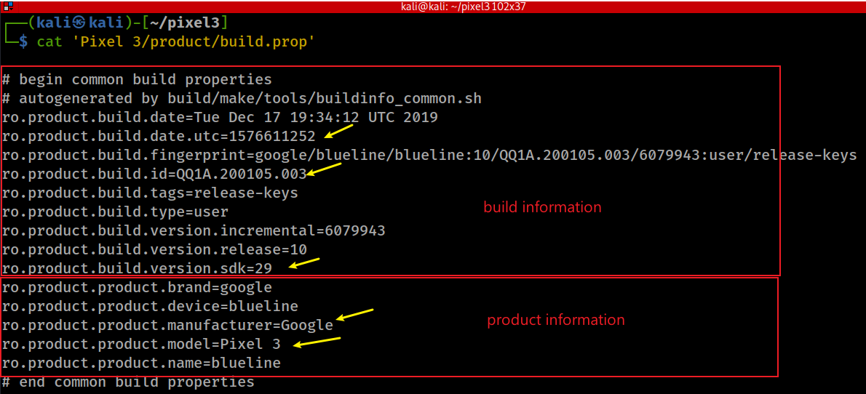
What is the product (phone) information?
build.prop
A system file that exists on every Android device.
The file contains build information and other system properties which are used throughout the operating system.
When the current ROM was compiled
software development kit: Version of the SDK used for android version
Device's codename
Notes:
cat 'Pixel 3/product/build.prop'
https://forum.xda-developers.com/t/explanation-of-build-prop-values.3069341/

Slide 6
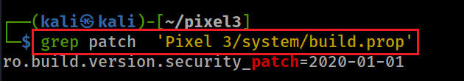
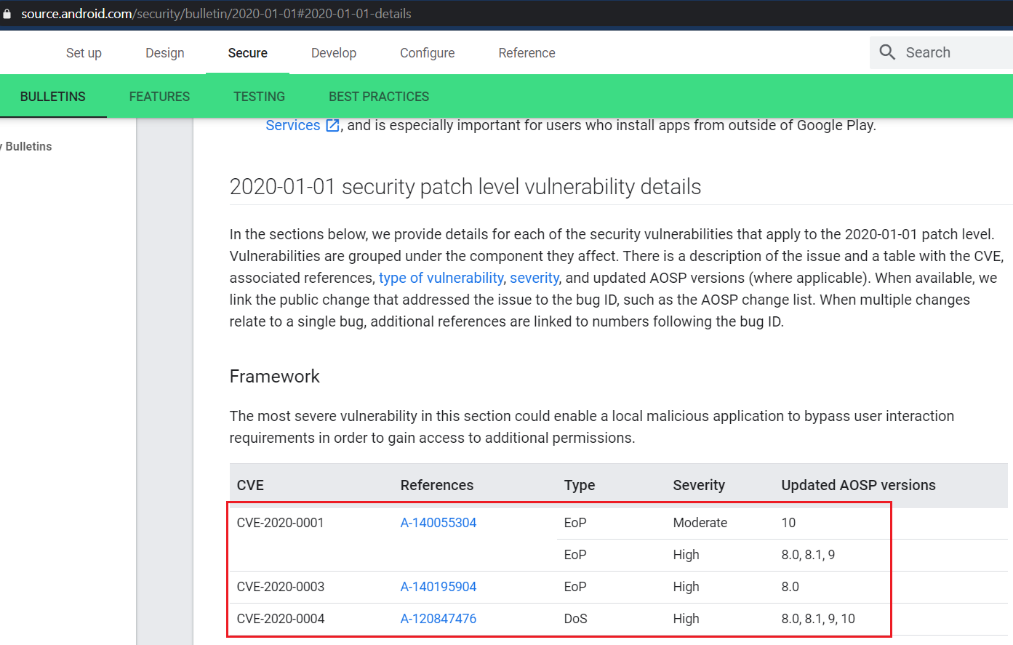
What is the latest security patch?
Notes:
https://source.android.com/security/bulletin/2020-01-01#2020-01-01-details

Slide 7
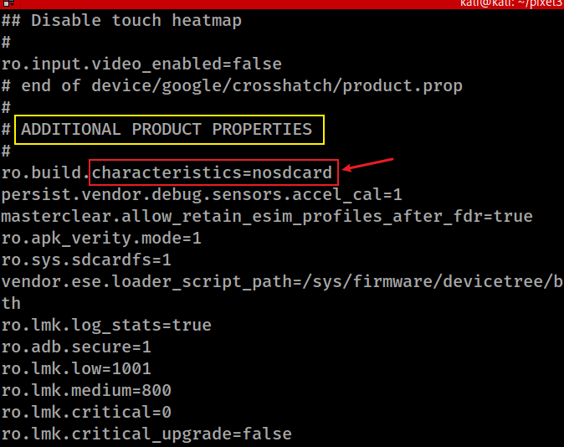
Does the Pixel have a SD card?
'Pixel 3/product/build.prop'

Slide 8
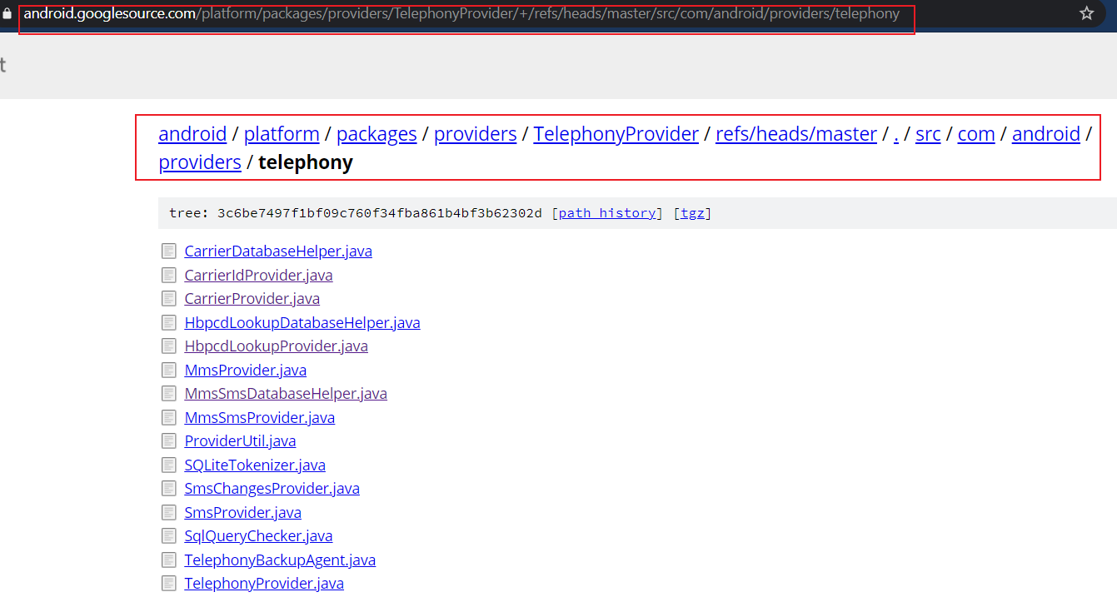
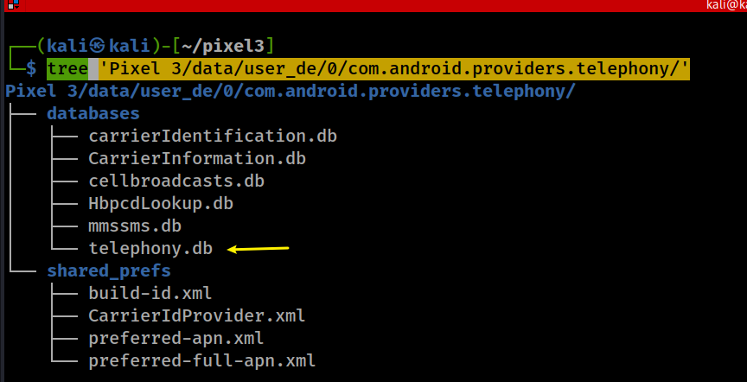
What is the mobile carrier/phone#?
Exam all files under com.android.providers.telephony folder
naming convention
all carrierIDs worldwide
QQ1A.200105.003
Notes:
tree 'Pixel 3/data/user_de/0/com.android.providers.telephony/’
https://android.googlesource.com/platform/packages/providers/TelephonyProvider/+/refs/heads/master/src/com/android/providers/telephony

Slide 9
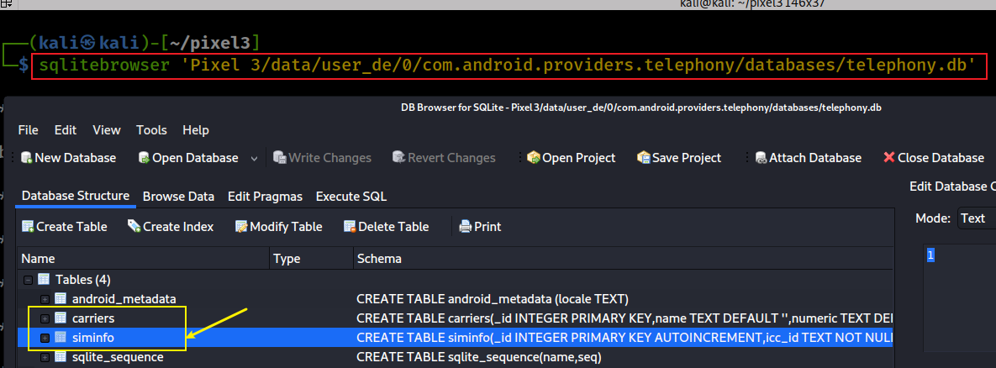

List tables on telephony.db
Notes:
sqlitebrowser 'Pixel 3/data/user_de/0/com.android.providers.telephony/databases/telephony.db'

Slide 10
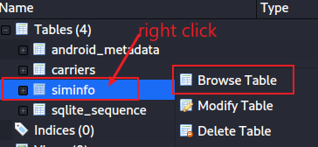
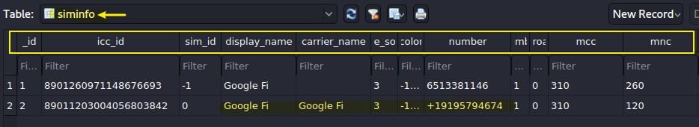
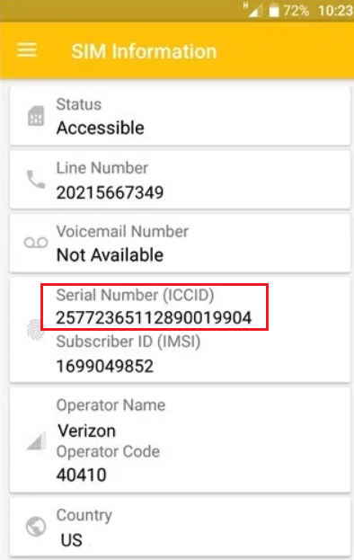
ICCID (Integrated Circuit Card Identifier) is a unique SIM card serial number.
A full ICCID number is 19 or 20 characters.
The number is printed on the back of your SIM (sometimes there in only the last 13 digits of ICCID)
you can also find it in your phone's settings. Read More about ICCID.
Based on ICCID number you can check your SIM Country and International phone code.
https://www.imei.info/iccid
mobile country code (MCC) and mobile network code (MNC) are used to find network providers
https://en.wikipedia.org/wiki/Mobile_Network_Codes_in_ITU_region_3xx_(North_America)#United_States_of_America_%E2%80%93_US
Notes:
8901260971148676693 6513381146
89011203004056803842 +19195794674

Slide 11

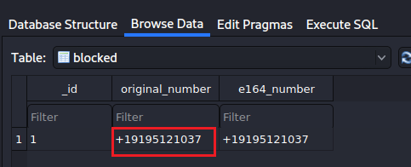
What is blocked phone number?
Show blockednumber
Notes:
ls 'Pixel 3/data/user_de/0/com.android.providers.blockednumber/databases/’
sqlitebrowser 'Pixel 3/data/user_de/0/com.android.providers.blockednumber/databases/blockednumbers.db'

Slide 12
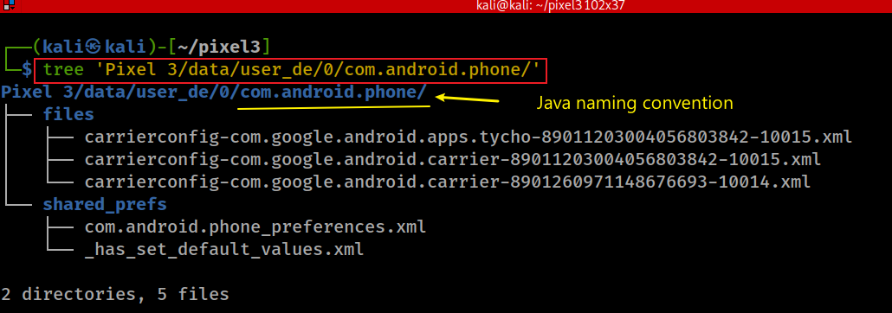
Check carrierconfig information to verify the carriers
Notes:
tree 'Pixel 3/data/user_de/0/com.android.phone/'

Slide 13
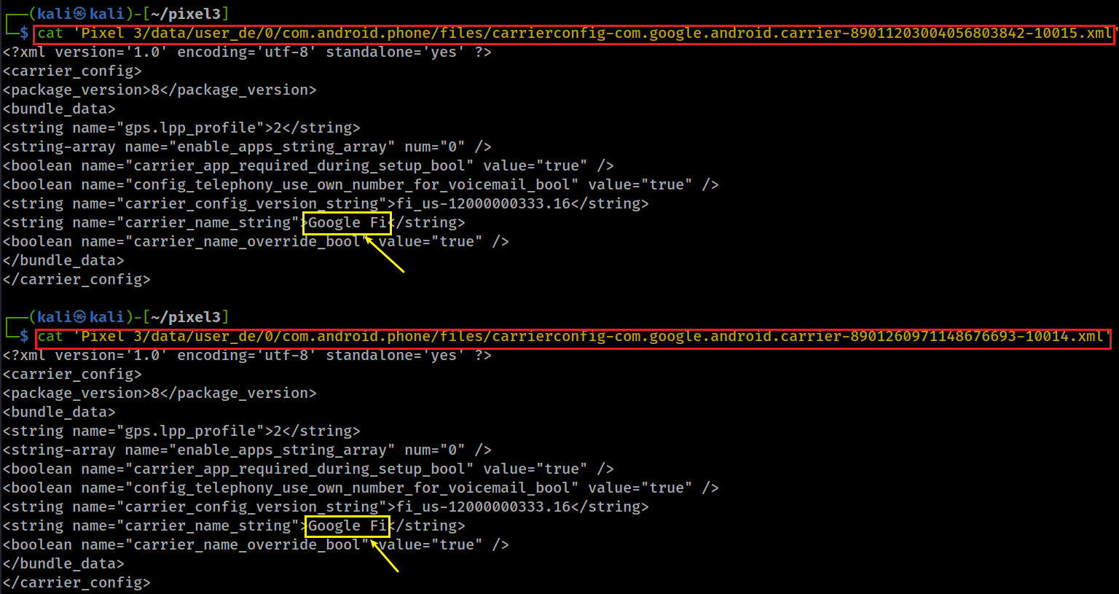
ICCID id
ICCID id
Notes:
cat 'Pixel 3/data/user_de/0/com.android.phone/files/carrierconfig-com.google.android.carrier-89011203004056803842-10015.xml’
cat 'Pixel 3/data/user_de/0/com.android.phone/files/carrierconfig-com.google.android.carrier-8901260971148676693-10014.xml'

Slide 14
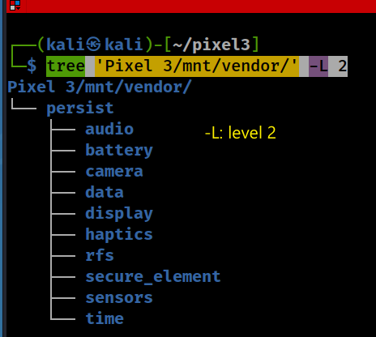
What is serial number of the device?
Hardware configurations may contain the serial number of the device
e.g., camera, audio devices configs
Find vendor specific configurations associated with hardware devices
Where are these configuration files?
store persistent data that survives reboots

Slide 15
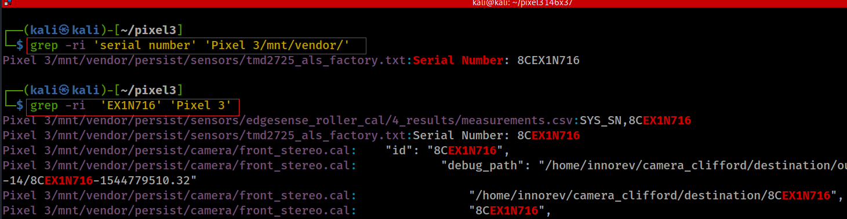
Search key word “serial number” under the /vendor folder
Pixel device’s light sensor system for screen brightness adjustment
Explanation of grep -ri:
grep: A command-line utility used to search for text patterns within files.
-r: Recursively searches all files in the specified directory and its subdirectories.
-i: Makes the search case-insensitive, meaning it will match both uppercase and lowercase
grep -ri "search_term" /path/to/directory
Notes:
grep –ri

Slide 16
Account information

Slide 17
Overview
Users‘ ID, owner | Pixel 3/data/system/users/userlist.xml
User name | Pixel 3/data/system/users/0.xml Pixel 3/data/system/users/1.xml
Gmail account | Pixel 3/data/data/com.google.android.gm/shared_prefs/Gmail.xml Pixel 3/data/data/com.google.android.gm/shared_prefs/UnifiedEmail.xml
Gmail with play store | Pixel 3/data/data/com.android.vending/cache/logs/
App account and password | Pixel 3/data/system_ce/0/account_ce.db Credential-Encrypted (CE) storage. Pixel 3/data/system_de/0/account_de.db Device-Encrypted (DE) storage
Pixel 3/data/: It contains various subdirectories for storing app data, system settings, and other persistent information.
account_ce.db: only accessible when the user has unlocked the device with their credentials (e.g., PIN, password, or pattern). Data here is tied to the user's login state.
account_de.db: accessible as soon as the device boots, even before the user unlocks it. Data here is encrypted using the device's hardware key and is not tied to the user's credentials.

Slide 18
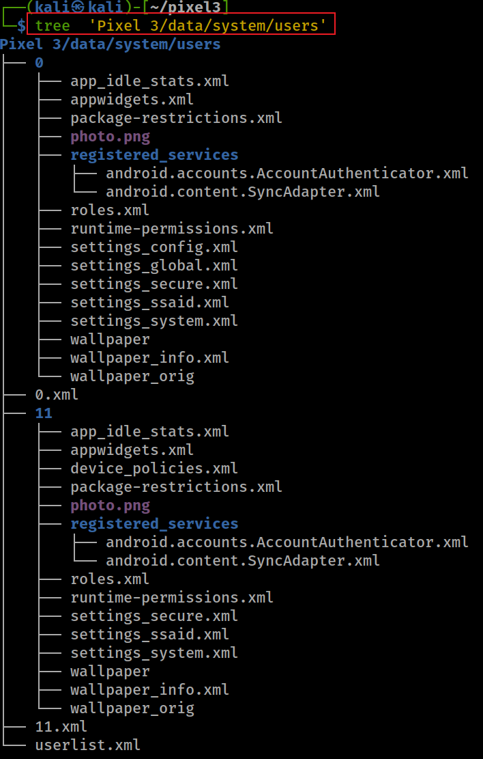
How many user accounts on the device? Two
0 - is a device owner/primary user
used for multi-user support.
keeps info on all users in the system

Slide 19
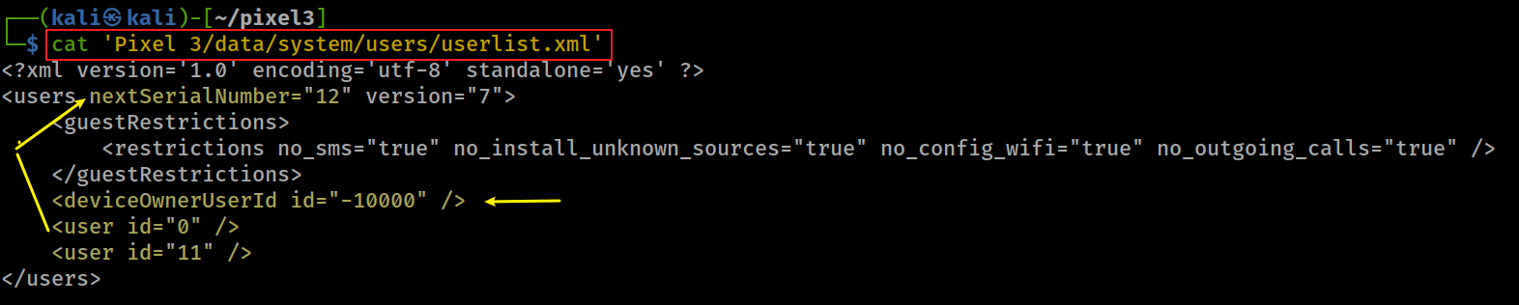
How many registered users does the device have?
Notes:
cat 'Pixel 3/data/system/users/userlist.xml’
<?xml version='1.0' encoding='utf-8' standalone='yes' ?>
<users nextSerialNumber="12" version="7">
<guestRestrictions>
<restrictions no_sms="true" no_install_unknown_sources="true" no_config_wifi="true" no_outgoing_calls="true" />
</guestRestrictions>
<deviceOwnerUserId id="-10000" />
<user id="0" />
<user id="11" />
</users>

Slide 20

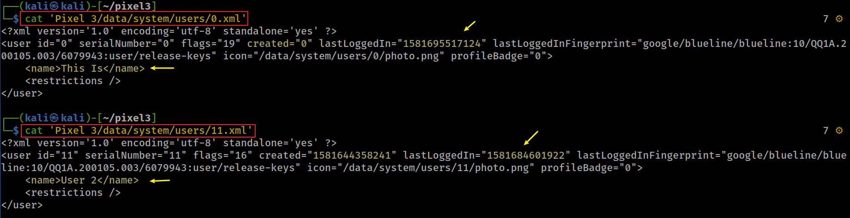

When did the device owner last time log in?
blueline: Android codename
Notes:
cat 'Pixel 3/data/system/users/0.xml’
cat 'Pixel 3/data/system/users/11.xml’
<?xml version='1.0' encoding='utf-8' standalone='yes' ?>
<user id="0" serialNumber="0" flags="19" created="0" lastLoggedIn="1581695517124" lastLoggedInFingerprint="google/blueline/blueline:10/QQ1A.200105.003/6079943:user/release-keys" icon="/data/system/users/0/photo.png" profileBadge="0">
<name>This Is</name>
<restrictions />
</user>
<?xml version='1.0' encoding='utf-8' standalone='yes' ?>
<user id="11" serialNumber="11" flags="16" created="1581644358241" lastLoggedIn="1581684601922" lastLoggedInFingerprint="google/blueline/blueline:10/QQ1A.200105.003/6079943:user/release-keys" icon="/data/system/users/11/photo.png" profileBadge="0">
<name>User 2</name>
<restrictions />
</user>

Slide 21
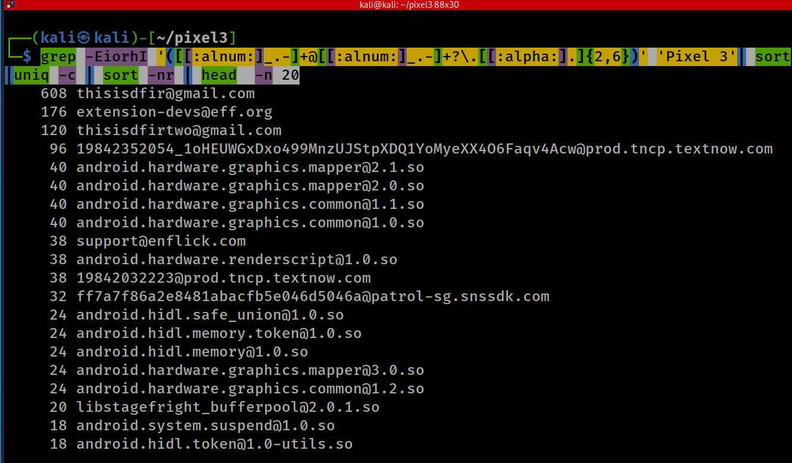
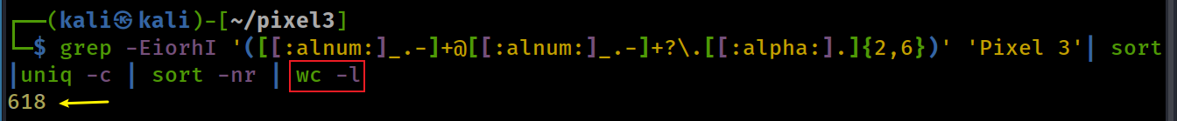
How many email addresses you can find on the image?
-E: Extended Regular Expression
-i: ignore case
-o: show only match, not whole lines
-r: recursive
-h: don’t show file name
-I: ignore binary files
list top 20 email
Count all emails
Notes:
grep -EiorhI '([[:alnum:]_.-]+@[[:alnum:]_.-]+?\.[[:alpha:].]{2,6})' 'Pixel 3'| sort|uniq -c | sort -nr | head -n 20
grep -EiorhI '([[:alnum:]_.-]+@[[:alnum:]_.-]+?\.[[:alpha:].]{2,6})' 'Pixel 3'| sort|uniq -c | sort -nr | wc –l
608 thisisdfir@gmail.com
176 extension-devs@eff.org
120 thisisdfirtwo@gmail.com
96 19842352054_1oHEUWGxDxo499MnzUJStpXDQ1YoMyeXX4O6Faqv4Acw@prod.tncp.textnow.com
40 android.hardware.graphics.mapper@2.1.so
40 android.hardware.graphics.mapper@2.0.so
40 android.hardware.graphics.common@1.1.so
40 android.hardware.graphics.common@1.0.so
38 support@enflick.com
38 android.hardware.renderscript@1.0.so
38 19842032223@prod.tncp.textnow.com
32 ff7a7f86a2e8481abacfb5e046d5046a@patrol-sg.snssdk.com
24 android.hidl.safe_union@1.0.so
24 android.hidl.memory.token@1.0.so
24 android.hidl.memory@1.0.so
24 android.hardware.graphics.mapper@3.0.so
24 android.hardware.graphics.common@1.2.so
20 libstagefright_bufferpool@2.0.1.so
18 android.system.suspend@1.0.so
18 android.hidl.token@1.0-utils.so

Slide 22
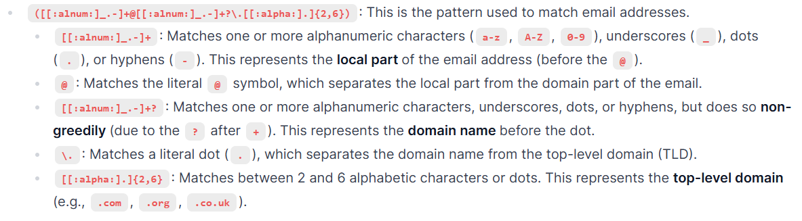
Notes:
([[:alnum:]_.-]+@[[:alnum:]_.-]+?\.[[:alpha:].]{2,6}): This is the pattern used to match email addresses.
[[:alnum:]_.-]+: Matches one or more alphanumeric characters (a-z, A-Z, 0-9), underscores (_), dots (.), or hyphens (-). This represents the local part of the email address (before the @).
@: Matches the literal @ symbol, which separates the local part from the domain part of the email.
[[:alnum:]_.-]+?: Matches one or more alphanumeric characters, underscores, dots, or hyphens, but does so non-greedily (due to the ? after +). This represents the domain name before the dot.
\.: Matches a literal dot (.), which separates the domain name from the top-level domain (TLD).
[[:alpha:].]{2,6}: Matches between 2 and 6 alphabetic characters or dots. This represents the top-level domain (e.g., .com, .org, .co.uk).

Slide 23
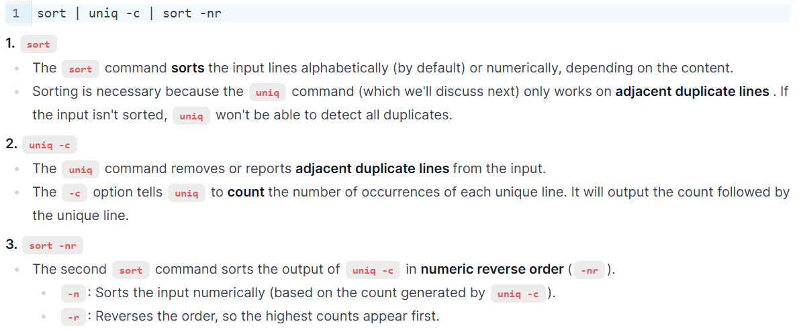
Notes:
1. sort
The sort command sorts the input lines alphabetically (by default) or numerically, depending on the content.
Sorting is necessary because the uniq command (which we'll discuss next) only works on adjacent duplicate lines . If the input isn't sorted, uniq won't be able to detect all duplicates.
2. uniq -c
The uniq command removes or reports adjacent duplicate lines from the input.
The -c option tells uniq to count the number of occurrences of each unique line. It will output the count followed by the unique line.
3. sort -nr
The second sort command sorts the output of uniq -c in numeric reverse order (-nr).
-n: Sorts the input numerically (based on the count generated by uniq -c).
-r: Reverses the order, so the highest counts appear first.

Slide 24
What is the App ID of Gmail?
Every Android app has a unique application ID
looks like a Java package name, such as com.example.myapp
Android app ID never changes
If upload a new version of app, the application ID (and the certificate you sign it with) must be the same as the original APK
if you change the application ID, Google Play Store treats the APK as a completely different app.
Good for forensic analysis
Easy to identify apps in a device
Notes:
https://developer.android.com/studio/build/application-id.html

Slide 25
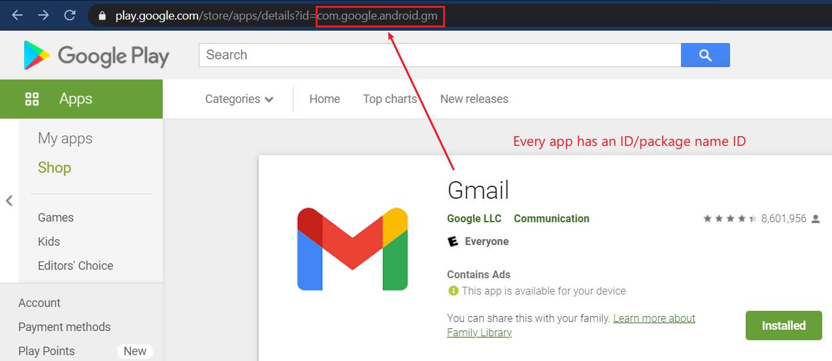
Notes:
https://play.google.com/

Slide 26
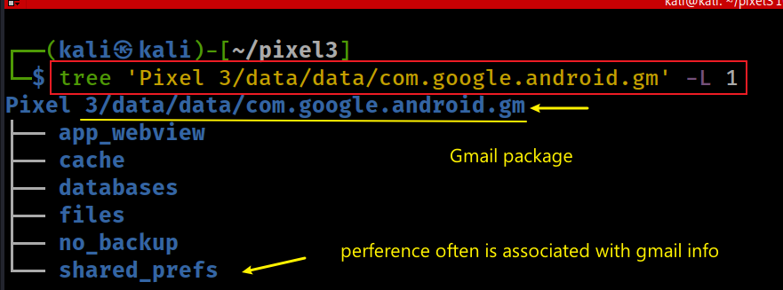
Which Gmail is registered for google service for Pixel 3?
Google use Gmail credential as a Single Sign-On (SSO)
for all the service they provide
Search for generated data by Gmail application
Gmail package com.google.android.gm
Exam all generated data/config of Gmail
Notes:
tree 'Pixel 3/data/data/com.google.android.gm' -L 1

Slide 27
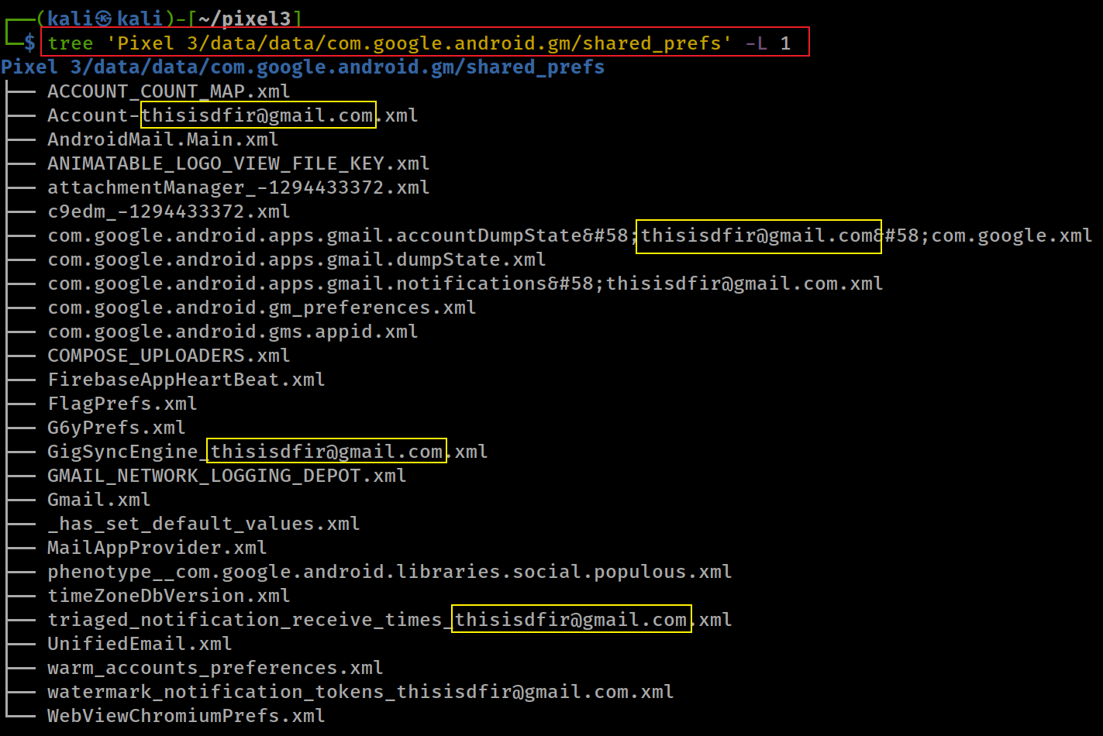
Show shared preference/configurations

Slide 28
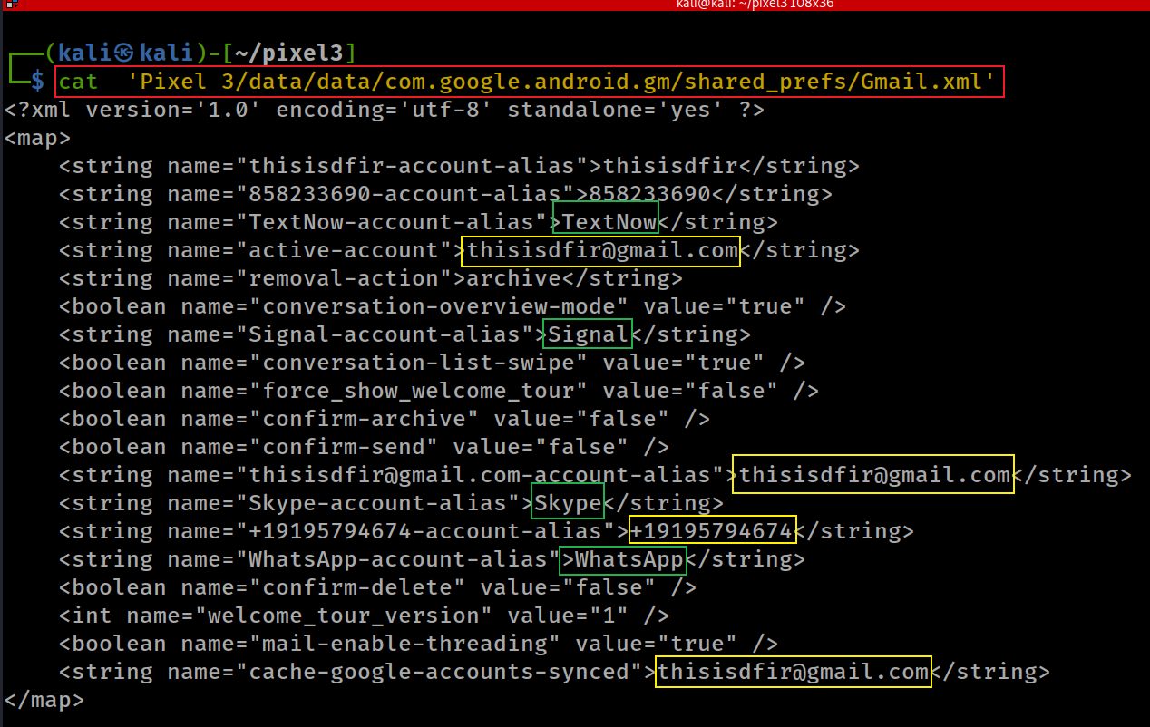
Check Gmail preference setting
Gmail is associated with
phone
apps: Textnow, Signal, Skyper, whatapp
Notes:
cat 'Pixel 3/data/data/com.google.android.gm/shared_prefs/Gmail.xml'

Slide 29
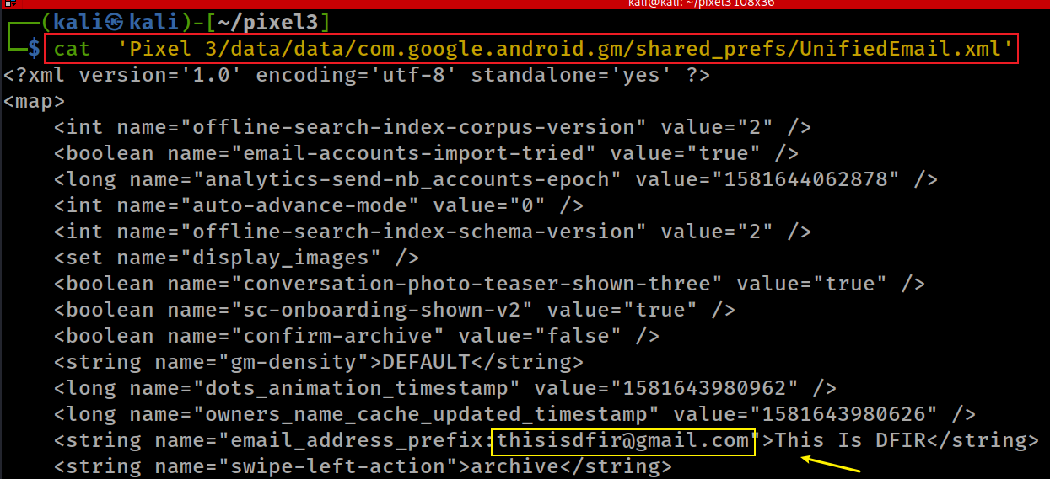
Gmail combines messages from multiple email accounts into one single inbox view.
Notes:
cat 'Pixel 3/data/data/com.google.android.gm/shared_prefs/UnifiedEmail.xml'

Slide 30
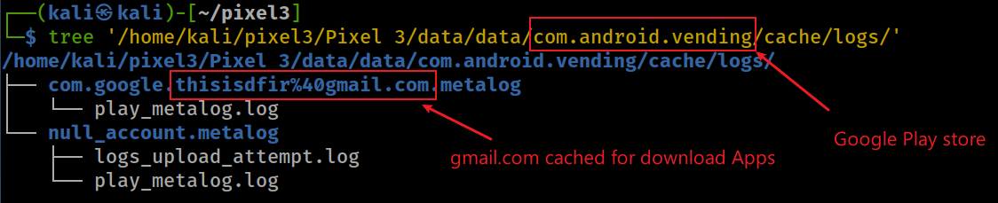
Which Gmail is registered in Play store?
Check Gmail information for Play store cache
We can’t find/don’t know anything from play_metalog.log
Notes:
tree 'Pixel 3/data/data/com.android.vending/cache/logs/'

Slide 31
Which Gmail used for scheduling Jobs?
A Job in Android is a background tasks, e.g.,
receive a message
read data from a database
Android provides a JobScheduler
It allows you to specify conditions for running work
e.g., a big downloading job is to run when the device is plugged in and has a WIFI connection.
Job-Info is stored in /data/system/job/jobs.xml
Job-info has a list of job objects
Each job contains forensic information
Notes:
https://www.intertech.com/android-development-tutorial-job-scheduler/
https://www.zoftino.com/android-job-scheduler-example

Slide 32
Job object information
* all time related parameters are specified in milliseconds
make the job periodic (a repeating job within a given period)
the interval between periodic job runs
the maximum execution delay – how long to wait to kick of the job (not a parameter for a periodic job task)
the minimum amount of time delay before starting the job (not a parameter for a periodic job task)
the device must be plugged in and charging in order to run the job
the device must be idle (“in an idle maintenance window”) in order to run the job
the device must have a network connection (either WIFI, unmetered, or any)
the device must not be connected to a network
the job should be rescheduled if the device reboots (called a “persistent” job).
Extra: account name/Gmail maybe associated with the job
Notes:
https://developer.android.com/reference/android/app/job/JobInfo.html
https://www.intertech.com/android-development-tutorial-job-scheduler/
https://medium.com/google-developers/scheduling-jobs-like-a-pro-with-jobscheduler-286ef8510129

Slide 33
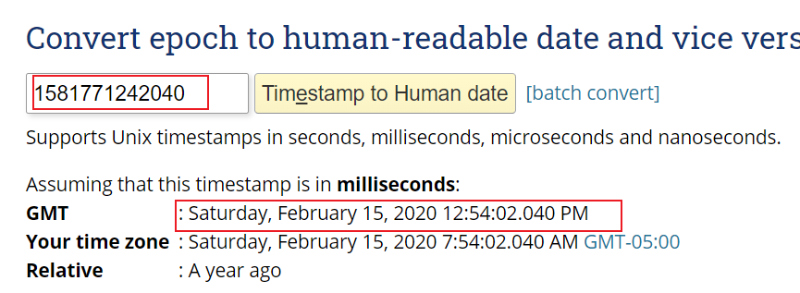
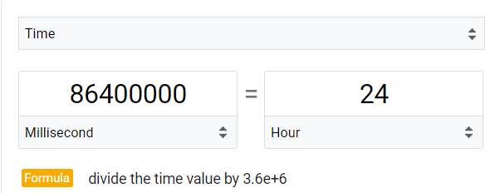
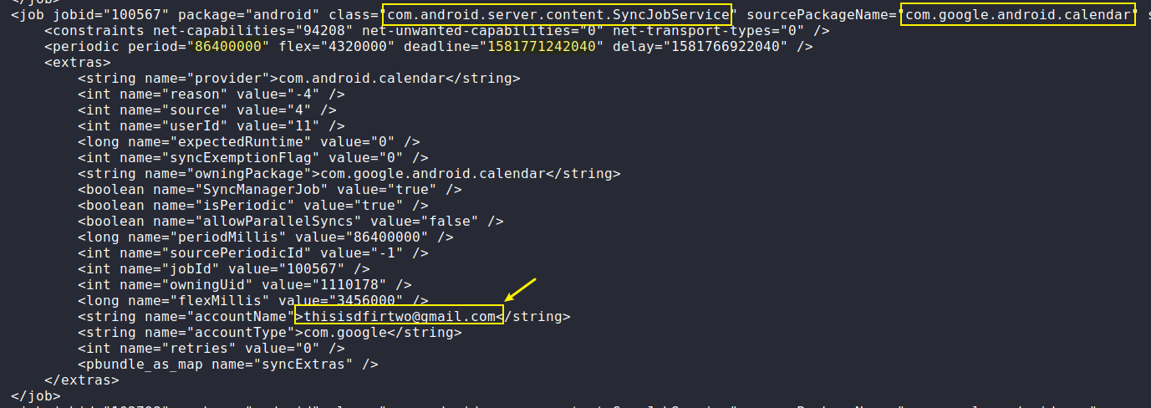
a calendar activities is running on background. The activity is associated with thisisdfirtwo@gmail.com
Extra:
If your job needs some information from your app to perform its work, you can pass along primitive data types as extras in the JobInfo.
Notes:
https://www.epochconverter.com/

Slide 34
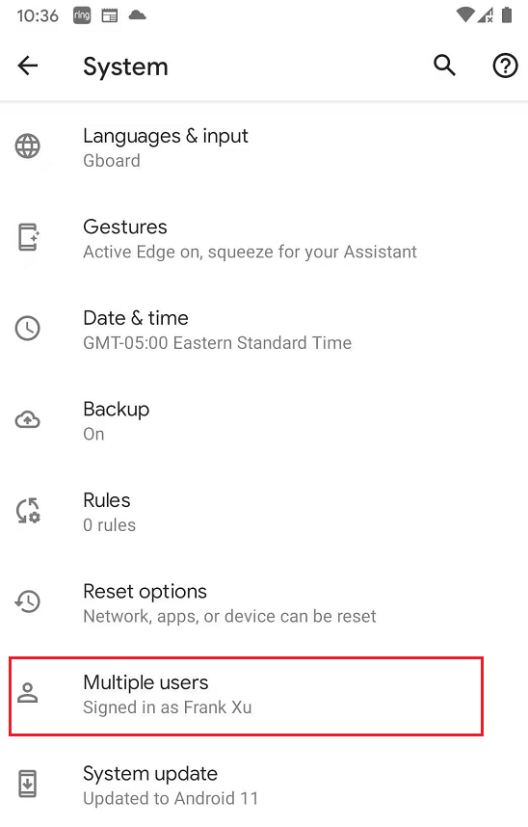
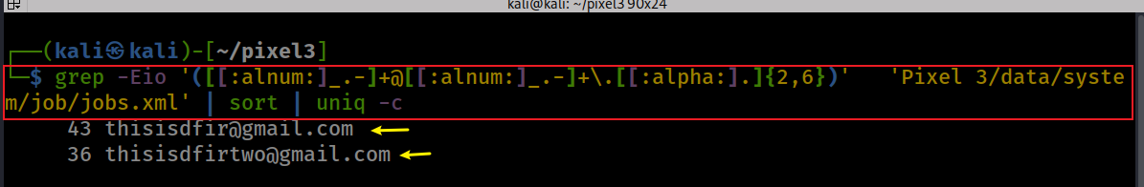
Android 10 allows to add multiple users to share the phone space, customized screens, apps. That is the reason you may see multiple Gmail associated with jobs
Find two emails that are associated with scheduled jobs
Notes:
grep -Eio '([[:alnum:]_.-]+@[[:alnum:]_.-]+\.[[:alpha:].]{2,6})' 'Pixel 3/data/system/job/jobs.xml' | sort | uniq -c

Slide 35
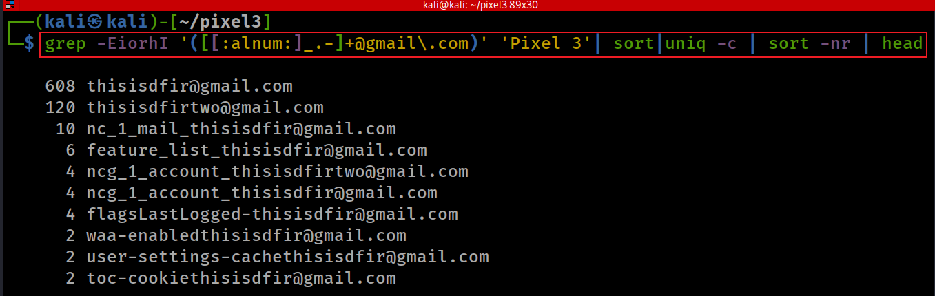
Find all Gmail addresses appeared in the phone?
Notes:
grep -EiorhI '([[:alnum:]_.-]+@gmail\.com)' 'Pixel 3'| sort|uniq -c | sort -nr | head
608 thisisdfir@gmail.com
120 thisisdfirtwo@gmail.com
10 nc_1_mail_thisisdfir@gmail.com
6 feature_list_thisisdfir@gmail.com
4 ncg_1_account_thisisdfirtwo@gmail.com
4 ncg_1_account_thisisdfir@gmail.com
4 flagsLastLogged-thisisdfir@gmail.com
2 waa-enabledthisisdfir@gmail.com
2 user-settings-cachethisisdfir@gmail.com
2 toc-cookiethisisdfir@gmail.com

Slide 36
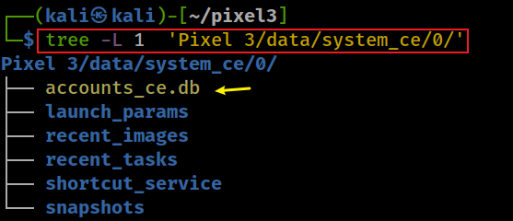
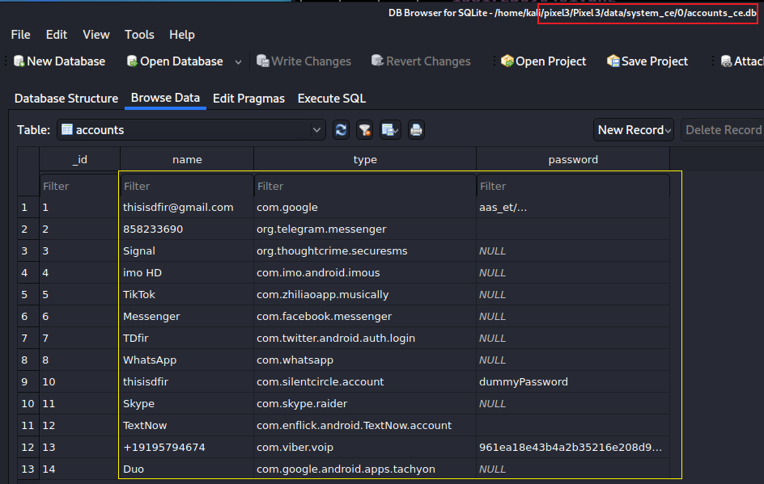
List possible apps username and password (account_ce.db/accounts)
Notes:
tree -L 1 'Pixel 3/data/system_ce/0/'

Slide 37
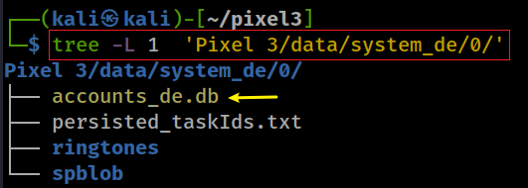
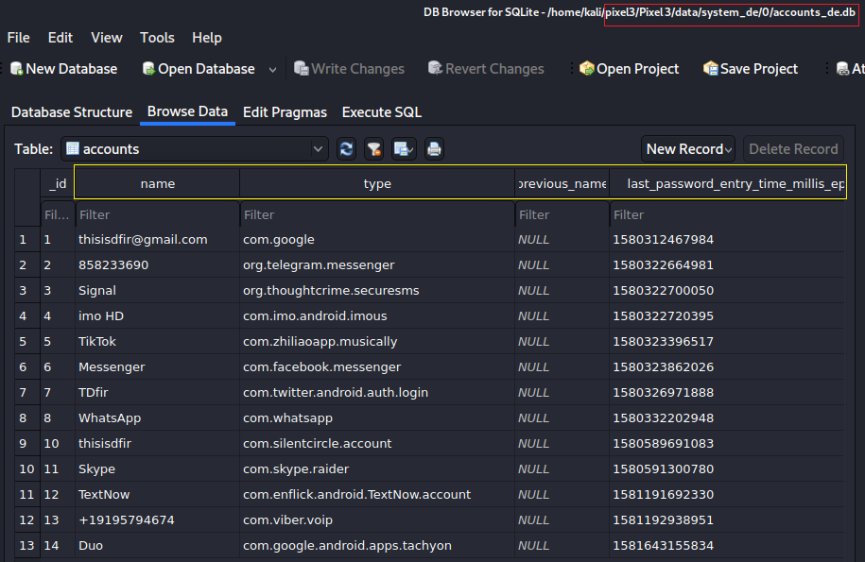
List possible apps username and password (account_de.db/accounts)
need convert last password entry time to human readable
Notes:
tree -L 1 'Pixel 3/data/system_de/0/'

Slide 38
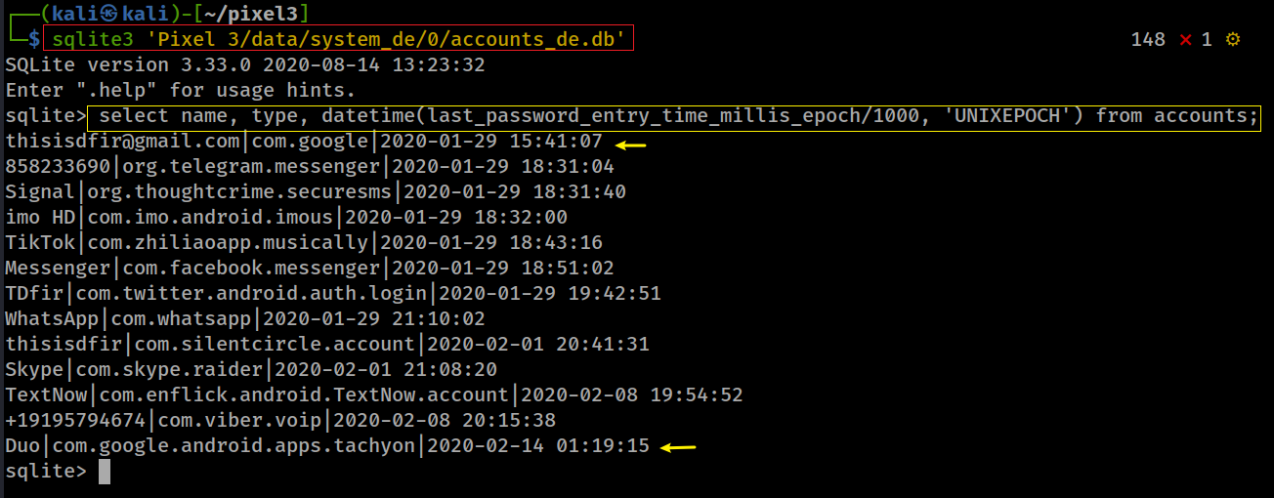
Convert last password entry time millis epoch to human readable
Notes:
sqlite3 'Pixel 3/data/system_de/0/accounts_de.db'
select name, type, datetime(last_password_entry_time_millis_epoch/1000, 'UNIXEPOCH') from accounts;
thisisdfir@gmail.com|com.google|2020-01-29 15:41:07
858233690|org.telegram.messenger|2020-01-29 18:31:04
Signal|org.thoughtcrime.securesms|2020-01-29 18:31:40
imo HD|com.imo.android.imous|2020-01-29 18:32:00
TikTok|com.zhiliaoapp.musically|2020-01-29 18:43:16
Messenger|com.facebook.messenger|2020-01-29 18:51:02
TDfir|com.twitter.android.auth.login|2020-01-29 19:42:51
WhatsApp|com.whatsapp|2020-01-29 21:10:02
thisisdfir|com.silentcircle.account|2020-02-01 20:41:31
Skype|com.skype.raider|2020-02-01 21:08:20
TextNow|com.enflick.android.TextNow.account|2020-02-08 19:54:52
+19195794674|com.viber.voip|2020-02-08 20:15:38
Duo|com.google.android.apps.tachyon|2020-02-14 01:19:15

Slide 39
Bluetooth Mac address and Wi-Fi

Slide 40
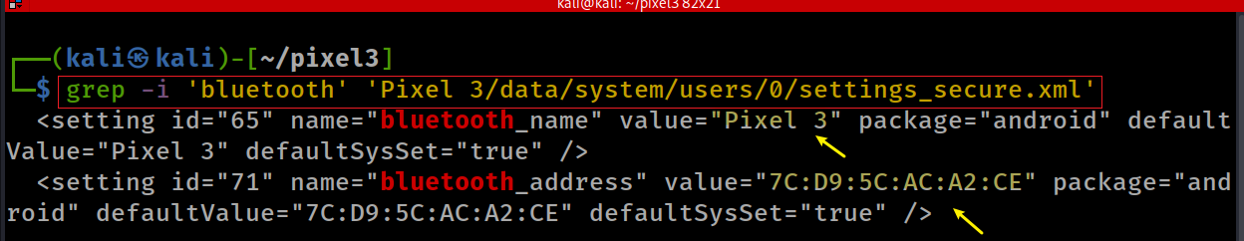
What is Bluetooth Mac address?
Notes:
grep -i 'bluetooth' 'Pixel 3/data/system/users/0/settings_secure.xml'
7C:D9:5C:AC:A2:CE

Slide 41
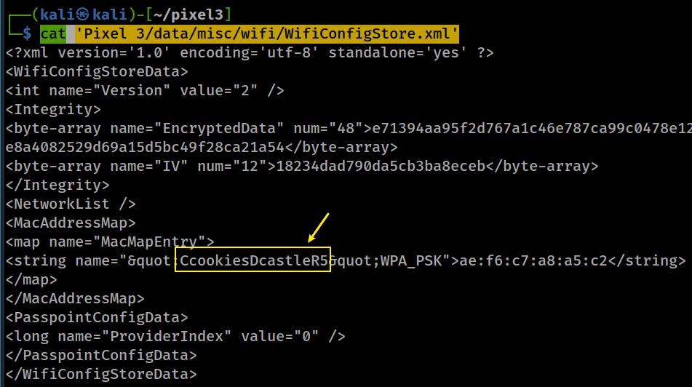
What is Wi-Fi Service Set Identifier (SSID)? (WifiConfigStore.xml)
SSID
a router’s MAC
Notes:
cat 'Pixel 3/data/misc/wifi/WifiConfigStore.xml’
<?xml version='1.0' encoding='utf-8' standalone='yes' ?>
<WifiConfigStoreData>
<int name="Version" value="2" />
<Integrity>
<byte-array name="EncryptedData" num="48">e71394aa95f2d767a1c46e787ca99c0478e12467241553a8551005969fd38294e8a4082529d69a15d5bc49f28ca21a54</byte-array>
<byte-array name="IV" num="12">18234dad790da5cb3ba8eceb</byte-array>
</Integrity>
<NetworkList />
<MacAddressMap>
<map name="MacMapEntry">
<string name="&quot;CcookiesDcastleR5&quot;WPA_PSK">ae:f6:c7:a8:a5:c2</string>
</map>
</MacAddressMap>
<PasspointConfigData>
<long name="ProviderIndex" value="0" />
</PasspointConfigData>
</WifiConfigStoreData>

Slide 42
For old version/other brands of Android
/data/misc/wifi/wpa_supplicant.conf (possible)
Example NOT from Pixel 3
# more wpa_supplicant.conf
ctrl_interface=eth0
update_config=1
network={
ssid="SomeWifiNetwork"
psk="MyPlaintextPassword"
key_mgmt=WPA-PSK
priority=1
}
#
Notes:
find 'Pixel 3' -iname 'wpa*’
cat 'Pixel 3/vendor/etc/wifi/wpa_supplicant.conf'

Slide 43
Artifacts generated by API usage

Slide 44
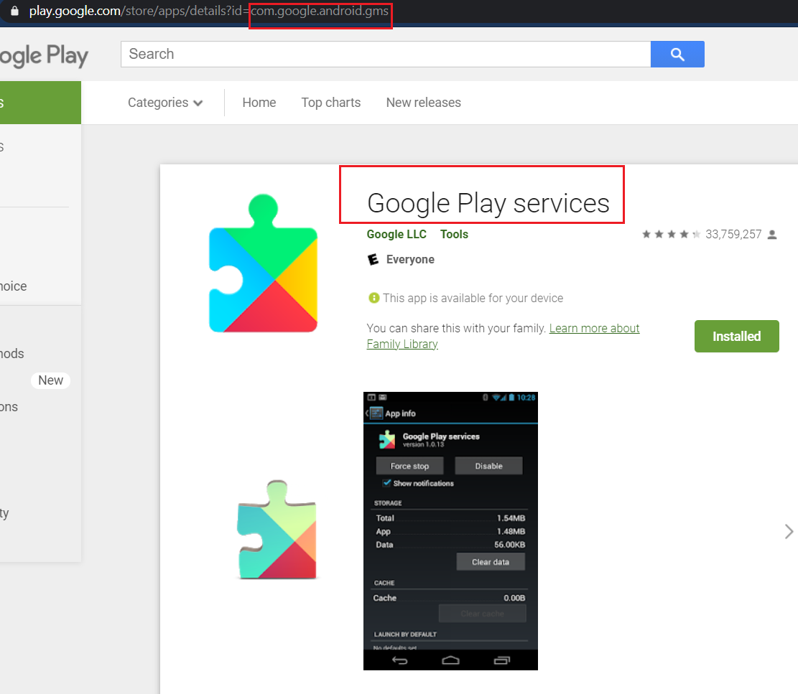
Google Play services
https://play.google.com/store/apps/details?id=com.google.android.gms
What is Google Play services?
Package name: com.google.android.gms
A proprietary Google system component installed on most Google-certified Android devices
Provides common Google APIs and background services to Android apps
Not part of AOSP; Android can operate without Google Play services
Major functions
Google account authentication APIs
Location services
Google Maps - related APIs
Firebase Cloud Messaging/push notifications
Security and compatibility services
Integration with other Google services
Normally installed as a privileged/system app and cannot be uninstalled by a standard user on Google-certified devices.

Slide 45
Why Google Play services matters in digital forensics
com.google.android.gms may contain account, device, location, notification, and Google-service artifacts
Multiple artifacts help reconstruct Android activity
Multiple artifacts can help investigators correlate activity across multiple apps and Google services

