Slide 1
AOSP Apps Investigations
Part 2: Contact Management Services
Notes:
https://android.googlesource.com/platform/packages/providers/ContactsProvider/+/b0f94c82189fdbe30037fbda532576043cbb067e/src/com/android/providers/contacts/ContactsProvider.java

Slide 2
Learning Objectives
Explain why Android uses a centralized Contacts Provider.
Locate contacts2.db, calllog.db, and profile.db in the forensic image.
Use table relationships to reconstruct contacts, groups, call logs, and owner profile data.
Distinguish raw database values from forensic interpretation.
Document findings while protecting sensitive personal information.

Slide 3
Contact Management Services

Slide 4
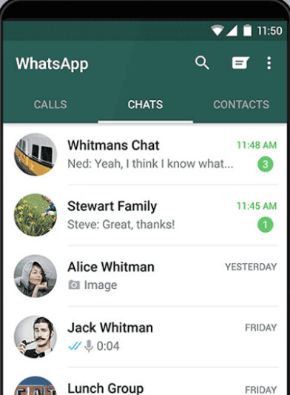
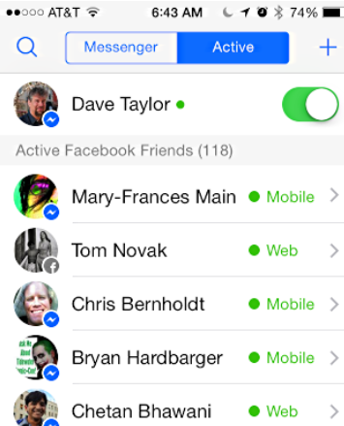
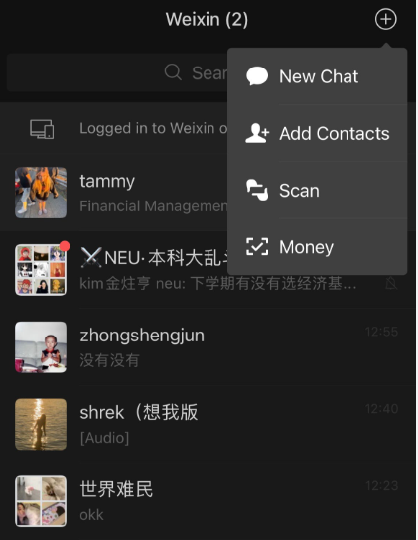
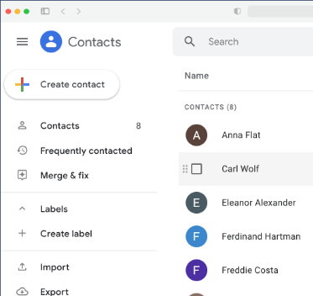
Why Contact Management Services Exist
Multiple apps need access to the same people, phone numbers, emails, and account identities.
If every app stores its own address book, contact data becomes duplicated, inconsistent, and harder to synchronize.
Android solves this with a central Contacts Provider that stores and shares contact-related data through standard APIs.
Notes:
https://www.dev2qa.com/android-contacts-database-structure/

Slide 5
Problems Without a Central Contacts Provider
Duplicate data: Phone, SMS, WhatsApp, Telegram, and other apps may keep separate contact copies.
Inconsistent records: one person may appear under different names, numbers, or accounts.
Synchronization gaps: Google, SIM, and third-party contact sources may not merge cleanly.
Privacy risk: each app could expose or manage contact data differently.

Slide 6
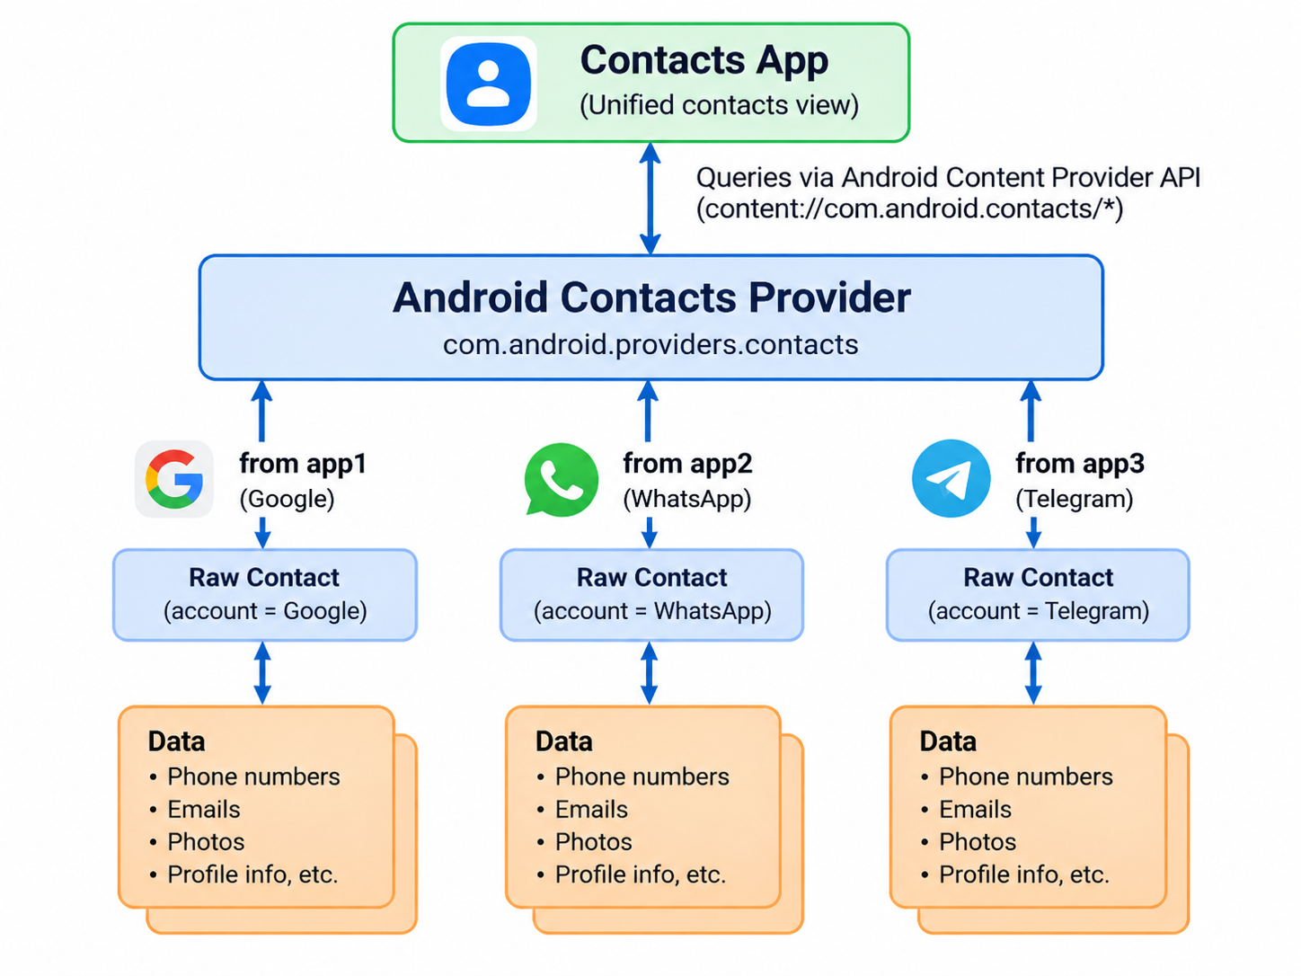
Solution: Android Contacts Provider
Android centralizes contact storage in com.android.providers.contacts.
The Contacts app displays unified contacts assembled from one or more raw contact records.
Raw contacts preserve source-account context such as Google, SIM, WhatsApp, or Telegram.
The provider also supports groups, photos, lookup/search, sync metadata, profile data, and call-log integration.

Slide 7
Forensic Value of Contact Services
Linked accounts: identify contact sources and communication platforms used on the device.
Contact details: recover phone numbers, emails, addresses, names, photos, and notes.
Relationship mapping: connect contacts to messages, calls, groups, favorites, and account sources.
Timeline evidence: interpret last-contacted and last-updated timestamps when populated.
Privacy caution: treat recovered contact/profile data as sensitive PII.

Slide 8
Sample Investigation Questions
Owner profile: What personal information is stored for the device owner?
Contact inventory: How many contacts and raw contacts are present?
Accounts: Which Google, SIM, or third-party accounts contributed contact records?
Groups: What groups exist, and which contacts belong to each group?
Deleted records: Are any raw contacts marked as deleted but still recoverable?
Call logs: What numbers, times, call types, durations, and voicemail records appear?

Slide 9
Contacts Service Files Overview

Slide 10
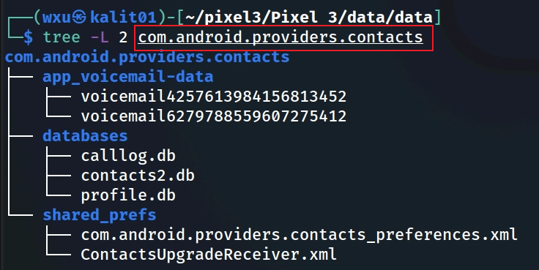
Contact management services files
Notes:
Cmd: sqlitebrowser 'Pixel 3/data/data/com.android.providers.contacts/databases/contacts2.db’
https://www.dev2qa.com/android-contacts-database-structure/

Slide 11
Contacts Provider Investigation Roadmap
Identify package: com.android.providers.contacts
Locate databases: contacts2.db, calllog.db, profile.db
Inventory tables and schemas using SQLite tools
Reconstruct contacts using accounts → raw_contacts → contacts → data → mimetypes
Investigate groups, deleted flags, call logs, voicemail, and owner profile data
Report extracted values, joins, interpretation, and limitations

Slide 12
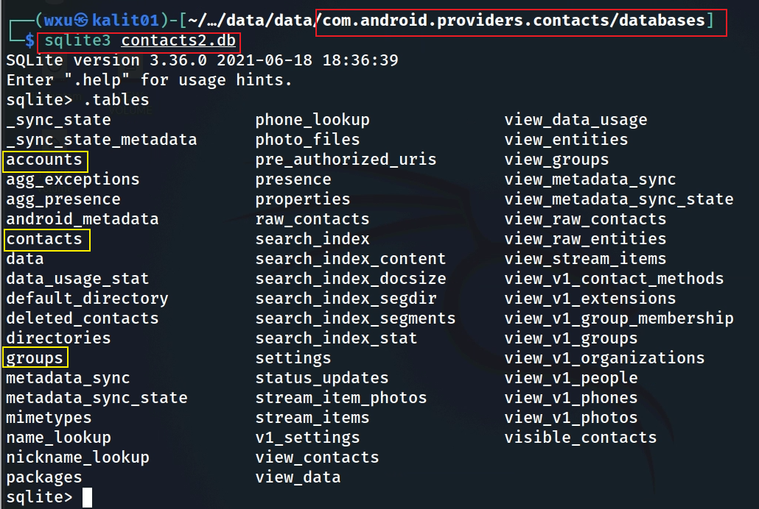
Tables in contacts2.db
Notes:
The image shows the output of the `.tables` command on the `contacts2.db` SQLite database, which is used by Android's contacts provider (`com.android.providers.contacts`) to store contact-related data on a device like the Pixel 3. Below, I’ll explain the tables and views that are most valuable in a digital forensics context, focusing on those that provide meaningful user data or behavioral insights. I’ll rank them based on their forensic value, excluding tables or views that are less useful (e.g., internal metadata or search-index-related tables like `search_index_content`, `search_index_segdir`, etc., which are primarily for system optimization).
### Explanation and Ranking of Valuable Tables/Views for Digital Forensics
#### 1. **contacts** (High Value)
- **Explanation**: The `contacts` table stores core information about each contact on the device, such as the contact ID, display name, and whether the contact has been starred or pinned. It often links to other tables (like `raw_contacts`) for more detailed data.
- **Forensic Value**: This table provides a high-level overview of all contacts stored on the device, which is critical for identifying relationships, frequent contacts, or key individuals in an investigation. It’s often the starting point for mapping a user’s social network.
- **Rank**: 1st ( foundational for identifying contacts and linking to more detailed data).
#### 2. **raw_contacts** (High Value)
- **Explanation**: The `raw_contacts` table contains raw contact entries, which are tied to specific accounts (e.g., Google, WhatsApp). Each raw contact entry links to a contact in the `contacts` table but provides additional metadata, such as the source account, sync status, and whether the contact was deleted.
- **Forensic Value**: This table is crucial for understanding the origin of contacts (e.g., synced from Gmail vs. manually added) and tracking account-specific interactions. It can reveal which apps or services the user is using to manage contacts, offering insights into their digital footprint.
- **Rank**: 2nd (provides account-level context and sync details).
#### 3. **data** (High Value)
- **Explanation**: The `data` table stores detailed information about contacts, such as phone numbers, email addresses, physical addresses, and other structured data (e.g., birthdays, nicknames). Each row is linked to a `raw_contacts` entry and uses a `mimetype` to define the type of data (e.g., `vnd.android.cursor.item/phone_v2` for phone numbers).
- **Forensic Value**: This table is a goldmine for forensics because it contains the actual contact details that can be used to reconstruct communication networks, identify key contacts, or cross-reference with other evidence (e.g., call logs, emails). It can also reveal personal details about contacts that might be relevant to an investigation.
- **Rank**: 3rd (rich in detailed contact information, though requires linking to `raw_contacts` for context).
#### 4. **groups** (Moderate to High Value)
- **Explanation**: The `groups` table stores information about contact groups (e.g., "Family," "Work," "Friends") created by the user. It includes group IDs, names, and metadata about the group’s visibility or sync status.
- **Forensic Value**: This table can reveal how the user organizes their contacts, which can provide behavioral insights (e.g., a group named "Suspects" or "Clients" might be relevant in a criminal or business investigation). It can also help identify clusters of related contacts.
- **Rank**: 4th (valuable for behavioral analysis and grouping, but less detailed than `data`).
#### 5. **phone_lookup** (Moderate Value)
- **Explanation**: The `phone_lookup` table is an index that maps phone numbers to contact IDs, optimized for quick lookups during calls or messaging.
- **Forensic Value**: This table is useful for cross-referencing phone numbers found in other evidence (e.g., call logs, SMS) with contacts on the device. It can help confirm whether a number belongs to a known contact, which is valuable for linking communications to specific individuals.
- **Rank**: 5th (helpful for mapping numbers to contacts, but less detailed than primary tables).
#### 6. **status_updates** (Moderate Value)
- **Explanation**: The `status_updates` table stores status updates for contacts, typically from social or messaging apps integrated with the contacts provider (e.g., WhatsApp status or Google Talk presence).
- **Forensic Value**: This table can provide insights into a user’s social interactions and the activity of their contacts (e.g., when a contact was last online). It’s particularly useful if the user is using apps that integrate status updates with the contacts system, offering a timeline of activity.
- **Rank**: 6th (useful for social activity tracking, but depends on app integration).
#### 7. **view_data** (Moderate Value)
- **Explanation**: The `view_data` view is a virtual table that combines data from the `data` table with other metadata, making it easier to query structured contact information (e.g., phone numbers, emails) in a more user-friendly format.
- **Forensic Value**: This view simplifies access to contact details, making it easier to extract actionable data without complex joins. It’s essentially a pre-joined version of the `data` table, so its forensic value overlaps with `data` but is more convenient for quick analysis.
- **Rank**: 7th (convenient for querying, but redundant with `data`).
#### 8. **accounts** (Moderate Value)
- **Explanation**: The `accounts` table lists the accounts synced with the device (e.g., Google, Samsung) that contribute to the contacts database. It includes account names and types.
- **Forensic Value**: This table helps identify which accounts are linked to the device, which can point investigators to other sources of evidence (e.g., Gmail, cloud backups). It also shows the scope of contact syncing, which can reveal the user’s digital ecosystem.
- **Rank**: 8th (useful for identifying linked accounts, but less directly tied to user behavior).
### Tables/Views Excluded (Low Forensic Value)
I’ve excluded tables like `search_index_*` (e.g., `search_index_content`, `search_index_segdir`), `android_metadata`, `sync_state`, `properties`, and others because they are primarily for system optimization, indexing, or internal bookkeeping. For example:
- `search_index_*` tables are for full-text search functionality and don’t contain user-facing data.
- `android_metadata` stores database versioning info (e.g., locale).
- `sync_state` and related tables manage synchronization metadata, which is less relevant unless investigating specific sync issues.
### Summary of Rankings
1. **contacts**: Core contact list, starting point for relationships.
2. **raw_contacts**: Links contacts to accounts, revealing sources.
3. **data**: Detailed contact info (phone, email, etc.).
4. **groups**: Shows user-defined contact organization.
5. **phone_lookup**: Maps numbers to contacts for cross-referencing.
6. **status_updates**: Tracks social activity via status updates.
7. **view_data**: Simplified access to contact details.
8. **accounts**: Identifies synced accounts for broader context.
These tables and views provide the most actionable data for digital forensics, focusing on user relationships, communication details, and behavioral patterns.

Slide 13
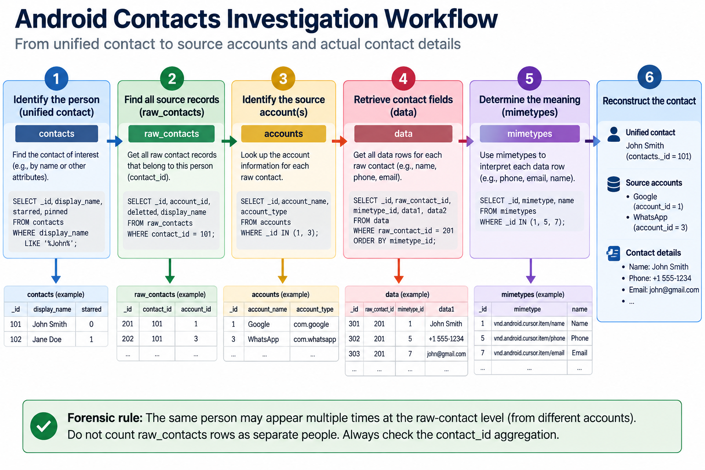

Slide 14
High-Value Tables in contacts2.db
accounts: synced account names and account types.
raw_contacts: account-specific contact records; may expose source, sync state, and deleted flags.
contacts: unified contact records shown to the user.
data: actual values such as names, phone numbers, emails, addresses, notes, and group memberships.
mimetypes: explains what each row in data represents.
groups: user-defined or synced contact groups.
phone_lookup: maps phone numbers to contacts for calls and messages.

Slide 15
accounts Table
Stores account sources that contribute contact data.
Important fields: _id, account_name, account_type, data_set.
Forensic value: reveals linked platforms such as Google, SIM, Exchange, WhatsApp, or Telegram.
Use accounts._id to explain where a raw contact came from.

Slide 16
raw_contacts Table
Stores account-specific contact records from different sources.
Important fields: _id, account_id, contact_id, display_name, deleted, dirty, sync1–sync4.
Forensic value: identifies the source account, sync state, and whether a record was marked deleted.
Several raw_contacts rows can aggregate into one contacts row.

Slide 17
contacts Table
Stores unified contact records displayed by the Contacts app.
Important fields: _id, name_raw_contact_id, starred, pinned, has_phone_number, lookup, contact_last_updated_timestamp.
Forensic value: provides the investigator’s top-level contact list and user-facing contact state.
Use contacts._id to link back to raw_contacts.contact_id.

Slide 18
data Table
Stores the actual contact details: names, phone numbers, emails, addresses, notes, photos, and group memberships.
Each row belongs to one raw contact: data.raw_contact_id = raw_contacts._id.
The mimetype_id tells what kind of value is stored in data1, data2, data3, etc.
Forensic value: this is usually where the most useful contact content is found.

Slide 19
groups Table
Stores contact groups such as Family, Friends, Work, or synced account groups.
Forensic value: shows how contacts are organized by the user or by account synchronization.
To list members, join groups to data rows whose mimetype indicates group membership.

Slide 20
phone_lookup Table
Maps phone numbers to contact IDs for fast lookup during calls and messaging.
Forensic value: helps connect phone numbers in SMS/MMS/call logs to saved contacts.
Use it as a cross-reference, not as the primary source of full contact detail.

Slide 21
status_updates Table
Stores status or presence information from apps that integrate with the Contacts Provider.
Forensic value depends on whether apps actually populate this table.
When populated, it may support timeline or social-activity analysis.

Slide 22
raw_contacts vs. contacts
raw_contacts: separate records from individual accounts or apps.
contacts: aggregated person records shown in the Contacts app.
Example: one person may have a Google raw contact and a WhatsApp raw contact, but Android may merge them into one unified contact.
Forensics: preserve both views—source-level evidence and user-facing interpretation.

Slide 23
accounts table

Slide 24
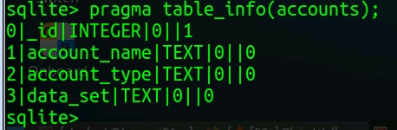
Column Name | Description
_id | Primary key (unique identifier for each account)
account_name | The user’s account name (e.g., email address or username)
account_type | The type of the account (e.g., com.google, com.whatsapp, com.android.exchange)
data_set | Optional — distinguishes data sets within the same account type (e.g., corporate directory vs. personal)

Slide 25
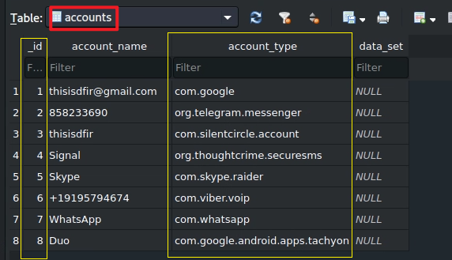
accounts table structure
Seven apps store contact information

Slide 26
raw_contacts table
stored aggregated contacts from all apps

Slide 27
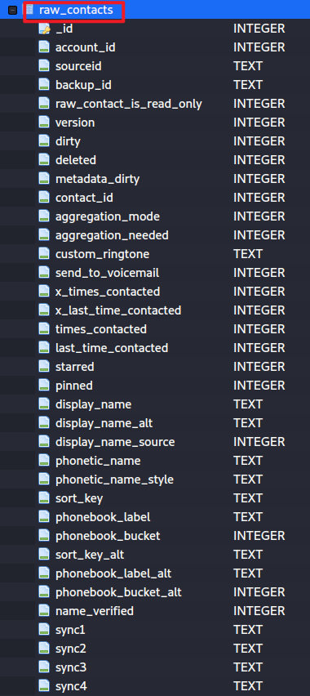
Column Name | Data Type | Description
_id | INTEGER | Primary key (unique ID of the raw contact)
account_id | INTEGER | Foreign key linking to the accounts table (accounts._id)
sourceid | TEXT | Unique ID of this contact in its source account (e.g., Google ID)
raw_contact_is_read_only | INTEGER | 1 if the contact cannot be edited locally
version | INTEGER | Version counter incremented when contact changes
dirty | INTEGER | 1 if unsynced changes exist
deleted | INTEGER | 1 if marked deleted but not yet purged
contact_id | INTEGER | Link to the aggregated contact in the contacts table
aggregation_mode | INTEGER | How this raw contact participates in aggregation (e.g., automatic/manual)
aggregation_needed | INTEGER | Indicates if re-aggregation is needed
display_name | TEXT | Cached display name (may be null or derived from data table)
display_name_alt | TEXT | Alternative display name format
custom_ringtone | TEXT | URI of a custom ringtone assigned to the contact
send_to_voicemail | INTEGER | 1 if calls should go straight to voicemail
last_time_contacted | INTEGER | Unix timestamp of last interaction
times_contacted | INTEGER | Counter of how many times the contact has been interacted with
starred | INTEGER | 1 if marked as favorite
pinned | INTEGER | Position in the “pinned” list
photo_id | INTEGER | Link to the photo in data table
photo_uri | TEXT | Cached URI of contact photo
photo_file_id | INTEGER | File ID if photo stored in the file table (Android 11+)
sync1 | TEXT | Adapter-reserved sync metadata field (customized for different apps)
sync2 | TEXT | Adapter-reserved sync metadata field
sync3 | TEXT | Adapter-reserved sync metadata field
sync4 | TEXT | Adapter-reserved sync metadata field

Slide 28
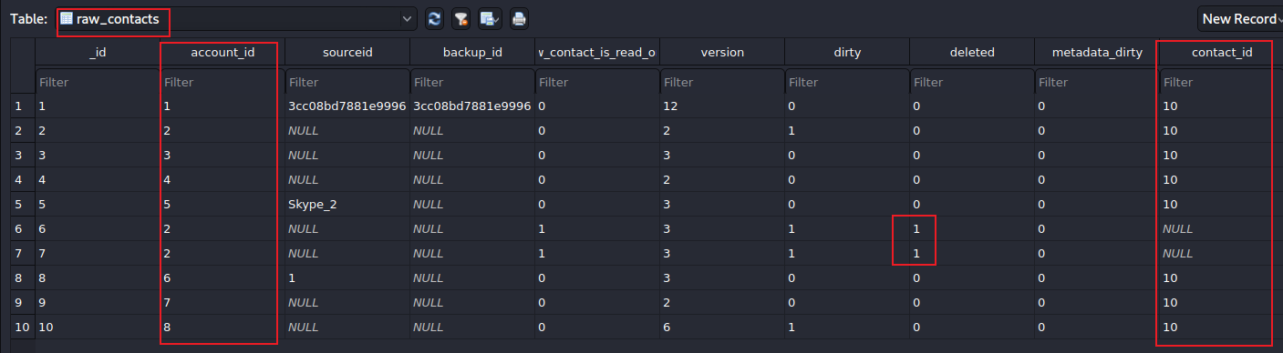


Find Contact Records by Account
_id | account_name | account_type
telegram saved three contacts; two of them are deleted
Goal: identify which raw contacts came from a specific account or application.
Example finding: Telegram saved three contacts; two were marked deleted.
Key join: raw_contacts.account_id = accounts._id.
Interpretation: a deleted flag can indicate a removed contact that still appears in the database.

Slide 29
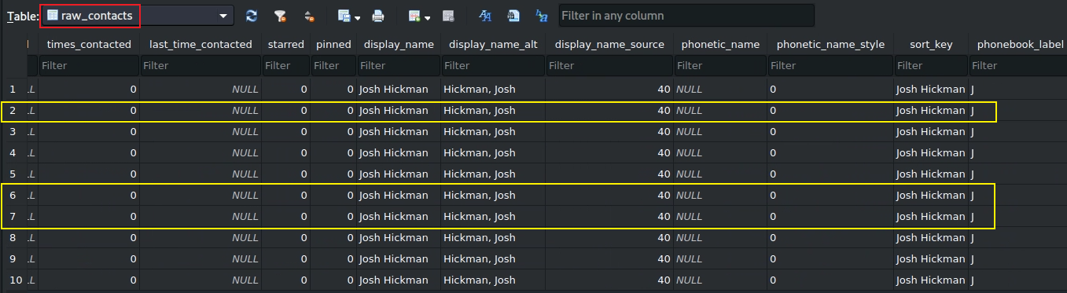
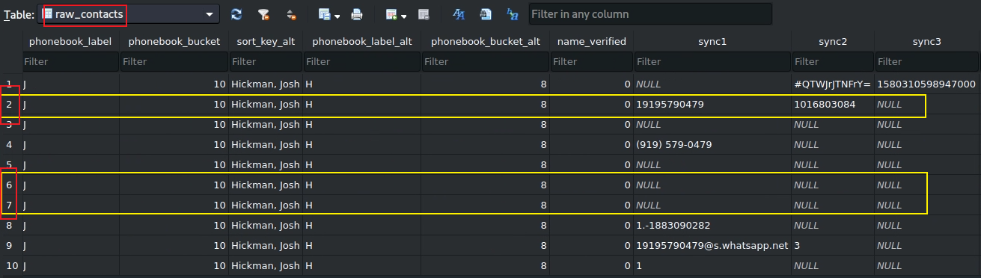




telegram.messager (account_id=2)

Slide 30
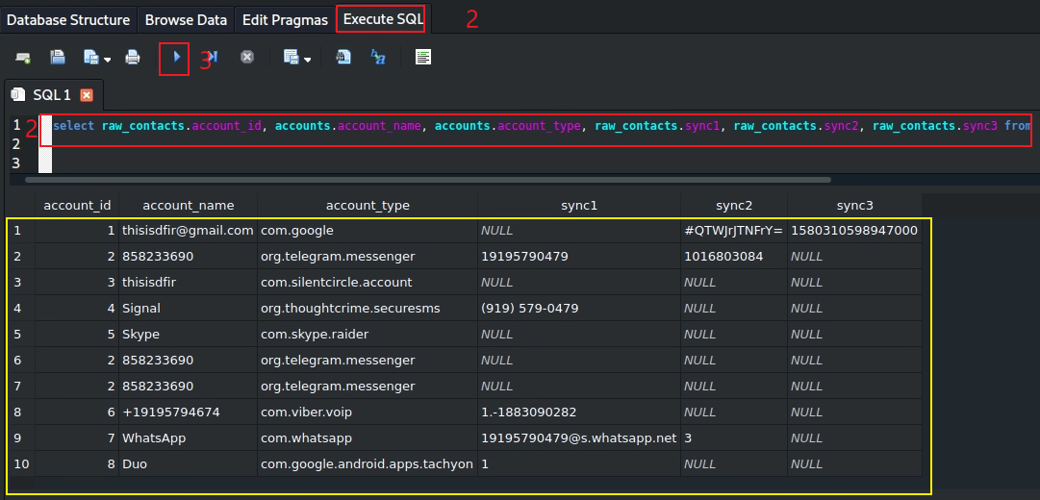

Results of joining raw_contacts with accounts
Find 10 raw contacts
SELECT raw_contacts.account_id, accounts.account_name, accounts.account_type,
raw_contacts.sync1, raw_contacts.sync2, raw_contacts.sync3
FROM raw_contacts
INNER JOIN accounts ON raw_contacts.account_id = accounts._id;

Slide 31
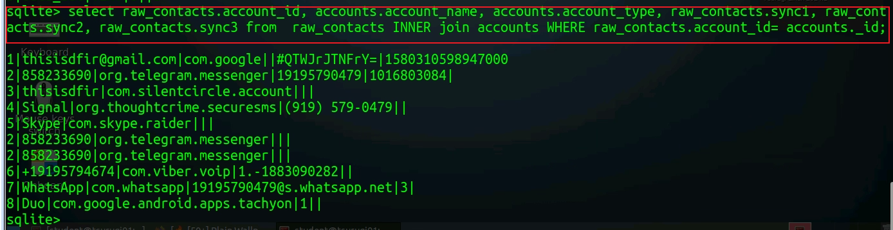
Find 10 raw contacts (same as previous commands, just different terminal)

Slide 32
data Table

Slide 33
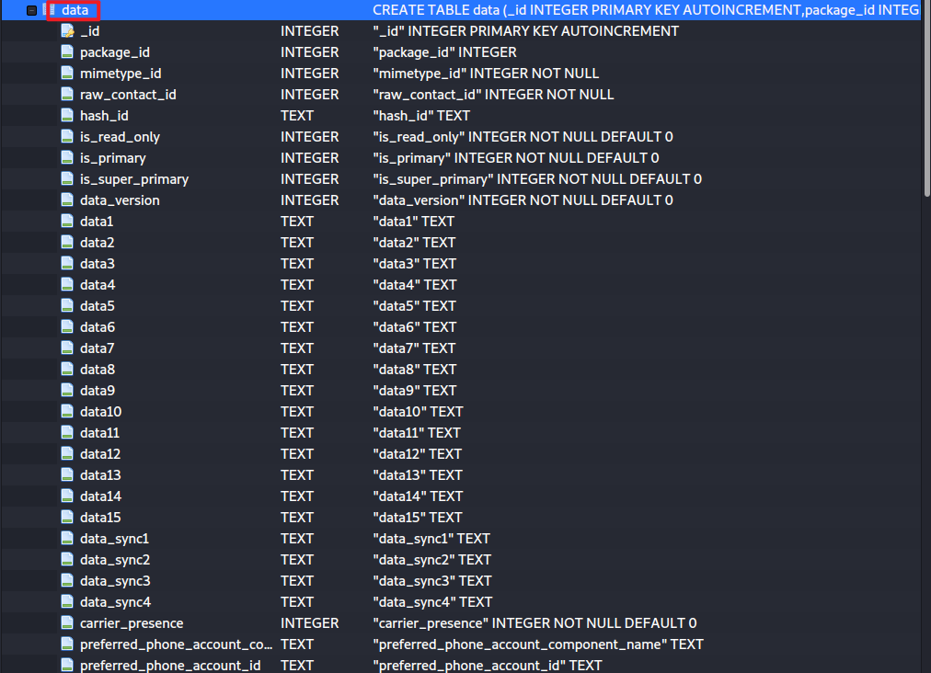
Investigating Contact ID 10
1. The data table contains the actual contact values.
2. The same contact may have multiple data rows: display name, phone number, email, address, note, photo, or group membership.
3. Always interpret a data row together with its mimetype.

Slide 34
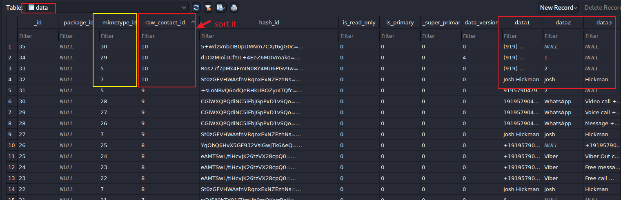
Interpreting Rows in data
indicate what data type is stored in this row.
See mimetypes Table
contact 10 (has four fields, each field has a different value type based on minetypes)
data is often the main value, but interpretation depends on the mimetype.
Each row stores one type of value, such as name, phone number, email, organization, note, photo, or group membership.

Slide 35
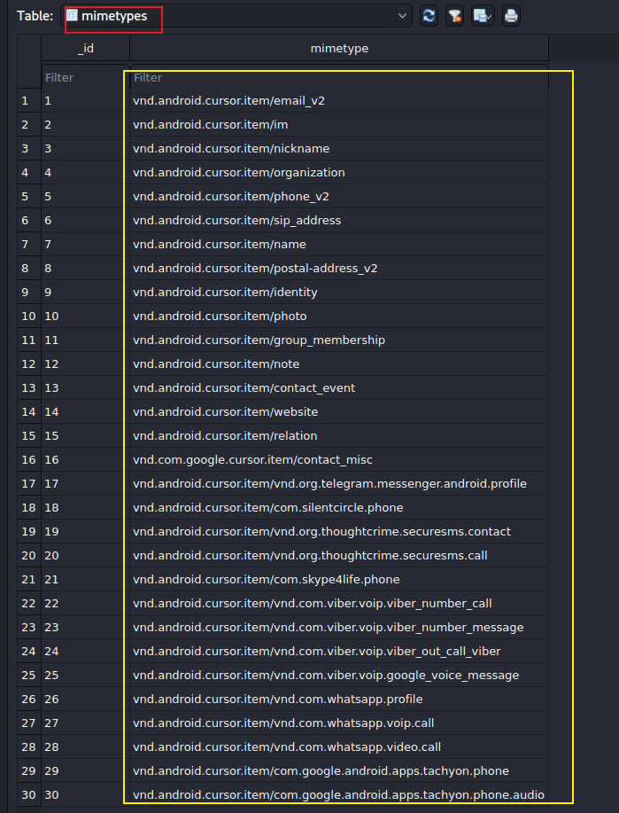
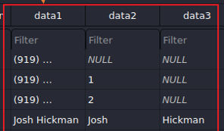
mimetypes Table
Defines how rows in the data table should be interpreted.
  Example: vnd.android.cursor.item/email_v2 means the row stores an email address.
  Example: vnd.android.cursor.item/phone_v2 means the row stores a phone number.
Forensics: never interpret data1/data2/data3 without first checking the mimetype.
google FI

Slide 36
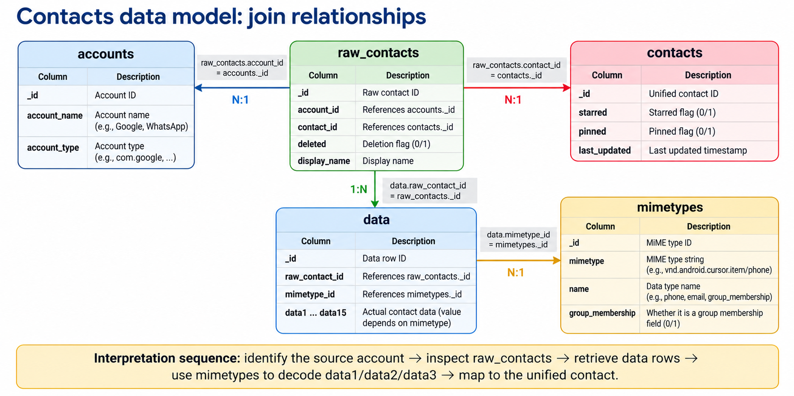



Slide 37
contacts table

Slide 38
Aggregation: Many Raw Contacts, One Person
Android may merge several raw contact records into one unified contact.
Example: ten raw_contacts rows may point to the same contacts._id.
This does not mean ten different people; it may mean one person represented across multiple accounts or records.
Forensics: report both the raw source records and the unified contact interpretation.
Conclusion: There are 10 raw contacts, but the system believes that one person (id=10) created 10 raw contacts

Slide 39
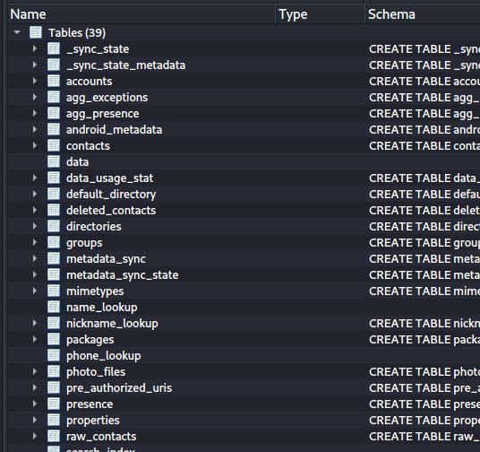
metadata of each contacts info, e.g., times contacted, last time contacted
contacts info
fields of contacts
contact group information, e.g., family, friends
raw data is unprocessed data, which contains contacts from difference accounts
Notes:
Cmd: sqlitebrowser 'Pixel 3/data/data/com.android.providers.contacts/databases/contacts2.db’
https://www.dev2qa.com/android-contacts-database-structure/

Slide 40
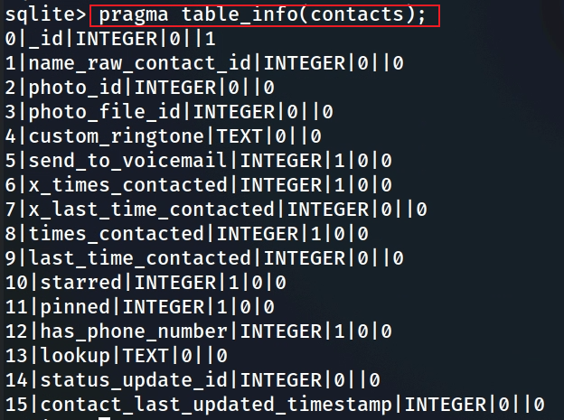
Column Name | Data Type | Description
_id | INTEGER | Primary key — unique ID for the aggregated contact.
name_raw_contact_id | INTEGER | References the raw_contacts._id used to display the contact’s name.
photo_id | INTEGER | References the contact’s main photo record in the data table.
photo_file_id | INTEGER | File-based photo reference (Android 11+ scoped storage).
custom_ringtone | TEXT | URI of a custom ringtone assigned to this contact.
send_to_voicemail | INTEGER | 1 if calls from this contact should go directly to voicemail.
x_times_contacted | INTEGER | Legacy counter for number of interactions (deprecated).
x_last_time_contacted | INTEGER | Legacy timestamp of last interaction (deprecated).
times_contacted | INTEGER | Number of times the contact has been interacted with.
last_time_contacted | INTEGER | Timestamp (in milliseconds) of the last interaction.
starred | INTEGER | 1 if the contact is marked as a “favorite.”
pinned | INTEGER | Indicates the position in the pinned favorites list.
has_phone_number | INTEGER | 1 if this contact has at least one phone number.
lookup | TEXT | Stable lookup key used by Android for contact identification.
status_update_id | INTEGER | Links to social status or presence information (if available).
contact_last_updated_timestamp | INTEGER | Unix timestamp of the last update to this contact record.
Notes:
The image shows the output of the SQLite command `pragma table_info(contacts);`, which provides the schema (structure) of the `contacts` table in the `contacts2.db` database. This table is part of Android's contacts provider system, used to store core information about contacts on a device like the Pixel 3. Below, I’ll explain each column in the `contacts` table, including its data type, constraints, and purpose, with a focus on its relevance in a digital forensics context.
### Explanation of Columns in the `contacts` Table
1. **_id** (INTEGER, NOT NULL, Primary Key)
- **Explanation**: This is the unique identifier for each contact entry in the table. It’s an auto-incrementing integer that serves as the primary key.
- **Purpose**: Used to uniquely identify a contact and link to related data in other tables (e.g., `raw_contacts`, `data`).
- **Forensic Value**: Essential for mapping relationships between tables. For example, you can use `_id` to find all phone numbers for a contact in the `data` table.
2. **name_raw_contact_id** (INTEGER, NULL, Default: 0)
- **Explanation**: This column stores the ID of the `raw_contacts` entry that provides the display name for this contact. A single contact in the `contacts` table can aggregate multiple `raw_contacts` entries (e.g., one from Google, one from WhatsApp), and this points to the primary one used for the name.
- **Purpose**: Links the contact to its primary raw contact for naming purposes.
- **Forensic Value**: Useful for tracing the source of a contact’s display name and understanding how contacts are aggregated across accounts.
3. **photo_id** (INTEGER, NULL, Default: 0)
- **Explanation**: This column stores the ID of the contact’s photo, if one exists, linking to a photo stored elsewhere (e.g., in the `data` table or a file system).
- **Purpose**: Associates a contact with a profile picture.
- **Forensic Value**: Can be used to retrieve a contact’s photo, which might be relevant for identification or visual confirmation in an investigation.
4. **photo_file_id** (INTEGER, NULL, Default: 0)
- **Explanation**: This column stores the ID of the file containing the contact’s photo, typically used for high-resolution images stored separately.
- **Purpose**: Provides a reference to the actual photo file, as opposed to `photo_id`, which might point to a thumbnail.
- **Forensic Value**: Similar to `photo_id`, it helps retrieve a contact’s photo, potentially offering higher-quality images for forensic analysis.
5. **custom_ringtone** (TEXT, NULL, Default: 0)
- **Explanation**: This column stores the URI (as text) of a custom ringtone assigned to the contact, if any.
- **Purpose**: Allows the user to set a specific ringtone for a contact, which plays when they call.
- **Forensic Value**: Indicates user customization, which can provide behavioral insights (e.g., a unique ringtone might suggest a significant contact, like a family member or close associate).
6. **send_to_voicemail** (INTEGER, NOT NULL, Default: 0)
- **Explanation**: A boolean flag (0 or 1) indicating whether calls from this contact should be sent directly to voicemail.
- **Purpose**: Used to manage call handling for specific contacts.
- **Forensic Value**: Can reveal the user’s relationship with the contact (e.g., sending calls to voicemail might indicate avoidance or a strained relationship).
7. **x_times_contacted** (INTEGER, NOT NULL, Default: 0)
- **Explanation**: This column tracks the number of times the user has initiated contact with this person (e.g., via calls or messages). Note: This field is deprecated in newer Android versions and may not be updated.
- **Purpose**: Historically used to rank contacts by frequency of interaction.
- **Forensic Value**: If populated, it can indicate the frequency of interaction, helping identify key contacts. However, its reliability depends on the Android version and usage.
8. **x_last_time_contacted** (INTEGER, NOT NULL, Default: 0)
- **Explanation**: Stores a timestamp (in milliseconds since epoch) of the last time the user initiated contact with this person. Like `x_times_contacted`, this field is deprecated.
- **Purpose**: Tracks the most recent interaction for ranking or display purposes.
- **Forensic Value**: If populated, it provides a timeline of interactions, which is valuable for establishing communication patterns. Its usefulness is limited if the field isn’t updated.
9. **last_time_contacted** (INTEGER, NULL, Default: 0)
- **Explanation**: Stores a timestamp (in milliseconds since epoch) of the last time the contact was interacted with (e.g., called, messaged). Unlike `x_last_time_contacted`, this field is still used in modern Android versions.
- **Purpose**: Tracks recent interactions for contact management and display.
- **Forensic Value**: Highly valuable for establishing a timeline of communication. It can help pinpoint when the user last interacted with a contact, which is critical in investigations.
10. **starred** (INTEGER, NOT NULL, Default: 0)
- **Explanation**: A boolean flag (0 or 1) indicating whether the contact is marked as a favorite (starred).
- **Purpose**: Allows users to mark important contacts for quick access.
- **Forensic Value**: Indicates the user’s prioritization of contacts, which can highlight significant relationships (e.g., a starred contact might be a close friend, family member, or key associate).
11. **pinned** (INTEGER, NOT NULL, Default: 0)
- **Explanation**: A boolean flag (0 or 1) indicating whether the contact is pinned to the top of the contact list.
- **Purpose**: Used for UI purposes to keep frequently accessed contacts at the top.
- **Forensic Value**: Similar to `starred`, it shows user prioritization, providing insight into important relationships.
12. **has_phone_number** (INTEGER, NOT NULL, Default: 0)
- **Explanation**: A boolean flag (0 or 1) indicating whether the contact has at least one phone number associated with them.
- **Purpose**: Used for quick filtering in the UI (e.g., to show only contacts with phone numbers in the dialer).
- **Forensic Value**: Helps identify contacts that can be called or messaged, which is useful for focusing on communication-related evidence.
13. **lookup** (TEXT, NULL, Default: 0)
- **Explanation**: Stores a lookup key (a unique string) used to identify the contact across apps and sync operations. It’s typically a combination of the contact’s ID and other data.
- **Purpose**: Ensures consistent identification of a contact, even if the `_id` changes (e.g., after a sync or restore).
- **Forensic Value**: Useful for tracking a contact across different systems or backups, ensuring continuity in an investigation.
14. **status_update_id** (INTEGER, NULL, Default: 0)
- **Explanation**: Links to an entry in the `status_updates` table, which stores status updates for the contact (e.g., from social apps like WhatsApp or Google Talk).
- **Purpose**: Associates a contact with their latest status update.
- **Forensic Value**: Can provide social activity insights, such as the contact’s last known status, which might indicate their availability or activity at a specific time.
15. **contact_last_updated_timestamp** (INTEGER, NULL, Default: 0)
- **Explanation**: Stores a timestamp (in milliseconds since epoch) of the last time the contact’s data was updated (e.g., when a phone number was added or the name was changed).
- **Purpose**: Tracks when the contact entry was last modified.
- **Forensic Value**: Critical for establishing a timeline of changes to the contact. It can help determine when a contact was added or modified, which might correlate with key events in an investigation.
### Summary of Forensic Relevance
- **High-Value Columns**:
- `last_time_contacted`: Establishes a timeline of interactions.
- `contact_last_updated_timestamp`: Shows when the contact was last modified.
- `_id`: Links to other tables for detailed data (e.g., phone numbers in `data`).
- `starred` and `pinned`: Indicate important contacts.
- `has_phone_number`: Filters contacts with communication potential.
- **Moderate-Value Columns**:
- `name_raw_contact_id`: Links to the source of the contact’s name.
- `status_update_id`: Provides social activity insights.
- `send_to_voicemail`: Reveals user behavior toward the contact.
- `custom_ringtone`: Indicates customization and potential significance.
- **Lower-Value Columns**:
- `photo_id`, `photo_file_id`: Useful for visual identification but less critical.
- `x_times_contacted`, `x_last_time_contacted`: Deprecated and often unreliable.
- `lookup`: More technical, useful for cross-system tracking but not direct evidence.
The `contacts` table serves as a foundational table in the `contacts2.db` database, linking to other tables like `raw_contacts` and `data` for more detailed information. In a forensic investigation, columns like `last_time_contacted` and `contact_last_updated_timestamp` are particularly valuable for timeline analysis, while `starred` and `pinned` help identify key relationships.

Slide 41


Show rows in contacts table
_id: 10 This contact’s unique ID is 10, which can be used to link to other tables (e.g., contacts’ _id in raw_contacts). This is the aggregation of multiple rows in raw_contacts.

Slide 42
(Alternative) Using sqlitebrowser
Exam contacts table

Slide 43
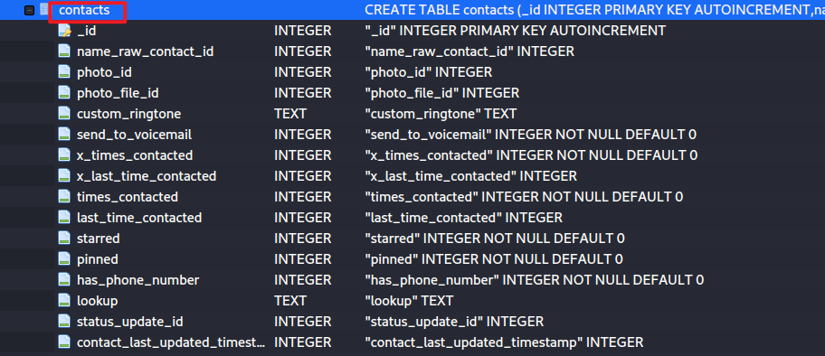
(Alternative)
The last time this contact is contacted. The format is in milliseconds.
The timestamp this contact is updated for the last time.
contact id

Slide 44
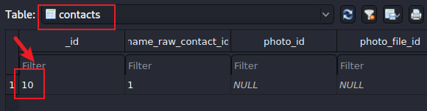
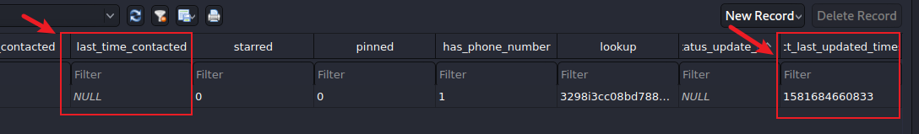

(Alternative) Show rows in contacts table
Notes:
date -d '@1581684660' -u

Slide 45
When a new raw contact entry is added to raw_contacts table

Slide 46
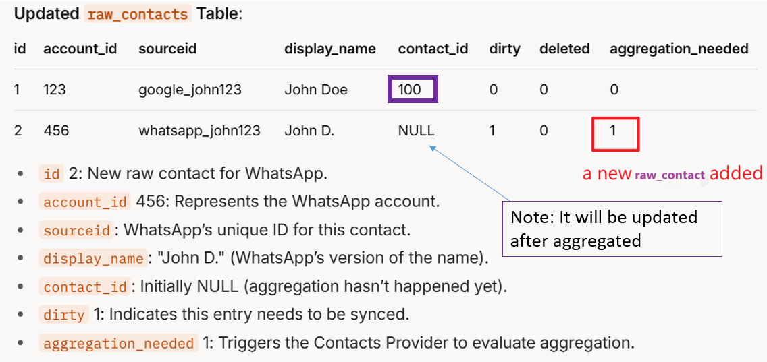

Slide 47
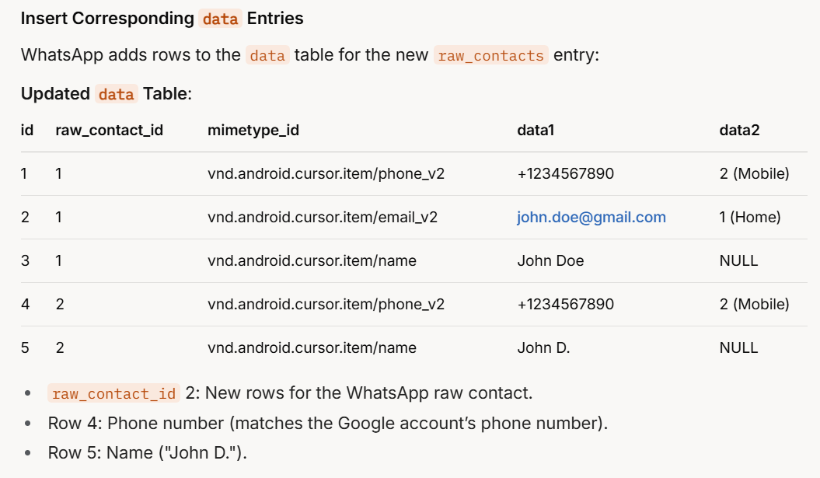
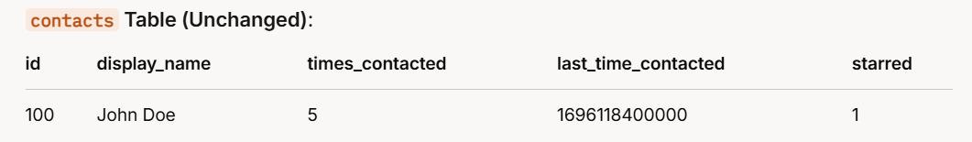



added

Slide 48
groups table

Slide 49
Investigating Contact Groups
Before adding a contact, Android can create or select a contact group.
Groups may reveal user-defined social, family, school, work, or app-specific organization.
Investigative questions: how many groups exist, what are their names, and which contacts belong to each group?
Exam contact group information, e.g., family, friends

Slide 50
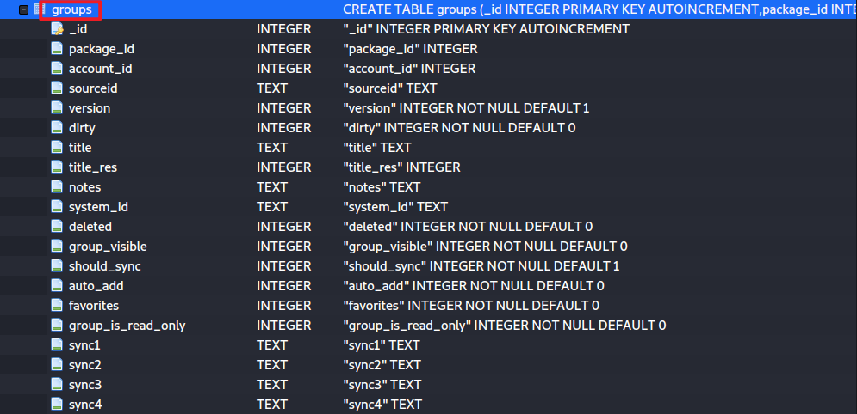
Show group table schema
group description info.

Slide 51
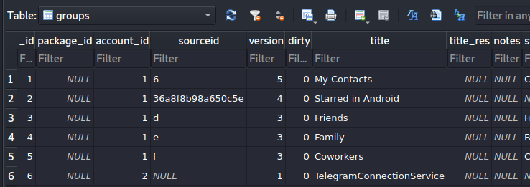
Show 6 groups and the names of the groups
Can you list all contacts in each group?

Slide 52
Investigating calllog.db

Slide 53
Why calllog.db Belongs to Contacts Provider
The Contacts Provider is not only an address book; it also supports person-related communication records.
Dialer and messaging apps use contact lookup APIs to display calls and messages by name.
calllog.db is therefore stored under com.android.providers.contacts.
Forensics: call logs can be joined with contact lookup data to identify callers and recipients.

Slide 54
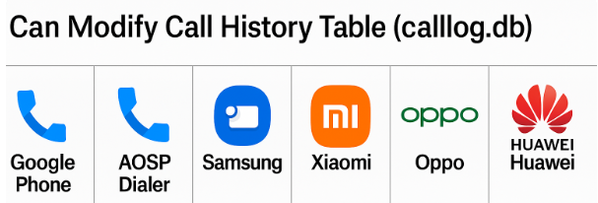
Who Can Affect Android Call Logs?
Apps do not normally write directly to calllog.db.
Android Telecom and CallLogProvider manage call-log records.
The default Phone app and Telecom-integrated calling apps can affect the system call history.
Category | Examples | Can Modify calllog.db? | Typical Action
Phone app |  | ✅ Full read/write | Add, edit, delete calls
Telecom-integrated calling apps | Duo, WhatsApp, Skype, Telegram, Signal | ⚙️ Partial (only pre-Android 10 or if default dialer) | Add VoIP call entries
Forensic takeaway: A calllog.db record may represent either a traditional cellular call or a Telecom-integrated VoIP call. Check fields such as phone_account_component_name before attributing the call to a specific service or app

Slide 55
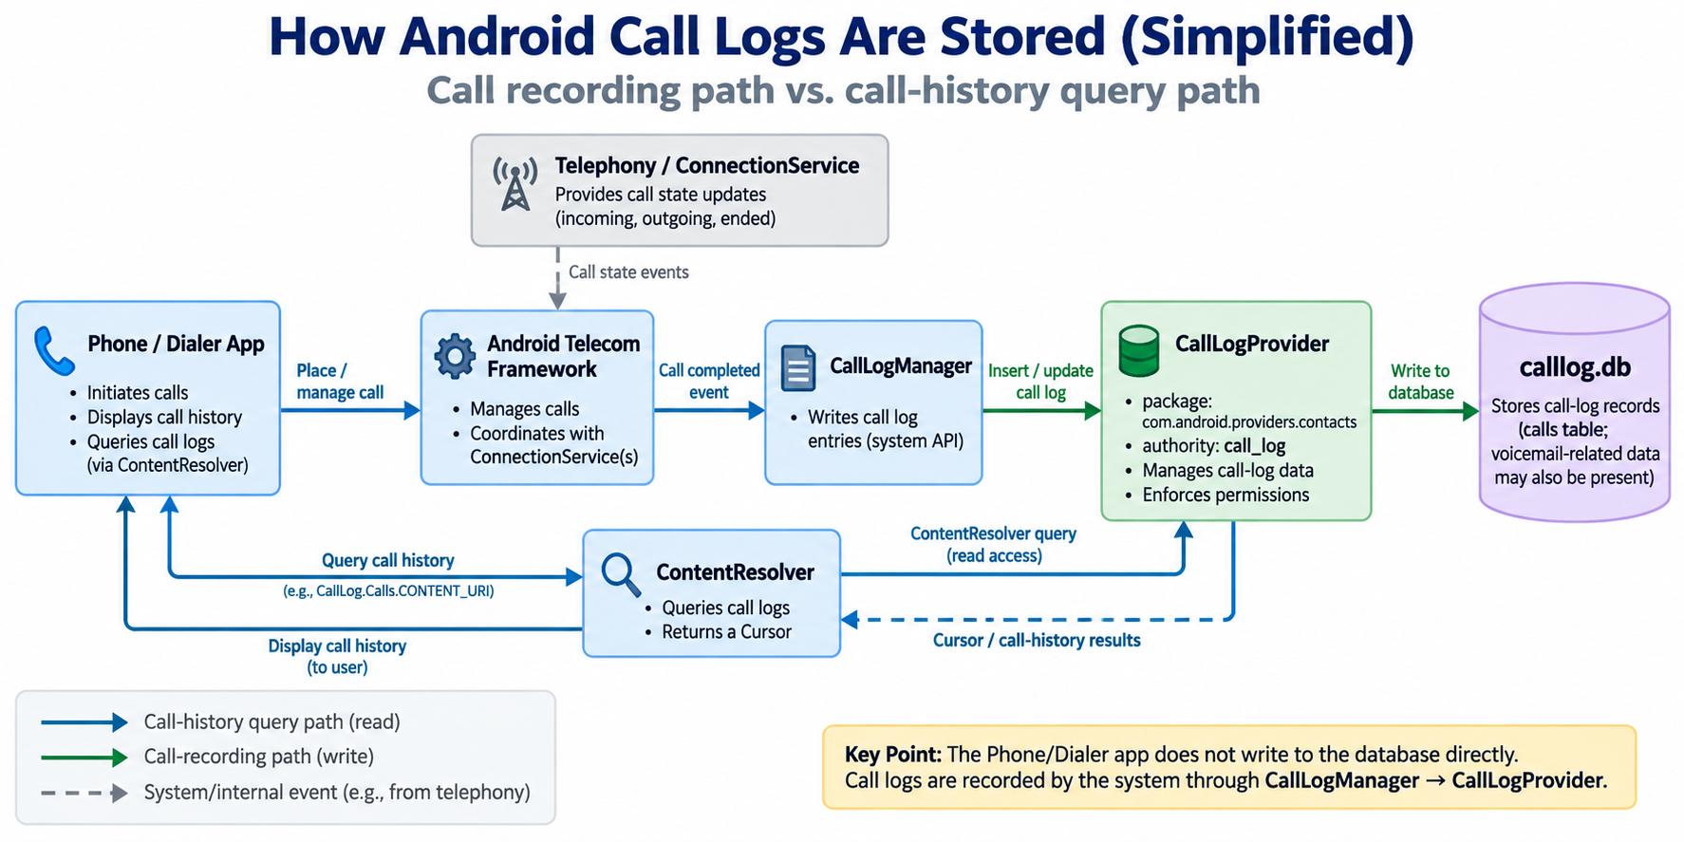
Notes:
digraph CallLogDataFlow {
rankdir=TB;
node [shape=box, style=filled, fillcolor=white, fontname="Helvetica"];
// App Layer
subgraph cluster_app {
label="App Layer (User-Facing)";
color=lightblue;
GoogleDialer [label="Google Dialer\n(com.google.android.dialer)\n- UI actions: view, insert, delete calls\n- Local cache: dialer.db, AnnotatedCallLog"];
}
// Provider Layer
subgraph cluster_provider {
label="Content Provider Layer";
color=lightyellow;
ContactsProvider [label="Contacts Provider\n(com.android.providers.contacts)\nAuthority: content://call_log/calls\n- Database: calllog.db (table: calls)\n- Mediates app access to call history"];
}
// System Layer
subgraph cluster_system {
label="System Service Layer";
color=lightgray;
TelephonyService [label="Telephony Service\n(android.telephony / com.android.phone)\n- Handles SIM, call state, network events"];
IMSService [label="IMS Service\n(com.google.android.ims)\n- Manages VoLTE, VoWiFi, RCS"];
}
// Data Flow
GoogleDialer -> ContactsProvider [label="ContentResolver API\nQuery / Insert / Delete calls", color=blue];
ContactsProvider -> calllogdb [label="SQLite write\n(calllog.db → calls table)", color=darkgreen, style=dotted];
TelephonyService -> ContactsProvider [label="Notify call start/end\n(via framework broadcast)", color=gray];
TelephonyService -> IMSService [label="Forward call events\nfor VoLTE / RCS", color=gray, style=dashed];
// Internal Database Node
calllogdb [shape=cylinder, label="calllog.db\n(owned by com.android.providers.contacts)", fillcolor="#EFEFEF"];
// Return Path
ContactsProvider -> GoogleDialer [label="Cursor / CursorLoader\nreturns call data to UI", color=blue];
}

Slide 56
Call-Log Scenario
Scenario: a call from +19195121037 was made to the device owner on February 12, 2020.
Questions for students:
  What was the approximate time of the call?
  Was the call answered, missed, rejected, blocked, or sent to voicemail?
  If answered, what was the duration?
  Can the number be linked to a saved contact or geographic indicator?

Slide 57
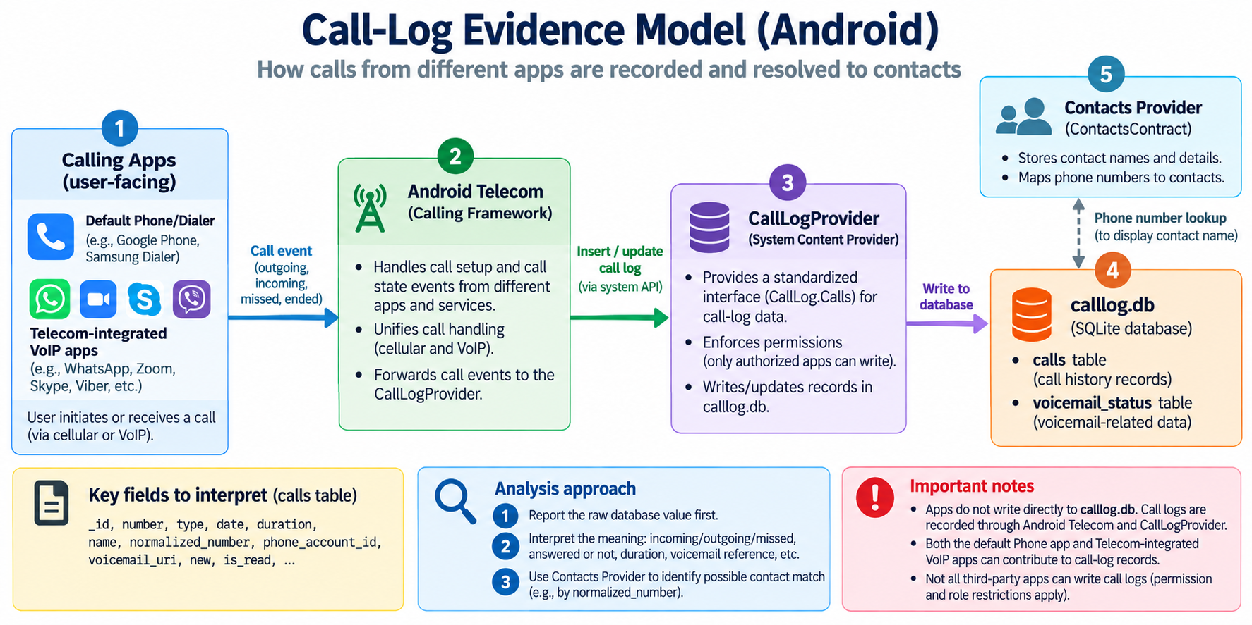

Slide 58
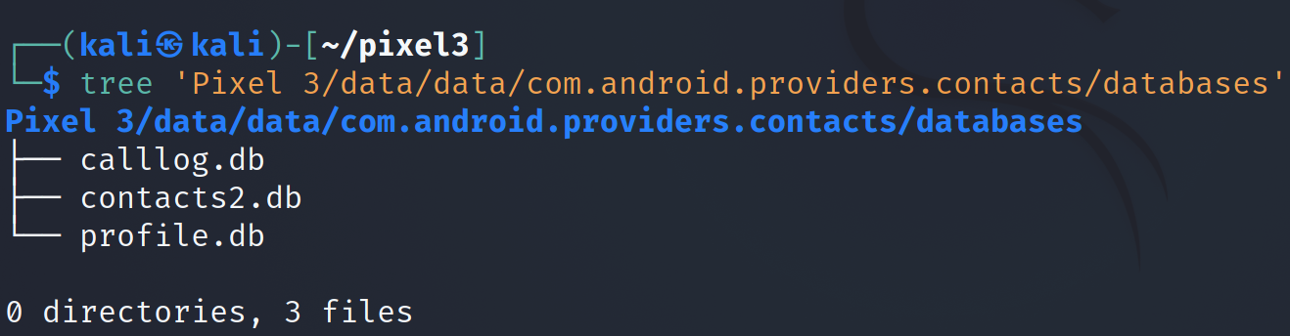
Find the database location
Notes:
Cmd: tree 'Pixel 3/data/data/com.android.providers.contacts/databases'

Slide 59
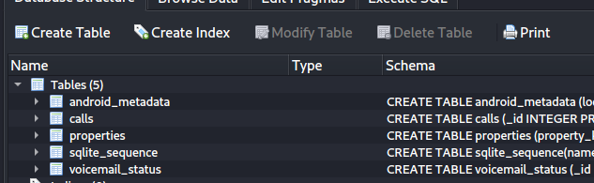
calls Table: Core Evidence Fields
Show all tables in the database
calls: call log. Contains made/received calls along with timestamps and duration

Slide 60
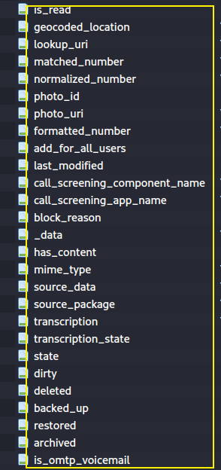
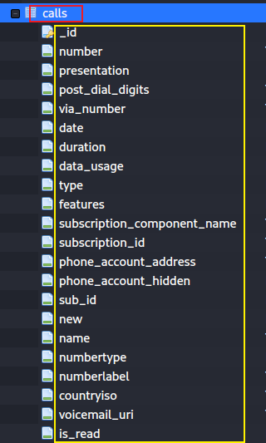
incoming/ outgoing number
if show phone number
Date/time when call was made/received
INCOMING_TYPE
OUTGOING_TYPE
MISSED_TYPE
VOICEMAIL_TYPE
REJECTED_TYPE
BLOCKED_TYPE
ANSWERED_EXTERNALLY_TYPE
phone account id
If it left voicemail, then url to the voice

Slide 61
Column Name | Data Type | Description
_id | INTEGER | Primary key — unique ID for each call record.
number | TEXT | The phone number dialed or received.
post_dial_digits | TEXT | Additional digits dialed after the main number (e.g., extensions).
via_number | TEXT | The intermediate routing number used for the call (if any).
presentation | INTEGER | How the number is presented (e.g., allowed, restricted, payphone).
type | INTEGER | Type of call:1 = Incoming, 2 = Outgoing, 3 = Missed, 4 = Voicemail, 5 = Rejected, 6 = Blocked, 7 = Answered externally.
features | INTEGER | Bitmask of call features (e.g., video, Wi-Fi, assisted dialing).
date | INTEGER | Timestamp (milliseconds since epoch) of when the call began.
duration | INTEGER | Length of the call in seconds.
subscription_id | INTEGER | SIM card slot ID or subscription used for the call.
phone_account_id | TEXT | Identifier of the phone account (SIM, VoIP, etc.) used.
phone_account_component_name | TEXT | Component name of the dialer or VoIP provider.
new | INTEGER | 1 if the call is new/unread, 0 if already viewed.
name | TEXT | Cached contact name at the time of the call (from contacts lookup).
numbertype | INTEGER | Type of number (home, mobile, work, etc.) if matched in contacts.
numberlabel | TEXT | Custom label for the number if applicable.
lookup_uri | TEXT | URI for the matching contact entry (if any).
matched_number | TEXT | Normalized phone number matched from contacts.
normalized_number | TEXT | Normalized E.164 format number.
countryiso | TEXT | Two-letter country code (ISO 3166-1 alpha-2).
geocoded_location | TEXT | Approximate region or city derived from number.
is_read | INTEGER | 1 if the missed call notification has been read.
voicemail_uri | TEXT | URI of the voicemail message (if applicable).
transcription | TEXT | Transcribed voicemail text (if supported).
data_usage | INTEGER | Data usage in bytes for VoIP or Wi-Fi calls.
add_for_all_users | INTEGER | Indicates whether the call log entry should be visible to all users.
block_reason | INTEGER | Reason for call block (e.g., spam, user block).
call_screening_app_name | TEXT | Name of the app that screened the call.

Slide 62
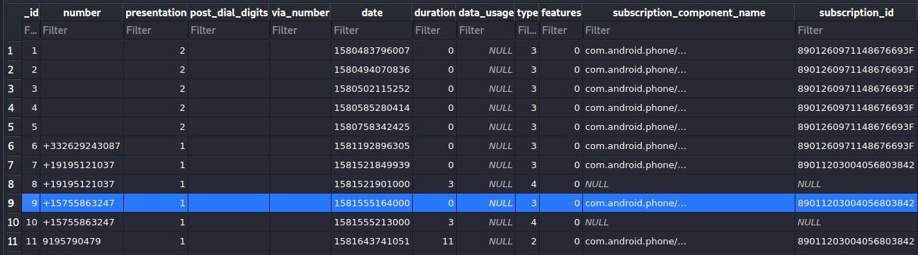
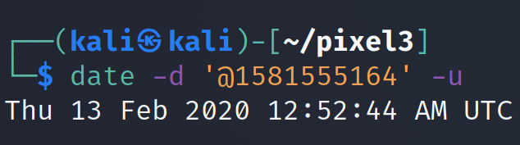
Exam calls table
incoming/ outgoing number
Date/time when call was made/received
missed call
record _id=10 are voicemail type after missed the call (record 9)
Duration of the call
Notes:
https://developer.android.com/reference/android/provider/CallLog.Calls

Slide 63
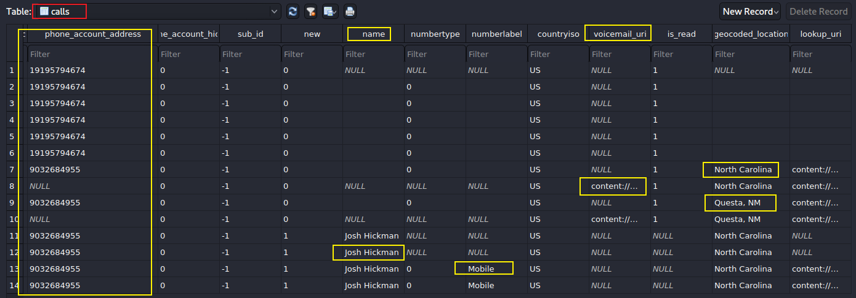

Slide 64
Call-Log Interpretation
The call occurred around February 12, 2020, 4:00 PM in the relevant timezone/context.
The call was not answered if the calls.type value indicates a missed call.
For a missed call, duration is normally 0 seconds.
Report the extracted database values first, then clearly state the interpretation and any assumptions.

Slide 65
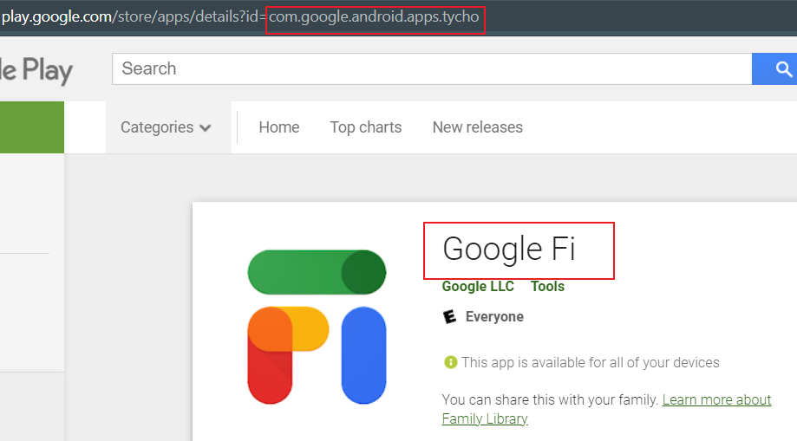
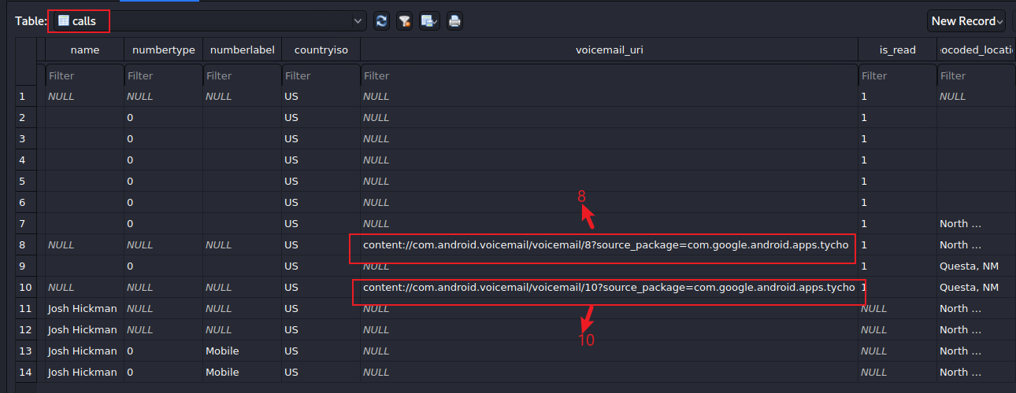
Voicemail Evidence
the owner uses Google FI and it provides voicemail
Find which service provides voicemail

Slide 66
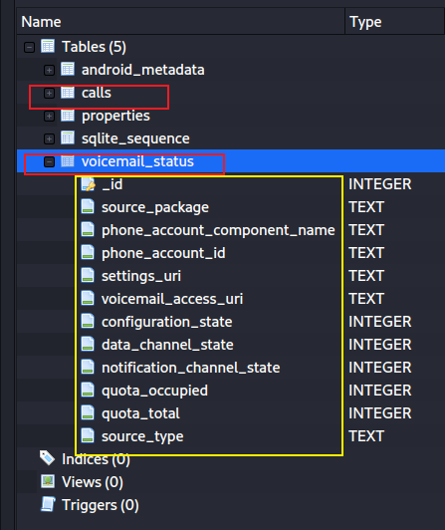
How to access voicemail?
Column Name | Data Type | Description
_id | INTEGER | Primary key — unique identifier for each voicemail status record.
source_package | TEXT | The package name of the app providing voicemail service (e.g., com.google.android.dialer).
phone_account_component_name | TEXT | The component name of the phone account responsible for handling voicemail (e.g., SIM carrier or VoIP provider).
phone_account_id | TEXT | Unique identifier of the specific phone or SIM account associated with this voicemail service.
settings_uri | TEXT | URI pointing to voicemail settings (used to open the voicemail setup screen).
voicemail_access_uri | TEXT | URI or dial string used to access or call the voicemail service directly.
configuration_state | INTEGER | Indicates whether voicemail is properly configured:0 = Not configured, 1 = OK, 2 = Error, 3 = Disabled.
data_channel_state | INTEGER | Status of the data channel used for voicemail retrieval:0 = OK, 1 = No connection, 2 = Server error.
notification_channel_state | INTEGER | Status of the voicemail notification channel:0 = OK, 1 = Blocked or disabled.
quota_occupied | INTEGER | Current space used by stored voicemails (in bytes).
quota_total | INTEGER | Total available voicemail storage quota (in bytes).
source_type | TEXT | Type of voicemail source (e.g., vvm for visual voicemail, carrier for SIM voicemail).
Notes:
The `voicemail_status` table in the Android `calllog.db` database is used to store information about voicemail configurations and status for a device. Based on the screenshot of the table structure you provided, here’s an explanation of the columns in the `voicemail_status` table:
1. **_id**:
A unique identifier for each row in the table. This is typically an auto-incremented integer that serves as the primary key for the table.
2. **source_package**:
The package name of the app or service that provides voicemail functionality (e.g., `com.android.dialer` for the default Android dialer app). It identifies which app is managing the voicemail.
3. **phone_account_component_name**:
The component name of the phone account associated with the voicemail service. This is usually a string representing the class or service handling the phone account, such as `com.android.dialer/com.android.dialer.voicemail.Voസ:VoicemailService`.
4. **phone_account_id**:
A unique identifier for the phone account associated with the voicemail. This links the voicemail status to a specific phone account (e.g., a SIM card or a VoIP account).
5. **settings_uri**:
A URI (Uniform Resource Identifier) that points to the settings screen for configuring voicemail settings. For example, it might direct the user to the voicemail setup page in the dialer app.
6. **voicemail_access_uri**:
A URI that provides access to the voicemail service, such as a phone number or link to retrieve voicemail messages (e.g., a number like `tel:123` to dial into voicemail).
7. **configuration_state**:
Indicates the configuration state of the voicemail service. Possible values might include:
- `0`: Not configured
- `1`: Configured
- `2`: Configuration error
This shows whether the voicemail service is properly set up and ready to use.
8. **data_channel_state**:
Represents the state of the data channel used for visual voicemail (if supported). Visual voicemail allows users to see a list of voicemail messages and play them selectively. Possible values might include:
- `0`: Not available
- `1`: Available
This indicates whether the data channel for fetching voicemail data is functional.
9. **notification_channel_state**:
Indicates the state of the notification channel for voicemail. This determines if the device can receive notifications about new voicemail messages. Possible values might include:
- `0`: Not available
- `1`: Available
This shows whether voicemail notifications are supported and active.
10. **quota_occupied**:
The amount of storage space (in bytes) currently used by voicemail messages. This is relevant for visual voicemail systems that store messages locally or on a server with limited space.
11. **quota_total**:
The total amount of storage space (in bytes) available for voicemail messages. This helps determine how much space is left for new voicemail messages.
12. **source_type**:
Specifies the type of voicemail source. This might indicate whether the voicemail is provided by the carrier, a third-party app, or another service. Possible values could include:
- `0`: Carrier-provided
- `1`: App-provided
- Other values depending on the system.
### Summary:
The `voicemail_status` table tracks the status and configuration of voicemail services for each phone account on an Android device. It includes identifiers, URIs for accessing settings and voicemail, states for configuration, data, and notifications, as well as storage quota information. This allows the Android system to manage and display voicemail functionality effectively.
If you need more details about any specific column or Android database structure, let me know! I can also search for additional information if needed.

Slide 67
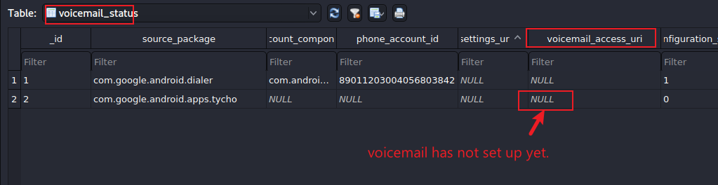
Find voicemail access url

Slide 68
Evidence Handling: Contacts and Call Logs
Contacts, call logs, voicemail references, and profile records are sensitive personal data.
Minimize disclosure: include only fields needed to support the investigative question.
Preserve provenance: record database name, table name, row ID, query, timestamp conversion method, and screenshot/query output.
Separate fact from interpretation: “calls.type = 3” is the database value; “missed call” is the interpretation.
Document limitations: deleted flags, NULL values, sync artifacts, time zones, and app-specific behavior may affect conclusions.

Slide 69
Investigating profile.db

Slide 70
Investigating profile.db
profile.db stores the device owner’s “Me” profile separately from ordinary contacts.
It may contain the owner’s name, phone number, email address, photo, and account-linked profile information.
Its structure mirrors contacts2.db, with tables such as raw_contacts, data, and mimetypes.
Forensics: profile.db can help identify the device owner, but it contains sensitive personal data.
Notes:
The `profile.db` file in the `com.android.providers.contacts` directory on an Android device is a SQLite database that stores the user's personal profile information, separate from the main contacts database (`contacts2.db`). This file is part of the Android Contacts Provider, which manages contact-related data on the device.
### Location and Purpose
The `profile.db` file is typically located at `/data/data/com.android.providers.contacts/databases/profile.db`. It is used to store the device owner's personal information, such as their name, email, phone number, and other details that are part of the "My Profile" or "Me" contact entry in the Contacts app. This separation allows the system to manage the user's profile distinctly from other contacts while maintaining a similar structure for easier integration with the Contacts Provider.
### Structure and Relation to `contacts2.db`
The structure of `profile.db` mirrors that of `contacts2.db`, which is the primary database for storing all other contacts on the device. Both databases are managed by the Contacts Provider and contain similar tables, such as:
- **raw_contacts**: Stores individual entries for the profile (e.g., the user's own contact info).
- **data**: Holds specific details like phone numbers, emails, and addresses, linked to the `raw_contacts` entries.
- **mimetypes**: Defines the types of data stored in the `data` table (e.g., phone number, email).
The key difference is that `profile.db` is dedicated solely to the user's profile, while `contacts2.db` contains data for all other contacts. This separation ensures that the user's profile can be accessed and managed independently, often with special permissions or restrictions, as it may be tied to system-level features like caller ID or account syncing.
### Why a Separate Database?
Using a separate `profile.db` allows Android to:
- **Enhance Security and Privacy**: The user's profile data can be isolated, potentially with stricter access controls, since it often contains sensitive personal information.
- **Simplify Syncing**: The profile can be synced separately with services like Google Contacts, ensuring that the "Me" contact is consistently updated across devices without affecting other contacts.
- **Optimize Performance**: Keeping the user's profile separate avoids cluttering the main contacts database, which might contain hundreds or thousands of entries.
### Accessing `profile.db`
Accessing `profile.db` typically requires root privileges because it resides in the protected `/data/data/` directory. You can pull the file using ADB (Android Debug Bridge) with commands like:
```
adb root
adb pull /data/data/com.android.providers.contacts/databases/profile.db
```
Once obtained, you can use a SQLite database browser (e.g., DB Browser for SQLite) to inspect its contents. However, direct access to this database is not intended for most apps or users; instead, the Contacts Provider API should be used to interact with profile data programmatically.
### Practical Use
The profile data in `profile.db` is what populates the "Me" card in the Contacts app. It’s often linked to the primary Google account on the device and can be accessed or modified via the Contacts app or through APIs like `ContactsContract.Profile`. For example, to retrieve the user’s profile programmatically, you can query the `ContactsContract.Profile.CONTENT_URI` without any selection criteria, as noted in Android documentation.
### Sources
This explanation is based on information from Android developer documentation and community discussions about the Contacts Provider database structure. Specifically, the role of `profile.db` is mentioned in contexts discussing the Contacts Provider’s architecture and database management. For further details, you can refer to the Android Developer documentation on the Contacts Provider.[](https://developer.android.com/identity/providers/contacts-provider)[](https://xianminx.github.io/2012/06/24/android-contact-provider-in-deep/)[](https://www.programmersought.com/article/5920369126/)

Slide 71
Chapter Summary
Contacts Provider centralizes people, accounts, contact fields, groups, profile data, and call-log integration.
contacts2.db supports relationship reconstruction through accounts, raw_contacts, contacts, data, mimetypes, groups, and lookup tables.
calllog.db records call events; key evidence fields include number, type, date, duration, voicemail_uri, and phone_account_id.
profile.db may identify the device owner and should be treated as highly sensitive evidence.
Strong reports cite table names, row IDs, join conditions, query outputs, and interpretation assumptions.

Slide 72
Assignment
Investigate profile.db and write a short forensic report.
Answer the following questions:
  How many tables does the database contain?
  How many records are in each table?
  What personal information, if any, is present?
  If no personal information is found, explain the evidence supporting that conclusion.
Include screenshots or query outputs that support your claims.

