Slide 1
Pixel 3 GMS App Investigations
Part 3: GMS Google Maps
Notes:
https://digitalcorpora.s3.amazonaws.com/corpora/mobile/android_10/Non-Cellebrite%20Extraction/Pixel%203.zip

Slide 2
Learning Objectives
Locate Google Maps application artifacts in an Android extraction.
Triage the major Maps databases and file-based artifacts in this Pixel 3 dataset.
Interpret saved-place, navigation, synchronization, and photo-location records.
Decode coordinates, timestamps, and serialized BLOB data without overstating what the evidence proves.
Build a defensible workflow that distinguishes artifact observation from behavioral inference.

Slide 3
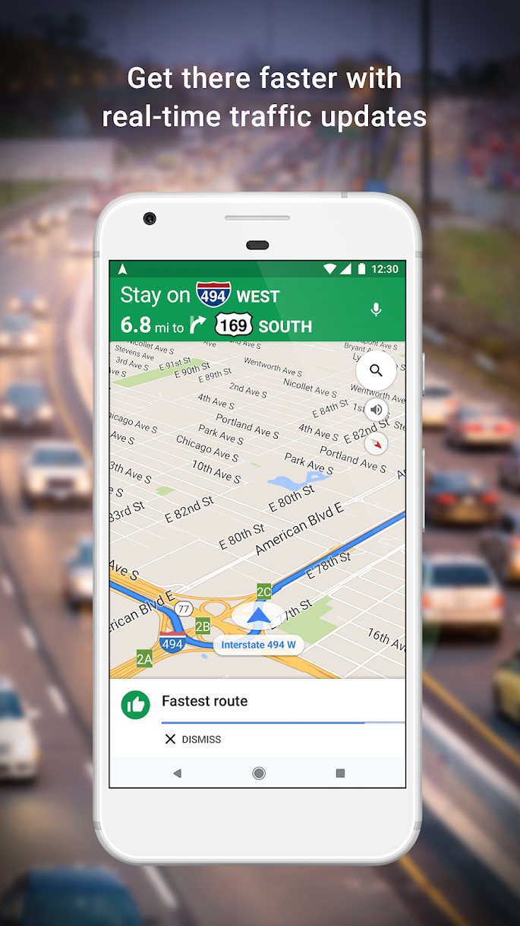
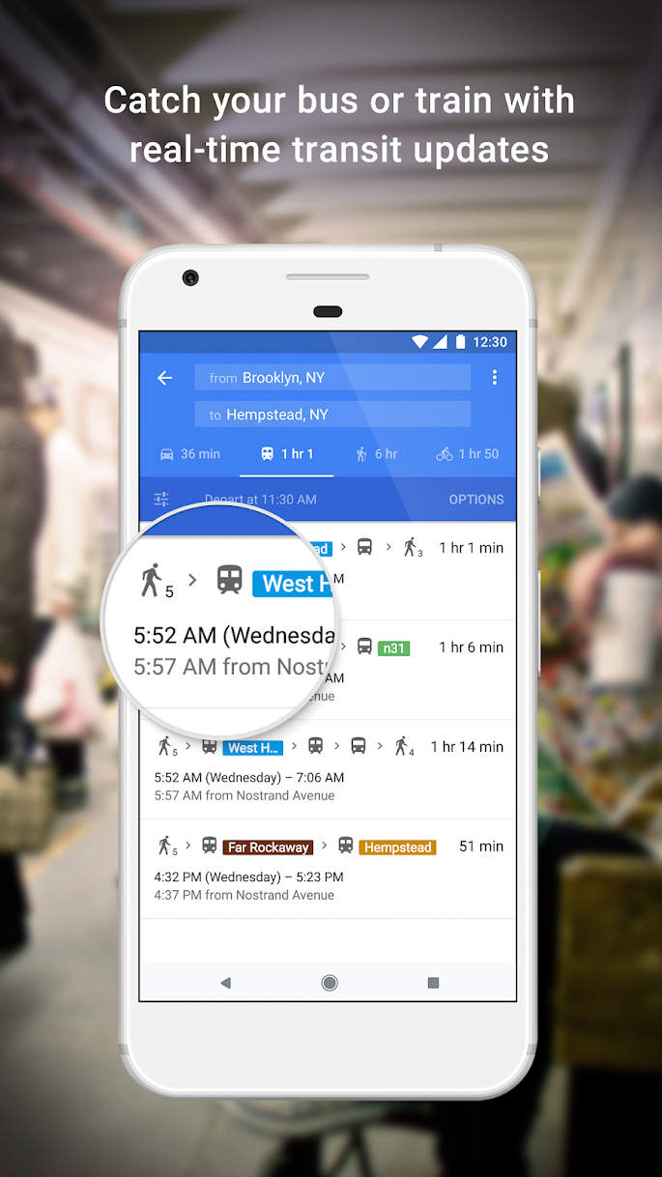
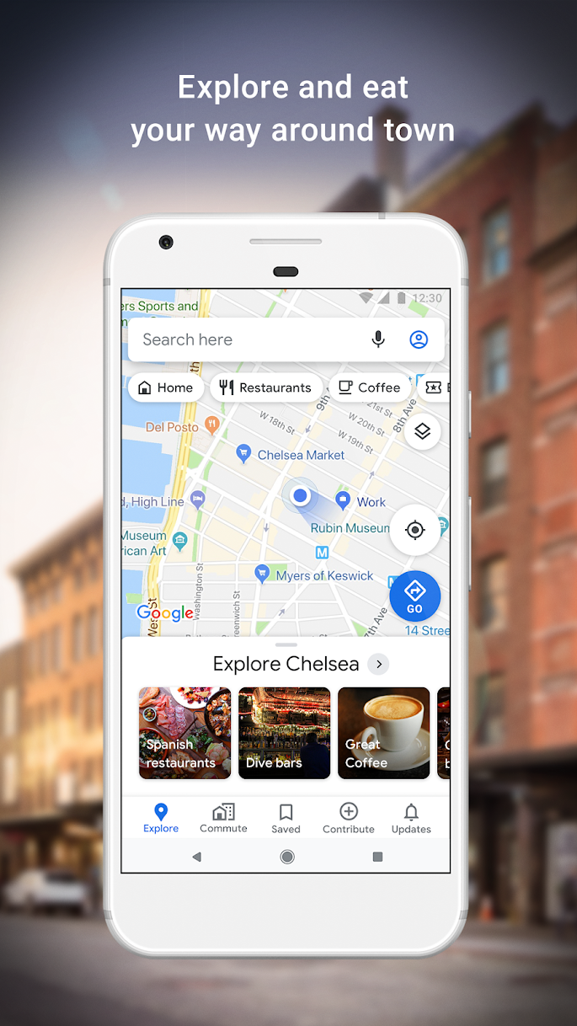

Google Maps as a Forensic Evidence Source
User actions such as searching, saving places, navigation, synchronization, and offline use may leave local artifacts.

Slide 4


From User Action to Forensic Artifact
Search for a place
Recover search-related location data
Save / label a place
Local databases / files
Recover saved-place coordinates
Request a route
Download offline content
Recover route / navigation artifacts
Navigation
…
Contribute / provide feedback
Potential forensic questions
Examples of user actions
Notes:
https://www.geos.ed.ac.uk/~mscgis/11-12/s1104136/design.htm

Slide 5
Questions Google Maps Artifacts Can Help Address
Which locations are represented in saved-place, search, or navigation artifacts?
Were offline map or offline-direction artifacts stored on the device?
What origin and destination were associated with a route or navigation session?
What route, distance, duration, or travel mode was recorded?
What timestamps can be correlated with other device evidence?
Do the artifacts support a completed navigation session, a planned route, or only a search?
Can the location evidence be corroborated with other sources before inferring physical presence?

Slide 6
Interpretation Ladder for Google Maps Evidence
Use the same structure when explaining every screenshot and database record
1. Observe
2. Decode
3. Contextualize
4. Corroborate
5. Report limits
What table, file, key, row, or field is present?
Can raw values be converted: E6 coordinates, timestamps, serialized BLOBs?
Which app feature likely produced the artifact: saved place, route, offline map, notification, sync?
Can another table, file, timestamp, account artifact, or device log support the same event?
State what the artifact shows and what it does not prove by itself.

Slide 7
Section 1
Locate and Triage the Evidence
Package directory, databases, and initial investigative questions

Slide 8
Locate the Google Maps Application Directory
Application package: com.google.android.apps.maps

Slide 9
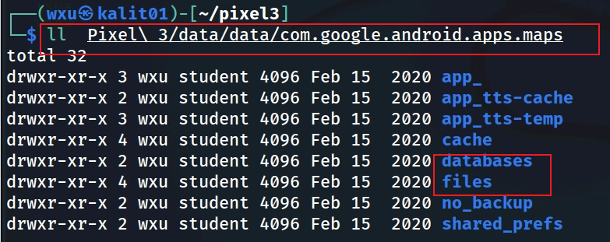
Notes:
Cmd: tree 'Pixel 3/data/data/com.google.android.apps.maps' -L 1

Slide 10
Forensic Evidence Categories
Saved locations: saved or labeled places.
Navigation / offline use: navigation and offline artifacts.
Synchronization metadata : show when and what data was synced, potentially linking to other devices or backups.
Notifications / event databases: reveal how the user interacts with the app and what notifications they received
User-generated photo metadata
Corroboration rule — a stored coordinate or route can reflect a search, saved place, or planned trip; it does not by itself prove the device physically visited that location.

Slide 11
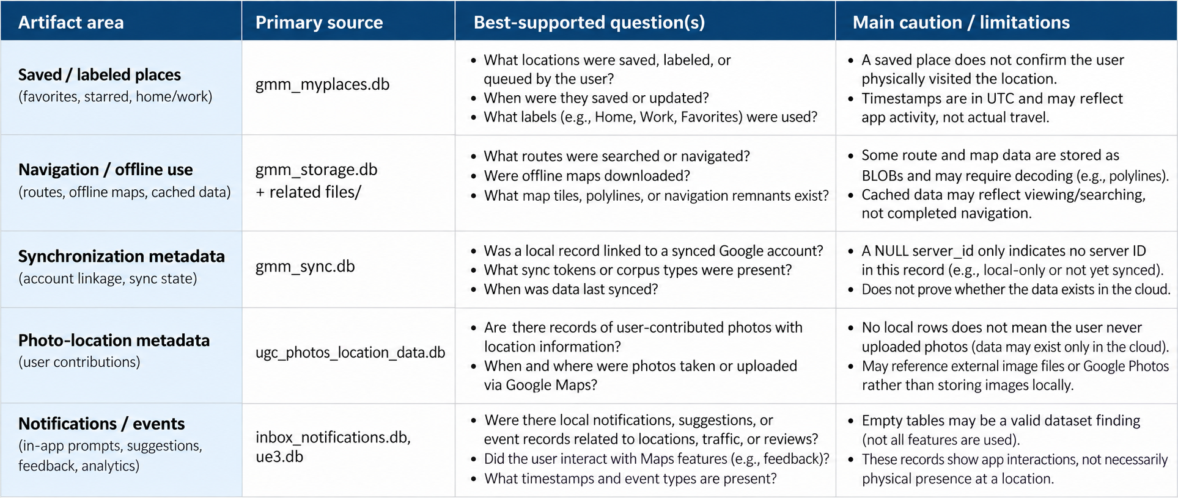
Clean Artifact Triage Matrix

Slide 12
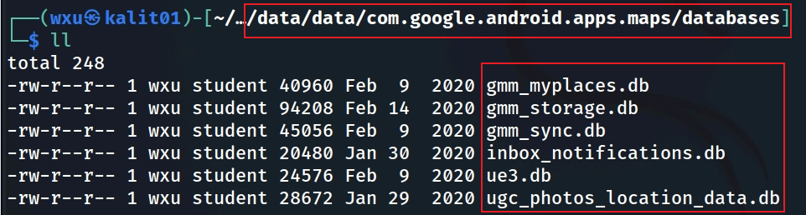
Enumerate Google Maps Databases
Show Google Maps databases
Notes:
Cmd: tree 'Pixel 3/data/data/com.google.android.apps.maps/databases'

Slide 13
Database Triage: What to Examine First
File Name | Purpose | Forensic Evidence Contained
gmm_myplaces.db | 💾 Stores My Places and Saved Locations (favorites, starred, labeled places). | - User-saved home/work/“starred” locations- Favorites and “Want to go” lists- Custom-labeled addresses- Timestamps of save/update
gmm_storage.db | 📦 General storage for cached data — search queries, recent views, temporary map tiles. | - Recently searched addresses and coordinates- Cached routes or viewed POIs- Session timestamps
gmm_sync.db | 🔄 Sync metadata for account-linked data between device and Google cloud. | - Sync tokens, account IDs- Flags for what was synced (My Places, history)- Useful for proving account linkage
inbox_notifications.db | 🔔 Stores notifications generated by Maps (traffic, new place suggestions, reviews). | - Notification text & timestamps- Links to suggested routes or reviews- May show user interaction with Google recommendations
ue3.db | 📍 “User Events 3” — captures certain local analytics or trip/session data. | - Location coordinates- Movement events- Session identifiers (used for timeline/trip reconstruction)
ugc_photos_location_data.db | 🖼 “User Generated Content” — metadata for photos tagged with location info. | - Image filenames or URIs- Associated latitude/longitude- Timestamps- Links to Google Photos/Maps uploads
Notes:
Summary of Each Database:
DatabaseLikely PurposeInvestigation Valuegmm_myplaces.dbStores user’s saved places (favorites, starred locations, lists).Reveals important locations, travel history, and personal interests.gmm_storage.dbStores miscellaneous app data (cached maps, user preferences, offline map metadata).Shows user preferences, offline map usage, and app interaction patterns.gmm_sync.dbManages synchronization of Google Maps data (saved places, history) with the user’s Google account.Indicates sync activity, cross-device usage, and potential data recovery.inbox_notifications.dbStores notifications or in-app messages (e.g., traffic alerts, contribution prompts).Reveals user interactions, location-based alerts, and contribution behavior.ue3.dbLikely stores user experience data (A/B testing, feedback, usage metrics).Provides behavioral insights, feedback on locations, and feature usage patterns.ugc_photos_location_data.dbManages user-uploaded photos and their location data for Google Maps contributions.Shows where the user has been, timestamps of visits, and potential visual evidence via photos.

Slide 14
Section 2
Saved Places and Coordinate Artifacts
gmm_myplaces.db, E6 coordinates, and serialized records

Slide 15
Saved-place and sync-related artifacts
Location Tracking: gmm_myplaces.db

Slide 16
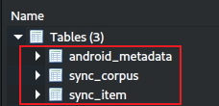
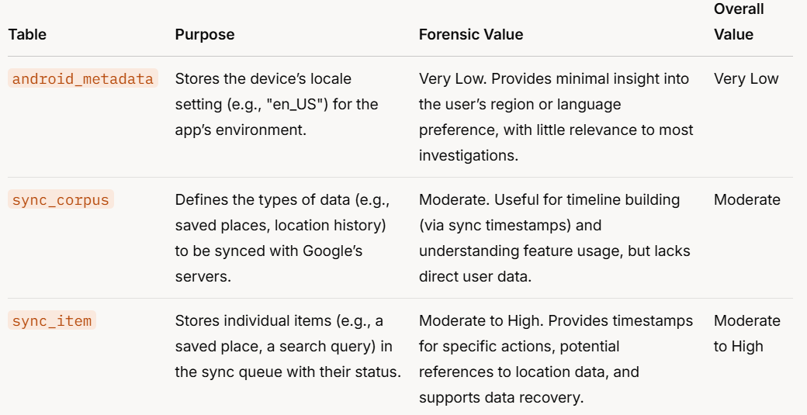
A corpus groups a category of data managed by the application sync mechanism.
A sync item represents one record associated with that corpus; its meaning must be established from schema and decoded content.

Slide 17
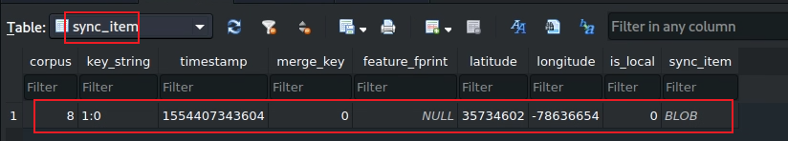
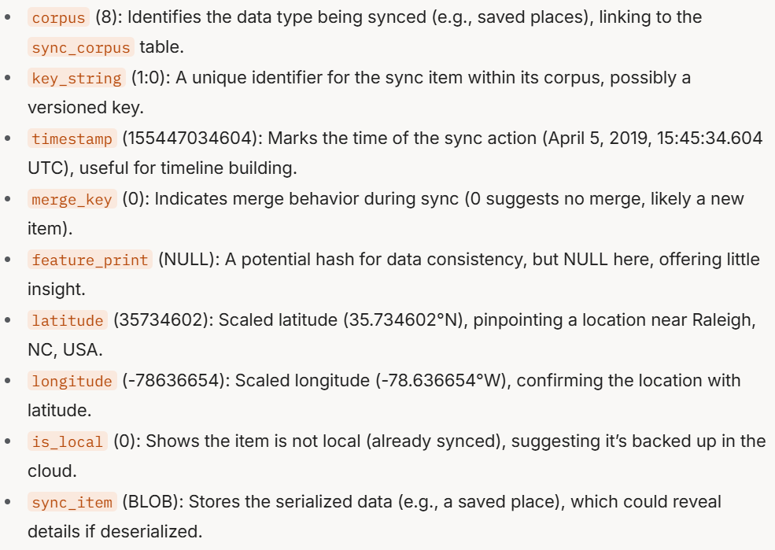
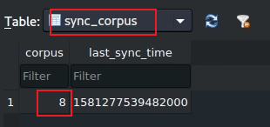
Inspect the sync_item Record and Serialized Data
Notes:
corpus (8): Identifies the data type being synced (e.g., saved places), linking to the sync_corpus table. key_string (1:0): A unique identifier for the sync item within its corpus, possibly a versioned key. timestamp (155447034604): Marks the time of the sync action (April 5, 2019, 15:45:34.604 UTC), useful for timeline building. merge_key (0): Indicates merge behavior during sync (0 suggests no merge, likely a new item). feature_print (NULL): A potential hash for data consistency, but NULL here, offering little insight. latitude (35734602): Scaled latitude (35.734602°N), pinpointing a location near Raleigh, NC, USA. longitude (-78636654): Scaled longitude (-78.636654°W), confirming the location with latitude. is_local (0): Shows the item is not local (already synced), suggesting it’s backed up in the cloud. sync_item (BLOB): Stores the serialized data (e.g., a saved place), which could reveal details if deserialized.

Slide 18
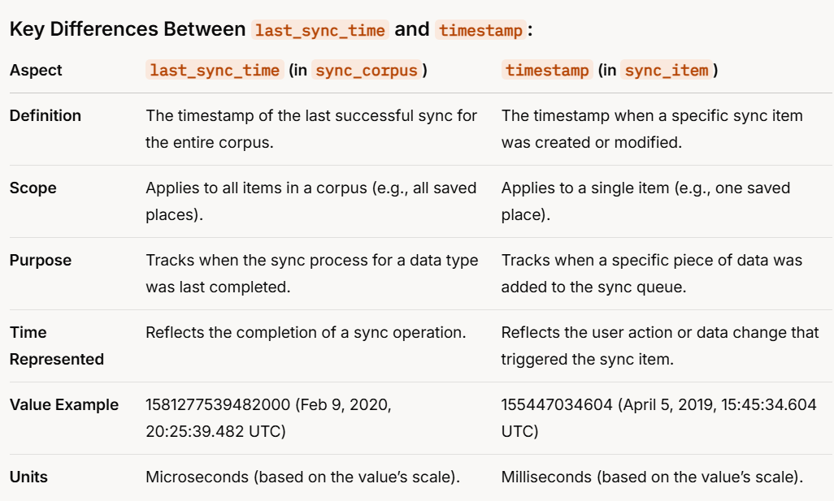
Interpret sync_corpus vs. sync_item Timestamps
Notes:
Key Differences Between last_sync_time and timestamp:
Aspectlast_sync_time (in sync_corpus)timestamp (in sync_item)DefinitionThe timestamp of the last successful sync for the entire corpus.The timestamp when a specific sync item was created or modified.ScopeApplies to all items in a corpus (e.g., all saved places).Applies to a single item (e.g., one saved place).PurposeTracks when the sync process for a data type was last completed.Tracks when a specific piece of data was added to the sync queue.Time RepresentedReflects the completion of a sync operation.Reflects the user action or data change that triggered the sync item.Value Example1581277539482000 (Feb 9, 2020, 20:25:39.482 UTC)155447034604 (April 5, 2019, 15:45:34.604 UTC)UnitsMicroseconds (based on the value’s scale).Milliseconds (based on the value’s scale).

Slide 19
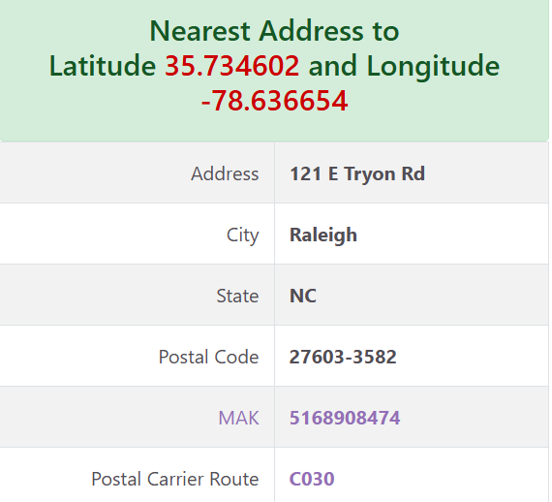

Decode E6 Coordinates
E6 coordinates are stored in microdegrees:
latitude = lat_e6 / 1,000,000
longitude = long_e6 / 1,000,000
After conversion, map or geocode the coordinate and document the service used.

Slide 20
Coordinate and Timestamp Validation Checklist
A stricter process for avoiding overclaiming
Coordinate validation
Timestamp validation
Confirm the field name and scale: E6 = value / 1,000,000.
Preserve the raw integer and the converted decimal coordinate in notes.
Identify the unit: seconds, milliseconds, microseconds, or app-specific encoding.
Flag negative, zero, or far-future values as suspicious until decoded.
Mapping validation
Inference validation
Record the mapping/geocoding service used.
Do not substitute a nearby place name for the exact coordinate without documenting uncertainty.
A coordinate can represent a searched place, saved place, route endpoint, cached resource, or sync artifact.
Physical presence requires corroboration.

Slide 21
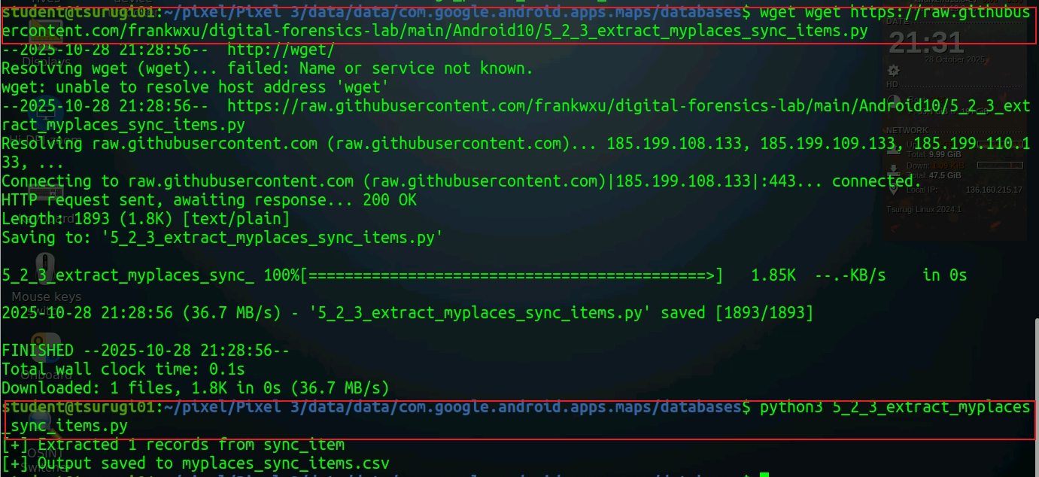
Decode the Serialized BLOB with Python
Notes:
wget https://raw.githubusercontent.com/frankwxu/digital-forensics-lab/main/Android10/5_2_3_extract_myplaces_sync_items.py
nano extract_myplaces_sync_items.py # paste the code above
python3 extract_myplaces_sync_items.py # execute

Slide 22
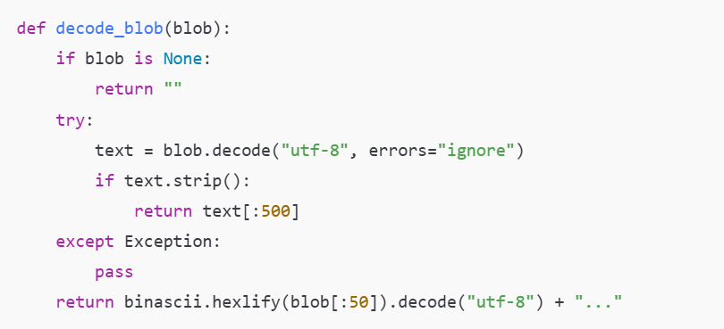
BLOB-Decoding Logic

Slide 23
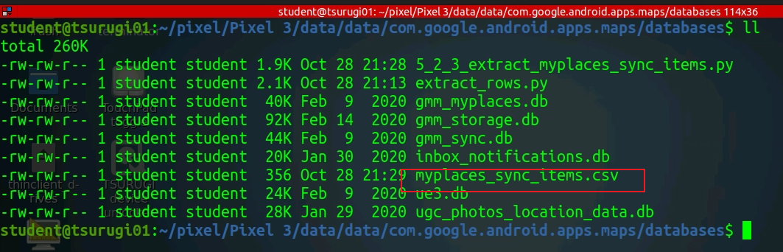
Validate the Decoded Output
Decoded blob

Slide 24
Section 3
Navigation and Offline Storage
gmm_storage.db and navigation-related key–value records

Slide 25
Travel planning, navigation, and offline-storage artifacts
Travel Planning: Offline Map information: gmm_storage.db

Slide 26
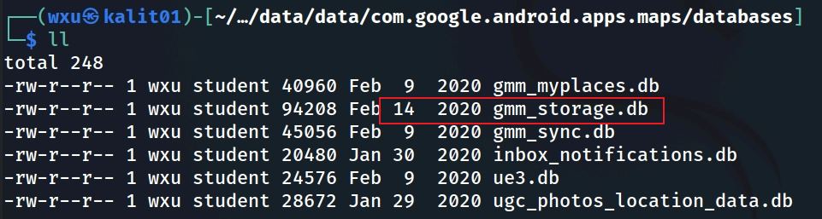
Inspect gmm_storage.db and gmm_storage_table
gmm_storage_table

Slide 27
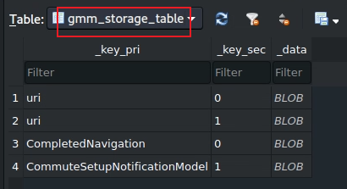
gmm_storage_table: Key–Value Structure
Stores miscellaneous app data in a key-value format
  key_pri, key_sec, and data (BLOB).
The table contains four rows, and the evidence that can be extracted
  key_pri = "uri“ (map-related resources (e.g., map tiles, offline maps)
  key_pri = "CompletedNavigation“ (a completed navigation session)
  key_pri = "CompletedNavigationSETUP_NOTIFICATION_MODEL" (notification settings or state post-navigation)
Treat the key name as a lead, not a complete interpretation: examine the associated BLOB and surrounding records.
Preserve the raw database before decoding or transforming values.

Slide 28
What the BLOB May Reveal After Decoding
uri — may reference map-related or offline resources (regions, expiration dates); determine the URI type from decoded content.
CompletedNavigation — may contain navigation-session fields such as origin/destination coordinates, distance, duration, mode, or timestamps.
CompletedNavigationSETUP_NOTIFICATION_MODEL — may contain post-navigation notification state or related metadata.
Interpretation caution — field presence and meaning depend on the app version and serialization schema. Validate against the actual decoded record.
Notes:
The `gmm_storage_table` in the `gmm_storage.db` database (from Google Maps on a Pixel 3) stores miscellaneous app data in a key-value format with columns `key_pri`, `key_sec`, and `data` (BLOB). The table contains four rows, and the evidence that can be extracted is summarized below, focusing on its forensic value in a digital investigation.
---
### Evidence Extracted from `gmm_storage_table`:
1. **Travel History (from "CompletedNavigation" Row):**
- **Evidence:** The row with `key_pri` = "CompletedNavigation" indicates a completed navigation session. If the `data` BLOB is deserialized, it may reveal:
- Start and end coordinates (latitude/longitude) of the route.
- Route details (e.g., distance, duration, mode of transport like driving or walking).
- Timestamps for when the navigation started and ended.
- **Forensic Value:** High (if BLOB is deserialized).
- **Location Insight:** Pinpoints where the user traveled, providing direct evidence of their movements.
- **Timeline Building:** Timestamps can establish when the travel occurred.
- **Behavioral Insight:** Indicates the user was traveling, potentially revealing their habits (e.g., frequent driving).
2. **User Interaction with Notifications (from "CompletedNavigationSETUP_NOTIFICATION_MODEL" Row):**
- **Evidence:** The row with `key_pri` = "CompletedNavigationSETUP_NOTIFICATION_MODEL" stores notification settings or state post-navigation. If the BLOB is deserialized, it may reveal:
- The type of notification shown (e.g., "You’ve arrived" or "Rate your trip").
- User interaction (e.g., dismissed, tapped, or responded to a feedback prompt).
- Timestamp of when the notification was shown.
- **Forensic Value:** Moderate to High (if BLOB is deserialized).
- **Behavioral Insight:** Shows how the user engaged with the app after navigation (e.g., ignoring feedback prompts might suggest disinterest).
- **Timeline Building:** Notification timestamp can pinpoint when the navigation ended and the user interacted with the app.
- **User Engagement:** Reflects the user’s interaction with Google Maps features.
3. **Travel Planning or App Resource Usage (from "uri" Rows):**
- **Evidence:** The two rows with `key_pri` = "uri" (with `key_sec` = 0 and 1) likely store URIs for map-related resources (e.g., map tiles, offline maps). If the BLOBs are deserialized, they may reveal:
- URIs for offline map data, indicating regions the user downloaded.
- Metadata like expiration dates or regions associated with the URIs.
- **Forensic Value:** Low to Moderate.
- **Travel Planning:** Offline map URIs can suggest areas the user planned to visit, especially if they downloaded maps for regions with poor connectivity.
- **App Usage:** Indicates how the app manages resources, but this is less directly relevant to user behavior.
---
### Overall Forensic Value:
- **Rating (from Previous Analysis):** 5/10
- **Rank (from Previous Analysis):** 5th (tied with `ue3.db`).
- **Summary of Evidence:**
- **Location and Travel History:** The "CompletedNavigation" row can provide route details, start/end points, and timestamps, revealing where and when the user traveled.
- **Behavioral Insights:** Notification data ("CompletedNavigationSETUP_NOTIFICATION_MODEL") shows user interaction post-navigation, while navigation itself indicates travel habits.
- **Travel Planning:** URI data might reveal offline map usage, suggesting planned travel to specific regions.
- **Timeline Building:** Timestamps in the BLOBs (e.g., navigation end time, notification time) can help establish user activity timelines.
- **Limitations:** The BLOB format requires deserialization to access detailed data, limiting immediate insights. The table’s focus on app-centric data (rather than direct user-generated content like photos or saved places) makes it less valuable compared to other databases like `ugc_photos_location_data.db` or `gmm_myplaces.db`.

Slide 29
Section 4
Synchronization Metadata
gmm_sync.db and cross-database correlation

Slide 30
Synchronization metadata and cross-database correlation
Map data Synchronization: gmm_sync.db

Slide 31
gmm_sync.db: Purpose and Investigative Role
Contains local metadata used by Google Maps synchronization mechanisms.
Can link records to corpora, client/server identifiers, coordinates, and timestamps when those fields are populated.
Use it to correlate locally stored sync metadata with artifacts in other Maps databases.
Do not infer cloud availability solely from one local field; corroborate sync status with related records and account evidence.
Notes:
Cmd: sqlitebrowser 'Pixel 3/data/data/com.google.android.apps.maps/databases/gmm_sync.db'

Slide 32
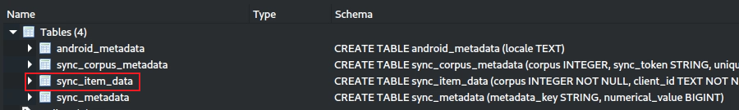
sync_item_data: Fields to Examine
The sync_item_data table
  Stores individual items that need to be synchronized between the device and Google’s servers as part of the Google Maps app’s sync process.
  Each row represents a specific piece of data (e.g., a saved place, a location history entry, or user settings) queued for sync.
Role in Google Maps
  This table acts as a sync queue, tracking items that have been created or modified on the device and need to be uploaded to Google’s servers (or downloaded from the server to the device).
  It includes detailed metadata like location coordinates, timestamps, and client/server IDs to manage the sync process.
Notes:
Cmd: sqlitebrowser 'Pixel 3/data/data/com.google.android.apps.maps/databases/gmm_sync.db'

Slide 33
Synchronization Interpretation Cautions
The sync database is useful, but several fields are easy to overread
corpus
client_id / server_id
timestamp / coordinates
Treat numeric corpus values as categories to be resolved through related tables, schema, or decoded content.
Do not label a corpus only from intuition.
A server_id can support cloud-linkage analysis.
A NULL server_id means no server identifier is present in that row; it does not prove cloud absence everywhere.
Validate timestamp scale before timeline use.
Coordinates identify an artifact location context, not automatically user presence.

Slide 34
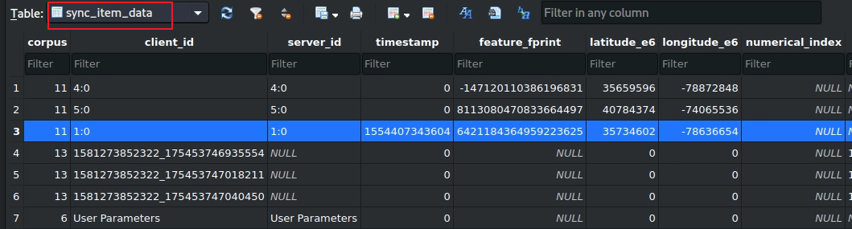

Correlate sync_item_data with gmm_myplaces.db
sync information
Interpretation:
• Rows with valid coordinates can identify locations associated with a sync record.
• A valid timestamp can support timeline correlation; invalid or zero values should not be forced into a date.
• Use corpus IDs and client/server IDs to cross-reference related records.
• A coordinate associated with a saved/synced record does not, by itself, prove physical presence.
sync_item table in gmm_myplaces.db
Summary:
The sync_item_data table provides valuable location data (Rows 1–3) and timeline insights (Row 3), particularly for tracking user movements (e.g., Raleigh, NC, and NYC).
Pending sync items (Rows 4–6) offer potential insights into user contributions and data recovery, while user settings (Row 7) are less useful.
Notes:
The image shows the schema and data of the `sync_item_data` table in the `gmm_sync.db` database, which is part of the Google Maps app on a Pixel 3 device (`/data/data/com.google.android.apps.maps/databases/`). This table contains seven rows with columns that track synchronization data for various items. Below, I’ll explain the purpose of the table, the role of each column, and the forensic value of the data in a digital investigation context.
---
### Context Recap:
- **Database:** `gmm_sync.db`
- **Name Explanation:**
- **"GMM"**: Google Maps Mobile, indicating this database belongs to the Google Maps app.
- **"sync"**: Refers to synchronization of data between the device and Google’s servers.
- **".db"**: A SQLite database file.
- **Purpose (from Previous Analysis):** Manages the synchronization of Google Maps data (e.g., saved places, location history, user parameters) between the device and the user’s Google account, ensuring consistency across devices.
- **Table:** `sync_item_data`
- This table is an extension or variation of the `sync_item` table previously analyzed in the same database. It stores individual items queued for synchronization, including additional metadata like location coordinates.
---
### Explanation of the `sync_item_data` Table:
#### Purpose:
- The `sync_item_data` table stores individual items that need to be synchronized between the device and Google’s servers as part of the Google Maps app’s sync process. Each row represents a specific piece of data (e.g., a saved place, a location history entry, or user settings) queued for sync.
- **Role in Google Maps:** This table acts as a sync queue, tracking items that have been created or modified on the device and need to be uploaded to Google’s servers (or downloaded from the server to the device). It includes detailed metadata like location coordinates, timestamps, and client/server IDs to manage the sync process.
#### Schema:
The table has the following columns:
- **`corpus` (INTEGER):** Identifies the type of data being synced (links to the `sync_corpus` table).
- **`client_id` (TEXT):** A unique identifier for the item on the client (device) side.
- **`server_id` (TEXT):** A unique identifier for the item on the server side (if assigned).
- **`timestamp` (INTEGER):** The time when the item was created or modified (Unix timestamp in milliseconds).
- **`feature_print` (TEXT):** A hash or fingerprint for data consistency (often NULL if not applicable).
- **`lat_e6` (INTEGER):** Latitude coordinate scaled by 1,000,000 (1E6).
- **`long_e6` (INTEGER):** Longitude coordinate scaled by 1,000,000 (1E6).
- **`numerical_index` (INTEGER):** An additional index for categorization or ordering (often 0 or NULL).
#### Data Rows:
The table contains seven rows:
1. **`corpus`: 11, `client_id`: 4:0, `server_id`: 4:0, `timestamp`: -1471201103836196831, `feature_print`: NULL, `lat_e6`: 35659596, `long_e6`: -78872848, `numerical_index`: NULL**
2. **`corpus`: 11, `client_id`: 5:0, `server_id`: 5:0, `timestamp`: 8113080470833664497, `feature_print`: NULL, `lat_e6`: 40784374, `long_e6`: -74065536, `numerical_index`: NULL**
3. **`corpus`: 11, `client_id`: 1:0, `server_id`: 1:0, `timestamp`: 1554470343604, `feature_print`: 6421184364959223625, `lat_e6`: 35734602, `long_e6`: -78636654, `numerical_index`: NULL**
4. **`corpus`: 13, `client_id`: 1581273852322_175453746935554, `server_id`: NULL, `timestamp`: 0, `feature_print`: NULL, `lat_e6`: 0, `long_e6`: 0, `numerical_index`: NULL**
5. **`corpus`: 13, `client_id`: 1581273852322_175453747010450, `server_id`: NULL, `timestamp`: 0, `feature_print`: NULL, `lat_e6`: 0, `long_e6`: 0, `numerical_index`: NULL**
6. **`corpus`: 13, `client_id`: 1581273852322_175453747040450, `server_id`: NULL, `timestamp`: 0, `feature_print`: NULL, `lat_e6`: 0, `long_e6`: 0, `numerical_index`: NULL**
7. **`corpus`: 6, `client_id`: User Parameters, `server_id`: NULL, `timestamp`: 0, `feature_print`: NULL, `lat_e6`: 0, `long_e6`: 0, `numerical_index`: NULL**
---
### Explanation of Each Column:
#### 1. `corpus`
- **Purpose:** Identifies the type of data being synced, linking to the `sync_corpus` table.
- **Values:**
- `11` (Rows 1–3): Likely corresponds to a corpus like "saved_places" or "location_history" (based on previous analysis where `corpus` 8 was linked to saved places, and these rows include coordinates).
- `13` (Rows 4–6): Another data type, possibly related to user contributions or events (no coordinates, so not location-specific).
- `6` (Row 7): Likely "User Parameters" (as indicated by `client_id`), such as app settings or preferences.
- **Forensic Value:** Helps identify the type of data being synced (e.g., saved places, user settings), guiding investigators to relevant databases (e.g., `gmm_myplaces.db`).
#### 2. `client_id`
- **Purpose:** A unique identifier for the item on the client (device) side, used to track the item locally.
- **Values:**
- `4:0`, `5:0`, `1:0` (Rows 1–3): Structured IDs, possibly in the format `type:index`, for items in corpus 11 (e.g., different saved places or location history entries).
- `1581273852322_175453746935554`, etc. (Rows 4–6): Composite IDs, likely combining a timestamp (e.g., 1581273852322) and a unique identifier, for items in corpus 13.
- `User Parameters` (Row 7): A descriptive ID indicating user settings.
- **Forensic Value:** Allows tracking of specific items locally, useful for cross-referencing with other tables or databases.
#### 3. `server_id`
- **Purpose:** A unique identifier for the item on the server side, assigned after successful sync (NULL if not yet synced).
- **Values:**
- Matches `client_id` in Rows 1–3 (`4:0`, `5:0`, `1:0`): Indicates these items have been synced with the server.
- `NULL` in Rows 4–7: Indicates these items have not yet been synced.
- **Forensic Value:** Shows sync status, helping determine if data is backed up in the cloud (recoverable) or only exists locally.
#### 4. `timestamp`
- **Purpose:** Records when the item was created or modified (Unix timestamp in milliseconds).
- **Values:**
- Row 1: `-1471201103836196831`: An invalid or corrupted timestamp (negative and excessively large, likely an error).
- Row 2: `8113080470833664497`: Another invalid timestamp (far future, likely an error).
- Row 3: `1554470343604`: April 5, 2019, 15:45:34.604 UTC (valid, previously analyzed).
- Rows 4–7: `0`: No timestamp recorded, possibly because these items are pending sync or not time-sensitive.
- **Forensic Value:** High for valid timestamps (e.g., Row 3), as it helps build a timeline of user actions (e.g., saving a place on April 5, 2019). Invalid or zero timestamps reduce utility.
#### 5. `feature_print`
- **Purpose:** A hash or fingerprint for data consistency, used to detect changes or duplicates during sync.
- **Values:**
- `6421184364959223625` (Row 3): A valid feature print, indicating this item has a unique identifier for sync consistency.
- `NULL` (Other Rows): No feature print, possibly because it’s not needed or the item hasn’t been processed.
- **Forensic Value:** Low. Useful for verifying data integrity if present, but mostly NULL here.
#### 6. `lat_e6` (Latitude, scaled by 1E6)
- **Purpose:** Stores the latitude coordinate of a location associated with the sync item, scaled by 1,000,000.
- **Values:**
- Row 1: `35659596` → 35.659596°N (near Raleigh, NC, USA).
- Row 2: `40784374` → 40.784374°N (near New York City, NY, USA).
- Row 3: `35734602` → 35.734602°N (near Raleigh, NC, USA, previously analyzed).
- Rows 4–7: `0`: No latitude recorded (not location-specific).
- **Forensic Value:** High for Rows 1–3. Provides precise location data, showing where the user was or what place they interacted with.
#### 7. `long_e6` (Longitude, scaled by 1E6)
- **Purpose:** Stores the longitude coordinate, scaled by 1,000,000.
- **Values:**
- Row 1: `-78872848` → -78.872848°W (near Raleigh, NC, USA).
- Row 2: `-74065536` → -74.065536°W (near New York City, NY, USA).
- Row 3: `-78636654` → -78.636654°W (near Raleigh, NC, USA).
- Rows 4–7: `0`: No longitude recorded.
- **Forensic Value:** High for Rows 1–3. Pairs with `lat_e6` to pinpoint exact locations (e.g., 35.659596°N, -78.872848°W).
#### 8. `numerical_index`
- **Purpose:** An additional index for categorization or ordering, often unused.
- **Values:** All `NULL` or 0, indicating it’s not used in this context.
- **Forensic Value:** None. Provides no meaningful insight here.
---
### Forensic Value of the `sync_item_data` Table:
#### Evidence Extracted:
1. **Location History (Rows 1–3, Corpus 11):**
- **Details:**
- Row 1: 35.659596°N, -78.872848°W (near Raleigh, NC, USA), but invalid timestamp.
- Row 2: 40.784374°N, -74.065536°W (near New York City, NY, USA), but invalid timestamp.
- Row 3: 35.734602°N, -78.636654°W (near Raleigh, NC, USA), timestamp April 5, 2019, 15:45:34.604 UTC.
- **Forensic Value:** High for Row 3 (valid timestamp); Moderate for Rows 1–2 (invalid timestamps).
- **Location Insight:** Pinpoints where the user was or what places they interacted with.
- **Timeline Building:** Row 3 provides a precise timestamp; others are limited by invalid timestamps.
- **Behavioral Insight:** Suggests the user saved places or recorded location history in these areas.
2. **Pending Sync Items (Rows 4–6, Corpus 13):**
- **Details:** Items with `client_id` starting with `1581273852322` (February 9, 2020), `server_id` NULL, no location data.
- **Forensic Value:** Moderate.
- **Timeline Building:** The `client_id` timestamp (February 9, 2020) suggests when these items were created.
- **Data Recovery:** `server_id` NULL indicates these items are local only, not yet synced, so they may not be recoverable from the cloud.
- **Behavioral Insight:** Corpus 13 might relate to user contributions (e.g., reviews, edits), indicating user engagement with Google Maps.
3. **User Settings (Row 7, Corpus 6):**
- **Details:** `client_id` = "User Parameters", no location or timestamp.
- **Forensic Value:** Low.
- **Behavioral Insight:** Indicates user settings were queued for sync, but no specific details without deserialization.
- **Data Recovery:** `server_id` NULL suggests these settings are local only.
#### Overall Forensic Value:
- **Rating (from Previous Analysis for `gmm_sync.db`):** 6/10
- **Rank (from Previous Analysis):** 4th out of 6 databases.
- **Summary:** The `sync_item_data` table provides valuable location data (Rows 1–3) and timeline insights (Row 3), particularly for tracking user movements (e.g., Raleigh, NC, and NYC). Pending sync items (Rows 4–6) offer potential insights into user contributions and data recovery, while user settings (Row 7) are less useful. Invalid timestamps in some rows limit their utility, but the table remains moderately useful for location tracking and timeline building when paired with the `sync_corpus` table.

Slide 35
Section 5
File-Based Navigation Artifacts
Files that can complement SQLite database evidence

Slide 36
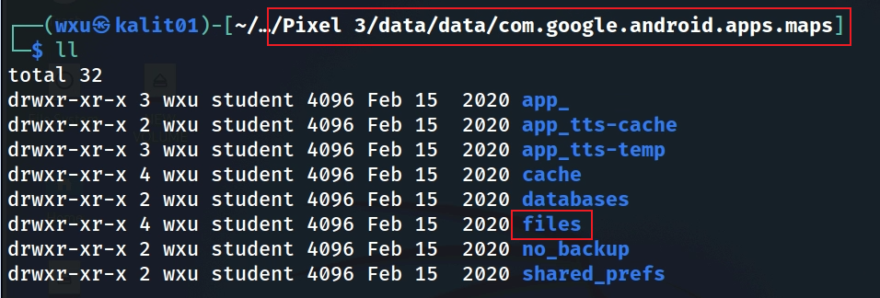
Locate the Google Maps files Directory
Inspect ordinary files in addition to databases
Notes:
Cmd: tree 'Pixel 3/data/data/com.google.android.apps.maps' -L 1

Slide 37
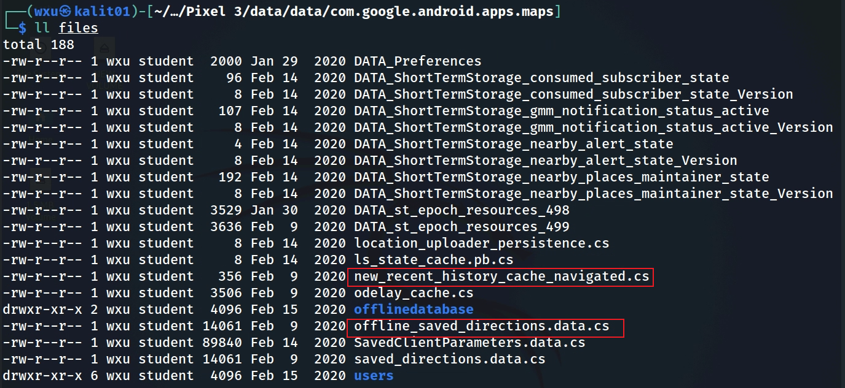
Identify Navigation-Related Files

Slide 38
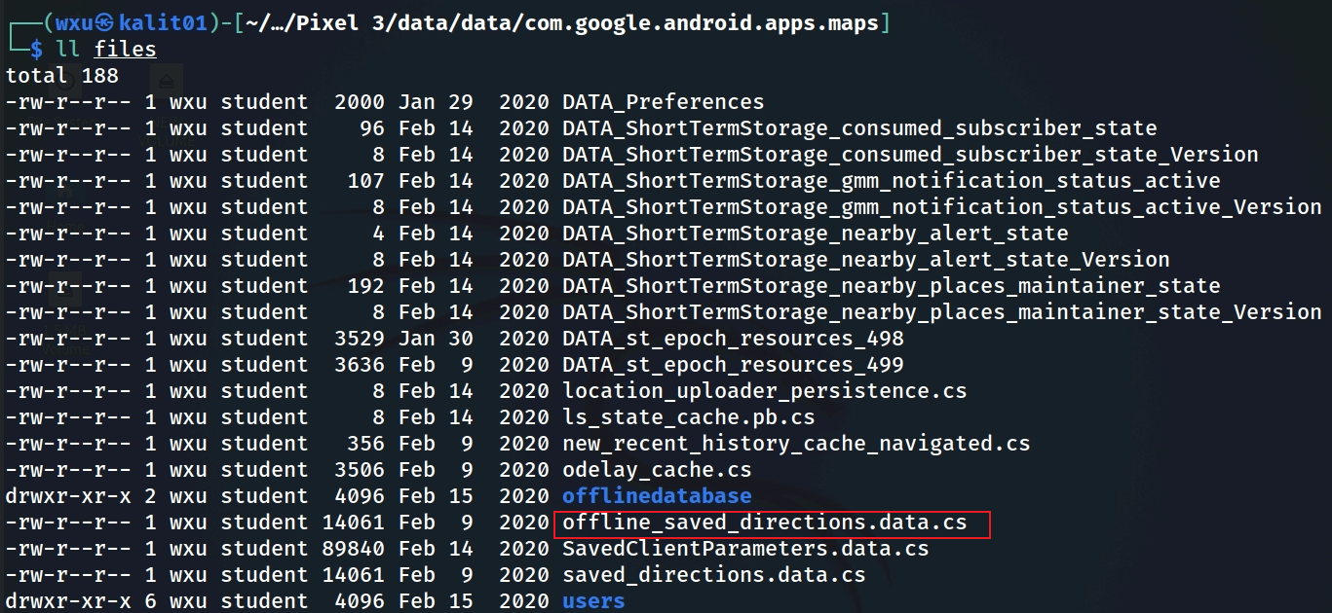
Locate Offline Saved-Direction Artifacts

Slide 39
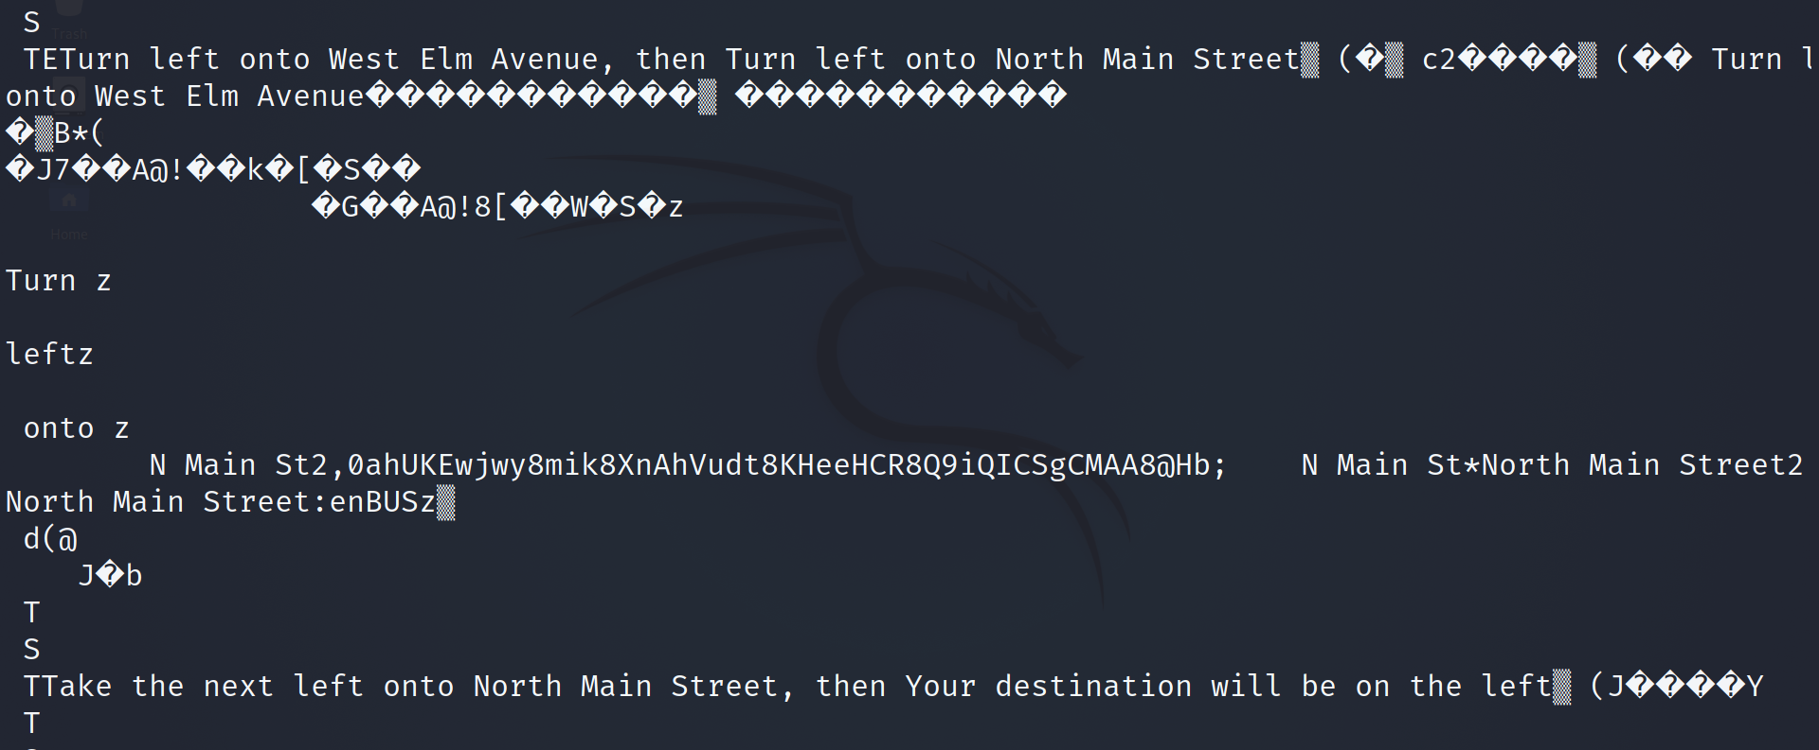
Review Offline-Direction Content

Slide 40
Section 6
Supporting Databases
Notifications, event data, and user-generated photo metadata

Slide 41
Supporting behavioral / notification artifacts
Behavioral Patterns: ue3.db and inbox_notifications.db

Slide 42
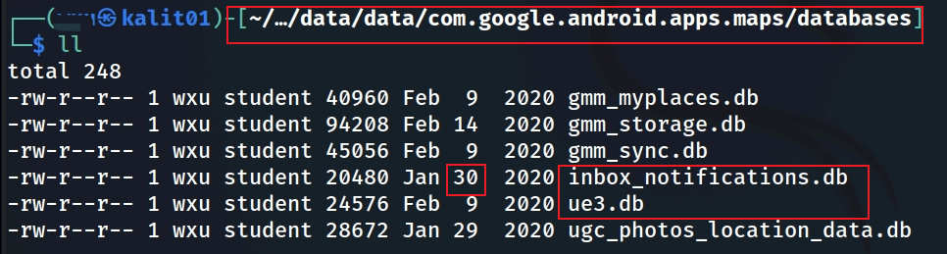
ue3.db and inbox_notifications.db: Dataset Result
In this extraction, the examined tables contain no records. Report that observation; do not generalize it to all devices or app versions.

Slide 43
User-Generated Photo Location Metadata

Slide 44
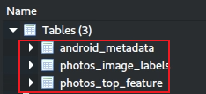
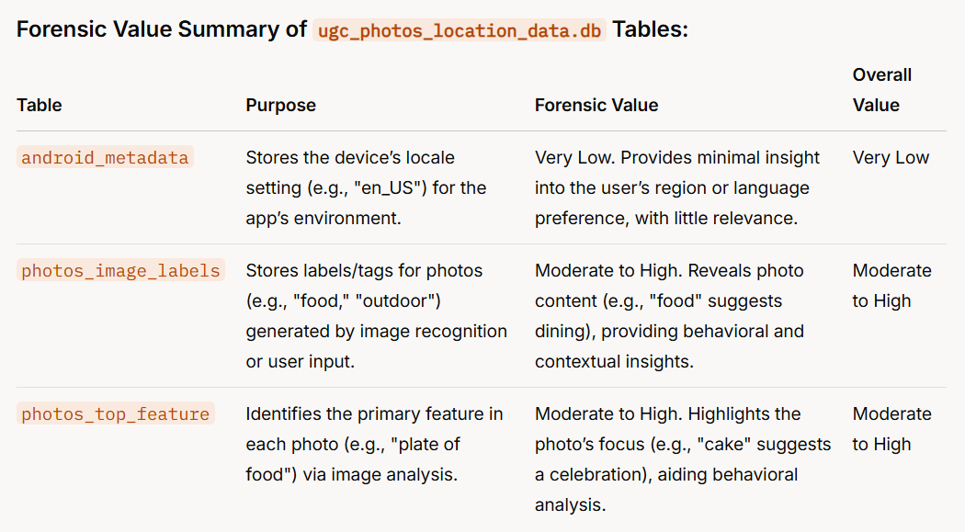
ugc_photos_location_data.db: Tables to Examine
Notes:
Forensic Value Summary of ugc_photos_location_data.db Tables:
TablePurposeForensic ValueOverall Valueandroid_metadataStores the device’s locale setting (e.g., "en_US") for the app’s environment.Very Low. Provides minimal insight into the user’s region or language preference, with little relevance.Very Lowphotos_image_labelsStores labels/tags for photos (e.g., "food," "outdoor") generated by image recognition or user input.Moderate to High. Reveals photo content (e.g., "food" suggests dining), providing behavioral and contextual insights.Moderate to Highphotos_top_featureIdentifies the primary feature in each photo (e.g., "plate of food") via image analysis.Moderate to High. Highlights the photo’s focus (e.g., "cake" suggests a celebration), aiding behavioral analysis.Moderate to High

Slide 45
No Photo-Location Records in the Examined Tables
Finding: the examined tables contain no photo-location rows in this extraction.
Interpretation: report the absence of local records at acquisition time. Do not infer that the user never uploaded or shared photos.

Slide 46
Reporting Language: Stronger and Safer Claims
Model the wording students should use in lab reports
Too strong
Better forensic wording
“The user visited this location.”
“The user never uploaded photos.”
“This record was synced to the cloud.”
“This extraction contains a Google Maps artifact with this coordinate.”
“The examined local photo-location tables contain no rows.”
“This row contains / lacks a server_id field value.”
Reporting standard: preserve the raw artifact, decoded value, interpretation, uncertainty, and corroborating evidence in separate sentences.

Slide 47
Google Maps Forensic Workflow
1. Identify the package and preserve the acquired application directory.
2. Inventory databases and files before focusing on individual artifacts.
3. Examine schema, tables, keys, and raw values; document app/device context.
4. Decode serialized BLOBs while retaining the original evidence.
5. Normalize coordinates and timestamps only after validating units and formats.
6. Correlate saved-place, navigation, sync, notification, and file-based artifacts.
7. Separate what the artifact shows from what you infer about user behavior.
8. Corroborate significant location or timeline conclusions with independent evidence.

Slide 48
Suggested Deliverable Checklist
Package path and acquisition context identified.
Database/file inventory with screenshots or command output.
At least one artifact explained with raw value → decoded value → interpretation.
Coordinate/timestamp conversion shown, including unit assumptions.
Limitations stated: BLOBs, empty tables, invalid timestamps, and cloud/local uncertainty.
Corroboration attempted across at least two artifact sources.

Slide 49
Key Takeaways
Google Maps evidence is distributed across multiple SQLite databases and ordinary files.
Coordinates and route data can reflect saved, searched, synchronized, or navigated locations—context determines meaning.
Serialized BLOBs can contain high-value evidence, but decoding must be validated against the actual schema and app version.
Empty tables are evidence about the examined extraction, not proof that an activity never occurred.
The strongest forensic conclusion combines artifact interpretation with independent corroboration.

