Slide 1
Pixel 3 GMS App Investigations
Part 3: GMS Google Maps
Notes:
https://digitalcorpora.s3.amazonaws.com/corpora/mobile/android_10/Non-Cellebrite%20Extraction/Pixel%203.zip

Slide 2
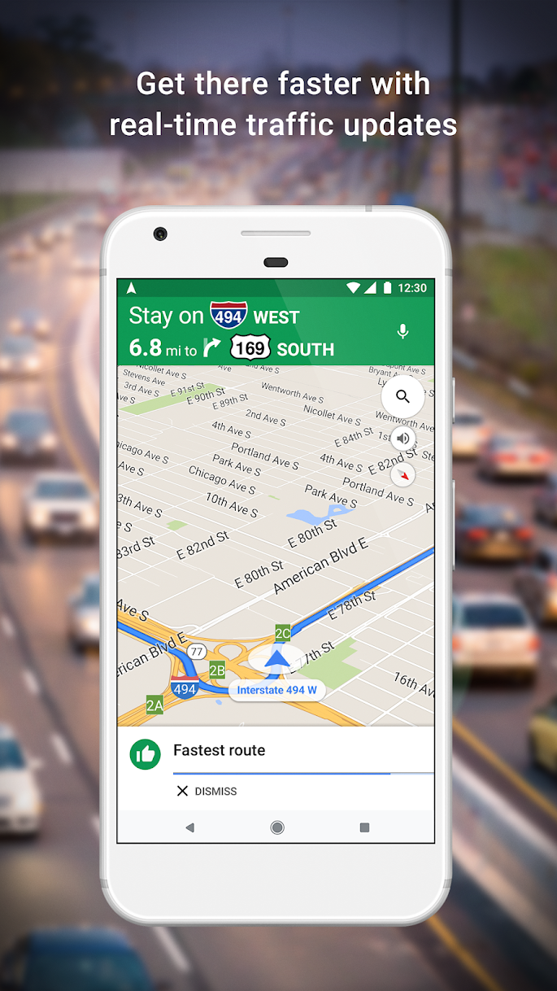
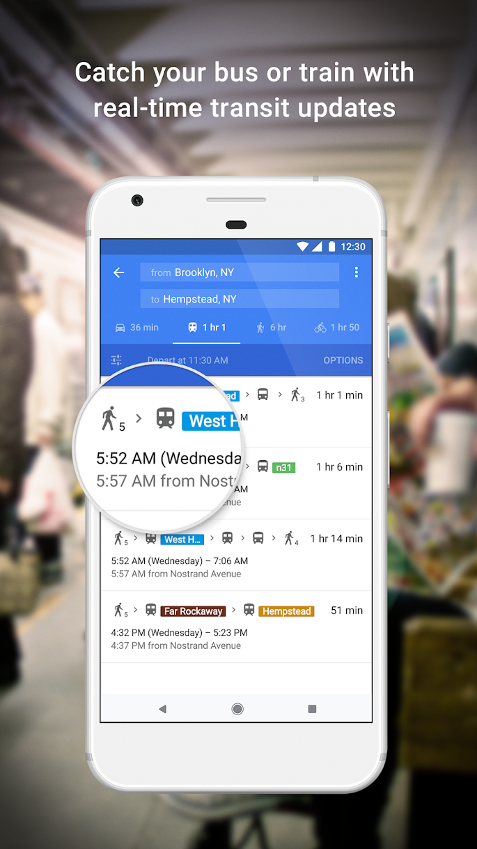
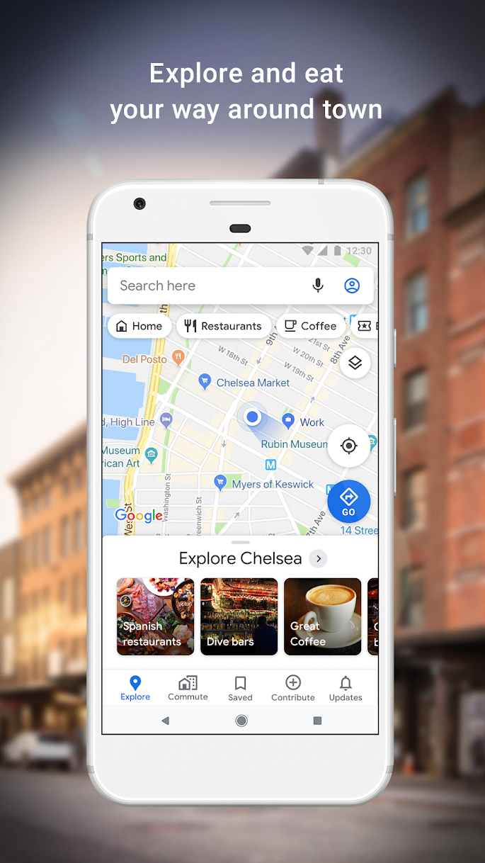

What is google maps?

Slide 3


Map evidence generation and investigations
Search for a place
get searched coordinates
Insert/Save a place
Databases /Files (saved evidence)
get inserted coordinates
Search for a route
Download offline map
get searched route
Navigation
…
provide feedback
investigation scenarios
Map use scenarios
Notes:
https://www.geos.ed.ac.uk/~mscgis/11-12/s1104136/design.htm

Slide 4
Sample questions
Which places did a suspect visit and at what time?
Did the suspect save any directions in offline mode?
What was the suspect’s starting point?
What was the distance from the source to the destination?
Which route did the suspect choose?
How long does it take to reach the destination?
Did the suspect make any stops on the way?

Slide 5
Google Maps Package Directory

Slide 6
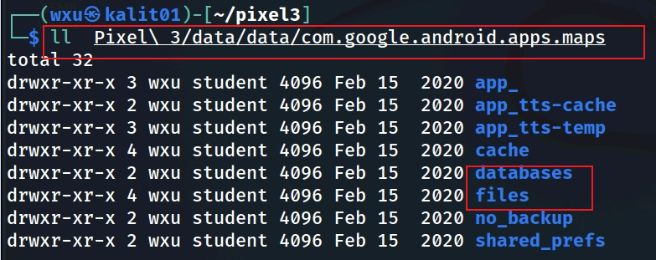
Notes:
Cmd: tree 'Pixel 3/data/data/com.google.android.apps.maps' -L 1

Slide 7
Databases

Slide 8
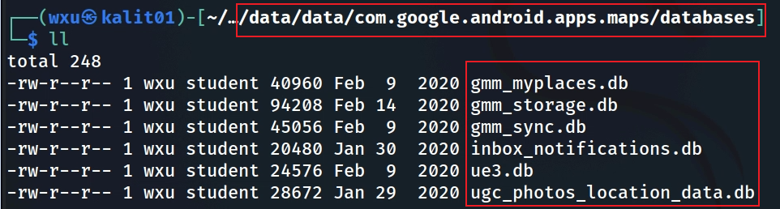
Show Google Maps databases
Notes:
Cmd: tree 'Pixel 3/data/data/com.google.android.apps.maps/databases'

Slide 9
File Name | Purpose | Forensic Evidence Contained
gmm_myplaces.db | 💾 Stores My Places and Saved Locations (favorites, starred, labeled places). | - User-saved home/work/“starred” locations- Favorites and “Want to go” lists- Custom-labeled addresses- Timestamps of save/update
gmm_storage.db | 📦 General storage for cached data — search queries, recent views, temporary map tiles. | - Recently searched addresses and coordinates- Cached routes or viewed POIs- Session timestamps
gmm_sync.db | 🔄 Sync metadata for account-linked data between device and Google cloud. | - Sync tokens, account IDs- Flags for what was synced (My Places, history)- Useful for proving account linkage
inbox_notifications.db | 🔔 Stores notifications generated by Maps (traffic, new place suggestions, reviews). | - Notification text & timestamps- Links to suggested routes or reviews- May show user interaction with Google recommendations
ue3.db | 📍 “User Events 3” — captures certain local analytics or trip/session data. | - Location coordinates- Movement events- Session identifiers (used for timeline/trip reconstruction)
ugc_photos_location_data.db | 🖼 “User Generated Content” — metadata for photos tagged with location info. | - Image filenames or URIs- Associated latitude/longitude- Timestamps- Links to Google Photos/Maps uploads
Notes:
Summary of Each Database:
DatabaseLikely PurposeInvestigation Valuegmm_myplaces.dbStores user’s saved places (favorites, starred locations, lists).Reveals important locations, travel history, and personal interests.gmm_storage.dbStores miscellaneous app data (cached maps, user preferences, offline map metadata).Shows user preferences, offline map usage, and app interaction patterns.gmm_sync.dbManages synchronization of Google Maps data (saved places, history) with the user’s Google account.Indicates sync activity, cross-device usage, and potential data recovery.inbox_notifications.dbStores notifications or in-app messages (e.g., traffic alerts, contribution prompts).Reveals user interactions, location-based alerts, and contribution behavior.ue3.dbLikely stores user experience data (A/B testing, feedback, usage metrics).Provides behavioral insights, feedback on locations, and feature usage patterns.ugc_photos_location_data.dbManages user-uploaded photos and their location data for Google Maps contributions.Shows where the user has been, timestamps of visits, and potential visual evidence via photos.

Slide 10
Investigation Value
Location Tracking: gmm_myplaces.db and ugc_photos_location_data.db are particularly valuable for mapping the user’s movements and identifying significant locations.
Behavioral Patterns: ue3.db and inbox_notifications.db can reveal how the user interacts with the app and what notifications they received, shedding light on their activities and interests.
Travel Planning: gmm_storage.db might indicate offline map usage, suggesting areas the user planned to visit without internet access.
Data Synchronization: gmm_sync.db can show when and what data was synced, potentially linking to other devices or backups.

Slide 11
gmm_myplace.db
Location Tracking

Slide 12
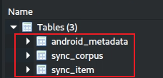
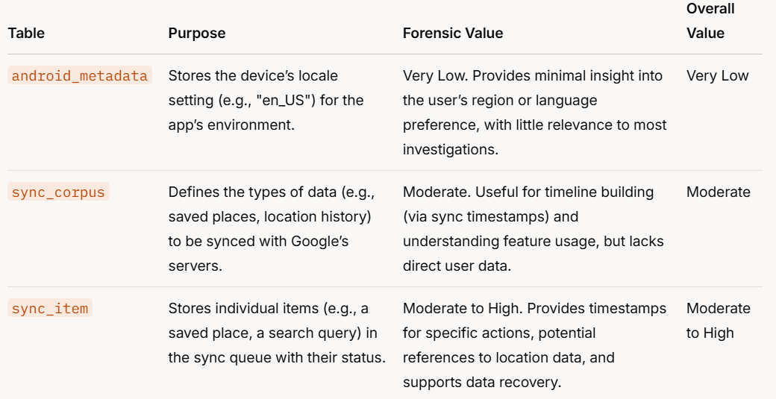
a "corpus" might represent a category of data, such as saved places, search history, location history, or user contributions (e.g., reviews, photos).
a specific piece of corpus that needs to be uploaded to or downloaded from Google’s servers.

Slide 13
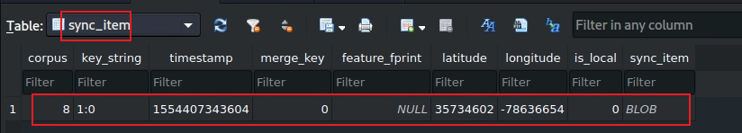
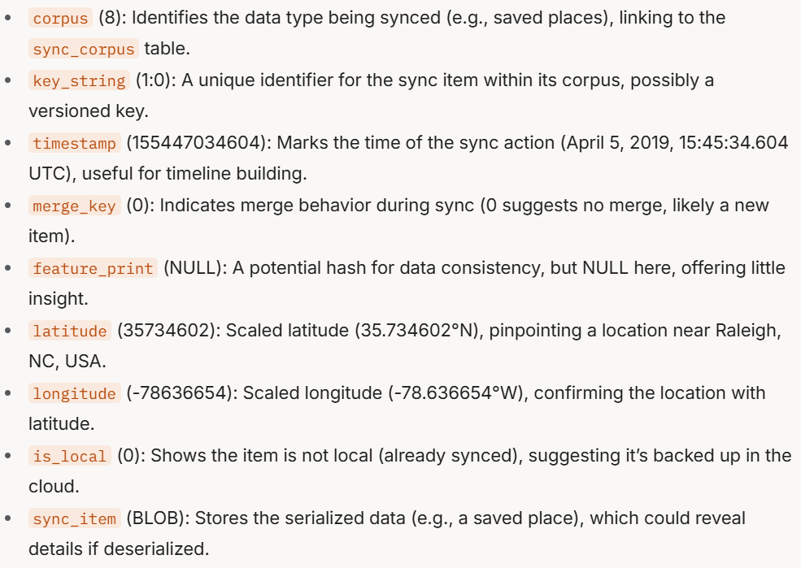
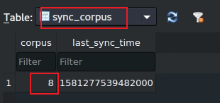
Notes:
corpus (8): Identifies the data type being synced (e.g., saved places), linking to the sync_corpus table. key_string (1:0): A unique identifier for the sync item within its corpus, possibly a versioned key. timestamp (155447034604): Marks the time of the sync action (April 5, 2019, 15:45:34.604 UTC), useful for timeline building. merge_key (0): Indicates merge behavior during sync (0 suggests no merge, likely a new item). feature_print (NULL): A potential hash for data consistency, but NULL here, offering little insight. latitude (35734602): Scaled latitude (35.734602°N), pinpointing a location near Raleigh, NC, USA. longitude (-78636654): Scaled longitude (-78.636654°W), confirming the location with latitude. is_local (0): Shows the item is not local (already synced), suggesting it’s backed up in the cloud. sync_item (BLOB): Stores the serialized data (e.g., a saved place), which could reveal details if deserialized.

Slide 14
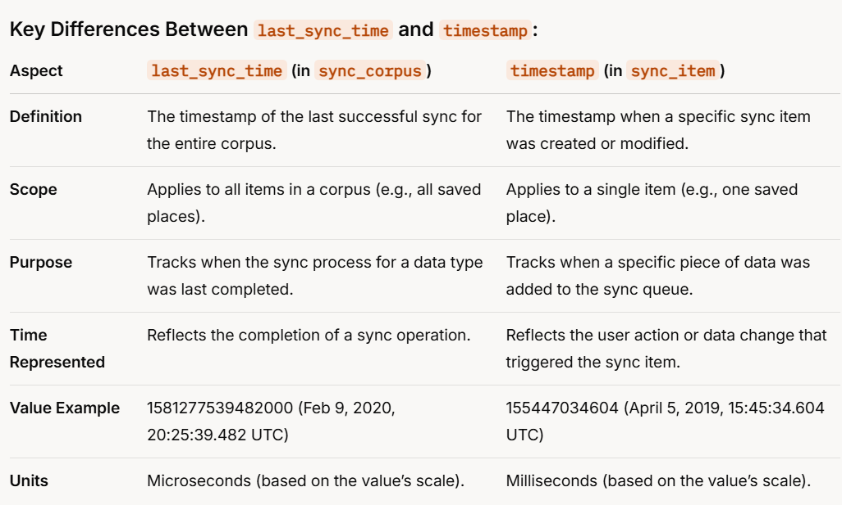
Notes:
Key Differences Between last_sync_time and timestamp:
Aspectlast_sync_time (in sync_corpus)timestamp (in sync_item)DefinitionThe timestamp of the last successful sync for the entire corpus.The timestamp when a specific sync item was created or modified.ScopeApplies to all items in a corpus (e.g., all saved places).Applies to a single item (e.g., one saved place).PurposeTracks when the sync process for a data type was last completed.Tracks when a specific piece of data was added to the sync queue.Time RepresentedReflects the completion of a sync operation.Reflects the user action or data change that triggered the sync item.Value Example1581277539482000 (Feb 9, 2020, 20:25:39.482 UTC)155447034604 (April 5, 2019, 15:45:34.604 UTC)UnitsMicroseconds (based on the value’s scale).Milliseconds (based on the value’s scale).

Slide 15
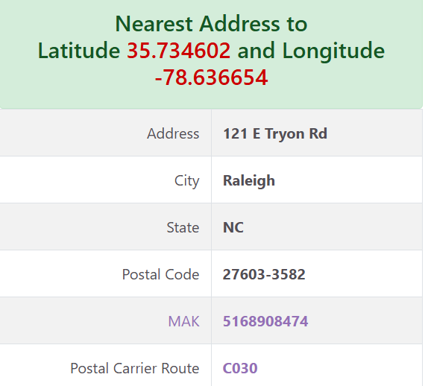

Use the below link to find the exact location using latitude and longitude​
https://www.melissa.com/v2/lookups/latlngzip4/​
​E6 format, which is a representation of latitude and longitude in microdegrees (degree=microdegrees /1,000,000)

Slide 16
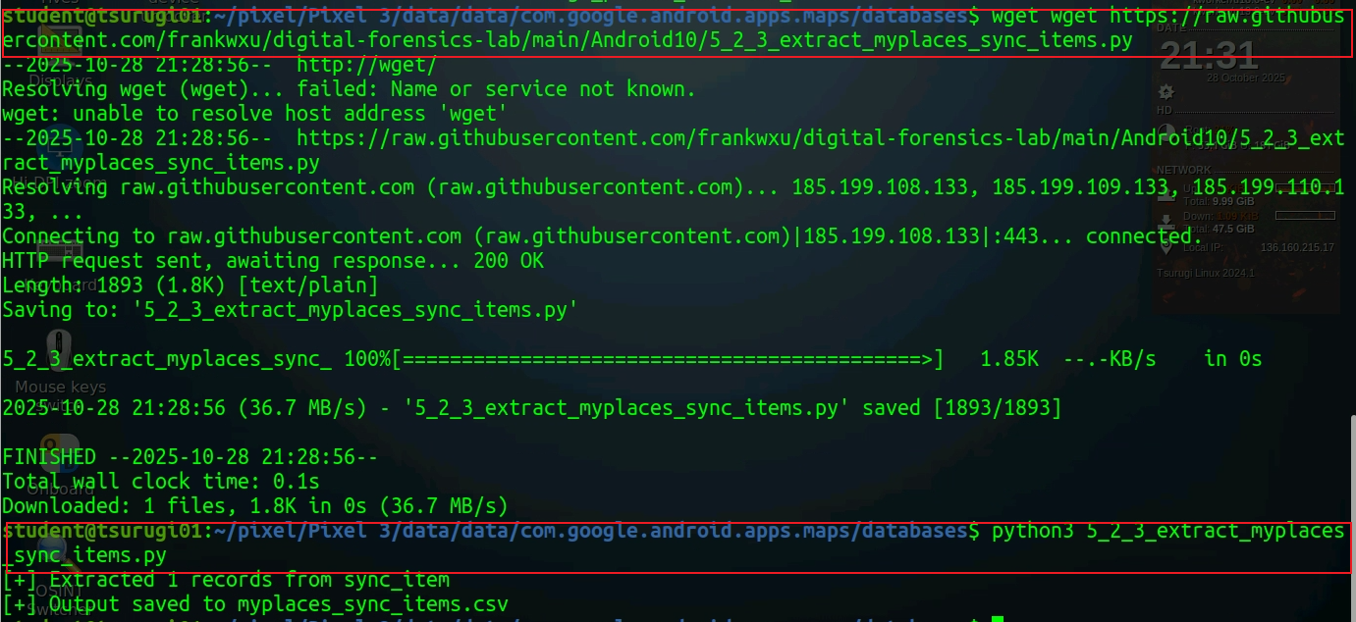
Python code to decode Blob
Notes:
wget https://raw.githubusercontent.com/frankwxu/digital-forensics-lab/main/Android10/5_2_3_extract_myplaces_sync_items.py
nano extract_myplaces_sync_items.py # paste the code above
python3 extract_myplaces_sync_items.py # execute

Slide 17
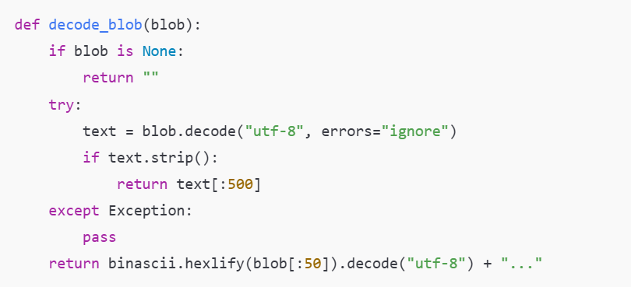

Slide 18
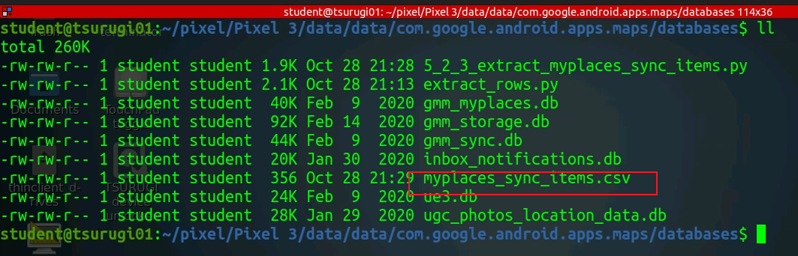
Decoded blob

Slide 19
gmm_storage.db
Travel Planning: Offline Map information

Slide 20
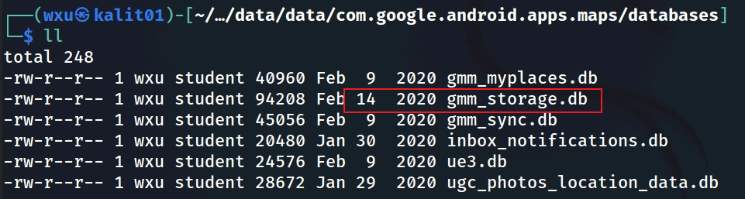
gmm_storage.db
gmm_storage_table

Slide 21
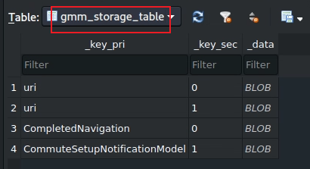
gmm_storage_table
Stores miscellaneous app data in a key-value format
key_pri, key_sec, and data (BLOB).
The table contains four rows, and the evidence that can be extracted
key_pri = "uri“ (map-related resources (e.g., map tiles, offline maps)
key_pri = "CompletedNavigation“ (a completed navigation session)
key_pri = "CompletedNavigationSETUP_NOTIFICATION_MODEL" (notification settings or state post-navigation)

Slide 22
if BLOB is deserialized
key_pri = "uri“
URIs for offline map data, indicating regions the user downloaded.
Metadata like expiration dates or regions associated with the URIs.
key_pri = "CompletedNavigation“
Start and end coordinates (latitude/longitude) of the route.
Route details (e.g., distance, duration, mode of transport like driving or walking).
Timestamps for when the navigation started and ended.
key_pri = "CompletedNavigationSETUP_NOTIFICATION_MODEL"
The type of notification shown (e.g., "You’ve arrived" or "Rate your trip").
User interaction (e.g., dismissed, tapped, or responded to a feedback prompt).
Timestamp of when the notification was shown.
Notes:
The `gmm_storage_table` in the `gmm_storage.db` database (from Google Maps on a Pixel 3) stores miscellaneous app data in a key-value format with columns `key_pri`, `key_sec`, and `data` (BLOB). The table contains four rows, and the evidence that can be extracted is summarized below, focusing on its forensic value in a digital investigation.
---
### Evidence Extracted from `gmm_storage_table`:
1. **Travel History (from "CompletedNavigation" Row):**
- **Evidence:** The row with `key_pri` = "CompletedNavigation" indicates a completed navigation session. If the `data` BLOB is deserialized, it may reveal:
- Start and end coordinates (latitude/longitude) of the route.
- Route details (e.g., distance, duration, mode of transport like driving or walking).
- Timestamps for when the navigation started and ended.
- **Forensic Value:** High (if BLOB is deserialized).
- **Location Insight:** Pinpoints where the user traveled, providing direct evidence of their movements.
- **Timeline Building:** Timestamps can establish when the travel occurred.
- **Behavioral Insight:** Indicates the user was traveling, potentially revealing their habits (e.g., frequent driving).
2. **User Interaction with Notifications (from "CompletedNavigationSETUP_NOTIFICATION_MODEL" Row):**
- **Evidence:** The row with `key_pri` = "CompletedNavigationSETUP_NOTIFICATION_MODEL" stores notification settings or state post-navigation. If the BLOB is deserialized, it may reveal:
- The type of notification shown (e.g., "You’ve arrived" or "Rate your trip").
- User interaction (e.g., dismissed, tapped, or responded to a feedback prompt).
- Timestamp of when the notification was shown.
- **Forensic Value:** Moderate to High (if BLOB is deserialized).
- **Behavioral Insight:** Shows how the user engaged with the app after navigation (e.g., ignoring feedback prompts might suggest disinterest).
- **Timeline Building:** Notification timestamp can pinpoint when the navigation ended and the user interacted with the app.
- **User Engagement:** Reflects the user’s interaction with Google Maps features.
3. **Travel Planning or App Resource Usage (from "uri" Rows):**
- **Evidence:** The two rows with `key_pri` = "uri" (with `key_sec` = 0 and 1) likely store URIs for map-related resources (e.g., map tiles, offline maps). If the BLOBs are deserialized, they may reveal:
- URIs for offline map data, indicating regions the user downloaded.
- Metadata like expiration dates or regions associated with the URIs.
- **Forensic Value:** Low to Moderate.
- **Travel Planning:** Offline map URIs can suggest areas the user planned to visit, especially if they downloaded maps for regions with poor connectivity.
- **App Usage:** Indicates how the app manages resources, but this is less directly relevant to user behavior.
---
### Overall Forensic Value:
- **Rating (from Previous Analysis):** 5/10
- **Rank (from Previous Analysis):** 5th (tied with `ue3.db`).
- **Summary of Evidence:**
- **Location and Travel History:** The "CompletedNavigation" row can provide route details, start/end points, and timestamps, revealing where and when the user traveled.
- **Behavioral Insights:** Notification data ("CompletedNavigationSETUP_NOTIFICATION_MODEL") shows user interaction post-navigation, while navigation itself indicates travel habits.
- **Travel Planning:** URI data might reveal offline map usage, suggesting planned travel to specific regions.
- **Timeline Building:** Timestamps in the BLOBs (e.g., navigation end time, notification time) can help establish user activity timelines.
- **Limitations:** The BLOB format requires deserialization to access detailed data, limiting immediate insights. The table’s focus on app-centric data (rather than direct user-generated content like photos or saved places) makes it less valuable compared to other databases like `ugc_photos_location_data.db` or `gmm_myplaces.db`.

Slide 23
gmm_sync.db
Map data Synchronization

Slide 24
gmm_sync.db
Purpose: Manages the synchronization of Google Maps data (e.g., saved places, location history, user parameters) between the device and the user’s Google account, ensuring consistency across devices.
Notes:
Cmd: sqlitebrowser 'Pixel 3/data/data/com.google.android.apps.maps/databases/gmm_sync.db'

Slide 25
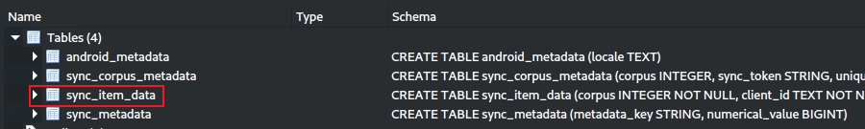
sync_item_data table in gmm_sync.db
The sync_item_data table
Stores individual items that need to be synchronized between the device and Google’s servers as part of the Google Maps app’s sync process.
Each row represents a specific piece of data (e.g., a saved place, a location history entry, or user settings) queued for sync.
Role in Google Maps
This table acts as a sync queue, tracking items that have been created or modified on the device and need to be uploaded to Google’s servers (or downloaded from the server to the device).
It includes detailed metadata like location coordinates, timestamps, and client/server IDs to manage the sync process.
Notes:
Cmd: sqlitebrowser 'Pixel 3/data/data/com.google.android.apps.maps/databases/gmm_sync.db'

Slide 26
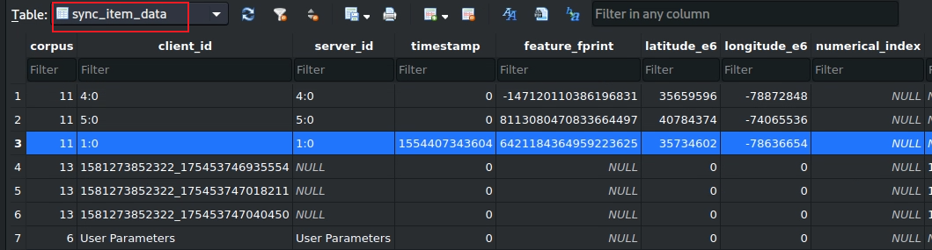

Open the sync_item_data table
sync information
Summary:
The sync_item_data table provides valuable location data (Rows 1–3) and timeline insights (Row 3), particularly for tracking user movements (e.g., Raleigh, NC, and NYC).
Pending sync items (Rows 4–6) offer potential insights into user contributions and data recovery, while user settings (Row 7) are less useful.
sync_item table in gmm_myplaces.db
Notes:
The image shows the schema and data of the `sync_item_data` table in the `gmm_sync.db` database, which is part of the Google Maps app on a Pixel 3 device (`/data/data/com.google.android.apps.maps/databases/`). This table contains seven rows with columns that track synchronization data for various items. Below, I’ll explain the purpose of the table, the role of each column, and the forensic value of the data in a digital investigation context.
---
### Context Recap:
- **Database:** `gmm_sync.db`
- **Name Explanation:**
- **"GMM"**: Google Maps Mobile, indicating this database belongs to the Google Maps app.
- **"sync"**: Refers to synchronization of data between the device and Google’s servers.
- **".db"**: A SQLite database file.
- **Purpose (from Previous Analysis):** Manages the synchronization of Google Maps data (e.g., saved places, location history, user parameters) between the device and the user’s Google account, ensuring consistency across devices.
- **Table:** `sync_item_data`
- This table is an extension or variation of the `sync_item` table previously analyzed in the same database. It stores individual items queued for synchronization, including additional metadata like location coordinates.
---
### Explanation of the `sync_item_data` Table:
#### Purpose:
- The `sync_item_data` table stores individual items that need to be synchronized between the device and Google’s servers as part of the Google Maps app’s sync process. Each row represents a specific piece of data (e.g., a saved place, a location history entry, or user settings) queued for sync.
- **Role in Google Maps:** This table acts as a sync queue, tracking items that have been created or modified on the device and need to be uploaded to Google’s servers (or downloaded from the server to the device). It includes detailed metadata like location coordinates, timestamps, and client/server IDs to manage the sync process.
#### Schema:
The table has the following columns:
- **`corpus` (INTEGER):** Identifies the type of data being synced (links to the `sync_corpus` table).
- **`client_id` (TEXT):** A unique identifier for the item on the client (device) side.
- **`server_id` (TEXT):** A unique identifier for the item on the server side (if assigned).
- **`timestamp` (INTEGER):** The time when the item was created or modified (Unix timestamp in milliseconds).
- **`feature_print` (TEXT):** A hash or fingerprint for data consistency (often NULL if not applicable).
- **`lat_e6` (INTEGER):** Latitude coordinate scaled by 1,000,000 (1E6).
- **`long_e6` (INTEGER):** Longitude coordinate scaled by 1,000,000 (1E6).
- **`numerical_index` (INTEGER):** An additional index for categorization or ordering (often 0 or NULL).
#### Data Rows:
The table contains seven rows:
1. **`corpus`: 11, `client_id`: 4:0, `server_id`: 4:0, `timestamp`: -1471201103836196831, `feature_print`: NULL, `lat_e6`: 35659596, `long_e6`: -78872848, `numerical_index`: NULL**
2. **`corpus`: 11, `client_id`: 5:0, `server_id`: 5:0, `timestamp`: 8113080470833664497, `feature_print`: NULL, `lat_e6`: 40784374, `long_e6`: -74065536, `numerical_index`: NULL**
3. **`corpus`: 11, `client_id`: 1:0, `server_id`: 1:0, `timestamp`: 1554470343604, `feature_print`: 6421184364959223625, `lat_e6`: 35734602, `long_e6`: -78636654, `numerical_index`: NULL**
4. **`corpus`: 13, `client_id`: 1581273852322_175453746935554, `server_id`: NULL, `timestamp`: 0, `feature_print`: NULL, `lat_e6`: 0, `long_e6`: 0, `numerical_index`: NULL**
5. **`corpus`: 13, `client_id`: 1581273852322_175453747010450, `server_id`: NULL, `timestamp`: 0, `feature_print`: NULL, `lat_e6`: 0, `long_e6`: 0, `numerical_index`: NULL**
6. **`corpus`: 13, `client_id`: 1581273852322_175453747040450, `server_id`: NULL, `timestamp`: 0, `feature_print`: NULL, `lat_e6`: 0, `long_e6`: 0, `numerical_index`: NULL**
7. **`corpus`: 6, `client_id`: User Parameters, `server_id`: NULL, `timestamp`: 0, `feature_print`: NULL, `lat_e6`: 0, `long_e6`: 0, `numerical_index`: NULL**
---
### Explanation of Each Column:
#### 1. `corpus`
- **Purpose:** Identifies the type of data being synced, linking to the `sync_corpus` table.
- **Values:**
- `11` (Rows 1–3): Likely corresponds to a corpus like "saved_places" or "location_history" (based on previous analysis where `corpus` 8 was linked to saved places, and these rows include coordinates).
- `13` (Rows 4–6): Another data type, possibly related to user contributions or events (no coordinates, so not location-specific).
- `6` (Row 7): Likely "User Parameters" (as indicated by `client_id`), such as app settings or preferences.
- **Forensic Value:** Helps identify the type of data being synced (e.g., saved places, user settings), guiding investigators to relevant databases (e.g., `gmm_myplaces.db`).
#### 2. `client_id`
- **Purpose:** A unique identifier for the item on the client (device) side, used to track the item locally.
- **Values:**
- `4:0`, `5:0`, `1:0` (Rows 1–3): Structured IDs, possibly in the format `type:index`, for items in corpus 11 (e.g., different saved places or location history entries).
- `1581273852322_175453746935554`, etc. (Rows 4–6): Composite IDs, likely combining a timestamp (e.g., 1581273852322) and a unique identifier, for items in corpus 13.
- `User Parameters` (Row 7): A descriptive ID indicating user settings.
- **Forensic Value:** Allows tracking of specific items locally, useful for cross-referencing with other tables or databases.
#### 3. `server_id`
- **Purpose:** A unique identifier for the item on the server side, assigned after successful sync (NULL if not yet synced).
- **Values:**
- Matches `client_id` in Rows 1–3 (`4:0`, `5:0`, `1:0`): Indicates these items have been synced with the server.
- `NULL` in Rows 4–7: Indicates these items have not yet been synced.
- **Forensic Value:** Shows sync status, helping determine if data is backed up in the cloud (recoverable) or only exists locally.
#### 4. `timestamp`
- **Purpose:** Records when the item was created or modified (Unix timestamp in milliseconds).
- **Values:**
- Row 1: `-1471201103836196831`: An invalid or corrupted timestamp (negative and excessively large, likely an error).
- Row 2: `8113080470833664497`: Another invalid timestamp (far future, likely an error).
- Row 3: `1554470343604`: April 5, 2019, 15:45:34.604 UTC (valid, previously analyzed).
- Rows 4–7: `0`: No timestamp recorded, possibly because these items are pending sync or not time-sensitive.
- **Forensic Value:** High for valid timestamps (e.g., Row 3), as it helps build a timeline of user actions (e.g., saving a place on April 5, 2019). Invalid or zero timestamps reduce utility.
#### 5. `feature_print`
- **Purpose:** A hash or fingerprint for data consistency, used to detect changes or duplicates during sync.
- **Values:**
- `6421184364959223625` (Row 3): A valid feature print, indicating this item has a unique identifier for sync consistency.
- `NULL` (Other Rows): No feature print, possibly because it’s not needed or the item hasn’t been processed.
- **Forensic Value:** Low. Useful for verifying data integrity if present, but mostly NULL here.
#### 6. `lat_e6` (Latitude, scaled by 1E6)
- **Purpose:** Stores the latitude coordinate of a location associated with the sync item, scaled by 1,000,000.
- **Values:**
- Row 1: `35659596` → 35.659596°N (near Raleigh, NC, USA).
- Row 2: `40784374` → 40.784374°N (near New York City, NY, USA).
- Row 3: `35734602` → 35.734602°N (near Raleigh, NC, USA, previously analyzed).
- Rows 4–7: `0`: No latitude recorded (not location-specific).
- **Forensic Value:** High for Rows 1–3. Provides precise location data, showing where the user was or what place they interacted with.
#### 7. `long_e6` (Longitude, scaled by 1E6)
- **Purpose:** Stores the longitude coordinate, scaled by 1,000,000.
- **Values:**
- Row 1: `-78872848` → -78.872848°W (near Raleigh, NC, USA).
- Row 2: `-74065536` → -74.065536°W (near New York City, NY, USA).
- Row 3: `-78636654` → -78.636654°W (near Raleigh, NC, USA).
- Rows 4–7: `0`: No longitude recorded.
- **Forensic Value:** High for Rows 1–3. Pairs with `lat_e6` to pinpoint exact locations (e.g., 35.659596°N, -78.872848°W).
#### 8. `numerical_index`
- **Purpose:** An additional index for categorization or ordering, often unused.
- **Values:** All `NULL` or 0, indicating it’s not used in this context.
- **Forensic Value:** None. Provides no meaningful insight here.
---
### Forensic Value of the `sync_item_data` Table:
#### Evidence Extracted:
1. **Location History (Rows 1–3, Corpus 11):**
- **Details:**
- Row 1: 35.659596°N, -78.872848°W (near Raleigh, NC, USA), but invalid timestamp.
- Row 2: 40.784374°N, -74.065536°W (near New York City, NY, USA), but invalid timestamp.
- Row 3: 35.734602°N, -78.636654°W (near Raleigh, NC, USA), timestamp April 5, 2019, 15:45:34.604 UTC.
- **Forensic Value:** High for Row 3 (valid timestamp); Moderate for Rows 1–2 (invalid timestamps).
- **Location Insight:** Pinpoints where the user was or what places they interacted with.
- **Timeline Building:** Row 3 provides a precise timestamp; others are limited by invalid timestamps.
- **Behavioral Insight:** Suggests the user saved places or recorded location history in these areas.
2. **Pending Sync Items (Rows 4–6, Corpus 13):**
- **Details:** Items with `client_id` starting with `1581273852322` (February 9, 2020), `server_id` NULL, no location data.
- **Forensic Value:** Moderate.
- **Timeline Building:** The `client_id` timestamp (February 9, 2020) suggests when these items were created.
- **Data Recovery:** `server_id` NULL indicates these items are local only, not yet synced, so they may not be recoverable from the cloud.
- **Behavioral Insight:** Corpus 13 might relate to user contributions (e.g., reviews, edits), indicating user engagement with Google Maps.
3. **User Settings (Row 7, Corpus 6):**
- **Details:** `client_id` = "User Parameters", no location or timestamp.
- **Forensic Value:** Low.
- **Behavioral Insight:** Indicates user settings were queued for sync, but no specific details without deserialization.
- **Data Recovery:** `server_id` NULL suggests these settings are local only.
#### Overall Forensic Value:
- **Rating (from Previous Analysis for `gmm_sync.db`):** 6/10
- **Rank (from Previous Analysis):** 4th out of 6 databases.
- **Summary:** The `sync_item_data` table provides valuable location data (Rows 1–3) and timeline insights (Row 3), particularly for tracking user movements (e.g., Raleigh, NC, and NYC). Pending sync items (Rows 4–6) offer potential insights into user contributions and data recovery, while user settings (Row 7) are less useful. Invalid timestamps in some rows limit their utility, but the table remains moderately useful for location tracking and timeline building when paired with the `sync_corpus` table.

Slide 27
Files used by Google Map

Slide 28
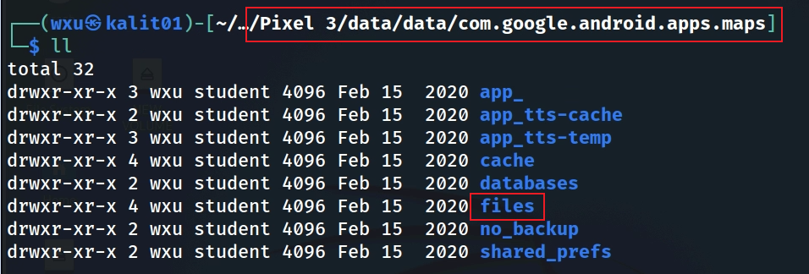
Show files folder location
Notes:
Cmd: tree 'Pixel 3/data/data/com.google.android.apps.maps' -L 1

Slide 29
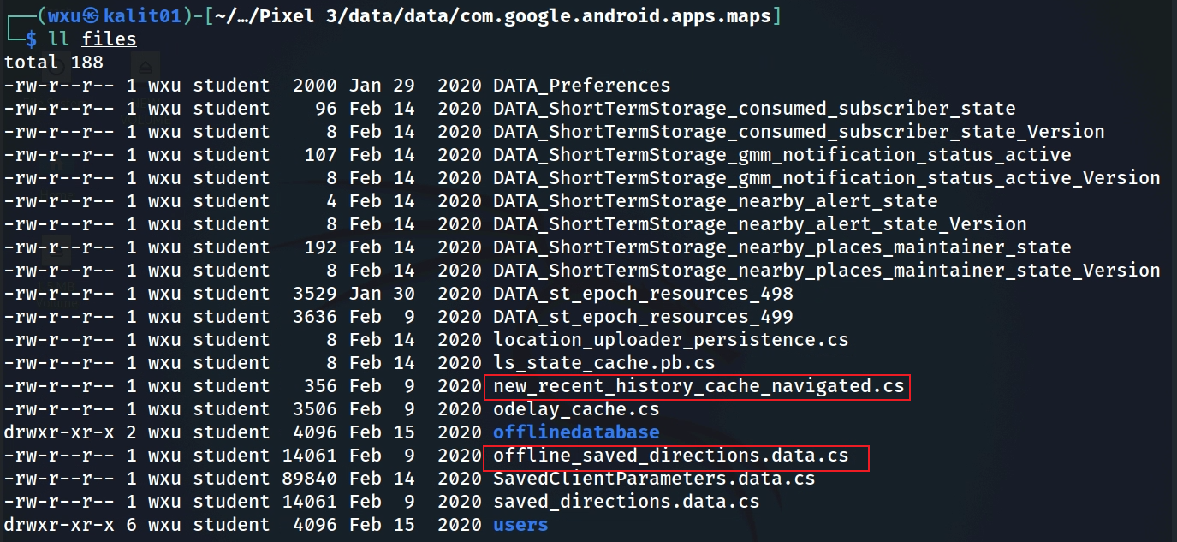
Interesting navigation files

Slide 30
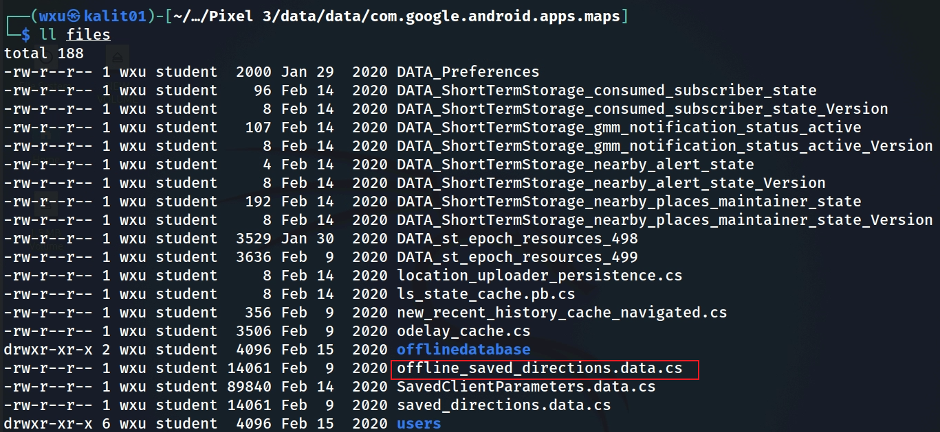
offline saved directions

Slide 31
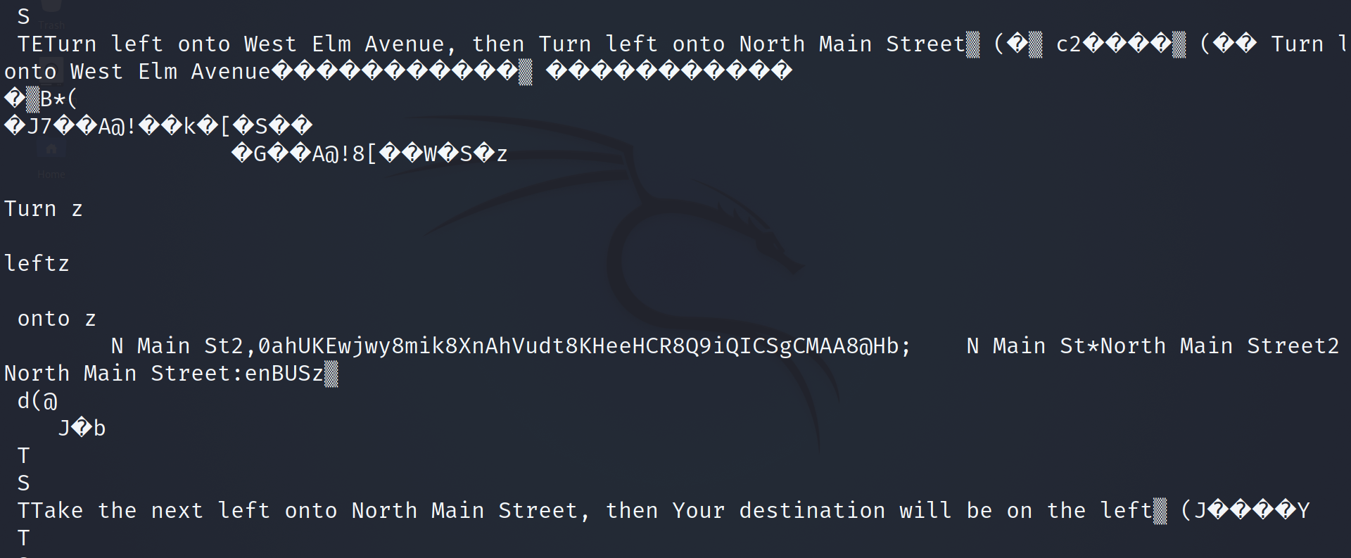
Review offline directions

Slide 32
ue3.db and inbox_notifications.db
Behavioral Patterns

Slide 33
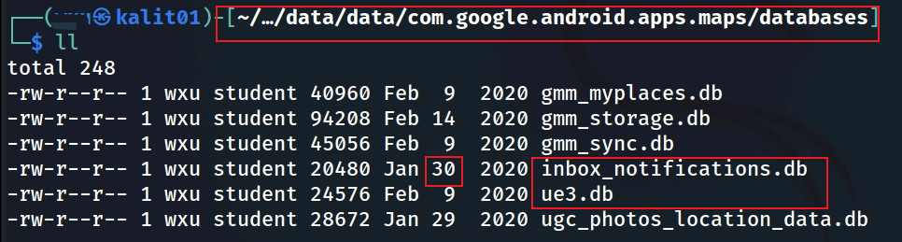
ue3.db and inbox_notifications.db
No values in these tables

Slide 34
ugc_photos_location_data.db

Slide 35
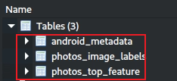
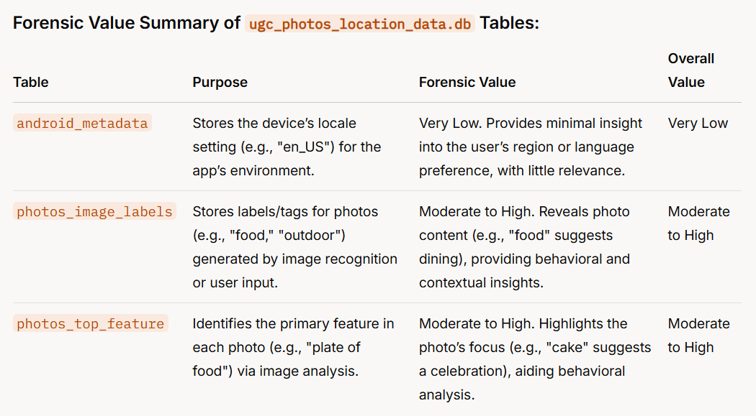
Notes:
Forensic Value Summary of ugc_photos_location_data.db Tables:
TablePurposeForensic ValueOverall Valueandroid_metadataStores the device’s locale setting (e.g., "en_US") for the app’s environment.Very Low. Provides minimal insight into the user’s region or language preference, with little relevance.Very Lowphotos_image_labelsStores labels/tags for photos (e.g., "food," "outdoor") generated by image recognition or user input.Moderate to High. Reveals photo content (e.g., "food" suggests dining), providing behavioral and contextual insights.Moderate to Highphotos_top_featureIdentifies the primary feature in each photo (e.g., "plate of food") via image analysis.Moderate to High. Highlights the photo’s focus (e.g., "cake" suggests a celebration), aiding behavioral analysis.Moderate to High

Slide 36
No values in these tables, which indicates the user did not upload any pictures.

Slide 37
To summarize
Understand the application
Locate the application package/folder
Look at the application directories
Go to the "databases" directory
Open xxx.db
Explore the tables
Look at the data in each column and fetch the information needed
Go to files folder to locate the offline directions file
Fetch the information needed from that file

