Slide 1
A Pixel 3 image
Image Acquisition & Android Forensics

Slide 2
Overview
Pixel 3 Image Acquisition
Android Forensics: Data Source
Hands-on Lab
Understand the Apps/Package
Case Study: Find an app’s official name

Slide 3
Pixel Image Acquisition

Slide 4
About the Pixel 3 Image
Created by Joshua Hickman
The Pixel device is rooted using the Team Win Recovery Project (TWRP)
TWRP is a custom recovery environment that boots separately from normal Android
  Used to flash, mount, copy, back up, or modify partitions
  Used to install Magisk
Magisk is what provides root access during normal Android operation.
Pixel 3 Image is not a real “dd image”
  It is a logical copy
Notes:
https://twrp.me/site/update/2019/10/23/twrp-and-android-10.html
https://thebinaryhick.blog/2020/02/15/android-10-image-now-available/
https://digitalcorpora.org/corpora/cell-phones/android-10/
https://thebinaryhick.blog/public_images/

Slide 5
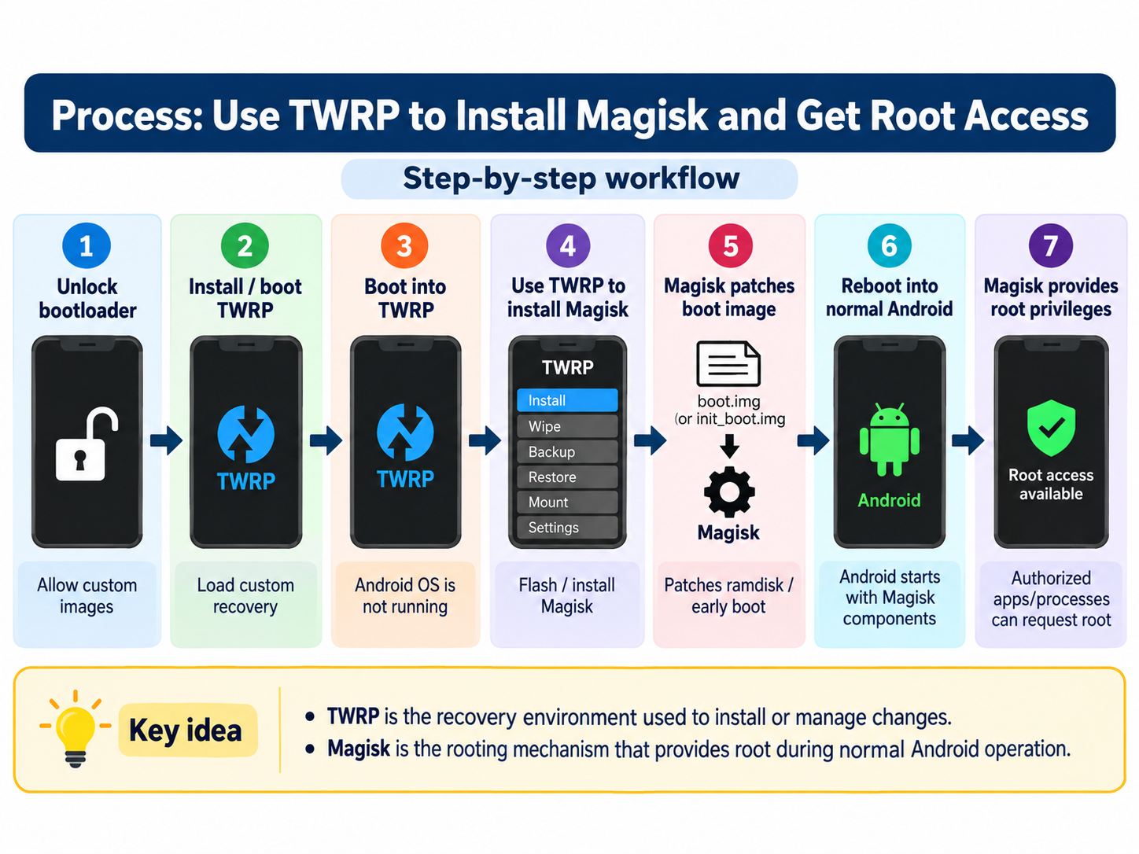

Slide 6
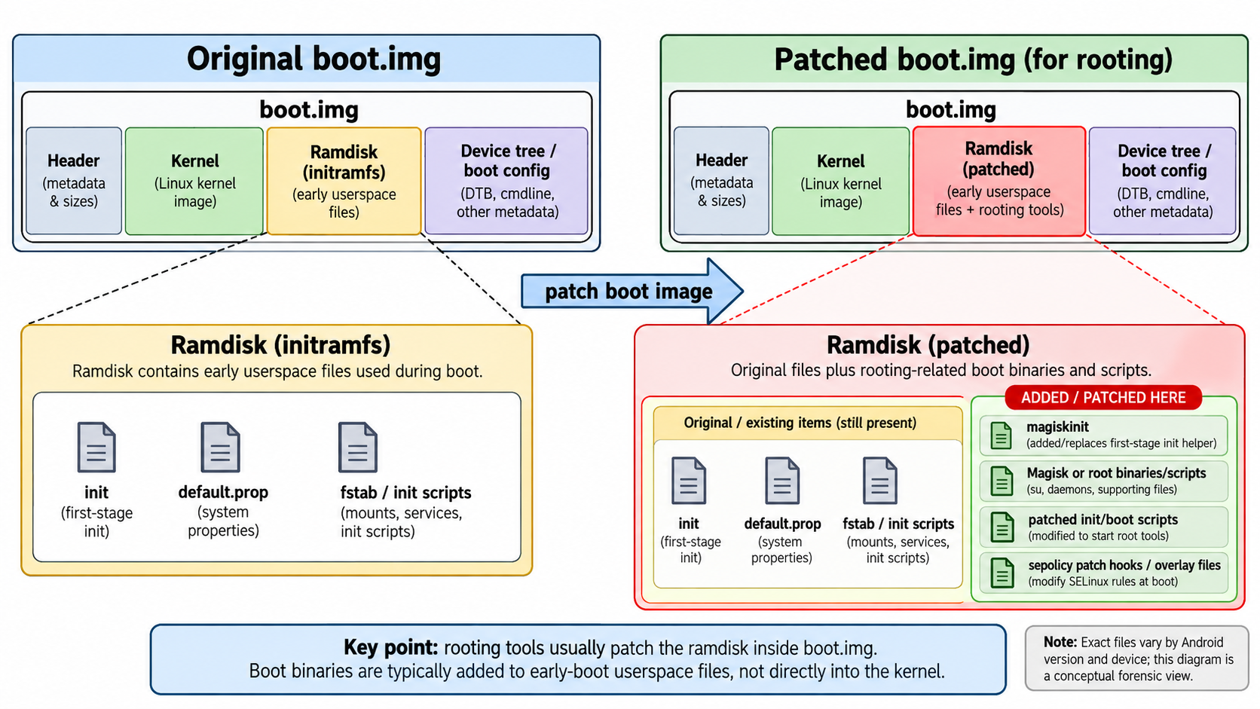

Slide 7
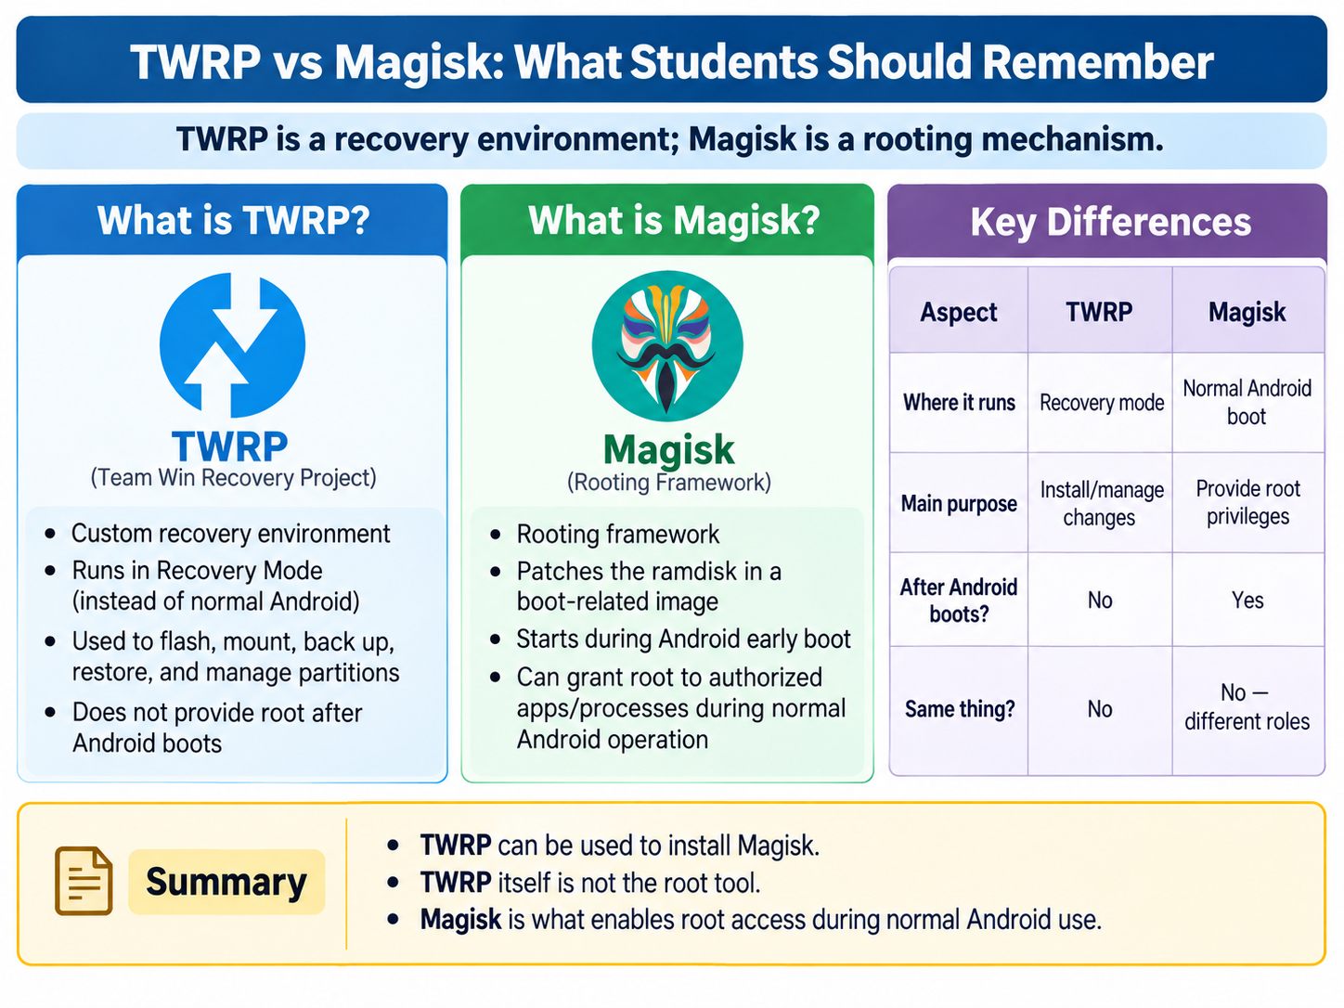

Slide 8
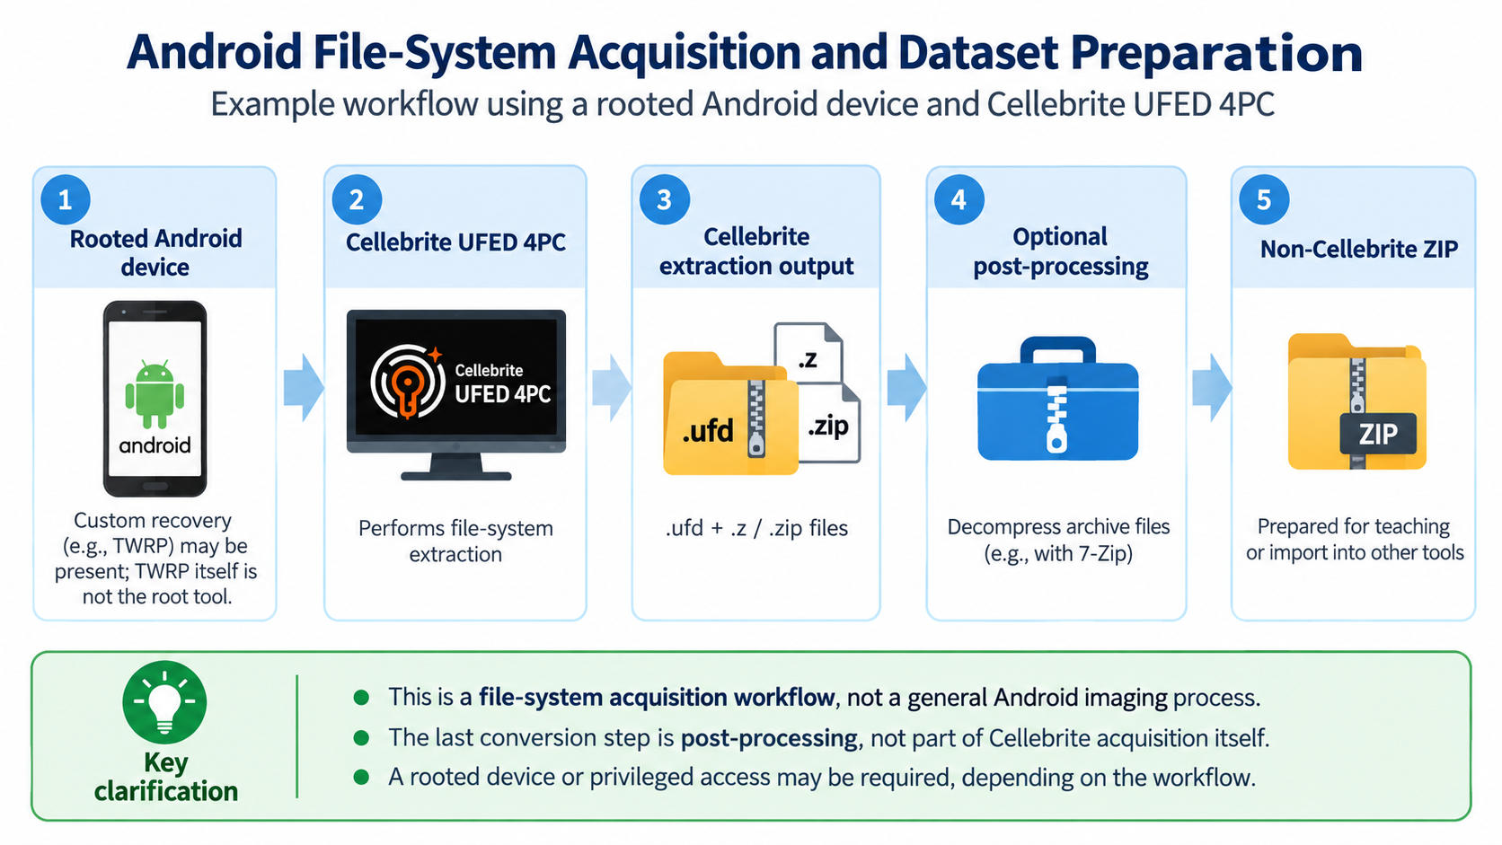

Slide 9
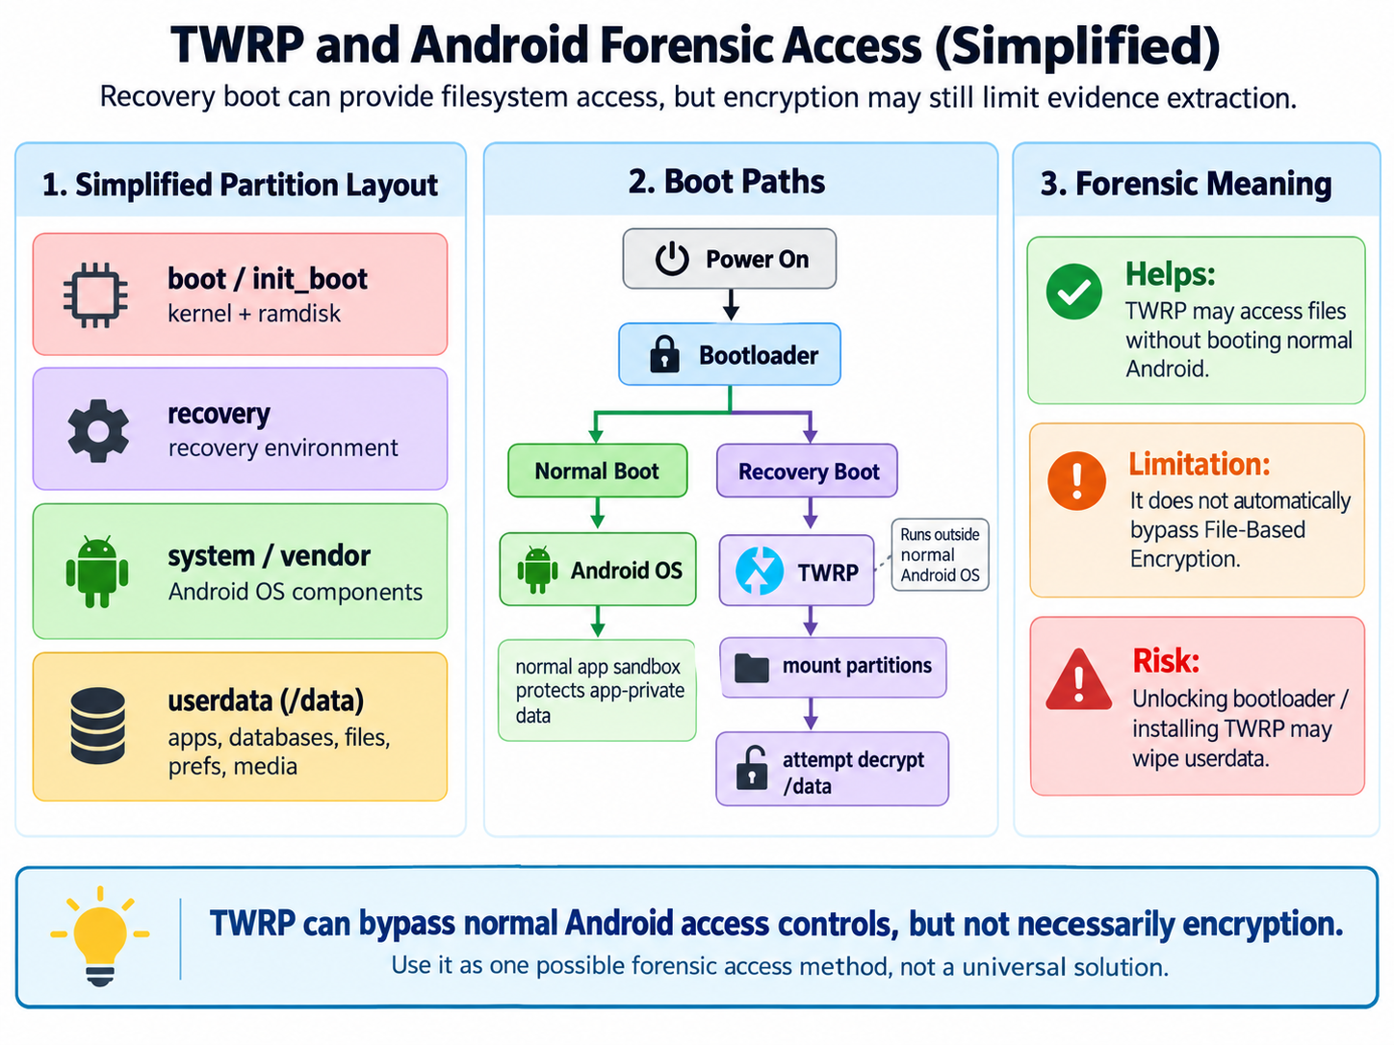
Notes:
Recall: Android devices have separate partitions for different parts of the system:
Boot partition: Contains the kernel and ramdisk for normal booting.
System partition: Holds the main OS files.
Recovery partition: A small, independent mini-OS that loads when you boot into recovery mode (usually via button combos like Volume Up + Power).
Data partition: User data, apps, settings.
TWRP is essentially a standalone, lightweight operating environment (based on a minimal Linux system) that gets flashed (installed) into the recovery partition. When you boot into recovery:
The device loads TWRP instead of the stock recovery.
It runs completely separate from your main Android OS — it doesn't touch or depend on your installed ROM unless you tell it to.
It mounts (makes accessible) partitions like /system, /data, /cache, and often /sdcard (internal storage or external SD).
On many devices, it can even decrypt the /data partition if it's encrypted (with your PIN/pattern), allowing full backups/restores.

Slide 10
Prepare Android Image

Slide 11
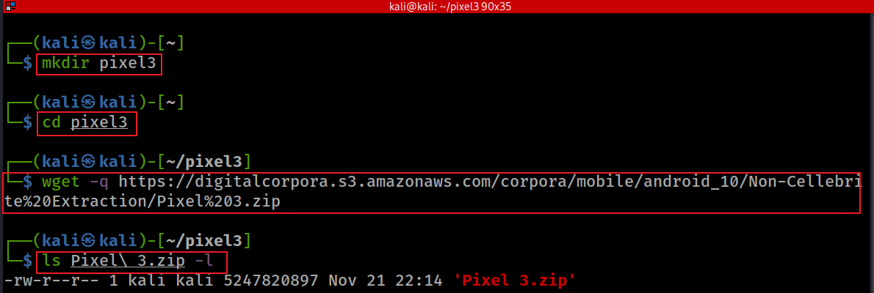
Download Pixel 3 image
A stock image of Android 10
The “%20" in the http link presents a space
The “\" in file name as an Escape Character
https://corp.digitalcorpora.org/corpora/mobile/android_10
https://corp.digitalcorpora.org/corpora/mobile/android_13/
https://corp.digitalcorpora.org/corpora/mobile/android_14/
https://thebinaryhick.blog/public_images/
Notes:
mkdir pixel3
cd pixel3
wget -q https://digitalcorpora.s3.amazonaws.com/corpora/mobile/android_10/Non-Cellebrite%20Extraction/Pixel%203.zip
ls Pixel\ 3.zip -l
https://linuxhint.com/kali_linux_top_forensic_tools/#:~:text=The%20hashdeep%20tool%20is%20a,are%20generated%20with%20every%20output.
https://digitalcorpora.org/corpora/cell-phones/

Slide 12
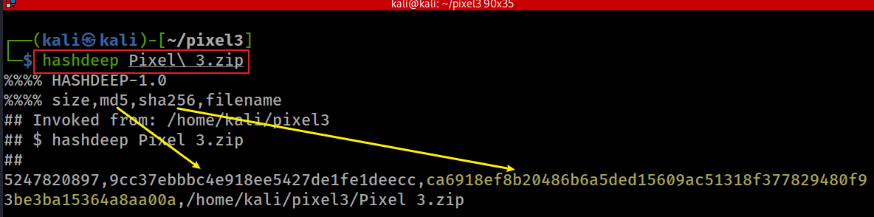
Verify hashes
SHA2-256: ca6918ef8b20486b6a5ded15609ac51318f377829480f93be3ba15364a8aa00a
Notes:
hashdeep Pixel\ 3.zip
5247820897,9cc37ebbbc4e918ee5427de1fe1deecc,ca6918ef8b20486b6a5ded15609ac51318f377829480f93be3ba15364a8aa00a,/home/kali/pixel3/Pixel 3.zip

Slide 13
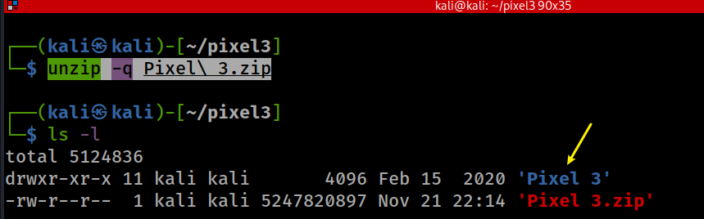
unzip to get Pixel 3 image
Notes:
unzip -q Pixel\ 3.zip

Slide 14
unzip to get Pixel 3 image
Notes:
unzip -q Pixel\ 3.zip

Slide 15
Android Forensics: Data Source
Understand the locations may contain forensics data

Slide 16
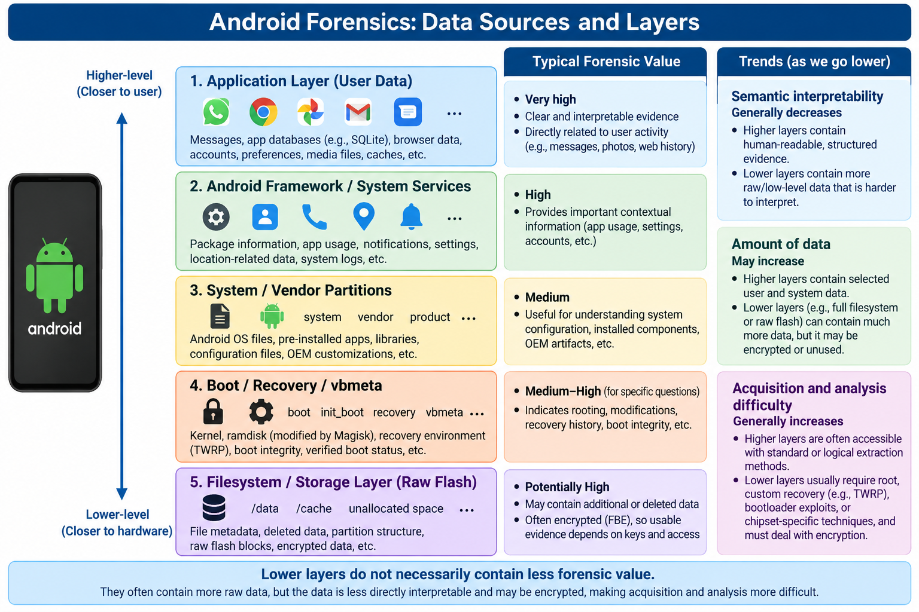
Notes:
https://www.geeksforgeeks.org/operating-systems/difference-between-system-software-and-application-software/

Slide 17
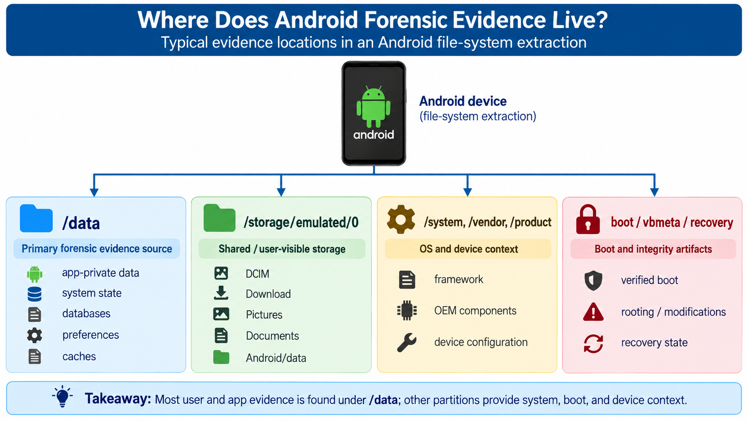
1
2
3

Slide 18
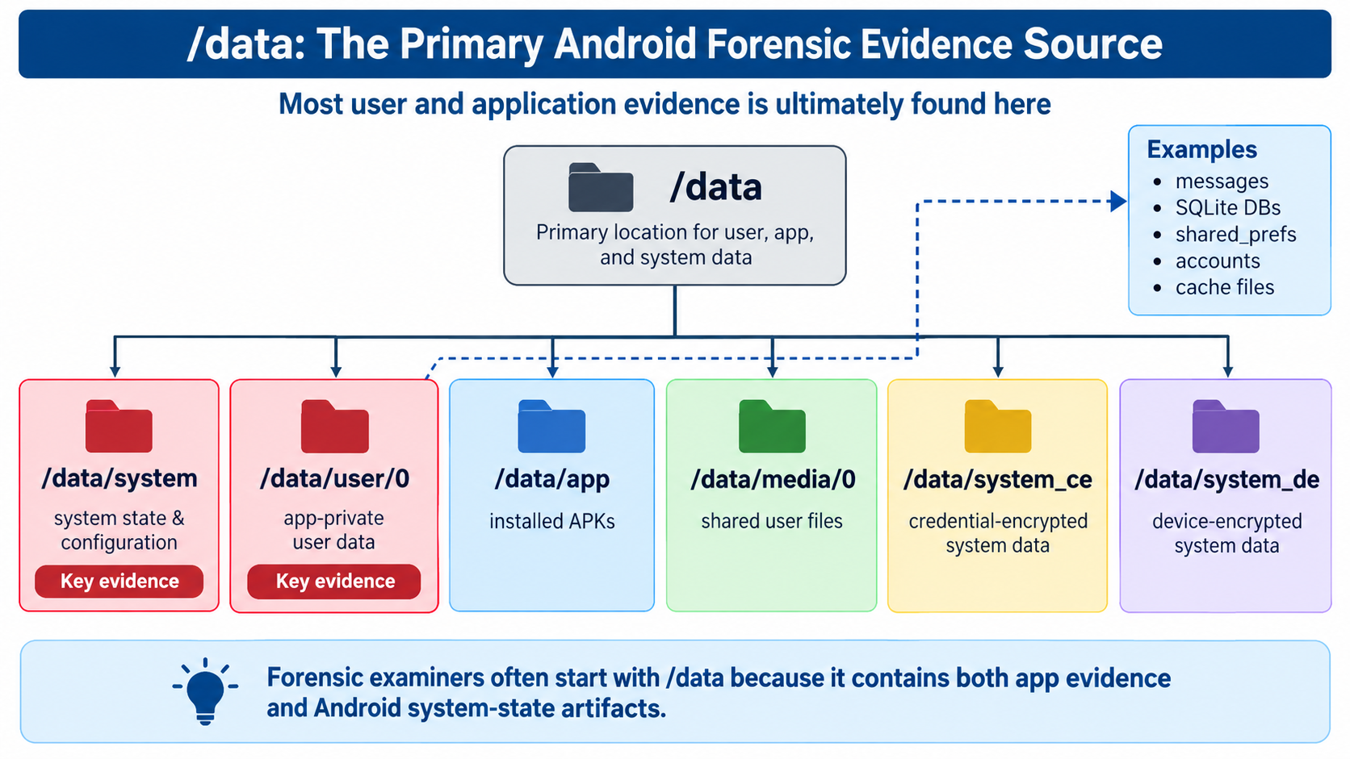
1
1.1
1.2

Slide 19
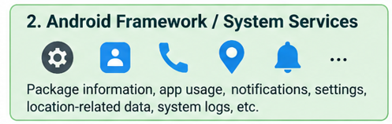
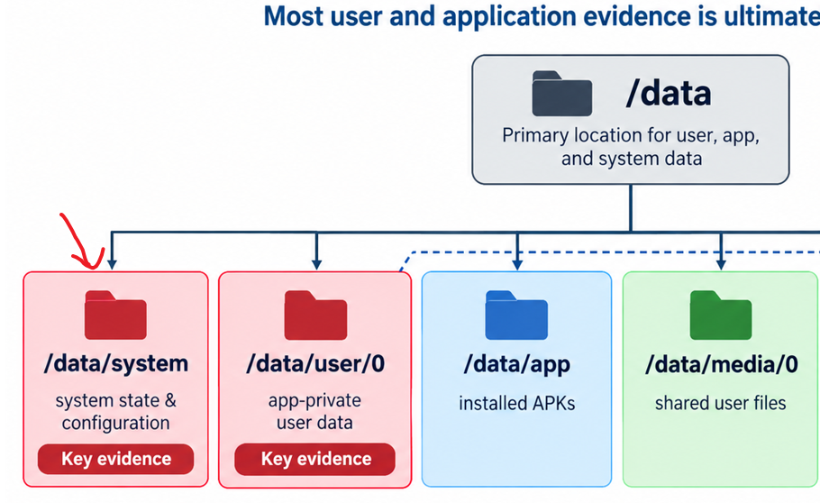


System-Level Evidence: /data/system
Key Question: What was installed, configured, and used on this device?
Representative Artifact | What it can tell the examiner
packages.xml | Installed apps, UIDs, permissions
settings_global.xml | Global device settings
settings_secure.xml | Android ID and secure settings
locksettings.db | Lock-screen configuration
usagestats/ | App usage/activity
netstats/ | Network usage
users/ | Android user profiles
1.1

Slide 20
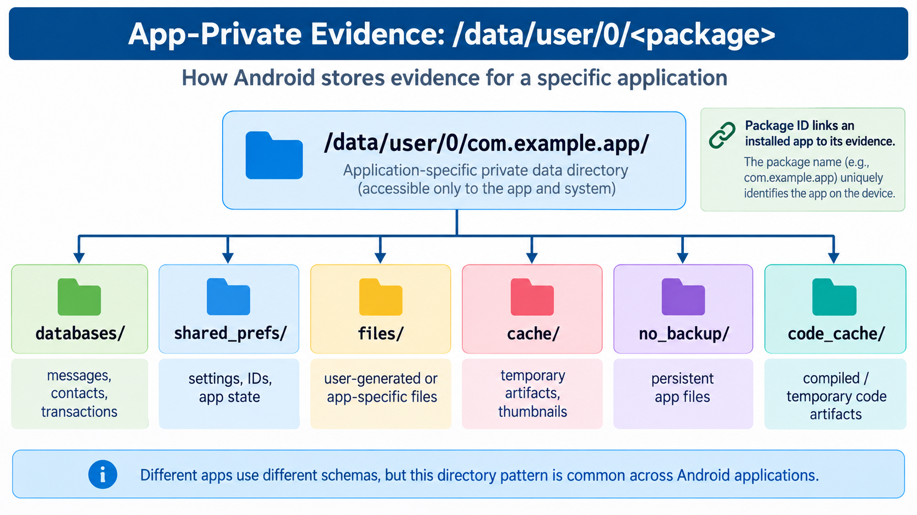
1.2.1

Slide 21
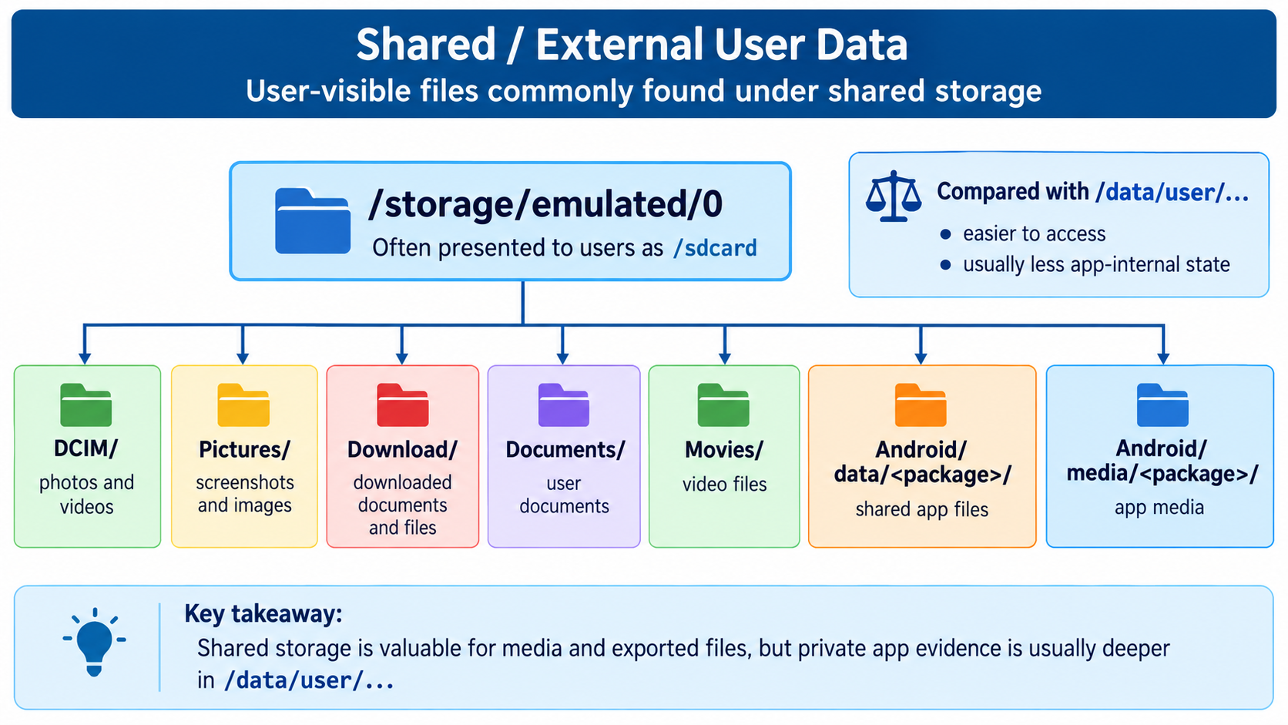
2

Slide 22
Artifact → Location → Forensic Question
Artifact | Location | Forensic question
packages.xml | /data/system/ | What apps were installed?
settings_global.xml | /data/system/users/0/ | What was the device configuration?
settings_secure.xml | /data/system/users/0/ | What device/user identifiers existed?
usagestats/ | /data/system/ | Which apps were recently used?
App *.db | /data/user/0/<package>/databases/ | What did the user do inside the app?

Slide 23
Labs

Slide 24
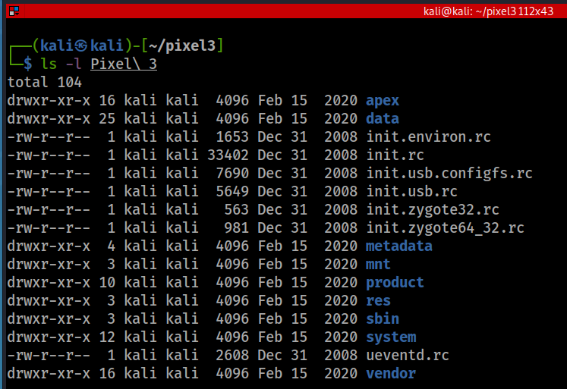
To speed up security updates
  Android Pony EXpress (APEX) is a container format introduced in Android 10 that is used in the install flow for lower-level system modules.
  This format facilitates the updates of system components that don’t fit into the standard Android application model.
list root directory
device
the most important folder
run commands(rc): OS boot script
mount point for other file systems
Resource, e.g., layout, color
binaries for several important daemons.
Android OS (AOSP), exclude Google services
Notes:
https://www.cnblogs.com/shangdawei/p/4513604.html
https://saketupadhyay.medium.com/apex-androids-new-file-format-187e21b8261

Slide 25
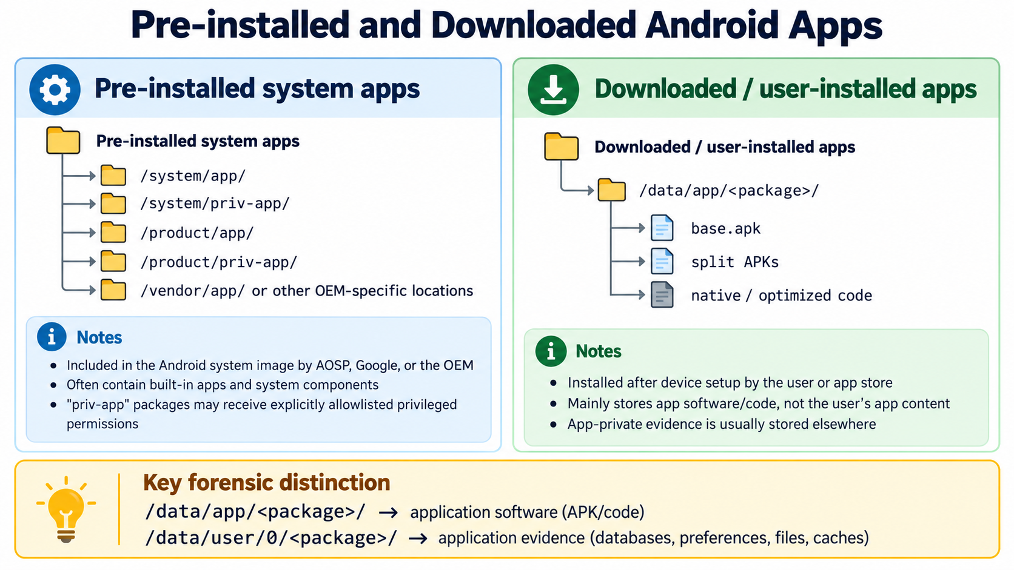
Notes:
https://android.stackexchange.com/questions/3002/where-in-the-file-system-are-applications-installed

Slide 26
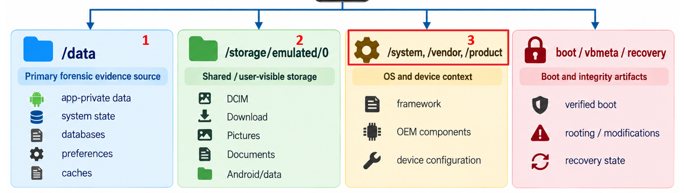
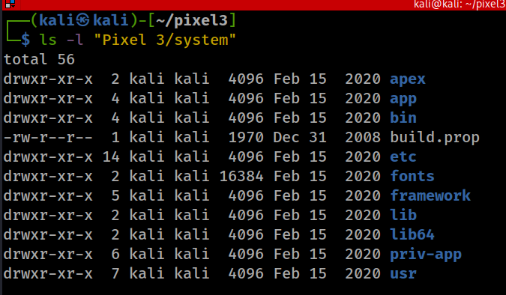
/System: Android OS Project (AOSP)
Android OS pre-installed bloatware apps, often can’t uninstall
"rooting" is required to modify the contents of this partition.
executable binaries, daemons or bash
App Framework
native libraries (C/C++; DLL)
Privileged apps, apps that are eligible for system permissions
all system-wide, read-only files installed by (or provided by) the OS
It is less likely that you need to investigate the folder

Slide 27
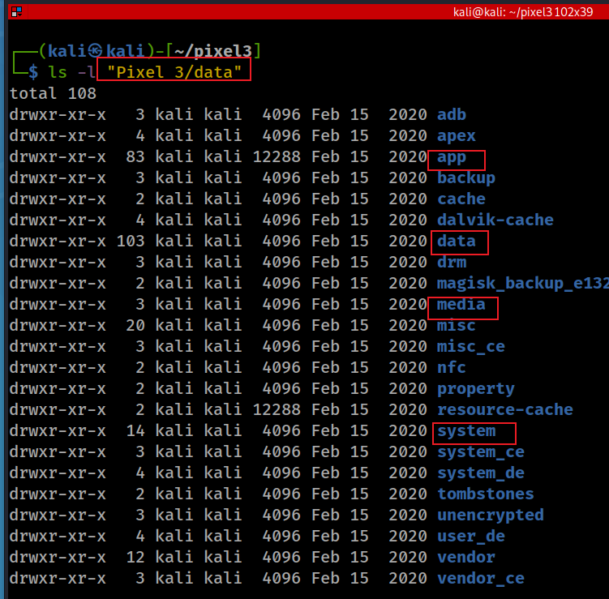
/data
downloaded .apk from Google Play Store
Android apps
App-generated data
System service data
installed apps/generated data
system config/ logs

Slide 28
data/system — Android system state and configuration
Stores system-service configuration and state
  e.g., package, user, lock-screen, usage, notification, and network-related artifacts.
Contains many forensically useful files and databases, for example
  .e.g, packages.xml, locksettings.db, usagestats/, netstats/, and user configuration files.
Access is normally restricted while Android is running; root, privileged access, or a forensic file-system extraction is typically needed to examine the directory directly.
On modern Android with File-Based Encryption, related per-user system data may also appear in:
  /data/system/users/<userID>/
  /data/system_ce/<userID>/ — credential-encrypted
  /data/system_de/<userID>/ — device-encrypted
Notes:
https://android.stackexchange.com/questions/157691/what-does-the-data-system-folder-store-and-its-significance/157862

Slide 29
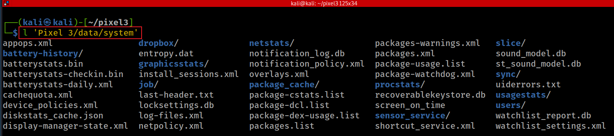
data/system — System State & Configuration
Do not confuse /data/system with /system: /data/system contains mutable device state; /system mainly contains Android OS files.
Notes:
https://android.stackexchange.com/questions/157691/what-does-the-data-system-folder-store-and-its-significance/157862

Slide 30
Common Android Configuration & Artifact File Formats
XML : Common for system and application settings
  Examples: packages.xml, appops.xml, shared_prefs/*.xml
SQLite databases (.db) : Common for structured system and application data
  Examples: locksettings.db, app databases under databases/
Property / key-value files : Store Android system properties and configuration
  Example: build.prop
Plain-text configuration files :
  Examples: .conf, .txt, .rc; init.rc contains Android boot/init instructions
JSON : Used by some Android services and applications
  Example: diskstats_cache.json
Binary / serialized files : Used when Android services store structured data in non-text formats
  Examples: .bin, protobuf/serialized service data

Slide 31
Android System-State & Security Artifacts
Artifact | Forensic meaning
appops.xml | App permission/operation state; helps determine what sensitive capabilities apps could use
batterystats.bin | App and system power-usage history; may provide supporting evidence of app activity
locksettings.db | Lock-screen and authentication configuration
netpolicy.xml | Network policy and app network restrictions
netstats/ | Network usage statistics associated with apps and interfaces
inputmethod/ | Keyboard/IME configuration, enabled input methods, locales
These artifacts describe device state, security configuration, and system-service activity.
Notes:
http://newandroidbook.com/
https://android.stackexchange.com/questions/157691/what-does-the-data-system-folder-store-and-its-significance/157862
https://github.com/lywschxd/Understanding-Android-Internals-Volume-One

Slide 32
Apps, Usage & User Artifacts
Artifact | Forensic meaning
packages.xml | Installed packages, UIDs, permissions, versions, and package metadata
packages.list | Simplified mapping of installed packages and UIDs
usagestats/ | App usage history and timestamps
users/ | Android user/profile information and per-user configuration
appwidgets.xml | Widgets configured for a user; may indicate apps actively used
wallpaper_info.xml | User personalization/context; usually supporting evidence
These artifacts help answer: What apps were installed? Which apps were used? Which Android users/profiles existed?

Slide 33
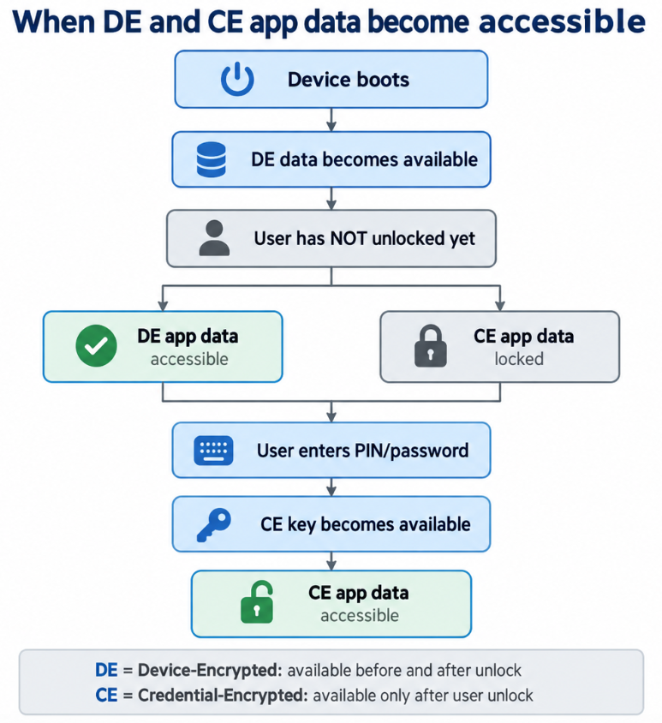
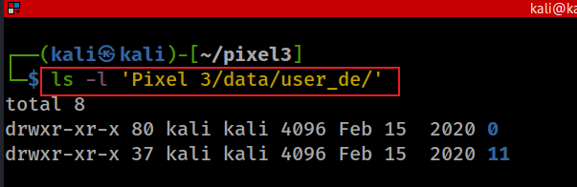
App-Private Data Storage
Primary user (user 0):
/data/data/<package_name>/
→ Alias/compatibility path for:
/data/user/0/<package_name>/
Credential-Encrypted (CE) app data:
/data/user/<userID>/<package_name>/
  Accessible after that user unlocks the device
  Stores most app-private data
  Examples: databases, SharedPreferences, files, caches
Device-Encrypted (DE) app data:
/data/user_de/<userID>/<package_name>/
  Accessible before and after user credential unlock
  Used for data that must be available during Direct Boot
  Examples: alarms that must ring after a reboot (before unlocking a device), phone or messaging services, boot-related settings, limited pre-unlock app state

Slide 34
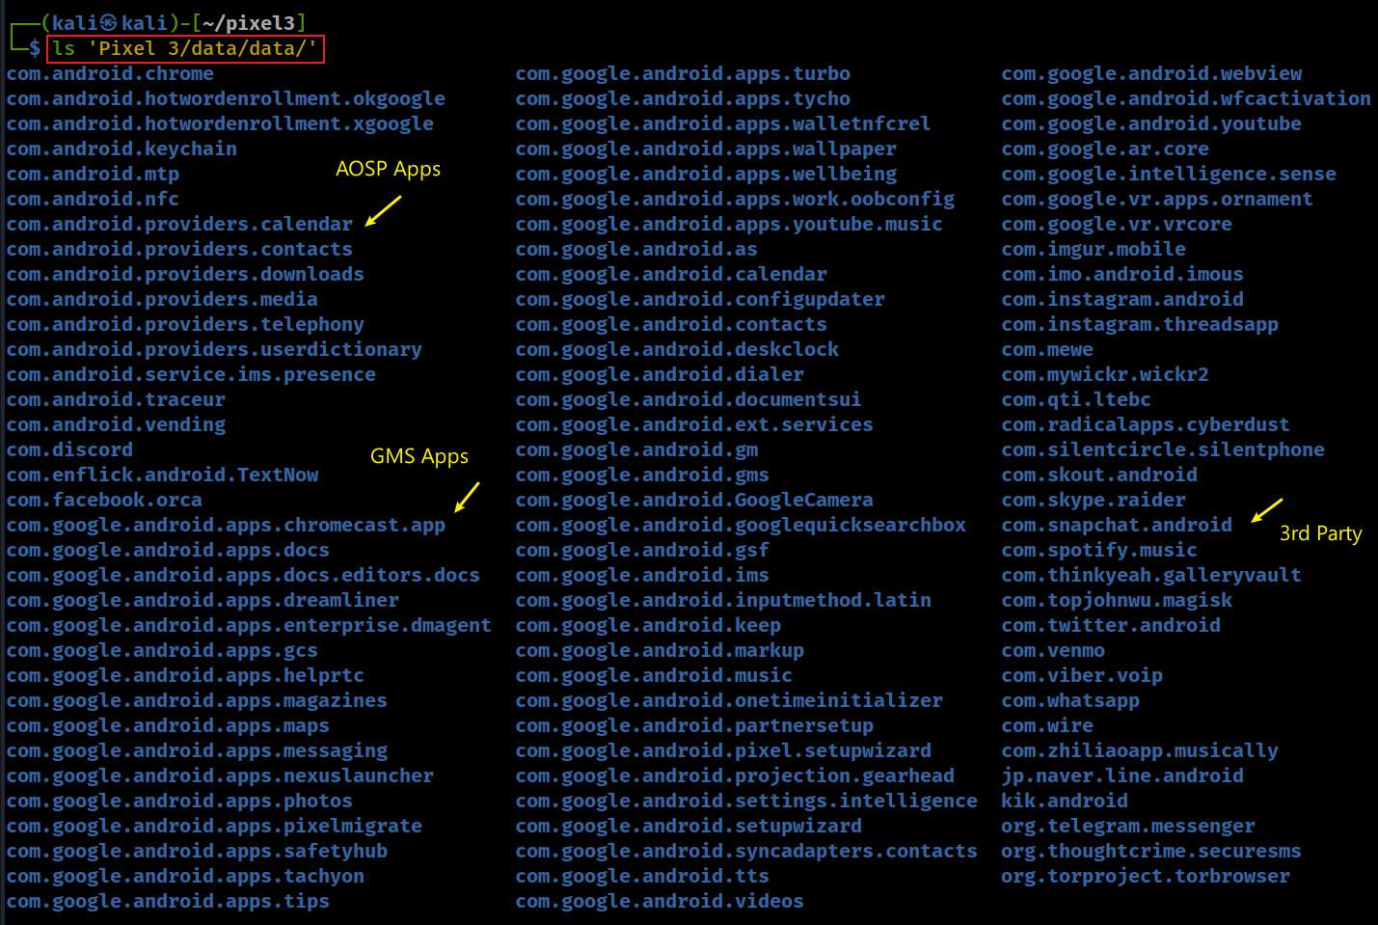
Use ApplicationID as a folder to save application data
Notes:
ls 'Pixel 3/data/data/'

Slide 35
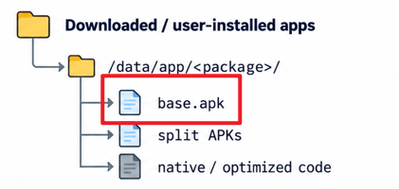
Understand the Apps/Package
Know where to extract forensic data

Slide 36
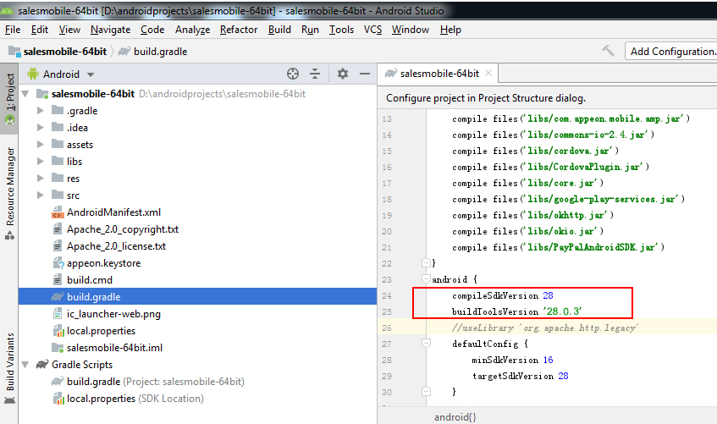
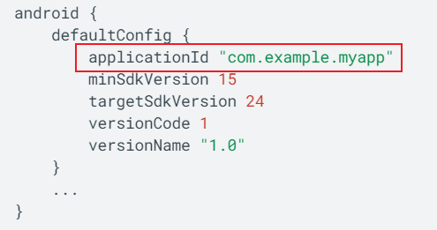
What is Android (application) package .APK?
Android Package (APK) is the package file format
  used by the Android OS
  zip + pre-defined specific structure
  compiled to .dex format
application ID is defined with the applicationId property in build.gradle
  Use the ID to identify apps and the generated data
exactly matches the Java-style package name
As a developer, you should never change the application ID.
Notes:
https://docs.appeon.com/pb2019r2/appeon_mobile_tutorials/ch04s03s02.html

Slide 37
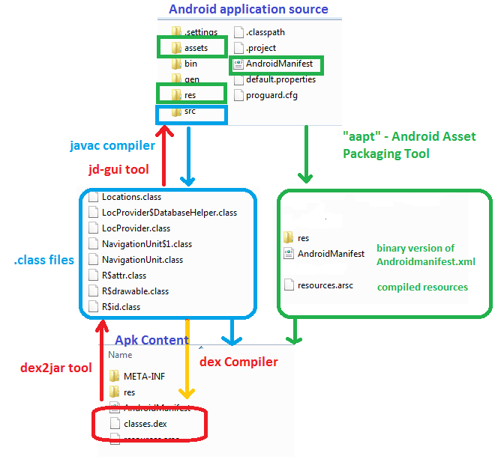
APK compilation and de-compilation
https://www.dunebook.com/apk-decompiler/
DEX (Dalvik Executable):
translates JVM bytecode to DVM bytecode and put all class files to one dex file.

Slide 38
Case Study: Find an app’s official name

Slide 39
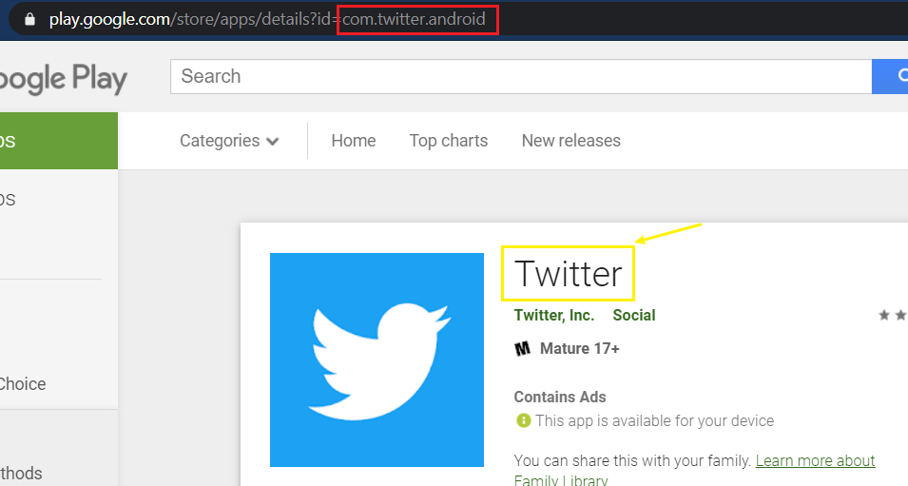
How to find apps’ official names?
https://play.google.com/store/apps/details?id=com.twitter.android

Slide 40
Steps to find the app’s name
Send a http request to https://play.google.com/store/apps/details?id=com.twitter.android
Parse the html
Search for a string (name of the application) from a specific location
How to identify the location? (next slice)

Slide 41
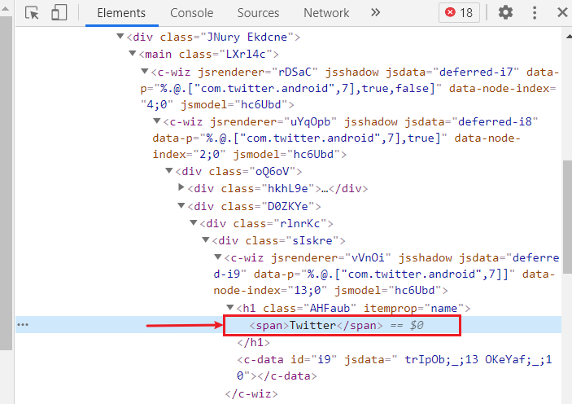
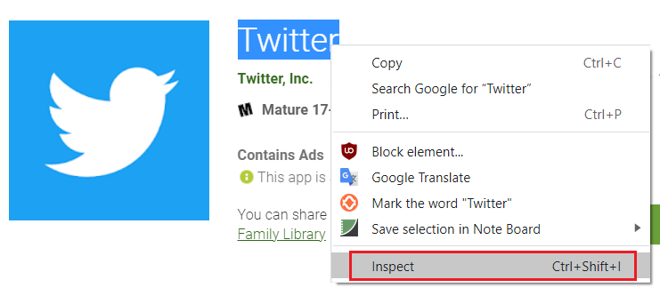
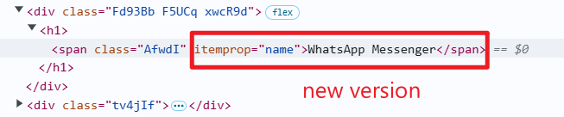
Find inspect the Twitter name location in Chrome
Warming: this is the old version of HTML
Warming: this is the new version

Slide 42

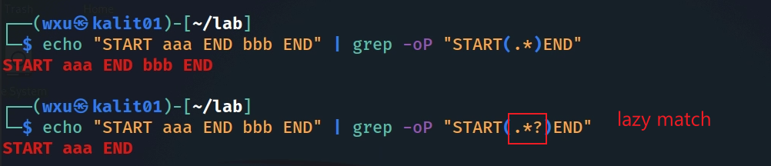
Notes:
echo "START aaa END bbb END" | grep -oP "START(.*)END“
echo "START aaa END bbb END" | grep -oP "START(.*?)END"

Slide 43
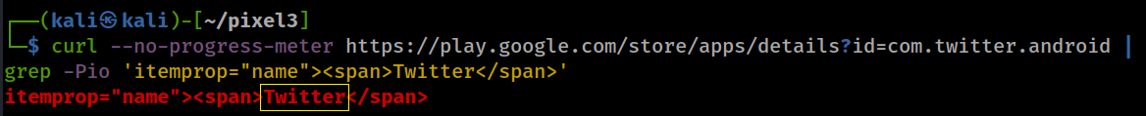
Show the location of Twitter name
Warming: this is the old version, use new version for your lab
-P, --perl-regexp PATTERNS are Perl regular expressions
-o, --only-matching show only nonempty parts of lines that match
-i, --ignore-case ignore case distinctions in patterns and data
Only show the name Twitter name (only match the word between 'itemprop="name"><span> and </span> )
? : lazy match
\K : Keep text matched so far out of the return match (discard previous match)
(?=pattern) : used as a zero-width look-ahead assertion after the text you want to output
Notes:
curl --no-progress-meter https://play.google.com/store/apps/details?id=com.twitter.android | grep -Pio 'itemprop="name"><span>Twitter</span>’
curl --no-progress-meter https://play.google.com/store/apps/details?id=com.twitter.android | grep -Pio 'itemprop="name"><span>\K.*?(?=</span>)’
echo "START aaa END START bbb END" | grep -oP 'START(.*)END’
echo "START aaa END START bbb END" | grep -oP 'START(.*?)END'

Slide 44
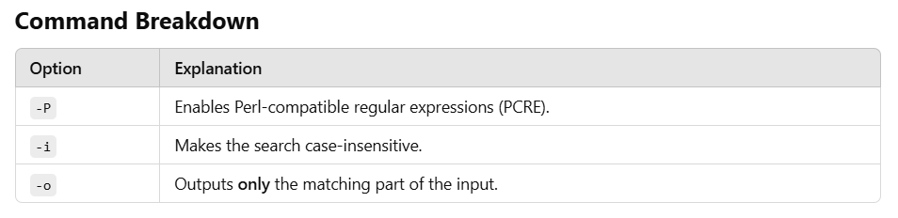
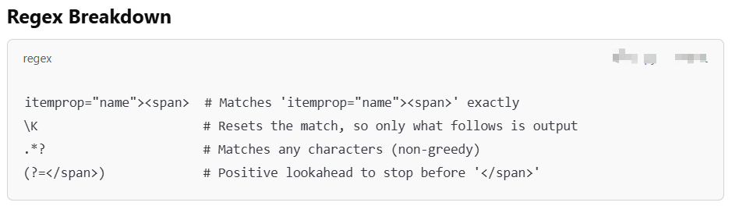

Slide 45
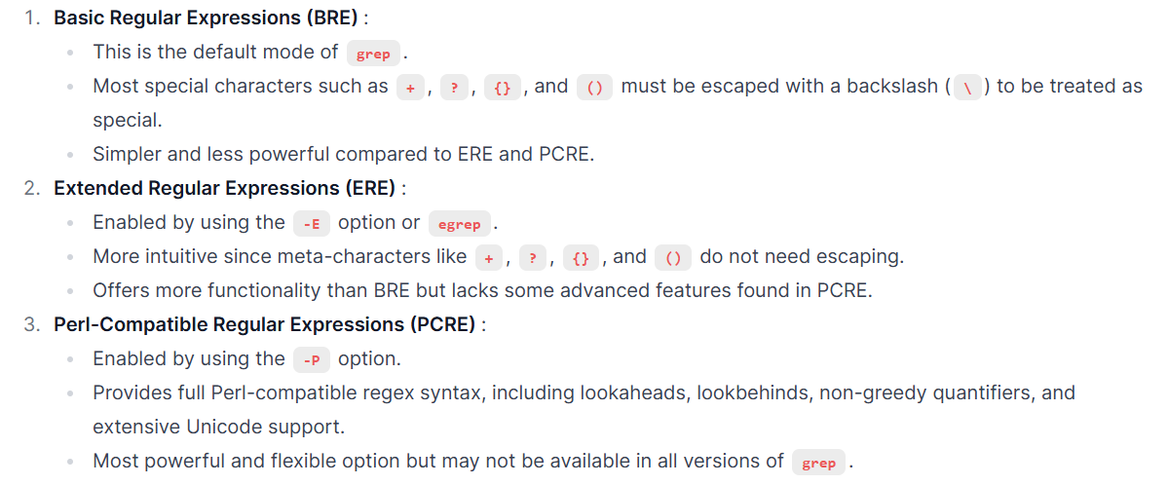
Grep supports multiple regular expression (regex) syntaxes

Slide 46
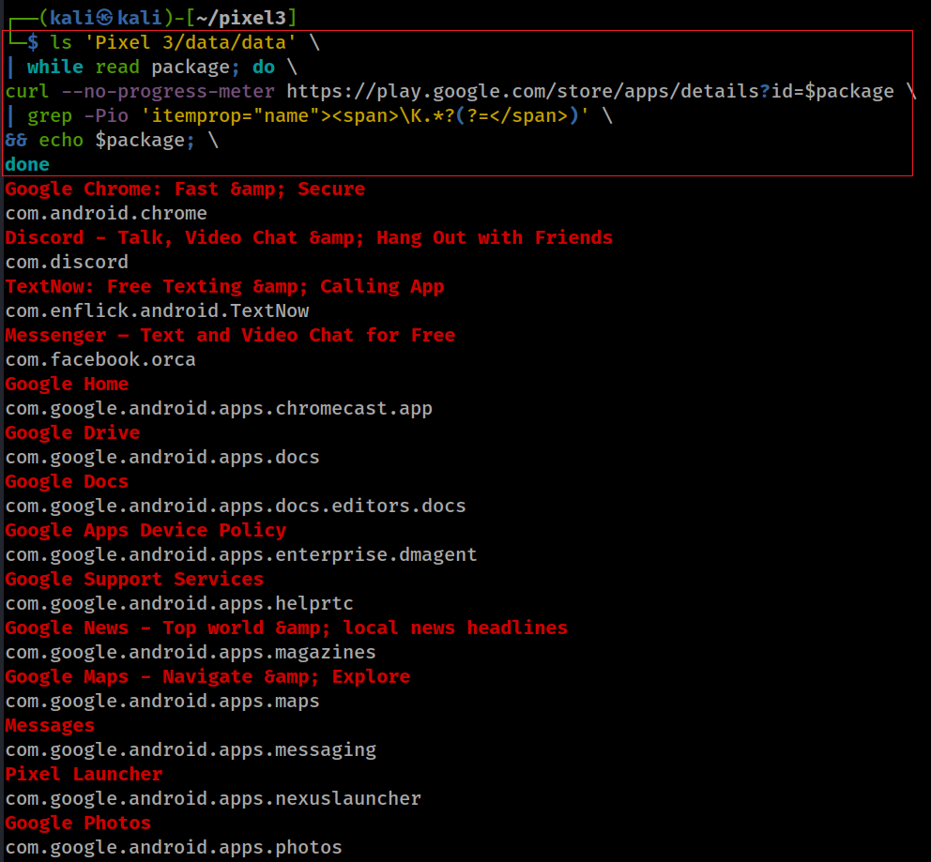
List all app names and package ID
ls 'Pixel 3/data/data' \
| while read package; do \
curl --no-progress-meter https://play.google.com/store/apps/details?id=$package \
| grep -Pio 'itemprop="name"><span>\K.*?(?=</span>)' \
&& echo $package; \
done
Notes:
ls 'Pixel 3/data/data' \
| while read package; do \
curl --no-progress-meter https://play.google.com/store/apps/details?id=$package \
| grep -Pio 'itemprop="name"><span>\K.*?(?=</span>)' \
&& echo $package; \
done
Google Chrome: Fast &amp; Secure
com.android.chrome
Discord - Talk, Video Chat &amp; Hang Out with Friends
com.discord
TextNow: Free Texting &amp; Calling App
com.enflick.android.TextNow
Messenger – Text and Video Chat for Free
com.facebook.orca
Google Home
com.google.android.apps.chromecast.app
Google Drive
com.google.android.apps.docs
Google Docs
com.google.android.apps.docs.editors.docs
Google Apps Device Policy
com.google.android.apps.enterprise.dmagent
Google Support Services
com.google.android.apps.helprtc
Google News - Top world &amp; local news headlines
com.google.android.apps.magazines
Google Maps - Navigate &amp; Explore
com.google.android.apps.maps
Messages
com.google.android.apps.messaging
Pixel Launcher
com.google.android.apps.nexuslauncher
Google Photos
com.google.android.apps.photos
Data Transfer Tool
com.google.android.apps.pixelmigrate
Personal Safety
com.google.android.apps.safetyhub
Google Duo - High Quality Video Calls
com.google.android.apps.tachyon
Google Fi
com.google.android.apps.tycho
Google Pay (old app)
com.google.android.apps.walletnfcrel
Wallpapers
com.google.android.apps.wallpaper
Digital Wellbeing
com.google.android.apps.wellbeing
YouTube Music - Stream Songs &amp; Music Videos
com.google.android.apps.youtube.music
Google Calendar
com.google.android.calendar
Contacts
com.google.android.contacts
Clock
com.google.android.deskclock
Phone by Google - Caller ID &amp; Spam Protection
com.google.android.dialer
Gmail
com.google.android.gm
Google Play services
com.google.android.gms
Google Camera
com.google.android.GoogleCamera
Google
com.google.android.googlequicksearchbox
Carrier Services
com.google.android.ims
Gboard - the Google Keyboard
com.google.android.inputmethod.latin
Google Keep - Notes and Lists
com.google.android.keep
Google Play Music
com.google.android.music
Android Auto - Google Maps, Media &amp; Messaging
com.google.android.projection.gearhead
Google Text-to-Speech
com.google.android.tts
Google TV (previously Play Movies &amp; TV)
com.google.android.videos
Android System WebView
com.google.android.webview
YouTube
com.google.android.youtube
Google Play Services for AR
com.google.ar.core
Pixel Ambient Services
com.google.intelligence.sense
Playground (was AR Stickers)
com.google.vr.apps.ornament
Google VR Services
com.google.vr.vrcore
Imgur: Find funny GIFs, memes &amp; watch viral videos
com.imgur.mobile
imo free HD video calls and chat
com.imo.android.imous
Instagram
com.instagram.android
Threads from Instagram
com.instagram.threadsapp
MeWe
com.mewe
Wickr Me – Private Messenger
com.mywickr.wickr2
Dust - a safer place to text
com.radicalapps.cyberdust
Silent Phone - Secure Calling &amp; Messaging
com.silentcircle.silentphone
SKOUT - Meet, Chat, Go Live
com.skout.android
Skype - free IM &amp; video calls
com.skype.raider
Snapchat
com.snapchat.android
Spotify: Listen to podcasts &amp; find music you love
com.spotify.music
Gallery Vault - Hide Pictures And Videos
com.thinkyeah.galleryvault
Twitter
com.twitter.android
Venmo
com.venmo
Viber Messenger - Free Video Calls &amp; Group Chats
com.viber.voip
WhatsApp Messenger
com.whatsapp
Wire • Secure Messenger
com.wire
TikTok
com.zhiliaoapp.musically
LINE: Free Calls &amp; Messages
jp.naver.line.android
Kik
kik.android
Telegram
org.telegram.messenger
Signal Private Messenger
org.thoughtcrime.securesms
Tor Browser: Official, Private, &amp; Secure
org.torproject.torbrowser

Slide 47
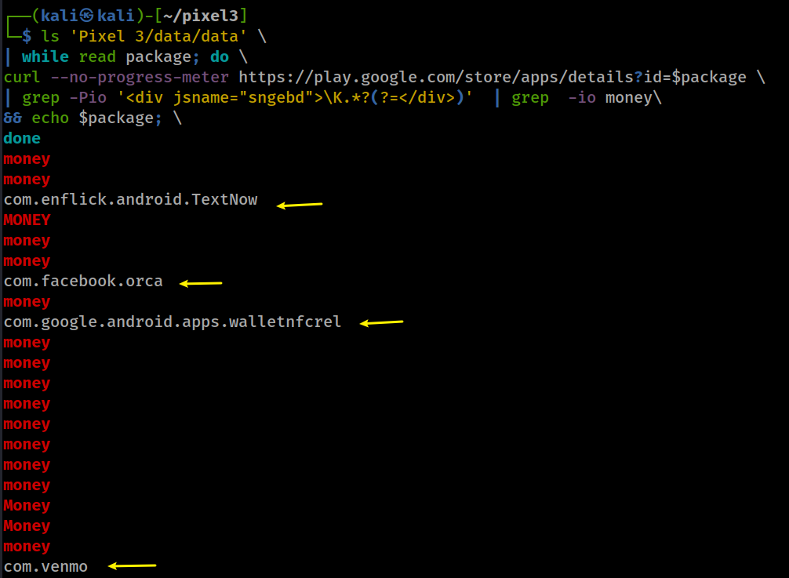
Are there any apps with money transfer function?
Interesting: It seems vemo mentioned money 10 times
Notes:
ls 'Pixel 3/data/data' \
| while read package; do \
curl --no-progress-meter https://play.google.com/store/apps/details?id=$package \
| grep -Pio '<div jsname="sngebd">\K.*?(?=</div>)' | grep -io money\
&& echo $package; \
money
money
com.enflick.android.TextNow
MONEY
money
money
com.facebook.orca
money
com.google.android.apps.walletnfcrel
money
money
money
money
money
money
money
money
Money
Money
money
com.venmo

Slide 48
Python version (List all app names and package IDs/ works for new Playstore HTTP response)
import os
import requests
import re
def get_android_apps():
package = "com.twitter.android"
# Base URL for Google Play Store app details
base_url = "https://play.google.com/store/apps/details?id="
try:
# Fetch the app details page
url = base_url + package
print(url)
response = requests.get(url)
if response.status_code != 200:
print(f"Failed to fetch details for package: {package}")
else:
# Extract the app name using a regular expression
match = re.search(r'itemprop="name">(.*?)</span>', response.text)
app_name = match.group(1) if match else "Unknown"
# Print the app name and package ID
print(f"App Name: {app_name}, Package ID: {package}")
except Exception as e:
print(f"Error processing package {package}: {str(e)}")
if __name__ == "__main__":
get_android_apps()
"""
Explanation of the Code
Listing Package IDs :
- The script uses os.listdir() to list all directories in the Pixel 3/data/data folder. Each directory corresponds to an installed app's package ID.
Fetching App Details :
- For each package ID, the script constructs the Google Play Store URL (https://play.google.com/store/apps/details?id=<package>).
- It uses the requests library to fetch the HTML content of the app's details page.
Parsing the HTML :
- The script uses BeautifulSoup from the bs4 module to parse the HTML response.
- It looks for the <h1> tag with the attribute itemprop="name" to extract the app name.
Output :
- The script prints the app name and its corresponding package ID.
"""
Notes:
"""
Explanation of the Code
Listing Package IDs :
- The script uses os.listdir() to list all directories in the Pixel 3/data/data folder. Each directory corresponds to an installed app's package ID.
Fetching App Details :
- For each package ID, the script constructs the Google Play Store URL (https://play.google.com/store/apps/details?id=<package>).
- It uses the requests library to fetch the HTML content of the app's details page.
Parsing the HTML :
- The script uses BeautifulSoup from the bs4 module to parse the HTML response.
- It looks for the <h1> tag with the attribute itemprop="name" to extract the app name.
Output :
- The script prints the app name and its corresponding package ID.
"""
import os
import requests
import re
def get_android_apps():
package = "com.twitter.android"
# Base URL for Google Play Store app details
base_url = "https://play.google.com/store/apps/details?id="
try:
# Fetch the app details page
url = base_url + package
print(url)
response = requests.get(url)
if response.status_code != 200:
print(f"Failed to fetch details for package: {package}")
else:
# Extract the app name using a regular expression
match = re.search(r'itemprop="name">(.*?)</span>', response.text)
app_name = match.group(1) if match else "Unknown"
# Print the app name and package ID
print(f"App Name: {app_name}, Package ID: {package}")
except Exception as e:
print(f"Error processing package {package}: {str(e)}")
if __name__ == "__main__":
get_android_apps()

Slide 49
Homework
Complete the lab by following screenshots
  including Linux commands and Python code
May change app name regular expression pattern because the Google Play Store encodes app names differently in HTML pages
Need to show Python execution results

