Slide 1
Digital IC Design
Hyperbolic Rotation:
Vectoring Mode
Department of Electronics Engineering, Chang Gung University
Presented by: 蕭銘宏 B1027236

Slide 2
Outline
Department of Electronics Engineering, CGU
Algorithm
Floating/Fixed Point Simulation
RTL Implementation
Synthesis Result

Slide 3
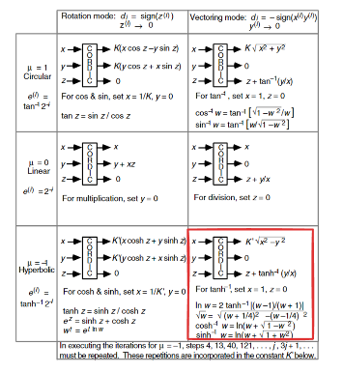
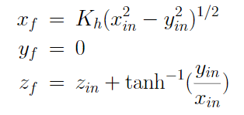
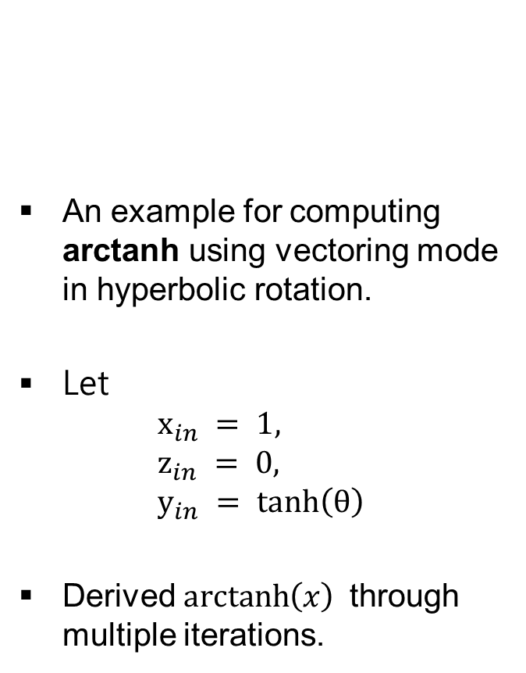
Algorithm
Digital IC Design Department of Electronics Engineering, CGU
An example for computing arctanh using vectoring mode in hyperbolic rotation.
Let
$$x_{in} = 1, \\ z_{in} = 0, \\ y_{in} = tanh\left(θ\right)$$
Derived $\operatorname{arctanh}\left(x\right)$through multiple iterations.
Notes:
Cordic 有分三種座標、兩種模式，我做的是 Hyperbolic 座標下的 Vectoring mode，以反雙曲正切函數(arctanh)的計算為期末專題。
---
tanh: hyperbolic tangent

Slide 4
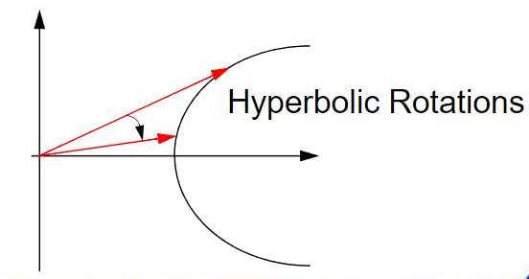
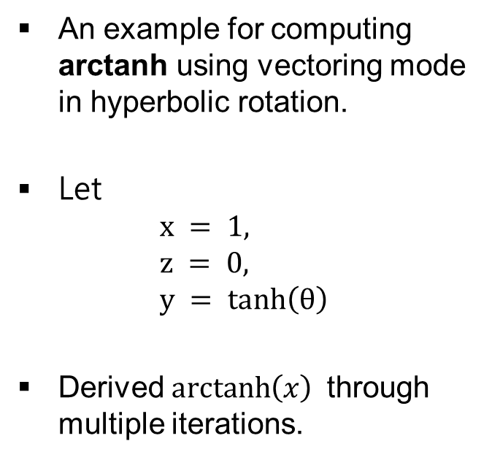
Algorithm
Digital IC Design Department of Electronics Engineering, CGU
An example for computing arctanh using vectoring mode in hyperbolic rotation.
Let
$$x = 1, \\ z = 0, \\ y = tanh\left(θ\right)$$
Derived $\operatorname{arctanh}\left(x\right)$through multiple iterations.
Notes:
Cordic 有分三種座標、兩種模式，我做的是 Hyperbolic 座標下的 Vectoring mode，以反雙曲正切函數(arctanh)的計算為期末專題。
---
tanh: hyperbolic tangent

Slide 5
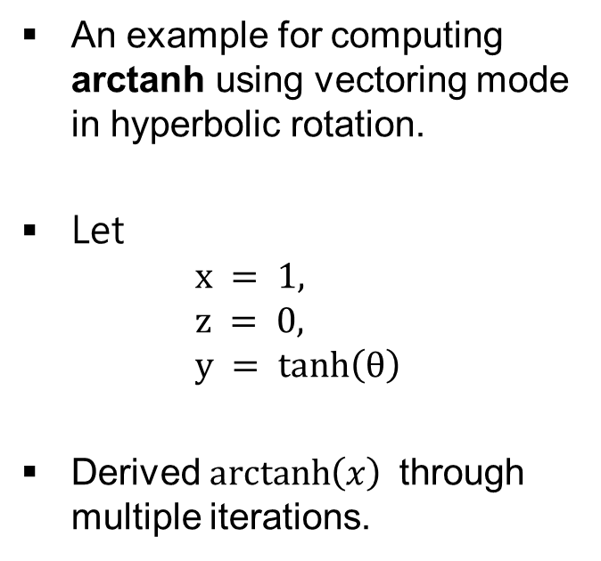
Digital IC Design Department of Electronics Engineering, CGU
Floating/Fixed Point Simulation
An example for computing arctanh using vectoring mode in hyperbolic rotation.
Let
$$x = 1, \\ z = 0, \\ y = tanh\left(θ\right)$$
Derived $\operatorname{arctanh}\left(x\right)$through multiple iterations.
Notes:
Cordic 有分三種座標、兩種模式，我做的是 Hyperbolic 座標下的 Vectoring mode，以反雙曲正切函數(arctanh)的計算為期末專題。
---
tanh: hyperbolic tangent

Slide 6
Introduction
Computer-Aided VLSI System Design Graduate Institute of Electronics Engineering, NTU
請完成一Gauss-Seidel Iteration Machine(GSIM)的電路設計來求出多元線性聯立方程式(Linear Equation)之解
如下圖所示，矩陣A、B為已知之整數值，待求矩陣X之解
– 在此專題中，N 固定為16

Slide 7
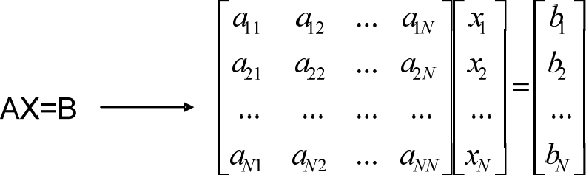
Introduction
Computer-Aided VLSI System Design Graduate Institute of Electronics Engineering, NTU
請完成一Gauss-Seidel Iteration Machine(GSIM)的電路設計來求出多元線性聯立方程式(Linear Equation)之解
如下圖所示，矩陣A、B為已知之整數值，待求矩陣X之解
– 在此專題中，N 固定為16

Slide 8

Computer-Aided VLSI System Design
Graduate Institute of Electronics Engineering, NTU
Block Diagram
testbed.v
o_mem_rreq
o_mem_addr ¹⁰
Matrix Memory
i_clk
i_mem_rrdy
i_reset
i_mem_dout 256
i_module_en
GSIM.v
i_mem_dout_vld
i_matrix_num ⁵
o_proc_done
o_x_wen
Solution Memory
o_x_addr
9
o_x_data
32

Slide 9


Computer-Aided VLSI System Design
Graduate Institute of Electronics Engineering, NTU
Input/Output
 | Signal Name | I/O | Width | Simple Description
 | i_clk | I | 1 | 本系統為同步於時脈正緣之同步設計。 (註: Host端採clk正緣時送資料。)
 | i_reset | I | 1 | 高位準”非”同步(active high asynchronous)之系統重置信號。
 | i_module_en | I | 1 | 模組控制訊號。當為high時模組操作有效。
 | i_matrix_num | I | 5 | 要計算矩陣數量。
 | o_proc_done | O | 1 | 運算完成訊號。當將所有要求的解輸出後，須將此訊號設為high代表運算完成，並在i_module_en為0時再設為low。
 | o_mem_rreq | O | 1 | 要讀取matrix memory時須設為high。
 | o_mem_addr | O | 10 | 要讀取matrix memory之位址。
 | i_mem_rrdy | I | 1 | 要讀取matrix memory之ready訊號。為high時代表此時可讀取 memory data。
 | i_mem_dout | I | 256 | Matrix memory data 。 共 有 16 筆 16-bit 資料 ， 採 用 2’s complement表示。細節請參考。
 | i_mem_dout_vld | I | 1 | Matrix memory data有效訊號。為high時代表此時i_mem_dout 有效。
 | o_x_wen | O | 1 | 輸出資料有效之控制訊號。當為High時，表示目前輸出的資料為有效的。
 | o_x_addr | O | 9 | 輸出矩陣解之位址。
 | o_x_data | O | 32 | 要輸出之矩陣解。採用2’s complement表示(16-bit整數+16-bit 小數)。

Slide 10



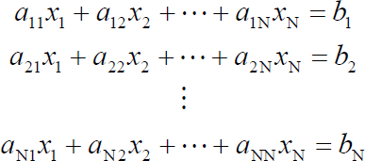
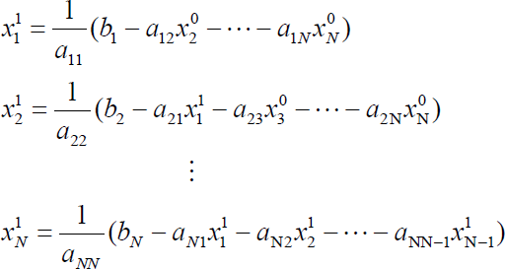
Gauss-Seidel Iteration Machine
Computer-Aided VLSI System Design Graduate Institute of Electronics Engineering, NTU
所求多元線性聯立方程式如下式所示
(1)
欲求x₁, x₂, …, x_{N}的值，可以將上式整理成底下式子
(2)

Slide 11

Gauss-Seidel Iteration Machine
Computer-Aided VLSI System Design Graduate Institute of Electronics Engineering, NTU
Gauss-Seidel Iteration就是將(2)式作相同的動作數次的疊代，其行為如下式所示，反覆地疊代數次後，即可將所有待求的x值收斂在某一個值，該x值即為所求，
– 在此專題中，疊代次數固定為16。
(3)

Slide 12


Computer-Aided VLSI System Design
Graduate Institute of Electronics Engineering, NTU
Data Presentation
2’s complement
– Ex. 16-bit(2-bit整數+14-bit小數) -> S1.14
矩陣A及b都是放在外面的memory中，由設計者決定怎麼讀取
a1,1 a2,1
a16,1
a1,2 a2,2
...
...
a1,16 a2,16
Matrix Memory (1024x256 bits)
addr
0
1
a16,1
...
a2,1
1/a_{1,1}
A =
...
...
...
...
a16,2
1/a_{2,2}
a1,2
...
...
a16,2
a16,16
15
1/a16,16
...
a2,16
a1,16
b₁ b₂
b16
...
16
b16
b₂
b₁
b =
...
...
Data presentation:
S15
S1.14
S15

Slide 13
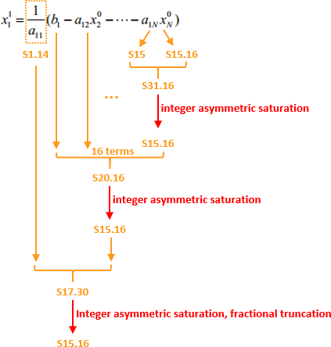
Order for Computation
Computer-Aided VLSI System Design Graduate Institute of Electronics Engineering, NTU
Integer asymmetric saturation
若發生overflow，則取其能表示的最大值/最小值來做為結果
Fractional truncation
小數部分當bit-width變小時直接truncate即可(不用四捨五入)

Slide 14

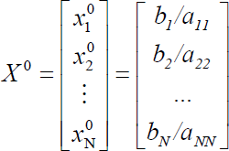
Computer-Aided VLSI System Design
Graduate Institute of Electronics Engineering, NTU
Initialization
X 初始化方式如下
b_{N}: S15 1/a_{NN}: S1.14
S15.16
S17.14
Integer asymmetric saturation

Slide 15

Matrix Storage
Computer-Aided VLSI System Design Graduate Institute of Electronics Engineering, NTU
假設要處理3個矩陣，則其儲存在memory的順序如下
A1 -> b1 -> A2 -> b2 -> A3 -> b3
addr
0
Matrix Memory (1024x256 bits)
A1
16
17
b1
A2
33
34
b2
A3
40
b3

Slide 16

Result Output
Computer-Aided VLSI System Design Graduate Institute of Electronics Engineering, NTU
將矩陣解輸出儲存至solution memory
– 一次只輸出32-bit答案
Solution Memory
_{addr} (512x32 bits)
Solution Memory
_{addr} (512x32 bits)
0
X1
0
1
x
1
x₂
x₁ x₂
16
X =
...
如果要解的矩陣有三個
X2
...
32
x16
15
x16
X3
(a)
(b)

Slide 17

Specification
Computer-Aided VLSI System Design Graduate Institute of Electronics Engineering, NTU
Only worst-case library is used for synthesis.
The synthesis result of data type should NOT include any Latch.
The slack for setup-time should be non-negative.
No any timing violation and glitches for the gate level
simulation and post-layout simulation.

Slide 18







Computer-Aided VLSI System Design
Graduate Institute of Electronics Engineering, NTU
Waveform
i_clk
i_reset
i_module_en
(1)
i_matrix_num 0
o_proc_done
3
3
0
(4)
o_mem_rreq
(2)o_mem_addr
i_mem_rrdy
0
a0
a1
a2 a3
a4
a255
i_mem_dout
0
d0
0
d1 d2 d3
0
0
i_mem_dout_vld
o_x_wen
o_x_addr
0
0
d1 d2 d3
0
o_x_data
0
0
d1 d2 d3
0
(3)

Slide 19



Computer-Aided VLSI System Design
Graduate Institute of Electronics Engineering, NTU
Handshake
i_clk
o_mem_rreq & i_mem_rrdy -> addr received
o_mem_rreq
o_mem_addr
0
a0
a1
a2 a3
a4
i_mem_rrdy
i_mem_dout
0
d0
0
d1 d2 d3
0
i_mem_dout_vld
Guarantee next cycle, data valid
i_mem_rrdy在每個cycle為1的機率為0.5

Slide 20

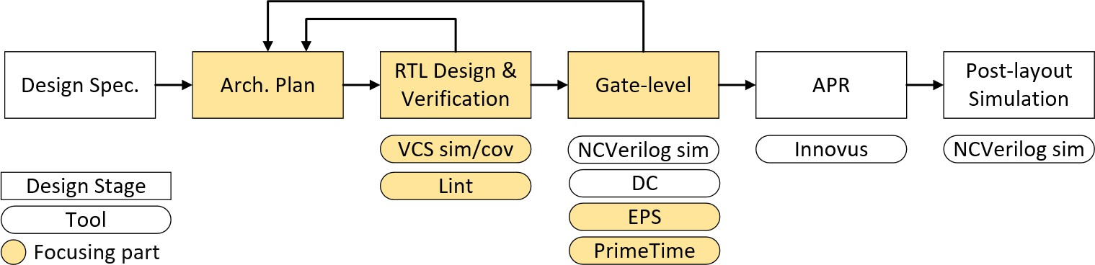
Computer-Aided VLSI System Design
Graduate Institute of Electronics Engineering, NTU
Design Flow
NCVerilog sim

Slide 21
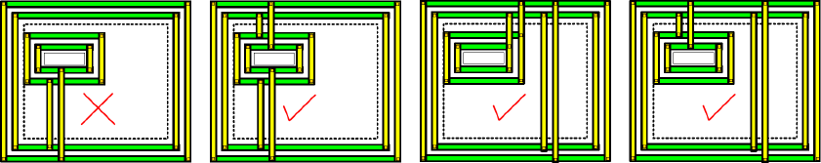
Specifications for APR (1)
Computer-Aided VLSI System Design Graduate Institute of Electronics Engineering, NTU
只需做Marco layout 即不用包含IO Pad 、 Bonding Pad)
set_aspect_ratio 0.6
VDD 與 VSS Power Ring 寬度請各設定為 2um 只須做一組
不需加Dummy Metal
Power Stripe 務必至少加一組，其VDD 、 VSS 寬度各設定為 2um
– Power Stripe 垂直方向至少一組，水平方向可不加

Slide 22
Specifications for APR (2)
Computer-Aided VLSI System Design Graduate Institute of Electronics Engineering, NTU
務必要加Power Rail (follow pin)
Core Filler 務必要加
APR 後之GDSII 檔案務必產生
完成APR DRC/LVS 完全無誤
記得先產生GSIM.ioc，再重新讀取該檔來設定 pin position

Slide 23

Grading Policy (1)
Computer-Aided VLSI System Design Graduate Institute of Electronics Engineering, NTU
Baseline 50% + Performance 35% + Report 15%
Item |  | % | Description
RTL Simulation |  | 10 | 通過提供的5個pattern
Verification |  | 10 | Coverage (line 100%), nLint no Error
Synthesis |  | 15 | EPS, Pass gate-level sim
APR |  | 15 | Finish APR with no DRC/LVS errors Pass post-layout simulation
Performance | Area, time | 20 | Area x Time
 | Power | 15 | 10:Compare active window, total energy 5: idle, idle_after_active
Report |  | 15

Slide 24

Grading Policy (2)
Computer-Aided VLSI System Design Graduate Institute of Electronics Engineering, NTU
Baseline 50% + Performance 35% + Report 15%
Violation | Penalty
不符合 design specification | Performance*0.5
無法通過hidden pattern | Performance*0.5
沒有考慮random i_mem_rrdy | Performance不評分
違反繳交格式與規則 | 總分-3

Slide 25

Grading Policy (3)
Computer-Aided VLSI System Design Graduate Institute of Electronics Engineering, NTU
RTL Simulation 注意事項
沒有考慮random i_mem_rrdy但能通過tb0~tb4也可以拿到所有分數
Coverage 注意事項
Coverage只針對執行tb3的line coverage的結果來進行評分()
Synthesis 注意事項
沒有做EPS但能過gate-level simulation還是能拿到所有分數
有做EPS除了能比較有機會做出比較小的面積以外，Report分數也會
看有沒有使用EPS進行評分
Power注意事項
只需跑gate-level tb4即可
評分會用Energy來進行評分

Slide 26


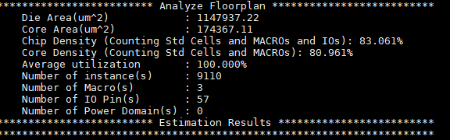

Performance (1)
Computer-Aided VLSI System Design Graduate Institute of Electronics Engineering, NTU
Score = Area × Time
– Area
innovus #> analyzeFloorplan
– Time

Slide 27

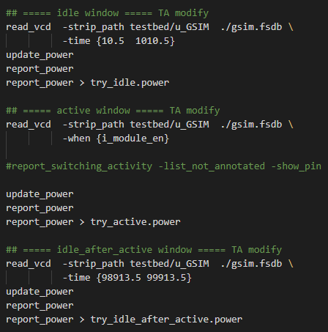
Computer-Aided VLSI System Design
Graduate Institute of Electronics Engineering, NTU
Performance (2)
Power
idle_power和 idle_after_active_power請根據模擬情形進行調整(參考 MTK講義p12)
若idle_power和 idle_after_active_power的 difference超過5%，此部分扣3分

Slide 28

Computer-Aided VLSI System Design
Graduate Institute of Electronics Engineering, NTU
Report
需要包含底下幾個項目
架構設計
硬體優化方法 (latency, area, power…)
nLint report with 0 errors
Coverage result
Congestion map (如果有跑EPS流程)
Primetime power report (Gate-level)
Layout
Area result
Performance 表格

Slide 29

Computer-Aided VLSI System Design
Graduate Institute of Electronics Engineering, NTU
Submission (1)
GSIM.v
GSIM_syn.v
GSIM_syn.sdf
GSIM_pr.v
GSIM_pr.sdf
GSIM.gds
GSIM_final.tar (archive of the design database directory)
report.pdf
all other design files included in your design for rtl simulation (optional)

Slide 30

Submission (2)
Computer-Aided VLSI System Design Graduate Institute of Electronics Engineering, NTU
Due Friday, Jan. 14, 23:59
Final project presentation (MTK experience sharing)
– Date: January 18, 2021

