Slide 1
ECG Classification

Slide 2
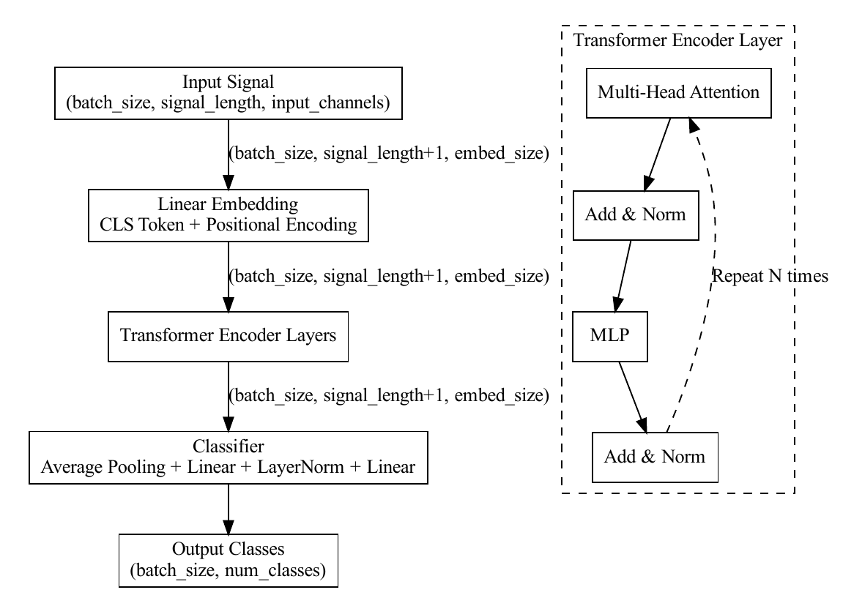
1
186+1
192

