Slide 1

Digital medicine
Case1:
Obesity detection
Group3
葉詠富 310554031
游智鈞 待填
高承翰 待填

Slide 2
contents
01 Introduction
02 Text Preprocessing
03 Method
04 Result

Slide 3
01 Introdcution

Slide 4
Target and dataset
Target
Use a doctor’s diagnosis certificate to determine whether the patient is obese.
Train/Test Dataset
Training data based on textual judgement
Textual judgement: 200 cases obesity vs. 200 cases unmentioned.
Testing data based on intuitive judgement
Intuitive judgement: 200 cases obesity vs. 200 cases absence
Validation Dataset
Validation data (50 cases) based on textual judgement

Slide 5
Data pipeline
Train
Statistic & weight
Dataset
Test
Text preprocessing
W2V
Clear
Validation
result
Naïve Bayes
Random Forest
SVM
Validation

Slide 6
02 Text preprecessing

Slide 7
Text clear
a. Remove punctuation
Remove punctuation and numbers to make word split more precise.
b. Word tokenize
The process of splitting a large sample of text into words.
c. Remove stopword
Used to improve the quality of text features or reduce the dimensionality of text features.
d. Lemmatize
Lemmatization is to remove the affixes of the word and extract the main part of the word.
For example, the word "cars" after lemmatize is "car", and the word "ate" after lemmatize is "eat".

Slide 8
W2V
Advantage
Compared with one hot encoding, Word to vector can consider a word in the context of the article.
Algorithm
word to vector contains two algorithms, Skip-gram and CBOW.
Skip-gram uses the central word to predict the context, and CBOW uses the context to predict the central word.
input
projection
output
input
projection
output
w(t-2)
w(t-2)
w(t-1)
w(t-1)
w(t)
w(t)
w(t+1)
w(t+1)
w(t+2)
w(t+2)
Skip-gram
CBOW

Slide 9
03 method

Slide 10
Statistic
a. Most similar
Use cosine to calculate the angle and find the most similar word of “obesity” and “obese”.
b. Weight
obesity and obese are key words for obesity, so 50 points are given for evaluation.
Morbidly, morbid, hyperlipidemia and obesity-related words are the most similar.
Asthma and htn are not so close, so give a weight of 20 points.
obesity
morbid
asthma
hyperlipidemia
htn
c. Criterion
obese
morbidly
Count the weight of an article, weight greater than 50 points is obesity.
weight
50
28
20

Slide 11
Machine learning
Naïve Bayes
使用機器學習演算法，這邊簡單介紹
Random Forest
使用機器學習演算法，這邊簡單介紹 待完成
SVM

Slide 12
04 result

Slide 13
Statistic result
a. Test dataset
Precision | 0.989
Recall | 0.96
Accuracy | 0.975
f1 | 0.975
b. Validation
f1 | 0.543

Slide 14
Machine learning result
Naïve Bayes
Random Forest
SVM
a. Test dataset
Precision | 待完成
Recall
Accuracy
f1
Precision
Recall
Accuracy
f1
Precision
Recall
Accuracy
f1
b. Validation
f1
f1
f1

Slide 15
Thank you

Slide 16
github

Slide 17
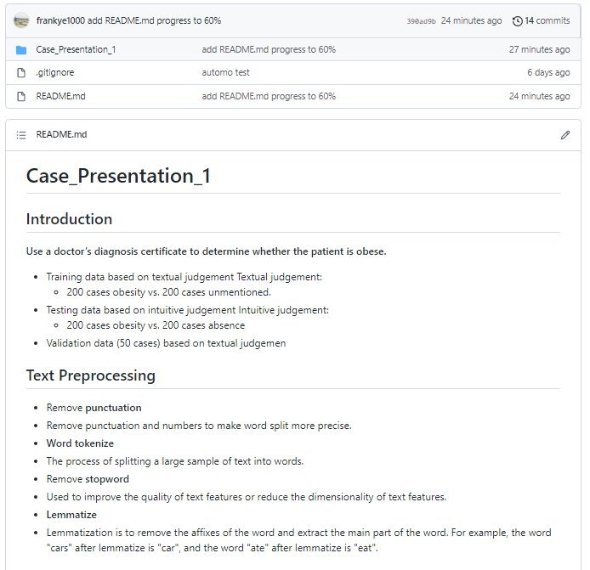
github
Case presentation 1
https://github.com/frankye1000/NYCU-DigitalMedicine

Slide 18
reference

Slide 19
reference
[1]python 去除所有的中文 英文标点符号(https://blog.csdn.net/weixin_38819889/article/details/105389248)
[2]Python處理中文標點符號大集合(https://codertw.com/%E7%A8%8B%E5%BC%8F%E8%AA%9E%E8%A8%80/356827/)
[3]英文自然語言處理的經典工具 NLTK(https://clay-atlas.com/blog/2019/07/30/nlp-python-cn-nltk-kit/)
[4] Word2Vec的参数解释(https://blog.csdn.net/laobai1015/article/details/86540813)
[5] NLP入门（三）词形还原（Lemmatization）(https://www.cnblogs.com/jclian91/p/9898511.html)
[6] Word2Vec的簡易教學與參數調整指南(https://www.kaggle.com/jerrykuo7727/word2vec)
[7]新手村逃脫！初心者的 Python 機器學習攻略 1.0.0 documentation(https://yaojenkuo.io/ml-newbies/07-performance.html)
[8] Word2vec from scratch (Skip-gram & CBOW)(https://medium.com/@pocheng0118/word2vec-from-scratch-skip-gram-cbow-98fd17385945)

Slide 20
Contribution of group members

Slide 21
contribute
Name | Responsible
葉詠富 | Data clear Word to vector Try Statistic method PPT design
游智鈞
高承翰

