Slide 1

Digital medicine
Case1:
Obesity detection
Group3
葉詠富 310554031
游智鈞 待填
高承翰 待填

Slide 2
contents
01 Introduction
02 Text Preprocessing
03 Method
04 Result

Slide 3
01 Introdcution

Slide 4
Target and dataset
Target
Use a doctor’s diagnosis certificate to determine whether the patient is obese.
Train/Test Dataset
Training data based on textual judgement
Textual judgement: 200 cases obesity vs. 200 cases unmentioned.
Testing data based on intuitive judgement
Intuitive judgement: 200 cases obesity vs. 200 cases absence
Validation Dataset
Validation data (50 cases) based on textual judgement
Notes:
資料介紹

Slide 5
Data pipeline
Train
Statistic & weight
Test
Data
result
Dataset
Test
Text preprocessing
W2V
Average
Naïve Bayes
Random Forest
XGboost
Validation
(kaggle)
Validation
Weight
Spacy.TextRecognizer
W2V
CNN
Notes:
資料前處理
W2v
方法:統計、ML、DL
測試集&kaggle結果

Slide 6
02 Text preprecessing

Slide 7
Text clear
a. Remove punctuation
Remove punctuation and numbers to make word split more precise.
b. Word tokenize
The process of splitting a large sample of text into words.
c. Remove stopword
Used to improve the quality of text features or reduce the dimensionality of text features.
d. Lemmatize
Lemmatization is to remove the affixes of the word and extract the main part of the word.
For example, the word "cars" after lemmatize is "car", and the word "ate" after lemmatize is "eat".
Notes:
移除標點符號 數字
斷字
移除停用字
詞性回復

Slide 8
W2V
Advantage
Compared with one hot encoding, Word to vector can consider a word in the context of the article.
Algorithm
word to vector contains two algorithms, Skip-gram and CBOW.
Skip-gram uses the central word to predict the context, and CBOW uses the context to predict the central word.
input
projection
output
input
projection
output
w(t-2)
w(t-2)
w(t-1)
w(t-1)
w(t)
w(t)
w(t+1)
w(t+1)
w(t+2)
w(t+2)
Skip-gram
CBOW
Notes:
W2由skip-gram & CBOW組成
Skip-gram考慮一個字詞上下文字出現機率
CBOW考慮上下文後，中間字出現機率
利用以上演算法得到vector算cosin角度，即可得知字詞相近程度

Slide 9
03 method

Slide 10
Statistic method
a. Most similar
Use cosine to calculate the angle and find the most similar word of “obesity” and “obese”.
b. Weight
obesity and obese are key words for obesity, so 50 points are given for evaluation.
Morbidly, morbid, hyperlipidemia and obesity-related words are the most similar.
Asthma and htn are not so close, so give a weight of 20 points.
obesity
morbid
asthma
hyperlipidemia
htn
c. Criterion
obese
morbidly
Count the weight of an article, weight greater than 50 points is obesity.
weight
50
28
20
Notes:
找到“obesity” and “obese”.相近字 並給權重
傳統統計方法 : 文章權重計算
>50

Slide 11
Machine learning article vector
A. Average
Calculate the average vector of the article and use it as the article vector.
B. Weight
Calculate the weight vector of the article, give the weight to the key words, and use it as the article vector.
obesity
morbid
asthma
other
hyperlipidemia
htn
obese
morbidly
weight
4
2
1
0.1
Notes:
機器學習方法
利用NaiveBayes 隨機森林 Xgboost分類
每篇文章維度計算
A方法:把每個字維度加起來，取平均
B方法:把每個字*權重的維度加起來，取平均

Slide 12
Machine learning Classification algorithm
Naïve Bayes
Naive Bayes is a classification model based on calculating the probability of conditions. By assuming that each event is independent, the probability under each condition can be calculated to obtain the probability of the event (category) occurring
Random Forest
The (random forest) algorithm establishes the outcome based on the predictions of the decision trees. It predicts by taking the average or mean of the output from various trees. Increasing the number of trees increases the precision of the outcome.
XGboost
XGboost (Extreme Gradient Boosting) is a Gradient Boosted Tree (GBDT) that keeps the original model unchanged every time, and adds a new function to the model to correct the error of the previous tree to improve the overall model. Mainly used to solve the problem of supervision is learning, can be used for classification can also be used for regression problems.
Notes:
機器學習方法
利用NaiveBayes : 假設每個事件獨立，利用條件機率計算，某事件發生機率
隨機森林 : 由很多決策樹組成，最後進行投票
Xgboost : 每一次保留原來的模型不變，並且加入一個新的函數至模型中，修正上一棵樹的錯誤，以提升整體的模型

Slide 13
Deep learning Spacy.TextRecognizer
W2V
Same as above
CNN
Convolutional neural network (CNN, or ConvNet) is a class of artificial neural network, most commonly applied to analyze visual imagery. They are also known as shift invariant or space invariant artificial neural networks (SIANN), based on the shared-weight architecture of the convolution kernels or filters that slide along input features and provide translation equivariant responses known as feature maps.
Spacy.TextRecognizer
The model supports classification with multiple, non-mutually exclusive labels. By default, the TextCategorizer class uses a convolutional neural network to assign position-sensitive vectors to each word in the document. The TextCategorizer uses its own CNN model, to avoid sharing weights with the other pipeline components. The document tensor is then summarized by concatenating max and mean pooling, and a multilayer perceptron is used to predict an output vector of length nr_class. The value of each output neuron is the probability that some class is present.
Notes:
深度學習:
TextCategorizer 使用卷積神經網絡為文檔中的每個敏感(重要)單詞 當作 該文章向量。
並使用多層神經網絡 來預測長度為 nr_class 的輸出向量。每個輸出神經元的值是某個類存在的機率。

Slide 14
04 result

Slide 15
Statistic result
a. Test dataset
Precision | 0.985
Recall | 0.96
Accuracy | 0.975
f1 | 0.975
b. Validation
f1 | 0.543

Slide 16
Machine learning result (a)
Naïve Bayes
Random Forest
XGboost
a. Test dataset
Precision | 0.70
Recall | 0.63
Accuracy | 0.70
f1 | 0.66
Precision | 0.72
Recall | 0.68
Accuracy | 0.73
f1 | 0.70
Precision | 0.73
Recall | 0.73
Accuracy | 0.75
f1 | 0.73
b. Validation
f1 | 0.543
f1 | 0.485
f1 | 0.514

Slide 17
Machine learning result (B)
Naïve Bayes
Random Forest
XGboost
a. Test dataset
Precision | 1.0
Recall | 0.9
Accuracy | 0.95
f1 | 0.95
Precision | 1.0
Recall | 0.95
Accuracy | 0.975
f1 | 0.974
Precision | 1.0
Recall | 0.95
Accuracy | 0.975
f1 | 0.974
b. Validation
f1 | 0.543
f1 | 0.57
f1 | 0.48

Slide 18
Deep learning result
a. Test dataset
Precision | 0.72
Recall | 0.72
Accuracy | 0.72
f1 | 0.72
b. Validation
f1 | 0.514

Slide 19
concLusion
a. Overfitting
no | Problem | Improve
1 | Train dataset is too small. | More train dataset.
2 | Bad weight design. | More dataset to reference.
3 | Test dataset vs validation dataset too different. | Pick data sets more evenly.
b. More try
Redesign and reduce word vector.
Word Clustering by K-Means、DBCAN.
Notes:
結論
Overfiting
原因:
改進:
額外嘗試

Slide 20
Thank you

Slide 21
github

Slide 22
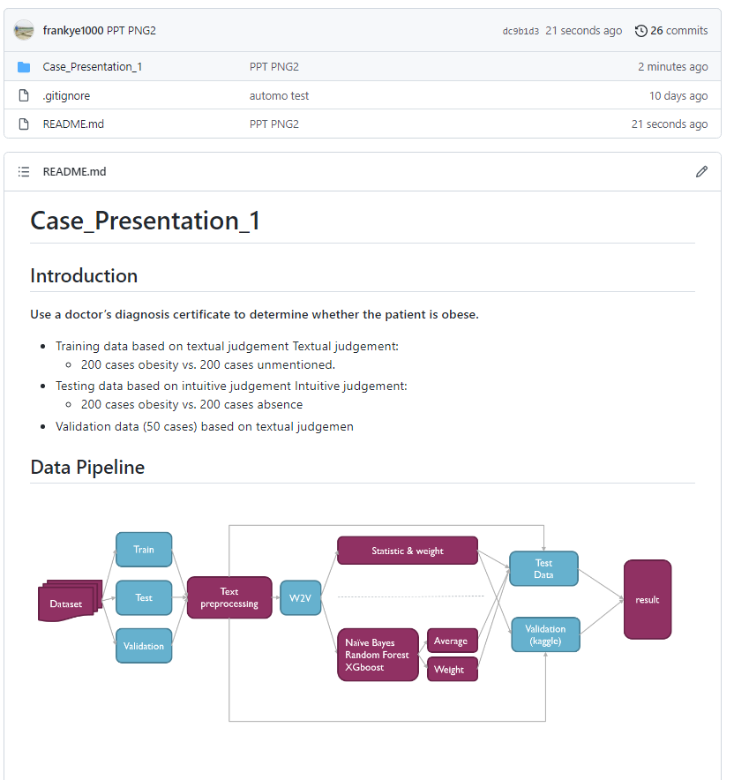
github
Case presentation 1
https://github.com/frankye1000/NYCU-DigitalMedicine

Slide 23
reference

Slide 24
reference
[1]python 去除所有的中文 英文标点符号(https://blog.csdn.net/weixin_38819889/article/details/105389248)
[2]Python處理中文標點符號大集合(https://codertw.com/%E7%A8%8B%E5%BC%8F%E8%AA%9E%E8%A8%80/356827/)
[3]英文自然語言處理的經典工具 NLTK(https://clay-atlas.com/blog/2019/07/30/nlp-python-cn-nltk-kit/)
[4] Word2Vec的参数解释(https://blog.csdn.net/laobai1015/article/details/86540813)
[5] NLP入门（三）词形还原（Lemmatization）(https://www.cnblogs.com/jclian91/p/9898511.html)
[6] Word2Vec的簡易教學與參數調整指南(https://www.kaggle.com/jerrykuo7727/word2vec)
[7]新手村逃脫！初心者的 Python 機器學習攻略 1.0.0 documentation(https://yaojenkuo.io/ml-newbies/07-performance.html)
[8] Word2vec from scratch (Skip-gram & CBOW)(https://medium.com/@pocheng0118/word2vec-from-scratch-skip-gram-cbow-98fd17385945)

Slide 25
reference
[9] ML入門（十七）隨機森林(Random Forest) (https://medium.com/chung-yi/ml%E5%85%A5%E9%96%80-%E5%8D%81%E4%B8%83-%E9%9A%A8%E6%A9%9F%E6%A3%AE%E6%9E%97-random-forest-6afc24871857)
[10] scikit-learn Machine Learning in Python (https://scikit-learn.org/stable/index.html)
[11] Introduction to Random Forest in Machine Learning(https://www.section.io/engineering-education/introduction-to-random-forest-in-machine-learning/)
[12]機器學習之XGBoost分類器XGBClassifier-- xgb使用sklearn介面(https://www.itread01.com/content/1545533828.html)
[13] Python xgboost 模块，XGBClassifier() 实例源码(https://codingdict.com/sources/py/xgboost/12189.html)
[14] Introduction to Naive Bayes: A Probability-Based Classification Algorithm(https://blog.paperspace.com/introduction-to-naive-bayes/)

Slide 26
Contribution of group members

Slide 27
contribute
Name | Responsible | contact
葉詠富 | Data clear Word to vector Try Statistic method Try Machine learning method PPT & github design | frankye100.c@nycu.edu.tw
游智鈞 | Data clear Word to vector Try Statistic method Try Deep learning method | 帶甜
高承翰 | Word to vector Try Statistic method PPT design | 帶甜

