Slide 1


Bastion Hosts
Like the lobby of a building
Highly exposed. (known to the Internet)
General principles:
  Keep it simple
    The simpler, the more secure
  Be prepared for the bastion hosts to be compromised
    Keep asking “what if it is compromised?”
    Reason: Most accessible from outside.
    Protect by checking passwords from bastion hosts or use packet filtering

Slide 2
Special Bastion Hosts
Non-routing dual-homed hosts
  Do not pass information
  Do not use it as the whole firewall
Victim machines
  For new services (do not know the security holes yet)
  Keep few services as possible.
  Key: disposable (no important stuffs there)
Internal bastion hosts
  E.g., internal SMTP servers (second bastion hosts),
  or News servers.

Slide 3
Choose a Machine
What OS?
  something you are familiar with (no time for new OS)
  UNIX (probably the best choice)
    has already a lot of tools
    In our talk, we will assume UNIX.
    Choose the versions you know (maximize your happiness) but least popular (minimize the chance of breakin)

Slide 4
Choose a Machine (cont)
How fast a machine?
  In general, no need to be fast. Reasons:
    costs
    Most do not need much work (even for T1 lines)
    E.g., 486-based UNIX platforms, Sparcstation-2.
  Need more powers for compression/decompression or searches, etc.
  Reasons for not oversized:
    a slower machine attracts less intruders
    less power makes it harder to attack internal systems
    a slower machine attracts less insiders to compromise. (Should not use it for other purpose.)

Slide 5
Choose a Machine (cont)
What Hardware Configuration?
  memory-intensive
    keeping connections may need a large amount of memory and swap space.
    cache proxy may need a large disk space.
  CD-ROM drive (compare files with those in CD-ROM)
  Easily add disks for maintenance work
  The boot disk should be easily removable (for maintenance)
  Dumb terminal is good enough.

Slide 6
Choose a Machine (cont)
Locating the bastion host on the network
  the network should not carry confidential traffic
    On Ethernet and token rings, all packets are exposed to connected hosts.
    programs like etherfind and tcpdump
    so, keep outside internal networks. (usually in perimeter network)

Slide 7
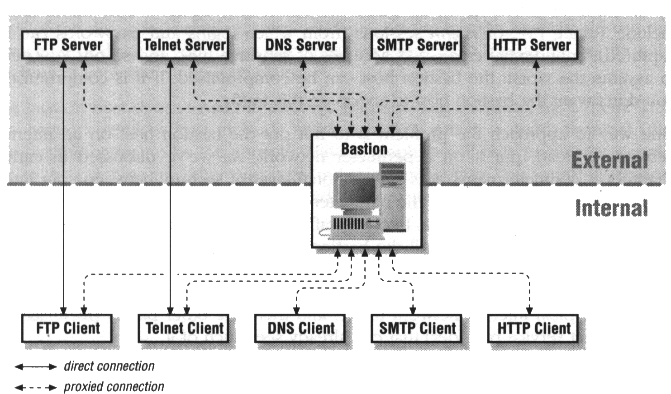
Selecting Services
Typical set:

Slide 8
Services Catalogues
Secure services
  Just use packet filtering, e.g., talk
Insecure services (normally) but can be secure
  provided on the bastion hosts, e.g., SMTP, FTP, Gopher, WAIS, HTTP, NNTP (above needs DNS)
Insecure services (normally) and cannot be secure
  Disable, or put it in a victim host.
Services you don’t use
  Just disable

Slide 9
User Accounts on Bastion Hosts
If possible, no!!! Reasons:
  Easy to be attacked.
  Users may behave unpredictably.
  Reduce stability and reliability
  Hard to detect attacks.

Slide 10
Building a Bastion Host
Secure the machine
Disable all non-required services
Install or modify the services to be provided.
Reconfigure the machine
Run a security audit to establish a baseline
Connect the machine to the network
Do not connect till the last step
(can be attacked then)

Slide 11
Securing the Machine
Minimal clean operating system installation
fix all known system bugs
      ftp://ftp.greatcircle.com/pub/firewalls/vendor_security_contacts
Use a checklist
Safeguard the system logs
  system logs for convenience (regular, for analysis)
  system logs for catastrophes
    Use dropsafe PC (instead of printer)
  setting up system logs
    UNIX: /etc/syslog.conf, others: syslog

Slide 12
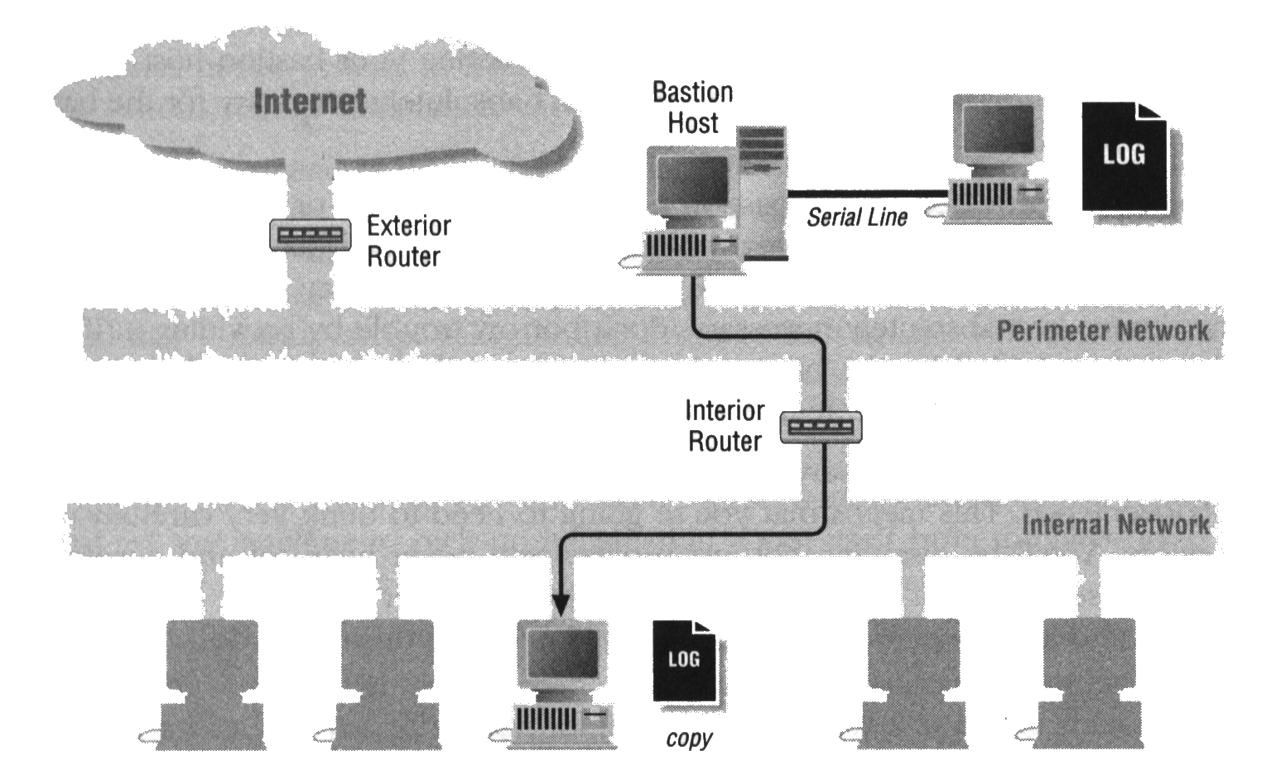

Slide 13
Disabling Non-required Services
How are services managed?
  Key files:
    /etc/rc: initial routines
    /etc/inetd.conf: services
How to disable services:
  comment out
Which services should be left enabled?
  init, swap, page, cron, syslogd, inetd
Which services should you disable?
  If you don’t need it, don’t know what it does,

Slide 14
Usually Disabled Services
  NFS and related services:
    nfsd,biod, mountd, statd,lockd, automount, keyserv, rquotad, amd (in /etc/rc)
  RPC Services:
    ypserv, ypbind, ypupdated, rexd, walld
  Booting services:
    tftpd, bootd, bootpd
  BSD “r” command services
  ftpd, (if needed, just do another one)
  Others
    routed, fingerd, uucpd, rwhod, lpd

Slide 15
Installing and Modifying Services
Use the TCP wrapper package to protect services
  install the package
  Reconfigure inetd to run TCP Wrapper (tcpd)
  tcpd evaluates requests
  If acceptable, starts “real” server.
  (check more in page 180)
Use netacl to protect services
  netperm configuration file.

Slide 16
Reconfiguring for Production
Reconfigure and rebuild the kernel
Remove all unnecessary programs
Mount as many file systems as possible to read-only
Things to be cautious:
Write all the tools to a tape before delete them
Setting a small, external, alternate boot disk.

Slide 17
Running a Security Audit
Auditing packages
  checking for well-known security holes
  Establishing a database of checksums of all files.
    recognize future changes (esp. unauthorized changes)
Examples
  COP, Tiger, Tripwire

Slide 18
Operating the Bastion Hosts
Profiles
  how many jobs to be run at a time?
  how much CPU time?
  What is the typical load?
Automate Monitoring
  Must catch break-in as soon as possible.
  SWATCH (Simple WATCHer).

