Slide 1

Boost.Asio
Boost.Asio: Asynchronous I/O in Boost Library.
References:
Boost.Asio documentation:
http://www.boost.org/libs/asio/
Boost.Asio tutorial:
http://www.boost.org/doc/libs/1_62_0/doc/html/boost_asio/tutorial.html
Boost.Asio examples: http://www.boost.org/doc/libs/1_62_0/doc/html/boost_asio/examples.html
Online book:
http://en.highscore.de/cpp/boost/asio.html http://www.highscore.de/cpp/boost/asio.html (German) http://zh.highscore.de/cpp/boost/asio.html (Chinese)
JTC1/SC22/WG21 paper N3389:
http://www.open-std.org/JTC1/SC22/WG21/docs/papers/2012/n3389.pdf

Slide 2

Boost.Asio
Boost.Asio
  is a cross-platform C++ library for network and low-level I/O programming
  provides developers with a consistent asynchronous model in C++.
Support kqueue(), epoll(), /dev/poll, and the traditional select()

Slide 3

Equivalents: Socket API to Boost.Asio
BSD Socket API Elements | Equivalents in Boost.Asio
socket descriptor - int(POSIX) or SOCKET(Windows) | For TCP: ip::tcp::socket, ip::tcp::acceptor
in_addr, in6_addr | ip::address, ip::address_v4, ip::address_v6
sockaddr_in, sockaddr_in6 | For TCP: ip::tcp::endpoint
socket() | For TCP: ip::tcp::acceptor::open(), ip::tcp::socket::open()
poll(), select(),pselect() | io_service::run(), io_service::run_one(), io_service::poll(), io_service::poll_one() Note: in conjunction with asynchronous operations.

Slide 4
BSD Socket API Elements | Equivalents in Boost.Asio
ioctl() | For TCP: ip::tcp::socket::io_control()
listen() | For TCP: ip::tcp::acceptor::listen() basic_socket_acceptor::listen()
accept() | For TCP: ip::tcp::acceptor::accept() basic_socket_acceptor::accept()
bind() | For TCP: ip::tcp::acceptor::bind(), ip::tcp::socket::bind()
close() | For TCP: ip::tcp::acceptor::close(), ip::tcp::socket::close()
connect() | For TCP: ip::tcp::socket::connect()

Slide 5
BSD Socket API Elements | Equivalents in Boost.Asio
readv(), recv(),read() | For TCP: ip::tcp::socket::read_some(), ip::tcp::socket::async_read_some(), ip::tcp::socket::receive(), ip::tcp::socket::async_receive()
recvfrom() | For UDP: ip::udp::socket::receive_from(), ip::udp::socket::async_receive_from() basic_datagram_socket::receive_from(), basic_datagram_socket::async_receive_from()
send(), write(),writev() | For TCP: ip::tcp::socket::write_some(), ip::tcp::socket::async_write_some(), ip::tcp::socket::send(), ip::tcp::socket::async_send()
sendto() | For UDP: ip::udp::socket::send_to(), ip::udp::socket::async_send_to() basic_datagram_socket::send_to(), basic_datagram_socket::async_send_to()

Slide 6
BSD Socket API Elements | Equivalents in Boost.Asio
getaddrinfo(), gethostbyaddr(), gethostbyname(), getnameinfo(), getservbyname(), getservbyport() | For TCP: ip::tcp::resolver::resolve(), ip::tcp::resolver::async_resolve()
gethostname() | ip::host_name()
getpeername() | For TCP: ip::tcp::socket::remote_endpoint()
getsockname() | For TCP: ip::tcp::acceptor::local_endpoint(), ip::tcp::socket::local_endpoint()
getsockopt() | For TCP: ip::tcp::acceptor::get_option(), ip::tcp::socket::get_option()

Slide 7
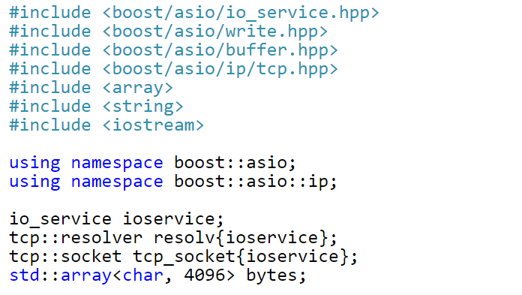

Example: Client
From https://theboostcpplibraries.com/boost.asio-network-programming

Slide 8
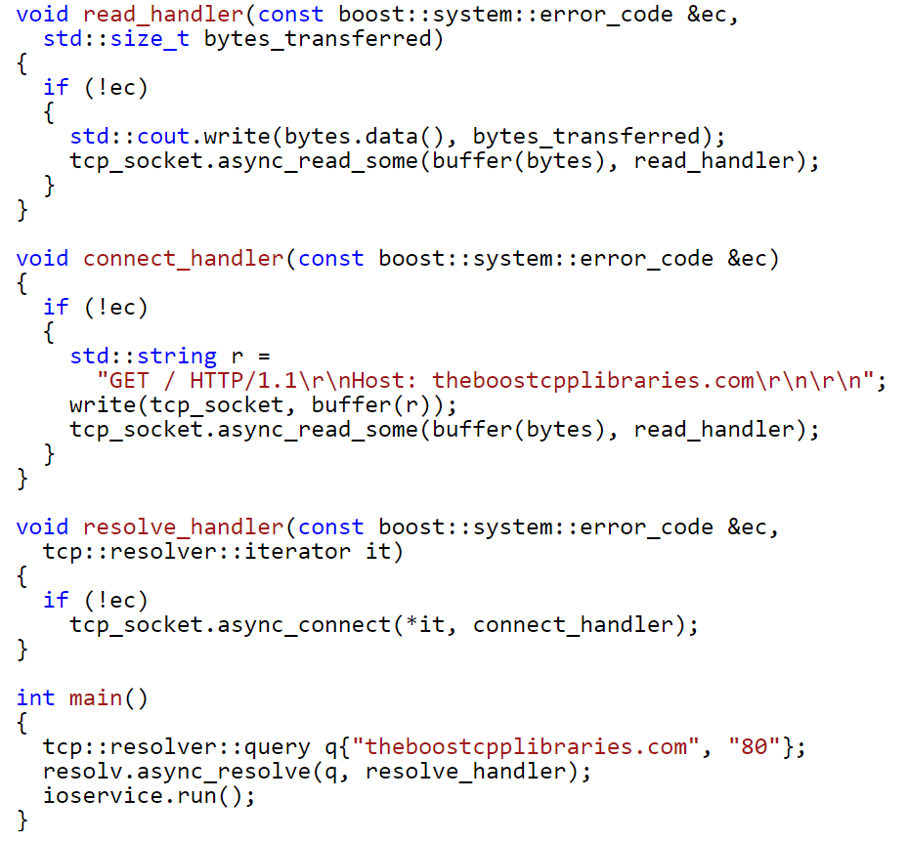

Slide 10
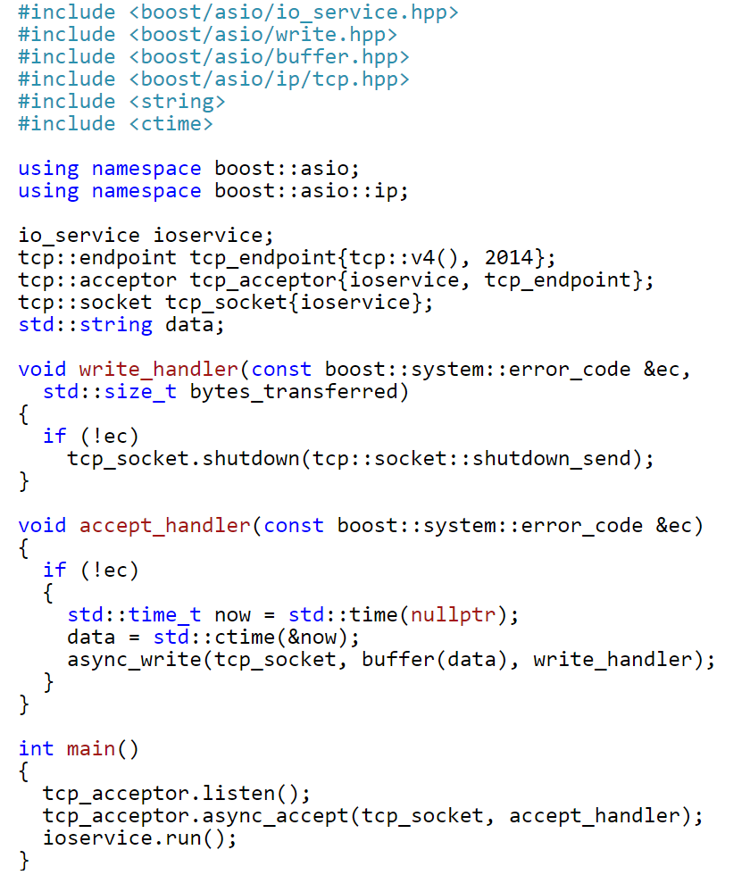
Example: Server

Slide 12

Boost.Asio and Threads
Cross Thread
  int Thread1Run() { ... async_read(ioservice, read_handler); ... }
  int Thread2Run() { ... ioservice.run(); ... }
  int read_handler(...) { ... /* handle read event */ ... }
Thread Safety
  In general, it is safe to make concurrent use of distinct objects, but unsafe to make concurrent use of a single object.
  However, types such as io_service provide a stronger guarantee that it is safe to use a single object concurrently.
    Safe, with the specific exceptions of the reset() and notify_fork() functions.
    (See http://www.boost.org/doc/libs/1_62_0/doc/html/boost_asio/reference/io_service.html)
Thread Pools
  Multiple threads may call io_service::run() to set up a pool of threads from which completion handlers may be invoked.
  int Thread1Run() { ... ioservice.run(); ... }
  int Thread2Run() { ... ioservice.run(); ... }
Strands: Use threads without explicit locking.
  A strand is defined as a strictly sequential invocation of event handlers (i.e. no concurrent invocation).

