Slide 1

Proxying
Why?
  Allow application-level filtering
Advantages:
  allow users to access Internet services “directly”
Disadvantages:
  Proxy Services lag behind non proxied services (software problems)
  Proxy services may require different servers for each service
  Proxy services usually require modifications to clients, procedures, or both
  Proxy services don’t protect you from all protocol weaknesses

Slide 2
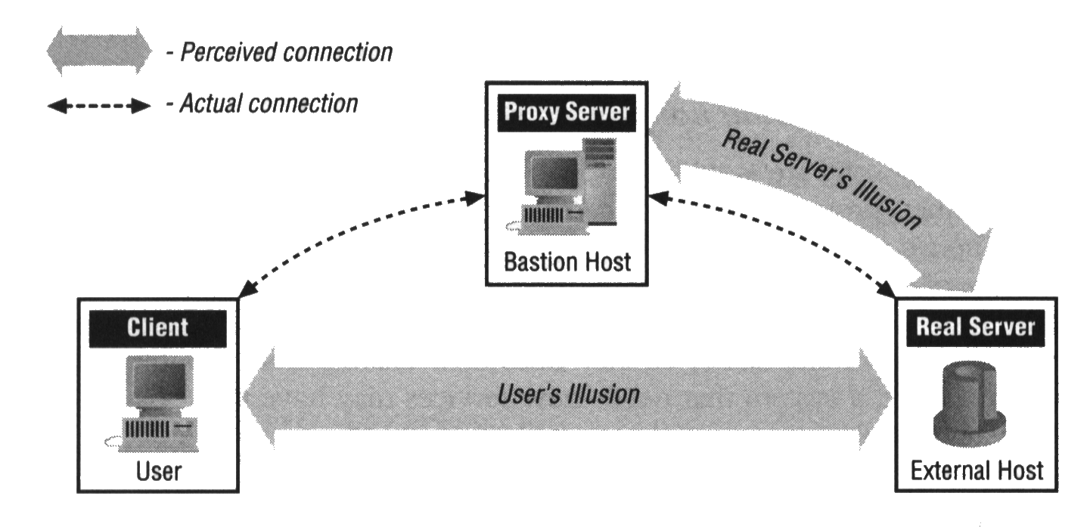

Slide 3

How Proxying Works
Custom client software
  the software must know how to contact the proxy server
  need modified software
  Problems:
    the software may be available on some platform only (e.g., SUNOS)
    it may not be software you wants (not have good interface, etc)
Custom user procedures
  use standard client software to talk to the proxy servers
  tells it to connect to the real server.
  Main problem:
    You have to teach your users.

Slide 4
Issues
Application-level vs. Circuit-level Proxies
  application-level: knows about the particular application
    advantage: have control on applications
  circuit-level: does not know
    advantage: provide wide variety of different protocols
Generic vs. Dedicated Proxies
  Generic: for all protocols
  for single protocol only.
Intelligent Proxy Servers
  E.g., HTTP server caches data.
No proxying:
  E.g., SMTP, NNTP, etc.

Slide 5


SOCKS
Free
de facto standard proxying package on the Internet.
Generic
  So, no intelligent logging or access control
Only works with TCP
  For UDP, use UDP Packet Relayer
Very popular
Components:
  SOCKS Server
  SOCKS client library for UNIX machines
    e.g., Rconnet() for connect(), change Makefile
  SOCKS-ified versions of serveral standard programs like FTP and Telnet.

