Slide 1

WebSocket
References:
  RFC 6455
  The WebSocket API - W3C draft specification of the API
  The WebSocket protocol - Internet-Draft published by the IETF HyBi Working Group

Slide 2
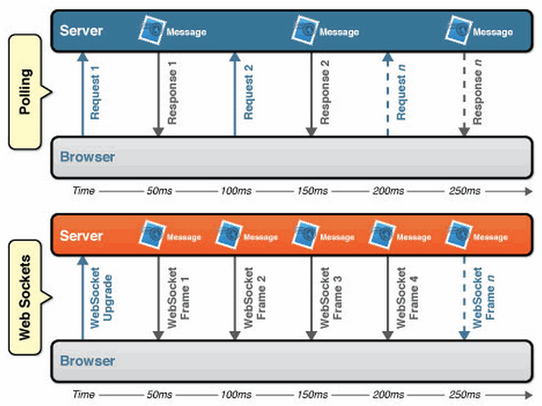
Background
In Brower, AJAX is still inefficient due to polling.
Polling by AJAX
Real-time response for WebSocket
[WebSocket.org]

Slide 3

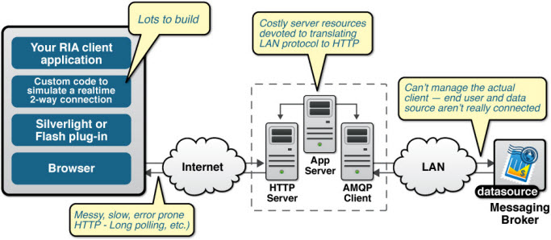
Problem

Slide 4

Motivation
Solution of the problem:
  Support socket for browsers.
New problem:
  Security Issue
    E.g., scan your intranet.
Solution of Java Applet:
  Connect back to the original server.
Problem of Applet Solution:
  The original server becomes bottleneck.

Slide 5
Goal of WebSocket
Current Situation:
  Ordinary TCP connections to port numbers other than 80 are frequently blocked by administrators outside of home environments.
Goal:
  A way to overcome these restrictions and provide similar functionality with some additional protocol overhead while multiplexing several WebSocket services over a single TCP port.
  A technology providing for bi-directional, full-duplex communications channels, over a single TCP socket.

Slide 6
Standardization
Standardization:
  The WebSocket API
    Standardized by the W3C,
  WebSocket protocol
    Standardized by the IETF as RFC 6455.

Slide 7
Browser Support
http://caniuse.com/#feat=websockets
Show all versions | IE | Firefox | Chrome | Safari | Opera | iOS Safari | Opera Mini | Android Browser | Blackberry Browser | IE Mobile
 |  |  |  |  |  |  |  | 2.1
 |  |  |  |  |  | 3.2 |  | 2.2
 |  |  |  |  |  | 4.0-4.1 |  | 2.3
 |  |  |  |  |  | 4.2-4.3 |  | 3.0
 | 8.0 | 22.0 |  |  |  | 5.0-5.1 |  | 4.0
 | 9.0 | 23.0 | 28.0 | 5.1 |  | 6.0-6.1 |  | 4.1 | 7.0
Current | 10.0 | 24.0 | 29.0 | 6.0 | 16.0 | 7.0 | 5.0-7.0 | 4.2 | 10.0 | 10.0
Near future | 11.0 | 25.0 | 30.0 | 7.0 | 17.0
Farther future |  |  | 31.0
Usage stats: | Global
Support: | 69.72%
Partial support: | 3.25%
Total: | 72.97%

Slide 8
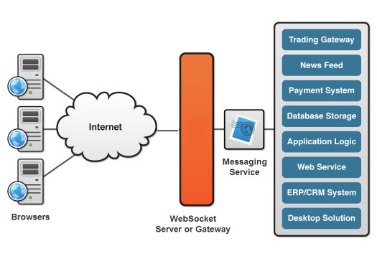
Architecture

Slide 9
WebSocket Protocol
Browser:
  GET /chat HTTP/1.1
  Host: server.example.com
  Upgrade: websocket
  Connection: Upgrade
  Sec-WebSocket-Key: dGhlIHNhbXBsZSBub25jZQ==
  Origin: http://example.com
  Sec-WebSocket-Protocol: chat, superchat
  Sec-WebSocket-Version: 13
Server:
  HTTP/1.1 101 Switching Protocols
  Upgrade: websocket
  Connection: Upgrade
  Sec-WebSocket-Accept: s3pPLMBiTxaQ9kYGzzhZRbK+xOo=
  Sec-WebSocket-Protocol: chat

Slide 10

Handshake
client request
  GET / HTTP/1.1
  Upgrade: websocket
  Connection: Upgrade
  Host: example.com
  Origin: null
  Sec-WebSocket-Key: sN9cRrP/n9NdMgdcy2VJFQ==
  Sec-WebSocket-Version: 13
server response
  HTTP/1.1 101 Switching Protocols
  Upgrade: websocket
  Connection: Upgrade
  Sec-WebSocket-Accept: fFBooB7FAkLlXgRSz0BT3v4hq5s=
  Sec-WebSocket-Origin: null
  Sec-WebSocket-Location: ws://example.com/
  Sec-WebSocket-Accept = BASE-64(SHA-1(Sec-WebSocket-Key+Magic-Key))
  Magic-Key is fixed to be 258EAFA5-E914-47DA-95CA-C5AB0DC85B11

Slide 11
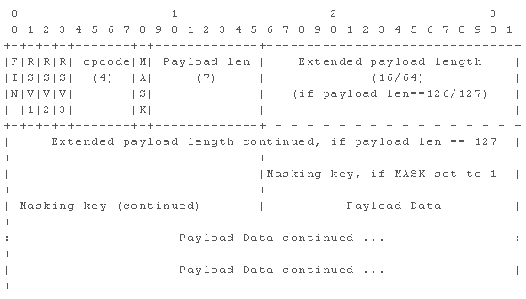
RFC 6455 Frame Header
After handshake, all messages should add lightweight headers (not HTTP).
  Browsers in clients will encode/decode headers automatically.
  Server should implement the encoding/decoding of headers.

Slide 12
Using the HTML5 WebSocket API
Create a web socket.
  var myWebSocket = new WebSocket("ws://www.websockets.org");
Set up event handlers for receiving messages.
  myWebSocket.onopen = function(evt) { alert("Connection open ..."); }; myWebSocket.onmessage = function(evt) { alert( "Received Message: " + evt.data); }; myWebSocket.onclose = function(evt) { alert("Connection closed."); };
Send messages.
  myWebSocket.send("Hello Web Sockets!");
  myWebSocket.close();

Slide 13
Resources
C++ sha1
C++ Base64
php webSocket Server(select implement)
IE10 support webSocket spec

