Slide 1
The Joys of JavaScript

Slide 2
Admin Items

Slide 3
Homework #2 – Questions?
Two parts to the assignment
Take existing Portfolio and apply Media Queries and Viewport to make mobile responsive.
Use Bootstrap CSS to recreate the portfolio you built in HW1. Your Bootstrap solution should minimize use of media queries.

Slide 4
Today’s Class!

Slide 5
Objectives
In today’s class we’ll be introducing:
JavaScript Definitions
JavaScript Basics:
- Variables
- Logging, Alerting, Prompting
- Arrays
If/Else Statements
Array Assignments
The Concept of For-Loops

Slide 6
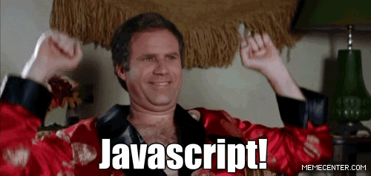
OMG JavaScript!
Prepare to become true coders.

Slide 7
How to Learn JavaScript

Slide 8
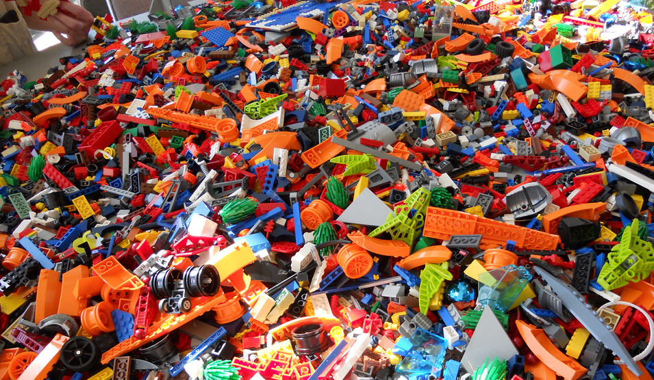
Your Brain on JavaScript…

Slide 9
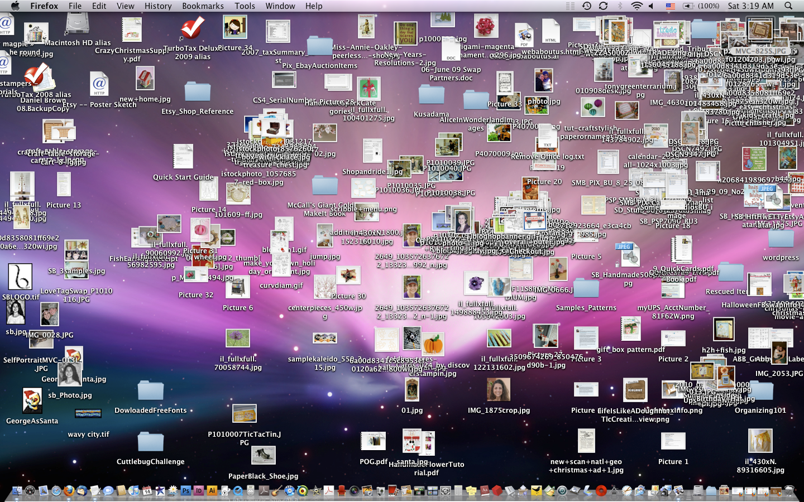
Keep Organized!!!

Slide 10
Overall Tips
Review Immediately: We’ll be building upon these concepts quickly. The firmer your grasp now, the better off you’ll be.
Re-do the exercises in class: Don’t just re-read! Actually spend the time to re-do them from scratch on your own.
Get Help: Come to office hours. Ask conceptual questions. Ask specific questions. Just keep asking questions!
Don’t be Afraid: You will get this. It will take time, but you will get this. Just keep at it. Patience will pay off.

Slide 11
Warmup Activity

Slide 12
> YOUR TURN!!
Code Dissection:
Look at Activity #1 in the Unit 3 folder.
Open the HTML file in Chrome and observe what happens.
With a partner, try to explain how the code connects to the events that happen on the page.
p.s. We haven’t covered JavaScript before, but a big part of being a developer is learning on the fly!

Slide 13
What is JavaScript?

Slide 14

JavaScript Definitions
JavaScript is the third of the three fundamental programming languages of the modern web (along with HTML, CSS).
JavaScript allows developers to create dynamic web applications capable of taking in user inputs, changing what’s displayed to users, animating elements, and much more.

Slide 15
Variables

Slide 16
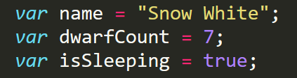
Basic Variables
Variables are the nouns of programming.
They are “things” (Numbers, Strings, Booleans, etc.).
They are composed of variable names and values.

Slide 17
Demo Time
Instructor: Demo
(BasicVariablesDemo | 02-BasicVariablesDemo)

Slide 18
Basic Variables (Syntax)
Var Keyword
Variable name
Assignment
Value
Termination
var
name
=
“Snow White”
;

Slide 19
Basic Variables (Syntax)
Var Keyword
Variable name
Assignment
Value
Termination
var
name
=
“Snow White”
;
Be sure to notice the quotes (“”),
which convey that Snow White is a string.

Slide 20
> YOUR TURN!!
Code Creation:
Using the instructions in the file sent to you, fill in the missing JavaScript code to create variables.
When you are done, open the file in Chrome and check the output.
If you successfully completed the activity, you should see a series of pop-up windows with text inside.
Finally, look at the rest of the code and try to figure out why the text displayed the way it did.

Slide 21
Logs, Prints, Alerts

Slide 22
Demo Time
Instructor: Demo
(ConsoleDemoInstructor.html | 04-ConsoleLogDemo)

Slide 23
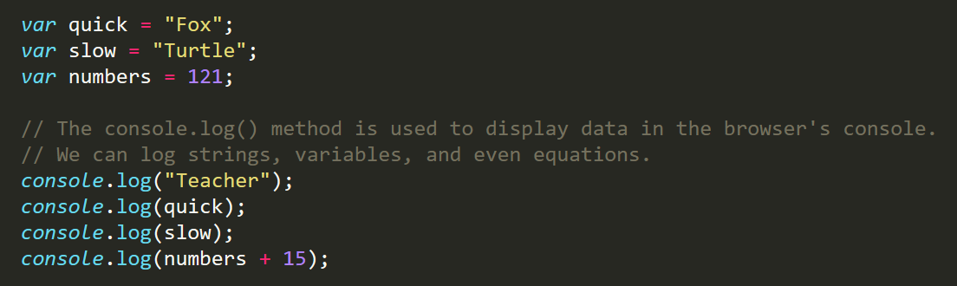
Console.log
console.log is a quick expression used to print content to the debugger.
It is a very useful tool to use during development and debugging.

Slide 24
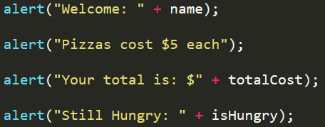
> YOUR TURN!!
Code Creation:
Using the file sent to you as a guide, modify the code so that is uses console.log instead of alerts to display messages.
Then open the file in the browser and open up chrome Developer tools -> Console to confirm the changes worked.
With a partner, discuss the different between using console.log and alert.

Slide 25
Demo Time
Instructor: Demo
(PromptDemo.html | 06-PromptDemo)

Slide 26
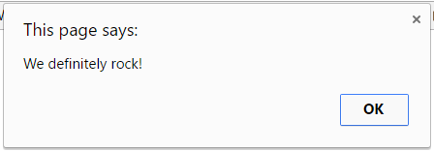
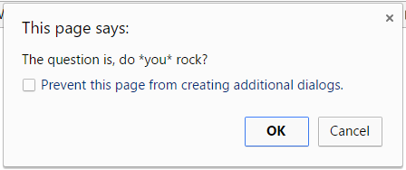
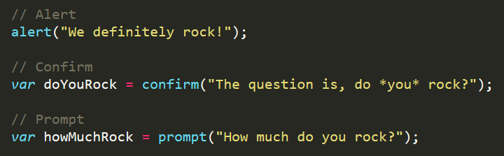
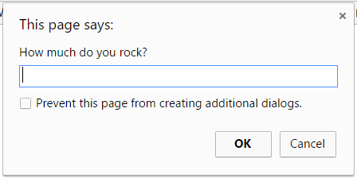
Alerts, Prompts, Confirms
Alerts, Confirms, and Prompts will create a popup box in the browser when run.
These are also useful for development and debugging.

Slide 27
> YOUR TURN!!
Code Creation:
Write JavaScript code that does the following:
Using a confirm, ask the user: “Do you like _____?” and store their response in a variable.
Using a prompt, ask the user: “What kind of _____? do you like?” and store their response in a variable.
Alert both variables to the screen.

Slide 28
If/Else Statements

Slide 29
Demo Time
Instructor: Demo
(conditionaldemo.html | 08-ConditionalDemo)

Slide 30
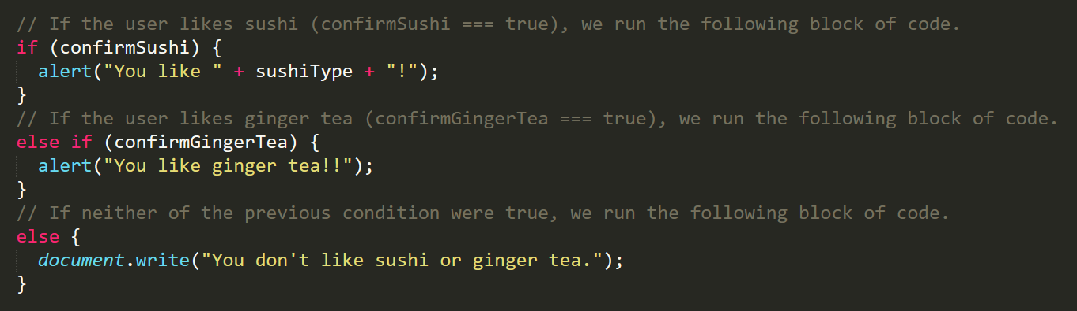
If/Else Statements
If/Else statements are critical.
Each statement is composed of an if, else-if, or else (keyword), a condition, and the resulting code in { } curly brackets.

Slide 31
> YOUR TURN!!
Code Creation:
Create a website (from scratch) that asks users if they eat steak.
If they respond with “yes”, write the following to the page: “Here’s a Steak Sandwich!”.
If they respond with “no”, write the following to the page: “Here’s a Tofu Stir-Fry!”.
Bonus: Ask what the user’s birth year is. If they are under 21, alert the following: “No Sake for you!”
Hint: You will need to use document.write( ) from the last activity.

Slide 32
Arrays

Slide 33
The Zoo Pen
Array Name: zooAnimals
Zebra
Rhino
Giraffe
Owl
Index 0
Index 1
Index 2
Index 3

Slide 34
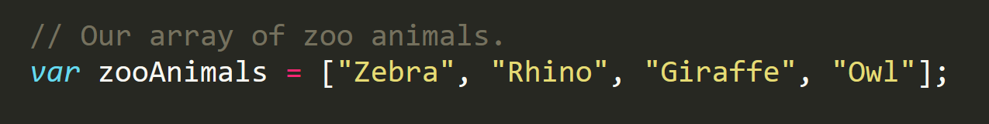
The Zoo Pen… Coded
Array Name: zooAnimals
Zebra
Rhino
Giraffe
Owl
Index 0
Index 1
Index 2
Index 3
Coded in JavaScript using an Array

Slide 35
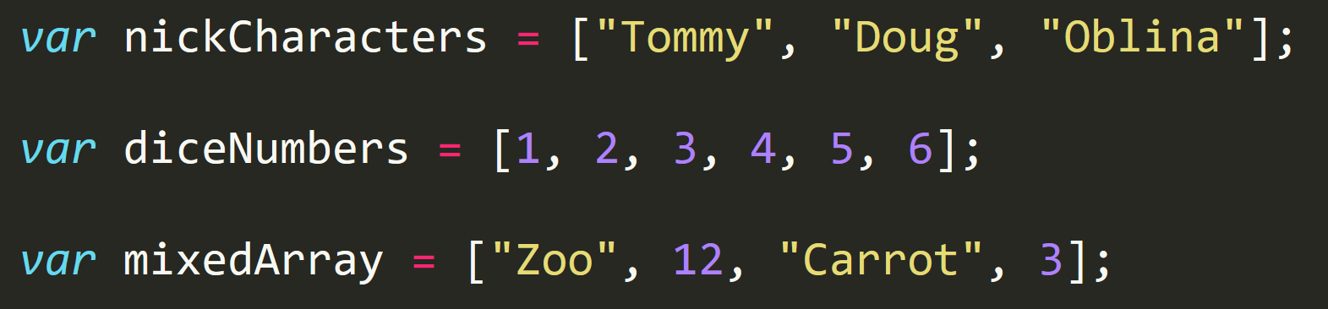
Basic Arrays
Arrays a type of variable that are collections.
These collections can be made up of strings, numbers, Booleans, other arrays, objects, anything.
Each element of the array is marked by an index. Indexes always start with 0.

Slide 36
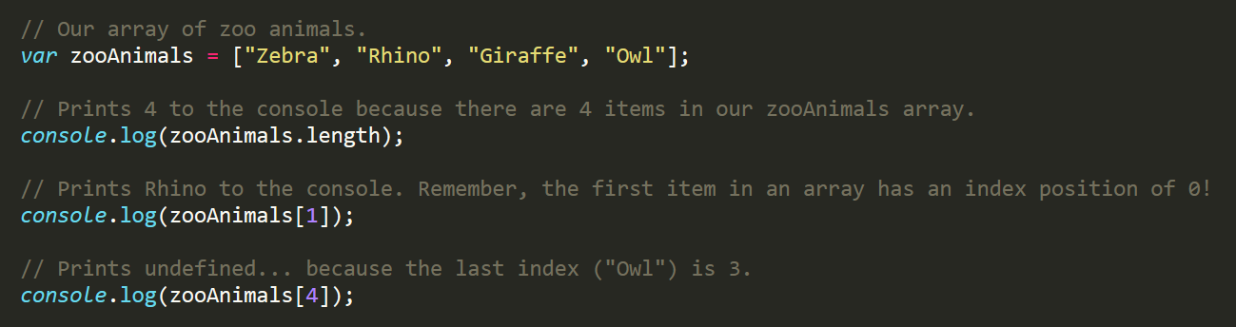
Basic Arrays Indices
To recover the value at any specific index you include the name of the array with a square bracket [ ] and inside the bracket is the element’s index.
You can easily grab the number of elements in the array using the method array.length.

Slide 37
Demo Time
Instructor: Demo
(ArraysDemo.html | 11-ArraysDemo)

Slide 38
> YOUR TURN!!
Class Code Dissection:
With a partner, take a few moments to look over the following code.
Above each console.log() write a comment “predicting” what you think the output will be.

Slide 39
Challenge Activity

Slide 40
> YOUR TURN!!
Code Creation (Challenge):
Create a website that accomplishes the following:
Create an array of your favorite bands.
With a prompt, ask the user’s favorite band.
If it’s one of your favorites, alert: “YEAH I LOVE THEM!”.
If it’s not, alert: “Nah. They’re pretty lame.”.
Hint: You will need to research how to use .indexOf()
Hint: You will need to research how to use .toLowerCase()

Slide 41
> YOUR TURN!!
Activity: 15-CoolPeopleArray | Suggested Time: 5 min
Code Creation: Array Logging
Follow the instructions provided in the file to console.log each of the names in the “coolPeople” variable.
Hint: You should be repeating the same line 6 times.
Be prepared to share once time is up.

Slide 42
> YOUR TURN!!
Activity: 16-ArraySetting | Suggested Time: 7 min
Code Creation: Array Setting
Follow the instructions in the file provided to convert each item in the array to lower case.
Make sure to only add in lines of code where instructed.
Hint: You will need to use the method .toLowerCase(). Research if you don’t remember how to use it.
Be prepared to share once time is up.

Slide 43
For Loops

Slide 44
Back to The Zoo Pen
Array Name: zooAnimals
Zebra
Rhino
Giraffe
Owl
Index 0
Index 1
Index 2
Index 3

Slide 45
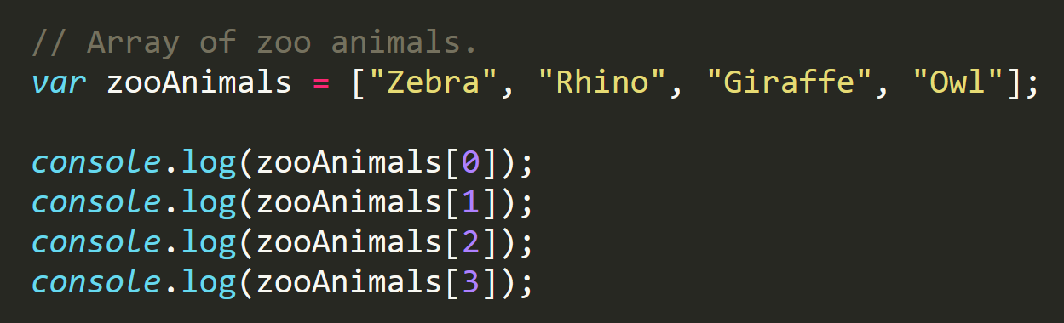
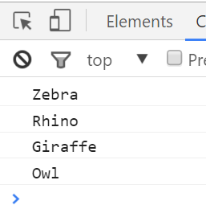
Back to The Zoo Pen (Logging)
Array Name: zooAnimals
Zebra
Rhino
Giraffe
Owl
Index 0
Index 1
Index 2
Index 3

Slide 46

Don’t Repeat Yourself (DRY)
Repeated Code!
Let’s be more efficient

Slide 47
> YOUR TURN!!
Activity: 17-MyFirstLoop | Suggested Time: 5 min
Code Creation: For Loop Dissection
With a partner, spend a few moments trying to dissect the code sent to you.
Try to explain to one another what is happening with each line of code.
Feel free to do research if you are stumped. As a hint, look into the phrase: “For-Loop”.
Be prepared to share when time is up.

Slide 48
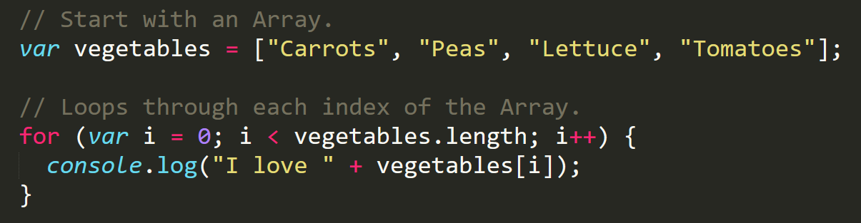
Enter the For-Loop
For loops are critical in programming.
We use for loops to run repeated blocks of code over a set period.
Each for loop is composed of a:
Variable declaration or counter (iterator)
A loop condition
An iteration (addition)

Slide 49
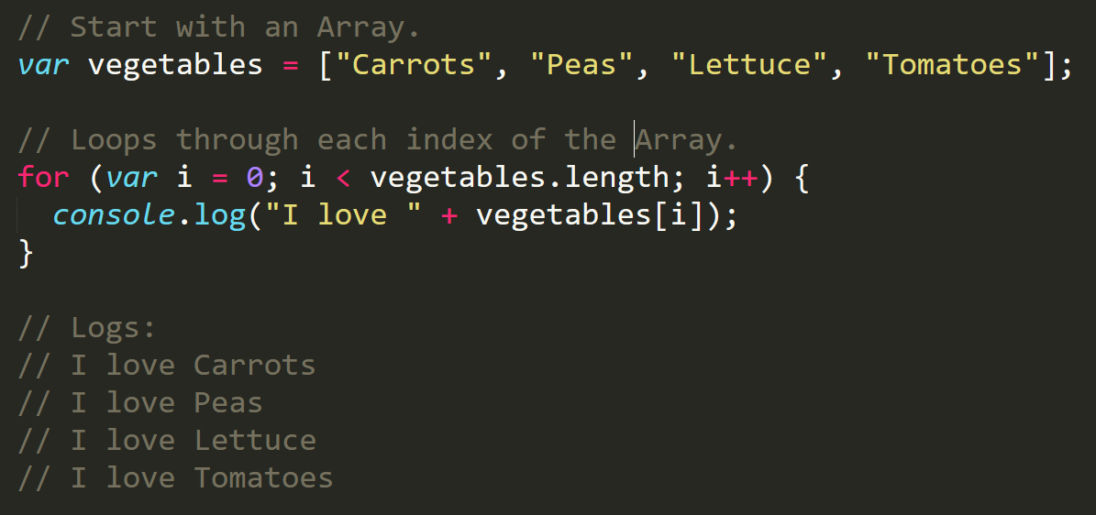
Enter the For-Loop
Iterator. Condition. Increment.

Slide 50
Enter the For-Loop
Code between the { } gets repeated each time the iterator is smaller than the condition. (i.e. in this case i < 4)

Slide 51
Enter the For-Loop
Running the code “loops” through and prints each element in the array.

Slide 52
Run That Loop
When i = 0 … console.log(“I love Carrots”)
Carrots
Peas
Lettuce
Tomatoes
Index 0
Index 1
Index 2
Index 3

Slide 53
Run That Loop
When i = 1 … console.log(“I love Peas”)
Carrots
Peas
Lettuce
Tomatoes
Index 0
Index 1
Index 2
Index 3

Slide 54
Run That Loop
When i = 2 … console.log(“I love Lettuce”)
Carrots
Peas
Lettuce
Tomatoes
Index 0
Index 1
Index 2
Index 3

Slide 55
Run That Loop
When i = 3 … console.log(“I love Tomatoes”)
Carrots
Peas
Lettuce
Tomatoes
Index 0
Index 1
Index 2
Index 3

Slide 56
> YOUR TURN!!
Activity: 18-ZooLoop | Suggested Time: 15 min
Code Creation: For-Loop Zoo
Spend a few moments, re-writing the code below using a for-loop.
If you need help, use the code from the previous example as a guide.
Then try to explain to the person next to you how your code works.

Slide 57
> YOUR TURN!!
Activity: 20-HardLoop | Suggested Time: 30 min
Code Creation: Hard Loop (Time Permitting)
Starting from scratch, write code that loops through the following array:
And console.logs the name of each animal on the farm.
Then using the .charAt() method (research it) check if the first letter in the animal’s name begins with a “c” or “o”. If it does, create an alert saying: “Starts with c or an o!”

Slide 58
Homework #3

Slide 59
Questions?

