Slide 1
CISSP Guide to Security Essentials, Second Edition
Chapter 1
Information Security and Risk Management
© 2016 Cengage Learning®. May not be scanned, copied or duplicated, or posted to a publicly accessible website, in whole or in part.

Slide 2
Objectives
How security supports organizational mission, goals and objectives
Risk management
Security management
Personnel security
CISSP Guide to Security Essentials, 2e
1
© 2016 Cengage Learning®. May not be scanned, copied or duplicated, or posted to a publicly accessible website, in whole or in part.
Notes:
1

Slide 3
Mission
Statement of its ongoing purpose and reason for existence.
Usually published, so that employees, customers, suppliers, and partners are aware of the organization’s stated purpose.
Should influence how we will approach the need to protect the organization’s assets.
CISSP Guide to Security Essentials, 2e
1
© 2016 Cengage Learning®. May not be scanned, copied or duplicated, or posted to a publicly accessible website, in whole or in part.

Slide 4
Example Mission Statements
“Promote professionalism among information system security practitioners through the provisioning of professional certification and training.” - (ISC)²
“Help civilize the electronic frontier; to make it truly useful and beneficial not just to a technical elite, but to everyone; and to do this in a way which is in keeping with our society's highest traditions of the free and open flow of information and communication.” – Electronic Frontier Foundation
CISSP Guide to Security Essentials, 2e
1
© 2016 Cengage Learning®. May not be scanned, copied or duplicated, or posted to a publicly accessible website, in whole or in part.

Slide 5
Example Mission Statements (cont.)
“Empower and engage people around the world to collect and develop educational content under a free license or in the public domain, and to disseminate it effectively and globally.” – Wikimedia Foundation
CISSP Guide to Security Essentials, 2e
1
© 2016 Cengage Learning®. May not be scanned, copied or duplicated, or posted to a publicly accessible website, in whole or in part.

Slide 6
Objectives
Statements of activities or end-states that the organization wishes to achieve.
Support the organization’s mission and describe how the organization will fulfill its mission.
Observable and measurable.
Do not necessarily specify how they will be completed, when, or by whom.
CISSP Guide to Security Essentials, 2e
1
© 2016 Cengage Learning®. May not be scanned, copied or duplicated, or posted to a publicly accessible website, in whole or in part.

Slide 7
Example Objectives
“Improve security audit results.”
“Develop a security awareness strategy.”
“Consolidate computer account provisioning processes.”
CISSP Guide to Security Essentials, 2e
1
© 2016 Cengage Learning®. May not be scanned, copied or duplicated, or posted to a publicly accessible website, in whole or in part.

Slide 8
Goals
Specify specific accomplishments that will enable the organization to meet its objectives.
Measurable, observable, objective, support mission and objectives
CISSP Guide to Security Essentials, 2e
1
© 2016 Cengage Learning®. May not be scanned, copied or duplicated, or posted to a publicly accessible website, in whole or in part.

Slide 9
Example Goals
“Obtain ISO 27001 certification by the end of third quarter.”
“Reduce development costs by twenty percent in the next fiscal year.”
“Complete the integration of CRM and ERP systems by the end of November.”
CISSP Guide to Security Essentials, 2e
1
© 2016 Cengage Learning®. May not be scanned, copied or duplicated, or posted to a publicly accessible website, in whole or in part.

Slide 10
Security Support of Mission, Objectives, and Goals
Influence development of mission, objectives, goals
Become involved in key activities
Risk management provides feedback
CISSP Guide to Security Essentials, 2e
1
© 2016 Cengage Learning®. May not be scanned, copied or duplicated, or posted to a publicly accessible website, in whole or in part.

Slide 11
Risk Management
“The process of determining the maximum acceptable level of overall risk to and from a proposed activity, then using risk assessment techniques to determine the initial level of risk and, if this is excessive, developing a strategy to ameliorate appropriate individual risks until the overall level of risk is reduced to an acceptable level.” – Wiktionary
Risk assessments
Risk treatment
CISSP Guide to Security Essentials, 2e
1
© 2016 Cengage Learning®. May not be scanned, copied or duplicated, or posted to a publicly accessible website, in whole or in part.

Slide 12
Qualitative Risk Assessment
Occurs with a predefined scope of assets or activities
Assets: software, business equipment, etc…
Activities: tasks carried out by an individual, group, or department.
For a given scope of assets, identify:
Vulnerabilities
Threats
Threat probability (Low / medium / high)
Impact (Low / medium / high)
Countermeasures
CISSP Guide to Security Essentials, 2e
1
© 2016 Cengage Learning®. May not be scanned, copied or duplicated, or posted to a publicly accessible website, in whole or in part.
Notes:
Refer to Table 1-1 in the textbook (p.5)
Threat Probability can be a Scale of 1-5, or 1-10.
Countermeasures = Mitigation, Transfer of Risk through insurance or use of 3rd party services.
1

Slide 13
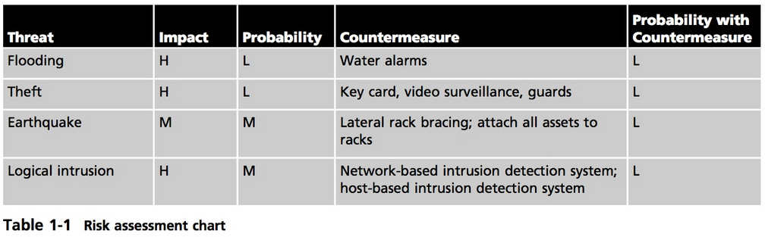
Qualitative Risk Assessment
CISSP Guide to Security Essentials, 2e
1

Slide 14
Quantitative Risk Assessment
Often produce stronger arguments for security policies.
Extension of a qualitative risk assessment. Metrics for each risk are:
Asset value: represents the replacement cost of an asset
Exposure Factor (EF): portion of asset damaged
Single Loss Expectancy: Cost of a single loss through an event.
(SLE) = Asset ($) x EF (%)
Annualized Rate of Occurrence (ARO)
Probability of loss in a year, %
Annual Loss Expectancy (ALE) = SLE x ARO
CISSP Guide to Security Essentials, 2e
1
© 2016 Cengage Learning®. May not be scanned, copied or duplicated, or posted to a publicly accessible website, in whole or in part.
Notes:
Bringing in hard numbers helps management understand the need for IT Budget support/increases.
1

Slide 15
Quantitative Risk Assessment
Hardware: $200,000
Software: $26,000
Man-hours: $5,000
Asset Value: $231,000
Exposure Factor: 40%
ARO (Annualized Rate of Occurrence) :10%
What is the Annual Loss Expectancy?
SLE = Asset Val. x Exposure Factor; ALE = SLE x ARO
CISSP Guide to Security Essentials, 2e
1
© 2016 Cengage Learning®. May not be scanned, copied or duplicated, or posted to a publicly accessible website, in whole or in part.

Slide 16
Calculating the SLE & ALE
SLE Calculations
Asset Val. X EF
$231,000 x 40% = $92,400
ALE Calculations
SLE x ARO
$92,400 x .10 = $9,240
CISSP Guide to Security Essentials, 2e
1
Notes:
Asset Value, Exposure Factor, Single Loss Expectancy, Annualized Rate of Occurrence, Annual Loss Expectancy
SLE = asset value x exposure factor
ALE = ARE x SLE
1

Slide 17
Quantifying Countermeasures
Goal: reduction of ALE (or the qualitative losses)
Impact of countermeasures:
Cost of countermeasure
Changes in Exposure Factor (EF)
Changes in Single Loss Expectancy (SLE)
CISSP Guide to Security Essentials, 2e
1
© 2016 Cengage Learning®. May not be scanned, copied or duplicated, or posted to a publicly accessible website, in whole or in part.
Notes:
You can see how countermeasures can pay-back some of their costs by reducing the ALE through its effects on EF and SLE.
1

Slide 18
Geographic Considerations
Replacement and repair costs of assets may vary by location
Exposure Factor may vary by location
Impact may vary by location
CISSP Guide to Security Essentials, 2e
1
© 2016 Cengage Learning®. May not be scanned, copied or duplicated, or posted to a publicly accessible website, in whole or in part.
Notes:
This may cause a company to want to move assets to a less disaster prone geography.
1

Slide 19
Risk Assessment Methodologies
NIST 800-30, Risk Management Guide for Information Technology Systems
OCTAVE (Operationally Critical Threat, Asset, and Vulnerability Evaluation)
FRAP (Facilitated Risk Analysis Process) – qualitative pre-screening
Spanning Tree Analysis – visual, similar to mind map
CISSP Guide to Security Essentials, 2e
1
© 2016 Cengage Learning®. May not be scanned, copied or duplicated, or posted to a publicly accessible website, in whole or in part.
Notes:
Octave was developed at Carnegie Mellon University’ Software Eng. Institute.
FRAP – prescreen to see if full-blown assessment is needed.
NIST – formal approach to risk assessment that includes threat and vulnerability identification, control analysis, impact analysis, and a matrix depiction of risk determination and control recommendations.
1

Slide 20
Risk Treatment
One or more outcomes from a risk assessment
Risk acceptance
“yeah, we can live with that”
Risk avoidance
Discontinue the risk-related activity
Risk reduction
Mitigate
Risk transfer
Buy insurance, or move the risk responsibility to a 3rd party service.
Risk treatment is often a blended approach
After risk treatment, any leftover risk is known as “residual risk”
CISSP Guide to Security Essentials, 2e
1
© 2016 Cengage Learning®. May not be scanned, copied or duplicated, or posted to a publicly accessible website, in whole or in part.

Slide 21
Security Management Concepts
Security controls
CIA Triad
Defense in depth
Single points of failure
Fail open, fail closed
Privacy
CISSP Guide to Security Essentials, 2e
1
© 2016 Cengage Learning®. May not be scanned, copied or duplicated, or posted to a publicly accessible website, in whole or in part.

Slide 22
Security Controls
Detective
Preventive
Deterrent
Administrative
Compensating
(covered in depth in Chapter 2)
CISSP Guide to Security Essentials, 2e
1
© 2016 Cengage Learning®. May not be scanned, copied or duplicated, or posted to a publicly accessible website, in whole or in part.
Notes:
Security controls are the measures that are taken to reduce risks through the origination and enforcement of security policies.
1

Slide 23
CIA: Confidentiality, Integrity, Availability
The three pillars of security: the CIA Triad
Confidentiality: information and functions can be accessed only by properly authorized parties
Integrity: information and functions can be added, altered, or removed only by authorized persons and means
Availability: systems, functions, and data must be available on-demand according to any agreed-upon parameters regarding levels of service
CISSP Guide to Security Essentials, 2e
1
© 2016 Cengage Learning®. May not be scanned, copied or duplicated, or posted to a publicly accessible website, in whole or in part.

Slide 24
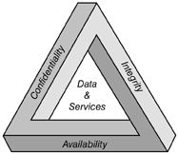
CIA: Confidentiality, Integrity, Availability
CISSP Guide to Security Essentials, 2e
1
© 2016 Cengage Learning®. May not be scanned, copied or duplicated, or posted to a publicly accessible website, in whole or in part.

Slide 25
Defense in Depth
A layered defense in which two or more layers or controls are used to protect an asset
Heterogeneity: the different controls should be different types, so as to better resist attack
Entire protection: each control completely protects the asset from most or all threats
Defense in depth reduces or eliminates the risks associated by single points of failure, fail open, malfunctions, and successful attacks on individual components
CISSP Guide to Security Essentials, 2e
1
© 2016 Cengage Learning®. May not be scanned, copied or duplicated, or posted to a publicly accessible website, in whole or in part.
Notes:
Heterogeneity - The quality or state of being diverse in character or content.
Entire Protection: listed in book as:
Holistic or comprehensive protection. Each layer of the defense fully protects an asset against the type of threat that the defense is designed to block. For example, anti-virus on an e-mail server and also on end-user workstation.
vulnerability.
Single vulnerability. If one of the components of a defense in depth had an exploitable vulnerability, chances are that another layer in the defense will not have the same vulnerability.
Single malfunction. If one of the components of a defense in depth malfunctions, chances are that another layer in the defense will not malfunction.
Fail open. If one of the components in a defense in depth fails open, the other component(s) will continue to operate and protect the asset.
1

Slide 26
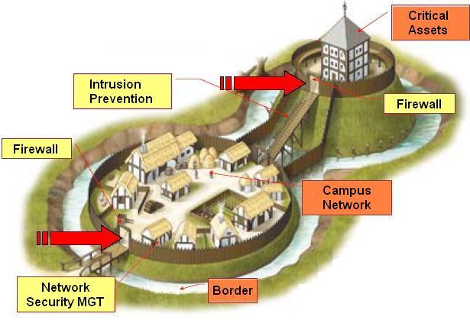
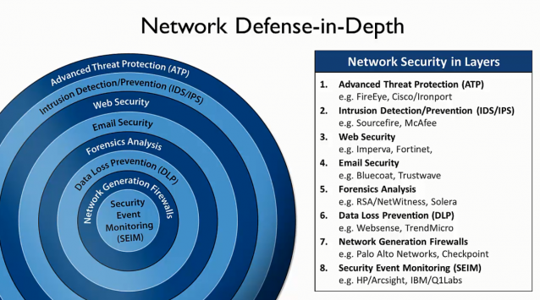
Defense in Depth
CISSP Guide to Security Essentials, 2e
1

Slide 27
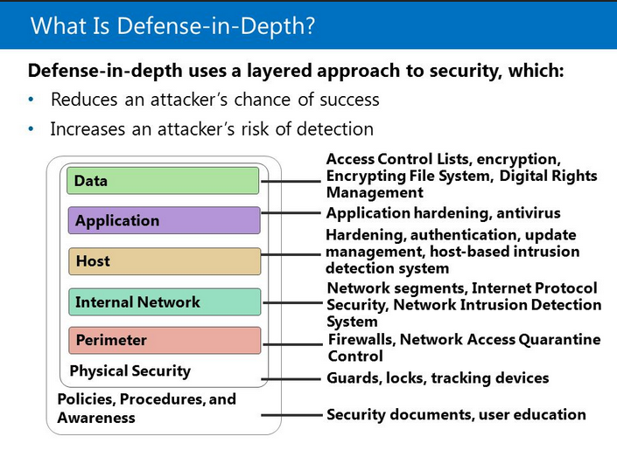
Defense in Depth
CISSP Guide to Security Essentials, 2e
1

Slide 28

Single Points of Failure
A single point of failure (SPOF) is a weakness in a system where the failure of a single component results in the failure of the entire system
CISSP Guide to Security Essentials, 2e
1
© 2016 Cengage Learning®. May not be scanned, copied or duplicated, or posted to a publicly accessible website, in whole or in part.

Slide 29
Fail Open, Fail Closed
When a security mechanism fails, there are usually two possible outcomes:
Fail open – the mechanism permits all activity
Fail closed – the mechanism blocks all activity
Principles
Different types of failures will have different results
Both fail open and fail closed are undesirable, but sometimes one or the other is catastrophic!
CISSP Guide to Security Essentials, 2e
1
© 2016 Cengage Learning®. May not be scanned, copied or duplicated, or posted to a publicly accessible website, in whole or in part.
Notes:
Another term for fail closed is fail safe.
Fail soft is the process of shutting down nonessential components on a system, thereby freeing up resources so that critical components can continue operating.
An example of undesirable fail open is a doorway controlled by a key card access system that can be bypassed if the key card system fails.
A desirable fail open would be the automatic opening of security doors to facilitate personnel exiting in case of fire.
1

Slide 30
Privacy
Defined: the protection and proper handling of sensitive personal information
Requires proper technology for protection
Requires appropriate business processes and controls for appropriate handling
Issues
Inappropriate uses of sensitive data
Unintended disclosures of sensitive data to others
CISSP Guide to Security Essentials, 2e
1
© 2016 Cengage Learning®. May not be scanned, copied or duplicated, or posted to a publicly accessible website, in whole or in part.
Notes:
“freedom from unauthorized intrusion.”
Personally identifiable information (PII) refers to the items that comprise a person’s identity, usually including:
Full name National identification number (in the United States, social security number) Telephone number Driver’s license number Passport number Residential address Bank account numbers Credit card numbers ( CARD Act), HIPAA-Health Insurance Portability and Accountability Act
1

Slide 31
Security Management
Executive oversight
Governance
Policy, guidelines, standards, and procedures
Roles and responsibilities
Service level agreements
Secure outsourcing
Data classification and protection
Certification and accreditation
Internal audit
CISSP Guide to Security Essentials, 2e
1
© 2016 Cengage Learning®. May not be scanned, copied or duplicated, or posted to a publicly accessible website, in whole or in part.
Notes:
Security management is primarily concerned with strategic-level activities that influence the operation of systems and the behavior of employees.
A service level agreement (SLA) is a contract between a service provider (either internal or external) and the end user that defines the level of service expected from the service provider. SLAs are output-based in that their purpose is specifically to define what the customer will receive.
1

Slide 32
Security Executive Oversight
Support and enforcement of policies
Allocation of resources
Prioritization of activities
Risk treatment
CISSP Guide to Security Essentials, 2e
1
© 2016 Cengage Learning®. May not be scanned, copied or duplicated, or posted to a publicly accessible website, in whole or in part.
Notes:
Resources – Sufficient Budgeting and Staffing Resources to support Security
Prioritization – accept the need to perform risk assessments and accept the outcomes.
Risk Treatment – accept, transfer, mitigate, or avoid.
1

Slide 33
Security Governance
Defined: “Security governance is the set of responsibilities and practices exercised by the board and executive management with the goal of providing strategic direction, ensuring that objectives are achieved, ascertaining that risks are managed appropriately and verifying that the enterprise's resources are used responsibly.” – IT Governance Institute
CISSP Guide to Security Essentials, 2e
1
© 2016 Cengage Learning®. May not be scanned, copied or duplicated, or posted to a publicly accessible website, in whole or in part.
Notes:
Reference for this definition: http://www.isaca.org/Journal/Past-Issues/2006/Volume-4/Pages/Information-Security-Governance-Motivations-Benefits-and-Outcomes1.aspx
1

Slide 34
Security Governance (cont.)
Steering committee oversight
Resource allocation and prioritization
Status reporting
Strategic decisions
The process and action that supports executive oversight
CISSP Guide to Security Essentials, 2e
1
© 2016 Cengage Learning®. May not be scanned, copied or duplicated, or posted to a publicly accessible website, in whole or in part.
Notes:
Steering committee oversight. A group of executives are regularly briefed on activities related to security and risk management. Discussions about incidents and events take place, changes to policies are made, and decisions and opinions are solicited.
Resource allocation and prioritization. Executives allocate resources to security-related activities in order that required activities may be carried out.
Status reporting. Information about events, trends, issues, and other security-related matters are collected and sent to upper management through status reports that provide feedback on decisions, strategic direction, and overall effectiveness of the security program.
Decisions. Decisions made at the steering committee level (and at lower levels) are sent downwards to appropriate levels to be carried out by managers and staff members.
1

Slide 35
Security Policies, Requirements, Guidelines, Standards, and Procedures
Policies: constraints of behavior on systems and people. Defines what, but not how. Acceptable Use Policy. Specifies what activities are required, limited, or forbidden.
Requirements: required characteristics of a system or process
Guidelines: defines how to support a policy.
Standards: what products, technical standards, and methods will be used to support policy
Procedures: step by step instructions on how tasks are done.
CISSP Guide to Security Essentials, 2e
1
© 2016 Cengage Learning®. May not be scanned, copied or duplicated, or posted to a publicly accessible website, in whole or in part.
Notes:
Policies are general statements of what should be done. p14
An example policy is, Information systems should be configured to require compliant security practices in the selection and use of passwords.
Requirements:
Requirements should reflect security policy; if security policy says, “a system shall be config- ured to prevent unauthorized access,” then a corresponding requirement would specify how this is accomplished. In this instance the requirement might state that users must lock out their systems when they leave the work area and also specify that system configurations automatically lock out after two minutes of inactivity.
Guidelines: provide information on how policy can be implemented. Generally, guidelines are suggestions or ideas on how specific policies may be implemented.
For example, if a security policy states that personnel access to business facilities shall be controlled, guidelines can suggest that key card systems with PIN pads be used at building entrances and within sensitive areas inside buildings.
Standards: Typically, standards will comprise the following:
Product standards. These are specific names of products that shall be used to support a policy.
Process standards. These may cite process templates, names, or methodologies. Technology standards. This includes the use of technology standards such as TCP/IP
or OSPF, computer languages, and so on.
Reference configurations. These include server build specs, router configurations, software configurations, hardening specifications, and so on.
Reference architectures. These include schematics for building networks, specifications for integrating applications, and so on.
It is expected that standards will change far more frequently than policies and guidelines.
An example standard is: Minimum password length is 8 characters. Passwords must consist of lower case, upper case, and numeric characters. Passwords shall expire after no more than 90 days. Accounts must automatically lock if a user has entered an incorrect password more than three times in ten minutes; accounts must be unlocked by an access administra- tor, or may be automatically unlocked one hour after the last logon attempt. Users may not use any of the previous 10 passwords used.
Procedures: The purpose of a procedure is to ensure the consistent and methodical completion of repeti- tive tasks. Consistency builds quality and reduces incidents, which allows the organization to operate more efficiently and at greater levels of service.
1

Slide 36
The international standard, ISO 27002:2013, Information technology— Security techniques—Code of practice for information security management,
The sections in the Framework standard are:
Information security policies
Organization of information security
Human resources security
Asset management
Access control
Cryptography
Physical and environmental security
Operations security
Communications security
Systems acquisition, development, and maintenance
Supplier relationships
Information security incident management
Information security aspects of business continuity management
Compliance; with legal requirements, such as policies, and with external requirements, such as laws
1

Slide 37
Security Roles and Responsibilities
Formally defined in security policy and job descriptions
These need to be defined:
Ownership of assets – responsible for operation/protection
Access to assets – owners decide who gets access
Use of assets – employees are responsible for their use of assets
Managers responsible for behavior of employees under thems
CISSP Guide to Security Essentials, 2e
1
© 2016 Cengage Learning®. May not be scanned, copied or duplicated, or posted to a publicly accessible website, in whole or in part.
Notes:
Not just for security employees, but all employees.
Job descriptions should define specific security-related roles and responsibilities.
1

Slide 38
Service Level Agreements
SLAs define a formal level of service
SLAs for security activities
Security incident response
Security alert / advisory delivery
Security investigation
Policy and procedure review
CISSP Guide to Security Essentials, 2e
1
© 2016 Cengage Learning®. May not be scanned, copied or duplicated, or posted to a publicly accessible website, in whole or in part.

Slide 39
Secure Outsourcing
Outsourcing risks
Control of confidential information
Loss of control of business activities
Accountability – the organization that outsources activities is still accountable for their activities and outcomes
An organization’s security program for assessing and treating risk associated with outsourced entities will depend on a number of factors, including the level of sensitivity and volume of sensitive data accessible by each outsourced party
CISSP Guide to Security Essentials, 2e
1
© 2016 Cengage Learning®. May not be scanned, copied or duplicated, or posted to a publicly accessible website, in whole or in part.
Notes:
Outsourcing is the subcontracting of a business process to a 3rd party company.
Accountability will also be covered in the SL
Additional terms related to the practice of outsourcing include: Insourcing. The use of internal staff to perform a business function. Offshoring. The use of internal or external staff in another country. Onshoring. The use of internal or external staff within a country.
Note that outsourcing and insourcing are related to whether an organization uses its own staff to perform business functions, while the terms offshoring and onshoring are related to the location of insourced or outsourced personnel.
A with the 3rd party, but the buck stops with the organization.
<number>

Slide 40
Data Classification and Protection
Components of a classification and protection program
Sensitivity levels
“confidential”, “restricted”, “secret”, unclassified, public, etc.
Marking procedures – aka Information Labeling
How to indicate sensitivity on various forms of information
Access procedures
Handling procedures
E-mailing, faxing, mailing, printing, transmitting, destruction
CISSP Guide to Security Essentials, 2e
1
© 2016 Cengage Learning®. May not be scanned, copied or duplicated, or posted to a publicly accessible website, in whole or in part.
Notes:
Most organizations use 3-4 sensitivity levels. More levels than that and it gets too complicated to manage.
Marking is done through affixing a word, symbol, or phrase on the set of data/document.
Wiping Standards:
https://www.blancco.com/blog-comprehensive-list-data-wiping-erasure-standards/
<number>

Slide 41
Certification and Accreditation
Two-step process for the formal evaluation and approval for use of a system
Certification is the process of evaluating a system against a set of formal standards, policies, or specifications.
Accreditation is the formal approval for the use of a certified system, for a defined period of time (and possibly other conditions).
CISSP Guide to Security Essentials, 2e
1
© 2016 Cengage Learning®. May not be scanned, copied or duplicated, or posted to a publicly accessible website, in whole or in part.

Slide 42
Internal Audit
Evaluation of security controls and policies to measure their effectiveness
Performed by internal staff
Objectivity is of vital importance
Formal methodology
Required by some regulations, e.g. Sarbanes Oxley
Methodologies
Standards and practices of internal auditing from The Institute of Internal Auditors
IT Audit and Assurance Standards, Tools, and Techniques from ISACA
CISSP Guide to Security Essentials, 2e
1
© 2016 Cengage Learning®. May not be scanned, copied or duplicated, or posted to a publicly accessible website, in whole or in part.
Notes:
Two of the most widely recognized meth- odologies are:
Standards and practices of internal auditing from The Institute of Internal Auditors, available at www.theiia.org
IT Audit and Assurance Standards, Tools, and Techniques from the Information Systems Audit and Control Association (ISACA), available at www.isaca.org /standards
<number>

Slide 43
Security Strategies
Management is responsible for developing the ongoing strategy for security management
Past events can help shape the future
Incidents
SLA performance
Certification and accreditation
Internal audit
CISSP Guide to Security Essentials, 2e
1
© 2016 Cengage Learning®. May not be scanned, copied or duplicated, or posted to a publicly accessible website, in whole or in part.
Notes:
The development and changes to the security strategy will be based upon several factors, including the organization’s mission, objectives, and goals; the organization’s risk tolerance; applicable security and privacy regulations; security requirements from customers, partners, and suppli- ers; and the results of past events,
<number>

Slide 44
Personnel Security
Hiring practices and procedures
Periodic performance evaluation
Disciplinary action policy and procedures
Termination procedures
CISSP Guide to Security Essentials, 2e
1
© 2016 Cengage Learning®. May not be scanned, copied or duplicated, or posted to a publicly accessible website, in whole or in part.
Notes:
personnel have access to vast stores of organizational data. The risk of security incidents caused by employees’ innocent mistakes as well as deliberate malicious acts cannot be eliminated:
<number>

Slide 45
Hiring Practices and Procedures
Effective assessment of qualifications
Background verification (prior employment, education, criminal history, financial history)
Non-disclosure agreement
Intellectual property agreement
Non-compete agreement
Employment agreement
Agreement to abide by all organizational policies
Formal job descriptions
CISSP Guide to Security Essentials, 2e
1
© 2016 Cengage Learning®. May not be scanned, copied or duplicated, or posted to a publicly accessible website, in whole or in part.
Notes:
Training
<number>

Slide 46
Termination
Immediate termination of all logical and physical access
Change passwords known to the employee
Recovery of all assets
Notification of the termination to affected staff, customers, other third parties
And possibly: code reviews, review of recent activities prior to the termination
CISSP Guide to Security Essentials, 2e
1
© 2016 Cengage Learning®. May not be scanned, copied or duplicated, or posted to a publicly accessible website, in whole or in part.

Slide 47
Work Practices
Separation of duties
Designing sensitive processes so that two or more persons are required to complete them
Job rotation
Good for cross-training, and also reduces the likelihood that employees will collude for personal gain
Mandatory vacations
Detect / prevent irregularities that violate policy and practices
CISSP Guide to Security Essentials, 2e
1
© 2016 Cengage Learning®. May not be scanned, copied or duplicated, or posted to a publicly accessible website, in whole or in part.
Notes:
Separation of Duties: Examples of tasks that should employ separation of duties include: Payment requests, or
Requests for privileged access
Mandatory Vacations are like short-term job rotations.
<number>

Slide 48
Security Education, Training, and Awareness
Training on security policy, guidelines, standards
Upon hire and periodically thereafter
Various types of messaging
E-mail, intranet, posters, flyers, trinkets, training classes
Testing – to measure employee knowledge of policy and practices
CISSP Guide to Security Essentials, 2e
1
© 2016 Cengage Learning®. May not be scanned, copied or duplicated, or posted to a publicly accessible website, in whole or in part.

Slide 49
Summary
An organization’s security program should support its mission, objectives, and goals.
The core principles of information security are confidentiality, integrity, and availability.
Privacy is related to the protection and proper handling of personal information.
Security governance is the set of responsibilities and practices related to the development of strategic direction and risk management.
Security policies specify the required characteristics of information systems and the required conduct of employees.
CISSP Guide to Security Essentials, 2e
1
© 2016 Cengage Learning®. May not be scanned, copied or duplicated, or posted to a publicly accessible website, in whole or in part.

Slide 50
Summary (cont.)
Security roles and responsibilities define the ownership, access, and use of assets, and the general responsibilities of managers and employees.
Data classification and protection defines levels of sensitivity for business information, as well as handling procedures for each level of sensitivity.
Internal audit is the activity of evaluating security controls and policies to measure their effectiveness.
An organization’s hiring process should include the use of non-disclosure, employment, non-compete, intellectual property, and acceptable use agreements, as well as background checks.
CISSP Guide to Security Essentials, 2e
1
© 2016 Cengage Learning®. May not be scanned, copied or duplicated, or posted to a publicly accessible website, in whole or in part.

Slide 51
Summary (cont.)
Upon termination of employment, the organization should retrieve all assets issued to the terminated employee and immediately rescind the employee’s access to all information systems.
Sound work practices include separation of duties, job rotation, and mandatory vacations.
A security education, training, and awareness program should keep employees regularly informed of their expectations.
CISSP Guide to Security Essentials, 2e
1
© 2016 Cengage Learning®. May not be scanned, copied or duplicated, or posted to a publicly accessible website, in whole or in part.

