Slide 1
CISSP Guide to Security Essentials, Second Edition
Chapter 2
Access Control
© 2016 Cengage Learning®. May not be scanned, copied or duplicated, or posted to a publicly accessible website, in whole or in part.

Slide 2
Objectives
Identification and Authentication
Centralized Access Control
Decentralized Access Control
Access Control Attacks
Access Provisioning Life Cycle
Testing Access Controls
© 2016 Cengage Learning®. May not be scanned, copied or duplicated, or posted to a publicly accessible website, in whole or in part.

Slide 3
Identification and Authentication
Identification: unproven assertion of identity
“My name is…”
user id
Authentication: proven assertion of identity
User id and password
User id and PIN
Biometric
© 2016 Cengage Learning®. May not be scanned, copied or duplicated, or posted to a publicly accessible website, in whole or in part.

Slide 4
Authentication Methods
What the user knows
User id and password
User id and PIN
What the user has
Smart card
Token
What the user is
Biometrics (fingerprint, handwriting, voice, etc.)
© 2016 Cengage Learning®. May not be scanned, copied or duplicated, or posted to a publicly accessible website, in whole or in part.

Slide 5
How Information Systems Authenticate Users
Request userid and password
Hash password
Retrieve stored userid and hashed password
Compare the hashes
If they are equal, user has entered the correct password
© 2016 Cengage Learning®. May not be scanned, copied or duplicated, or posted to a publicly accessible website, in whole or in part.
Notes:
Information systems authenticate users by requesting a password, then hashing that password, and comparing that hash with a stored hash of the user’s actual password. If the hashes are the same, the user has entered the correct password.

Slide 6
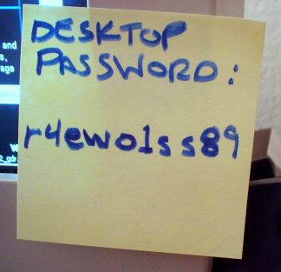
How a User Should Treat Userids and Passwords
Keep a secret
Do not share with others
Do not leave written down where someone else can find it
Store in an encrypted file or vault
© 2016 Cengage Learning®. May not be scanned, copied or duplicated, or posted to a publicly accessible website, in whole or in part.

Slide 7
How a System Stores Userids and Passwords
Typically stored in a database table
Application database or authentication database
Userid stored in plaintext
Facilitates lookups by others
Password stored encrypted or hashed
If encrypted, can be retrieved under certain conditions
“Forgot password” function, application emails to user
If hashed, cannot be retrieved under any circumstance
“Salting” should be employed when hashing a password, to resist rainbow table attacks
© 2016 Cengage Learning®. May not be scanned, copied or duplicated, or posted to a publicly accessible website, in whole or in part.
Notes:
Storing a password in plaintext is a BAD IDEA

Slide 8
Strong Authentication
Traditional userid + password authentication has known weaknesses
Easily guessed passwords
Disclosed or shared passwords
Stronger types of authentication available, usually referred to as “strong authentication”
Token
Certificate
Biometrics
© 2016 Cengage Learning®. May not be scanned, copied or duplicated, or posted to a publicly accessible website, in whole or in part.

Slide 9
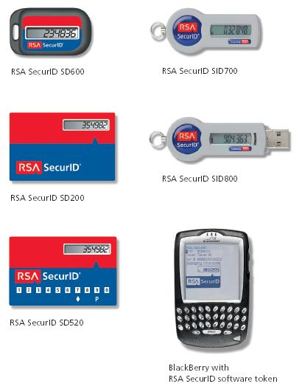
Multi-Factor Authentication
Single factor: what user knows
Two factor: what user knows and has
Password token
USB key
Digital certificate
Smart card
Without the second factor, user cannot log in
Defeats password guessing / cracking
© 2016 Cengage Learning®. May not be scanned, copied or duplicated, or posted to a publicly accessible website, in whole or in part.
Notes:
Use of these types of devices is AKA Possession-based Authentication or Token Authentication. Improved security over just knowledge-based authentication.
More expensive to implement, manage and support.
In addition, Biometrics (Entitiy-based Auth) is another form of Multi-factor Auth when combined with Knowledge-based Auth.

Slide 10

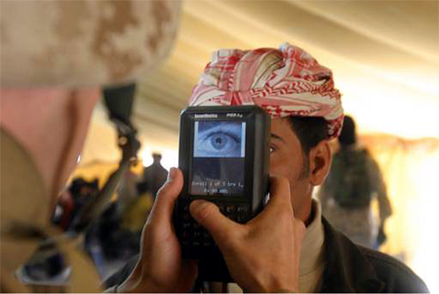
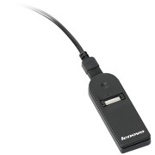
Biometric Authentication
Stronger than userid + password
Stronger than token-based
Measures a part of user’s body
Fingerprint
Iris scan
Signature
Voice
Etc.
© 2016 Cengage Learning®. May not be scanned, copied or duplicated, or posted to a publicly accessible website, in whole or in part.
Notes:
AKA Entity-based Authentication.
Disadvantages: Cost, Changes in the user’s characteristics, Sudden changes to Chars., False-Readings: False Reject Rate, False Accept Rate, and Crossover Error Rate- the middle ground. All of these relate back to the sensitivity of the reading device. p.43-44

Slide 11
Authentication Issues
Password quality
Consistency of user credentials across multiple environments
Too many userids and passwords
Handling password resets
Dealing with compromised passwords
Staff terminations
© 2016 Cengage Learning®. May not be scanned, copied or duplicated, or posted to a publicly accessible website, in whole or in part.
Notes:
Password quality. Each organization needs to establish standards for password quality. Passwords need to be complex but not too complex
Forgotten credentials. Need Standards for resetting passwords.
Compromised credentials. Organizations need a way to know when a user’s credentials have been compromised and be able to quickly reset credentials or temporarily restrict compromised users’ access to systems.
Staff terminations. those users’ credentials must be quickly revoked

Slide 12
Access Control Technologies
Centralized management of access controls
LDAP
Active Directory
RADIUS
Diameter
TACACS
Kerberos
© 2016 Cengage Learning®. May not be scanned, copied or duplicated, or posted to a publicly accessible website, in whole or in part.
Notes:
p.45
LDAP Lightweight Directory Access Protocol

Slide 13
Single Sign-On (SSO)
Authenticate once, access many information systems without having to re-authenticate into each
Centralized session management
Often the “holy grail” for identity management
Harder in practice to achieve – integration issues
Weakness: intruder can access all participating systems if password compromised
Best to combine with two-factor / strong authentication
© 2016 Cengage Learning®. May not be scanned, copied or duplicated, or posted to a publicly accessible website, in whole or in part.
Notes:
access control method whereby a user can authenticate once and be able to access many different information systems without having to reauthenticate into each one separately.
Advantages: of SSO is the convenience of eliminating many redundant logins for busy end users & centralized management of access for many applications and systems. A Disadvantage: a user’s compromised login credentials means that an intruder will have access to all of the applications and systems that the user also has access to.

Slide 14
Reduced Sign-On
Like single sign-on (SSO), single credential for many systems
But… no inter-system session management
User must log into each system separately
Weakness: intruder can access all systems if password is compromised
Best to combine with two-factor / strong authentication
© 2016 Cengage Learning®. May not be scanned, copied or duplicated, or posted to a publicly accessible website, in whole or in part.
Notes:
LDAP or Active Directory
LDAP stands for Lightweight Directory Access Protocol. As the name suggests, it is a lightweight client-server protocol for accessing directory services, specifically X.500-based directory services. LDAP runs over TCP/IP or other connection oriented transfer services. It’s used for various directory purposes, including authentication. LDAP is also a data storage model that provides specific methods for storing directory-type information. Because it is an open standard, LDAP is very popular and is the basis for a number of commercial products, including Microsoft Active Directory. Other commercial LDAP server products include:
Apache Directory Server, Apple Open Directory, Fedora Directory Server, IBM Tivoli Directory Server Novell eDirectory, OpenDS OpenLDAP Oracle Directory Server Enterprise Edition Oracle Internet Directory Penrose SIDVault
Active Directory Microsoft Active Directory is a commercial implementation of LDAP. “AD,” as it is commonly called, is built into Microsoft server operating systems and is tightly coupled with Microsoft’s workstation and domain authentication and also Exchange e-mail.
RADIUS The Remote Authentication Dial In User Service, or RADIUS, is a UDP-based authentication protocol that traces its origins to dial-up remote access. Another popular use for RADIUS is centralized control of authentication for network devices such as routers.
Diameter is an authentication protocol similar to RADIUS. provides an upgrade path for RADIUS. Diameter has several advantages Diameter uses the more reliable TCP protocol instead of UDP.
A Diameter session can be encrypted with SSL (TLS).
TACACS Terminal Access Controller Access-Control System (TACACS, pronounced “tack-acks”) is a remote access authentication protocol that permits a device to communi- cate to a central authentication server. TACACS+ is its replacement.
Kerberos Kerberos is a standard protocol that provides for mutual authentication (an end user and a Kerberos server authenticate each other) over a nonsecure network. There are several components in a Kerberos environment:
Client. The workstation (usually) that desires to access systems or services AS (authentication server). A centralized system to which a user initially authenticates TGS (ticket granting server). A centralized system that issues tickets SS (service server). A server that provides some useful service TGT (ticket granting ticket). A token that permits access to an SS ST (service ticket). An encrypted key
When a user wishes to log on to the network and access a service or application, the follow- ing steps are performed:
1. The client authenticates to the AS. This creates a user session that will expire, typically in eight hours.
2. The AS sends a TGT back to the client system.
3. The client sends the TGT to the TGS to get authenticated.
4. The TGS creates an encrypted key with an expiration time and sends it to the client.
5. The client sends the ST to an SS that the user wishes to access.
6. The SS confirms that the ST is still valid (by checking the expiration time). If the ST is valid, communication is established between the client and the server (SS)s

Slide 15
Access Control Processes
Access requests and provisioning
Internal transfer
Termination
Periodic access review
Internal and external audit
© 2016 Cengage Learning®. May not be scanned, copied or duplicated, or posted to a publicly accessible website, in whole or in part.

Slide 16
Access Requests and Provisioning
Steps in a basic formal process
Request
Review
Approve
Provision
Recordkeeping for each step
© 2016 Cengage Learning®. May not be scanned, copied or duplicated, or posted to a publicly accessible website, in whole or in part.

Slide 17
Internal Transfer
User’s access rights that are specific to the job he or she is leaving should be terminated
User’s accesses needed in new position should be formally requested
Lack of these processes results in “accumulation of privileges”
© 2016 Cengage Learning®. May not be scanned, copied or duplicated, or posted to a publicly accessible website, in whole or in part.
Notes:
Principle of Least Privilege

Slide 18
Termination
Former employee access rights should be revoked upon termination
Access revoked typically with in 24 hours
Access should be revoked immediately if the termination is adverse (e.g. organization is firing employee, or employee quits without giving notice)
Some organizations immediately terminate all access as soon as employee gives notice of termination
© 2016 Cengage Learning®. May not be scanned, copied or duplicated, or posted to a publicly accessible website, in whole or in part.

Slide 19
Periodic Access Reviews
Reviews to verify effectiveness of access control processes
Verify that terminations are performed, and within set time
Verify that all granted access rights were requested, reviewed, and approved
Look for user accounts that have not been used in an extended period of time
Look for combinations of access rights that would result in a segregation of duties conflict
Look for access rights that would violate the principle of least privilege
© 2016 Cengage Learning®. May not be scanned, copied or duplicated, or posted to a publicly accessible website, in whole or in part.

Slide 20
Internal and External Audits
Organizations often undergo audits of access controls and access control processes
Internal – audits performed by company staff
External – audits performed by external audit firm or industry regulators
© 2016 Cengage Learning®. May not be scanned, copied or duplicated, or posted to a publicly accessible website, in whole or in part.

Slide 21
Access Control Attacks
Intruders will try to defeat, bypass, or trick access controls in order to reach their target
Attack objectives
Guess credentials
Malfunction of access controls
Bypass access controls
Replay known good logins
Trick people into giving up credentials
© 2016 Cengage Learning®. May not be scanned, copied or duplicated, or posted to a publicly accessible website, in whole or in part.

Slide 22
Buffer Overflow
Cause malfunction in a way that permits illicit access
Send more data than application was designed to handle properly
“Excess” data corrupts application memory
Execution of arbitrary code
Malfunction
Countermeasure: “safe” coding that limits length of input data; filter input data to remove unsafe chars
© 2016 Cengage Learning®. May not be scanned, copied or duplicated, or posted to a publicly accessible website, in whole or in part.

Slide 23
Script Injection
Insertion of scripting language characters into application input fields
Execute script on server side
SQL injection – obtain data from application database
Execute script on client side – trick user or browser
Cross site scripting
Cross site request forgery
Countermeasures: strip “unsafe” characters from input
© 2016 Cengage Learning®. May not be scanned, copied or duplicated, or posted to a publicly accessible website, in whole or in part.
Notes:
Input Validation

Slide 24
Data Remanence
Literally: data that remains after it has been “deleted”
Examples
Deleted hard drive files
Data in file system “slack space”
Erased files
Reformatted hard drive
Discarded / lost media: USB keys, backup tapes, CDs
Countermeasures: improve media physical controls
© 2016 Cengage Learning®. May not be scanned, copied or duplicated, or posted to a publicly accessible website, in whole or in part.

Slide 25
Denial of Service (DoS)
Actions that cause target system to fail, thereby denying service to legitimate users
Specially crafted input that causes application malfunction
Large volume of input that floods application
Distributed Denial of Service (DDoS)
Large volume of input from many (hundreds, thousands) of sources
Countermeasures: input filters, patches, high capacity attack scrubbers
© 2016 Cengage Learning®. May not be scanned, copied or duplicated, or posted to a publicly accessible website, in whole or in part.

Slide 26
Dumpster Diving
Literally, going through company trash in the hopes that sensitive printed documents were discarded that can be retrieved
Personnel reports, financial records
E-mail addresses
Trade secrets
Technical architecture
Countermeasures: on-site shredding
© 2016 Cengage Learning®. May not be scanned, copied or duplicated, or posted to a publicly accessible website, in whole or in part.

Slide 27
Eavesdropping
Interception of data transmissions
Login credentials
Sensitive information
Methods
Network sniffing (maybe from a compromised system)
Wireless network sniffing
Countermeasures: encryption, stronger encryption
© 2016 Cengage Learning®. May not be scanned, copied or duplicated, or posted to a publicly accessible website, in whole or in part.
Notes:
Keylogging, Shoulder-surfing, listening in on phone calls.

Slide 28
Emanations
Electromagnetic radiation that emanates from computer equipment
Network cabling
More prevalent in networks with coaxial cabling
CRT monitors
Wi-Fi networks
Countermeasures: shielding, twisted pair network cable, LCD monitors, lower power or eliminate Wi-Fi
© 2016 Cengage Learning®. May not be scanned, copied or duplicated, or posted to a publicly accessible website, in whole or in part.
Notes:
TEMPEST U.S. Govt program to capture Compromising Emenations.

Slide 29
Spoofing and Masquerading
Specially crafted network packets that contain forged address of origin
TCP/IP protocol permits forged MAC and IP address
SMTP protocol permits forged e-mail From address
Countermeasures: router / firewall configuration to drop forged packets, judicious use of e-mail for signaling or data transfer
© 2016 Cengage Learning®. May not be scanned, copied or duplicated, or posted to a publicly accessible website, in whole or in part.

Slide 30
Social Engineering
Tricking people into giving out sensitive information by making them think they are helping someone
Methods
In person
By phone
Schemes
Log-in, remote access, building entrance help
Countermeasures: security awareness training
© 2016 Cengage Learning®. May not be scanned, copied or duplicated, or posted to a publicly accessible website, in whole or in part.

Slide 31
Phishing
Incoming, fraudulent e-mail messages designed to give the appearance of origin from a legitimate institution
“Bank security breach”
“Tax refund”
“Irish sweepstakes”
Tricks user into providing sensitive data via a forged web site (common) or return e-mail (less common)
Countermeasures: security awareness training
© 2016 Cengage Learning®. May not be scanned, copied or duplicated, or posted to a publicly accessible website, in whole or in part.
Notes:
Spear Phishing – targets specific users or a group.
Whaling – targets top executives.

Slide 32
Pharming
Redirection of traffic to a forged website
Attack of DNS server (poison cache, other attacks)
Attack of “hosts” file on client system
Often, a phishing e-mail to lure user to forged website
Forged website has appearance of the real thing
Countermeasures: user awareness training, patches, better controls
© 2016 Cengage Learning®. May not be scanned, copied or duplicated, or posted to a publicly accessible website, in whole or in part.

Slide 33
Password Guessing
Trying likely passwords to log in as a specific user
Common words
Spouse / partner / pet name
Significant dates / places
Countermeasures: strong, complex passwords, aggressive password policy
© 2016 Cengage Learning®. May not be scanned, copied or duplicated, or posted to a publicly accessible website, in whole or in part.

Slide 34
Password Cracking
Obtain / retrieve hashed passwords from target
Run password cracking program
Runs on attacker’s system – no one will notice
Attacker logs in to target system using cracked passwords
Countermeasures: frequent password changes, controls on hashed password files, more
© 2016 Cengage Learning®. May not be scanned, copied or duplicated, or posted to a publicly accessible website, in whole or in part.
Notes:
Software: Crack, L0phtcrack, John the Ripper.

Slide 35
Malicious Code
Viruses, worms, Trojan horses, spyware, key logger
Harvest data or cause system malfunction
Countermeasures: anti-virus, anti-spyware, security awareness training
© 2016 Cengage Learning®. May not be scanned, copied or duplicated, or posted to a publicly accessible website, in whole or in part.

Slide 36
Access Control Concepts
Principles of access control
Types of controls
Categories of controls
© 2016 Cengage Learning®. May not be scanned, copied or duplicated, or posted to a publicly accessible website, in whole or in part.

Slide 37
Principles of Access Control
Separation of duties
No single individual should be allowed to perform high-value or sensitive tasks on their own
Financial transactions
User account creation / changes
Least privilege
Persons should have access to only the functions / data that they require to perform their stated duties
© 2016 Cengage Learning®. May not be scanned, copied or duplicated, or posted to a publicly accessible website, in whole or in part.

Slide 38
Principles of Access Controls (cont.)
Defense in depth
Use of multiple controls to protect an asset
Heterogeneous controls preferred
If one type fails, the other remains
If one type is attacked, the other remains
Examples
Nested firewalls
Anti-virus on workstations, file servers, e-mail servers
© 2016 Cengage Learning®. May not be scanned, copied or duplicated, or posted to a publicly accessible website, in whole or in part.

Slide 39
Types of Controls
Technical
Authentication, encryption, firewalls, anti-virus
Physical
Key card entry, fencing, video surveillance
Administrative
Policy, procedures, standards
© 2016 Cengage Learning®. May not be scanned, copied or duplicated, or posted to a publicly accessible website, in whole or in part.

Slide 40
Categories of Controls
Detective controls
Deterrent controls
Preventive controls
Corrective controls
Recovery controls
Compensating controls
© 2016 Cengage Learning®. May not be scanned, copied or duplicated, or posted to a publicly accessible website, in whole or in part.

Slide 41
Detective Controls
Monitor and record specific types of events
Does not stop or directly influence events
Video surveillance
Audit logs
Event logs
Intrusion detection system
© 2016 Cengage Learning®. May not be scanned, copied or duplicated, or posted to a publicly accessible website, in whole or in part.

Slide 42
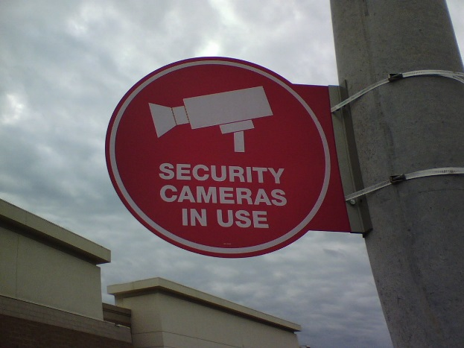
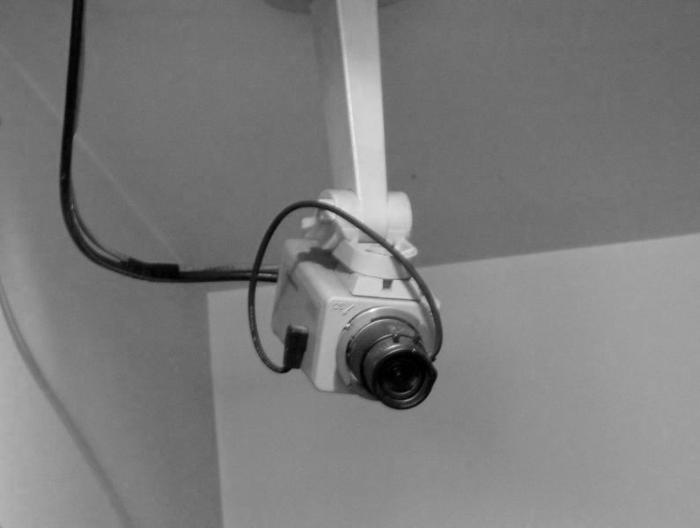
Deterrent Controls
Designed to prevent specific actions by influencing choices of would-be intruders
Does not prevent or even record events
Signs
Guards, guard dogs
Razor wire
© 2016 Cengage Learning®. May not be scanned, copied or duplicated, or posted to a publicly accessible website, in whole or in part.

Slide 43
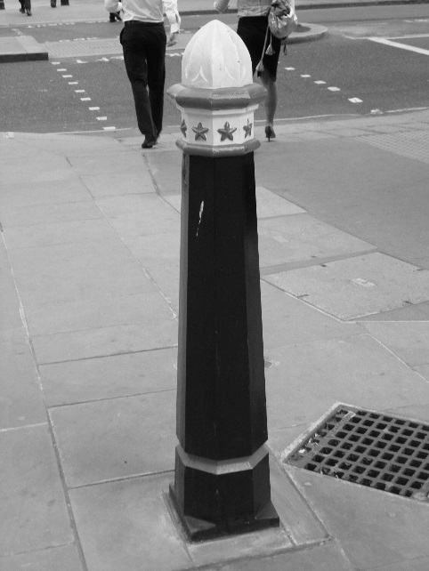
Preventive Controls
Block or control specific events
Firewalls
Anti-virus software
Encryption
Key card systems
Fencing
Bollards
Crash guards
© 2016 Cengage Learning®. May not be scanned, copied or duplicated, or posted to a publicly accessible website, in whole or in part.

Slide 44
Corrective Controls
Post-event controls to prevent recurrence
“Corrective” refers to when it is implemented
Can be preventive, detective, deterrent, administrative
Examples
Spam filter
Anti-virus on e-mail server
WPA Wi-Fi encryption
© 2016 Cengage Learning®. May not be scanned, copied or duplicated, or posted to a publicly accessible website, in whole or in part.

Slide 45
Recovery Controls
Post-incident controls to recover systems
“Recovery” refers to when it is implemented
Can be detective, preventive, deterrent, administrative
Examples
System restoration
Database restoration
© 2016 Cengage Learning®. May not be scanned, copied or duplicated, or posted to a publicly accessible website, in whole or in part.

Slide 46
Compensating Controls
Control that is introduced that compensates for the absence or failure of a control
“Compensating” refers to why it is implemented
Can be detective, preventive, deterrent, administrative
Examples
Daily monitoring of anti-virus console
Monthly review of administrative logins
© 2016 Cengage Learning®. May not be scanned, copied or duplicated, or posted to a publicly accessible website, in whole or in part.

Slide 47
Testing Access Controls
Access controls are the primary defense that protect assets
Testing helps to verify whether they are working properly
Types of tests
Security scanning and penetration testing
Application vulnerability tests
Application code reviews
Audit log analysis
© 2016 Cengage Learning®. May not be scanned, copied or duplicated, or posted to a publicly accessible website, in whole or in part.

Slide 48
Security Scanning and Penetration Testing
Security scans will discover vulnerabilities
Scan TCP/IP for open ports, discover active “listeners”
Potential vulnerabilities in open services
Test operating system, middleware, server, network device features
Missing patches
Example tools: Rapid7, Qualys, Nessus, Nikto, Retina, ISS, Microsoft baseline security scanner
Penetration testing goes further and employs manual techniques to identify and exploit specific vulnerabilities
© 2016 Cengage Learning®. May not be scanned, copied or duplicated, or posted to a publicly accessible website, in whole or in part.

Slide 49
Application Vulnerability Testing
Discover vulnerabilities in an application
Automated tools and manual tools
Example vulnerabilities
Cross-site scripting, injection flaws, malicious file execution, broken authentication, broken session management, information leakage, unsecure use of encryption, and many more
© 2016 Cengage Learning®. May not be scanned, copied or duplicated, or posted to a publicly accessible website, in whole or in part.

Slide 50
Application Code Reviews
Manual reviews of changes to source code
Reviews performed by someone other than the developer who made the change
Automated scans of source code
Identification of logic flaws
Identification of security flaws
© 2016 Cengage Learning®. May not be scanned, copied or duplicated, or posted to a publicly accessible website, in whole or in part.

Slide 51
Audit Log Analysis
Regular examination of audit and event logs
Detect unwanted events
Attempted break-ins
System malfunctions
Account abuse
Audit log protection
Write-once media
Centralized audit logs
© 2016 Cengage Learning®. May not be scanned, copied or duplicated, or posted to a publicly accessible website, in whole or in part.

Slide 52
Summary
Identification is unproven assertion of identity.
Authentication is proven assertion of identity.
Multi-factor authentication is authentication that relies on two or more factors: knowledge-based, possession-based, or entity-based. Two-factor authentication uses any two of these.
Biometric authentication includes something the user is. Examples include fingerprint, hand scan, iris scan.
© 2016 Cengage Learning®. May not be scanned, copied or duplicated, or posted to a publicly accessible website, in whole or in part.

Slide 53
Summary (cont.)
Authentication standards include LDAP, TACACS, RADIUS, Kerberos, and Diameter.
Single sign-on (SSO) provides a single identity with session management across applications.
Reduced sign-on provides a single identity across applications but no session management.
Access controls are attacked by several methods, including buffer overflow, script injection, malicious code, denial of service, eavesdropping, spoofing, social engineering, phishing, and password attacks.
© 2016 Cengage Learning®. May not be scanned, copied or duplicated, or posted to a publicly accessible website, in whole or in part.

Slide 54
Summary (cont.)
Malicious code is used to attempt to interfere with or gain control of a system.
Access management processes include access requests and provisioning, internal transfers, terminations, periodic reviews, and audits.
Separation of duties: split tasks between two or more
Least privilege: minimize user access
Defense in depth: protect assets with many controls
© 2016 Cengage Learning®. May not be scanned, copied or duplicated, or posted to a publicly accessible website, in whole or in part.

Slide 55
Summary (cont.)
Audit log analysis helps to detect unwanted events.
Types of controls: technical, physical, administrative
Categories of controls: detective, deterrent, preventive, corrective, recovery, compensating
Access controls are tested with security scanning, penetration testing, application vulnerability testing, log analysis, and code reviews.
© 2016 Cengage Learning®. May not be scanned, copied or duplicated, or posted to a publicly accessible website, in whole or in part.

