Slide 1
CISSP Guide to Security Essentials, Second Edition
Chapter 5
Cryptography
© 2016 Cengage Learning®. May not be scanned, copied or duplicated, or posted to a publicly accessible website, in whole or in part.

Slide 2
Objectives
Applications and uses of cryptography
Encryption methodologies
Cryptanalysis
Management of cryptography
Key management
© 2016 Cengage Learning®. May not be scanned, copied or duplicated, or posted to a publicly accessible website, in whole or in part.

Slide 3
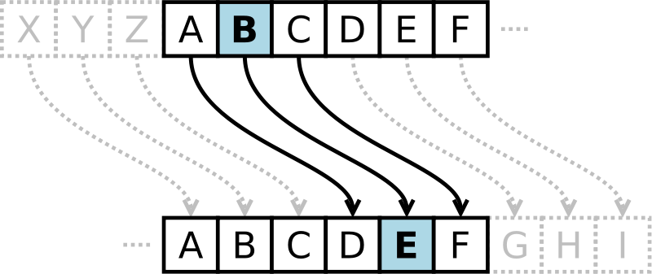
What is Cryptography?
Cryptography is the science of hiding information in plain sight, in order to conceal it from unauthorized parties.
Substitution cipher first used by Caesar for battlefield communications
© 2016 Cengage Learning®. May not be scanned, copied or duplicated, or posted to a publicly accessible website, in whole or in part.

Slide 4
Encryption Terms and Operations
Plaintext – an original message
Ciphertext – an encrypted message
Encryption – the process of transforming plaintext into ciphertext (also encipher)
Decryption – the process of transforming ciphertext into plaintext (also decipher)
Encryption key – the text value required to encrypt and decrypt data
© 2016 Cengage Learning®. May not be scanned, copied or duplicated, or posted to a publicly accessible website, in whole or in part.
Notes:
Encryption is the process of converting plaintext into ciphertext and vice versa using a key.
Cleartext is data that is never intended to be encrypted.

Slide 5
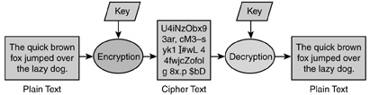
Encryption Terms and Operations (cont.)
© 2016 Cengage Learning®. May not be scanned, copied or duplicated, or posted to a publicly accessible website, in whole or in part.

Slide 6
Methods of Encryption
Substitution
Transposition
Monoalphabetic
Polyalphabetic
Running-key
One time pads
© 2016 Cengage Learning®. May not be scanned, copied or duplicated, or posted to a publicly accessible website, in whole or in part.

Slide 7
Types of Encryption
Block cipher
Stream cipher
© 2016 Cengage Learning®. May not be scanned, copied or duplicated, or posted to a publicly accessible website, in whole or in part.

Slide 8
Types of Encryption Keys
Symmetric key
A common secret that all parties who participate must know
Asymmetric key
Public / private key
Openly distribute public key to all parties
One-time pad
Used once, is as large as the message to be encrypted
© 2016 Cengage Learning®. May not be scanned, copied or duplicated, or posted to a publicly accessible website, in whole or in part.

Slide 9
Substitution Cipher
Plaintext characters are substituted to form ciphertext
“A” becomes “R”, “B” becomes “G”, etc.
Character rotation
Caesar rotated three to the right (A > D, B > E, C > F, etc)
A table or formula is used
© 2016 Cengage Learning®. May not be scanned, copied or duplicated, or posted to a publicly accessible website, in whole or in part.
Notes:
Caesar cipher was an early substitution cipher aka Shift-cipher, shift 3 to right.
ROT13 is a cipher that shifts 13 to the right.

Slide 10
Transposition Cipher
Plaintext messages are transposed into ciphertext
Plaintext:
ATTACK AT ONCE VIA NORTH BRIDGE
Write into columns going down
Read from columns to the right
Ciphertext:
AKCNBTAEORTTVRIAOITDCNAHG
Subject to frequency analysis attack
A | K | C | N | B
T | A | E | O | R
T | T | V | R | I
A | O | I | T | D
C | N | A | H | G
© 2016 Cengage Learning®. May not be scanned, copied or duplicated, or posted to a publicly accessible website, in whole or in part.
Notes:
AKA Permutation Cipher
plaintext message are rearranged—or transposed—
https://en.wikipedia.org/wiki/Transposition_cipher

Slide 11
Monoalphabetic Cipher
One alphabetic character is substituted for another
Caesar right-three shift:
Or a more random scheme:
Subject to frequency analysis attack
A | B | C | D | E | F | G | H | I | J | … | Z
D | E | F | G | H | I | J | K | L | M | … | C
A | B | C | D | E | F | G | H | I | J | … | Z
W | E | R | T | B | N | P | Q | C | U | … | X
© 2016 Cengage Learning®. May not be scanned, copied or duplicated, or posted to a publicly accessible website, in whole or in part.

Slide 12
Polyalphabetic Cipher
Two or more substitution alphabets
CAGED becomes RRADB
Not subject to frequency attack
Plaintext | A | B | C | D | E | F | G | H | I | … | Z
Alpha 1 | W | E | R | T | B | N | P | Q | C | … | X
Alpha 2 | R | B | I | K | Q | D | X | U | N | … | E
Alpha 3 | V | B | D | R | H | W | A | X | I | … | U
Alpha 4 | M | U | T | X | D | G | P | O | W | … | F
Alpha 5 | Y | D | V | B | J | I | K | E | Z | … | O
© 2016 Cengage Learning®. May not be scanned, copied or duplicated, or posted to a publicly accessible website, in whole or in part.

Slide 13
Running-Key Cipher
Plaintext letters converted to numeric (A=0, B=1, etc)
Plaintext values “added” to key values giving ciphertext
Modulo arithmetic is used to keep results in range 0-26
Add 26 if results < 0; subtract 26 if results > 26
Plaintext | A | T | T | A | C | K | A | T | O | N | C | E | V | I | A | N
Key | S | E | C | R | E | T | S | E | C | R | E | T | S | E | C | R
Plaintext | 0 | 19 | 19 | 0 | 2 | 10 | 0 | 19 | 14 | 13 | 2 | 4 | 21 | 8 | 0 | 13
Key | 18 | 4 | 2 | 17 | 4 | 19 | 18 | 4 | 2 | 17 | 4 | 19 | 18 | 4 | 2 | 17
Sum | 18 | 23 | 21 | 17 | 6 | 3 | 18 | 23 | 16 | 4 | 7 | 23 | 11 | 12 | 2 | 4
Ciphertext | S | X | V | R | G | D | S | X | Q | E | H | X | L | M | C | E
© 2016 Cengage Learning®. May not be scanned, copied or duplicated, or posted to a publicly accessible website, in whole or in part.

Slide 14
One-Time Pad
Works like running key cipher, except that key is length of plaintext, and is used only once
Highly resistant to cryptanalysis
Plaintext | A | T | T | A | C | K | A | T | O | N | C | E | V | I | A | N
Key | X | V | G | J | E | R | I | O | Q | W | J | P | E | K | A | F
Plaintext | 0 | 19 | 19 | 0 | 2 | 10 | 0 | 19 | 14 | 13 | 2 | 4 | 21 | 8 | 0 | 13
Key | 23 | 21 | 6 | 9 | 3 | 17 | 8 | 14 | 16 | 22 | 9 | 15 | 4 | 10 | 0 | 5
Sum | 23 | 14 | 25 | 9 | 5 | 1 | 8 | 7 | 4 | 9 | 11 | 19 | 25 | 18 | 0 | 18
Ciphertext | X | O | Z | J | F | B | I | H | E | J | L | T | Z | U | A | U
© 2016 Cengage Learning®. May not be scanned, copied or duplicated, or posted to a publicly accessible website, in whole or in part.
Notes:
AKA – Vernam Cipher.
The key is as long as the message.
The key is used only one time for that message only and then destroyed
A one-time pad is considered unbreakable by most means, but the administration of a one- time pad makes it impractical for use in information systems.

Slide 15
Block Ciphers
Encrypt and decrypt a block of data at a time
Typically 128 bits
Typical uses for block ciphers
File encryption, E-mail messages, text communications, web communications (HTTPS), virtual private networks (VPN)
Well known encryption algorithms
AES, DES, 3DES, CAST, Blowfish, Serpent
© 2016 Cengage Learning®. May not be scanned, copied or duplicated, or posted to a publicly accessible website, in whole or in part.

Slide 16
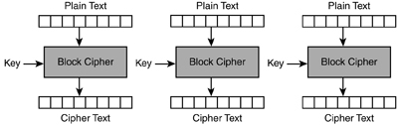
Block Cipher: Electronic Codebook
Simplest block cipher mode
Each block encrypted separately
Like plaintext encrypts to like ciphertext
© 2016 Cengage Learning®. May not be scanned, copied or duplicated, or posted to a publicly accessible website, in whole or in part.
Notes:
ECB = Electronic CodeBook

Slide 17
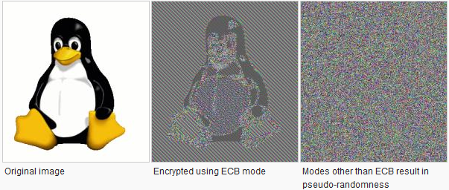
Block Cipher: Electronic Codebook

Slide 18
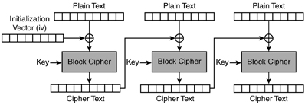
Block Cipher: Cipher-Block Chaining (CBC)
In CBC mode, each block of plaintext is XORed with the previous ciphertext block before being encrypted. This way, each ciphertext block depends on all plaintext blocks processed up to that point. To make each message unique, an IV must be used in the first block.
© 2016 Cengage Learning®. May not be scanned, copied or duplicated, or posted to a publicly accessible website, in whole or in part.
Notes:
CBC – Cipher Block Chaining.
An initialization vector (IV) is a starting block of information that is required for several block cipher modes. The IV is used as a part of the input data needed to encrypt the first block in the plaintext message. In order for the encryption to be secure, the IV must be random and can never be reused.
A pseudo-random number generator (PRNG) is a mechanism that is frequently used to create an initialization vector. A PRNG uses an algorithm of some kind to create random numbers. The quality of the PRNG is related to how easy it is for an attacker to guess the random numbers that will be generated.

Slide 19
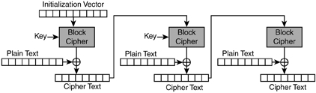
Block cipher: Cipher Feedback (CFB)
The Cipher Feedback (CFB) mode, a close relative of CBC, makes a block cipher into a self-synchronizing stream cipher.
If part of the ciphertext is lost (e.g. due to transmission errors), then the receiver will lose only some part of the original message and should be able to continue correct decryption after processing some amount of input data.
© 2016 Cengage Learning®. May not be scanned, copied or duplicated, or posted to a publicly accessible website, in whole or in part.

Slide 20
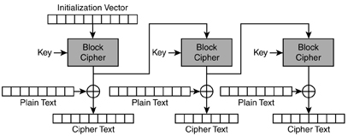
Block Cipher: Output Feedback (OFB)
Plaintext is XOR’d with the encrypted material in the previous block to produce ciphertext
© 2016 Cengage Learning®. May not be scanned, copied or duplicated, or posted to a publicly accessible website, in whole or in part.

Slide 21
Block Cipher: Counter (CTR)
Like OFB, Counter mode turns a block cipher into a stream cipher. It generates the next keystream block by encrypting successive values of a "counter". The counter can be any function which produces a sequence which is guaranteed not to repeat for a long time, although an actual increment-by-one counter is the simplest and most popular.

Slide 22
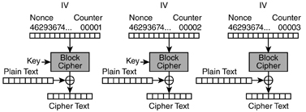
Block Cipher: Counter (CTR)
Uses a “nonce” (a random number that is used once) that is concatenated with a counter or other simple function, which is encrypted by the block cipher, and the output XOR’d with the plaintext block to product the ciphertext block
© 2016 Cengage Learning®. May not be scanned, copied or duplicated, or posted to a publicly accessible website, in whole or in part.

Slide 23
Stream Ciphers
Used to encrypt a continuous stream of data, such as an audio or video transmission
A stream cipher is a substitution cipher that typically uses an exclusive-or (XOR) operation that can be performed very quickly by a computer.
© 2016 Cengage Learning®. May not be scanned, copied or duplicated, or posted to a publicly accessible website, in whole or in part.

Slide 24
Stream Ciphers (cont.)
Encryption: simple XOR with key:
Decryption: simple XOR with the same key:
Plaintext | 1 | 1 | 0 | 1 | 0 | 0 | 1 | 1 | 0 | 1 | 0 | 0 | 1 | 1 | 0 | 0
Key | 0 | 1 | 1 | 0 | 1 | 0 | 0 | 1 | 0 | 1 | 1 | 0 | 1 | 0 | 1 | 0
Ciphertext | 1 | 0 | 1 | 1 | 1 | 0 | 1 | 0 | 0 | 0 | 1 | 0 | 0 | 1 | 1 | 0
Ciphertext | 1 | 0 | 1 | 1 | 1 | 0 | 1 | 0 | 0 | 0 | 1 | 0 | 0 | 1 | 1 | 0
Key | 0 | 1 | 1 | 0 | 1 | 0 | 0 | 1 | 0 | 1 | 1 | 0 | 1 | 0 | 1 | 0
Plaintext | 1 | 1 | 0 | 1 | 0 | 0 | 1 | 1 | 0 | 1 | 0 | 0 | 1 | 1 | 0 | 0
© 2016 Cengage Learning®. May not be scanned, copied or duplicated, or posted to a publicly accessible website, in whole or in part.

Slide 25
Types of Encryption Keys
Symmetric keys
Same key used at both ends of a communications channel or session
A symmetric key is also known as a shared secret
Issues related to communicating the key to the other party – it must be safely transmitted “out of band”
Encryption algorithms that use symmetric keys
DES, 3DES, AES, Blowfish, IDEA, RC5
© 2016 Cengage Learning®. May not be scanned, copied or duplicated, or posted to a publicly accessible website, in whole or in part.
Notes:
DES (Data Encryption Standard). Developed in 1976 by IBM and designed as the U.S. NSA (National Security Agency) official cryptographic standard. DES uses a 56-bit key, considered short by today’s standards. DES uses the Digital Encryption Algorithm (DEA).
3DES. Known as triple-DES, this extension to the original DES algorithm effectively increases the key length to 168 bits.
AES (Advanced Encryption Standard). A replacement for the aging DES standard, designated in 2000. AES uses the Rijndael cipher.
Blowfish. IDEA (International Data Encryption Algorithm). A block cipher that is not in wide
use because it is patented. RC5.

Slide 26
Types of Encryption Keys (cont.)
Asymmetric keys (public key cryptography)
Overcomes the problem of communicating a shared secret to another party
Key distribution scales better than symmetric cryptography
All parties can share each others’ public keys
Use cases
Encrypt message, sign message, sign and encrypt message
© 2016 Cengage Learning®. May not be scanned, copied or duplicated, or posted to a publicly accessible website, in whole or in part.

Slide 27
Types of Encryption Keys (cont.)
Asymmetric keys / public key cryptography (cont.)
Algorithms that use asymmetric keys
RSA, El Gamal, Elliptic Curve
© 2016 Cengage Learning®. May not be scanned, copied or duplicated, or posted to a publicly accessible website, in whole or in part.
Notes:
Some of the well-known asymmetric key encryption algorithms in use include:
RSA. A key transport algorithm based upon factors of large prime numbers.
El Gamal. Based upon discrete logarithms.
Elliptic Curve. A new and stronger method for factoring prime numbers based upon elliptic curves.

Slide 28
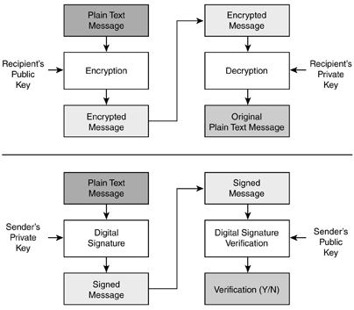
Public Key Cryptography
© 2016 Cengage Learning®. May not be scanned, copied or duplicated, or posted to a publicly accessible website, in whole or in part.

Slide 29
Diffie-Hellman Key Exchange
Another way to overcome the problem of exchanging encryption keys without compromising them
1. Alice and Bob agree to a large prime number p and a base integer g. The values p and g may be transmitted over the network in the clear.
2. Alice picks a secret integer a, then calculates gª mod p and sends the result to Bob .
3. Bob picks a secret integer b, then calculates g^{b} mod p and sends the result to Alice.
4. Alice computes k=(g^{b} mod p)ª mod p.
5. Bob computes k=(gª mod p)^{b} mod p.
P is at least 300 digits; a and b at least 100 digits
© 2016 Cengage Learning®. May not be scanned, copied or duplicated, or posted to a publicly accessible website, in whole or in part.
Notes:
With numbers of this size, it is computationally infeasible to break the D-H protocol even with all of mankind’s computing power.
https://security.stackexchange.com/questions/45963/diffie-hellman-key-exchange-in-plain-english
https://www.youtube.com/watch?v=NmM9HA2MQGI
g^key mod prime

Slide 30
Length of Encryption Keys
For a given encryption algorithm, its ability to resist attack is based on the quality of the encryption algorithm itself and
The length of the key.
Key length
Too short – low resistance to attack
Too long – performance penalty
As attacks improve and processors get faster, encryption key lengths gradually get longer
© 2016 Cengage Learning®. May not be scanned, copied or duplicated, or posted to a publicly accessible website, in whole or in part.
Notes:
The right key length is a balance between security and too big of a performance penalty. It’s an arms race.

Slide 31
Protection of Encryption Keys
Symmetric keys
Must be restricted to as few people as possible
Protected by a strong password, or encrypted again if needed
Asymmetric keys
Private key requires protection similar to symmetric key
Public keys can be published, even on the Internet
© 2016 Cengage Learning®. May not be scanned, copied or duplicated, or posted to a publicly accessible website, in whole or in part.
Notes:
Any system containing symmetric keys should also be hardened and protected with other controls such as firewalls, intrusion prevention systems (IPSs), and file integrity monitoring systems (FIMs).

Slide 32
Protecting Keys in Applications
More difficult to protect keys that applications must be able to access directly
Hardening techniques
Separation of duties
Key value known only to ops, not dev or support
Split custody
Split key value or password among two or more persons
Store encryption key in hardware
Use of a key-encrypting key
© 2016 Cengage Learning®. May not be scanned, copied or duplicated, or posted to a publicly accessible website, in whole or in part.
Notes:
KEK – Key-Encrypting Key: A cryptographic key that is used for the encryption or decryption of other keys to provide confidentiality protection. Also see Key-wrapping key.

Slide 33
Cryptanalysis
Frequency analysis
Birthday attacks
Ciphertext only attack
Chosen plaintext attack
Chosen ciphertext attack
Known plaintext attack
Man in the middle attack
Replay attack
Rubber hose attack
Social engineering attack
© 2016 Cengage Learning®. May not be scanned, copied or duplicated, or posted to a publicly accessible website, in whole or in part.
Notes:
Cryptanalysis is the study of deciphering an encrypted message without access to the encryption key.
Frequency analysis is the study of the frequency of occurrence of characters in a message ciphertext. Ex. substitution cipher.
Birthday Attack: a collision within a hashing algorithm. Probability – 2 out of 23, or more, people will share the same birthday.
Ciphertext-only attack (COA) is a cryptanalysis where the attacker has only ciphertext to work with. WEP can be broken with this type of attack.
Chosen plaintext attack (CPA), the attacker is able to choose known plaintext messages, get them encrypted, and obtain ciphertexts for those plaintexts.
Chosen ciphertext attack (CCA) can choose ciphertext, have it decrypted, and obtain the plaintext. This is a trial-and-error attack that requires many decryption opera- tions before the attacker can begin to deduce the key and/or the decryption algorithm.
Known plaintext attack (KPA) - attacker possesses both plaintext and corresponding ciphertext messages - analyze both in order to obtain the encryption key.
Rubber-hose Attack – Personal threats/coercion are used to get the key.

Slide 34
Uses for Cryptography
File encryption
PGP and GPG
WinZip (version 9 uses AES) and variants such as 7Zip
EFS (encrypting file system) for Windows
Crypt tool for Unix/Linux
© 2016 Cengage Learning®. May not be scanned, copied or duplicated, or posted to a publicly accessible website, in whole or in part.
Notes:
EFS: This is the file and directory encryption capability that is built in to the NTFS file system on Windows 2000, XP, Windows Vista, 7, and 8. EFS protects files in place.
PGP: This popular tool can be used to encrypt files using one or more recipient public keys, or symmetric encryption using a shared secret. Creates a separate encrypted file (Symantec). OpenPGP is an IETF Standard.
GPG: based on and compatible with OpenPGP standards.
Crypt: creates an encrypted copy of a file.

Slide 35
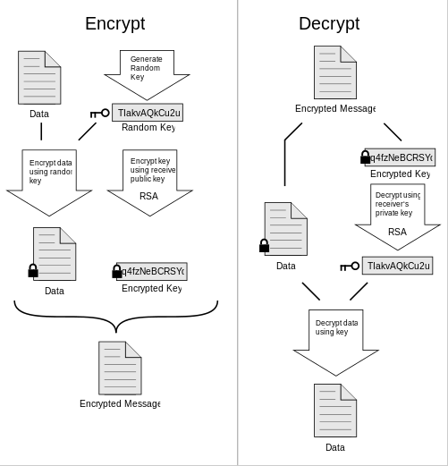
PGP
Uses symmetric-key crypto and public-key crypt
Each public key is bound to a user name.

Slide 36
Uses for Cryptography (cont.)
Encrypted volumes and disks
Truecrypt for Windows, Mac, Unix
Bitlocker for Windows Vista, 7, 8
PGP Disk
SafeBoot
© 2016 Cengage Learning®. May not be scanned, copied or duplicated, or posted to a publicly accessible website, in whole or in part.
Notes:
TrueCrypt. This is a public domain tool that can be used to encrypt the entire hard drive or create an encrypted volume.
BitLocker. This tool is built into premium versions of Win Vista, 7, and 8 and is used to create an encrypted disk volume that contains the operating system and user files.
PGP (Pretty Good Privacy). Commercial versions of PGP include PGP Disk, a tool used to create an encrypted volume on a computer’s hard drive.
SafeBoot. A commercial disk encryption tool for Windows systems and PDA/
smartphone platforms.

Slide 37
Uses for Cryptography (cont.)
E-mail
S/MIME (Secure / Multipurpose Internet Mail Extensions) – certificate based
PGP / GPG – asymmetric key (public key crypto)
PEM (Privacy Enhanced Mail) – not widely used, requires a single global PKI with a single root (which was never implemented)
MOSS (MIME Object Security Services) – not widely used
© 2016 Cengage Learning®. May not be scanned, copied or duplicated, or posted to a publicly accessible website, in whole or in part.
Notes:
(S/MIME) is a certificate-based e-mail encryption standard, used to encrypt and/or digitally sign e-mail messages. Outlook, Thunderbird.
(MOSS) is a standard protocol that provides confidentiality, authentication, and non-repudiation using message digests and public key encryption.

Slide 38
Uses for Cryptography (cont.)
Web browsing – protects session contents from eavesdropping
SSL / TLS (Secure Sockets Layer / Transport Layer Security)
40-512 bit encryption with secure key exchange
Server authentication common, client authentication rare
SET (Secure Electronic Transaction)
No longer widely used
© 2016 Cengage Learning®. May not be scanned, copied or duplicated, or posted to a publicly accessible website, in whole or in part.

Slide 39
Uses for Cryptography (cont.)
Protecting network communications
SSH
Replacement for telnet, rsh, rlogin
Secure FTP
SSL
Protects web browser traffic
IPsec
Encrypts all packets between established pairs of hosts
© 2016 Cengage Learning®. May not be scanned, copied or duplicated, or posted to a publicly accessible website, in whole or in part.
Notes:
IPSec: Two modes:
Transport Mode: each packet’s payload is encrypted.
Tunnel Mode: Packet payload and Header are encrypted. Supports NAT-T
IPSec uses Security Associations to setup a one way trust relationship between endpoints. A SA is a one-way association to an endpoint, meaning that only one end can initiate traffic. If you want traffic to be able to be initiated from both endpoints, you need to configure two SAs.
IPSec can run in Authentication Header (AH) mode or Encapsulating Security Payload (ESP) mode.
AH provides Authentication, Integrity, and Non-Repudiation. Port 51. No NAT.
ESP provides Encryption, Authentication, and Integrity. Port 50.
The SA must specify whether AH or ESP mode.

Slide 40
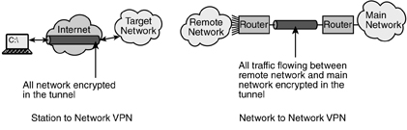
Virtual Private Networks
Logical network connection between two networks, between two endpoints, or between an endpoint and a network
Often encrypted with SSL, IPsec
© 2016 Cengage Learning®. May not be scanned, copied or duplicated, or posted to a publicly accessible website, in whole or in part.
Notes:
An IPsec VPN requires a client program, which adds a little administrative overhead, since this VPN program must be installed and maintained on all VPN users’ workstations.
SSL encryption allows so-called clientless VPN connections that utilize SSL capabilities that are built in to virtually every workstation.

Slide 41
Key Management
Key creation
Process and results must be protected
Key protection and custody – secured keys in control by the fewest number of persons
Key rotation – periodic update of encryption keys
Key destruction – securely destroy, to protect encrypted data to be retired. Destroy all copies in all locations. Wipe the file.
Key escrow – keys held by a trusted third party. Can protect against lost keys due to a disaster.
© 2016 Cengage Learning®. May not be scanned, copied or duplicated, or posted to a publicly accessible website, in whole or in part.
Notes:
Creation should ensure randomness/unpredictability.
perfect forward secrecy is used in this regard to describe whether past or future encryption keys can be predicted based on the value of any known encryption keys.
perfect forward secrecy (PFS), is a feature of specific key agreement protocols that gives assurances your session keys will not be compromised even if the private key of the server is compromised.^{[1]} Forward secrecy protects past sessions against future compromises of secret keys or passwords.^{[2]} By generating a unique session key for every session a user initiates, even the compromise of a single session key will not affect any data other than that exchanged in the specific session protected by that particular key.

Slide 42
Message Digests and Hashing
Message digest – the result of a cryptographic operation on a file or message.
Fixed-length result regardless of message size
Impossible to derive original message from digest
No other message should produce the same digest
Algorithms
SHA-1, SHA-2, SHA-3, HMAC
MD-5 is no longer recommended
© 2016 Cengage Learning®. May not be scanned, copied or duplicated, or posted to a publicly accessible website, in whole or in part.
Notes:
SHA-1 = 160 bit output
SHA-2 = SHA-224, SHA-256, SHA-384, and SHA-512
SHA-3 = 1600 bit output
HMAC (Hashed Message Authentication Code). An algorithm that utilizes a message digest (such as MD5, SHA-1, or SHA-2) together with a secret key.

Slide 43
Digital signatures
Message digest that is cryptographically combined with signer’s private key
Requires public key cryptography
Verifies message integrity
Verifies identity of signer
Algorithms: DSA, El Gamal, Elliptic Curve DSA
© 2016 Cengage Learning®. May not be scanned, copied or duplicated, or posted to a publicly accessible website, in whole or in part.
Notes:
Integrity and Non-repudiation.

Slide 44
Digital Certificates
An electronic document
individual’s public encryption key
identifying information (name, contact info)
digital signature of the individual’s public encryption key
signed by a trusted certificate authority (CA)
X.509 is most common standard in use
assumes a strict hierarchical system of certificate authorities(CAs) for issuing the certificates
Different than web of trust
© 2016 Cengage Learning®. May not be scanned, copied or duplicated, or posted to a publicly accessible website, in whole or in part.
Notes:
The most common form of a digital certificate is X.509, an ITU (International Telecommuni-
cation Union) standard. The structure of an X.509v3 digital certificate is:
Version (usually a “3” for X.509v3)
Serial Number
Algorithm ID (the encryption algorithm used)
Issuer (the organization that signed the certificate)
Validity– Not Before (date) – Not After (date)
Subject (identifying information about the certificate user)
Subject Public Key Info – Public Key Algorithm (the algorithm used) –
Subject Public Key (the actual public key)
Issuer Unique Identifier (optional)
Subject Unique Identifier (optional)
Extensions (optional)
Certificate Signature Algorithm (the actual digital algorithm)
Certificate Signature (the actual digital signature)

Slide 45
Non-Repudiation
Inability for a user to repudiate (deny) an action, because of the methods used to permit or authorize the action
Digital signature
Verifies integrity of transaction
Verifies identity of person performing transaction
Password required to use digital signature
Multi-factor authentication strengthens non-repudiation
© 2016 Cengage Learning®. May not be scanned, copied or duplicated, or posted to a publicly accessible website, in whole or in part.

Slide 46
Public Key Infrastructure (PKI)
Online facility
Storage of users’ public encryption keys
Fast lookup via an API that makes use automatic
PKI platforms
LDAP
Microsoft Active Directory
Cloud-based or on-premises
© 2016 Cengage Learning®. May not be scanned, copied or duplicated, or posted to a publicly accessible website, in whole or in part.

Slide 47
Encryption Alternatives
Steganography
Data hidden in image files, subtle changes that the eye won’t see; can be encrypted as well
Many “stego” tools available
Watermarking
Like a digital signature – a visible or invisible mark that claims ownership
© 2016 Cengage Learning®. May not be scanned, copied or duplicated, or posted to a publicly accessible website, in whole or in part.
Notes:
Steganography, which is also known as “stego,” is the practice of hiding a message within another medium – image, sound file, video clip, file’s slack space.
In stego, a message may or may not be encrypted. If the method used to hide a message can be discovered, then the contents of the message will be compromised. The act of communicating through the use of steganography can be thought of as one form of a covert channel.

Slide 48
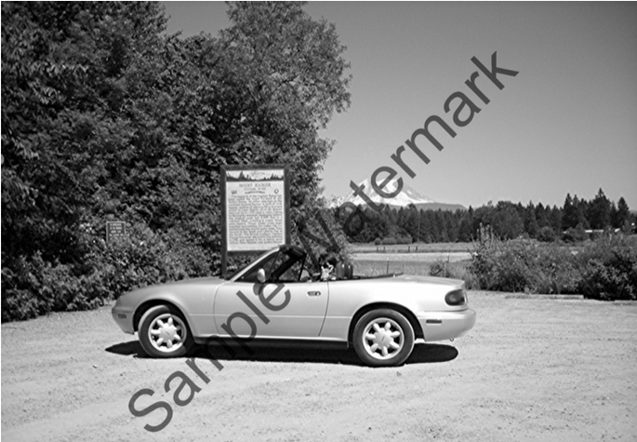
Encryption Alternatives (cont.)
Watermarking example:
© 2016 Cengage Learning®. May not be scanned, copied or duplicated, or posted to a publicly accessible website, in whole or in part.

Slide 49
Summary
The methods of encryption are substitution, transposition, monoalphabetic, polyalphabetic, running-key, and one time pads.
Block ciphers are used to encrypt messages and files.
Stream ciphers are used to encrypt continuous streams of data such as video or audio.
Two types of keys are symmetric and asymmetric (or public key)
© 2016 Cengage Learning®. May not be scanned, copied or duplicated, or posted to a publicly accessible website, in whole or in part.

Slide 50
Summary (cont.)
Cryptanalysis is an attack on a cryptosystem.
Key management encompasses several procedures and safeguards used to create, manage, protect, use, and (eventually) destroy encryption keys.
Hashing is uses a cryptographic algorithm to create a message digest of a file or message, to verify integrity.
Non-repudiation is the concept of ensuring that a person cannot later deny having performed some action.
© 2016 Cengage Learning®. May not be scanned, copied or duplicated, or posted to a publicly accessible website, in whole or in part.

Slide 51
Summary (cont.)
A public-key infrastructure (PKI) is a network-based service used to store digital certificates or public encryption keys of individuals in a community.
Digital signatures are used to authenticate and confirm the integrity of a document.
A digital certificate is an electronic document used to prove the integrity and identity of a public encryption key.
© 2016 Cengage Learning®. May not be scanned, copied or duplicated, or posted to a publicly accessible website, in whole or in part.

Slide 52
Summary (cont.)
A public-key infrastructure (PKI) is a network-based service used to store digital certificates or public encryption keys of individuals in a community.
Steganography is used to hide information within some other media, such as an image, audio file, video stream, or slack space in a file.
Watermarking is a visible form of steganography that is used to “label” a document, image, or data.
© 2016 Cengage Learning®. May not be scanned, copied or duplicated, or posted to a publicly accessible website, in whole or in part.

