Slide 1
CISSP Guide to Security Essentials, Second Edition
Chapter 8
Physical and Environmental Security
© 2016 Cengage Learning®. May not be scanned, copied or duplicated, or posted to a publicly accessible website, in whole or in part.

Slide 2
Objectives
Site access controls including key card access systems, biometrics, video surveillance, fences and walls, notices, and exterior lighting
Secure siting: identifying and avoiding threats and risks associated with a building site
Equipment protection from fire, theft, and damage
Environmental controls including HVAC and backup power
© 2016 Cengage Learning®. May not be scanned, copied or duplicated, or posted to a publicly accessible website, in whole or in part.

Slide 3
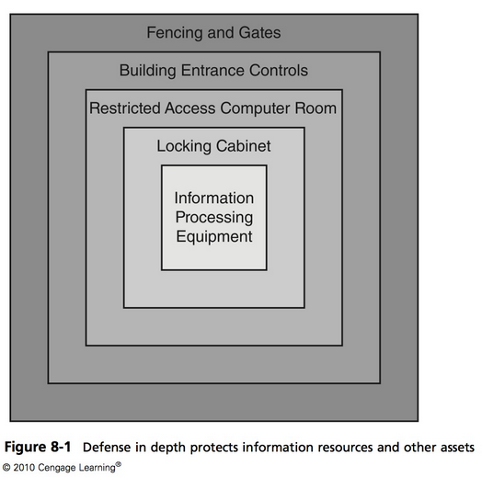

Slide 4
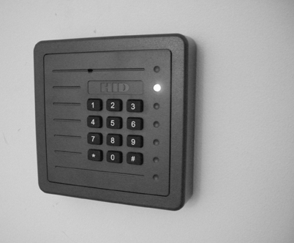
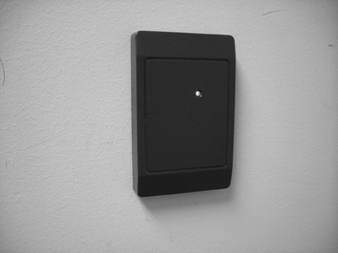
Site Access Controls
Key cards
Centralized access control consists of card readers, central computer, and electronic door latches
Pros: easy to use, provides an audit record, easy to change access permissions
Cons: can be used by others if lost
© 2016 Cengage Learning®. May not be scanned, copied or duplicated, or posted to a publicly accessible website, in whole or in part.
Notes:
Other CONS: Also vulnerable to “tailgating,” Cloning the RFID or Magnetic-Strip Card
Remedies: One-card – One-person policy and enforce it.
Mantraps, or security guard.
PIN Pad entry system coupled with RFID Card.

Slide 5
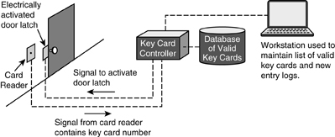
Site Access Controls (cont.)
© 2016 Cengage Learning®. May not be scanned, copied or duplicated, or posted to a publicly accessible website, in whole or in part.

Slide 6
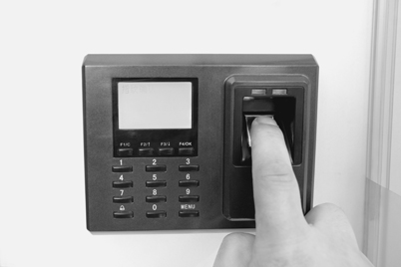
Biometric Access Controls
Based upon a specific biometric measurement
Greater confidence of claimed identity
Fingerprint, iris scan, retina scan, hand scan, voice, facial recognition, others
More costly than key card alone
© 2016 Cengage Learning®. May not be scanned, copied or duplicated, or posted to a publicly accessible website, in whole or in part.
Notes:
Biometrics is a means for measuring a physiological characteristic of a person
The most common biometrics in use in facility access controls are:
Fingerprint.
Hand print. popular biometric measurement is the geometry of a human hand.
Iris scan. Human irises are as unique as fingerprints, and high-resolution digital imaging is able to capture a high-quality image from a comfortable distance from the subject. Iris scan-based biometric systems are available and growing in popularity.

Slide 7
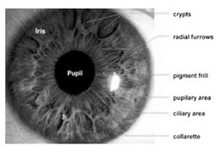

Slide 8
Metal Keys
Pros: suitable backup when a key card system fails
Uses in limited areas such as cabinets
Best to use within keycard access areas
Cons
Easily copied, cannot tell who used a key to enter
© 2016 Cengage Learning®. May not be scanned, copied or duplicated, or posted to a publicly accessible website, in whole or in part.
Notes:
Metal keys are discouraged for use as a primary access control for the above reasons and because many locksets are vulnerable to a specially crafted key called a “bump key” as well as lock-picking, which show no sign of forced entry
Metal Keys are great for a backup method of entry into a facility/room.
All metal keys should be issued according to a strict procedure that includes written records. When possible, each key should be serialized (stamped with a unique identifying mark or num- ber), which enables identification of a specific key, should it be found. Employees who are issued metal keys should sign a form that describes their responsibility for safekeeping of the key.

Slide 9

Man Trap
Double doors, where only one can be opened at a time
Used to control personnel access
Manually operated or automatic
Only room for one person
© 2016 Cengage Learning®. May not be scanned, copied or duplicated, or posted to a publicly accessible website, in whole or in part.

Slide 10
Security Guards
Trained personnel with a variety of duties:
Checking employee identification, handling visitors, checking parcels and incoming/outgoing equipment, managing deliveries, apprehending suspicious persons, calling additional security personnel or law enforcement, assisting persons as needed
Advantages: flexible, employ judgment, mobile
© 2016 Cengage Learning®. May not be scanned, copied or duplicated, or posted to a publicly accessible website, in whole or in part.
Notes:
There are several advantages to security guards, including:
Human judgment. Through situational awareness, a guard can spot a suspicious activity that no automated system can handle.
Flexibility. A guard can perform many other duties such as helping visitors and employees.
Roaming. A guard can walk to another part of a facility to check on a suspicious activity or apprehend an intruder.

Slide 11
Guard Dogs
Serve as detective, preventive, and deterrent controls
Apprehend suspects
Detect substances
© 2016 Cengage Learning®. May not be scanned, copied or duplicated, or posted to a publicly accessible website, in whole or in part.

Slide 12
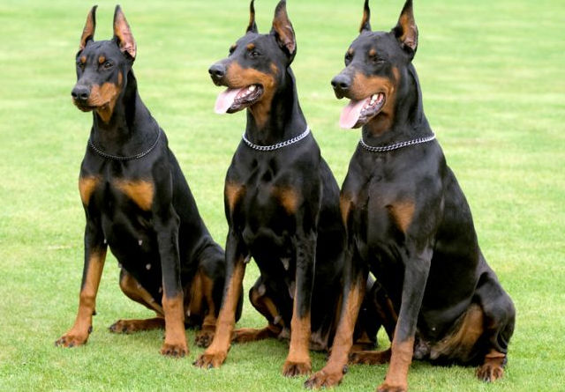

Slide 13
Access Logs
Record of events
Personnel entrance and exit
Visitors
Vehicles
Packages
Equipment
© 2016 Cengage Learning®. May not be scanned, copied or duplicated, or posted to a publicly accessible website, in whole or in part.
Notes:
An access log is a record that contains building access attempts. The types of access logs that should be maintained at a work facility include:
Personnel entrance and exit. This can usually be accomplished with a key card system or some other automated means.
Visitor log. This allows the organization to track all visitors who have entered the facility. The log should contain identifying information and the nature of their visit.
Vehicles. If the facility includes a gated parking facility, the entrances and exits of all vehicles should be recorded.
Packages. All incoming and outgoing parcels should be logged, including their contents, origin or destination, and personnel associated with the parcel.
Equipment. Personnel taking equipment into and out of the facility should be logged, including serial numbers where applicable.

Slide 14
Fences and Walls
Effective preventive and deterrent control
Keep unwanted persons from accessing specific areas
Height | Effectiveness
3-4 ft | Deters casual trespassers
6-7 ft | Too difficult to climb easily
8 ft plus 3 strands of barbed or razor wire | Deters determined trespassers
© 2016 Cengage Learning®. May not be scanned, copied or duplicated, or posted to a publicly accessible website, in whole or in part.
Notes:
Remember fences can have motion detection which alerts when someone is trying to climb. So it can be a Detective Control as well.

Slide 15
Video Surveillance
Supplements security guards
Provide points of view not easily achieved with guards
Locations
Entrances
Exits
Loading bays
Stairwells
Refuse collection areas
© 2016 Cengage Learning®. May not be scanned, copied or duplicated, or posted to a publicly accessible website, in whole or in part.
Notes:
A video surveillance system is a system consisting of one or more video cameras, together with viewing, storage, and playback features that are used to observe and/or record activities such as personnel movement.

Slide 16
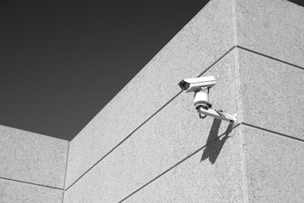
Video Surveillance (cont.)
© 2016 Cengage Learning®. May not be scanned, copied or duplicated, or posted to a publicly accessible website, in whole or in part.

Slide 17
Video Surveillance (cont.)
Camera types
CCTV, IP wired, IP wireless
Night vision
Fixed, Pan / tilt / zoom
Hidden / disguised
Recording capabilities
None; motion-activated; periodic still images; continuous
© 2016 Cengage Learning®. May not be scanned, copied or duplicated, or posted to a publicly accessible website, in whole or in part.
Notes:
CCTV cameras send standard composite video (and, sometimes, audio) signals through CCTV cabling.
IP cameras. Cameras can send their video signals through wired TCP/IP networks to an IP-enabled controller.
IP wireless cameras. Cameras can transmit their video signals through WiFi,
Bluetooth, or other wireless networks.
Night vision cameras. Some video surveillance cameras are designed with night vision capability. This enables surveillance of an area even in complete darkness.
Fixed cameras. Video cameras that are permanently aimed in one direction. Pan/tilt/zoom cameras. Video cameras that can be remotely controlled by an operator
for a closer look at some activity or person of interest.
Hidden cameras. Surveillance cameras can be placed secretly out of sight to record activities that might not take place if cameras were visible. Hidden surveillance cameras that are disguised as common objects like clocks, smoke detectors, books, radios, and other objects are available.

Slide 18
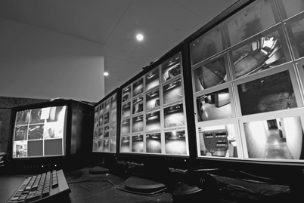
Video Surveillance (cont.)
© 2016 Cengage Learning®. May not be scanned, copied or duplicated, or posted to a publicly accessible website, in whole or in part.
Notes:
Recording Capabilities Video systems can provide real-time-only viewing, recording of video information, or both. The range of recording and viewing capabilities includes:
Real-time viewing only. Events taking place will be viewable only when they are occurring.
Motion-activated recording. Surveillance system can record video only when there is motion to record, such as a person walking or a vehicle driving through a camera’s field of view.
Periodic still images. A surveillance system can record still images from each camera every few seconds, whether something is going on or not.
Continuous video recording. A surveillance system can continuously record video whether there is motion or not.
Surveillance systems can record data onto videotape, hard drive, or DVR/RW media. Systems can be configured to retain images for a day, a month, several months, or longer, depending upon the storage capacity of the system.

Slide 19
Intrusion, Motion, and Alarm Systems
Automatic detection of intruders
Central controller and remote sensors
Door and window sensors
Motion sensors
Glass break sensors
Duress alarms
Alarming and alerting
Audible alarms
Alert to central monitoring center or law enforcement
© 2016 Cengage Learning®. May not be scanned, copied or duplicated, or posted to a publicly accessible website, in whole or in part.
Notes:
An alarm system is an apparatus that consists of a central controller called an alarm panel, plus several sensors of different kinds including:
Floor sensors, thermal sensors.
Alerting: Strobe-light,
purpose of a duress alarm is to give personnel a means for discretely signaling others of some sort of an emergency situation.

Slide 20
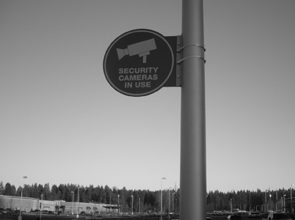
Visible Notices
No Trespassing signs
Surveillance notices
Sometimes required by law
Surveillance monitors
© 2016 Cengage Learning®. May not be scanned, copied or duplicated, or posted to a publicly accessible website, in whole or in part.
Notes:
Laws or regulations in some areas require an employer to post visible notices if video surveillance is present at a facility.

Slide 21
Exterior Lighting
Discourage intruders during nighttime hours, by lighting intruders’ actions to that others will call authorities
NIST standards require 2 foot-candles of power to a height of 8 ft
© 2016 Cengage Learning®. May not be scanned, copied or duplicated, or posted to a publicly accessible website, in whole or in part.
Notes:
Deterrent control.
Lighting should not betray the locations of other security controls such as surveillance cameras, motion detectors, or guard posts.
NIST - there should be no dark areas between lamps/lights.

Slide 22
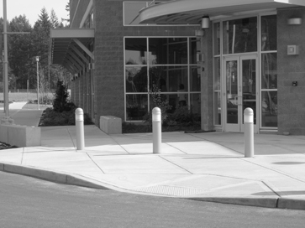
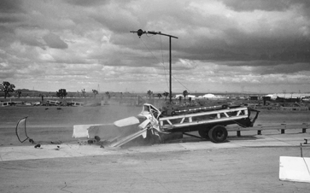
Other Physical Controls
Bollards
Crash gates
Prevent vehicle entry
Retractable
© 2016 Cengage Learning®. May not be scanned, copied or duplicated, or posted to a publicly accessible website, in whole or in part.

Slide 23
Secure Siting
Locating a business at a site that is reasonably free from hazards that could threaten ongoing operations
Identify threats
Natural: flooding, landslides, earthquakes, volcanoes, waves, high tides, severe weather
Man-made: chemical spills, transportation accidents, utilities, military base, social unrest
© 2016 Cengage Learning®. May not be scanned, copied or duplicated, or posted to a publicly accessible website, in whole or in part.

Slide 24
Secure Siting (cont.)
Other siting factors
Building construction techniques and materials
Building marking
Loading and unloading areas
Shared-tenant facilities
Nearby neighbors
© 2016 Cengage Learning®. May not be scanned, copied or duplicated, or posted to a publicly accessible website, in whole or in part.

Slide 25
Asset Protection
Laptop computers
Anti-theft cables
Defensive software (firewalls, anti-virus, location tracking, destruct-if-stolen)
Strong authentication such as fingerprint
Full encryption
Training
© 2016 Cengage Learning®. May not be scanned, copied or duplicated, or posted to a publicly accessible website, in whole or in part.

Slide 26
Asset Protection (cont.)
Servers and backup media
Keep behind locked doors
Locking cabinets
Video surveillance
Off-site storage for backup media
Secure transportation
Secure storage
© 2016 Cengage Learning®. May not be scanned, copied or duplicated, or posted to a publicly accessible website, in whole or in part.

Slide 27
Asset Protection (cont.)
Protection of sensitive documents
Locked rooms
Locking, fire-resistant cabinets
“Clean desk” policy
Reduced chance that a passer-by will see and remove a document containing sensitive information
Secure destruction of unneeded documents
© 2016 Cengage Learning®. May not be scanned, copied or duplicated, or posted to a publicly accessible website, in whole or in part.

Slide 28
Asset Protection (cont.)
Equipment check-in / check-out
Keep records of company owned equipment that leaves business premises
Improves accountability
Recovery of assets upon termination of employment
© 2016 Cengage Learning®. May not be scanned, copied or duplicated, or posted to a publicly accessible website, in whole or in part.

Slide 29
Asset Protection (cont.)
Damage protection
Earthquake bracing
Required in some locales
Equipment racks, storage racks, cabinets
Water detection and drainage
Alarms
© 2016 Cengage Learning®. May not be scanned, copied or duplicated, or posted to a publicly accessible website, in whole or in part.

Slide 30
Asset Protection (cont.)
Fire protection
Fire detection: smoke detectors, pull stations
Fire extinguishment
Fire sprinklers
Inert gas systems
Fire extinguishers
© 2016 Cengage Learning®. May not be scanned, copied or duplicated, or posted to a publicly accessible website, in whole or in part.
Notes:
Class A. Ordinary combustibles: wood, paper, and so on.
Class B. Flammable liquids and gases: gasoline, propane, and so on.
Class C. Energized electrical equipment.
Class D. Combustible metals: magnesium, and so on.
Class K. Cooking oils.
Smoke Detectors:
Optical. These types of detectors utilize an infrared LED and a photo detector, and they function by detecting minute changes in the refraction of light caused by smoke.
Ionization. These detectors detect smoke before it is visible by measuring slight changes in current between electrodes in the vicinity of a small amount of radioactive Americium-241.
Wet pipe systems. The simplest and most common type of sprinkler system, wet pipe systems are filled with pressurized water, which is released when a sprinkler head’s fusible link is melted by heat from a nearby fire.
Dry pipe systems. A more complex type of sprinkler system where water is not present in the pipes until the system is activated from a central valve.
Deluge systems. A system where all sprinklers are open. When the system is activated, water is discharged from all sprinklers.
Pre-Action Systems. A dry pipe that is converted to a wet pipe system when a smoke, fire, or heat alarm is activated. This type of system is often used in computing facilities, where the consequence of an accidental discharge is high.
Foam water sprinkler systems. A variation of any of the water-based sprinkler systems where the liquid discharged is a combination of water and fire-retardant foam.
gaseous fire suppression systems consist of inert gas in storage tanks, delivered via piping and nozzles. Gaseous fire suppression systems are used in areas with valuable electrical equipment such as computer systems. They work by displacing oxygen from the room(s) where the fire is located. In the heat-oxygen-fuel fire triangle, gaseous fire suppression works by removing oxygen from the fire by interfering with chemical combustion. Examples of sub- stances used for gaseous fire suppression include FM-200 and Inergen.

Slide 31
Asset Protection (cont.)
Cabling security – on-premises
Place cabling in conduits or away from exposed areas
Cabling security – off-premises (e.g. telco)
Select a different carrier
Utilize diverse / redundant network routing
Utilize encryption
© 2016 Cengage Learning®. May not be scanned, copied or duplicated, or posted to a publicly accessible website, in whole or in part.

Slide 32
Environmental Controls
Heating, ventilation, and air conditioning (HVAC)
Vital, yet relatively fragile
Backup units (“N+1”) recommended
Ratings
BTU/hr
Tonns
Also regulates humidity
Should be 30% - 50%
© 2016 Cengage Learning®. May not be scanned, copied or duplicated, or posted to a publicly accessible website, in whole or in part.
Notes:
The relative humidity in a facility with workers and computing equipment should range from 30 percent to 50 percent. Levels below 30 percent will result in discomfort and excessive thirst for staff, cause electronic equipment to become more brittle, and permit more static electricity.
Levels above 50 percent will permit dust mites to survive, and higher levels may result in condensa-
tion, where moisture causes corrosion. Moisture condensing on equipment will cause short circuits.

Slide 33
Environmental Controls (cont.)
Electric power
Anomalies
Blackout. A total loss of power.
Brownout. A prolonged reduction in voltage below the normal minimum specification.
Dropout. A total loss of power for a very short period of time (milliseconds to a few seconds).
Inrush. The instantaneous draw of current by a device when it is first switched on.
Noise. Random bursts of small changes in voltage.
Sag. A short drop in voltage.
Surge. A prolonged increase in voltage.
Transient. A brief oscillation in voltage.
© 2016 Cengage Learning®. May not be scanned, copied or duplicated, or posted to a publicly accessible website, in whole or in part.

Slide 34
Environmental Controls (cont.)
Electric power protection
Line conditioner – filters incoming power to make it cleaner and free of most anomalies
Uninterruptible Power Supply (UPS) – temporary supply of electric power via battery storage
Electric generator – long term supply of electric power via diesel (or other source) powered generator
© 2016 Cengage Learning®. May not be scanned, copied or duplicated, or posted to a publicly accessible website, in whole or in part.
Notes:
Line conditioners aren’t usually seen as standalone devices but instead are found in UPS sys- tems, discussed next.

Slide 35
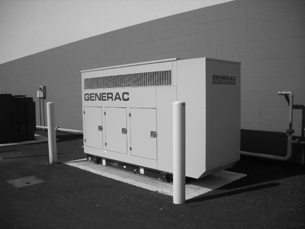
Environmental Controls (cont.)
© 2016 Cengage Learning®. May not be scanned, copied or duplicated, or posted to a publicly accessible website, in whole or in part.

Slide 36
Redundant Controls
Assured availability of critical environmental controls
Dual electric power feeds
Redundant generators
Redundant UPS
Redundant HVAC
Redundant data communications feeds
© 2016 Cengage Learning®. May not be scanned, copied or duplicated, or posted to a publicly accessible website, in whole or in part.

Slide 37
Summary
Site access control for personnel is usually achieved with key cards, PIN pads, biometrics, and metal keys.
A mantrap is an access control that consists of a set of two doors, one after the other, where only one door can be open at a time.
Site security is also achieved with guards, guard dogs, access logs, fences and walls, video surveillance, alarm systems, visual notices, exterior lighting, bollards, and crash gates.
A business should be located in an area that is reasonably free of hazards and threats (secure siting).
Natural threats include floods, landslides, avalanches, earthquakes, volcanoes, tsunamis, and severe weather.
Man made threats include chemical spills, transportation corridors, utilities, social unrest, and nearby military bases.
© 2016 Cengage Learning®. May not be scanned, copied or duplicated, or posted to a publicly accessible website, in whole or in part.

Slide 38
Summary (cont.)
Other siting issues include building construction techniques and materials, building marking, loading and unloading areas, and shared-tenancy.
Business equipment should be physically secured to prevent theft, tampering, sabotage, and water damage.
Cabling should be protected from authorized access.
Heating, Ventilation, and Air Conditioning (HVAC) systems control the temperature and humidity of air in buildings.
Electric power is protected with line conditioners, Uninterruptible Power Supplies (UPSs), and electric generators.
Facilities that cannot tolerate downtime due to the failure of HVAC, UPS, or generators should consider redundant, or “N+1”, environmental controls.
© 2016 Cengage Learning®. May not be scanned, copied or duplicated, or posted to a publicly accessible website, in whole or in part.

