Slide 1
CISSP Guide to Security Essentials, Second Edition
Chapter 9
Security Architecture and Design
© 2016 Cengage Learning®. May not be scanned, copied or duplicated, or posted to a publicly accessible website, in whole or in part.

Slide 2
Objectives
Security models including Biba, Bell LaPadula, Access Matrix, Take-Grant, Clark-Wilson, Multi-Level, Mandatory Access Control, and Discretionary Access Control
Information systems evaluation models including Common Criteria, TCSEC, ITSEC
Computer hardware architecture
Computer software: operating systems, applications, and tools
Software and system security threats and countermeasures
Cloud security threats and countermeasures
© 2016 Cengage Learning®. May not be scanned, copied or duplicated, or posted to a publicly accessible website, in whole or in part.

Slide 3
Security Models
A model is a simplified representation used to explain a real world system
Bell LaPadula
Biba
Clark-Wilson
Access matrix
Multi-Level
Mandatory access control (MAC)
Discretionary access control (DAC)
Role-based access control (RBAC)
Non-interference
Information flow
© 2016 Cengage Learning®. May not be scanned, copied or duplicated, or posted to a publicly accessible website, in whole or in part.
Notes:
In the natural sciences, models are used as a means for understanding some phenomenon in nature. In data security it’s the other way around: models are used as the basis for the design of a security mechanism that can be used to protect secrets and systems.
When designing a new information system (or the access model for a new or existing system), a system developer may wish to use a security model in order to build or choose an access model that will fulfill the system’s security access requirements. Similarly, an analyst or devel- oper who is studying an existing security system might wish to compare the system to security models in order to better understand the system.
There are two important terms used in discussions of security models. They are:
Subjects. These are usually people who use a system. In cases of system-to-system communication, a subject can also be another system, or a process running on another system.
Objects. These are the systems, data, or other resources that someone wants to access.

Slide 4
Bell-LaPadula
State machine model that addresses the confidentiality of information.
A subject can read all documents at or below his level of security, but cannot read any documents above his level of security (no read up, NRU). Prevents leaks.
A subject can write documents at or above his level of security, but cannot write documents below his level (no write down, NWD). Prevents leaks.
© 2016 Cengage Learning®. May not be scanned, copied or duplicated, or posted to a publicly accessible website, in whole or in part.
Notes:
Published in 1973, the Bell-LaPadula model is a state machine model that addresses the confidentiality of information. This data confidentiality model was developed to formalize and explain the DoD multilevel security policy.
NRU. This prevents a subject from learning secrets at a higher level than the subject’s own. For example, a diplomat can read objects intended for common citizens but cannot read objects intended for the president.
NWD. This prevents a subject from accidentally leaking secrets at the subject’s level into an object at a lower level. For example, a diplomat can write objects intended for the president but cannot write objects for common citizens, out of the concern that the diplomat may accidentally leak sensitive information to the common citizens.

Slide 5
Biba
The first formal integrity model, by preventing modifications to data by unauthorized persons.
Addresses shortcoming in Bell LaPadula: a subject at a lower security level can overwrite and potentially destroy secret information at a higher level (even though they cannot see it).
A subject cannot read documents below his level (no read down, NRD).
A subject cannot write documents above his level (no write up, NWU).
© 2016 Cengage Learning®. May not be scanned, copied or duplicated, or posted to a publicly accessible website, in whole or in part.
Notes:
Biba is called a data integrity model. published in 1977
NRD. For example, a diplomat can read documents written by the president but cannot read documents written by common citizens.
NWU. For example, a diplomat can write procedures to be read by common citizens but cannot write procedures to be read by the president.

Slide 6
Biba
The Biba Model has these three rules:
No Write Up Rule, which says a subject can’t write data to an object at a higher integrity level.
No Read Down Rule, which states a subject cannot read data located at a lower integrity level.
The Invocation Rule where a subject can’t request a service at a higher integrity level (depending on classification level: Top Secret/Secret/Confidential).
Notes:
Neither the Bell-LaPadula nor the Biba are perfect security models; each has its shortcomings and advantages. Principles from each can be used to construct other security models and mechanisms.

Slide 7
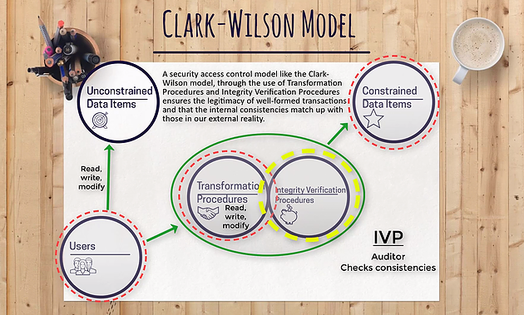
Notes:
published in 1987 as a rebuttal to the Bell- LaPadula and Biba models, which Clark and Wilson argued were more suited for confidentiality than integrity. The Clark-Wilson model consists of two principals—authenticated users and programs (called transformation procedures, or TPs)—which operate on two types of data items: unconstrained data items (UDIs) and constrained data items (CDIs). One type of
TP, called an integrity verification procedure (IVP), is used to transform UDIs into CDIs.

Slide 8
Clark-Wilson Model
Users.
It all starts with users, otherwise known as the subjects. The subjects which will access the objects. Users are the ones that need the information.
Transformation Procedures (TPs)
Then we have Transformation Procedures. Think of them as operations the subject is trying to perform.
Is the subject trying to read a file?
Write to a file?
Or modify a file?
Transformation Procedures are simply operations which can be performed.

Slide 9
Clark-Wilson Model
Constrained Data Items (CDIs)
There’s Constrained Data Items and Unconstrained Data Items.
Objects which belong in the subset of Constrained Data Items are at a higher level of protection.
In a Clark-Wilson Model, there are two types of protections given to data items, constrained and unconstrained.
In order to read an object located in the Constrained Data Items subset, we have to go through a transformation procedure.

Slide 10
Clark-Wilson Model
Constrained Data Items can only be manipulated by a Transformation Procedure.
Objects within a Constrained Data Items are so valuable, that in a Clark-Wilson model, a subject has to go through an intermediary to even just access it.
Unconstrained Data Items (UDIs)
Now objects in an Unconstrained Data Item subset, well they probably aren’t that important.

Slide 11
Clark-Wilson Model
Unconstrained Data Items (UDIs)
These can be accessed by the subject directly, it doesn’t need to go through an intermediary like a Transformation Procedure. The subject can perform their own read and write operations without going through a Transformation Procedure.
Subjects access objects in a UDI like how they would normally access an object in a networked environment, as if they weren't using a Clark-Wilson Model. Like how we access files or objects in Windows operating systems.

Slide 12
Clark-Wilson Model
Integrity Verification Procedures (IVPs)
What is an Integrity Verification Procedure?
Are they anything like Transformation Procedure?
Remember how we talked about internal and external consistency?
That’s what Integrity Verification Procedures do, they check the internal and external consistency.
IVPs are a way to audit the transformation procedure.

Slide 13
Clark-Wilson
Integrity model with two principals: users and programs (called transformation procedures, or TPs) that operate on two types of data: unconstrained data items (UDIs), and constrained data items (CDIs).
One type of TP, called an integrity verification procedure (IVP), is used to transform UDIs into CDIs.
There are two sets of rules: certification (C) rules and enforcement (E) rules.
© 2016 Cengage Learning®. May not be scanned, copied or duplicated, or posted to a publicly accessible website, in whole or in part.

Slide 14
Clark-Wilson (cont.)
Certification rules:
C1 – an IVP must ensure that CDIs are valid.
C2 – for a given CDI, a TP must transform the CDI from one valid state to another valid state.
C3 – allowed relations (or “triples” that consist of a user, a TP, and one or more CDIs) must enforce separation of duties.
C4 – TPs must create a transaction log that contains all transaction details.
C5 – TPs that accept a UDI as input may perform only valid transactions on the UDI (to convert it to a CDI) or reject the UDI.
© 2016 Cengage Learning®. May not be scanned, copied or duplicated, or posted to a publicly accessible website, in whole or in part.

Slide 15
Clark-Wilson (cont.)
Enforcement rules:
E1 – the system must permit only the TPs certified to operate on a CDI to actually do so.
E2 – the system must maintain the associations between users, TPs, and CDIs. The system must prevent operations outside of registered associations.
E3 – every user must be authenticated before they may run a TP.
E4 – only a TP’s certifier may modify its associations.
© 2016 Cengage Learning®. May not be scanned, copied or duplicated, or posted to a publicly accessible website, in whole or in part.

Slide 16
Access Matrix
Two dimensional matrix that defines which subjects are permitted to access which objects
Subject | Contracts directory | Personnel directory | Expense Reports
Warren | Read | Read | Submit
Wilson | None | None | Approve
Wyland | Read/Write | None | Submit
Yelte | Read/Write | None | None
© 2016 Cengage Learning®. May not be scanned, copied or duplicated, or posted to a publicly accessible website, in whole or in part.

Slide 17
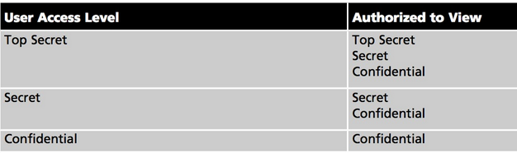
Multilevel
Used by a system that has several levels of security and is used by persons of varying security levels
System will control access to objects according to their level and the level of the persons accessing them
© 2016 Cengage Learning®. May not be scanned, copied or duplicated, or posted to a publicly accessible website, in whole or in part.
Notes:
For example, a file server contains documents at three different levels of security: Confidential, Secret, and Top Secret. The users of the system are registered as having one of three levels of clearance: Confidential, Secret, or Top Secret. A user with Secret clearance can view documents at Confidential and Secret levels, but not Top Secret. A user with Confidential clearance can only view Confidential documents. A user with Top Secret clearance can view all documents (before application of “need to know”). T

Slide 18
Discretionary Access Control (DAC)
The owner of an object controls who and what may access it. Access is at the owner’s discretion.
Example: shared file server where access permissions are administered by the owners (users) of its contents.
© 2016 Cengage Learning®. May not be scanned, copied or duplicated, or posted to a publicly accessible website, in whole or in part.

Slide 19
Mandatory Access Control (MAC)
System controls access to resources
When a subject requests access to an object, the system examines the user’s identity and access rights, and compares to access permissions of the object
System then permits or denies the access
Example: shared file server where access permissions are administered by an administrator
© 2016 Cengage Learning®. May not be scanned, copied or duplicated, or posted to a publicly accessible website, in whole or in part.
Notes:
Subject can be a program/process/thread.
Object can be a file/device/stream/port.

Slide 20
Role-Based Access Control (RBAC)
An improvement over the mandatory access control (MAC) security model
Access permissions are granted to “roles” instead of “persons”.
Provides consistent access
Makes changes much easier, because they involve changes to roles instead of to individuals
© 2016 Cengage Learning®. May not be scanned, copied or duplicated, or posted to a publicly accessible website, in whole or in part.

Slide 21
Rule-based Access Control
Rule-based access control is used to manage aspects of access control aside from which subjects are permitted to access which objects. Examples of rule-based access control include:
Time-of-day access restrictions
Geographic access restrictions

Slide 22
Non-Interference
Specifies that low inputs and outputs will not be altered by high inputs and outputs
In other words, activities at a higher security level cannot be detected (and will not interfere with) at lower security levels
Prevents leakage of information from higher security levels to lower security levels
© 2016 Cengage Learning®. May not be scanned, copied or duplicated, or posted to a publicly accessible website, in whole or in part.

Slide 23
Information Flow
Based upon flow of information rather than on access controls
Data objects are assigned to a class or level of security
Flow of objects are controlled by security policy that specifies where objects of various levels are permitted to flow
© 2016 Cengage Learning®. May not be scanned, copied or duplicated, or posted to a publicly accessible website, in whole or in part.

Slide 24
Evaluation Models
Models and frameworks provide for a consistent and repeatable approach to the evaluation of systems
Common Criteria
TCSEC
TNI
ITSEC
SEI-CMMI
SSE-SMM
© 2016 Cengage Learning®. May not be scanned, copied or duplicated, or posted to a publicly accessible website, in whole or in part.
Notes:
Trusted Computer System Evaluation Criteria – Wikipedia
https://en.wikipedia.org/wiki/Trusted_Computer_System_Evaluation_Criteria
DOD standard for assessing computer security controls. AKA – Orange Book
ITSEC - Information Technology Security Evaluation Criteria (ITSEC) is a structured set of criteria for evaluating computer security within products and systems (European Standard).

Slide 25
Common Criteria
Formal name: Common Criteria for Information Technology Security Evaluation
Usually known as just Common Criteria or CC
ISO 15408 international standard
Supersedes TCSEC and ITSEC
© 2016 Cengage Learning®. May not be scanned, copied or duplicated, or posted to a publicly accessible website, in whole or in part.
Notes:
Common Criteria is a framework for the specification, implementation, and evaluation of a system against a given set of security requirements.

Slide 26
Common Criteria (cont.)
Seven levels of evaluation (Evaluation Assurance Levels, or EALs)
EAL1: Functionally Tested.
EAL2: Structurally Tested.
EAL3: Methodically Tested and Checked.
EAL4: Methodically Designed, Tested and Reviewed.
EAL5: Semiformally Designed and Tested.
EAL6: Semiformally Verified Design and Tested.
EAL7: Formally Verified Design and Tested.
© 2016 Cengage Learning®. May not be scanned, copied or duplicated, or posted to a publicly accessible website, in whole or in part.
Notes:
Evaluation of a system to CC standards is both expensive and time-consuming. According to the U.S. General Accounting Office (GAO), evaluation at levels EAL2 through EAL4 can take as long as two years and cost as much as US$350,000. See Figure 9-1.

Slide 27
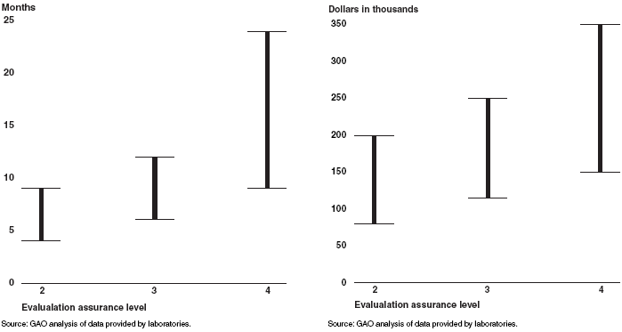
Common Criteria (cont.)
Time and expense required to perform evaluation
© 2016 Cengage Learning®. May not be scanned, copied or duplicated, or posted to a publicly accessible website, in whole or in part.

Slide 28
TCSEC
Trusted Computer Security Evaluation Criteria
U.S. DoD Orange Book as part of the Rainbow Series
A – Verified Protection
B – Mandatory Protection
B3 – Security domains
B2 – Structured protection
B1 – Labeled security
C – Discretionary protection
C2 – Controlled access
C1 – Discretionary protection
D – Minimal security
Superseded by
Common Criteria
© 2016 Cengage Learning®. May not be scanned, copied or duplicated, or posted to a publicly accessible website, in whole or in part.

Slide 29
TNI
Trusted Network Implementation
U.S. DoD Red Book in the Rainbow Series
Used to evaluate confidentiality and integrity in communications networks
© 2016 Cengage Learning®. May not be scanned, copied or duplicated, or posted to a publicly accessible website, in whole or in part.

Slide 30
ITSEC
Information Technology Security Evaluation Criteria
European standard for security evaluations
Superseded by Common Criteria
ITSEC addresses confidentiality, integrity, and availability, whereas TCSEC evaluated only confidentiality
© 2016 Cengage Learning®. May not be scanned, copied or duplicated, or posted to a publicly accessible website, in whole or in part.
Notes:
ITSEC uses two sets of security levels (functionality and evaluation) that map to TCSEC’s levels. See Table 9-3 p.337

Slide 31
SEI-CMMI
Software Engineering Institute Capability Maturity Model Integration
Objective measure of the maturity of an organization’s system engineering practices
Level 0 – Incomplete
Level 1 – Performed
Level 2 – Managed
Level 3 – Defined
Level 4 – Quantitatively Managed
Level 5 – Optimizing
© 2016 Cengage Learning®. May not be scanned, copied or duplicated, or posted to a publicly accessible website, in whole or in part.
Notes:
The objective of an organization’s assessment is to arrive at a rating of maturity levels, which are:
Level 0—Incomplete. Processes are incomplete and many activities are performed ad hoc if at all.
Level 1—Performed. Processes are documented and performed. Level 2—Managed. Processes are managed and supported with skilled workers and
tools.
Level 3—Defined. Processes are defined according to a standard process framework model.
Level 4—Quantitatively Managed. Processes are measured and managed according to the results of those measurements.
Level 5—Optimizing. Processes are measured and changed over time in order to improve them.

Slide 32
SSE-CMM
Systems Security Engineering Capability Maturity Model
Objective measure of the maturity of security engineering
Capability Level 1 - Performed Informally
Capability Level 2 - Planned and Tracked
Capability Level 3 - Well Defined
Capability Level 4 - Quantitatively Controlled
Capability Level 5 - Continuously Improving
© 2016 Cengage Learning®. May not be scanned, copied or duplicated, or posted to a publicly accessible website, in whole or in part.
Notes:
(SSE-CMM) is a process evaluation reference model that is focused on the requirements for implementing security in a system. Developed by the International Systems Security Engineering Association (ISSEA),

Slide 33
Certification and Accreditation
Processes used to evaluate and approve a system for use
Two-step process
Certification is the process of evaluation of a system’s architecture, design, and controls, according to established evaluation criteria.
Accreditation is the formal management decision to approve the use of a certified system.
© 2016 Cengage Learning®. May not be scanned, copied or duplicated, or posted to a publicly accessible website, in whole or in part.
Notes:
C & A are the processes used to evaluate and approve a system for use. These activities are not generally seen in average businesses, but instead are found in government and military environments, and also in highly regulated industries such as pharmaceuticals and aeronautics.

Slide 34
Certification and Accreditation (cont.)
Standards / processes for certification and accreditation
FedRAMP (Federal Risk and Authorization Management Program, 2012)
FISMA (Federal Information Security Management Act of 2002)
DITSCAP (Department of Defense Information Technology Security Certification and Accreditation Process)
DIACAP (DoD Information Assurance Certification and Accreditation Process) This supercedes DITSCAP!
NIACAP (Nat’l Information Assurance Cert. and Accreditation Process) Used for systems that handle U.S. National Security Info. (NSA)
DCID 6/3 (Director of Central intelligence Directive 6/3)
© 2016 Cengage Learning®. May not be scanned, copied or duplicated, or posted to a publicly accessible website, in whole or in part.
Notes:
(FedRAMP) is a U.S. government-wide program that defines a standardized approach to security assessments, authorization, and continuous monitoring for cloud-based service providers. FedRAMP marks the first major shift from compliance-based security to risk-based security and is aligned with NIST 800-137, “Information Security Continuous Monitoring (ISCM) for Federal Information Systems and Organizations.”
FISMA is a law that requires all U.S. federal information systems to conform to security standards and processes used to evaluate them. p.339
Determine Scope/Information Types, Document System, Risk Assessment, Implement Security Controls, Certification, Accreditation, and Continuous Monitoring
Director of Central Intelligence Directive 6/3 (DCID 6/3) is the process for pro- tecting sensitive compartmented information within information systems at the U.S. Central Intelligence Agency (CIA).

Slide 35
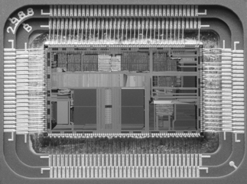
Computer Components
Central processor
Bus
Main storage
Secondary storage
Communications
Firmware
© 2016 Cengage Learning®. May not be scanned, copied or duplicated, or posted to a publicly accessible website, in whole or in part.
Notes:
A security manager must fully understand how every facet of information systems works, including the underlying hardware. The security manager is explicitly responsible for the protection of information and information systems; a working knowledge of every facet and layer of the organization’s information systems is necessary in order to be able to protect it.

Slide 36
Central Processor (CPU)
Executes program instructions
Components
Arithmetic logic unit (ALU). Performs arithmetic and logic operations.
Registers. These are temporary storage locations that are used to store the results of intermediate calculations. A CPU can access data in its registers far more quickly than main memory.
Program counter. A register that keeps track of which instruction in a program the CPU is currently working on.
Memory interface. This is the circuitry that permits the CPU to access main memory.
© 2016 Cengage Learning®. May not be scanned, copied or duplicated, or posted to a publicly accessible website, in whole or in part.

Slide 37
Central Processor (CPU) (cont.)
Operations
Fetch. The CPU fetches (retrieves) an instruction from memory.
Decode. The CPU breaks the instruction into its components: the opcode (or operation code – literally the task that the CPU is expected to perform) and zero or more operands, or numeric values that are associated with the opcode (for example, if the CPU is to add two numbers together, the opcode will direct an addition, and two opcodes will be the two numbers to add together).
Execute. This is the actual operation as directed by the opcode.
Writeback. The CPU writes the result of the opcode (for instance, the sum of the two numbers to add together) to some memory location.
© 2016 Cengage Learning®. May not be scanned, copied or duplicated, or posted to a publicly accessible website, in whole or in part.

Slide 38
Central Processor (CPU) (cont.)
CPU instruction sets (of opcodes)
CISC (Complex Instruction Set Computer)
VAX, PDP-11, Motorola 68000, Intel x86
RISC (Reduced Instruction Set Computer)
SPARC, Dec Alpha, MIPS, Power PC
Explicitly Parallel Instruction Computing (EPIC)
Intel Itanium
Single core, multi-core (2 to 8 CPUs on a single die)
© 2016 Cengage Learning®. May not be scanned, copied or duplicated, or posted to a publicly accessible website, in whole or in part.
Notes:
CISC (Complex Instruction Set Computer). A microprocessor architecture in which each instruction can execute several operations in a single instruction cycle. Earlier microprocessors had larger instruction sets to more closely match the semantics of high-level languages.
RISC (Reduced Instruction Set Computer). A newer microprocessor design where the CPU has a smaller (reduced) instruction set that permits it to be more efficient.
A microprocessor that permits parallel execution in a single CPU. The prime example in use is the Intel Itanium.

Slide 39
Central Processor (CPU) (cont.)
Single and multi processor computers
Symmetric multiprocessing (SMP) – two or more CPUs connected to the computer’s main memory. Virtually all multi processor computers are SMP.
Asymmetric multiprocessing (ASMP) – two or more CPUs, in a master-slave relationship.
© 2016 Cengage Learning®. May not be scanned, copied or duplicated, or posted to a publicly accessible website, in whole or in part.
Notes:
Microprocessor CPUs began as single-core designs; that is, the CPU die consisted of a single processor unit. Newer dual-core CPUs have two independent CPUs present on a single die. There are also quad-core and eight- core CPU designs.
Servers can have several, even dozens or hundreds, of CPUs. There are two main types of multiprocessor designs: symmetric and asymmetric.
Symmetric: An operating system that supports SMP can easily move tasks among CPUs in order to improve computing efficiency and throughput. Most multiprocessor systems use the SMP model.
Asymmetric: master- and slave- processors, processors of different types, or processors that are dedicated to specific tasks. ASMP has fallen out of favor, so much so that no current operating system supports ASMP.

Slide 40
Central Processor (CPU) (cont.)
CPU security features
Protected mode – CPU prevents a process from being able to access the memory space assigned to another process
Executable space protection – prevents the execution of instructions that reside in data
© 2016 Cengage Learning®. May not be scanned, copied or duplicated, or posted to a publicly accessible website, in whole or in part.
Notes:
Executable space protection. A running computer program consists of instructions (the program) and data (stored variables); executable space protection prevents the CPU from executing instructions that reside in data.

Slide 41
Bus
Subsystem that is used to transfer data among the computer’s internal components (CPU, storage, network, peripherals), and also between computers
Actually a special high-speed network
Modern computers have more than one bus, usually one for communication with memory, one for communication with peripherals, and another separate bus for disk I/O
One or more of a computer’s buses usually contains connectors that permit the installation of additional components such as additional memory, storage, or peripheral devices.
© 2016 Cengage Learning®. May not be scanned, copied or duplicated, or posted to a publicly accessible website, in whole or in part.

Slide 42
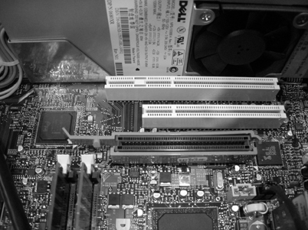
Bus (cont.)
© 2016 Cengage Learning®. May not be scanned, copied or duplicated, or posted to a publicly accessible website, in whole or in part.

Slide 43
Bus (cont.)
Internal bus architectures
Unibus (used in PDP-11 and VAX computers)
SBus (used in SPARC and Sun computers)
Microchannel (used in IBM PS/2 computers)
PCI (Peripheral Component Interconnect) (used in modern PCs)
© 2016 Cengage Learning®. May not be scanned, copied or duplicated, or posted to a publicly accessible website, in whole or in part.

Slide 44
Bus (cont.)
External bus architectures
SCSI (Small Computer Systems Interface)
SATA (Serial ATA)
IEEE1394 (also known as FireWire)
PC card (formerly known as PCMCIA)
Universal Serial Bus (USB)
© 2016 Cengage Learning®. May not be scanned, copied or duplicated, or posted to a publicly accessible website, in whole or in part.
Notes:
PCI Express. Used primarily for communications with storage devices and graphics
processors.
PC card. Formerly known as PCMCIA, this standard is used for the connection of peripheral devices for laptop computers.

Slide 45
Main Storage
Also known as primary storage or memory
Stores instructions and data being actively worked on
Computer’s fastest storage (aside from CPU registers)
Used by operating system, active processes
Main technologies
DRAM (Dynamic Random Access Memory)
SRAM (Static Random Access Memory)
© 2016 Cengage Learning®. May not be scanned, copied or duplicated, or posted to a publicly accessible website, in whole or in part.
Notes:
Dynamic random access memory (DRAM) is RAM that must be “refreshed” many times per second in order to retain the correct values stored. Some of the common packages of DRAM include SIPP (Single In-line Pin Package), SIMM (Single In-line Memory Module), DIMM (Dual In-line Memory Module), and SO-DIMM (Small outline DIMM).
Static random access memory (SRAM) is RAM that needs no refresh as does DRAM. Because it draws more power and is less dense than DRAM, SRAM is usually not used for personal computer main storage, but it is sometimes found in devices such as modems and CD-ROM drives for buffer storage.

Slide 46
Secondary Storage
Much larger, slower than main storage
Usually implemented with hard drives
Persistence
Capacity
© 2016 Cengage Learning®. May not be scanned, copied or duplicated, or posted to a publicly accessible website, in whole or in part.
Notes:
(HDD) and solid state drives (SSD). The reasons for secondary storage include:
Persistence. Secondary storage is usually permanent; data stored in secondary storage will remain intact even if the computer is powered down or disconnected.
Capacity. The available amount of storage in secondary storage is usually far greater than in main storage, by a factor of hundreds to tens of thousands.

Slide 47
Secondary Storage (cont.)
Structured storage
Partitions
File systems
Directories
Files
Unstructured storage
“raw” partitions
© 2016 Cengage Learning®. May not be scanned, copied or duplicated, or posted to a publicly accessible website, in whole or in part.
Notes:
Partitions are a means used to divide an entire storage device into logical components that can be used for separate purposes.
A secondary storage device can also contain a Master Boot Record (MBR), which contains computer instructions that can be read into memory when a computer is powered up or restarted.
Secondary storage can also be unstructured, or raw. UNIX operating systems use the term raw for secondary storage that is used to store raw characters or blocks of data, and the term cooked for secondary storage that contains one or more file systems that can be accessed by the operating system, its tools, and software applications.

Slide 48
Virtual Memory
Permits main storage to overflow into, and occupy, secondary storage
Swapping – copying a process’ entire memory image from primary to secondary storage
Paging – copying individual pages of a process’ memory image from primary to secondary storage
Permits more efficient and flexible use of main memory
© 2016 Cengage Learning®. May not be scanned, copied or duplicated, or posted to a publicly accessible website, in whole or in part.
Notes:
A system will experience thrashing, which is the severe performance degradation that occurs when too many active processes are causing excessive swapping.
When an active process is running and it addresses a page of memory that is not presently occupying main memory, a page fault occurs. This causes the operating system to fetch the requested page from disk and place it in main memory for the process to use. In an active operating system, page faults can be occurring at a high rate (hundreds or even thousands per second) while the OS is moving requested pages in from secondary storage and moving idle pages from main memory to secondary storage. In NT-based versions of Windows (Windows XP, Windows Vista, Windows 7, and Windows 8), all of the system’s paging data is stored in a single file, pagefile.sys.

Slide 49
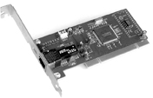
Communications
Communications is generally performed by hardware modules that are connected to the computer’s bus
adaptors, communications adaptors, communications controllers, interface cards, or network interface cards (NICs)
© 2016 Cengage Learning®. May not be scanned, copied or duplicated, or posted to a publicly accessible website, in whole or in part.
Notes:
Handling different communication speeds is accomplished with communications buffers—temporary storage of data being transmitted through the hardware module, as well as the necessary logic to com- municate properly on the bus and on the communications medium.

Slide 50
Firmware
Software that is embedded in persistent memory chips
Used to store the initial computer instructions required to put the computer into operation after power is applied to it
Firmware is used to store the BIOS (Basic Input-Output Subsystem) in an Intel-based PC
© 2016 Cengage Learning®. May not be scanned, copied or duplicated, or posted to a publicly accessible website, in whole or in part.
Notes:
Several technologies are used to store firmware, including: PROM (Programmable Read-Only Memory) EPROM (Erasable Programmable Read-Only Memory) EEPROM (Electrically Erasable Programmable Read-Only Memory) Flash memory

Slide 51
Firmware (cont.)
Firmware technologies
PROM (Programmable Read-Only Memory)
EPROM (Erasable Programmable Read-Only Memory)
EEPROM (Electrically Erasable Programmable Read-Only Memory)
Flash Memory
© 2016 Cengage Learning®. May not be scanned, copied or duplicated, or posted to a publicly accessible website, in whole or in part.

Slide 52
Trusted Computing Base
Trusted Computing Base (TCB)
The hardware, firmware, operating system, and software that effectively supports security policy.
The Orange Book defines the trusted computing base as “the totality of protection mechanisms within it, including hardware, firmware, and software, the combination of which is responsible for enforcing a computer security policy.”
© 2016 Cengage Learning®. May not be scanned, copied or duplicated, or posted to a publicly accessible website, in whole or in part.

Slide 53
Reference Monitor
A hardware or software component in a system that mediates access to objects according to their security level or clearance
An access control mechanism that is auditable
It creates a record of its activities that can be examined at a later time
© 2016 Cengage Learning®. May not be scanned, copied or duplicated, or posted to a publicly accessible website, in whole or in part.

Slide 54
Virtualization
Software technology used to facilitate the existence of several operating system instances (called virtual machines or guests)
Hypervisor runs and manages virtual machines
Type 1 runs on “bare metal”
Type 2 runs atop an active operating system
© 2016 Cengage Learning®. May not be scanned, copied or duplicated, or posted to a publicly accessible website, in whole or in part.

Slide 55
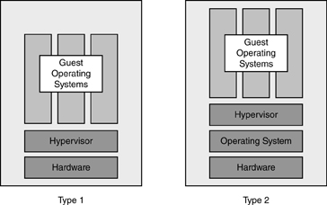
Virtualization (cont.)

Slide 56
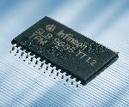
Security Hardware
Trusted Platform Module (TPM)
the implementation of a secure cryptoprocessor
a separate microprocessor in the computer that stores and generates cryptographic keys and generates random numbers for use in cryptographic algorithms
Used for a variety of cryptographic functions
disk encryption
authentication
© 2016 Cengage Learning®. May not be scanned, copied or duplicated, or posted to a publicly accessible website, in whole or in part.

Slide 57
Hardware Authentication
Smart card reader – part of two-factor authentication
Fingerprint reader
Facial recognition camera
© 2016 Cengage Learning®. May not be scanned, copied or duplicated, or posted to a publicly accessible website, in whole or in part.

Slide 58
Security Modes of Operation
Dedicated security mode. This is a system with only one level of security level. All of the information on the system is at the same security level, and all users must be at or above the same level of security and have a valid need-to-know for all of the information on the system.
System high security mode. Similar to dedicated security mode, except that users may access some data on the system based upon their need-to-know.
Compartmented security mode. Similar to system high security mode, except that users may access some data on the system based upon their need-to-know plus formal access approval.
Multilevel security mode. Similar to compartmented security mode, except that users may access some data based upon their need-to-know, formal access approval, and proper clearance.
© 2016 Cengage Learning®. May not be scanned, copied or duplicated, or posted to a publicly accessible website, in whole or in part.
Notes:
Security modes of operation is the term used to designate the type of security in place on a MAC (mandatory access controls) based system containing classified information. This term is generally used only in the context of U.S. government and military systems.

Slide 59
Security Countermeasure Principles
Defense in depth: protecting assets with layers of defense
System hardening: configuration to be more resistant to attack
Attack surface: the set of components in a system that may be the target of attack
Security through obfuscation: hiding functionality to make it more difficult for an attacker to find
Single use: system design, where each system has a single logical use
© 2016 Cengage Learning®. May not be scanned, copied or duplicated, or posted to a publicly accessible website, in whole or in part.
Notes:
Defense in Depth: defense in depth includes the practice of using different types of controls to protect an object. For example, an organization might utilize two layers of firewalls to protect a system. Part of the principle of defense in depth would suggest that these two firewalls should not be identical but instead should be of different makes. Heterogeneous vs. homogeneous environments.
System Hardening: remove unnecessary services/programs/user accounts. Change admin-level account names, change all default passwords, Deny all access security.
System Hardening reduces the Attack Surface.
Attack Surface: qualitative term that is meant to invoke a mental image of a system’s level of vulnerability. The more complex the system, the larger the attack surface.
Security through Obscurity: Non-standard port #s, non-standard account names, and
Code obfuscation. Here, the computer instructions or variables in an application may be scrambled in order to make reverse engineering a more daunting task. This can make important functions such as encryption and key management far more difficult for an attacker to figure out.
Single Use: For instance, in a three-tier environment with web servers, application servers, and database servers, these three functions should be segregated and run on separate systems. When using VMs, one physical system hosts Web server VMs, another physical system hosts DB VMs, and another physical system hosts Application server VMs.

Slide 60
Operating Systems
Components
Kernel
Device drivers
Tools
Functions
Process management
Resource management
Access management
Event management
Communications management
© 2016 Cengage Learning®. May not be scanned, copied or duplicated, or posted to a publicly accessible website, in whole or in part.
Notes:
Software is viewed as either an Operating System or Applications.
Kernel: The “core” software that runs on the computer to allocate resources and control processes.
Device drivers. These are programs that permit the operating system and other programs to communicate with hardware devices that are a part of the computer or connected to it.
Tools are separate programs that are used to build and maintain a system. Tools are used to change system configurations, edit files, create directories, and install other programs.
Process management. Processes are programs that are running on the computer. The OS’s process management includes starting, allocating resources to, and terminating processes.
Resource management. The OS provides access to resources such as primary storage, secondary storage, and devices such as displays and external storage devices.
Access management. Authentication and access controls to determine whether to grant access to a specific resource such as a file or a device.
Event management. The OS responds to common events and error conditions in a variety of ways including logging, starting or stopping processes, or communicating with internal processes or external entities.
Communications management. Uses the resources and devices present in the computer for that purpose.

Slide 61
Operating systems (cont.)
Operating system security methods
Privilege level
Windows: admin, user, guest
Unix: root, non-root
Protection ring
Ring 0: kernel
Ring 1: device drivers
Ring 2: user processes
© 2016 Cengage Learning®. May not be scanned, copied or duplicated, or posted to a publicly accessible website, in whole or in part.
Notes:
OS uses security protection: preventing one process from interfering with other processes, and controlling access to resources. Two common protection models are:
Privilege level. OS implements levels of privilege. The Windows operating system implements this through the administrative- level privilege, user-level privilege, and guest privilege. UNIX implements this through root and non-root privilege levels.
Protection ring. This is a scheme of concentric rings, starting with Ring 0 in the center that is the highest security that the kernel uses, plus one or more additional rings where device drivers and user programs run.
The OS Kernel enforces these Protection Models.

Slide 62
Subsystems
Database management systems (DBMS)
Microsoft SQL Server, IBM DB2, Oracle, and Sybase.
Web server
Authentication server
E-mail server
File / print server
Directory server (DNS, NIS, AD, LDAP)
© 2016 Cengage Learning®. May not be scanned, copied or duplicated, or posted to a publicly accessible website, in whole or in part.
Notes:
Subsystems are software programs that perform functions that are required by
applications and programs.
The Network Information Service, or NIS (originally called Yellow Pages or YP), is a client–server directory service protocol for distributing system configuration data such as user and host names between computers on a computer network. Sun Microsystems developed the NIS; the technology is licensed to virtually all other Unix vendors.

Slide 63
Programs, Tools, and Applications
Programs
Firefox, writer, photoshop, acrobat
Tools
Compilers, debuggers, defragmenters
Applications – collection of programs and tools
Financial (GL, AP, AR, etc.), payroll, mfg resource planning, customer relationship mgmt, etc.
© 2016 Cengage Learning®. May not be scanned, copied or duplicated, or posted to a publicly accessible website, in whole or in part.
Notes:
Program. A single set of instructions for a computer that usually resides in a single file. A program can refer either to an executable program that contains machine-readable instructions or to the source code that contains human-readable instructions.
Tool. A tool is also, strictly speaking, a program, but is used for some simpler purpose in support of applications, programs, and subsystems.
Application. A collection of programs and tools that support a business function.
Applications often require the support of subsystems such as database management systems (DBMSs) to manage stored data, authentication servers, directory servers, and web servers to provide users with a user interface.

Slide 64
Software Secuirty Threats
Covert channel
Unauthorized, hidden channel of communications that exists within a legitimate communications channel
Difficult to detect
Examples: unused fields, steganography
Side channel attack
Observation of the physical characteristics of a system in order to make inferences on its operation - timing, power consumption, emenations
Generally the term side- channel attack is used to describe an attack on a cryptosystem.
© 2016 Cengage Learning®. May not be scanned, copied or duplicated, or posted to a publicly accessible website, in whole or in part.
Notes:
A threat is a potential and harmful action
There are two types of covert channels, storage and timing.
A covert storage channel involves a storage location used by a target system. The location may be a memory location, a disk sector, or a file. The unauthorized third party may be able to directly or indirectly read the storage location and gain some level of knowledge about the information stored there. ICMP data payloads.
A covert timing channel uses observable timings seen in an information system to determine what is happening in the system (blinking HDD light). One process will manipulate system resources in a specific, predefined way, and these responses will be interpreted by a second process or service. Despite relatively low data rates, use of covert timing channels can overcome an “air gap,” or lack of network connection, to transfer information.
Examples of Covert Channels:
Use of unused fields. Covert messages can be inserted into the padding or unused fields in network communications frames or packets, or in unused fields in stored or transmitted data streams.
Steganography. This is the technique of hiding data within images, sounds, or video files.

Slide 65
Software Secuirty Threats (cont.)
Inference attack
Analysis of available data to learn more about a target
Aggregation attack
Data mining technique of public records to gather and combine sensitive data
State attacks
Time of check to time of use (tocttou), also known as a race condition
© 2016 Cengage Learning®. May not be scanned, copied or duplicated, or posted to a publicly accessible website, in whole or in part.
Notes:
A simple example of an inference attack is the analysis of positions offered/ announcements that list the technologies in use in an organization; this can help an attacker better understand the technologies in use in an organization and possibly help an attacker avoid detection.
Aggregation attack: Obtaining dates of birth and mothers’ maiden names can help an attacker gain illegitimate access to banking and other high-value user accounts.
Inference and Aggregation attacks look like footprinting.
TOCTTOU: a tocttou bug is one where changes in a system occur between the checking of a condition and the use that results from the check.
**optional**Here is an example: Two users wish to open a file for exclusive use. The program that each user is running first checks to see if the file is in use; the program for each user reports that the file is not opened by anyone. Because of that, both users’ programs open the file, expect- ing that they each have exclusive use of the file. Depending upon the use of the file, compro- mise occurs either because the attacker is able to view the contents of the file, or the attacker is able to disrupt normal operations related to the file.

Slide 66
Software Security Threats (cont.)
Emanations
RF (radio frequency) emissions from CRTs, network cabling, and other equipment
Maintenance hooks and back doors
Privileged programs
Artifacts of development, testing utility/tool that are left behind
Supply chain attacks
Compromise a system by compromising one of its individually manufactured components
© 2016 Cengage Learning®. May not be scanned, copied or duplicated, or posted to a publicly accessible website, in whole or in part.
Notes:
(RF) electrical signals— called compromising emanations (CE)—are emitted from computing and network equipment. While this is most often associated with CRT (cathode ray tube) monitors and poorly terminated network wiring, emanations can also be emitted from circuits within computers and other devices themselves.
The U.S. Department of Defense conducted research into the field of emanations in a pro- gram that was code-named TEMPEST. The result has been a set of standards for shielding equipment, rooms, and entire buildings from compromising emanations.
Occasionally, programmers deliberately place hooks and back doors into programs and leave them there intentionally, either to ease the support process or for malicious reasons, such as falsifying information or theft.
Supply Chain Attack: compromise of a company that produces the BIOS (basic input/output system—in other words, the firmware) for a computer system will enable an attacker to compromise those computer systems via a defect introduced into their firmware.
Could also be theft of secrets: The SecureID product produced by RSA was attacked in 2011; attackers obtained specific secrets that permitted them to compromise the SecureID product. The objective of this attack was thought to be certain U.S.-based defense contractors that used the SecureID product. Compromise of SecureID would permit attackers to access those defense contractors’ net- works as though they possessed SecureID t

Slide 67
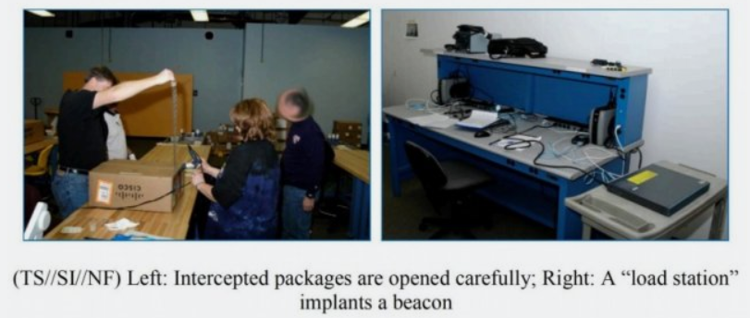
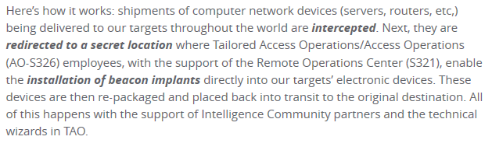
NSA Shenanigans

Slide 68
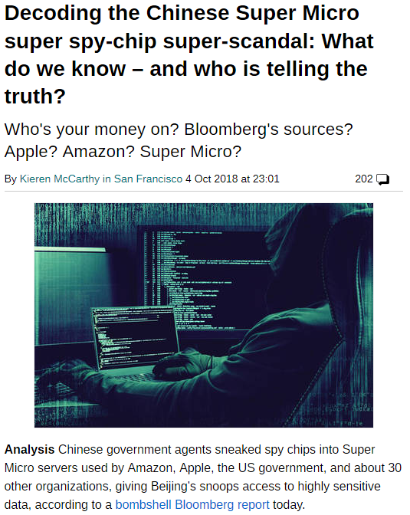
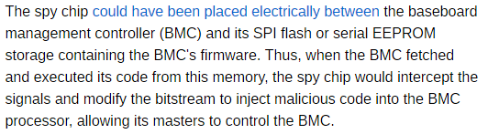
China Shenanigans

Slide 69
Software Security Countermeasures
Reduce the potential of a threat by reducing its probability of occurrence or its impact
Sniffers (network, Wi-Fi)
Source code reviews
Auditing tools (filesystem integrity, configuration, log analyzers)
Vulnerability scanning tools
Penetration testing
© 2016 Cengage Learning®. May not be scanned, copied or duplicated, or posted to a publicly accessible website, in whole or in part.
Notes:
Tripwire is a well-known file system integrity tool.
LogRhythm is a well-known tool for this purpose. (log analyzer)

Slide 70
Cloud Computing Threats and Countermeasures
Multitenancy and logical separation
Data for multiple clients must be logically separate
Data sovereignty
Data owner’s legal control
Data jurisdiction
Legal (regulatory) jurisdiction of data storage and usage
Controls and audits
Independent verification of the effectiveness of controls in a cloud provider environment
© 2016 Cengage Learning®. May not be scanned, copied or duplicated, or posted to a publicly accessible website, in whole or in part.
Notes:
Cloud Computing advantages: Reduced Cost, Reduced need for specialized expertise, Focus on Core Competencies (business focus instead of IT).
FEDRAMP
Data Jurisdiction:
One well-known issue is the U.S. PATRIOT Act that gives federal law enforcement secret subpoena powers that include examination of data in cloud-based systems. Through a National Security Letter, law enforcement would compel a cloud-based service provider to turn over records and data and prevent the service provider from informing affected customers.
Controls/Audits:
Two well-known examples of these external audits are:
ISAE 3402 (International Standard on Assurance Engagements No. 3402). This is an international external auditing methodology governed by the International Auditing and Assurance Standards Board (IAASB), which is part of the International Federation of Accountants (IFAC).
SSAE-16 (Statement on Standards for Attestation Engagements No. 16). This is a U.S.-based external auditing methodology standard governed by the American Institute of Certified Public Accountants (AICPA). The SSAE 16 standard was built upon the ISAE 3402 framework.

Slide 71
Summary
Security models
Bell LaPadula, Biba, Clark-Wilson, Access Matrix, Multi-Level, Mandatory Access Control (MAC), Discretionary Access Control (DAC), Role Based Access Control (RBAC), Non-interference, Information Flow
Evaluation Models
Common Criteria, TCSEC, TNI, ITSEC, SEI-CMMI, SSE-SMM
Certification and Accreditation
FISMA, DITSCAP, DIACAP, NIACAP, DCID 6/3
© 2016 Cengage Learning®. May not be scanned, copied or duplicated, or posted to a publicly accessible website, in whole or in part.

Slide 72
Summary (cont.)
Computer hardware architecture
CPU (central processing unit) performs instructions
Components: Arithmetic logic unit (ALU), Registers, Program counter, Memory interface
Operations: Fetch, Decode, Execute, Writeback
Instruction sets: CISC, RISC, SPARC, EPIC
Single core, multi-core
Single CPU computer, SMP, ASMP
Security features: Protected mode, Executable space protection
© 2016 Cengage Learning®. May not be scanned, copied or duplicated, or posted to a publicly accessible website, in whole or in part.

Slide 73
Summary (cont.)
Computer hardware architecture (cont.)
Bus
Main storage
Secondary storage
Virtual memory
Communications
Firmware
Trusted Computing Base (TCB)
Reference Monitor
Trusted Platform Module (TPM)
© 2016 Cengage Learning®. May not be scanned, copied or duplicated, or posted to a publicly accessible website, in whole or in part.

Slide 74
Summary (cont.)
Security Modes of Operation
Dedicated security mode, System high security mode, Compartmented security mode, Multilevel security mode
Software
Operating systems (components, functions, security methods)
Subsystems (DBMS, Web, application, e-mail, file / print, directory)
Programs, tools, and applications
© 2016 Cengage Learning®. May not be scanned, copied or duplicated, or posted to a publicly accessible website, in whole or in part.

Slide 75
Summary (cont.)
Threats
Covert channel, side channel attack, state attacks, emanations, maintenance hooks and back doors, privileged programs
Countermeasures
Sniffers, source code reviews, auditing tools, penetration testing, application vulnerability testing
Cloud security threats and countermeasures
Multitenancy, logical separation, data sovereignty, data jurisdiction, controls and audits
© 2016 Cengage Learning®. May not be scanned, copied or duplicated, or posted to a publicly accessible website, in whole or in part.

