Slide 1
What I'll cover
Text2SQL Agent
1
Project background
2
Live demo (Telegram)
3
Architecture
4
Flowchart
5
A question, step by step
6
Three design decisions
7
Multi-turn and memory
8
How I evaluate it
All data is a synthetic e-commerce schema.
No real company data.
9
Limits and what's next
Notes:
Hi, thanks for having me. I'm going to show you a text-to-SQL agent I built end to end: you ask a question in plain English, and it returns SQL that has been checked.
The plan: first the problem, then the architecture and the request flow. Then a short live demo in Telegram, and one question followed step by step through the system. After that, three design decisions and why I made them, how follow-up questions and memory work, how I evaluate it, and where it falls short and what I would change for production.
One thing up front: all the data is a synthetic e-commerce schema. There is no real company data in this project.

Slide 2



Why text-to-SQL needs more than a prompt
Hallucinated names
Silently wrong meaning
Not reproducible
A plausible column that does not exist. The SQL still parses, so it looks fine.
Two columns named amount: orders.amount or payments.amount? The query runs and returns a confident wrong number.
The same question gives different SQL on different days, so a fix cannot be regression-tested.
Root cause
Goal
One prompt has to understand language, recall the schema and write SQL. Three different jobs in one step you cannot verify.
SQL you can check and explain.
Scope: NL → validated ClickHouse SQL. Execution is out of scope.
Notes:
Before the architecture, the problem. The obvious approach is: give the schema to an LLM and ask for SQL. In production that breaks in three ways.
One: hallucinated names. The model invents a plausible column. The SQL parses, so it looks fine.
Two, and this is the dangerous one: silently wrong meaning. There are two columns called amount in different tables. The model picks one, the query runs, and you get a confident wrong number with no error anywhere.
Three: it is not reproducible. The same question gives different SQL on different days, so you cannot regression-test a fix.
The root cause is that one prompt bundles three different jobs: understanding language, recalling the schema, and writing SQL. My design is about separating them so each one can be verified. The scope is natural language in, validated ClickHouse SQL out. I do not execute the query.

Slide 3
Live demo: Telegram
1
Revenue by region for the last 7 days
Table inferred from the metric, join added, 7-day filter
2
What about yesterday?
Follow-up: only the time changes, the rest is inherited
3
Only gold members
A filter is patched in on top of the previous query
4
Top 3 categories by revenue in each region
Ranks categories inside each region: LIMIT 3 BY region
5
Total amount by channel last month
Order amount or payment amount? It asks instead of guessing. Reply: payment
Notes:
Demo script, in one Telegram chat. Each answer takes around ten seconds, so keep talking while it runs.
One. Revenue by region for the last 7 days. Point out that I never said which table: it is inferred from the metric, the join to users is added, and the time filter is there.
Two. What about yesterday? It does not ask again. The metric and the grouping are inherited, only the time changes.
Three. Only gold members. Same thing: a filter is patched in.
Four. Top 3 categories by revenue in each region. It is still a follow-up: it keeps yesterday and gold members, groups by category, and ranks the top three inside each region. In ClickHouse that is LIMIT 3 BY region.
Five. Total amount by channel last month. This is a new question, and 'amount' is ambiguous: it could be the order amount, which is revenue, or the payment amount. Both scores are close and below the acceptance line, so instead of guessing it lists the candidates and asks. Reply 'payment' (by name, because the order of the options can change). It then writes SQL on the payments table, joined to orders for the channel, filtered to last month. That interrupt is the theme of this talk: ask, don't guess.
If anything fails, switch to the recording, then to the curl fallback.

Slide 4
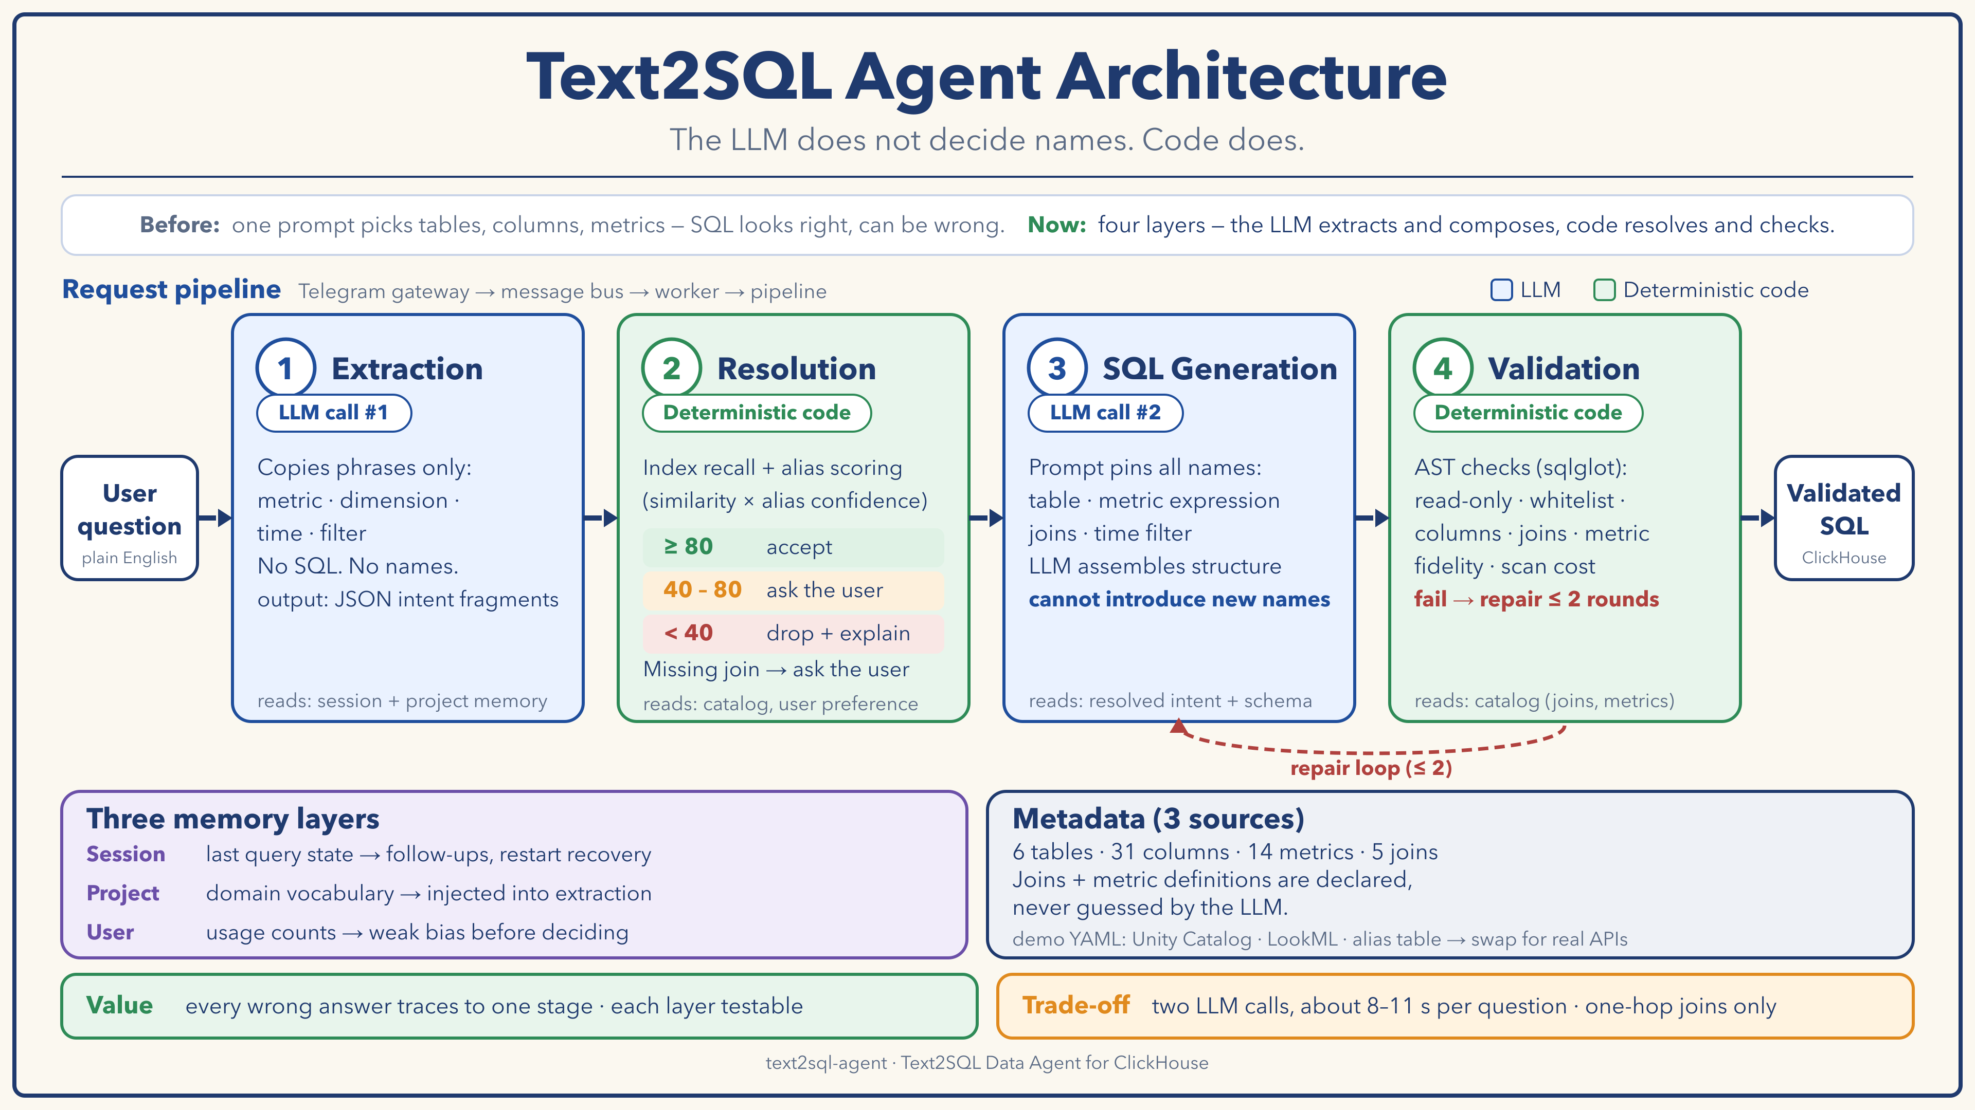
Notes:
You just saw it work. Here is what is happening inside. This is the whole system on one page. The design principle is one sentence: the LLM does not decide names, code does.
Four layers. Blue boxes are LLM calls, green boxes are deterministic code.
Layer one is extraction. The LLM only copies phrases from the question: the metric, the dimension, the time, the filter. It does not write SQL and does not translate names.
Layer two is resolution, and this is where names get decided, in code. Each candidate gets a score: alias similarity times how trustworthy the alias source is. Above eighty we accept, ninety for metrics. Between forty and eighty we ask the user. Below forty we drop it and say so. Joins come from declared metadata.
Layer three is the second LLM call. It writes the SQL, but the prompt pins the table, the metric expression, the joins and the time filter. It assembles structure, it cannot introduce a name.
Layer four is validation: we parse the SQL into an AST and check it. If it fails, the error goes back for a repair, at most two rounds.
Below: three memory layers, and metadata split the way a company splits it, into three sources. And the trade-off on the bottom right: two LLM calls, around ten seconds per question.

Slide 5
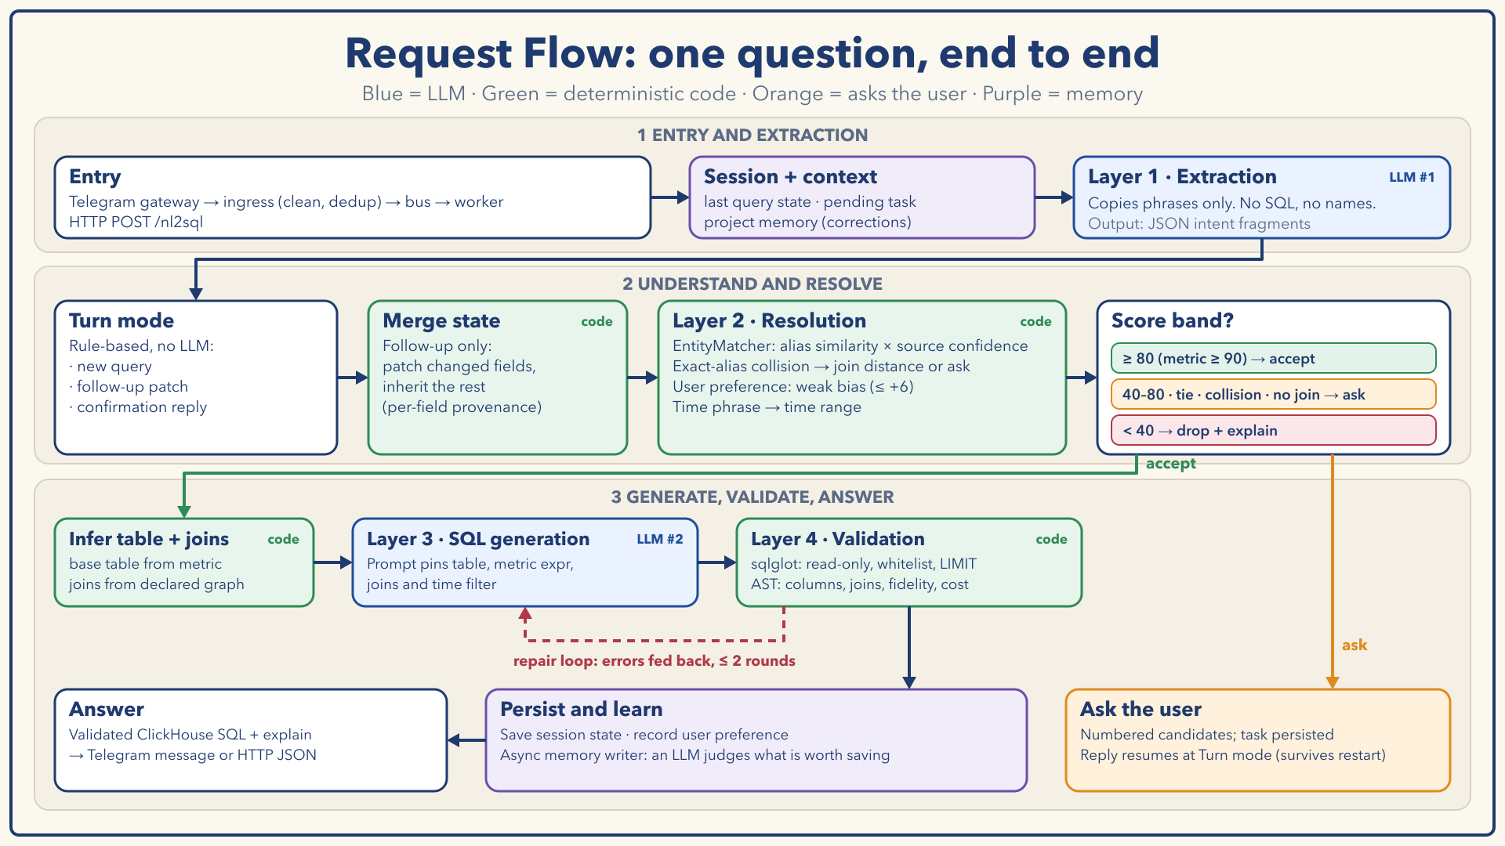
Notes:
Now the same system as a request flow, and you can map the demo onto it. Your first question took the green path. The follow-ups, what about yesterday and only gold members, went through the merge step. And the last one, total amount by channel last month, took the orange path: amount was ambiguous, so it asked me, and after my reply it picked up where it left off and finished the query.
A message comes in from Telegram or HTTP, gets cleaned and de-duplicated, and reaches the orchestrator with the session state and project memory.
Extraction runs first. Then a rule-based step decides the turn mode: a new query, a follow-up patch, or a reply to a pending question. For a follow-up we merge into the previous state.
Resolution scores every entity, and the score band decides. Accept goes down the green path: infer the table and joins, generate, validate, with the repair loop in red. Anything uncertain goes down the orange path: the system asks the user with numbered candidates, the task is persisted, and the reply resumes at the turn mode. That survives a restart.
At the end we save the session state and the user preference, and an asynchronous step lets an LLM decide whether something is worth remembering for the project.

Slide 6
One question, step by step
Revenue by region for the last 7 days
2 LLM calls · 8.4 s total
① Extract
LLM #1 · 4.4 s
③ Generate
LLM #2 · names pinned
metric "revenue" · dimension "region" · time "last 7 days"
SELECT users.region AS region,
sum(orders.amount) AS revenue
FROM orders
JOIN users
ON orders.user_id = users.id
WHERE orders.created_at >=
now() - INTERVAL '7' DAY
GROUP BY users.region
LIMIT 100
② Resolve
code · under 0.1 s
revenue → metric revenue (exact, 100) = sum(orders.amount); base table orders is inferred from it
region → users.region and sellers.region both score 100: a collision, resolved by join distance from orders
last 7 days → last_n_days, n = 7
join from the declared graph: orders.user_id = users.id
The prompt pins the base table, the metric expression, the join condition and the time filter. The model only assembles structure.
④ Validate
code
Read-only · joins match declared edges · metric expression present · warning: large_scan, ~82M rows (static estimate)
GMV → revenue (alias, 100)
region, no base table → ask: users.region or sellers.region
customer lifetime value → avg_order_value 85.5, below 90 → ask
Notes:
Let me follow one real question through the system. These are real outputs from a run.
Step one, extraction: the LLM returns three phrases: revenue, region, last 7 days. That took about four seconds.
Step two, resolution, in code. Revenue matches the metric revenue exactly, defined as the sum of orders.amount, and because that metric belongs to orders, orders becomes the base table. Region is the interesting one: both users.region and sellers.region match with a perfect score. That is a collision. The system does not pick the first one: it measures the join distance from orders, users is one hop away, sellers is two, so users.region wins. If there were no base table, it would ask instead. The time phrase becomes the last seven days, and the join comes from the declared graph.
Step three, the second LLM call writes the SQL with all of these names pinned.
Step four, validation: read-only, joins match the declared edges, the metric expression is present. It also warns about a large scan: the demo orders table is set to eighty million rows. That is a static estimate, not a measurement.
At the bottom, the same matcher on other inputs: GMV is an alias for revenue. Region with no base table asks. And customer lifetime value fuzzy-matches average order value at 85.5, which is below the 90 bar I set for metrics, so it asks instead of answering with the wrong metric.

Slide 7



Decision 1: layers, not one prompt
One prompt
Four layers
Understand language + recall schema + write SQL in a single step. When the answer is wrong, you cannot tell which job failed.
Each stage has a contract and its own tests. The LLM appears twice, in constrained positions.
Testability
Control
Cost of change
A wrong answer traces to one stage. The mocked-LLM suite pins everything except the two LLM calls.
Definitions such as revenue live in the catalog. The model receives them and never improvises them.
A new metric is a row in a YAML file, not a prompt re-tune that might break something else.
Trade-off: two LLM calls, about 8–11 s per question. I accepted that for reliability and for answers I can explain.
Notes:
The first decision: why layers and not one big prompt.
First, testability. When an answer is wrong I want to know which stage failed. With one prompt I cannot tell if the model misunderstood the question or invented a column. With layers, each stage has an input and an output I can test on its own. In my test suite the LLM calls are mocked, so everything else is regression-tested like ordinary code.
Second, control. A business definition like revenue should never be improvised by a model. It lives in the catalog, and the model receives it. So revenue means the same thing every time.
Third, cost of change. Adding a metric means adding a row to a YAML file, not re-tuning a prompt and hoping nothing else breaks.
The trade-off is two LLM calls and around ten seconds per question. I accepted that.
If asked why not just use a bigger model or fine-tune: a stronger model makes fewer mistakes but it still cannot know your company's definition of a metric, and fine-tuning would need redoing every time the schema changes.

Slide 8



Decision 2: a declared schema, not guesswork
tables.yaml
score = alias similarity × source confidence
Physical catalog (Unity Catalog mock): columns, types, comments, row counts, sampled enum values
Source confidence
Decision bands
≥ 80 accept
metrics.yaml
(metric ≥ 90)
Semantic layer (LookML mock): metric definitions, the join graph, default time dimensions
40–80 ask
or tie within 10
< 40 drop
aliases.yaml
and explain
Alias table: entity, alias, source, confidence, status. LLM-generated aliases start as pending
Same alias, two entities?
region exists in users and sellers. With a base table, join distance decides. Otherwise the system asks. Never first-wins.
Joins and metric definitions are declared, never guessed.
Notes:
The second decision: the schema is declared, not guessed.
Metadata is split the way a company splits it. One file mocks the physical catalog, like Unity Catalog: tables, columns, types, row counts. One mocks a semantic layer, like LookML: governed metric definitions and the join graph. And one is an alias table: business names mapped to entities, each with a source and a confidence.
Matching is deterministic. The score is alias similarity times the confidence of the alias source. A curated alias counts fully. One mined from query logs counts sixty percent, so on its own it can never be auto-accepted. LLM-generated aliases start as pending and are not even indexed until someone reviews them.
Then the policy. Eighty or more: accept. For metrics I use ninety, because a wrong metric means every number is wrong. Between forty and eighty, or if the top two are within ten points: ask the user. Below forty: drop it and say so.
One more case: the same alias pointing at two entities, like region in users and in sellers. We never take the first one. If we know the base table, join distance decides. If not, we ask.
The point: joins and metric definitions are declared, never guessed.

Slide 9



Decision 3: AST guardrails
Generated SQL
Parse with sqlglot
Run the checks
Answer
Syntax guard
Semantic checks
Cost estimate
One read-only statement
Tables on the whitelist
LIMIT injected if missing
Columns exist (alias-aware)
Joins match declared edges and keys
Fidelity: resolved tables, metric expression and filters must appear in the SQL
Scan size from catalog row counts
Full scan of a fact table
Join and subquery depth
A real check failing
If a check fails
missing_metric_expr: expression sum(orders.amount) of metric revenue does not appear in the SQL
The error goes back to the model: up to 2 repairs. Then a clear message, never plausible SQL.
Notes:
The third decision: validate the AST, not the vibe.
Even with a constrained prompt the model can still make mistakes, so every generated query goes through checks that do not use an LLM.
First, a syntax guard: exactly one read-only statement, only tables from the whitelist, and a LIMIT is injected if it is missing.
Second, semantic checks. The SQL is parsed into an AST with sqlglot. Columns must exist, with aliases resolved. Joins must match the edges and keys declared in the metadata, so the model cannot invent a join condition. And the check I like most is fidelity: the resolved tables, the declared metric expression and the filters must actually appear in the SQL. If the model paraphrased the metric, the check fails. That is the semantic-drift catcher. In my live runs the metric expression was present every time.
Third, a cost estimate from catalog row counts: full scans of fact tables, join depth. It is shown in the explain payload.
When a check fails, the error text goes back to the model for a repair, at most two rounds. If it still fails, the user gets a clear message instead of plausible SQL. The guardrail is independent from the model it guards.

Slide 10



Multi-turn and memory
A session, turn by turn. The metric (revenue) is inherited in every follow-up.
Session
Question | Mode | Time | Group by | Filter | Window
Revenue by region for the last 7 days | new query | last 7 days | region | - | -
What about yesterday? | follow-up | yesterday | region | - | -
Only gold members | follow-up | yesterday | region | vip_level = gold | -
Top 3 categories by revenue in each region | follow-up | yesterday | category | vip_level = gold | top 3 / region
Last query state and pending task, saved as an append-only log. Survives a restart.
Project
An index file points to topic files injected into extraction. An LLM decides what to save.
User
Green = set this turn · grey = inherited from the previous turn
Usage counts give a weak bias, at most +6 points, applied before the decision.
Priority: explicit input > session state > project memory > user preference
Notes:
Real users do not ask one perfect question. They say: what about yesterday? So the system keeps state, and I treat multi-turn as a state machine, not as chat history pasted into a prompt.
This table is a real session. Turn one is a new query, so everything is set. Turn two, what about yesterday: only the time changes, the metric and the grouping are inherited. Turn three, only gold members: a filter is added, the rest is inherited. Turn four, top three categories in each region: it now groups by category and ranks inside each region, and still keeps yesterday and gold members. Every field remembers whether it was set this turn or inherited, so I can always explain where a value came from.
Turn detection itself is rule-based, so it is fast and predictable.
On the right, three memory layers. Session memory is that state, saved to disk, so a restart in the middle of a conversation is fine, and a pending question stays valid. Project memory holds domain vocabulary and corrections, for example big orders means amount over one thousand. It is an index file that points to topic files, injected into the extraction prompt. I modeled this part on how Claude Code's agent memory works, and an LLM decides in the background what is worth saving. User memory is only a weak signal: usage counts nudge the ranking by a few points before the decision, and can never override it.
The priority when they disagree: explicit input first, then session state, then project memory, then user preference.

Slide 11
How I evaluate it
Layer 1 · Mocked LLM, real pipeline
Layer 2 · Live LLM, real pipeline
362
tests in ~6 s
36/36
regular queries answered as expected
45 golden cases in 9 groups. Matching, thresholds, state merge, confirmation and persistence run for real. 5 known limits are pinned as strict xfail.
Measures what mocks cannot: extraction and SQL quality, with the real model.
34/34
generated SQL passed the validator
33/33
metric expression present in the SQL
9.2 s
average per question (2 LLM calls)
From 30/36 to 36/36: the misses asked, never guessed
What the live eval caught
An earlier run had 6 misses, all a question to the user. Mostly a bare "orders" as the metric (score 67). Fixed with data: one curated alias, plus plural folding.
An invented filter column, fuzzy-matched to the wrong one, and 'credit card' vs credit_card. Both fixed and pinned as regression cases.
Notes:
I use two kinds of evaluation, and they answer different questions.
The first is fast and offline. It mocks the two LLM calls but runs everything else for real: matching, thresholds, state merging, the confirmation flow and persistence. There are 362 tests and 45 golden cases, and the suite runs in about six seconds, so it can run on every change. The known limits are pinned as strict expected failures, so they are visible, named, and flip to a failure the day someone fixes them.
The second is a live run against the real model. It measures what mocks cannot: extraction quality and SQL quality. In my latest run, 36/36 regular questions were answered as expected. Of the SQL it generated, 34/34 passed the validator, and the declared metric expression was present in 33/33. The average was 9.2 s per question.
It was not always that clean. An earlier run was 30 out of 36, and all six misses had the same shape: the system asked the user instead of answering. Mostly the model extracted the bare word orders as the metric, which scores 67 against the order count metric, below my bar, so it asked. That is the trade-off of tight thresholds: fewer silent wrong answers, more questions. The fix was data, not prompt tuning: one curated alias, plus folding plurals like product categories.
Two honest caveats. The model varies between runs, so these numbers are a sample, not a stable accuracy figure. And valid SQL is not the same as correct SQL. The live eval is also how I found two real bugs: an invented filter column that was fuzzy-matched to the wrong column, and a value written as credit card where the data says credit_card. Both fixed, and pinned as regression cases.

Slide 12
Limits and what's next
Known limits today
From demo to production
Each one is a failing test on purpose
1
Catalog integration
Swap the 3 source adapters for Unity Catalog, semantic-layer and alias-DB clients. Versioned snapshots; rebuild the index in the background, then swap it atomically.
Multi-hop joins
It asks for a bridge table but cannot finish the chain.
2
Alias governance
Aliases as reviewed data, layered by source. Nothing unreviewed goes live.
Unknown group-by
A column that does not exist is silently dropped.
3
Hybrid retrieval
An embedding retriever beside the lexical index, then a constrained LLM final selection.
Unsupported time phrase
last quarter falls back to the last 7 days.
4
Verified queries + feedback
Validated question-to-SQL library as few-shot. Confirmations become candidate aliases after review. Golden eval gates every release.
More questions
Tight thresholds ask on loose wording. Fix: curated aliases, or the optional LLM final selection.
5
Execution + governance
Read-only account, cost gate, timeouts, result cache. Row-level security, rate limits, PII masking, audit log.
Notes:
Every demo hides its boundaries, so here are mine. Each one on the left is a test that fails on purpose.
Multi-hop joins: when the path between two tables has an intermediate table, the system asks which bridge table to use, but it cannot yet complete the chain.
Unknown group-by: if the user asks to group by something that does not exist, it is silently dropped today. It should ask, like the matcher does.
Unsupported time phrases, like last quarter, fall back to the last seven days.
And the cost of tight thresholds: loosely worded questions now trigger a question. Curated aliases fix most of that, and there is an optional LLM step that can pick a clear winner among the existing candidates, off by default.
Now the production path, in the order I would build it. The principle: metadata is produced by the governance stack, and the agent only consumes it. The search index is derived, and can be rebuilt at any time.
One: catalog integration. In the demo three YAML files stand in for a physical catalog, a semantic layer and an alias table, each read by its own adapter. In production I swap each adapter for the real client, pull versioned snapshots, rebuild the index in the background and swap it atomically, and keep a last-known-good snapshot so the service still starts if the catalog is down.
Two: alias governance. Aliases become reviewed data with a source and a confidence. Nothing unreviewed goes live.
Three: hybrid retrieval. Add an embedding retriever next to the lexical index, then let an LLM make a constrained final choice among the candidates. The interface for that is already in the code.
Four: a verified query library for few-shot examples, and a feedback loop where user confirmations become candidate aliases after review, with the golden eval as the release gate.
Five: execution and governance. A read-only account, a cost gate, timeouts and result caching, plus row-level security, rate limits, PII masking and audit logging.

Slide 13
Takeaways
1
The LLM is a component, not the authority
It appears in two constrained places. Names are decided by deterministic code.
2
Ask, don't guess
Scored bands, a confirmation flow, and typed multi-turn state.
3
Evidence over claims
A mocked suite for the core, a live eval for the model, and known limits published as tests.
Questions?
Notes:
To close. This is a text-to-SQL agent where the model is a component, not the authority. Names come from a catalog, resolution is deterministic and scored, the SQL is checked by an AST, and the system asks when it is unsure. I measured it with two layers of evaluation, including the places where it fails, and I published those as tests.
I'm happy to go deeper on any layer. Thank you.

