Slide 1
Predictive Lead Conversion Modeling
Analytics & Data Management, HP ES
May 22, 2014

Slide 2
Data consolidation
Lead
Product Interest
Opportunity
Account
Contact
Response
Campaign

Slide 3
Lead entity and lead scoring process
Lead ID 1
contact C
Product Interest P
Response ID1: response date time 1
Response ID2: response date time 2
Response ID3: response date time 3
Status: nurturing or qualified
Recency
Date time
Response1
Response2
Response3
Prediction date
(Qualification date)
Lead scoring process:
predicting the probability of each lead being qualified to send to Sales department
Event-triggering scoring: new responses received
Time based regular (daily) scoring: parameter “recency” is changing even without any new response coming in

Slide 4
Data volume as on April 22, 2014
total number of responses | 4,871,359
total number of leads | 2,844,112
number of qualified leads | 41,932
(qualification rate: 1.47%)

Slide 5
Attribute examples in model
Attributes in the model | Lead Attributes | Recency
 |  | Number of Responses So far
 |  | Number of Responses to Different Channels
 |  | ……
 | Latest Response Attributes | Channel
 |  | BANT Validated YN
 |  | Response Time Frame
 |  | ……
 | Campaign Attributes | Campaign Business Unit
 |  | Tactic
 |  | ……
 | Product Attributes | Product Line
 |  | past sales Of this Product
 |  | product sentiment
 |  | ……
 | Contact Attributes | Contact Job Role
 |  | Number of Responses of this contact in last 12M
 |  | Suppress from Campaign
 |  | ……
 | Account Attributes | Account Industry Vertical
 |  | Account employee count
 |  | Account revenue
 |  | Account purchase with HP
 |  | ……

Slide 6
Experiment Design: to simulate the daily use
time period: March 1, 2014 ~ April 22,2014
Step 1: create a historical lead snapshot for each day
On each day, take into consideration only those responses that happened on or before this day
All the leads that were qualified later than this date were considered/reset unqualified
Step 2: randomly pick 10% data from the each day lead snapshot (including both qualified and unqualified) to do modeling
This set of data will be divided into training set and validation set in order to pick a relatively better model during modeling
Step 3: use the model to score the unqualified leads on each day
For illustration purpose, picked 10% of unqualified leads on March 1, 2014;
This “same” set of leads will be scored on each day

Slide 7
Output Data
predictionDate | LeadID | propensityToBeQualified | rank | topPercentage | bestChannel | decisionStage
3/31/2014 | 386262 | 0.0001 | 205983 | 75.24 | Phone | Research
3/31/2014 | 384406 | 0.0001 | 130712 | 47.74 | Customer Visit | Research
3/31/2014 | 239584 | 0.0001 | 171133 | 62.51 | Direct mail | Research
3/31/2014 | 389 | 0.0001 | 246125 | 89.9 | Email | Research
3/31/2014 | 170428 | 0.0001 | 101226 | 36.97 | Email | Research
3/31/2014 | 386194 | 0.0001 | 69258 | 25.3 | Managed by Sales | Research
3/31/2014 | 384849 | 0.0001 | 145822 | 53.26 | Customer Visit | Research
3/31/2014 | 238906 | 0.0001 | 235195 | 85.91 | Web | Research
3/31/2014 | 387337 | 0.0001 | 223988 | 81.81 | Email | Research
3/31/2014 | 387364 | 0.0001 | 100879 | 36.85 | Direct mail | Research
3/31/2014 | 386876 | 0.0001 | 223907 | 81.79 | Email | Research
3/31/2014 | 387541 | 0.0001 | 266677 | 97.41 | Web | Evaluate
3/31/2014 | 388009 | 0.0001 | 70379 | 25.71 | Managed by Sales | Research
3/31/2014 | 385121 | 0.0001 | 106577 | 38.93 | Direct mail | Evaluate
3/31/2014 | 157717 | 0.0001 | 244470 | 89.3 | Customer Visit | Research
3/31/2014 | 387139 | 0.0001 | 156694 | 57.23 | Web | Research
3/31/2014 | 133501 | 0.0001 | 203624 | 74.38 | Web | Research
3/31/2014 | 137174 | 0.0001 | 231497 | 84.56 | Managed by Sales | Research
3/31/2014 | 151808 | 0.0001 | 209331 | 76.46 | Email | Evaluate

Slide 8
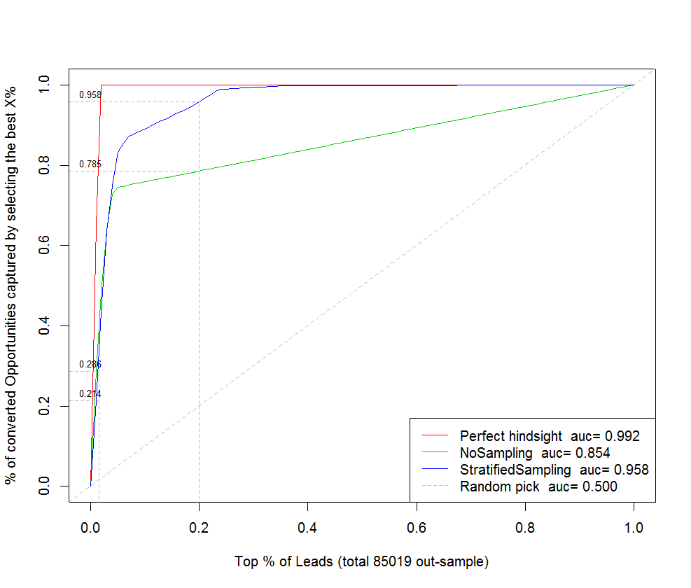
Predictive model performance: 10% on April 22, 2014
Capture curve:
Rank leads in decreasing order of qualification probability
For any % of out-sample leads on the horizontal axis, the y-value of each curve is the % of qualified leads that are captured by the model
For this data set:
At 1.5%, Tree without sampling captures 28.6%; tree with sampling captures 27.4%
At 20%, tree without sampling captures 78.5%; tree with sampling captures 95.8%
0.015

Slide 9
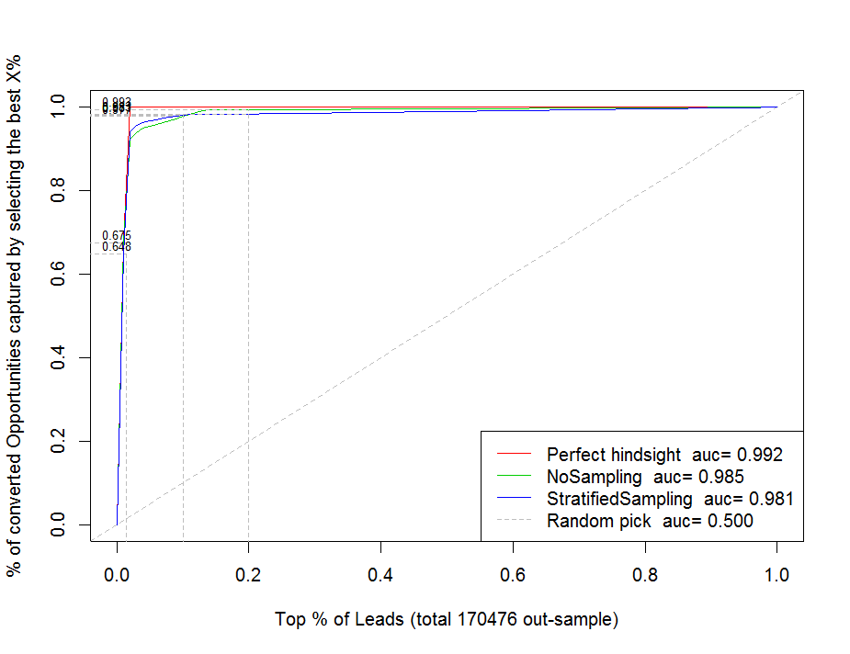
Predictive model performance: 20% on April 22, 2014
For this data set:
At 1.5%, Tree without sampling captures 67.5%; tree with sampling captures 64.8%
At 10%, tree without sampling captures 97.7%; tree with sampling captures 98.1%
At 20%, tree without sampling captures 99.3%,; tree with samling cpatuers 98.3%
0.0148

Slide 10
Other metrics on predictive accuracy
Metrics definition:
True positive rate (aka. Recall) = True predicted positive/ All true positive
False positive rate (aka. Fall-out) = False predicted positive/ All true negative
Precision = True predicted positive/ predicted positive
= True predicted positive /(True predicted positive + False predicted positive)
Accuracy = (True predicted positive + True predicted negative)/all data points (hit rate)

Slide 11
Other metrics on predictive accuracy
a) If we pick 20% of model ranked leads as highly likely convertible leads
b) If we pick 10% of model ranked leads as highly likely convertible leads
 |  | Predictions
 |  | positive | negative | sum
True Values | positive | 276 | 13 | 289
 | negative | 54539 | 219179 | 273718
 | sum | 54815 | 219192 | 274007
 |  | Predictions
 |  | positive | negative | sum
True Values | positive | 261 | 28 | 289
 | negative | 27140 | 246578 | 273718
 | sum | 27401 | 246606 | 274007
True positive rate (recall): | 95.50%
false positive rate: | 19.93%
pecision: | 0.50%
accuracy: | 80.09%
True positive rate (recall): | 90.31%
false positive rate: | 9.92%
pecision: | 0.95%
accuracy: | 90.08%

Slide 12
Significant predictors (20% data set on Apr 22)
Important factors | Importance
recency | 7245.10
BusinessUnit_s (contact) | 3291.99
BANTValidatedYN | 1272.08
CampaignBusinessDivision (product) | 1164.20
RespRespType_s | 815.39
RespRespMethod_s | 801.04
ProductLineInterest1 | 526.00
ProductLineInterest2 | 69.43
RespShipMeth (Channel) | 46.13
PurchasingRole | 20.91
RespWillingToBuy | 7.42
(If recency > 175, and BANTValidatedYN is N or unknown, not qualified; )
Notes:
Current process: contact scoring

Slide 13
Optimization on Channel
In the model, two attributes: previous responded channel, responded channel
Set “Previous Channel” ← responded Channel
(current channels:
Direct mail
Web
Managed By Sales
Phone
Email
Customer Visit)
Predict the propensity to convert for each possible channel as responded channel
Select the one that maximize the propensity; Randomly pick one channel among “tied” channels
Other business rules for tie breaking can be incorporated

Slide 14
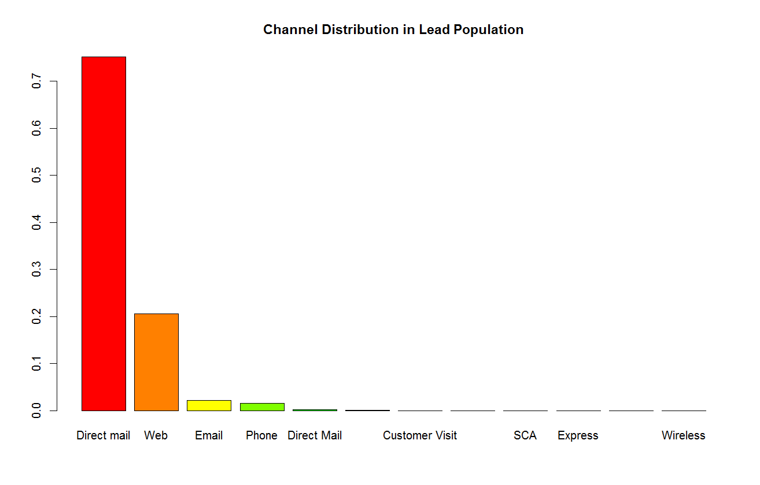

Slide 15
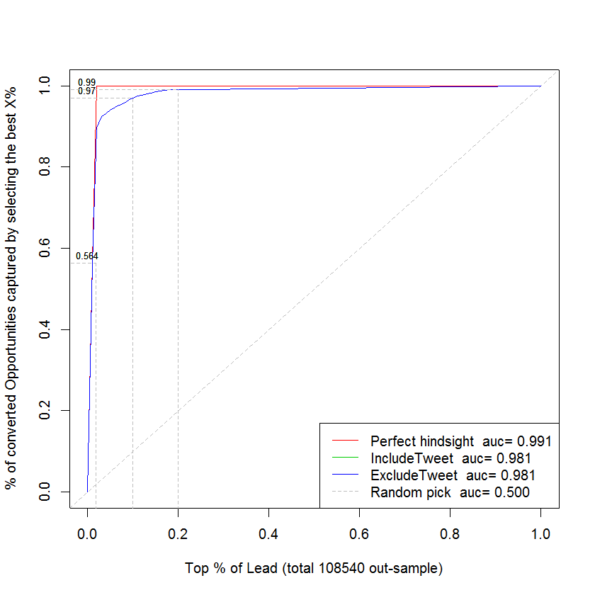
Test the impact of Twitter Data
Product Sentiment:
Total number of Tweets
Percentage of positive tweets
Percentage of neutral tweets
Average sentiment score
Average positive sentiment score
Average negative sentiment score

Slide 16
Does account information provide predictive power?
Facts:
 | With Account Information | Without Account Information | Combined
total number of leads | 1,036,081 | 1,808,011 | 2,844,092
qualified leads | 10,544 | 31,388 | 41,932
qualification rate | 1.018% | 1.736% | 1.474%

Slide 17
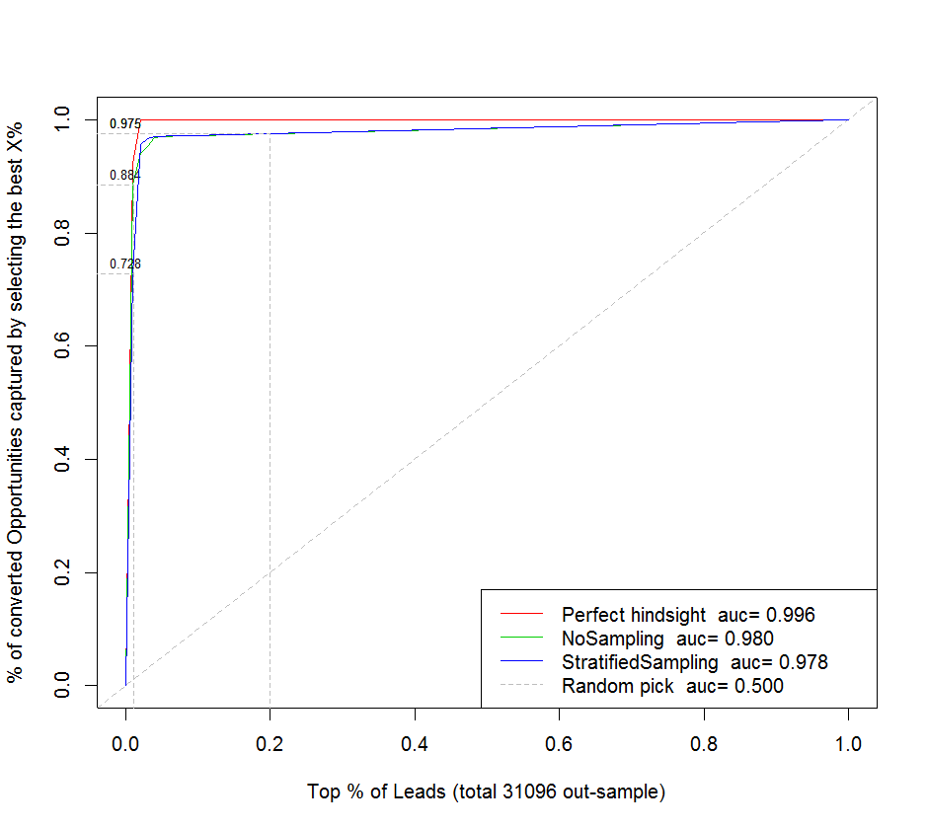
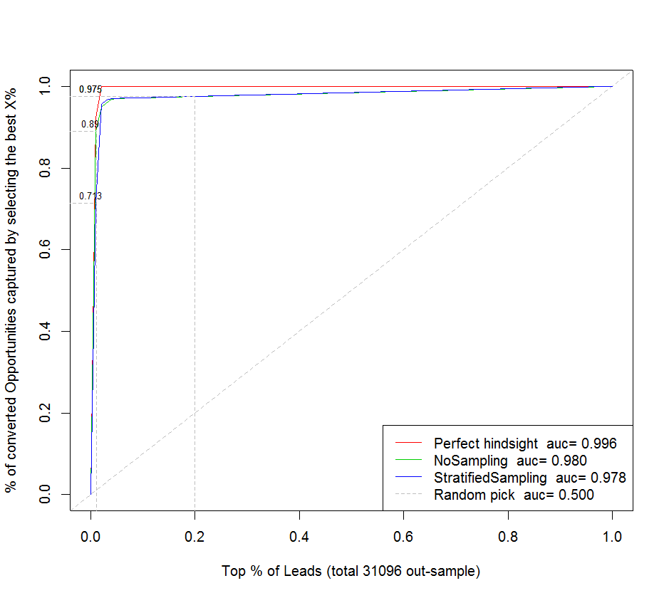
Leads with account
With account information
Without account information
0.01

Slide 18
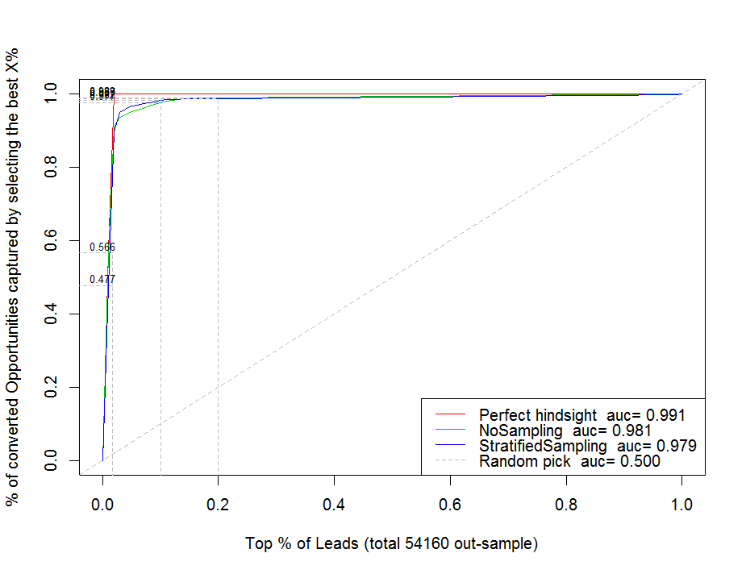
Lead without account

Slide 19
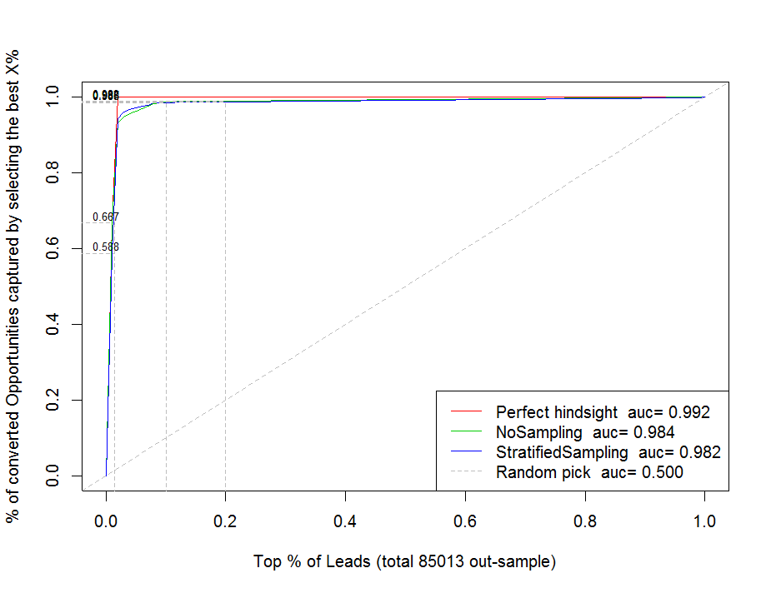
Combined leads with account and leads without account

Slide 20
Validation in terms of model prediction accuracy
out-sample validation
Unqualified lead forecasting using historical data (simulation of actual use)
For the scoring results on March 1, 2014, at 10%, it captured 90% of leads that were qualified later; at 20%, it captured 95.5% of leads that were qualified later.

Slide 21
Validation in terms of improved conversion rate (future)
Prediction
Action
new Outcome (qualified)
New data collected

Slide 22
Backup

Slide 23
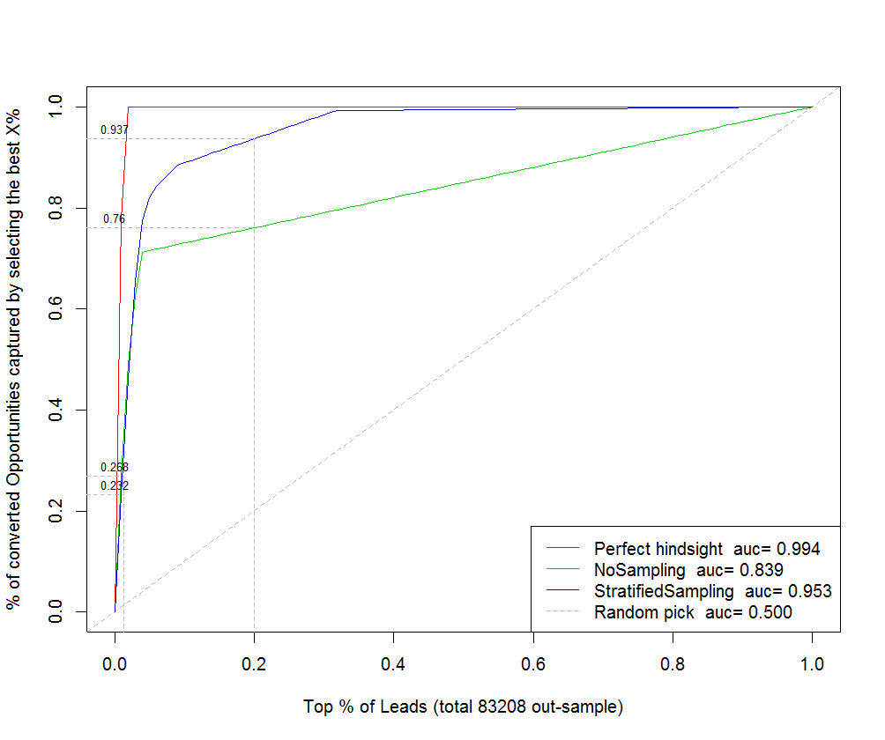
Model Performance: March 1, 2014
0.013

Slide 24
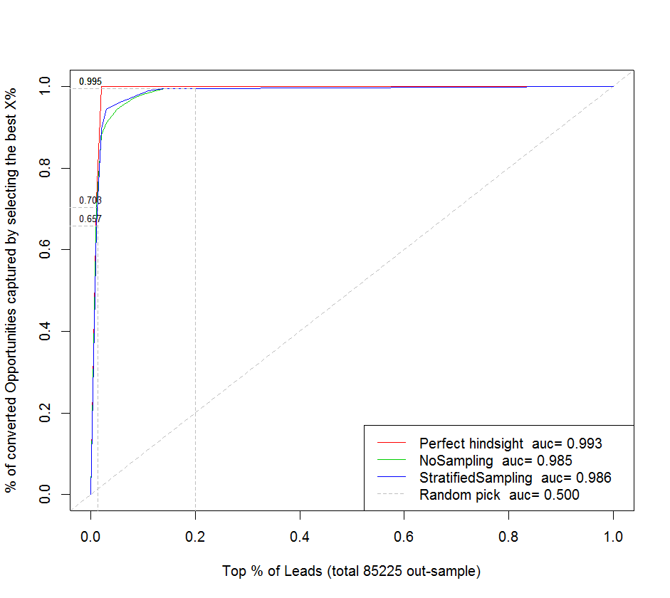
Model Performance: March 31, 2014
0.014

