Slide 1
Workgroups
CIFS Administration on
Data ONTAP 7.3

Slide 2
Module Objectives
By the end of this module, you should be able to:
License CIFS on a storage system
Join a storage system to a Windows workgroup environment using the cifs setup command
Observe the results of cifs setup
Manage newly created configuration files for the CIFS workgroup environment
Notes:
2-<number>

Slide 3

Setup Overview

Slide 4
Preparing a Storage System
To prepare a storage system to support
Windows Clients, perform the following:
License CIFS
Set up the CIFS environment
Configure CIFS
Manage CIFS
Notes:
2-<number>
To prepare a storage system to support Windows client users, perform the following:
1. License CIFS
2. Set up the CIFS environment
3. Configure CIFS
4. Manage CIFS

Slide 5
CLI or FilerView
The CIFS service on a storage system can be
configured from either:
Command Line Interface (CLI)
  Console
  Telnet
  RSH
  SSH
FilerView®
  Navigate to: http://[storage_system_name_or_ip]/na_admin
  Click the FilerView icon
Notes:
2-<number>
For more information on how to access the storage system’s console via command line, please see the Data ONTAP® Fundamental course.
FilerView is the graphical user interface for a storage system.
To access FilerView
Open an Internet browser and type the following address:
http://storage_system_name/na_admin
where storage_system_name is the name or IP address of the storage system.
The FilerView main navigational page appears.
Click the FilerView icon.
FilerView Main Navigational Page

Slide 6
License

Slide 7
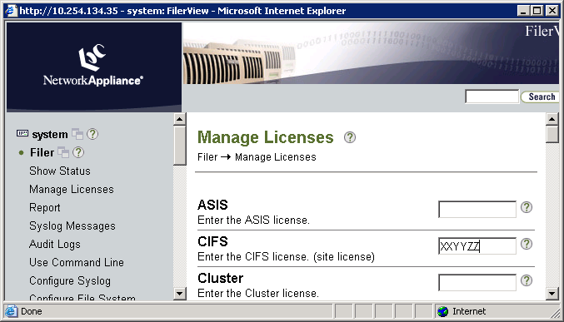
Licensing CIFS
From CLI:
  Enter the license add command with the license code.
  system> license add license_code
  A cifs site license has been installed.
  Run cifs setup to enable cifs.
From FilerView
  Go to the Manage Licenses window
NOTE: CIFS license may have been preinstalled at the factory
Notes:
2-<number>
To license CIFS on the storage system, you can use either Data ONTAP command line interface or FilerView.
From the Data ONTAP command line interface (CLI) on the storage system, enter the license add command with the CIFS license code.
Format: license add license_code
system> license add XXYYZZA
A cifs site license has been installed.
Run cifs setup to enable cifs.
From the FilerView interface for the storage system, do the following:
In the left column, select Filer and then Manage Licenses.
Enter the CIFS license.
Click the Apply button located at the bottom of the window.
Note: The CIFS license may have been preinstalled at the factory.

Slide 8
Joining a CIFS Environment
To join a storage system to a CIFS environment:
From CLI, run the cifs setup command
NOTE: If the CIFS license was preinstalled at the factory, the cifs setup script is run automatically at the end of storage system setup script.
From FilerView, choose the CIFS Setup Wizard
  FilerView->CIFS->Configure->Setup Wizard
NOTE: Upon completion of setup, the CIFS service is started.
Notes:
2-<number>
To join a storage system to a CIFS environment, you can use either the Data ONTAP CLI or FilerView:
From the Data ONTAP CLI, run the cifs setup command.
Format: cifs setup
Note: If the CIFS license was preinstalled at the factory, the cifs setup script is
run automatically at the end of storage system setup script.
From FilerView, choose the CIFS Setup Wizard.
FilerView->CIFS->Configure->Setup Wizard
Upon completion of the setup, the CIFS service is started.

Slide 9
CLI cifs setup

Slide 10
CLI cifs setup: WINS
During cifs setup
system> cifs setup
This process will enable CIFS access to the filer
from a Windows system.
Note: Use "?" for help at any prompt and Ctrl C to exit without committing changes.
Your filer does not have WINS configured and is
visible only to clients on the same subnet.
Do you want to make the system visible via WINS?
[n]:
Notes:
2-<number>
Windows Internet Name Service (WINS) is Microsoft’s implementation of NetBIOS Name Server on Windows. As of Windows 2000, DNS is preferred over WINS, particularly for Active Directory. WINS servers usually support only pre-Windows 2000 and mixed Windows 2000 installs.

Slide 11
CLI cifs setup: Initial Questions
During cifs setup (Cont.)
A filer can be configured for multiprotocol access,
or as an NTFS-only filer. Since NFS, DAFS, VLD,
FCP, and iSCSI are not licensed on this filer, we
recommend that you configure this filer as an NTFS-only filer
(1) NTFS-only filer
(2) Multiprotocol filer
Selection (1-2)? [1]:
This list varies depending
on other licensed protocols.
Note: Key protocol is NFS.
Notes:
2-<number>
If the storage system will be in a Windows only environment, selecting the NTFS-only configures the storage system to be most compliant with Microsoft environments.
Note: All existing volumes will be converted to NTFS, but qtrees are unaffected.
If the storage will participate in both Windows and non-Windows environments, the storage system should be configured as Multiprotocol.

Slide 12
Results of NTFS-only
NTFS-only security style changes as a result of cifs setup.
Verify by options wafl command
Option | Defaults Before | Values After
wafl.default_security_style | unix | ntfs
wafl.nt_admin_priv_map_to_root | on | off
Notes:
2-<number>
After running the cifs setup command, the options wafl command is run. The option wafl.default_security_stye is changed from UNIX to NTFS. This causes all new volumes to default to NTFS security style.
Additionally, the nt_admin_priv_map_to_root option changes from on to off.

Slide 13
Switching Back to Multiprotocol
To switch back to multiprotocol:
  Use cifs setup
  wafl.default_security_style unix
Results of switching NTFS-only to multiprotocol:
  ACLs are unchanged
  Security style of volumes and qtrees remains unchanged
  New volumes have security style of UNIX
Notes:
2-<number>
Although you can change a storage system from NTFS-only to multiprotocol using cifs setup, you can achieve the same effect more easily by simply setting the wafl.default_security_style option to unix.
The results of changing an NTFS-only storage system to a multiprotocol storage system are the following:
Existing ACLs remain unchanged.
The security style of all volumes and qtrees remains unchanged.
When you create a volume, its default security style is UNIX.
The wafl.default_security_style option is set to UNIX.

Slide 14
Switching Back to Multiprotocol (Cont.)
Root volume security style will remain ntfs
UNIX root user might be denied access
You can gain access:
  Map of Windows user to UNIX root
    Discussed in Module 3
  cifs.nfs_root_ignore_acl on
Notes:
2-<number>
Because the security style of the root volume remains ntfs after you change the storage system from NTFS-only to multiprotocol, you might be denied access to the root volume when you connect from UNIX as root.
You can gain access if the ACL for the root volume allows full control for the Windows user that maps to root.
You also can gain access by setting the cifs.nfs_root_ignore_acl option to on.
When this option is on, ACLs will not affect root access from the Network File System (NFS).

Slide 15
CLI cifs setup: Root User
During cifs setup (Cont.):
CIFS requires local /etc/passwd and /etc/group files and default files will be created. The default passwd file contains entries for 'root','pcuser', and 'nobody'.
Note: These files are used during CIFS authentication processing when
mapping Windows users to UNIX users even if it is NTFS-only security style.
Enter the password for the root user [ ]:
Retype the password:
[This is the root user created in the /etc/passwd file. With respect
to CIFS, this root user is used in a non-Windows workgroup only and when authentication is performed with the /etc/passwd file.]
The password is entered, but it is not displayed.
Notes:
2-<number>
With respect to CIFS, the root user is used in a non-Windows (UNIX) workgroup only and when authentication is performed with the /etc/passwd file.

Slide 16
CLI cifs setup: Server Name
During cifs setup (Cont.):
The default name for this CIFS server is ' system '.
would you like to change this name? [n]:
Notes:
2-<number>

Slide 17
CIFS Authentication Methods
During cifs setup (Cont.):
Data ONTAP CIFS services support four styles of user authentication.
Choose the one from the list below that best suits your situation.
    Active Directory domain authentication (Active Directory domains only)
    Windows NT 4 domain authentication (Windows NT or Active Directory domains)
    Windows Workgroup authentication using the filer's local user accounts
    etc/passwd and/or NIS/LDAP authentication
Selection (1-4)? [1]:
Notes:
2-<number>
If you plan to have the storage system join a Windows domain and make use of that domain's users and groups, you should choose Option 1 or 2. Options 3 and 4 are authentication methods that do not require the use of domain controllers, but may still require other systems for full functionality.
Option 1: Use this option if the storage system is joining an Active Directory-based domain (i.e., a Windows 2000 or later domain).
Option 2: Use this option if the storage system is joining a Windows NT 4-based domain or an Active Directory-based domain as a Windows NT 4 server.
Option 3: Use this option if you want to join a Windows Workgroup and do not want to depend on external domain controllers. You will need to define a set of local users on the storage system.
Option 4: Use this option for a non-Windows Workgroup that uses UNIX style authentication. This style requires the use of cleartext passwords from Windows clients.

Slide 18
CLI: cifs setup Workgroup
Selecting Windows Workgroup:
  Active Directory domain authentication (Active Directory domains only)
  Windows NT 4 domain authentication (Windows NT or Active Directory domains
  Windows Workgroup authentication using the filer's local user accounts
  /etc/passwd and/or NIS/LDAP authentication
  Selection (1-4)? [1]: 3
Notes:
2-<number>

Slide 19
CLI: cifs setup Workgroup (Cont.)
What is the name of the Workgroup? [WORKGROUP]: workgroup1
Fri Jun 23 19:32:53 GMT [wafl.quota.sec.change:notice]:
security style for /vol/vol0/ changed from unix to ntfs
CIFS - Starting SMB protocol...
It is recommended that you create the local administrator
account(DEVSLU10-F1\administrator)for this filer.
(The local administrator account can be locally authenticated via
CIFS authentication and has privileges to administer CIFS on the
storage system. The local users and passwords are stored in the
storage system registry file.)
Do you want to create the system\administrator account? [y]:
Enter the new password for system\administrator:
Retype the password:
Notes:
2-<number>

Slide 20
CLI: cifs setup Workgroup (Cont.)
Workgroup completion continued
Welcome to the WORKGROUP1 Windows(R) workgroup
CIFS local server is running.
system> Fri Jun 23 19:33:18 GMT
[nbt.nbns.registrationComplete:info]: NBT: All CIFS name
registrations have completed for the local server.
Notes:
2-<number>

Slide 21
Results

Slide 22
CIFS Server Files
During setup, several configuration files are created.
/etc/cifsconfig_setup.cfg
  Stores CIFS setup configuration
/etc/usermap.cfg
  Multiprotocol support for NFS and CIFS
  Discussed in the next module
/etc/passwd
  Multiprotocol and UNIX workgroup
/etc/cifsconfig_share.cfg
  Default share definitions
/etc/lclgroups.cfg
  Local groups definitions
NOTE: Additional files are created depending on the environment
Notes:
2-<number>
During the CLI cifs setup script or FilerView CIFS Setup Wizard, CIFS support and configuration files are created in the /etc directory. The number and content of the files are dependent on the environment.
The following are files that are common to all environments:
/etc/cifsconfig_setup.cfg (Stores the CIFS setup configuration)
/etc/usermap.cfg (Multiprotocol support for mapping users of NFS and CIFS)
/etc/passwd (Multiprotocol and UNIX workgroup)
/etc/cifsconfig_shares.cfg (Default shares definitions)
Additional files are created depending on the environment as in a workgroup (Windows or non-Windows) or a Windows domain.

Slide 23
/etc/cifsconfig_setup.cfg File
/etc/cifsconfig_setup.cfg file
  Contents are persistent across reboots
  Runs each time the CIFS service is started
system> rdfile /etc/cifsconfig_setup.cfg
#Generated automatically by cifs commands
cifs setup -security unix -cp 0 -NTFSonly
  The content of the file varies depending
  on the environment that is selected.
Notes:
2-<number>
The following shows the contents of an /etc/cifsconfig_setup.cfg file:
system> rdfile /etc/cifsconfig_setup.cfg
#Generated automatically by cifs commands
cifs setup -security unix -cp 0 -NTFSonly
The content of the file varies depending on the environment that is selected. This file is used each time CIFS service is started and persists across reboots.

Slide 24
/etc/passwd File
/etc/passwd file
  system> rdfile /etc/passwd
root:_J9../ongnoStt3Ei79o:0:1::/:
    pcuser::65534:65534::/:
    nobody::65535:65535::/:
    ftp::65533:65533:FTP Anonymous:/home/ftp:
  Is checked during CIFS authentication processing when mapping Windows users to UNIX UID and GID
  Can be used for authentication in a non-Windows (UNIX) workgroup environment
An encrypted root user password is shown.
Note: This root user was created during cifs setup for the /etc/passwd file. This is not for the storage system user “root” that is used for system administration.
Unless the Windows user is mapped to a specific UNIX user name,
pc user is the default.
Notes:
2-<number>

Slide 25
CIFS Default Shares
Setup creates three default shares:
  C$ maps to /vol/<root volume>
  ETC$ maps to /vol /<root volume>/etc
  HOME is /vol /<root volume>/home
    Home directory is accessible to everyone
$ shares are hidden.
C$ and ETC$ are available only to administrators.
Notes:
2-<number>
These are the three default share definitions:
C$ is /vol/<root volume>. This is a hidden “admin share” to root of the root
volume.
ETC$ is /vol /<root volume>/etc. This is a hidden “admin share” to /etc directory
on root volume.
The /etc directory stores storage system configuration files, executables
required to boot the system, and some log files.
HOME is /vol /<root volume>/home. This share is to the /home directory on root
volume that is accessible to everyone.
A hidden share means that it is not visible when browsing. An “admin share” only is available to users who are members of an administrator group.
The storage system default root volume is /vol/vol0 unless the installer selected a unique volume name during the storage system setup script. You also can change which volume on your storage system is used as root volume or create a new one and in the process designate a different name for the root volume. The root volume contains special directories and configuration files for administering the storage system.

Slide 26
/etc/cifsconfig_share.cfg File
/etc/cifsconfig_share.cfg file
  system> rdfile /etc/cifsconfig_share.cfg
  #Generated automatically by cifs commands
  cifs shares -add "ETC$" "/etc" "Remote
  Administration“
  cifs access "ETC$" S-1-5-32-544 Full Control
  cifs shares -add "HOME" "/vol/vol0/home“
  "Default Share“
  cifs access "HOME" S-NONE "nosd“
  (The HOME share acts special in that it maps to the user
  who is trying to log in and the security descriptors on the user’s
  home directory apply.)
  cifs shares -add "C$" "/" "Remote Administration“
  cifs access "C$" S-1-5-32-544 Full Control
This file can be altered via CLI commands or GUIs
nosd = No Security Descriptor
Notes:
2-<number>
The HOME share acts special in that it maps to the user who is trying to login. The security descriptors on the user’s home directory apply.

Slide 27
/etc/lclgroups.cfg File
The local administrator is added to lclgroups.cfg:
  system> rdfile /etc/lclgroups.cfg
  [ "Replicators" 552 ( "not supported" ) ]
  [ "Backup Operators" 551 ( "Members can bypass file security to backup files" ) ]
  [ "Power Users" 547 ( "Members that can share directories" ) ]
  [ "Guests" 546 ( "Users granted Guest Access" ) ]
  [ "Users" 545 ( "Ordinary Users" ) ]
  [ "Administrators" 544 ( "Members can fully
  administer the filer" ) ]
S-1-5-21-265246955-68147109-1151652928-500
Local Administrator
Notes:
2-<number>
The lclgroups.cfg file defines the members of the groups on the storage system.

Slide 28
SIDs

Slide 29
CLI: cifs lookup
Windows security identifiers (SIDs) can be converted to user and group IDs or the reverse
  CLI: cifs lookup command
  FilerView
system> cifs lookup S-1-5-32-544
name = BUILTIN\Administrators
system> cifs lookup S-1-5-21-265246955-68147109-1151652928-500
name = system\administrator
NOTE: SID might be listed in the/etc/lclgroups.cfg file
Notes:
2-<number>
Security IDs (SIDs) can be converted to user and group IDs using CLI or FilerView.
The following examples demonstrate conversion using the CLI with the cifs lookup command.
system> cifs lookup S-1-5-32-544
name = BUILTIN\Administrators
The SID S-1-5-32-544 is the name “BUILTIN\Administrators”.
system> cifs lookup S-1-5-21-265246955-68147109-1151652928-500
name = system\administrator
This is the SID for the local administrator, system\administrator, which also is listed in the /etc/lclgroups.cfg file.

Slide 30
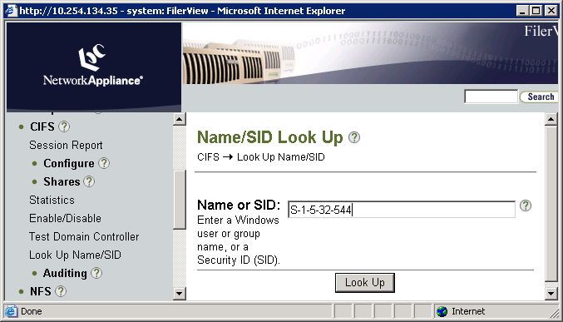
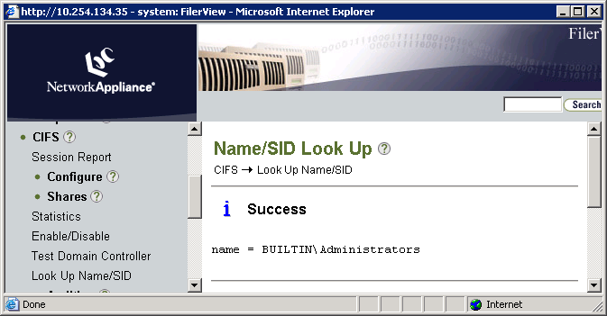

FilerView: cifs lookup Command
FilerView -> CIFS -> Look Up Name / SID
Notes:
2-<number>
The Windows SID can be converted to user and group names with FilerView.
On FilerView go to CIFS→Look Up Name/SID.
Enter a Windows user or group name, or a SID.
Click the Look Up button.
The response to the lookup appears in the Name/SID Look Up page.
In this example, the SID S-1-5-32-544 shows that the name is BUILTIN\Administrators.

Slide 31
SID Cache
To manage the SID Cache,
options cifs.sidcache.enable on
  Turns on SID Cache
options cifs.sidcache.lifetime time
  Sets the normal life span of cached SIDs
cifs sidcache clear all
  Clears all CIFS SID-to-name map cache entries
cifs sidcache clear domain [domain]
  Clears CIFS SID-to-name map cache entries for a particular domain
cifs sidcache clear user [user]
  Clears CIFS SID-to-name map cache entries for a particular user
cifs sidcache clear sid [sid]
  Clears CIFS SID-to-name map cache entries for a particular SID
Notes:
2-<number>
CIFS frequently is required to map security identifiers (SIDs) to user and group names and vice versa for user authentication, quota management, console command processing, and various RPC responses. The SID-to-name map cache contains entries that map SIDs to pre-Windows 2000 user and group names.
The storage system obtains the SID-to-name mapping information by querying the domain controller. To minimize multiple lookups of the same names, SID-to-name information received from the domain controller is saved in the SID-to-name map cache on the storage system.
The SID-to-name map cache is enabled on the storage system by default. You can manually control the cache by changing the lifetime of the entries, clearing entries, or turning SID-to-name map caching off or on. The cache persists if CIFS is terminated or restarted, but it does not persist across a reboot or a takeover and giveback.
When the storage system requires SID-to-name mapping information, it first looks for a matching entry in the SID-to-name map cache. If a matching entry is not found or if an expired matching entry is found, the storage system queries the appropriate domain controller for current mapping information. If the domain controller is not available, an expired mapping entry might be used by the storage system.

Slide 32
NetBIOS Aliases

Slide 33
NetBIOS
NetBIOS
  Means “Network Basic Input/Output System”
  Is an API that allows machines to be discovered by “name”
  Is typically used by various applications such as Network Neighborhood and net use
Windows clients set NetBIOS name by the Computer Name tab of the System Properties, which can be accessed via the Control Panel/System or by right-clicking on My Computer and selecting Properties
On the Storage System, set NetBIOS name(s) using nbalias and the cifs_nbalias.cfg file
Notes:
2-<number>
The Network Basic Input/Output System (NetBIOS) is an Application Program Interface (API) that provides simple networking services enabling users to share and use one another’s resources easily.
NetBIOS over TCP/IP (NBT or NetBT) is the standard protocol used for CIFS prior to Windows 2000. NBT is used with Windows 95, Windows 98, and Windows NT. The NetBIOS Name Server (NBNS) protocol is part of the NetBIOS over TCP/IP family of protocols.

Slide 34
NetBIOS Aliases
system> rdfile /etc/cifs_nbalias.cfg
#
# This file contains NetBIOS aliases used by the filer.
# See the System Administrator's Guide for a full
# description of this file.
#
# There is a limit to the number of aliases that may be specified.
# Currently that limit is 200.
#
# Aliases must be entered one per line.
#
# After editing this file, use the console command "cifs nbalias load"
# to make the filer process the entries in this file.
#
# Note that the "#" character is valid in a CIFS NetBIOS alias.
# Therefore the "#" character is only treated as a comment in this
# file if it is in the first column.
#
myfiler
NA1
Filer
Stumpy
system>
Notes:
2-<number>
The /etc/cifs_nbalias.cfg configuration file contains the NetBIOS aliases for the storage system. A NetBIOS alias allows the storage system to be accessed by a Windows client using an alternate name for the storage system.
To list the current NetBIOS aliases, do the following:
system> cifs nbalias
No NetBIOS aliases
system> rdfile /etc/cifs_nbalias.cfg
# After editing this file, use the console command
# "cifs nbalias load"
# to make the filer process the entries in this file.
#
# Note that the "#" character is valid in a CIFS
# NetBIOS alias.
# Therefore the "#" character is only treated as a
# comment in this
# file if it is in the first column.
grumpy
happy [Edit and add the NetBIOS aliases.]
sneezy
system>

Slide 35
NetBIOS Aliases (Cont.)
cifs nbalias command
List aliases
  cifs nbalias
Load file after making changes
  cifs nbalias load
Notes:
2-<number>
Once the /etc/cifs_nbalias.cfg file has been edited with the proper NetBIOS Aliases, use the cifs nbalias load command to register the update with the Windows Internet Naming Service (WINS) server.

Slide 36
Terminating/Restarting CIFS

Slide 37
Stopping and Restarting CIFS
To terminate CIFS service (a complete shutdown) where all CIFS sessions are ended:
  cifs terminate [-t minutes]
To restart CIFS service after terminating:
  cifs restart
Notes:
2-<number>

Slide 38
CLI: Stopping and Restarting CIFS
As an example, stop and restart CIFS services on the storage system called “system”.
  system> cifs terminate
  CIFS local server is shutting down...
  CIFS local server has shut down...
  system> cifs restart
  CIFS local server is running.
  system> Tue Aug 1 19:07:26
  GMT[nbt.nbns.registrationComplete:info]: NBT:
  All CIFS name registrations have completed for
  the local server.
Notes:
2-<number>

Slide 39
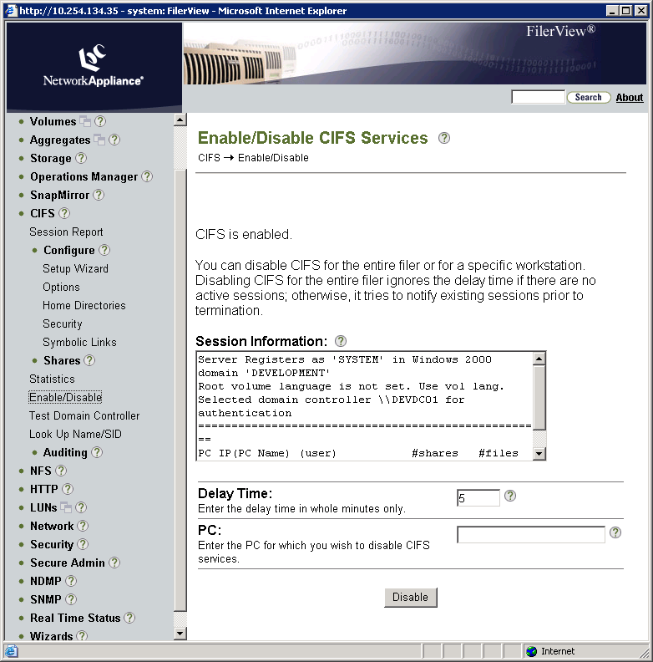
FilerView: Stopping CIFS Services
Notes:
2-<number>
You can disable CIFS for the entire storage system or for a specific workstation. Disabling CIFS for the entire storage system ignores the delay time if there are no active sessions. Otherwise, it tries to notify existing sessions prior to termination.
As an example with FilerView, stop CIFS services on the storage system by performing the following steps:
Go to FilerView→CIFS→Enable/Disable.
There are no active sessions for the storage system, so the Delay Time is ignored.
Click the Disable button.
Note: You also can enter the name of a specific PC (Windows workstation) to disable CIFS services.

Slide 40
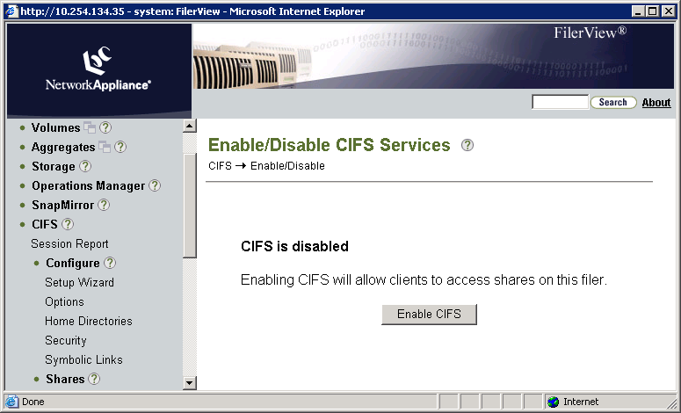
FilerView: Restarting CIFS Services
Notes:
2-<number>
As an example with FilerView, restart the CIFS services on the storage system by performing the following steps:
Go to FilerView→CIFS→Enable/Disable.
Click the Enable CIFS button.
Enabling CIFS will allow clients to access shares on this storage system.

Slide 41
Module Summary

Slide 42
Module Summary
In this module, you should have learned:
The CIFS service on a storage system can be configured via CLI with the cifs setup command or from FilerView
A successful configuration automatically starts the CIFS service
Resulting files reference users using SIDs
SIDs can resolved using the cifs lookup command
NetBIOS allows machines to be discovered by “name”
A storage system can have multiple “aliases” or NetBIOS “names”
The CIFS service may be stopped and started from the CLI and FilerView
Notes:
2-<number>

Slide 43
Exercise
Module 2: Workgroups
Estimated Time: 45 minutes
Notes:
Please refer to your Exercise Guide for more instruction.

Slide 44
Check Your Understanding
In cifs setup, what are the two security style choices for which a storage system can be configured?
During the initial questions in CLI cifs setup, for which root user can you enter a password?
What are the three default share volumes created as a result of cifs setup?
What is the name of the NetBIOS alias file?
Notes:
2-<number>

Slide 45
Answers
Module 2: Workgroups
Notes:
Student Notes should state: Please refer to your Exercise Guide for more instruction.

Slide 46
Check Your Understanding - Answers
In cifs setup, what are the two security style choices for which a storage system can be configured?
  NTFS-only
  Multiprotocol
During the initial questions in CLI cifs setup, for which root user can you enter a password?
The UNIX root user in the /etc/passwd file
Used in a non-Windows workgroup only
Notes:
2-<number>

Slide 47
Check Your Understanding – Answers
What are the three default share volumes created as a result of cifs setup?
C$
ETC$
HOME
What is the name of the NetBIOS alias file?
  cifs_nbalias.cfg
Notes:
2-<number>

