Slide 1
Access Control
CIFS Administration on
Data ONTAP 7.3

Slide 2
Module Objectives
By the end of this module, you should be able to:
Create and manage local users for a storage system
Identify how to create a local group and make a local user a member of that group
Use the CLI, FilerView® or Microsoft tools to add, delete, and modify access permissions of shares
Use Microsoft tools to add, delete, and modify access permissions of files and folders
Determine and verify user mappings for CIFS users accessing NTFS and UNIX volumes/qtrees
Notes:
3-<number>

Slide 3

Local Users

Slide 4
Local Users
Local users are:
Accounts that are authenticated locally
Associated with Groups on the storage system
Created and managed using useradmin command or a text editor
Saved in the /etc/registry or /etc/passwd
Notes:
3-<number>
On the storage system, the domain administrators group and the local administrator account are part of the BUILTIN\Administrators group. They can do the following:
Provide a text editor to edit configuration files. Data ONTAP does not include an editor.
Provide the ability to administer a storage system and hence have access to the root file system (C$ and ETC$).
Modify the share access for C$ and ETC$ to grant additional users access.
The local administrator can setup local users on the storage system with the useradmin user add command.

Slide 5
Purpose of Local Users
Two main reasons for local user authentication:
Provides local administrators the ability to configure the storage system
  Discussed in Data ONTAP Fundamentals Course
Provides local client users access to the resources on the storage system for all environments
  Windows workgroup
  Non-Windows workgroup
  Windows domain
NOTE: You can create a maximum of 96 local user accounts.
Notes:
3-<number>
Reasons for local user accounts include the following:
Windows workgroup
You must create local user accounts so that the storage system can authenticate local users.
Non-Windows workgroup (UNIX mode)
Do not create local user accounts because the storage system authenticates users with the UNIX password (/etc/passwd) database.
Windows domain
The storage system can authenticate users (with the local user accounts) who try to connect to the storage system from an untrusted domain.
Local users can access the storage system when the domain controller is down or not available for domain authentication.
Note: You can create a maximum of 96 local user accounts.

Slide 6
Purpose of Local Users (Cont.)
When the CIFS server is configured for:
Windows workgroup
  You must create local user accounts so that the storage system can authenticate users
  Use the useradmin command
  User accounts are stored in /etc/registry
Non-Windows workgroup (UNIX mode)
  You must create local UNIX users
  Use the passwd command
  User accounts are stored in /etc/passwd and /etc/shadow
Notes:
3-<number>

Slide 7
Purpose of Local Users (Cont.)
When the CIFS server is configured for:
Windows domain
  Storage system can authenticate users (with the local user accounts) who try to connect to the storage system from an untrusted domain
  Local users can access the storage system when the domain controller is down or not available for domain authentication
  Use the useradmin command
  User accounts are stored in /etc/registry
Notes:
3-<number>

Slide 8
Local Administrator
As you recall, during cifs setup, the local
administrator account may be created.
It is highly recommended that you create the local
administrator account: (system\administrator) for
this filer. This account allows access to CIFS
from Windows when domain controllers are not
accessible.
Do you want to create the system\administrator
account? [y]:
Enter the new password for system\administrator:
Retype the password:
Notes:
3-<number>

Slide 9
Local User Definitions
List the local users on the storage system.
system> useradmin user list
Name: root
Info: Default system administrator.
Rid: 0
Groups:
Name: administrator
Info: Built-in account for administering the filer
Rid: 500
Groups: Administrators
A local administrator is added to the user list if the response during
cifs setup was to create a local administrator account for the
storage system. Be sure to set an appropriate password for the
administrator account.
This is the storage system root user account.
Notes:
3-<number>
A local administrator is added to the user list if the response during cifs setup was to create a local administrator account for the storage system. Be sure to set an appropriate password for the administrator account.

Slide 10
Administrating Local Users
Local Users
Must provide a unique name
Associate user to a group
Created only via CLI’s useradmin command when the storage system is set to CIFS workgroup authentication
Notes:
3-<number>
With FilerView, you cannot create local user accounts.
Microsoft Management Console (MMC) tools have some capabilities that are discussed in the next module because they only are available when the storage system is using CIFS domain authentication.

Slide 11
Local User Management
Manage local users fully by using the CLI
useradmin command.
To add a new local user:
useradmin user add user_name –g group_name
To modify a local user :
useradmin user modify user_name –g group_name
To list user information:
useradmin user list user_name
To delete a local user:
useradmin user delete user_name
Notes:
3-<number>

Slide 12
CLI: Adding a New Local User
As an example, add a local user called Jane to
the predefined Guests group.
Note: User names are not case sensitive.
system> useradmin user add jane -g Guests
New password:
Retype new password:
user <jane> added.
system> Mon Jul 31 01:13:18 GMT
[useradmin.added.deleted:info]:
The user 'jane' has been added.
Password is typed but not displayed.
Notes:
3-<number>
As an example, add a local user called Jane to the predefined Guests group.
Note: User names are not case sensitive.
system> useradmin user add jane -g Guests
New password:
Retype new password:
User <jane> added.
system> Mon Jul 31 01:13:18 GMT [useradmin.added.deleted:info]: The user 'jane' has been added.
Note: The password is typed but not displayed.

Slide 13
CLI: Adding a New Local User (Cont.)
In the example, verify that the local user Jane
has been added to the predefined Guests group.
system> useradmin user list jane
Name: jane
Info:
Rid: 131075
Groups: Guests
Full Name:
Allowed Capabilities:
Password min/max age in days: 0/4294967295
Status: enabled
Notes:
3-<number>
In the example, verify that the local user Jane has been added to the predefined Guests group.
system> useradmin user list jane
Name: jane
Info:
Rid: 131075
Groups: Guests
Full Name:
Allowed Capabilities:
Password min/max age in days: 0/4294967295
Status: enabled
Note: Jane has no allowed capabilities in the Guests group, but she can log in and be authenticated.

Slide 14
Local Groups

Slide 15
Local Groups
Local Groups
Contain local and domain users
Created only via CLI’s useradmin command when the storage system is set to CIFS workgroup authentication
Notes:
3-<number>
With FilerView, you cannot create local group accounts.
Microsoft Management Console (MMC) tools have some capabilities that are discussed in the next module because they only are available when the storage system is using CIFS domain authentication.

Slide 16
CLI: Group Management
Manage local groups by using the CLI useradmin.
To add a new group:
  useradmin group add group_name –r role
To modify an existing group:
  useradmin group modify group_name –g
  new_group_name
To list group information:
  useradmin group list group_name
To delete a group:
  useradmin group delete group_name
To add an existing Windows domain user to a group:
  useradmin domainuser add username –g
  group_name
To list Windows domain users in a group:
  useradmin domainuser list –g group_name
Notes:
3-<number>

Slide 17
CLI: Local Groups
As an example, add a local group called Helpers
with the predefined admin role and verify the
Results.
system> useradmin group add Helpers -r admin
Group <Helpers> added.
system > Mon Jul 31 02:02:43 GMT
[useradmin.added.deleted:info]: The group
'Helpers' has been added.
system > useradmin group list Helpers
Name: Helpers
Info:
Rid: 131076
Roles: admin
Allowed Capabilities: login-*,cli-*,api
*,security-*
Notes:
3-<number>
As an example, add a local group called Helpers with the predefined admin role and verify the results.
system> useradmin group add Helpers -r admin
Group <Helpers> added.
system> Mon Jul 31 02:02:43 GMT [useradmin.added.deleted:info]: The group 'Helpers' has been added.
system> useradmin group list Helpers
Name: Helpers
Info:
Rid: 131076
Roles: admin
Allowed Capabilities: login-*,cli-*,api-*,security-*
Note: The admin role has full capabilities.
When groups are created, they are placed in the lclgroups.cfg file. Normally, this file is for administrative reference only; it is not used to reload groups into the system memory. However, sometimes you need Data ONTAP to reload this file―for example, when you migrate a storage system. Do not edit this file without direction from support.

Slide 18
Share Permissions

Slide 19
Permissions
Permissions can be set at:
  Share level
  Folder/File level
Both permission levels must be satisfied to gain access to the resource
Notes:
3-<number>

Slide 20
Share Permissions
Share permissions can be managed by:
  CLI: cifs access command
  FilerView
  MMC such as Computer Management
Windows share permissions are the following:
  Read-only
  Full control
  Change
If all the permissions are denied, then there is no access.
Notes:
3-<number>

Slide 21
cifs access Command
CLI cifs access command sets or modifies the share-level ACL to share definitions
  To modify a share access:
  cifs access <share> [-g] [user_rights]
  To delete an ACL entry for a user on a share:
  cifs access -delete <share> [-g] [user]
The –g option specifies that the user is the name of a UNIX group. Use this command when you have:
  A UNIX group and a UNIX user or an NT user or group with the same name
Notes:
3-<number>
The CLI cifs access command sets or modifies the share-level access control list (ACL) to share definitions.
To modify a share access:
cifs access <sharename> [-g] [user_rights]
To delete an ACL entry for a user on a share:
cifs access -delete <sharename> [-g] [user]
The -g option specifies that the user is the name of a UNIX group. Use this command when you have
A UNIX group and a UNIX user or an NT user or group with the same name.

Slide 22
CLI: Setting and Deleting Share Access
As an example, on the datatree1 share, set the share
access for the administrator to Full Control and delete
the Everyone access
system> cifs access datatree1 administrator Full Control
1 share(s) have been successfully modified
system> cifs access -delete datatree1 everyone
1 share(s) have been successfully modified
system> cifs shares datatree1
Name Mount Point Description
---- ----------- -----------
datatree1 /vol/flexvol1/datatree1 Windows Qtree
  system\administrator / Full Control
NOTE: This is the storage system local administrator
Notes:
3-<number>
For example, on the datatree1 share, set the share access for the administrator to Full Control and delete the Everyone access.
system> cifs access datatree1 administrator Full Control
1 share(s) have been successfully modified
system> cifs access -delete datatree1 everyone
1 share(s) have been successfully modified
system> cifs shares datatree1
Name Mount Point Description
---- ----------- -----------
datatree1 /vol/flexvol1/datatree1 Windows Qtree
system\administrator / Full Control
Note: The system\administrator is the storage-system local administrator.

Slide 23
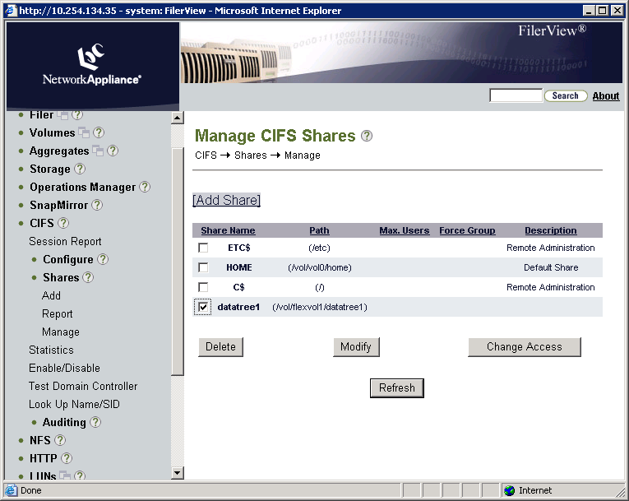
FilerView: Managing Share Access
Notes:
3-<number>
As an example with FilerView, on the datatree1 share, set the share access for the administrator to Full Control and delete the Everyone access by performing the following steps:
Go to FilerView→CIFS→Shares→Manage.
For datatree1 share, click operation Change Access.

Slide 24
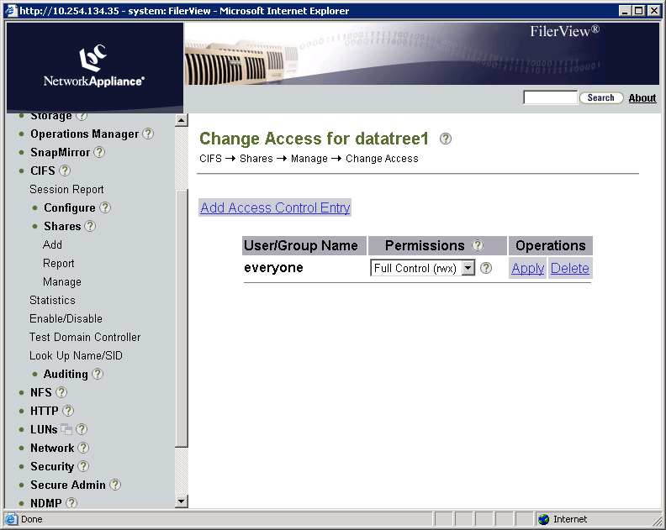
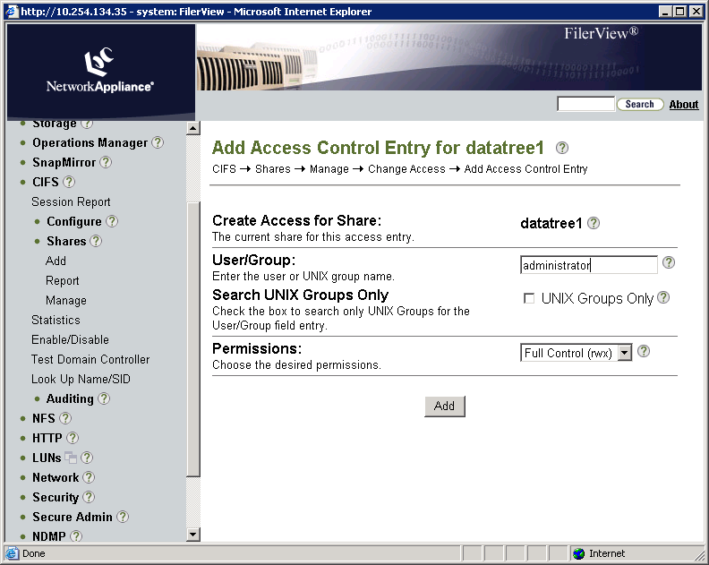
FilerView: Managing Share Access (Cont.)
Notes:
3-<number>
(The following continues the setting and deleting of share access.)
In the Change Access for datatree1 page, click Add Access Control Entry.
In the Add access Control Entry for datatree1 page, perform these steps:
In the User/Group text box, type administrator.
In the Permissions list box, select Full Control (rwx).
Click the Add button.

Slide 25
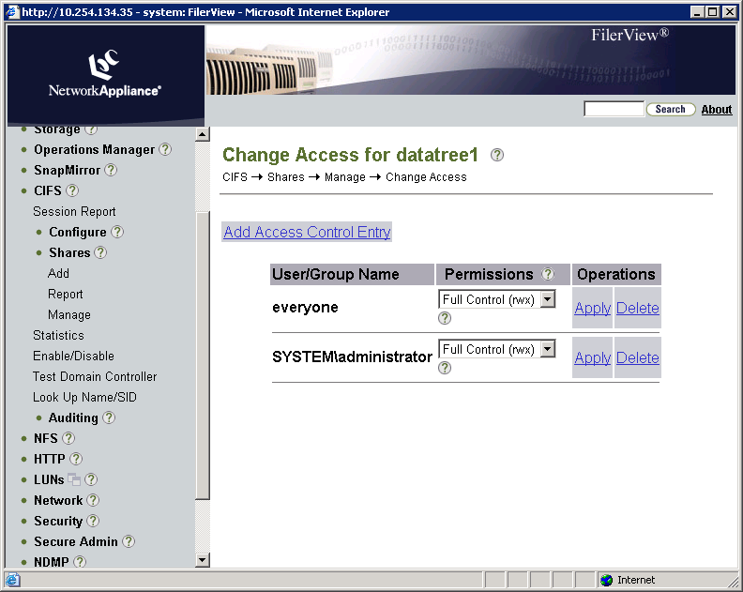
FilerView: Managing Share Access (Cont.)
Click the operation
Delete.
Notes:
3-<number>
(The following continues the setting and deleting of share access.)
In the Change Access for datatree1 page, view the newly added administrator with Full-Control share access.
In the everyone row, click the operation Delete to remove the share access.

Slide 26
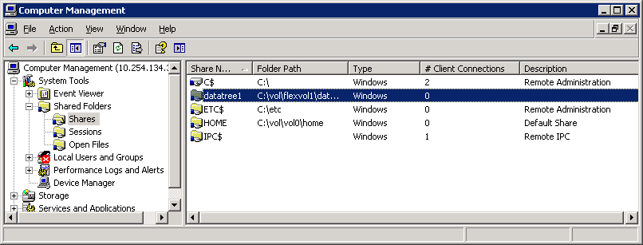
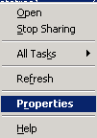
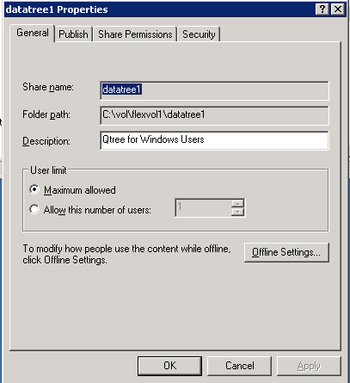
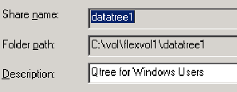
MMC: Setting and Deleting Share Access
Right-click datatree1 share.
Choose Properties.
Click the Share Permissions tab.
Notes:
3-<number>
As an example with Windows Computer Management GUI, on the datatree1 share, set the share access for the administrator to Full Control and delete the Everyone access by performing the following steps:
Right-click the datatree1 share and choose Properties.
In the datatree1 Properties window, the General tab appears displaying the share name, folder path, and description for the datatree1 share. Click the Share Permissions tab.

Slide 27
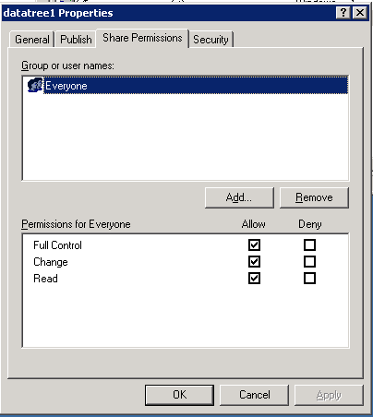
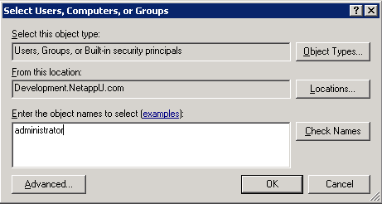
MMC: Managing Share Access (Cont.)
Location of users or groups.
Click the Add button.
Type administrator.
Notes:
3-<number>
(The following continues the setting and deleting of share access.)
In the Share Permissions tab, click the Add button. The Select Users, Computers, or Groups window appears.
In the Enter the object names to select text box, type administrator and click the OK button. The datatree1 Properties window appears, displaying the new share access for the administrator.

Slide 28
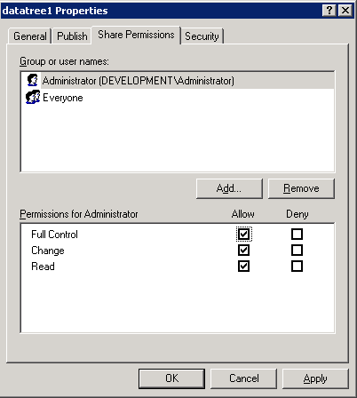
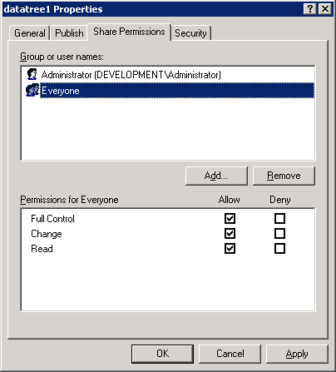
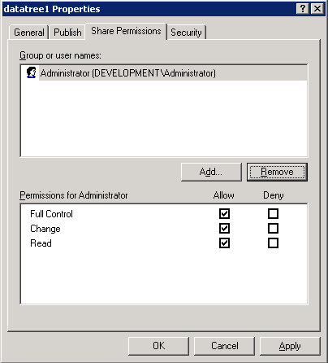
MMC: Managing Share Access (Cont.)
Select Everyone.
Click the Remove button.
Notes:
3-<number>
(The following continues the setting and deleting of share access.)
In the dataree1 Properties window, select Everyone and click the Remove button to delete share access for Everyone.
The datatree1 Properties window displays that the Everyone share access is deleted.

Slide 29
File Permissions

Slide 30
Folder/File Permissions
A storage system stores the NTFS file-level permissions for folders and files.
  Managed only from a Windows client or GPOs
Standard Windows GUI tools display and set permissions.
Manage permissions as you would an NTFS file system on a Windows workstation or server.
Notes:
3-<number>
A storage system stores the NTFS file-level permissions for folders and files. They can be managed from a Windows client only or Group Policy Objects (GPOs).
Standard Windows GUI tools display and set permissions. Manage permissions as you would an NTFS file system on a Windows workstation or server.

Slide 31
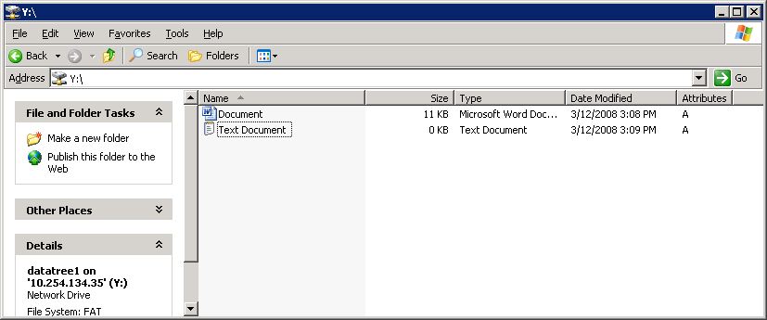
File Permissions of a Mapped Drive
Right-click the file, and choose Properties.
Right-click and choose Properties.
Notes:
3-<number>
To display the file permissions, perform the following steps:
From a mapped network drive, right-click the file.
Choose Properties from the shortcut menu.

Slide 32
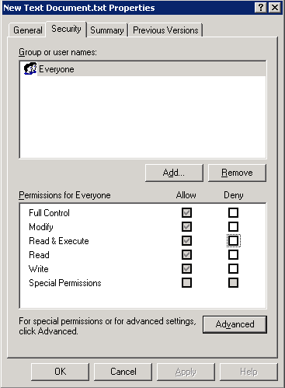
Security Tab
Click the Security tab
The Everyone system group
has full control for permissions,
including Modify, Read & Execute,
Read, Write, and Special Permissions
Notes:
3-<number>
In the file Properties window, click the Security tab.
Note the group and user names and the permissions for the group or user.
Click the OK button.
In this example, the Everyone system group has full control for permissions including Modify, Read and Execute, Read, Write, and Special Permissions.

Slide 33
ABE

Slide 34
Access-based Enumeration
Share permissions conventionally allow users to view shared folders or files regardless of whether the users have access to them
  Causes security risk
Administrators can protect sensitive information using Access-based Enumeration (ABE) option
  cifs shares -change <sharename>
  [-accessbasedenum | -noaccessbasedenum]
  May be set with -add switch when creating shares
  No ABE is the default
Notes:
3-<number>
Conventional share properties allow you to specify which users (individually or in groups) have permission to view or modify shared resources. However, they do not allow you to control whether shared folders or files are visible to users who do not have permission to access them. This could pose problems, if the names of shared folders or files describe sensitive information, such as the names of customers or new products under development.
Access-based Enumeration (ABE) extends share properties to include the enumeration of shared resources. When ABE is enabled on a CIFS share, users who do not have permission to access a shared folder or file underneath it (whether through individual or group permission restrictions) do not see that shared resource displayed in their environment. ABE therefore enables you to filter the display of shared resources based on user access rights.
ABE for a CIFS share on a NetApp storage system can be managed by the CIFS shares option [–accessbasedenum | -noaccessbasedenum].

Slide 35
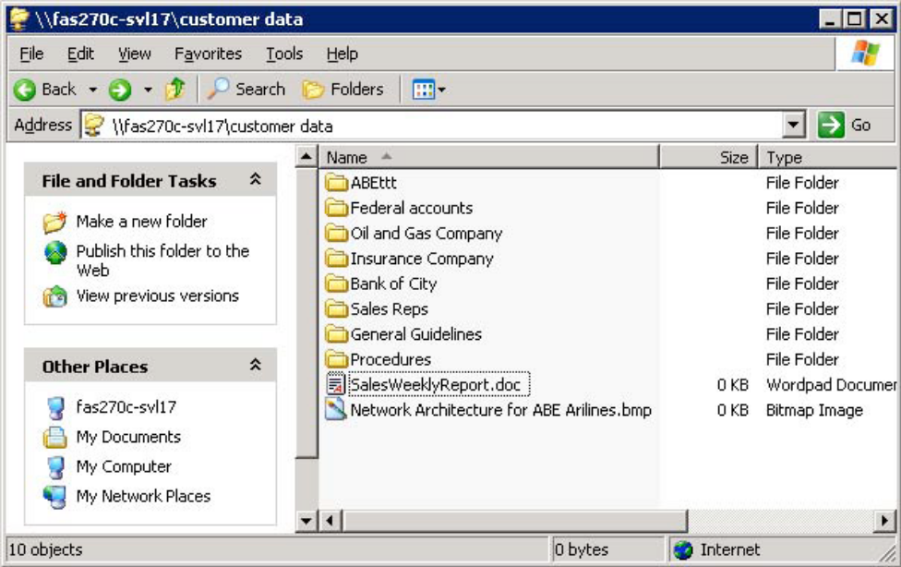
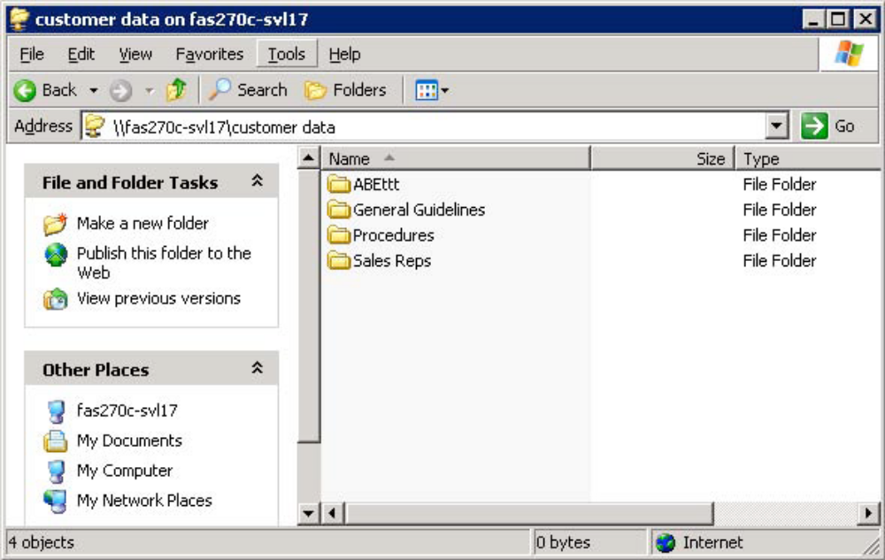
Access-based Enumeration (Cont.)
Without ABE
With ABE
Notes:
3-<number>
The two figures illustrate how ABE affects Data ONTAP directory listing. In the first figure, all the folders under the share “customer data” are visible to the user, even though he or she does not have access to some of the folders containing sensitive information. In the bottom figure, after enabling Access-based Enumeration on this share, users can see only the folders to which they have access.

Slide 36
Multiprotocol
But CIFS users don’t necessarily have to access only NTFS volumes or qtrees
Volumes and qtrees can have either:
  NTFS style ACL permissions
  UNIX style permissions
Having UNIX style permissions does not prevent Windows (CIFS) users from accessing a volume or qtree if Multiprotocol is correctly configured
Notes:
3-<number>

Slide 37
Multiprotocol

Slide 38

Security Style Interaction
For a Windows user to
access:
A NTFS style volume or qtree
  Windows user is tested against NTFS style ACLs
A UNIX style volume or qtree
  Windows user must be mapped to a UNIX UID and GID
Windows HOST
Windows
User and
Group ID
UNIX
User and
Group ID
NTFS
UNIX
Notes:
3-<number>
Note: There is always a user mapping (UNIX user ⬄NTFS user) whether the chosen security style is NTFS or multiprotocol. Even when a Windows client user is accessing data through an NTFS qtree on a storage system with NTFS security style, a user mapping occurs for the Windows client user. Both NTFS and UNIX users are always mapped.

Slide 39

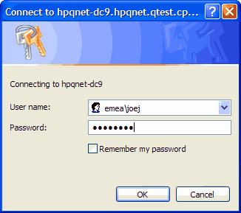
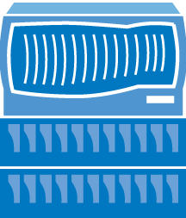
Windows to UNIX User Resolution
Domain
Authenticated
Windows
authenticated
Unauthenticated
Windows
Domain
Controller
Workgroup Authentication
Authenticated by
/etc/registry
Windows
authenticated
Unauthenticated
Storage System
Notes:
3-<number>
When a CIFS user attempts to access a volume or qtree that has UNIX permissions, the user is authenticated with the method by which the CIFS server has previously been configured. If the storage system has been configured for domain authentication, the storage system passes the credentials to the domain controller for proper authentication. The credentials are either authenticated or not. If the storage system has been configured for workgroup authentication, then the storage will authenticate the user via the /etc/registry.

Slide 40
Windows to UNIX User Resolution (Cont.)
If not verified
Check
wafl.default_unix_user
Windows
authenticated
Check mapping
/etc/usermap.cfg
Domain/user => UNIX
If mapping exists,
try mapped user
Verify UNIX user by /etc/passwd,
NIS, or domain
If no mapping,
try Windows user
If mapped to ‘ ‘
Invalid user
User accepted
Notes:
3-<number>
A Windows authenticated user then is looked up in the /etc/usermap.cfg file. Three possibilities are available. The user maybe mapped to a UNIX user, not mapped at all, or mapped to an empty string. If the user is mapped, then the mapped UNIX user is passed to verification. If the user is not mapped, then the authenticated CIFS users name is tried for UNIX verification with all letter lowercased. If the user is mapped to an empty string “ ”, then the user is invalid.
Verification
The storage system will attempt to verify a UNIX user by employing the mechanism as stated in the /etc/nsswitch.conf file. These mechanisms are using /etc/passwd, NIS, and/or LDAP. If verification is unsuccessful, then the option wafl.default_unix_user is tried as a generic user account. A typical default UNIX user is “pcuser” with UID =65534 and GID=65534, which is stored in /etc/passwd file by default. If verification is successful, the CIFS user is properly associated with a UNIX account. If verification is unsuccessful, the CIFS user is invalid.
Window Administrator
The Windows Administrator user is a special case. The administrator is mapped to the UNIX user name “root” with UID=0 and GID= if the wafl.nt_admin_priv_map_to_root option is set “on”.

Slide 41
Windows to UNIX User Resolution (Cont.)
Unauthenticated
or Invalid user
Guest account configured
options
cifs.guest_account
Try
guest
user
Verify
UNIX user by
/etc/passwd,
NIS, or LDAP
Guest user
accepted
Yes
No
Unauthenticated
or Invalid user
rejected
Guest user
rejected
Notes:
3-<number>
Unauthenticated or invalid users still may be allowed access to the resource if options cifs.guest_account is configured. The guest account then is passed to the storage system for UNIX verification that are specified by the /etc/nsswitch.conf file.

Slide 42
Verify Mappings
A Windows-to-UNIX user mapping is kept as part of the CIFS session credential.
  A fresh Windows-to-UNIX user mapping is required only when a new CIFS session is established for a user.
  Use cifs session -s command to verify mapping.
Notes:
3-<number>

Slide 43
Multiprotocol Options
A CIFS user can access the file without disrupting UNIX permissions.
A CIFS user might then attempt to set security restrictions on a file or folder.
  Prior to Data ONTAP 7.2, the CIFS user must have an add-on from the NOW™ site called SecureShare®.
  Data ONTAP 7.2 and later, the CIFS user can manage security directly with cifs.preserve_unix_security
Notes:
3-<number>

Slide 44
Preserving UNIX Permissions
cifs.preserve_unix_security option preserves UNIX permissions as files are edited and saved by Windows applications that perform the following steps:
    Read the security properties of the file
    Create a new temporary file
    Apply those properties to the temporary file
    Rename temporary file with original file name
Windows clients that perform a security query receive a constructed ACL that exactly represents the UNIX permissions
Notes:
3-<number>
Enabling the cifs.preserve_unix_security option preserves UNIX permissions as files are edited and saved by Windows applications that perform the following steps:
Read the security properties of the file.
Create a new temporary file.
Apply those properties to the temporary file.
Then give the temporary file the original file name.
Windows clients that perform a security query receive a constructed ACL that exactly represents the UNIX permissions.

Slide 45
Preserving UNIX Permissions (Cont.)
cifs.preserve_unix_security option
allows manipulation of UNIX permissions by
using the Security tab on a Windows client
  When enabled, UNIX qtrees appear as NTFS volumes
  The default for this option is “off”
NOTE: You cannot change the owner and group from the Windows
Security tab.
Notes:
3-<number>
Enabling the cifs.preserve_unix_security option also allows you to manipulate the UNIX permissions by using the Security tab on a Windows client, or using any application that can query and set Windows ACLs.
When enabled, UNIX qtrees appear as NTFS volumes. The default for this option is off.
Note: You cannot change the owner and group from the Windows Security tab.

Slide 46
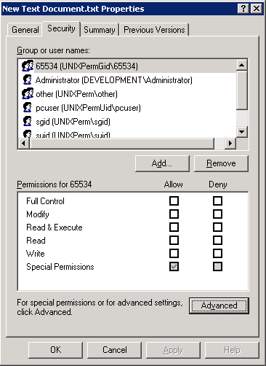
File Permissions with Mapped UNIX User
UNIX credentials are used
when evaluating access
requests by comparing
Windows credentials against
the file or folder’s permissions.
Notes:
3-<number>
In this example, a Windows user is accessing a UNIX file. The Security tab in the file Properties window displays the user’s mapped UNIX credentials.
The UNIX credentials are used when evaluating the user’s access requests by comparing the user’s credentials against the file or folder’s UNIX access permissions.

Slide 47
Module Summary

Slide 48
Module Summary
In this module, you should have learned to:
Create and manage local users for a storage system
Identify how to create a local group and make a local user a member of that group
Use the CLI, FilerView® or Microsoft tools to add, delete, and modify access permissions of shares
Use Microsoft tools to add, delete, and modify access permissions of files and folders
Determine and verify user mappings for CIFS users accessing NTFS and UNIX volumes/qtrees
Notes:
3-<number>

Slide 49
Exercise
Module 4: Access Control
Estimated Time: 30 minutes
Notes:
Please refer to your Exercise Guide for more instruction.

Slide 50
Check Your Understanding
What is the purpose of a local administrator account on a storage system, and why does cifs setup recommend creating one?
What does it mean when a storage system is configured for multiprotocol access?
What command adds local users and groups to the storage system?
Notes:
3-<number>

Slide 51
Answers
Module 4: Access Control
Notes:
Student Notes should state: Please refer to your Exercise Guide for more instruction.

Slide 52
Check Your Understanding – Answers
What is the purpose of a local administrator account on a storage system, and why does cifs setup recommend creating one?
  Local administrator can administer CIFS Access
  the storage system when the domain controller is down
What does it mean when a storage system is configured for multiprotocol access?
  Any file can be accessed by NFS (UNIX users) and CIFS
  (Windows users) protocols
  Both NFS and CIFS must be licensed
What command adds local users and groups to the storage system?
  useradmin
Notes:
3-<number>

