Slide 1
Domains
CIFS Administration on
Data ONTAP 7.3

Slide 2
Module Objectives
By the end of this module, you should be able to:
Terminate the CIFS service to prepare for CIFS domain configuration
Reconfigure the CIFS service for a Windows domain
Identify the resulting files
Create domain users and add the domain users to a local storage system group
Set up Preferred Domain Controllers (DCs)
Notes:
4-<number>

Slide 3

Reconfiguring CIFS

Slide 4
Reconfiguring CIFS
To reconfigure CIFS on a storage system:
  Disconnect users and stop CIFS service:
    cifs terminate
  Reconfigure CIFS service:
    cifs setup
CIFS server restarts with the new configuration
Next we will investigate reconfiguring a storage system for an Active Directory domain
Notes:
4-<number>
To reconfigure CIFS on a storage system:
Disconnect users and stop CIFS service:
cifs terminate
Reconfigure CIFS service:
cifs setup
The storage system automatically attempts to restart the CIFS service with the new CIFS configuration.

Slide 5
CLI cifs setup: AD
cifs setup Windows 2000 (Active Directory)
domain completion
(1) Active Directory domain authentication
(Active Directory domains only)
(2) Windows NT 4 domain authentication
(Windows NT or Active Directory domains)
(3) Windows Workgroup authentication using
the filer's local user accounts
(4) /etc/passwd and/or NIS/LDAP
authentication
Selection (1-4)? [1]:
Notes:
4-<number>
This is an example of the administrator configuring the storage system for a Active Directory (AD) domain.

Slide 6
CLI cifs setup: AD (Cont.)
Windows 2000 completion continued
What is the name of the Active Directory
domain? [development.netappu.com]:
In Active Directory-based domains, it is essential that the filer's time match the domain's internal time so that the Kerberos-based authentication system works correctly.
If the time difference between the filer and the domain controllers is more than 5 minutes, CIFS authentication will fail. Time services currently are not configured on this filer.
Would you like to configure time services? [y]:
Notes:
4-<number>
Active Directory uses a time-based key mechanism. It is important for the domain controller and the storage system to be in sync by five (5) minutes or less.

Slide 7
CLI cifs setup: AD (Cont.)
Windows 2000 completion continued
CIFS Setup will configure basic time services. To continue, you
must specify one or more time servers. Specify values as a
comma or space separated list of server names or IPv4
addresses. In Active Directory-based domains, you can also
specify the fully qualified domain name of the domain being
joined (for example:(“DEVELOPMENT.NETAPPU.COM") and time
services will use those domain controllers as time servers.
Enter the time server host(s) and/or address(es)
[DEVELOPMENT.NETAPPU.COM]:10.254.134.2
[The IP address is for the domain controller or a time server.
It is best to enter the IP address of the main (root) domain
controller for the domain.]
Would you like to specify additional time servers? [n]:
Wed Jun 21 16:28:22 GMT [rc:ALERT]: timed: time daemon started
Notes:
4-<number>
The IP address is for the domain controller or a time server. It is best to enter the IP address of the main (root) domain controller for the domain.
The timed daemon allows the storage system to synchronize its time with external resources.
You need to configure the following:
options timed.max_skew 30m
options timed.proto ntp
options timed.sched hourly
options timed.servers [server_ip_or_name,…]
For a list of available time servers, see http://www.eecis.udel.edu/~mills/ntp/servers.htm
options timed.enable on
options timed.log on

Slide 8
CLI cifs setup: AD (Cont.)
Windows 2000 completion continued
In order to create an Active Directory machine account for the filer, you must supply the name and password of a Windows
account with sufficient privileges to add computers to the DEVELOPMENT.NETAPPU.COM domain.
Enter the name of the Windows user
[Administrator@DEVELOPMENT.NETAPPU.COM]:
[This Windows user is the domain account administrator
that has privileges to join (add) the storage system to the
domain controller.]
Password for Administrator@DEVELOPMENT.NETAPPU.COM:
CIFS -Logged in as Administrator@DEVELOPMENT.NETAPPU.COM.
The user that you specified has permission to create the filer's machine account in several (4) containers. Please choose where you would like this account to be created.
Notes:
4-<number>
This Windows user is the domain account administrator that has privileges to join (add) the storage system to the domain controller.

Slide 9
CLI cifs setup: AD (Cont.)
[The container list displays OUs (Organizational
Units) in which you have permission to create
computer accounts. The list reflects your Active
Directory domain and may contain customized OUs.]
CN=computers
NOTE: CN means Common Name. The storage system is joining as a member server.
(2) OU=Domain Controllers
(3) OU=Additional_OU
(4) OU=sub_Additional_OU,OU=Additional_OU
(5) None of the above
Selection (1-5)? [1]:
Notes:
4-<number>
The container list displays Organizational Units (OUs) in which you have permission to create computer accounts. The list reflects your Active Directory domain structure and may contain customized OUs.

Slide 10
CLI cifs setup: AD (Cont.)
Windows 2000 completion continued
Wed Jun 21 16:29:23 GMT [wafl.quota.sec.change:notice]: security style for /vol/vol0/ changed from unix to ntfs
CIFS - Starting SMB protocol...
It is highly recommended that you create the local administrator account (system\administrator) for this filer. This account allows access to CIFS from Windows when domain controllers are not accessible.
Do you want to create the system\administrator account? [y]:
Enter the new password for system\administrator:
Retype the password:
Notes:
4-<number>
The local administrator account has privileges to administer CIFS on the storage system even if the domain controller is down. The local administration can set up local users on the storage system with the useradmin user add command.

Slide 11
CLI cifs setup: AD (Cont.)
Windows 2000 completion continued
Currently, the user “system\administrator" and members of the group “DEVELOPMENT\Domain Admins" have permission to administer CIFS on this filer. You may specify an additional user or group to be added to the filer's "BUILTIN\Administrators" group, thus giving them administrative privileges as well.
Would you like to specify a user or group that can administer CIFS? [n]:
Wed Jun 21 16:30:18 GMT [nbt.nbns.registrationComplete:info]: NBT: All CIFS name registrations have completed for the local server.
Welcome to the DEVELOPMENT.NETAPPU.COM (DEVELOPMENT) Active Directory(R) domain.
CIFS local server is running.
Notes:
4-<number>

Slide 12
FilerView Setup

Slide 13
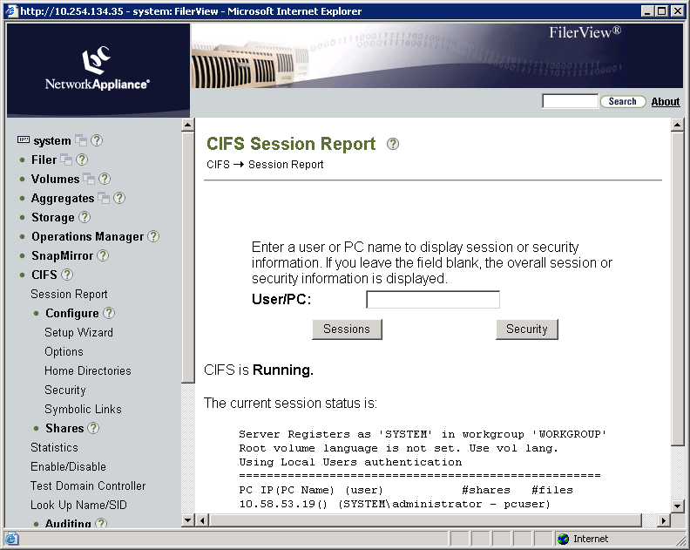
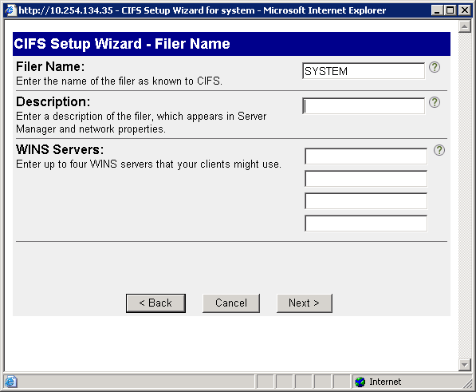
CIFS Setup Wizard
This description is available
from the CLI: cifs comment
Notes:
4-<number>
To start the CIFS Setup Wizard, choose CIFS→Configure→Setup Wizard.
The CIFS Setup Wizard helps you through configuration of your storage system for CIFS access. You may run the wizard at any time to change the settings. CIFS is stopped and restarted upon completion of the wizard.
In the CIFS Setup Wizard – Filer Name window, the name of the storage system appears. You can add a description of the storage system. This description is available from the CLI by typing cifs comment.

Slide 14
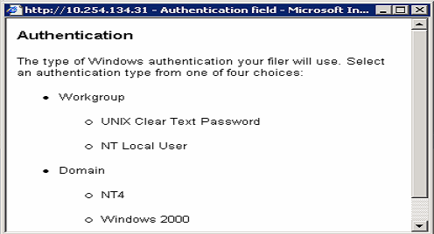
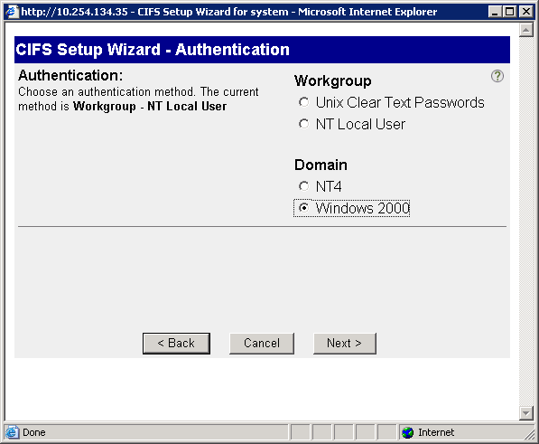
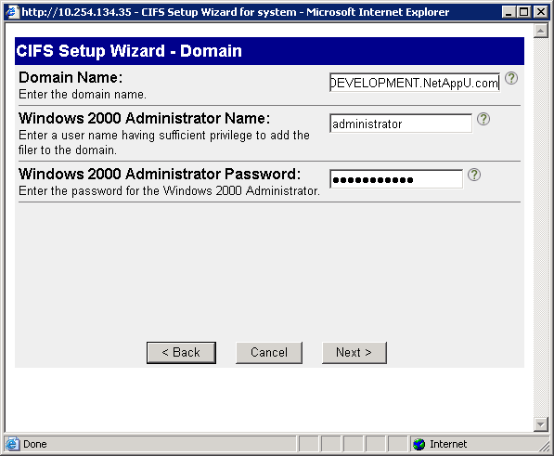
CIFS Setup Wizard (Cont.)
Help (?)
Domain user must have authority to join the storage system to the domain.
Notes:
4-<number>
In the CIFS Setup Wizard – Authentication window, choose an authentication method. You can click ? for help. The Authentication help window shows the four choices for authentication methods:
Workgroup
UNIX Clear Text Password (Non-Windows workgroup)
NT Local User (Windows workgroup)
Domain
NT4 (Windows NT4 domain)
Windows 2000 (Windows Active Directory domain)
For workgroup authentication, enter the name of the workgroup.
For the NT domain authentication, a domain administrator must precreate a machine account for the storage system on the domain controller (Primary Domain Controller) before the storage system joins the domain. Enter the NT4 domain name.
The domain user (administrator) added to the Windows 2000 domain must have the authority (privileges) to join the storage system to the domain. Enter the Windows 2000 (Active Directory) domain name, administrator name, and administrator password.

Slide 15
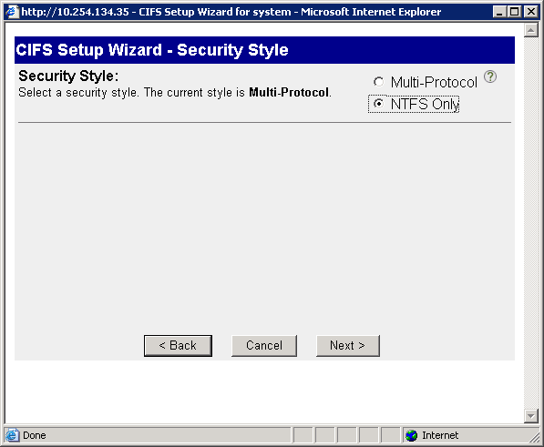
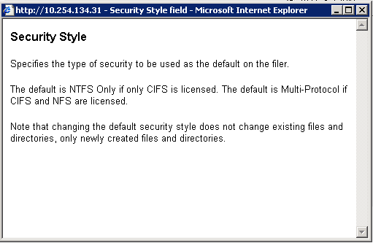
CIFS Setup Wizard (Cont.)
Notes:
4-<number>
In the CIFS Setup Wizard – Security Style window, choose the type of security style to be used as the default on the storage system. The choices are multiprotocol or NTFS-only.
The default security style is NTFS-only if CIFS only is licensed. If both CIFS and NFS are licensed, the default is multiprotocol. Note that changing the default security style does not change existing files and directories, but only the newly created files and directories.

Slide 16
Results

Slide 17
Results
Additional files created in domain environment:
/etc/filersid.cfg
  Contains the storage system SID
/etc/cifssec.cfg
  Contains the Windows domain SID
NOTE: These files are not readable; do not edit the files
Notes:
4-<number>
The /etc/filersid.cfg file is created in a domain environment and contains the storage system security ID (SID).
The /etc/cifssec.cfg file contains the Windows domain controller account information.
Note: These files are not readable; do not edit the files.

Slide 18
lclgroups.cfg Changes
Domain administrators are added to lclgroups.cfg:
system> rdfile /etc/lclgroups.cfg
[ "Replicators" 552 ( "not supported" ) ]
[ "Backup Operators" 551 ( "Members can bypass file security to backup files" ) ]
[ "Power Users" 547 ( "Members that can share directories" ) ]
[ "Guests" 546 ("Users granted Guest Access") ]
[ "Users" 545 ( "Ordinary Users" ) ]
[ "Administrators" 544 ( "Members can fully administer the filer" ) ]
S-1-5-21-265246955-68147109-1151652928-500
S-1-5-21-3723512375-496415379-1150184651-512
Remember use cifs lookup to resolve SIDs
Local Administrator
Domain Admins Group
Notes:
4-<number>

Slide 19
Domain Specific Commands
After configuring the storage system for a
domain environment, do the following:
Display your domain information:
  cifs domaininfo
Test the storage system connection to the Windows domain controller:
  When CIFS has been successfully started and is operational:
    cifs testdc
  When the CIFS subsystem is not running:
    cifs testdc [WINSsvrIPaddress]domainname [storage_sys_name]
Notes:
4-<number>

Slide 20
CLI: cifs domaininfo Command
The following example is output from the cifs
domaininfo command on a storage system in
a domain
system> cifs domaininfo
NetBios Domain: DEVELOPMENT
Windows 2000 Domain Name:development.netappu.com
Type: Windows 2000
Filer AD Site: none
Notes:
4-<number>

Slide 21
CLI: cifs domaininfo Command (Cont.)
Example output from the cifs domaininfo
command (cont.):
Current Connected DCs: \\WIN2K3
Total DC addresses found:2
Preferred Addresses: None
Favored Addresses: None
Other Addresses: 10.0.0.5 WIN2K2 PDC
10.0.0.6 PDC
Connected AD LDAP Server:\\win2k3.netapp.com
Preferred Addresses: None
Favored Addresses: None
Other Addresses: 10.0.0.
win2k3.netapp.com 10.0.0.6 win2k3-2.netapp.com
Notes:
4-<number>

Slide 22
CLI: cifs testdc Command
The following example is output from the cifs testdc
command on a storage system in a domain
system> cifs testdc
Using Established configuration
Current Mode of NBT is B Mode
Netbios scope ""
Registered names...
system < 0> Broadcast
system < 3> Broadcast
system <20> Broadcast
GRUMPY < 0> Broadcast
GRUMPY < 3> Broadcast
GRUMPY <20> Broadcast
HAPPY < 0> Broadcast
HAPPY < 3> Broadcast
HAPPY <20> Broadcast
Notes:
4-<number>

Slide 23
CLI: cifs testdc Command (Cont.)
Output from the cifs testdc command
(cont.):
SNEEZY < 0> Broadcast
SNEEZY < 3> Broadcast
SNEEZY <20> Broadcast
DEVELOPMENT < 0> Broadcast
Testing all Primary Domain Controllers
found 1 unique addresses
found PDC DEVDC01 at 10.254.134.2
Testing all Domain Controllers
found 1 unique addresses
found DC DEVDC01 at 10.254.134.2
Notes:
4-<number>

Slide 24
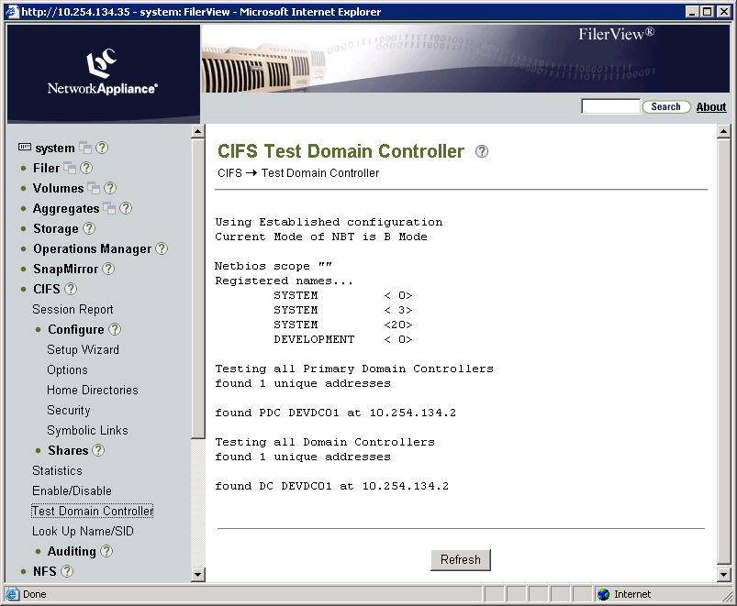
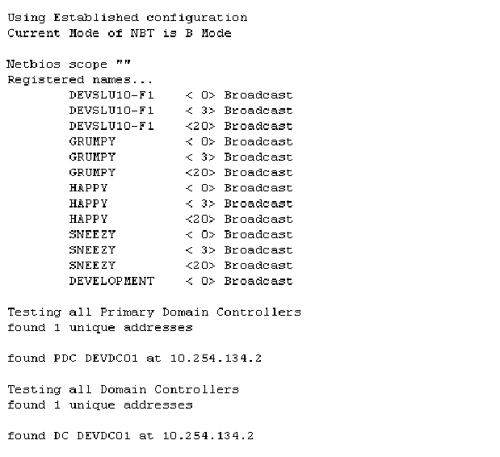
FilerView: CIFS Test Domain Controller
Notes:
4-<number>

Slide 25
Preferred DCs

Slide 26
Preferred DCs
Microsoft domain members use a mechanism called “site awareness” to discover their closest domain controllers within the domain
Storage system administrators can override this default mechanism by setting preferences for other domain controllers
  options cifs.site_awareness.enable off
  cifs prefdc
Notes:
4-<number>
Site awareness, also called site discovery, is the process of automatically discovering the preferred domain controller. By default, a storage system is configured with cifs.stie_awareness.enable turned on. A storage administrator can override this default mechanism by turning the cifs.stie_awareness.enable option to off and setting preferred domain controllers using the cifs prefdc command.

Slide 27
Configuring prefdc List
The cifs prefdc command configures and displays
CIFS preferred domain controller information
To display the preferred domain controller list:
  cifs prefdc print [domain]
To add a preferred domain controller list:
  cifs prefdc add domain address [address…]
To delete a preferred domain controller list:
  cifs prefdc delete domain
system> cifs prefdc print No preferred domain controllers configured.Domain controllers will be automatically discovered.
Notes:
4-<number>
The cifs prefdc command configures and displays CIFS preferred domain controller information.
To display the preferred domain controller list:
cifs prefdc print [domain]
To add a preferred domain controller list:
cifs prefdc add domain address [address…]
To delete a preferred domain controller list:
cifs prefdc delete domain
In the following example, there are no preferred domain controllers configured and domain controllers will be automatically discovered.
system> cifs prefdc print
No preferred Domain Controllers configured.
DCs will be automatically discovered.

Slide 28

DC Ping Ordering
Best!
Specified
by the Admin
Preferred
Determined
by DC Ping
Ordering
Favored
Other
Worst!
Notes:
4-<number>
Most Window server environments have multiple domain controllers. A NetApp storage system contacts domain controller in the following order:
Preferred: Any domain controller(s) configured as preferred with the cifs prefdc command.
Favored: Any domain controller(s) which is determined by site awareness rules to be readily accessible.
Other: Any other domain controller(s) that is reachable.
Note: DC ping occurs every time the CIFS serves starts, every time cifs prefdc is executed and every four hours.

Slide 29
Domain Users

Slide 30
Domain User
Domain user is:
Created in a domain
Authenticated by the domain
Created with the Active Directory Users and Computers tool
Notes:
4-<number>
A domain user is a non-local user who belongs to a Windows domain and is authenticated by the domain. This type of user also can be placed into storage system groups to grant them capabilities on the storage system.
On the Windows workstation, you can create a domain user with the Active Directory Users and Computers tool. The Windows Active Directory Users and Computers tool allows management of users, groups, organizational units, and all other Active Directory objects. You can administer and publish information in the directory.
The following example demonstrates adding a domain user named: Jane Doe.
To create a domain user with the Active Directory Users and Computers Tool, perform the following steps:
1. To open the tool from your Windows workstation, go to Start→Programs→Administrative Tools→Active Directory Users and Computers.

Slide 31
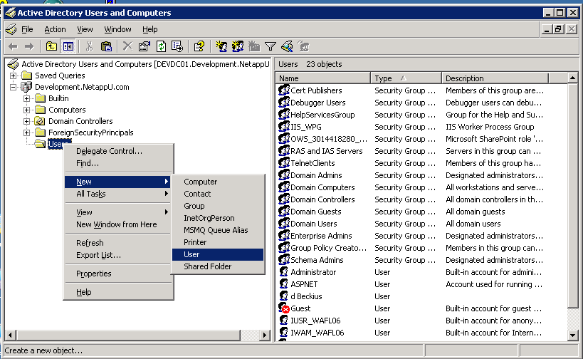
Creating a Domain User
Right-click the
Users folder.
Notes:
4-<number>
2. To add a new domain user, right-click the Users folder and choose New→User.

Slide 32
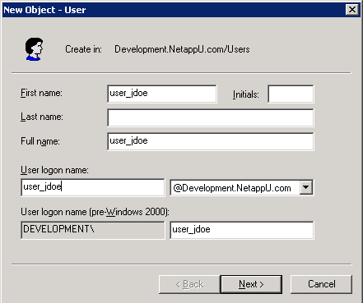
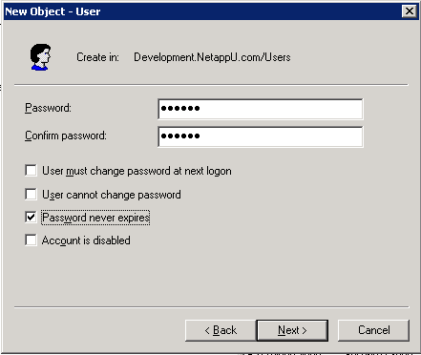
Creating a Domain User (Cont.)
Notes:
4-<number>
3. In the New Object – User window, type the name of the user in the First name, Last name, and Full name text boxes.
In this example, user_jdoe (for Jane Doe) is typed in the First name text box and repeated in the Full name text box.
4. In the User logon name text box, type the user logon of user_jdoe to add the domain user Jane Doe.
5. Click the Next button.
6. In the password window, type the password for Jane Doe and confirm the password.
7. Mark the Password never expires check box for this example.
8. Click the Next button.
9. Click the Finish button to complete adding user_jdoe to the domain.

Slide 33
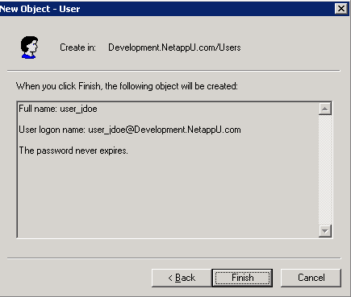
Creating a Domain User (Cont.)
Notes:
4-<number>

Slide 34
Local User Authentication
When the storage system is using CIFS Domain
authentication:
Local user authentication is still possible
Additional MMC functionality is available
  Users:
    Displays a current list of local users only
    Cannot create, delete, or view properties of local users
    Cannot administer passwords
  Groups:
    Can display, create, and delete a group, and add or delete users in the group
    Cannot add or modify roles (and hence, capabilities) for the group
Notes:
4-<number>

Slide 35
Adding Domain Users to Groups
Assign a Windows domain user to a custom or
predefined local group
CLI: useradmin domainuser subcommand
Computer Management (MMC)
useradmin domainuser add win_user_name -g {custom_group|Administrators|"Backup Operators"|Guests|"Power Users"|Users}
Notes:
4-<number>

Slide 36
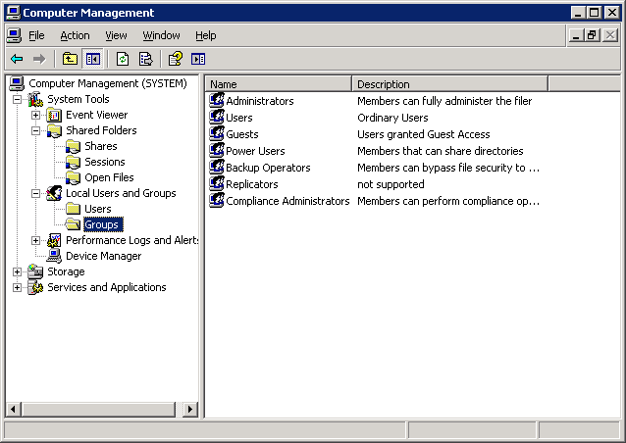
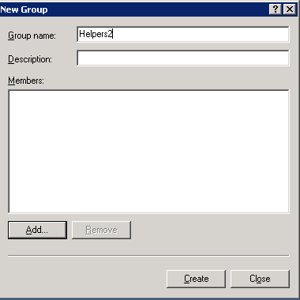

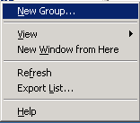
MMC: Groups
Right-click
Groups folder.
Type the Group Name.
Click the Add button to add members.
Choose New Group….
Notes:
4-<number>
As an example with the Windows Computer Management GUI, in the Groups folder, add a new group Helpers2 and add local user Jane to the group by performing the following steps:
1. Go to System Tools→Local Users and Groups→Groups.
2. Right-click the Groups folder and choose New Group.
3. In the New Groups window, in the Group name text box, type the group name Helpers2.
4. Click the Add button to add members to the new group.

Slide 37
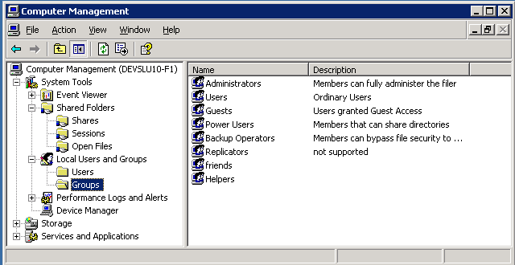
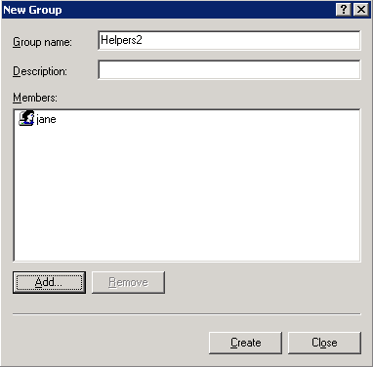
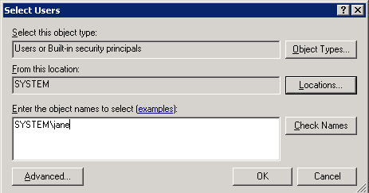
MMC: Groups (Cont.)
Click the Create button, and then click the Close button.
Type the local user Jane, and remember to use the storage_sys_name\user_name format.
Notes:
4-<number>
(The following continues the adding of a new local group.)
5. In the Select User, Computers, or Groups window, use the format of Storage_Sys_Name\user_name and type the local user DEVSLU10-F1\jane.
6. Click the OK button. The New Group window displays and shows the local user Jane as a member.
7. In the New Group window, click the Create button and then click the Close button.

Slide 38
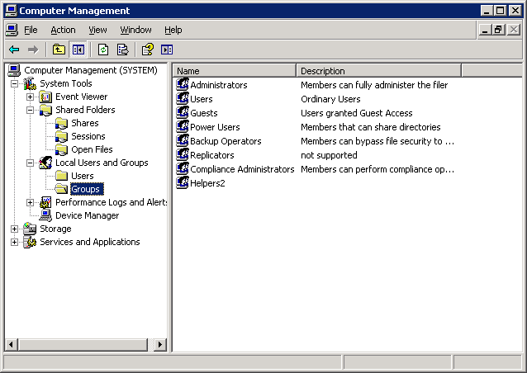
MMC: Groups (Cont.)
Note that the new group
Helpers2 has been added.
Notes:
4-<number>
(The following continues the adding of a new local group.)
8. Note that in the Computer Management GUI, the new group Helpers2 has been added.

Slide 39
Module Summary

Slide 40
Module Summary
In this module, you should have learned to:
Create and manage local users for a storage system
Identify how to create a local group and make a local user a member of that group
Use the CLI, FilerView®, or Microsoft tools to add, delete, and modify access permissions of shares
Use Microsoft tools to add, delete, and modify access permissions of files and folders
Determine and verify user mappings for CIFS users accessing NTFS and UNIX volumes/qtrees
Notes:
4-<number>

Slide 41
Exercise
Module 5: Domains
Estimated Time: 60 minutes
Notes:
Please refer to your Exercise Guide for more instruction.

Slide 42
Check Your Understanding
For which objects can you create shares?
What are three methods used to manage CIFS shares?
CIFS Kerberos-based authentication fails if the time difference between the storage system and the domain controller is more than how many minutes?
Which command or commands allow you to configure the preferred domain controllers?
Notes:
4-<number>

Slide 43
Answers
Module 5: Domains
Notes:
Please refer to your Exercise Guide for more instruction.

Slide 44
Check Your Understanding - Answers
For which objects can you create shares?
  Folders
  Qtrees
  volumes
What are three methods used to manage CIFS shares?
  CLI
  Microsoft Tools such as Computer Management
  FilerView
CIFS Kerberos-based authentication fails if the time difference between the storage system and the domain controller is more than how many minutes?
  Five minutes
Which command or commands allow you to configure the preferred domain controllers?
  cifs prefdc
Notes:
4-<number>
Q2DEV: The editorial guidelines state that a legal attribution paragraph should be included in the notes to the last slide and also on the instructor guide Word document (pg 33 – Presentations (PowerPoint). Should this text (below) be here or is this document an exception?
NetApp, the NetApp logo, Go further, faster, FilerView, and Data ONTAP are trademarks or registered trademarks of NetApp, Inc. in the U.S. and other countries. All other brands or products are trademarks or registered trademarks of their respective holders and should be treated as such.

