Slide 1
Advanced Administration
CIFS Administration on
Data ONTAP 7.3

Slide 2
Module Objectives
By the end of this module, you should be able to:
Configure event auditing
Set up Auto Home Shares for your user-base
Configure Group Policy Objects (GPOs)
Manage CIFS opportunistic locks (oplocks)
Set up virus scanning
Increase security by configuring caching, SMB signing, and the minimum security level
Notes:
5-<number>

Slide 3

Event Auditing

Slide 4
Auditing CIFS Events
Enable auditing of:
  Logon and logoff events
  File access events
    NTFS volumes/qtrees
    MIXED volumes/qtrees
    UNIX volumes/qtrees
      cifs.audit.nfs.enable on
Audit records are recorded in an internal format and then are saved off into an external format for viewing
Notes:
5-<number>
You can enable auditing for the following categories of events:
Logon and logoff events
File access events
These are the prerequisites for auditing file access events:
The file or directory can be audited in a mixed or NTFS volume or qtree
If the cifs.audit.nfs.enable option is on, you can audit events for files in UNIX security-style qtrees
You must activate auditing for individual files and directories according to your Windows documentation
For more information about configuring NFS auditing, please see technical report #3595 at http://www.netapp.com/library/tr/3595.pdf.

Slide 5
Configuring Auditing
To set up CIFS auditing:
  Determine what you are going to audit
  Configure any System ACLs (SACLs) needed
  Set options for CIFS auditing and turn it on
  Save off audit record into .evt file
  Use Microsoft Event Viewer to access the audit record
When you configure Data ONTAP for CIFS auditing, the event log file and settings for all options persist across a reboot or if CIFS is terminated or restarted.
Notes:
5-<number>

Slide 6
Determining What to Audit
To enable auditing for file access events:
  options
  cifs.audit.file_access_events.enable
  on
To enable auditing for logon and logoff events:
  options
  cifs.audit.logon_events.enable on
Notes:
5-<number>
To enable auditing specifically for file access events:
options cifs.audit.file_access_events.enable on
The auditing of file access events is turned on by default and requires that the cifs.audit.enable option is on.
To enable auditing specifically for logon and logoff events:
options cifs.audit.logon_events.enable on
The auditing of logon and logoff events is turned on by default and requires that the cifs.audit.enable option is on.
Note: Auditing settings applies to the entire storage system, not just an individual share or volume.

Slide 7
Setting an SACL for Event Logging
If you desire file access events auditing, you must set a SACL on a file and specify the groups/users/events to monitor.
To set a SACL
  For a volume or qtree:
    Use Storage-Level Access Guard security
  For individual files and directories:
    Use the Windows Properties/Security tab to set the ACL
      Security tab >Advanced > Auditing
    Use Storage-Level Access Guard security
Notes:
5-<number>
System access control lists (SACLs) can be used to enable auditing access on files and directories.
There are three ways to set SACLs for auditing access:
If you want to audit access events on all files and directories within a volume or qtree, it is recommended that you set SACLs by applying Storage-Level Access Guard security. For more information about Storage-Level Access Guard, see the Data ONTAP Fundamentals, Release 7.3 course.
If you want to audit access events on individual files and directories, you can set SACLs in two ways:
Using your Windows Explorer GUI.
Using Storage-Level Access Guard security
Note: Make sure that you select only the events you need to audit, because selecting too many audit options might impact system performance.

Slide 8
Auditing Configuration
Set the location of the saved log file
  options cifs.audit.saveas <path>
Set the log file size
  options cifs.audit.logsize <value>
To enable CIFS auditing on the storage system:
  options cifs.audit.enable on
  The default is CIFS auditing disabled (off)
Notes:
5-<number>

Slide 9
Saving the Audit Record
The audit record is recorded in an internal format.
  /etc/log/auditlog.alf
  Can wrap, resulting in event loss, if not written to external file
The audit record can be saved to an external file
2 ways:
  Manually
    cifs audit save [-f]
  Automatically, on the occurrence of
    File size threshold
      cifs.audit.autosave.onsize.enable
      cifs.audit.autosave.onsize.threshold
    Time interval
      cifs.audit.autosave.ontime.enable
      cifs.audit.autosave.ontime.threshold
    File size threshold and time interval
Notes:
5-<number>

Slide 10
Options for Autosaving
The saved files are automatically named.
Each time the internal log file is saved, an extension is added to the base name of the
  .evt file.
  Counter
    options cifs.audit.autosave.file.extension counter
      Example: If the base file name is evtlog, when an automatic save occurs, the newest evtlog.evt is renamed to evtlog1.evt, the former evtlog1.evt is then renamed to evtlog2.evt, and so on.
  Timestamp
    options cifs.audit.autosave.file.extension timestamp
      basename.YYYYMMDDHHMMSS.evt
Notes:
5-<number>

Slide 11
Options for Autosaving (Cont.)
This option limits the number of files
automatically saved.
The administrator can specify how many files can be saved by the autosave feature; when saved, event files are much larger than the internal .alf files.
To specify the maximum number of .evt files that can be automatically stored (1 to 999):
  options cifs.audit.autosave.limit value
  options cifs.audit.autosave.limit 20
Notes:
5-<number>

Slide 12
View the External Audit File
From a Windows client, you can view audit
events with Microsoft Event Viewer with the
following displays:
Real-time display using Live View (Windows 2000 or later)
  options cifs.audit.liveview.enable
Static display of the event log file
Notes:
5-<number>
Live View
To enable or disable Live View on your storage system, set options cifs.audit.liveview.enable on | off.
From a Windows client, start Event Viewer from Administrative Tools or from MMC.
From the Action menu, select Connect to Another Computer. Enter the name of the storage system you
want to audit and click OK.
On the left side of the application, select the Security entry.
The right side of the application is populated with the latest audit events captured on the storage system (up to
5,000 events).

Slide 13
Auto Home Shares

Slide 14
Auto Home Shares
Auto Home Shares
  Match users by “name” and provide a home directory share automatically
  Save administrators from manually creating home shares for their users
When user logs in, user’s “name” is matched to a home directory path and share becomes available
  Each user can connect to the user’s home directory only, not to the home directories of other users.
  Exception: BUILTIN\Administrators group can access others shares by setting options cifs.homedirs_public_for_admin on
Notes:
5-<number>
You can create user home directories on the storage system and configure Data ONTAP to offer each user a home directory share automatically. Each user can connect to the user’s home directory only, not to the home directories of other users.
The cifs share command does not display the home directories.
To specify the naming style used for matching home directories to users:
options cifs.home_dir_namestyle {ntname | hidden | domain | mapped | “”}
To specify whether members of the storage system BUILTIN\Administrators group can connect to the CIFS home directories of other users:
options cifs.homedirs_public_for_admin on
When you create a user’s folder for the user’s home directory, Data ONTAP automatically searches the paths in the cifs_homedir.cfg file for the user name that matches the login name and dynamically creates the share for that user.

Slide 15
Creating Auto Home Shares
To set up an auto home share:
Configure the parent location of the users’ home directories
Specify the naming style of the home directories
Create individual directories in a home directory path
Access the auto home share
NOTE: The cifs share command does not
display the home directories.
Notes:
5-<number>

Slide 16
Creating Home Directories
Create a parent directory or qtree for the users’ home directories
  Example: /vol/vol1/mktghome
Specify the parent home directory paths by editing the /etc/cifs_homedir.cfg file
  Changes to this file are processed automatically whenever CIFS starts.
  You can also process changes immediately to this file by using the cifs homedir load command.
  The cifs homedir command displays the current list of home directory paths.
Notes:
5-<number>
The /etc/cifs_homedir.cfg configuration file contains the configured home directory paths for users that access the storage system using the CIFS network protocol. For changes to take effect after editing the file, you must run the cifs homedir load command.

Slide 17
Creating Home Directories
This slide is intentionally left blank.
Notes:
5-<number>
DEVSLU10-F1> rdfile /etc/cifs_homedir.cfg
#
# This file contains the path(s) used by the filer to
# determine if a CIFS user has a home directory. See
# the System Administrator's Guide
# for a full description of this file and a full
# description of the CIFS homedir feature.
#
# There is a limit to the number of paths that may be
# specified.
# Currently that limit is 1000.
# Paths must be entered one per line.
After editing this file, use the console command "cifs homedir load“ to make the storage system process the entries in this file.
#
# Note that the "#" character is valid in a CIFS
# directory name. Therefore the "#" character is only
# treated as a comment in this file if it is in the
# first column.
#
# Two example path entries are given below.
# /vol/vol0/users1
# /vol/vol1/users2
# Actual path entries follow this line
/vol/userVol/users

Slide 18
Specify Naming Style
Naming Style
  Determines how Data ONTAP will attempt to match the user to the directory
To specify the naming style used for matching home directories to users:
  options cifs.home_dir_namestyle {ntname | hidden | domain | mapped | “”}
    ntname or “” = \\toaster\jdoe
    hidden = \\toaster\jdoe$
    domain = \\toaster\~marketing~jdoe
    mapped = \\toaster\~jdoe
Notes:
5-<number>
The cifs homedir command displays the current list of home directory paths. The options cifs.home_dir_namestyle command enables you to specify the naming style used for matching home directories to users.
Use ntname if the home directories have the same names as the Window user names.
Use hidden if you want to use a Windows user name with a dollar sign ($) appended to it to initiate a search for a home directory with the same name as the Windows user name.
Use domain if you want to use the domain name in addition to the Windows user name to search for the home directory.
Use mapped if the home directories have the UNIX user names as specified in the usermap.cfg file.
Use “” if you do not want to specify a namestyle and want Data ONTAP to match home directories to users the same way it did before Data ONTAP 6.0
Note: By default, the cifs.home_dir_namestyle option is “”.

Slide 19
Create Users’ Directories
If the namestyle is set to ntname, hidden, mapped or “”, create users’ directories under the home directory path.
  Example: /vol/vol1/mktghome/jdoe
If the namestyle is set to domain, create a domain directory under the home directory path before the user directory.
  Example: /vol/vol1/mktghome/marketing/jdoe
Notes:
5-<number>

Slide 20
Access the Home Directory
Log in as the user
Access the home share by
  Run dialog box from the Start menu
  Map a drive to the share
NOTE: A user may have logins in two domains
  If jdoe is logged in as engineering/jdoe, jdoe sees only the engineering home directory
  To access the marketing domain’s home share, use
    net use * \\toaster\jdoe /user:marketing\jdoe
Notes:
5-<number>

Slide 21
Group Policy Objects

Slide 22
Group Policy Objects
Group Policy Objects (GPOs) are a set of rules that apply to computers in an Active Directory environment.
  While not all GPOs are applicable to your storage system, the storage system recognizes and processes relevant GPOs.
When CIFS and GPOs are enabled on your storage system, Data ONTAP sends LDAP queries to the Active Directory server and requests GPO information.
  If the GPO definitions are applicable to the storage system, the Active Directory server returns the GPO information.
Notes:
5-<number>
Group Policy Objects (GPOs) are a set of rules that apply to computers in an Active Directory environment. While not all GPOs are applicable to your storage system, the storage system recognizes and processes relevant GPOs.
When CIFS and GPOs are enabled on your storage system, Data ONTAP sends Lightweight Directory Access Protocol (LDAP) queries to the Active Directory server and requests GPO information. If the GPO definitions are applicable to the storage system, the Active Directory server returns the GPO information.

Slide 23
Relevant GPOs
The following GPOs are currently supported on
your storage system:
Startup and shutdown scripts
Group Policy refresh interval for computers
File System security policy
Restricted Groups security policy
Event Log
Auditing
Notes:
5-<number>
The following GPOs are currently supported on your storage system:
Startup and shutdown scripts
Group Policy refresh interval for computers
File System security policy
Restricted Groups security policy
Event Log
Auditing

Slide 24
Example of Using GPOs
GPO File System security settings can be
applied directly to Data ONTAP file system
objects (directories or files).
The settings are propagated down the directory hierarchy.
The File System security settings can be applied to mixed or NTFS volumes or qtrees only.
  Cannot be applied UNIX security style
The File System security ACL propagation is limited to about 280 levels of directory hierarchy.
Notes:
5-<number>
You can specify GPO File System security settings directly on Data ONTAP file system objects (directories or files). The settings are propagated down the directory hierarchy, so that when you set a GPO security setting on a directory, the settings are applied to objects within that directory.
The File System security settings can be applied to mixed or NTFS volumes or qtrees only. They cannot be applied to a file or a directory in a UNIX volume or a qtree.
The File System security ACL propagation is limited to about 280 levels of directory hierarchy.

Slide 25
Configuring GPOs
To use GPOs on your storage system:
CIFS is licensed and enabled on the storage system.
CIFS is configured using cifs setup, and the storage system joins a Windows 2000 (or later) domain environment.
GPOs are configured on a Windows Active Directory server by associating a GPO to an Organizational Unit (OU), and then placing the storage system within that OU.
GPO support is enabled on the storage system with options cifs.gpo.enable on.
  When support is enabled the first time, the /etc/ad directory is created as an information repository.
Notes:
5-<number>
To use GPOs on your storage system:
CIFS is licensed and enabled on the storage system.
CIFS is configured using cifs setup, and the storage system joins a Windows 2000 (or later) domain environment.
GPOs are configured on a Windows Active Directory server by associating a GPO to an Organizational Unit (OU), and then placing the storage system within that OU.
GPO support is enabled on the storage system with
options cifs.gpo.enable on.
When support is enabled the first time, the /etc/ad directory is created as an information repository.

Slide 26
CLI GPO Commands
cifs gpresult
  Displays GPOs currently in effect for the storage system and the results of those GPOs
cifs gpupdate
  Updates GPOs on the storage system immediately with the most current Group Policy settings available in the Active Directory domain
Notes:
5-<number>
To display GPOs currently in effect for the storage system and the results of those GPOs, use the cifs gpresult command.
To update GPOs on the storage system immediately with the most current Group Policy settings available in the Active Directory domain, use the cifs gpupdate command.

Slide 27
GPO: Mapping User Home Folders
A “login” GPO in Active Directory can be configured to automatically map the user’s auto home share.
The basic steps are:
  Create an OU
  Create the GPO within the OU
  Create a script and associate it with the GPO
  Test the configuration
Notes:
5-<number>
The corresponding labs provide detail instructions on how to create a GPO to automatically map the user’s auto home share to a network drive. The next several slides are only intended for high-level discussion.

Slide 28
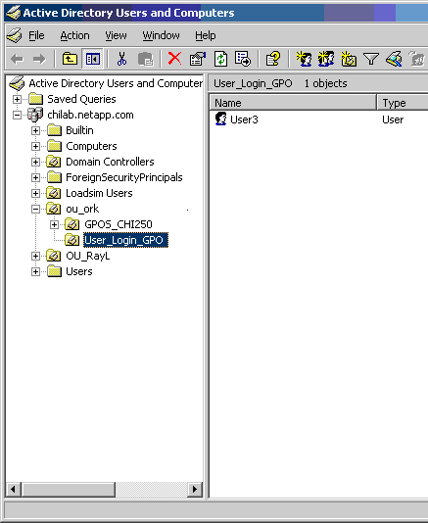
GPO: Mapping User Home Folders (Cont.)
Create an OU
This user has been added to the OU.
This is the new OU.
Notes:
5-<number>

Slide 29
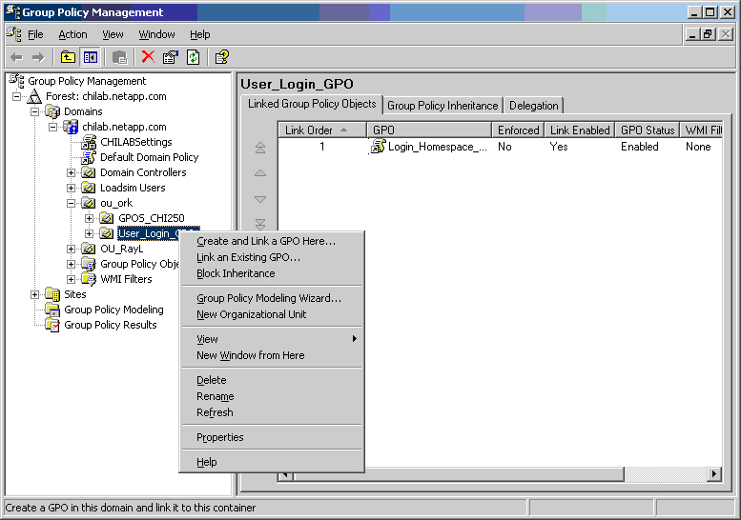
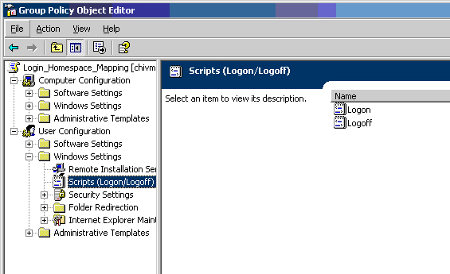
GPO: Mapping User Home Folders (Cont.)
Create the GPO within the OU
Right-click
Select
Notes:
5-<number>
Right-click User_Logon_GPO and select the Properties tab, then select the Create and Link a GPO here… option.
In this example, the Login_Homespace_Mapping GPO has already been created. To edit an existing GPO, right-click the GPO and select Edit to open the Group Policy Object Editor.

Slide 30
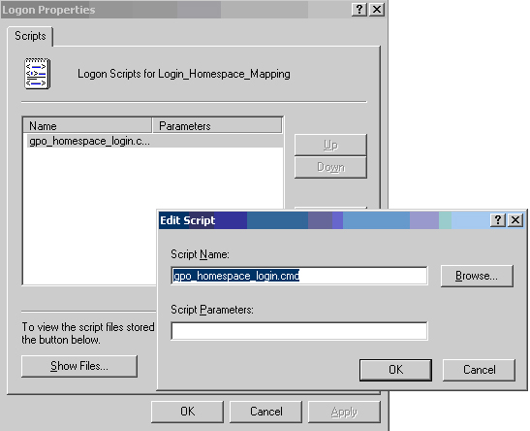
GPO: Mapping User Home Folders (Cont.)
Create a script and associate it with the GPO
Right-click
Notes:
5-<number>

Slide 31
GPO: Mapping User Home Folders (Cont.)
Create the script:
  net use m: \\<storagesystem>\%username%
  NOTE: This assumes ntname or “” namestyle
Place the script in the GPO logon scripts default location.
  C:\Windows\SYSVOL\<domain>\policies\<SID>\user\scripts\logon
Test the configuration.
  Log in as a user and there should be an auto home share mapped to the “m” drive.
Notes:
5-<number>

Slide 32
Oplocks

Slide 33
CIFS Oplocks
CIFS opportunistic locks (oplocks) enable the redirector on a CIFS client in certain file-sharing scenarios to perform client-side caching of read-ahead, write-behind, and lock information.
  A client can then work with a file (read or write it) without regularly reminding the server that it needs access to the file in question.
  This improves performance by reducing network traffic.
CIFS oplocks on the storage system are on by default.
Notes:
5-<number>
CIFS opportunistic locks (oplocks) enable the redirector on a CIFS client in certain file-sharing scenarios to perform client-side caching of read-ahead, write-behind, and lock information.
A client can then work with a file (read or write it) without regularly reminding the server that it needs access to the file in question. This improves performance by reducing network traffic.
CIFS oplocks on the storage system are on by default.

Slide 34
CIFS Oplocks (Cont.)
To set the CIFS protocol oplock setting:
  options cifs.oplocks.enable [on|off]
Setting the cifs.oplocks.enable option:
  OFF
    Disables oplocks on the storage system regardless of the volumes’ or qtrees’ setting
  ON
    Enables oplocks on the storage system if enabled on the volume or qtree
Notes:
5-<number>
To set the systemwide oplock setting:
options cifs.oplocks.enable [on|off]
Setting the cifs.oplocks.enable option has the following effects:
If you set the cifs.oplock.enable option to off, then oplocks are disable on the storage system.
If you set the cifs.oplock.enable option back to on, then CIFS oplocks are enabled if enabled at the volume or qtree level. See qtree status to verify whether oplocks is enabled or disabled for particular volumes or qtrees.

Slide 35
CIFS Oplocks (Cont.)
You might turn oplocks off for one of the following reasons:
  You are using a database application with documentation that recommends oplocks be
  turned off.
  The CIFS clients are on an unreliable network.
  You are handling critical data, and you cannot afford even the slightest data loss.
Otherwise, leave CIFS oplocks on.
To change CIFS oplocks use:
  qtree oplocks [path] {enable|disable}
Notes:
5-<number>
You might turn oplocks off for one of the following reasons:
You are using a database application whose documentation recommends oplocks be turned off.
The CIFS clients are on an unreliable network.
You are handling critical data, and you cannot afford even the slightest data loss.
Otherwise, leave CIFS oplocks on.

Slide 36
Virus Scanning

Slide 37
CIFS Virus Protection
CIFS virus protection:
Provides on-access virus scanning of files on a storage system
Requires a virus-scanning Windows server running compliant antivirus applications
May require a file to be scanned before a CIFS client can open it
Notes:
5-<number>
CIFS virus protection is a Data ONTAP feature that enables a virus-scanning Windows server running compliant antivirus applications to provide on-access virus scanning of files on a storage system.
On-access virus scanning means that a file is scanned before a CIFS client is allowed to open it.

Slide 38
CIFS Virus Scanning
The following steps describe how virus scanning
works:
The scanner (Windows server) registers with the storage system, so no storage system configuration is required.
At the storage system prompt, type the vscan on command to enable scanning.
The scanner waits for requests to come from the storage system.
  Several scanners can register with the storage system. This is recommended for performance and reliability.
  A single scanner can scan multiple storage systems.
The scanner pings the storage system from time to time to detect and recover from reboots and takeovers.
Notes:
5-<number>
The following steps describe how virus scanning works:
The scanner (Windows server) registers with the storage system, so no storage system configuration is required.
At the storage system prompt, type the vscan on command to enable scanning.
The scanner waits for requests to come from the storage system.
Several scanners can register with the storage system. This is recommended for performance and reliability.
A single scanner can scan multiple storage systems.
The scanner pings the storage system from time to time to detect and recover from reboots and takeovers.

Slide 39



Virus-Scanning Process
Client requests a file
Storage system requests scanner to scan file
Scanner returns a go or no-go reply
  If file is go, the storage system allows access.
  If file is no-go, storage system denies access.
Scanner
Storage System
Ethernet
Client
Notes:
5-<number>
The client requests a file.
The storage system requests the scanner to scan the file.
The scanner returns a go or no-go reply
If a file is go, the storage system allows access.
If a file is no-go, the storage system denies access.

Slide 40
vscan Commands
vscan help | List of virus-scanning commands
vscan extensions | Specify files to check or ignore for viruses
vscan off | Disable virus scanning
vscan on | Enable virus scanning
vscan options | Set timeout value, mandatory scan, and Client MsgBox
vscan reset | Reset cache of already-scanned files
vscan scanners | Manage scanning clients
Notes:
5-<number>
The following is a list of vscan commands and their meanings:
vscan help List virus-scanning commands
vscan extensions Specify files to check or ignore for viruses.
vscan off Disable virus scanning.
vscan on Enable virus scanning.
vscan options Set timeout value, mandatory scan, and Client MsgBox.
vscan reset Reset cache of already-scanned files.
vscan scanners Manage scanning clients.

Slide 41
Client MsgBox
There are three “styles” of MsgBox:
“Attempt to scan modified file failed.”
  Your machine is probably the source of the virus.
“Attempt to scan file failed.”
  Your Windows workstation is probably innocent, but it has attempted to open an infected file.
“Could not scan file and storage system is configured to deny access.”
  vscan “mandatory_scan” is set, and no scanners are available to scan files.
Notes:
5-<number>
There are three “styles” of MsgBox:
“Attempt to scan modified file failed.”
Your machine is probably the source of the virus.
“Attempt to scan file failed.”
Your Windows workstation is probably innocent, but it has attempted to open an infected file.
“Could not scan file and storage system is configured to deny access.”
The vscan “mandatory_scan” is set, and no scanners are available to scan files.

Slide 42
Secondary Scanners
Actual virus scanning is done by an attached antivirus scanner, running on a Windows server.
All scanners are primary scanners unless explicitly made a secondary.
The secondary scanner’s main purpose is to act as a hot standby in case the primary goes down.
Storage system will not use the secondary scanner unless there are no primary scanners available.
To turn on secondary scanners:
  system> vscan scanners secondary_scanners IP1[,IP2…]
  system> vscan scanners secondary_scanners 10.1.2.3,10.2.3.4
Notes:
5-<number>
Actual virus scanning is done by an attached antivirus scanner, running on a Windows server. All scanners are primary scanners unless explicitly made secondary.
The secondary scanner’s main purpose is to act as a hot standby in case the primary goes down. The storage system will not use the secondary scanner unless there are no primary scanners available.
To turn on secondary scanners:
storage_sys> vscan scanners secondary_scanners IP1[,IP2…]
storage_sys > vscan scanners secondary_scanners 10.1.2.3,10.2.3.4

Slide 43
Setting Up Virus Scanning
Turn on vscan
  vscan on
Set vscan extension
  vscan extensions include
  vscan extensions exclude
Set vscan options
  vscan options timeout [seconds]
  vscan mandatory_scan [on | off]
  vscan client_msgbox [on | off]
Set up secondary scanners
  vscan scanners secondary_scanners [IP,…]
Notes:
5-<number>
NOTE: Primary scanners “attach” to the storage system automatically and will appear in the list of available scanners by using the vscan scanners command. Administrators may designate primary scanners as secondary or designate a secondary back to a primary scanner.

Slide 44
vscan Options for CIFS Shares
cifs shares -add <sharename> <path>
  [novscan]
  [novscanread]
  Example: cifs shares –add engineering /vol/vol0 –novscan
cifs shares –change <sharename> <path>
  [novscanread|vscanread]
  [vscan|novscan]
  Example: cifs shares –change engineering /vol/vol0 -novscanread
Notes:
5-<number>

Slide 45
File Scanning
File Policies (FPolicy)
  Allows administrators to create file policies that specify file operation permissions according to file type
  Example: Restrict .jpg and .mpg files from being stored on a storage system
FPolicy is enabled two ways:
  Using third-party file screening software
    Can be located at www.netapp.com/partners
  Using native file blocking
Notes:
5-<number>
You use file screening to specify files or directories with restrictions to be placed on them.
Upon receiving a file operation request (such as open, write, create, or rename), Data ONTAP checks its file screening policies before permitting the operation.
A file screening policy determines how the storage system handles requests from individual client systems for operations such as open, rename, create, and delete.

Slide 46
Triggering Operations
Operations that can trigger a file policy:
create
open
write
rename
delete
close
create_dir
getattr
link
lookup
read
rename_dir
setattr
symlink
Notes:
5-<number>

Slide 47
Third-Party File-Screening Process
Client requests a file.
Storage system consults the screen server.
Screen server responds as follows:
  If file is OK, storage system allows access.
  If a file is denied, storage system denies access.
File Screen Server
Storage System
Ethernet
Possible operations controlled by file screening are creation of a new file, opening an existing file, and renaming a file.
Client
Notes:
5-<number>

Slide 48
Configuring FPolicy
To enable FPolicy:
Turn the feature on
  options fpolicy.enable on
Create a file policy
  fpolicy create <PolicyName> screen
    Screen is the only supported policy type
Add/remove extensions and options to the file policy
Set up a file policy monitor
Enable the file policy
  fpolicy enable <PolicyName>
Notes:
5-<number>

Slide 49
Blocking MP3s Example
To block MP3s on a storage system:
  fpolicy create mp3blocker screen
    Creates the FPolicy
  fpolicy ext inc set mp3blocker mp3
    Adds the extension mp3 to the FPolicy
  fpolicy options mp3blocker required on
    Requires FPolicy to be implemented
  fpolicy monitor set mp3blocker -p cifs,nfs create,rename
    Assigns FPolicy to create and rename operation over CIFS and NFS traffic
  fpolicy enable mp3blocker -f
    Turns it on
Notes:
5-<number>
This is intended as a high-level discussion. The corresponding labs have detailed instructions on how to implement this example.

Slide 50
Security

Slide 51
Security
Security is always a concern.
NetApp® provides several mechanisms to increase security within the CIFS protocol:
  Disable share caching
  Enable SMB signing
  Set minimum security level
Notes:
5-<number>

Slide 52
Share Caching
Administrators can configure caching by using a share property:
  Enable manual caching (default)
    cifs shares -change sharename
    -manual_caching
  Enable automatic caching of documents
    cifs shares -change sharename
      -auto_document_caching
  Enable automatic caching of programs
    cifs shares -change sharename
      -auto_program_caching
To increase security:
  Disable caching
    cifs shares -change sharename -nocaching
Notes:
5-<number>
Client-side caching enables Windows clients to cache files on a share so that the files are available for offline use. Client-side caching can be specified from the storage system or from a Windows 2000, XP, 2003, Vista, or 2008 client. A shared folder caching policy can be set to the following options:
Manual caching is enabled by default for new shares.

Slide 53
SMB Signing
SMB Signing helps to ensure secure network traffic between clients and storage system.
If enabled, the storage system will sign if client requires it.
Client SMB policies are set through Security Settings using MMC.
The two SMB policies are:
  Microsoft Network client: Digitally sign communications (if server agrees)
  Microsoft Network client: Digitally sign communications (always)
Notes:
5-<number>
Data ONTAP supports Server Message Block (SMB) signing when requested by the client. SMB signing helps to ensure that network traffic between the storage system and the client has not been compromised by preventing replay attacks (also known as “man in the middle” attacks).
[Continues on next page.]
When SMB signing is enabled on the storage system, it is the equivalent of the Microsoft Network server policy "Digitally sign communications (if client agrees)". It is not possible to configure the storage system to require SMB signing communications from all clients, which is the equivalent of the Microsoft Network server policy "Digitally sign communications (always)." SMB signing is disabled by default on the storage system for performance reasons.
A client SMB signing policy is set through Security Settings using a Microsoft Management Console (MMC). The two SMB signing Policies are:
Microsoft Network client: Digitally sign communications (if server agrees). This setting controls whether or not the client’s SMB signing capability is enabled. It is enabled by default. When this setting is disabled on the client, the client communicates normally with the storage system without SMB signing, regardless of the SMB signing setting on the storage system. When this setting is enabled on the client
If SMB signing is enabled on the storage system, all communications between client and storage system use SMB signing.
If SMB signing is not enabled on the storage system, communications proceed normally without SMB signing.

Slide 54
SMB Signing
This slide is intentionally left blank.
Notes:
5-<number>
Microsoft Network client: Digitally sign communications (always). This setting controls whether the client requires SMB signing to communicate with a server. It is disabled by default. When this setting is disabled on the client, SMB signing behavior is based on the policy setting for “Digitally sign communications (if server agrees)” and the setting on the storage system. When this setting is enabled on the client
If SMB signing is enabled on the storage system, all communications between client and storage system use SMB signing.
If SMB signing is not enabled on the storage system, the client rejects communication with it.
Note: If your environment includes Windows clients configured to require SMB signing, you must enable SMB signing on the storage system. If you do not, the storage system cannot serve data to these systems.

Slide 55
SMB Signing Configuration
Configuring SMB Signing
  options cifs.signing.enable [on|off]
  Off by default
NOTE: Enabling SMB signing will significantly impact performance.
Most Windows clients will negotiate SMB signing by default if enabled on the server.
Notes:
5-<number>

Slide 56
Minimum Security Level
Administrators can require a certain level to be negotiated between client and a storage system.
  options cifs.LMCompatibilityLevel
  This option takes values from 1-5:
    LM, NTLM, NTLMv2 session security, NTLMv2, Kerberos (Default)
    NTLM, NTLMv2 session security, NTLMv2, Kerberos
    NTLMv2 session security, NTLMv2, Kerberos
    NTLMv2, Kerberos
    Kerberos only
Clients not willing to communicate at the required level are denied.
Notes:
5-<number>
Windows servers can set policies to define the minimum level of security that they support when clients connect. Data ONTAP administrators can configure the storage system to deny requests from clients that are attempting to use a security level lower than the defined minimum.
Data ONTAP 7.3 provides an option that sets the minimum security level similar to the way Microsoft’s registry variable provides this setting:
LMCompatibilityLevel:
level 0 - accept anything (default)
level 1 - LM, NTLM, NTLMv2, Kerberos
level 2 - NTLM, NTLMv2, Kerberos
level 3 - NTLMv2, Kerberos
level 4 - Kerberos only
When Data ONTAP is processing an NTLM authentication token or a Kerberos ticket from a client, the value of this option will determine if the client request will be allowed or denied.
When option cifs.LMCompatibilityLevel is enabled, the following EMS message will be displayed when Data ONTAP rejects an authentication request:
Login rejected, This type of LM/NTLM response is not accepted with current value of cifs.LMCompatibilityLevel.

Slide 57
Module Summary

Slide 58
Module Summary
In this module, you should have learned:
Logon/Logoff and file access events may be audited on a storage system
Auto home shares allows administrators to set up user home directories without creating individual shares
Group Policy Objects allows highly configurable policies with an Active Directory domain
Oplocks provide a write-behind, read-ahead mechanism that is usually suitable for most environments
Virus scanning allows management of undesirable filesIncrease security by disabling caching, turn on SMB signing and set a minimum level of security
Notes:
5-<number>

Slide 59
Exercise
Module 6: Advanced Administration
Estimate Time: 90 minutes
Notes:
Please refer to your Exercise Guide for more instruction.

Slide 60
Check Your Understanding
What triggers can be set to autosave the event file?
What command(s) is/are used to reload the CIFS GPOs?
What command(s) is/are used to configure virus scanning on a storage system?
Name three operations a FPolicy can be configured to monitor.
Share caching is disabled by default. True/False
Notes:
5-<number>

Slide 61
Answers
Module 6: Advanced Administration
Notes:
Student Notes should state: Please refer to your Exercise Guide for more instruction.

Slide 62
Check Your Understanding – Answers
What triggers can be set to autosave the event file?
  File size threshold
  Time interval
  Both
What command(s) is/are used to reload the CIFS GPOs?
  cifs gpupdate
  cifs restart
Notes:
5-<number>

Slide 63
Check Your Understanding – Answers
What command(s) is/are used to configure virus scanning on a storage system?
  vscan
Name three operations a FPolicy can be configured to monitor.
  all, none, close, create, cre_ate_dir, delete,
  delete_dir, getattr, link, lookup, open, read,
  rename, rename_dir, setattr, symlink, write
Share caching is disabled by default.
  True/False
  False
Notes:
5-<number>

