Slide 1

Artificial Intelligence und Deep Learning in Python

Slide 2
Reinforcement Learning
Policy Iteration Algorithm

Slide 3
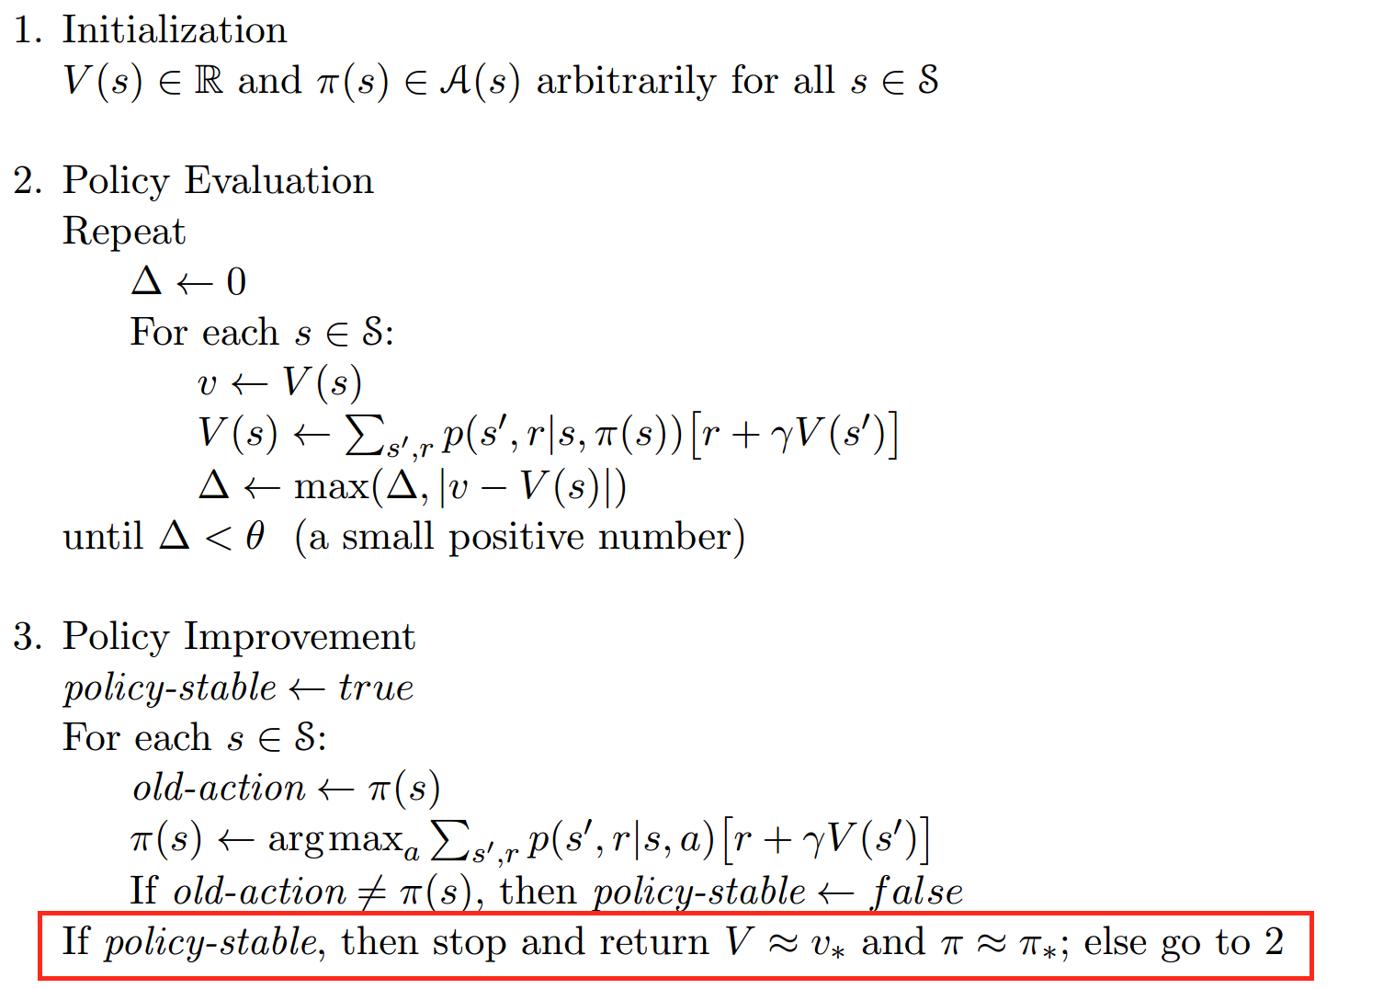
Reinforcement Learning
Policy Iteration Algorithm
Quelle: Sutton & Barto: Reinforcement Learning

Slide 4
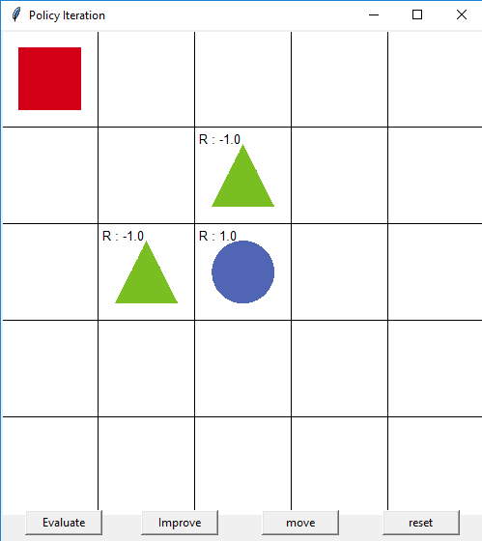
Reinforcement Learning
Grid World Environment

Slide 5
Reinforcement Learning
Policy Iteration Algorithm
Policy-based: Wir wollen die Policy berechnen
On-policy: Wir lernen auf aktuellen Episoden

