Slide 1

Artificial Intelligence und Deep Learning in Python

Slide 2
Convolutional Neural Network
Parameter
Conv Layer:
Number of Filters
Filter Size
Stride
Padding
Pooling Layer:
Pool Size
Stride
Padding

Slide 3
Convolutional Neural Network
Conv Layer
Filter Size: 3x3
Padding = “SAME”
Stride = (1, 1)
Quelle: Vincent Dumoulin, Francesco Visin - A guide to convolution arithmetic for deep learning

Slide 4
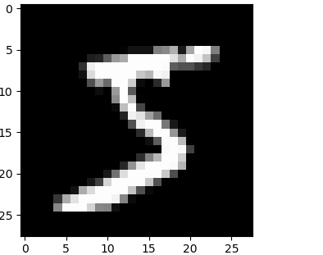
Convolutional Neural Network
Conv Layer

Slide 5
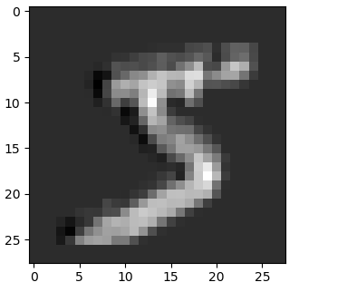
Convolutional Neural Network
Conv Layer

Slide 6
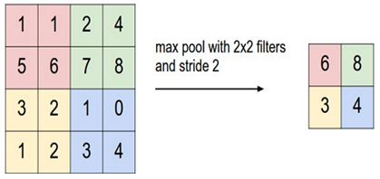
Convolutional Neural Network
Pooling Layer
Filter Size: 2x2 (Standard)
Padding = “VALID” (Standard)
Stride = Filter Size (Standard)
Quelle: http://cs231n.github.io/convolutional-networks/

Slide 7
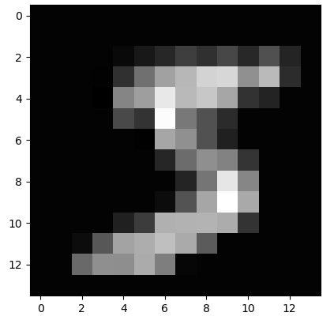
Convolutional Neural Network
Pooling Layer
Quelle: http://cs231n.github.io/convolutional-networks/

