Slide 1

Computer Science 101

Slide 2
JAN SCHAFFRANEK

Slide 3
Who am I
M.Sc. Applied Computer Science (Machine Learning)
Working as an algorithm engineer at ZF for autonomous driving
Instructor on Udemy since December 2017

Slide 4
Computer Science 101

Slide 5
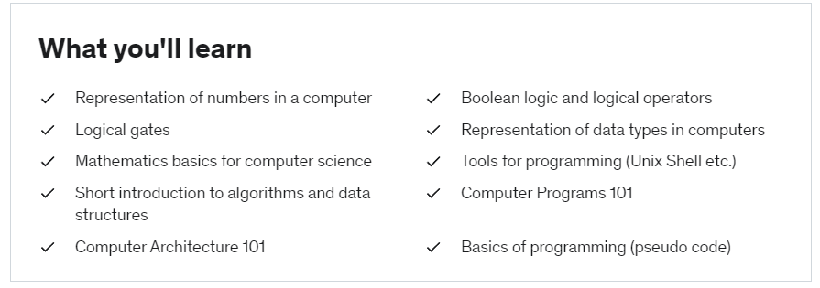

Slide 6
