Slide 1

Deep Learning und AI: Generative Adversarial Networks (GAN)

Slide 2
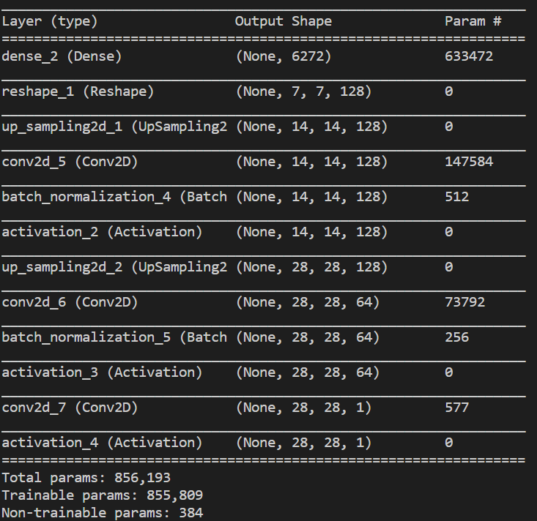
Deep Convolutional Generative Adversarial Networks
Das Generator Netzwerk

Slide 3
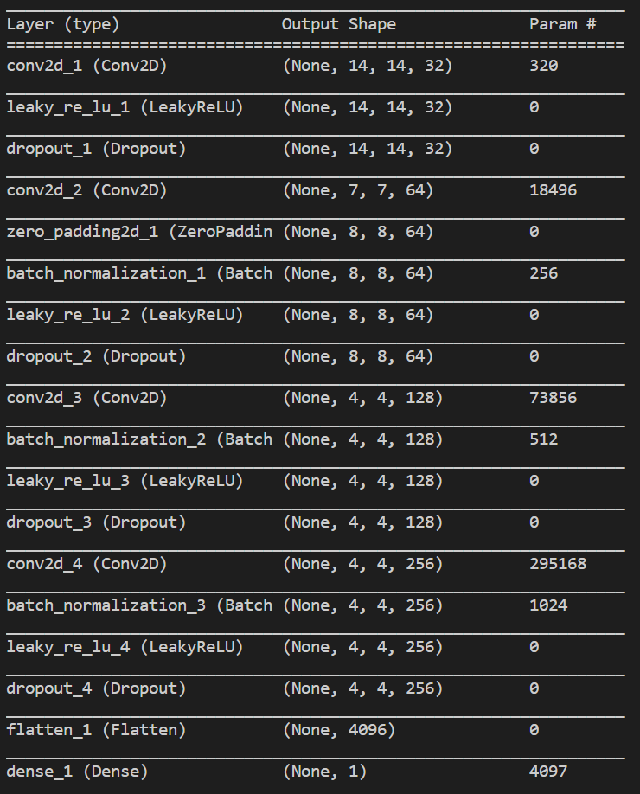
Deep Convolutional Generative Adversarial Networks
Das Discriminator Netzwerk

