Slide 1

Deep Learning und AI: Generative Adversarial Networks (GAN)

Slide 2
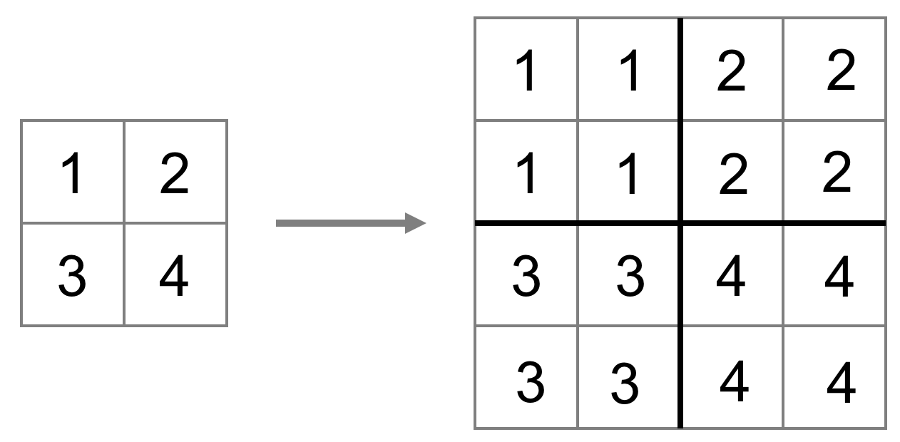
UpSampling
Quelle: Vincent Dumoulin, Francesco Visin - A guide to convolution arithmetic for deep learning

Slide 3
Transposed Convolution
Quelle: Vincent Dumoulin, Francesco Visin - A guide to convolution arithmetic for deep learning

