Slide 1
Computer Architecture 101

Slide 2
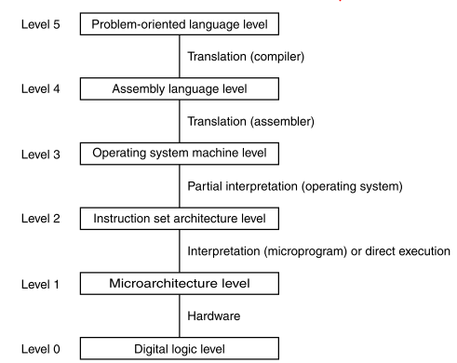
Levels of Abstraction

Slide 3
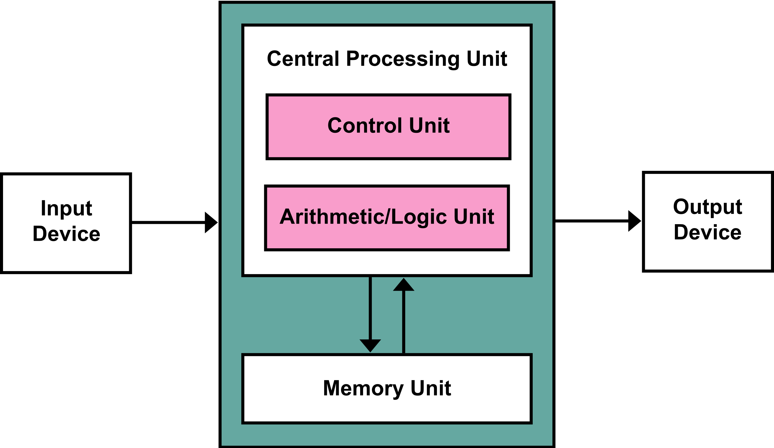
Von-Neumann Computer
Source: https://en.wikipedia.org/wiki/Von_Neumann_architecture#/media/File:Von_Neumann_Architecture.svg

Slide 4
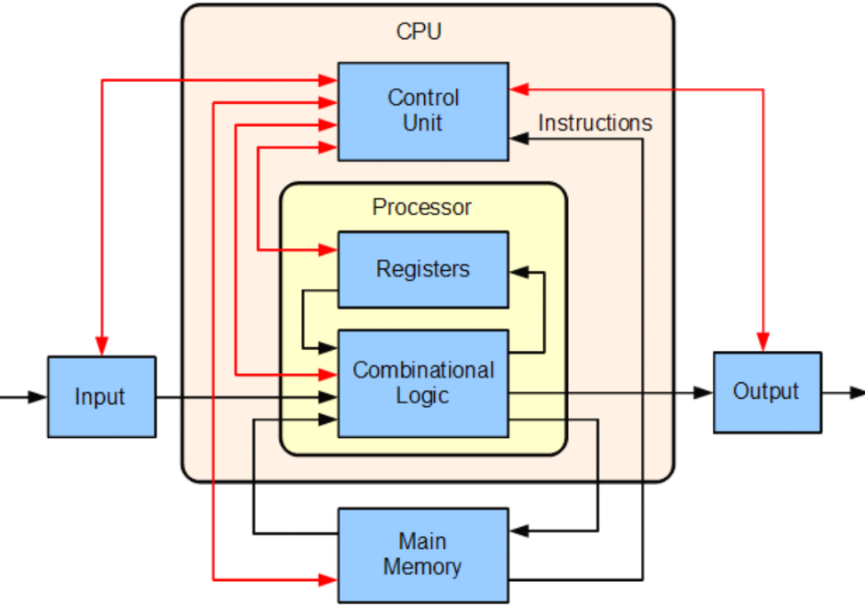
More detailed

Slide 5
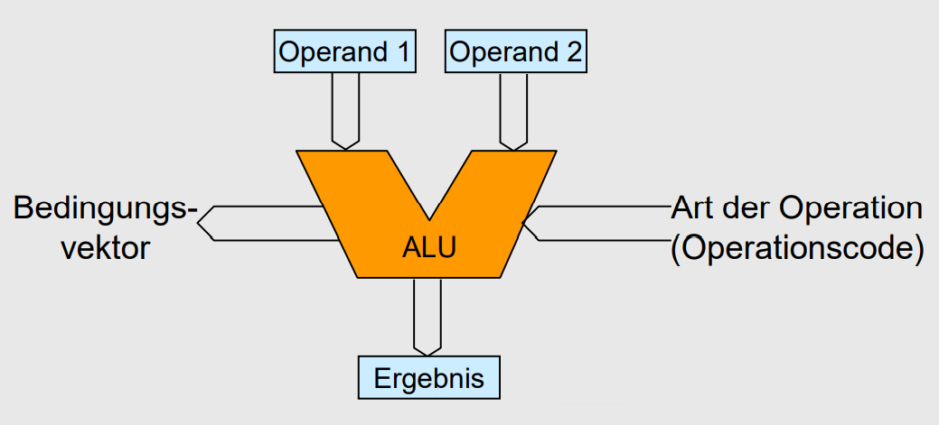

ALU – Arithmetic Logical Unit

Slide 6
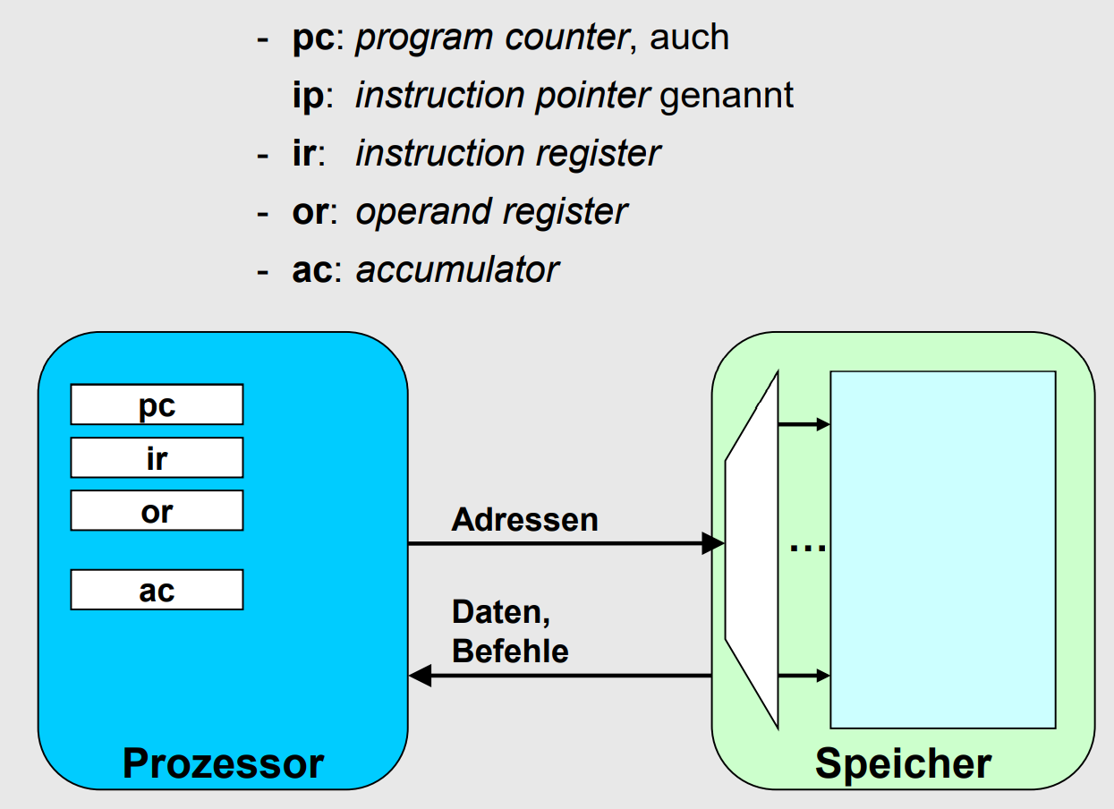



Execute Instructions

Slide 7
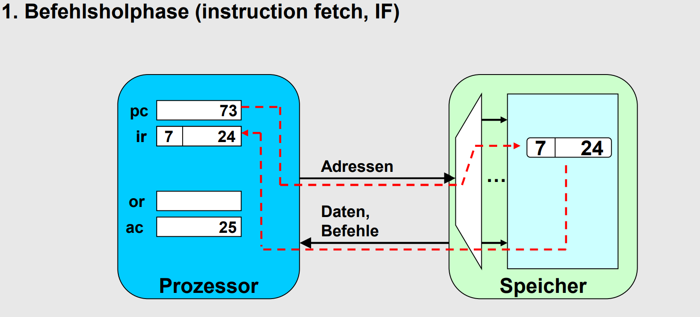



Slide 8
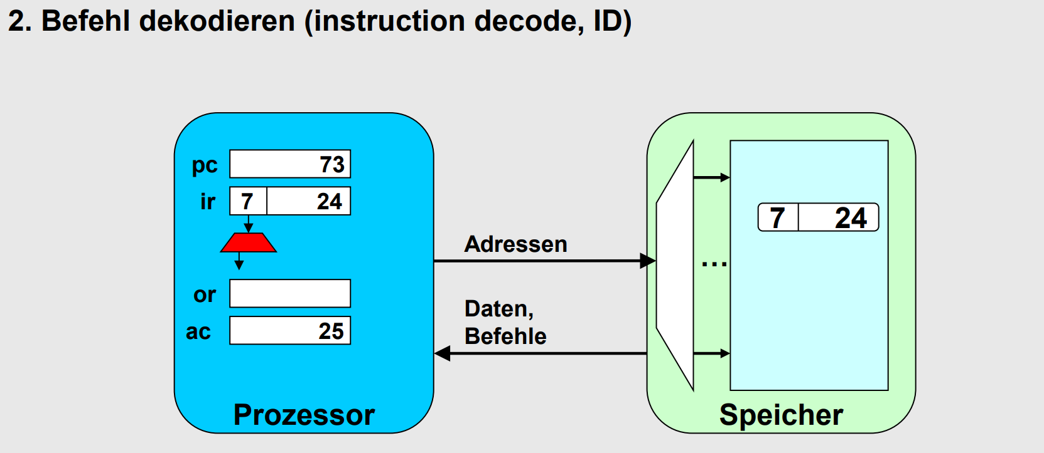



Slide 9
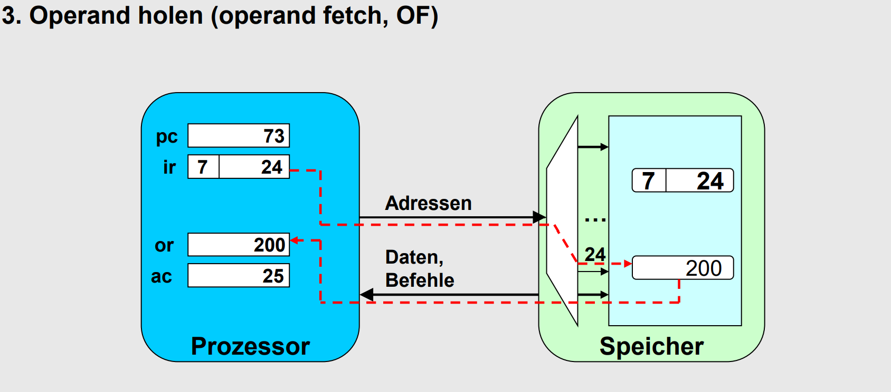



Slide 10

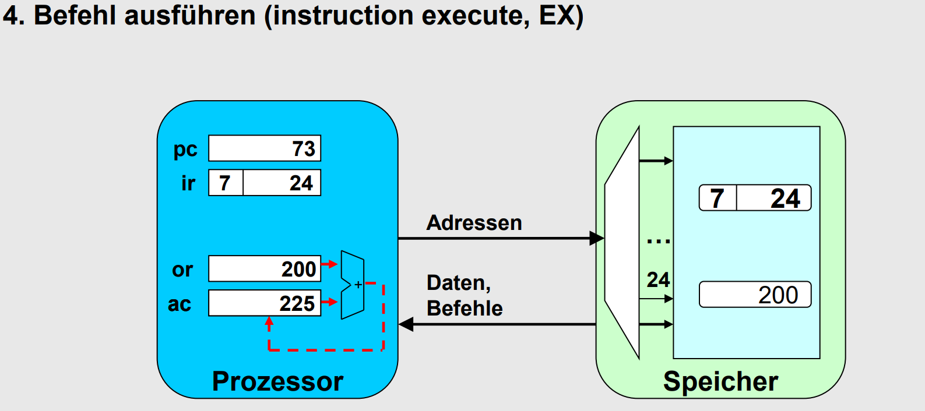



Slide 11
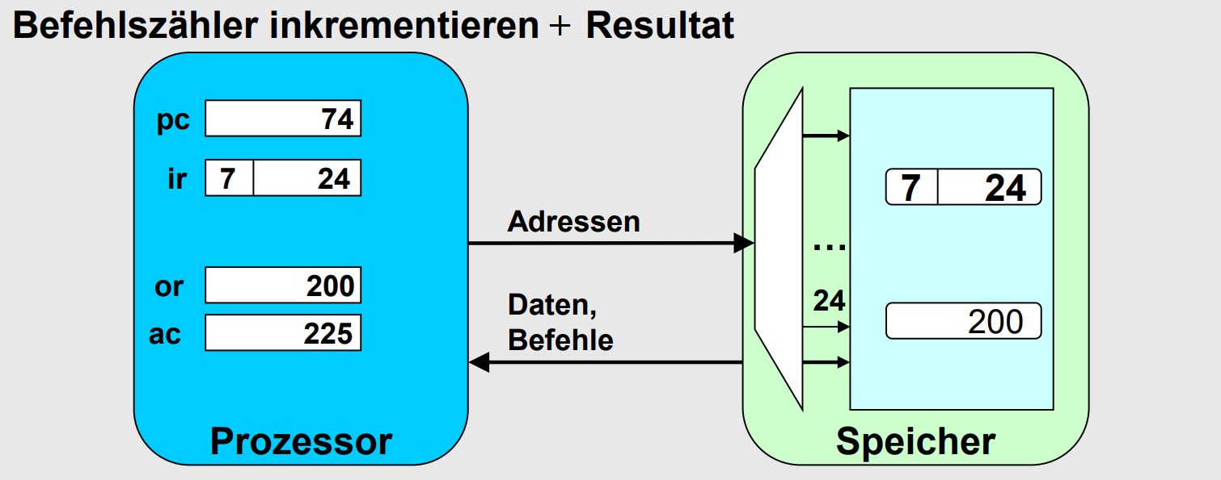

Slide 12
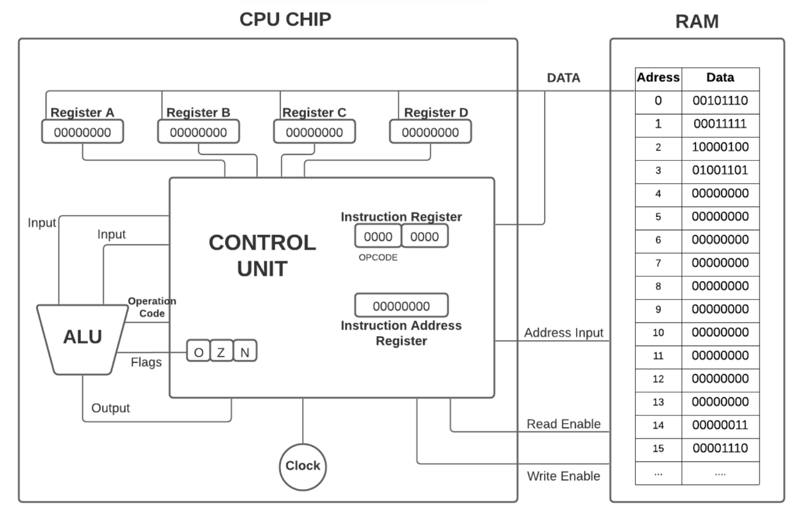
In the next Video…

Slide 13
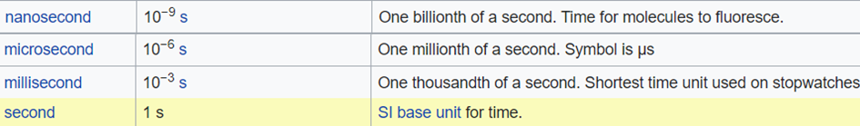
Time Intervals

Slide 14
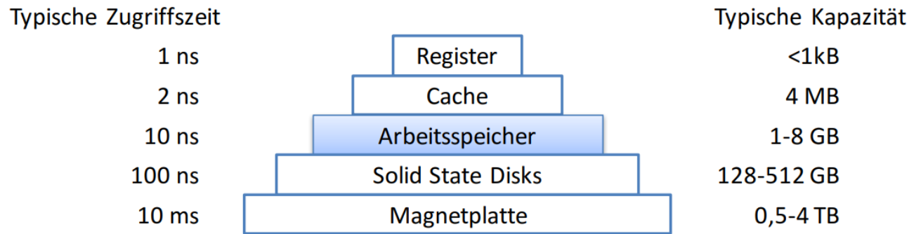

Computer Memory
REGISTER
CACHE
RAM
SSD
HDD

