Slide 1
Programming Language 101

Slide 2
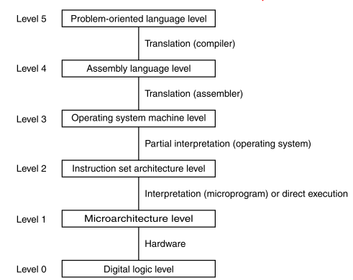
Programming Language

Slide 3
Programming Language
Input/output commands so that the program can accept data and output it again.
Declaration of variables and fields to be able to cache information
Basic and standard mathematical functions
Basic string processing functions
Conditional statements, repetitions, program subdivision (e.g. into subfunctions) as well as inclusion of libraries

Slide 4
Programming Language
Low-Level:
High-Level:
Assembler
(C/C++, Rust)
Java
JavaScript
Python
C#

Slide 5
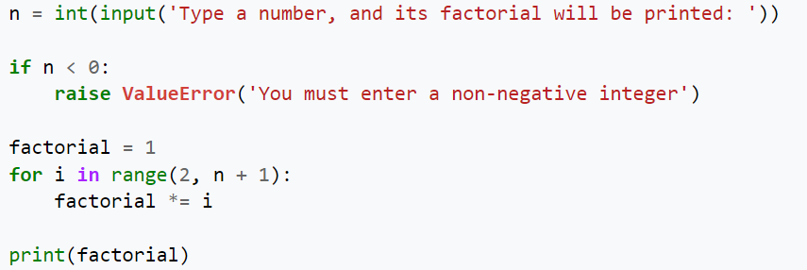
Programming Language
Low-Level:
High-Level:
Assembler
(C/C++, Rust)
Java
JavaScript
Python
C#

Slide 6
Programming Language
Compiled to Machine Code:
Interpreted or Compiled to Bytecode:
C/C++
Rust
Java
Python
JavaScript
Statically Types:
Dynamically Types:
C/C++
(Rust)
Java
JavaScript
Python

