Slide 1
Computer Program 101

Slide 2
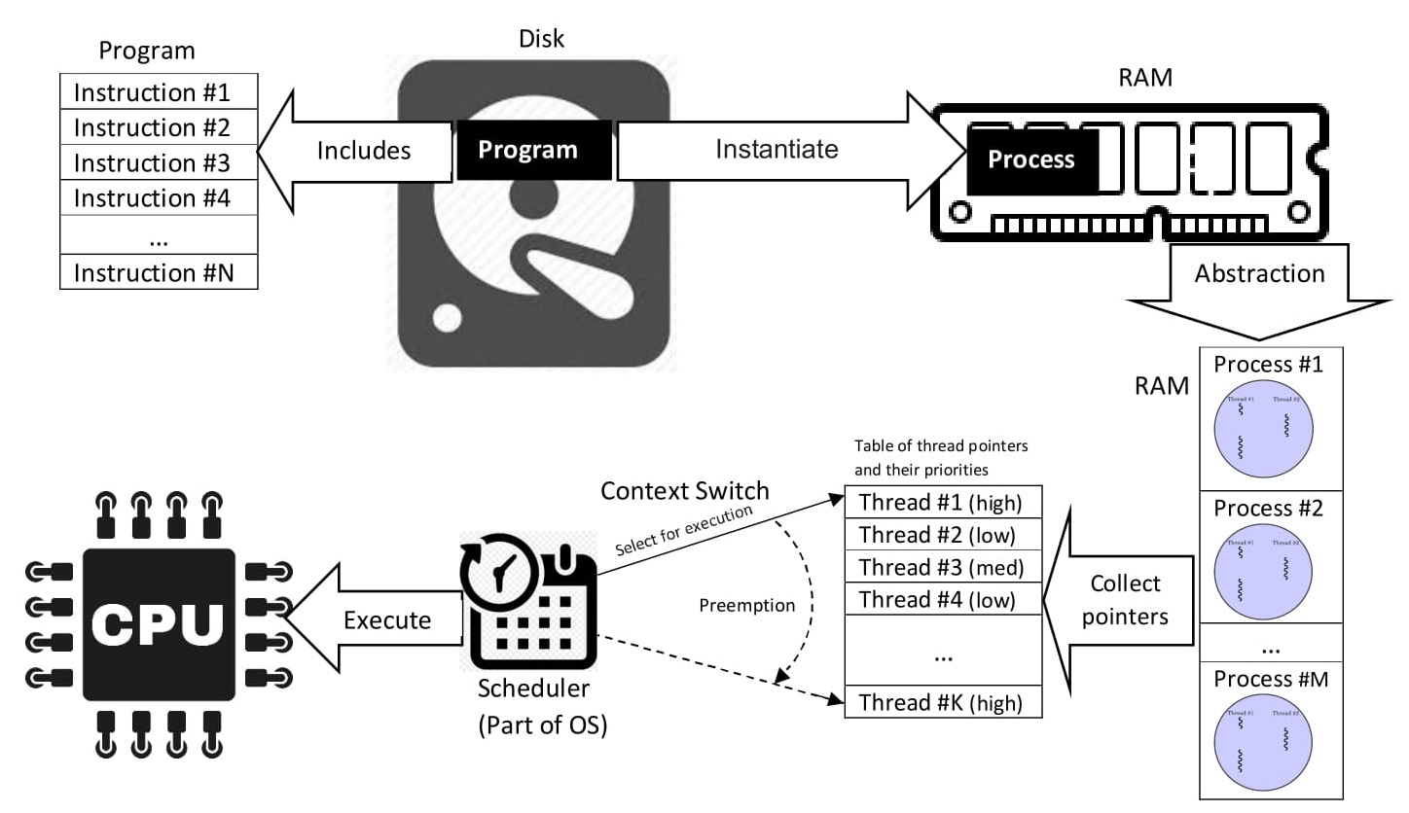
Program
Source: https://upload.wikimedia.org/wikipedia/commons/2/25/Concepts-_Program_vs._Process_vs._Thread.jpg

Slide 3
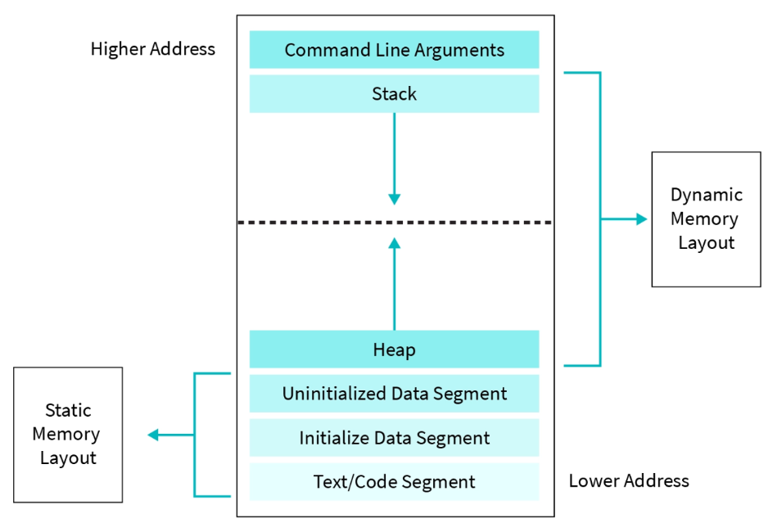
Memory Layout

