Slide 1
UNIVERSITY OF GREENWICH
Computer science
MATH1180 – Computational Methods and Numerical Techniques
Coursework 1 – Part B: Group Presentation
Date of submission: 8 December 2025
Group Members:
Alex chates Garzon (Student ID: 001338150)
Jose Gutierrez claros (Student ID: 001390237)
Cristian Pacheco (Student ID: 001386789)
Fran Navarro Gil (Student ID: 001376282)
Parameters:
a = (average of the 6th digits of student IDs) = 5
b = (average of the 7th digits of student IDs) = 3

Slide 2

Part (i) – Object O₁: Volume under the surface z = x² + 2y
In this section, I will calculate the volume under the surface
z = x² + 2y over the triangular region Ω₁.
The region Ω₁ is defined by the vertices:
A(0,0), B(a,b) = (5,3) and C(a+b,0) = (8,0)
This problem is solved using a double integral, which represents the total volume below the surface and above the region in the xy-plane.
B(5,3)
A(0,0)
B(8,0)
Reference: Paul Dawkins (2024), Calculus II Notes – Double Integrals, Lamar University.

Slide 3

Setting up the Double Integral for Region Ω₁
To compute the total volume under the surface
z = x² + 2y
over the triangular region Ω₁, we must integrate the function f(x,y)= x² + 2y
across the area defined by A(0, 0), B(5, 3), and C(8, 0).
The boundaries of Ω₁ are:
– y=0 (base AC)
– y=5/3​x (left side AB, for 0 ≤ x ≤ 5)
– y= -x + 8 (right side BC, for 5 ≤ x ≤ 8)
Because the upper boundary changes at x = 5,
the region is divided into two subregions and integrated separately.
Region 1
Region 2
B(5,3)
A(0,0)
C(8,0)
Each double integral represents the volume of one triangular subregion.
Reference: Paul Dawkins (2024), Calculus II Notes – Double Integrals, Lamar University.

Slide 4

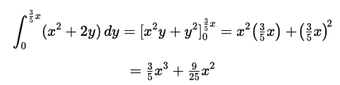
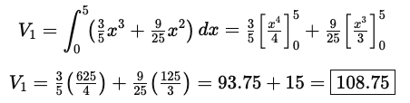
Solving the First Integral (Region 1: 0 ≤ x ≤ 5)
AIM: Compute the partial volume under z= x² +2y for Region 1, where the upper limit is y=3/5x
Main Integral Setup
Region 1
Region 2
Step 1 – Integrate with respect to y
B(5,3)
Step 2 – Integrate with respect to x
Region 1: 0 ≤ x ≤ 5
Partial Volume = 108.75 units³
A(0,0)
C(8,0)
Interpretation
The partial volume of the first subregion (Region 1) is 108.75 units³.
This result represents the volume under the surface z = x2 +2y
For 0 ≤ x ≤ 5 and 0 ≤ y ≤ 5/3​x .
Reference: Paul Dawkins (2024), Calculus II Notes – Double Integrals, Lamar University.

Slide 5

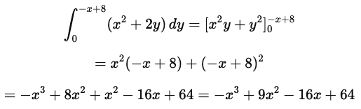
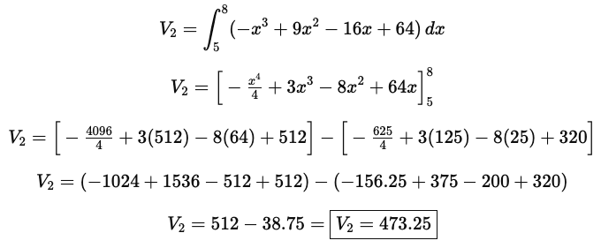
SOLVING THE SECOND INTEGRAL AND TOTAL VOLUME \(V_{O₁}\)
AIM: Compute the partial volume for Region 2, where: 5≤ x ≤ 8 and the upper limit is y = –x + 8
Main Integral Setup
Region 1
Region 2
B(5,3)
Step 1 – Integrate with respect to y
Region 2: 5 ≤ x ≤ 8
Partial Volume = 473.25 units³
Step 2 – Integrate with respect to x
A(0,0)
C(8,0)
Interpretation
The total volume under z = x2 + 2y over the triangular region Ω₁ is approximately 582 cubic units.
Region 1 contributes 108.75 units³, and Region 2 contributes 473.25 units³.
Reference: Paul Dawkins (2024), Calculus II Notes – Double Integrals, Lamar University.

Slide 6
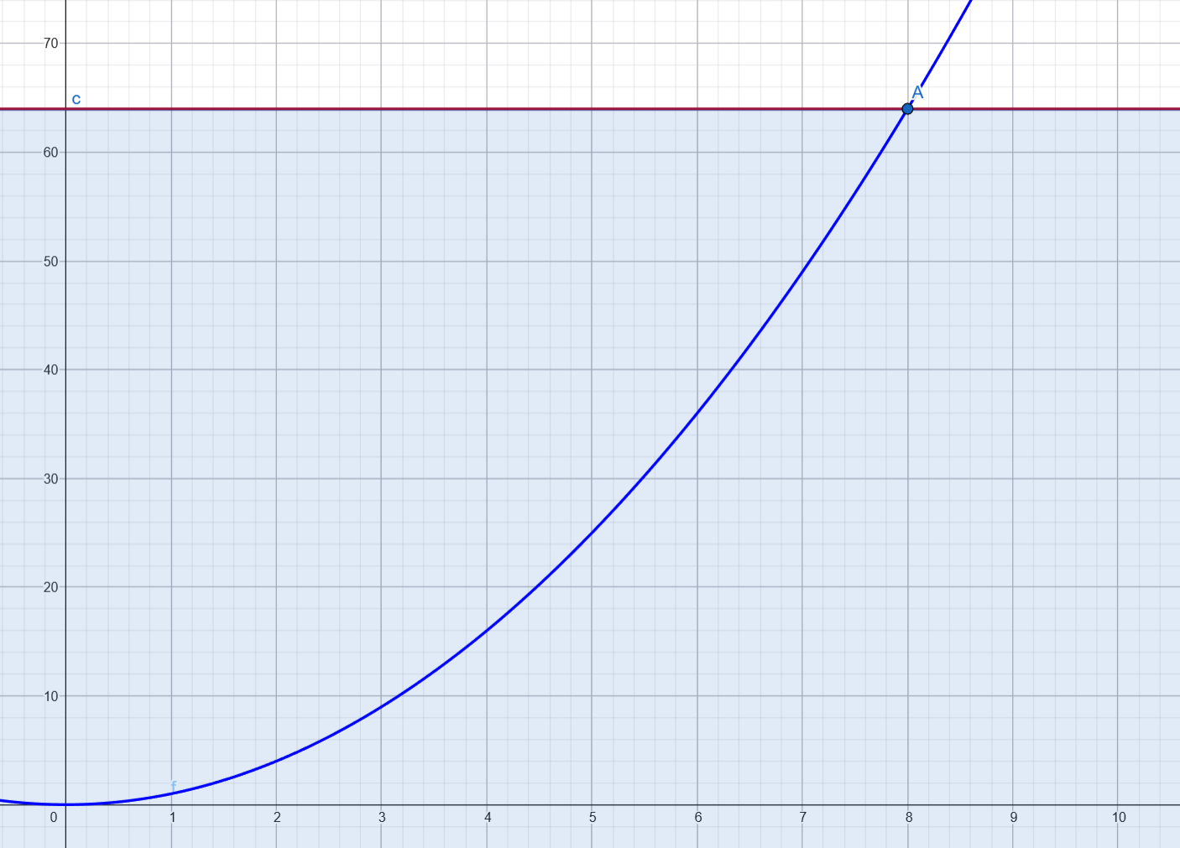
Part (i) – Object O₂: Volume under the surface z = x² + 2y
The region Ω₂ is defined in the xy-plane by:
• The parabola y = x²
• The horizontal line y = (a+b)² = 64
• The vertical line x = 4(a+b)= 32
Using the group parameters a = 5 and b = 3, we have a + b = 8.
The volume is computed using a double integral, which represents the total volume below the surface and above the region in the xy-plane.

Slide 7
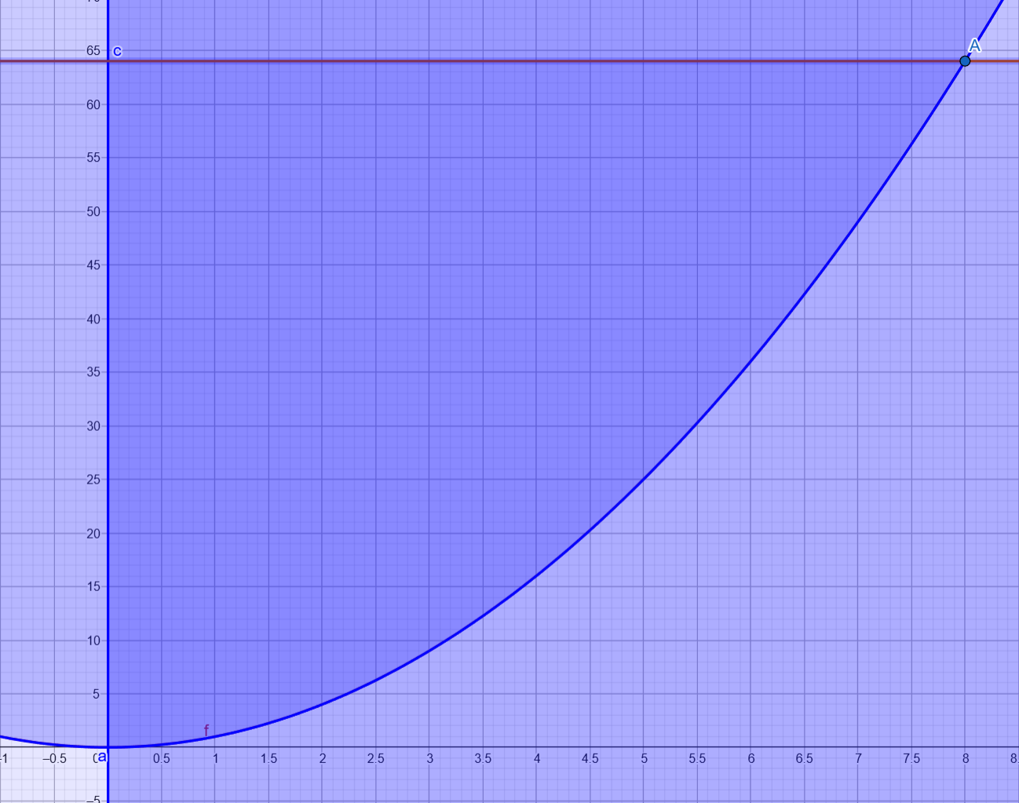
Sketch and description of Ω₂
The region Ω₂ is a curved area in the xy-plane bounded by:
• The parabola y = x²
• The horizontal line y = 64
• The condition x ≥ 0, which restricts the region to the first quadrant
Since a + b = 8 for our group, the intersection between the parabola and the line
y = 64 occurs at x = ±8.
In our calculation, we focus on the first quadrant, so we consider the region between:
• 0 ≤ x ≤ 8
• x² ≤ y ≤ 64
This defines the region over which the volume of Object O₂ will be constructed.

Slide 8
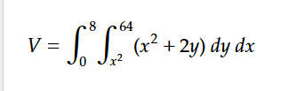
Setting up the double integral
To calculate the volume of Object O₂ under the surface z = x² + 2y,we integrate the function over the region Ω₂ described previously.
Using the limits of the region:
• 0 ≤ x ≤ 8
• x² ≤ y ≤ 64
the volume can be expressed as a double integral.
The inner integral measures the height z = x² + 2y with respect to y, from the parabola up to the horizontal line y = 64.
The outer integral then sums these contributions along the x-direction.
In mathematical form, the volume is written as the following double integral:

Slide 9
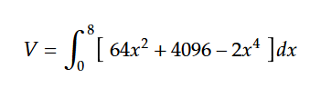
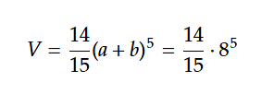
Solving the double integral
To compute the volume of Object O₂, we evaluate the double integral step-by-step.
First, we integrate the function
z = x² + 2y
with respect to y, from the lower boundary y = x² to the upper boundary y = 64.
This gives the accumulated contribution of the surface height for each fixed value of x.
Next, we integrate the resulting expression with respect to x, over the interval 0 ≤ x ≤ 8.
This final step adds up all vertical slices of the region, producing the total volume under the surface.
The complete computation results in the following integral expression:
And the final evaluated result is:

Slide 10
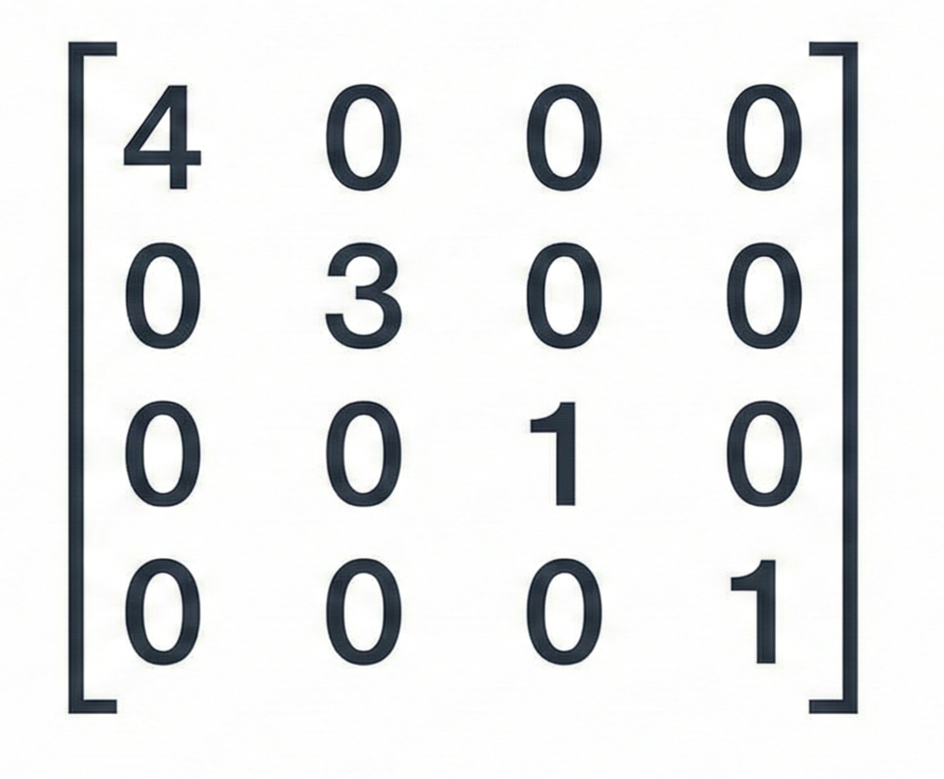
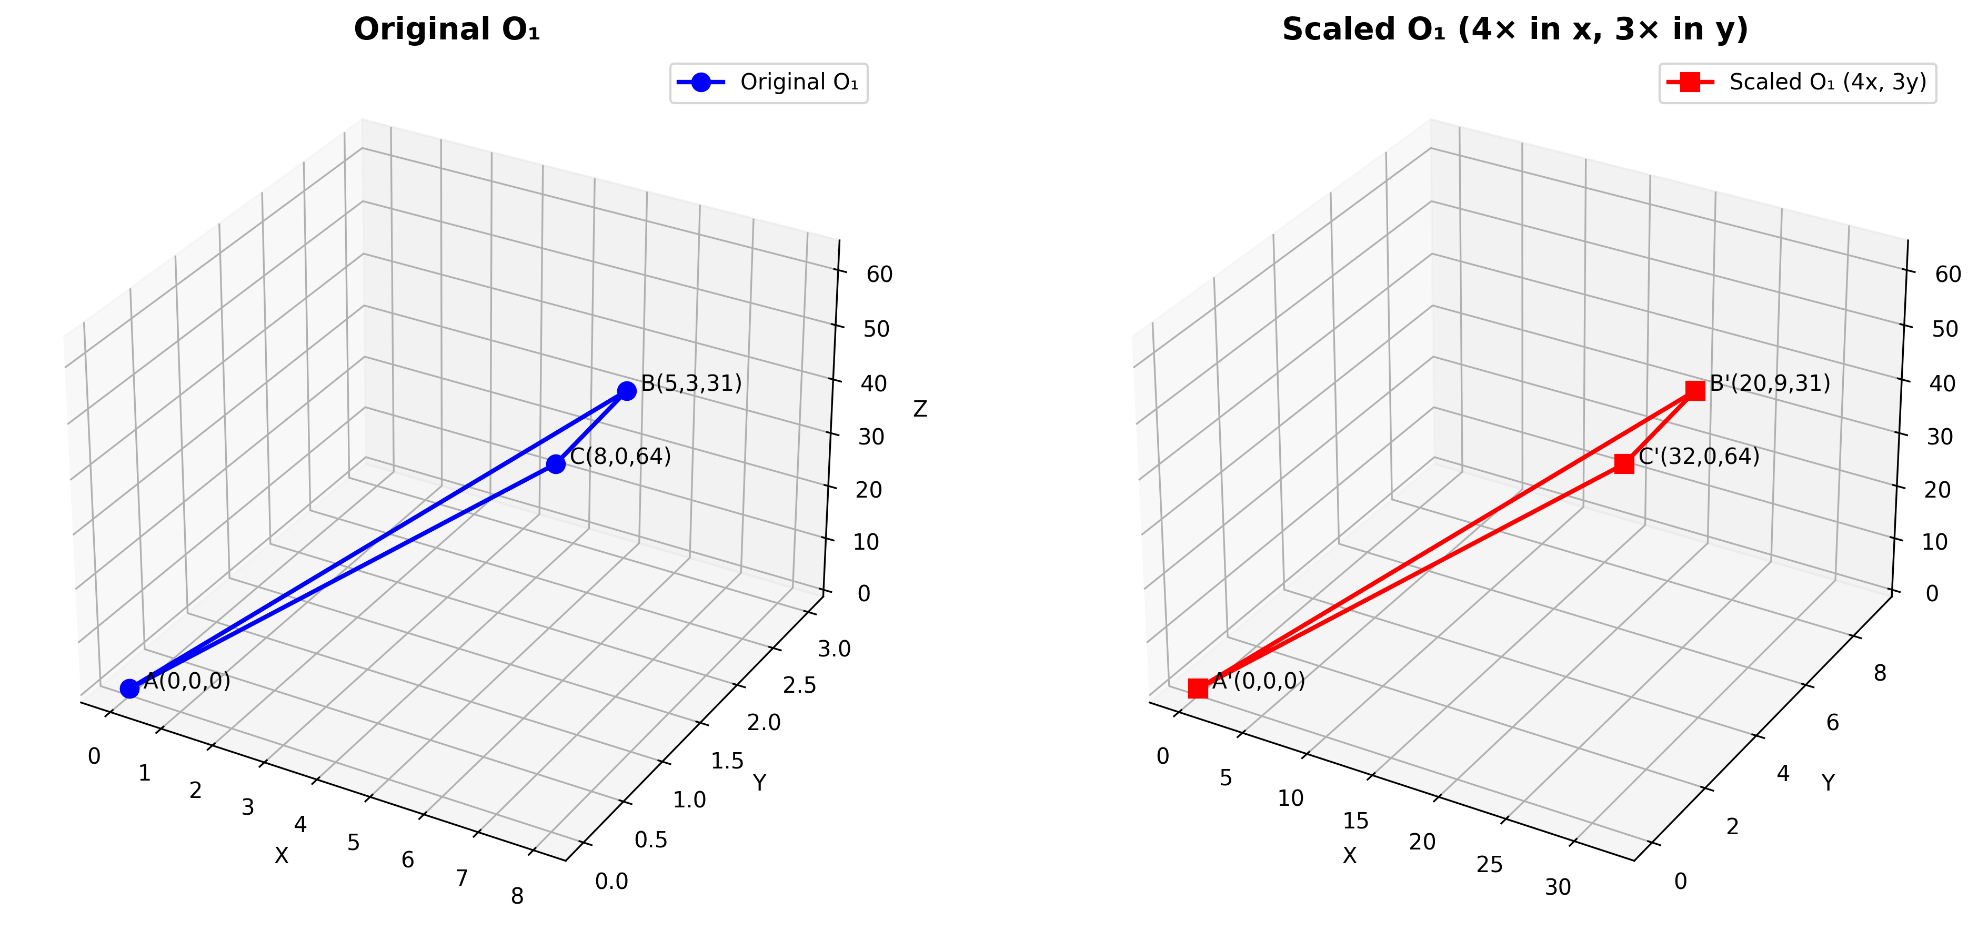
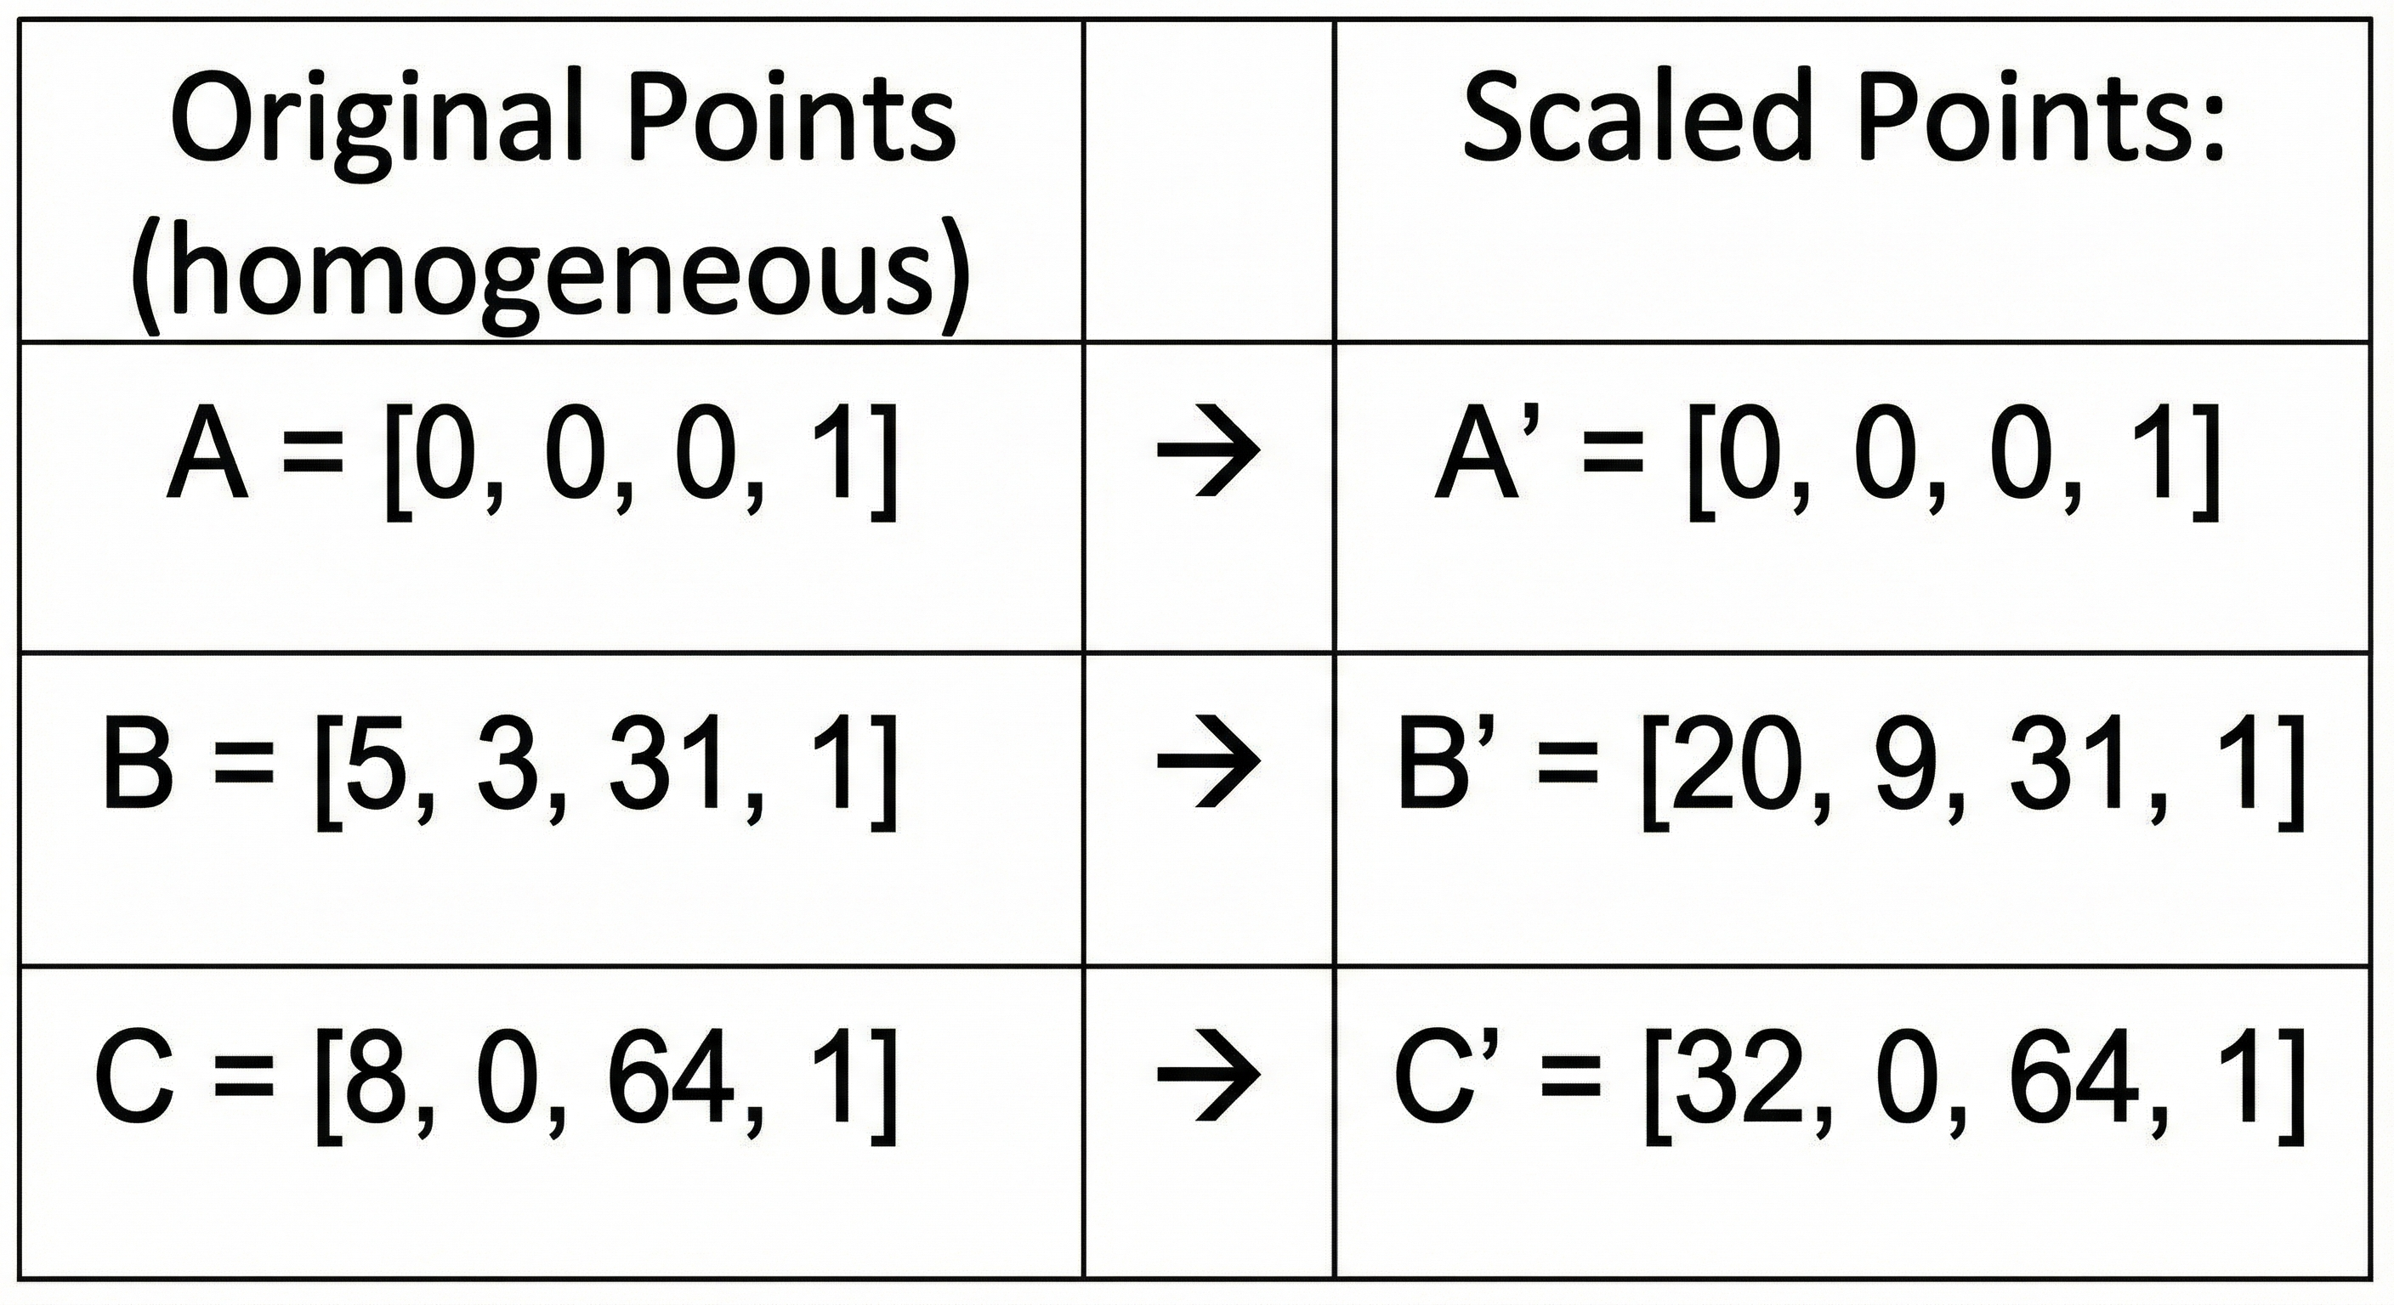
PART(II-A): Scaling Transformation for O₁
Transformation: Scale by 4 in x-direction, 3 in y-direction
Scaling Matrix S:
Applying transformation to O₁ vertices:
Result: Triangle is 4× wider (x: 8 → 32)and 3× taller (y: 3 →9)
(Eck, 2023)

Slide 11
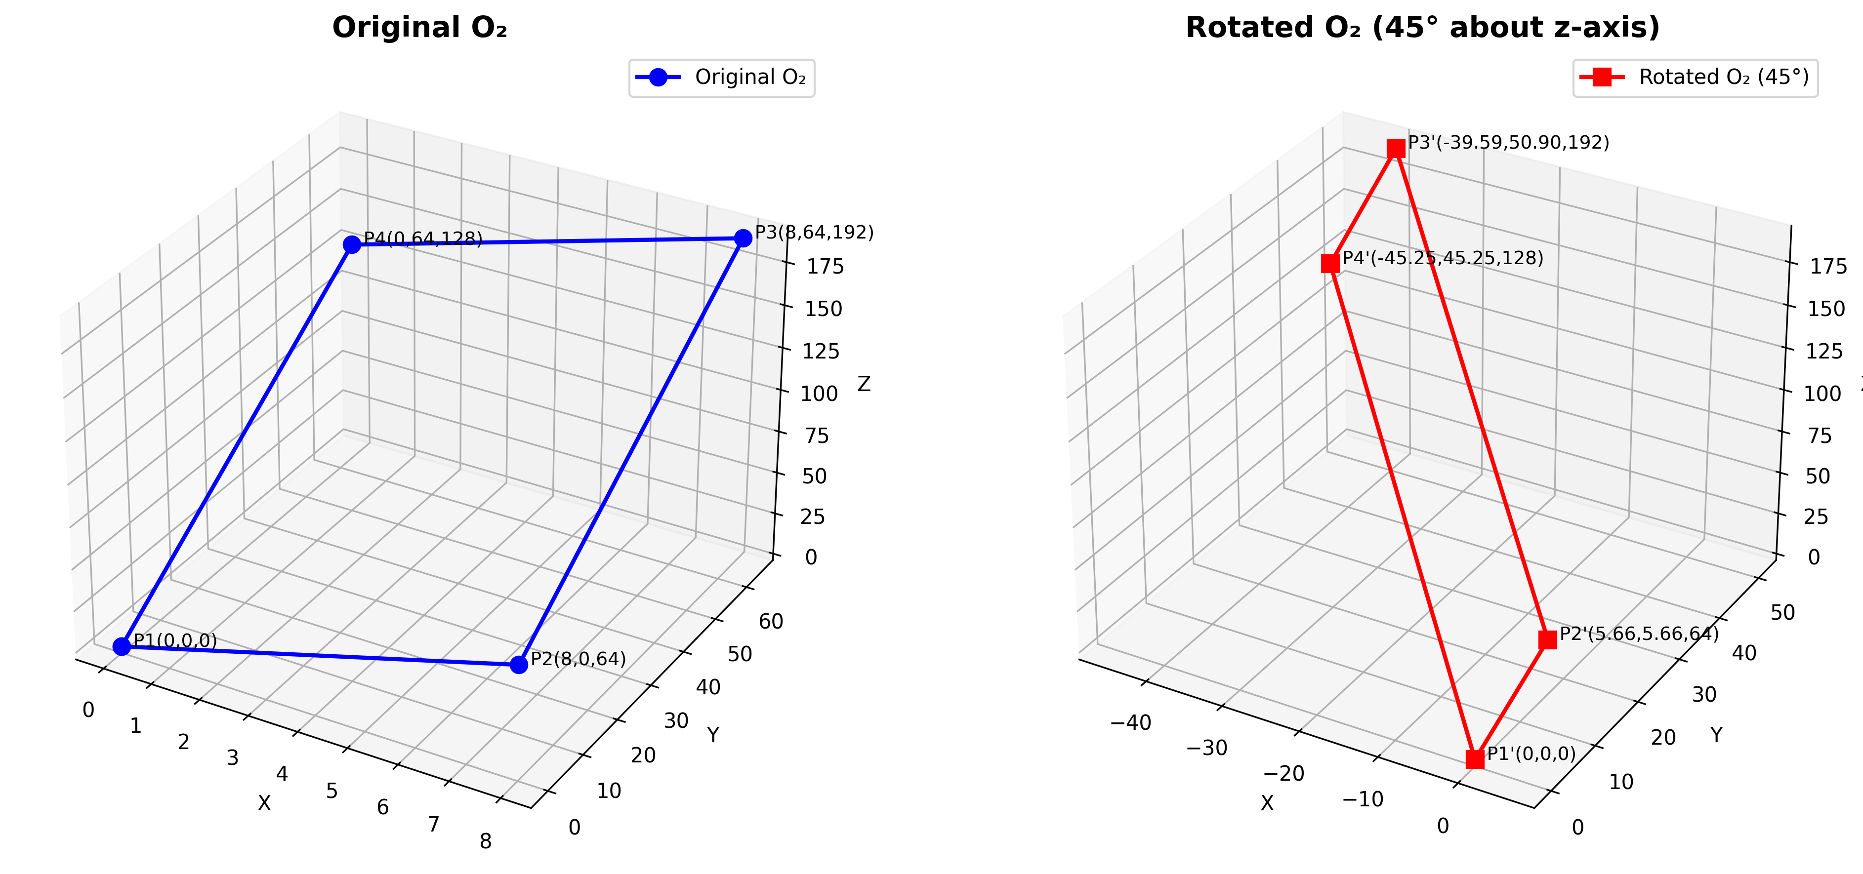
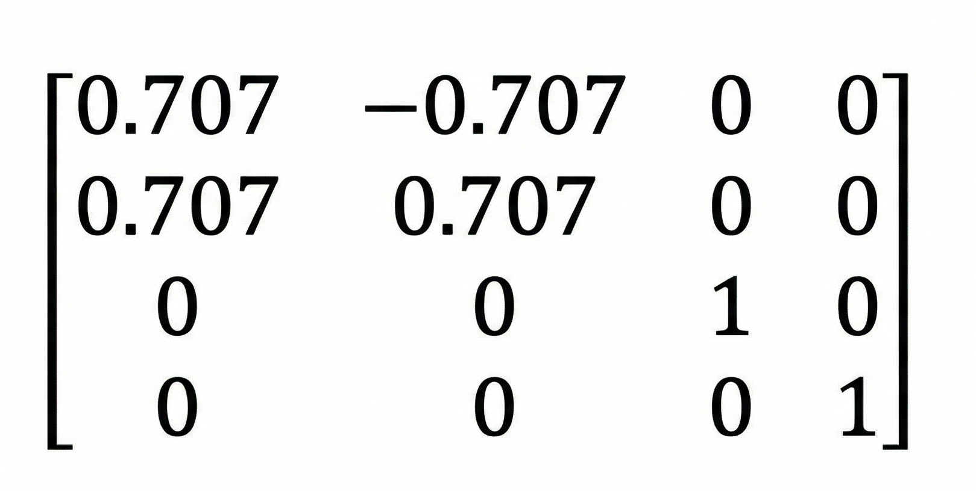
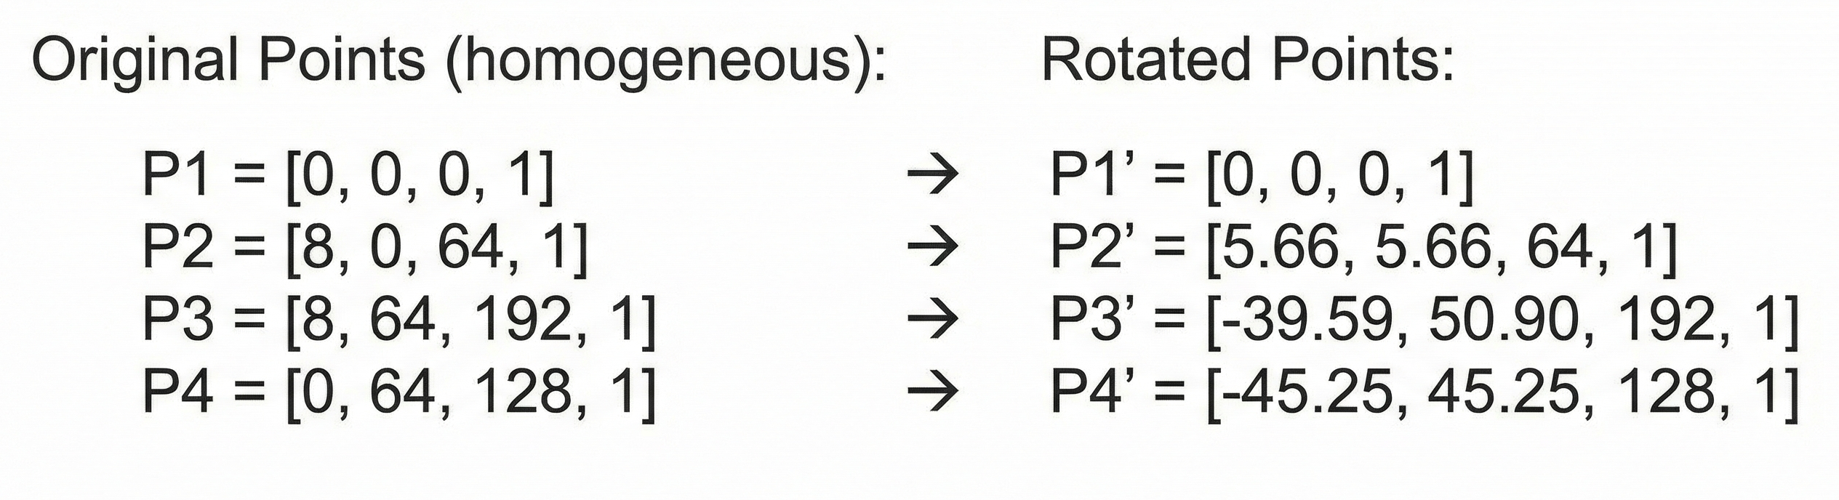
Part (ii-b): Rotation Transformation for O₂
Transformation: Rotate 45° anti-clockwise about z-axis
Rotation Matrix R:
Where: cos(45°) = 0.707, sin(45°) = 0.707
Applying transformation to O₂ vertices:
Result: Object rotated 45° counterclockwise in xy-plane. Z-coordinates unchanged (rotation is around z-axis).
(Eck, 2023)

Slide 12
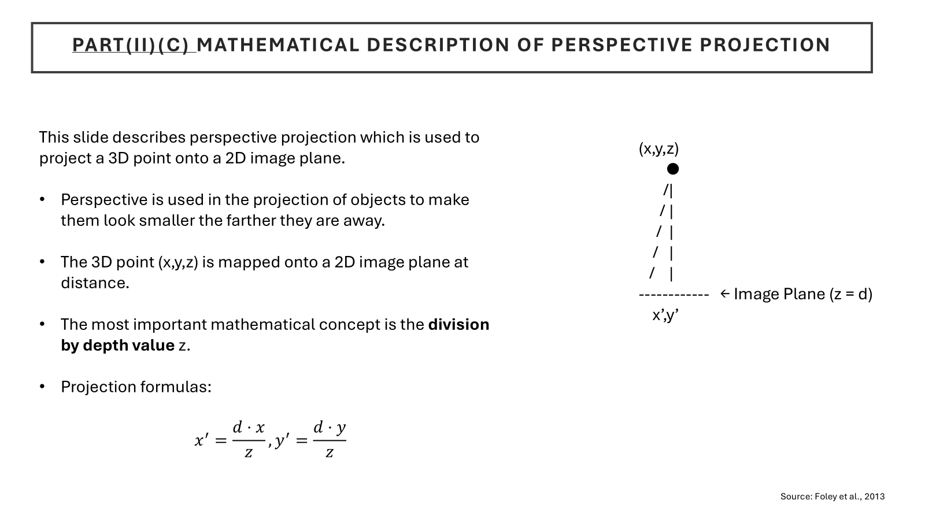

Slide 13
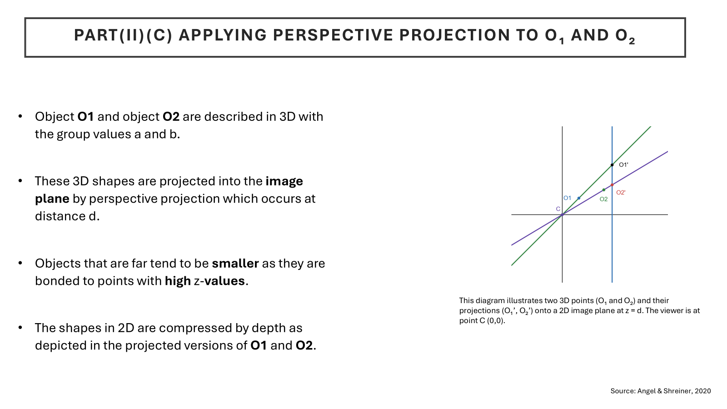

Slide 14
references
Dawkins, P. (2024) Calculus II Notes – Double Integrals. Lamar University. Available at: https://tutorial.math.lamar.edu/Classes/CalcII/DoubleIntegrals.aspx (Accessed: 10 November 2025).
Stewart, J., Clegg, D. and Watson, S., 2021. Calculus: early transcendentals. Cengage.
Anton, H. and Herr, A., 1988. Calculus with analytic geometry. New York;: Wiley.
Foley, J.D., van Dam, A., Feiner, S.K. and Hughes, J.F. (2013) Computer Graphics: Principles and Practice. 3rd edn. Addison-Wesley.
https://ptgmedia.pearsoncmg.com/images/9780321399526/samplepages/0321399528.pdf
Angel, E. and Shreiner, D. (2020) Interactive Computer Graphics: A Top-Down Approach with WebGL. 8th edn. Pearson.
https://api.pageplace.de/preview/DT0400.9781292019338_A26886573/preview-9781292019338_A26886573.pdf
Eck, D.J. (2023) Introduction to Computer Graphics. Version 1.4. Hobart and William Smith Colleges. Available at: https://math.hws.edu/eck/cs424/downloads/graphicsbook-linked.pdf (Accessed: 18 November, 2025)

