Slide 1

Text Processing
Master’s Degree in Artificial Intelligence and Data Engineering
Academic Year 2024/2025
M. Gemelli – F. Nocella

Slide 2
Project Goals
Optimize a text processing pipeline's performance.
Maximize hardware resources utilization (CPU cores).
Achieve high throughput (tokens/second).
Ensure scalable performance with increasing threads.
M. Gemelli – F. Nocella

Slide 3
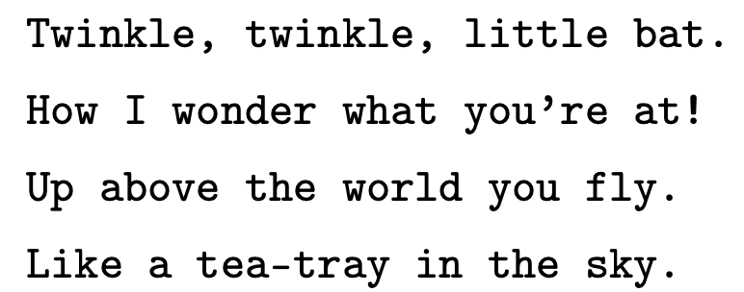
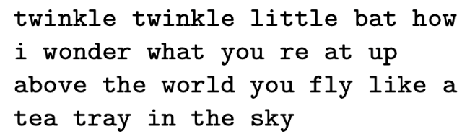
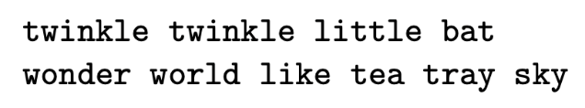
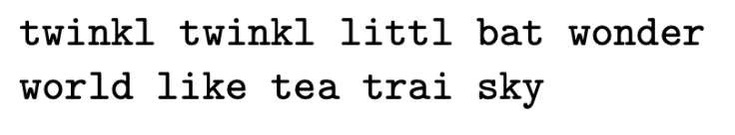
Text Processing: Example
Original Text
Tokenisation
Stopword removal
Stemming
M. Gemelli – F. Nocella

Slide 4
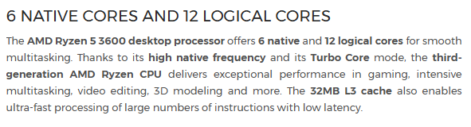
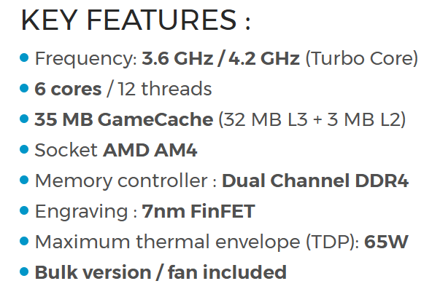
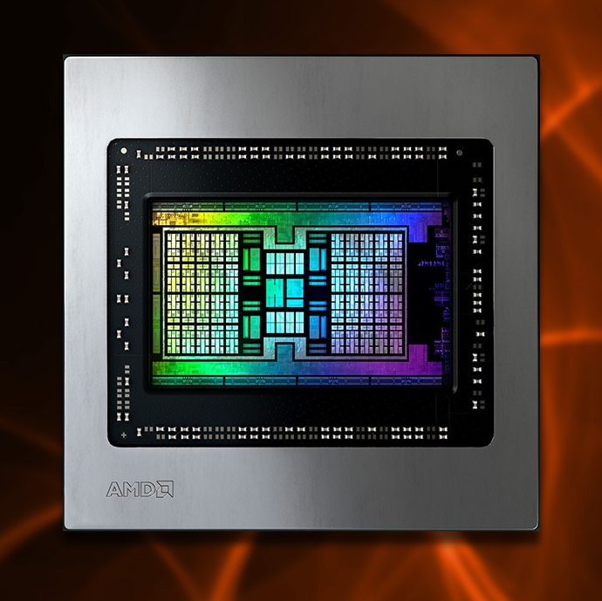
Test Machine 1 - CPU Specifications
Processor Specifications: Ryzen 5 3600
M. Gemelli – F. Nocella

Slide 5
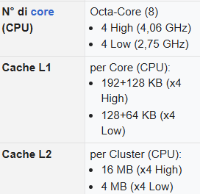
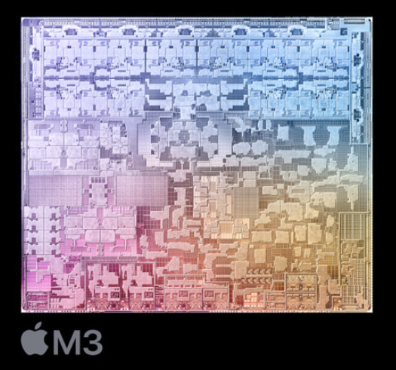
Test Machine 2 - CPU Specifications
Processor Specifications: Silicon Arm M3
M. Gemelli – F. Nocella

Slide 6
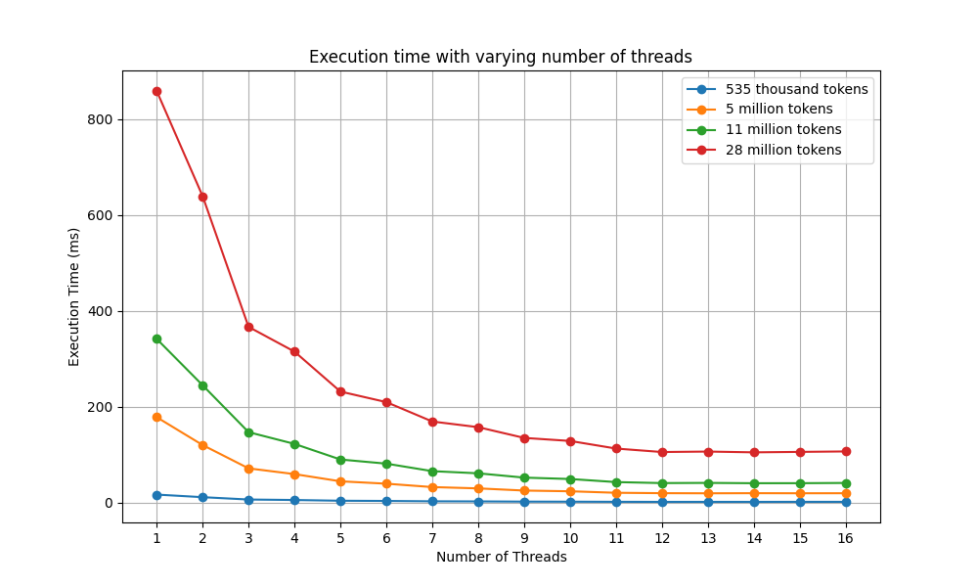

Initial Version Performance: Ryzen
M. Gemelli – F. Nocella

Slide 7
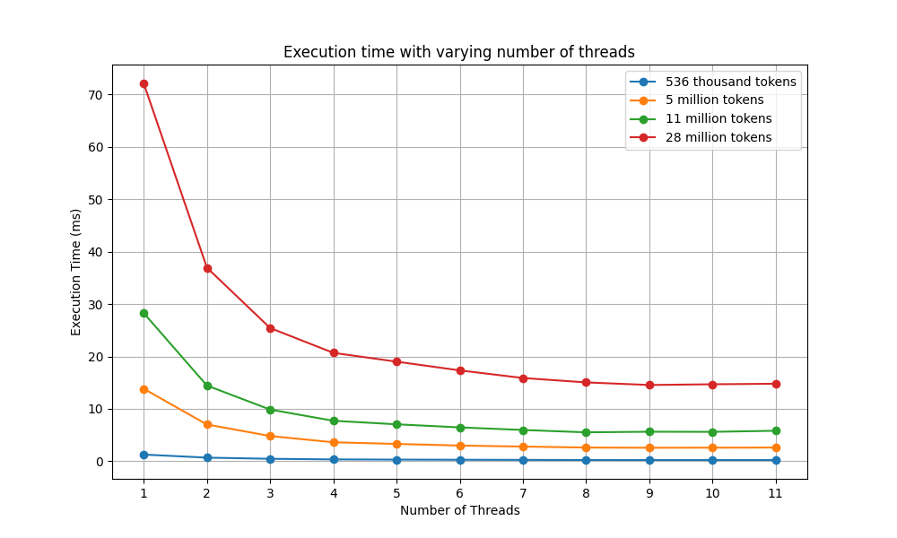
Initial Version Performance: M3
M. Gemelli – F. Nocella

Slide 8
Total Time with 1 thread: ≈ 70ms Total Time with 8 threads: ≈ 20ms
Execution time Ryzen 5:
Total Time with 1 thread: ≈ 800ms Total Time with 12 threads: ≈ 100ms
Execution time M3:
M. Gemelli – F. Nocella

Slide 9
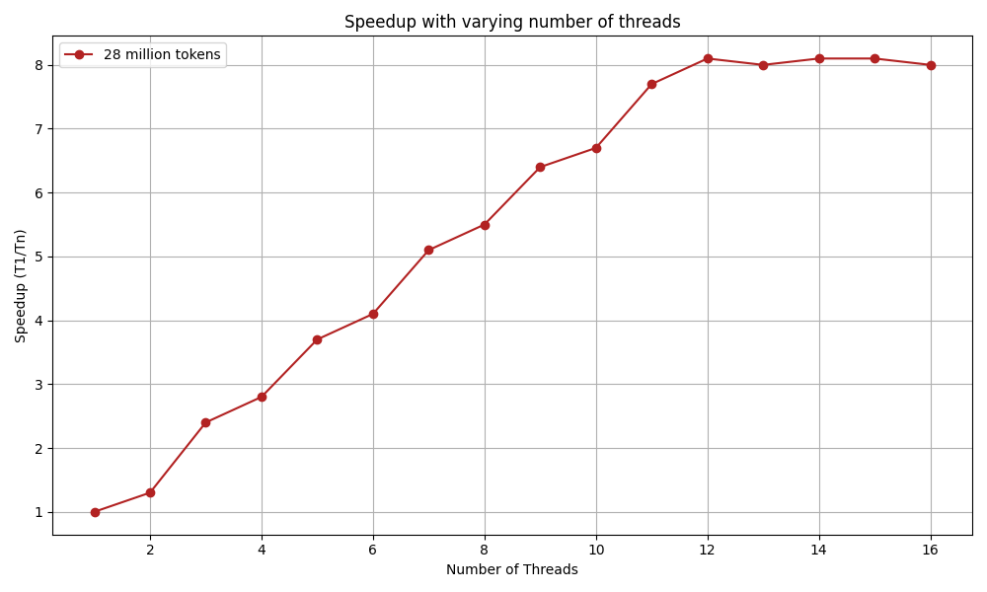
Initial Version Speedup: Ryzen
M. Gemelli – F. Nocella

Slide 10
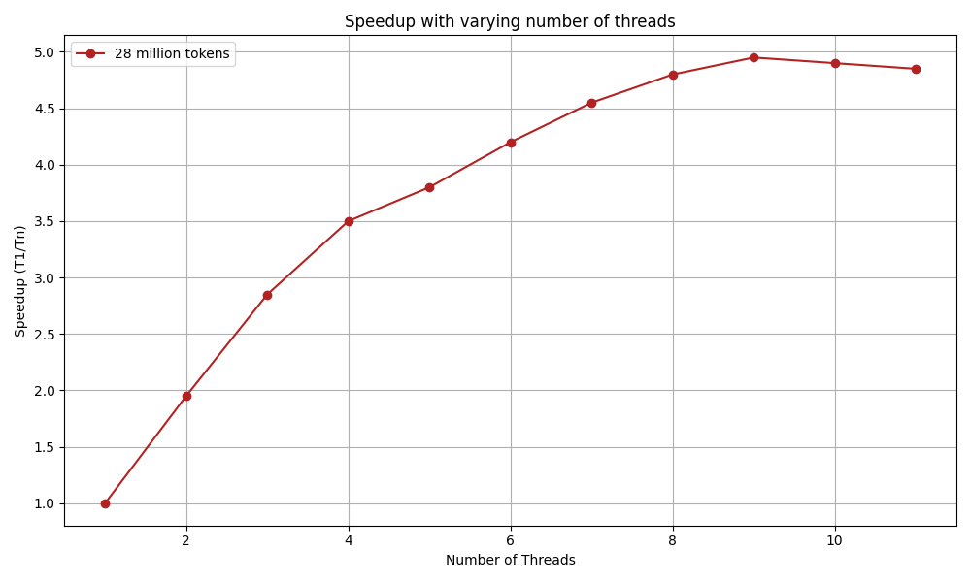
Initial Version Speedup: M3
M. Gemelli – F. Nocella

Slide 11
Initial version
Ryzen
Throughput at 12 Threads
≈ 250.000.000 tokens/sec
M3
Throughput at 8 Threads
≈ 2.000.000.000 tokens/sec
M. Gemelli – F. Nocella

Slide 12

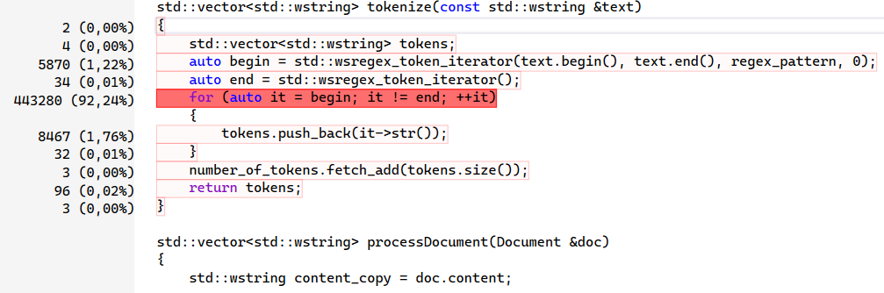
Performance Profiling: Identifying Bottlenecks
Profiler Used: Visual Studio Community
Key Bottleneck Found: Text Tokenization
The tokenize function, responsible for splitting text into tokens, is the primary performance bottleneck.
The core loop iterating through text segments using a regex token iterator (std::wsregex_token_iterator) consumes ~92.2% of the execution time in this profiled section.
M. Gemelli – F. Nocella

Slide 13
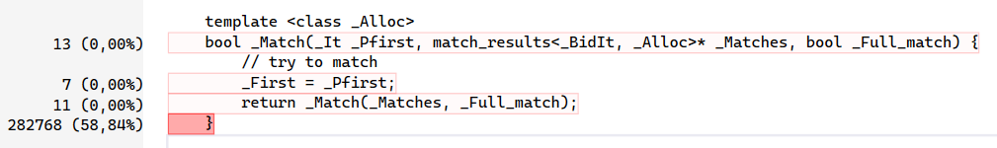
Regex bottleneck
Main Use:
Filtering words/tokens via patterns.
Supporting text tokenization (splitting).
Stopword removal.
The Issue:
Regex matching (std::_Matcher) is a critical bottleneck.
Consumes approx. 58.8% of execution time.
Significantly slows down text processing.
M. Gemelli – F. Nocella

Slide 14
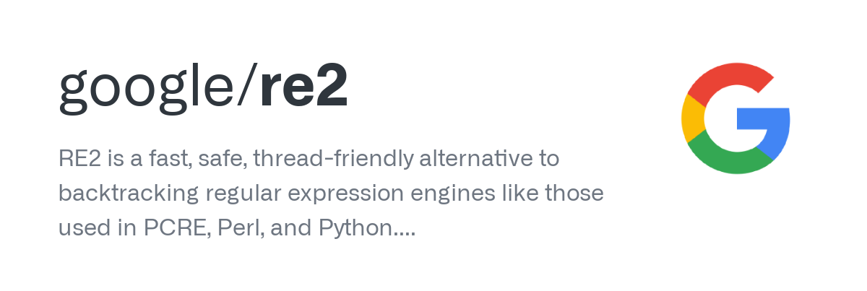
Tokenization
Optimization
M. Gemelli – F. Nocella

Slide 15
RE2 Tokenization
Advantages of RE2:
High Performance: Uses efficient DFA-based algorithms.
Guaranteed Linear Time: Execution time scales predictably with input size.
No Catastrophic Backtracking: Avoids performance cliffs and potential ReDoS; safer than std::regex.
Result: Significantly faster and more reliable tokenization compared to the previous method.
M. Gemelli – F. Nocella

Slide 16
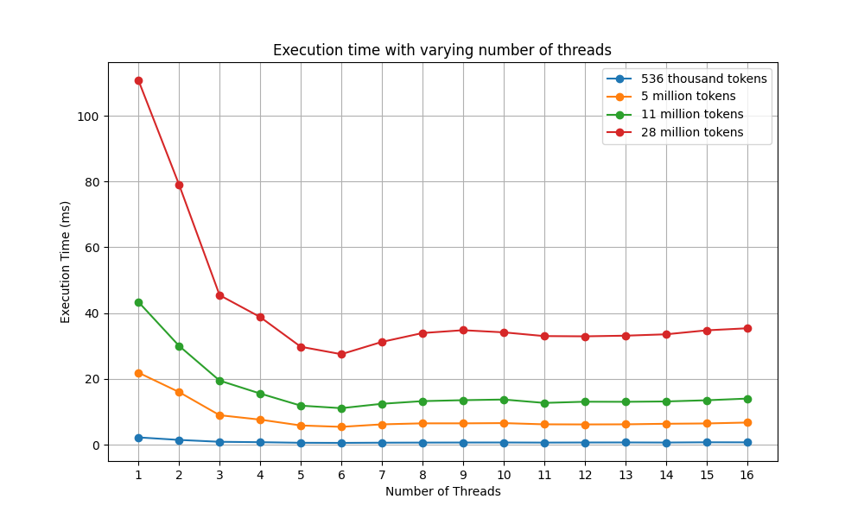
Optimization Performance: Ryzen
M. Gemelli – F. Nocella

Slide 17
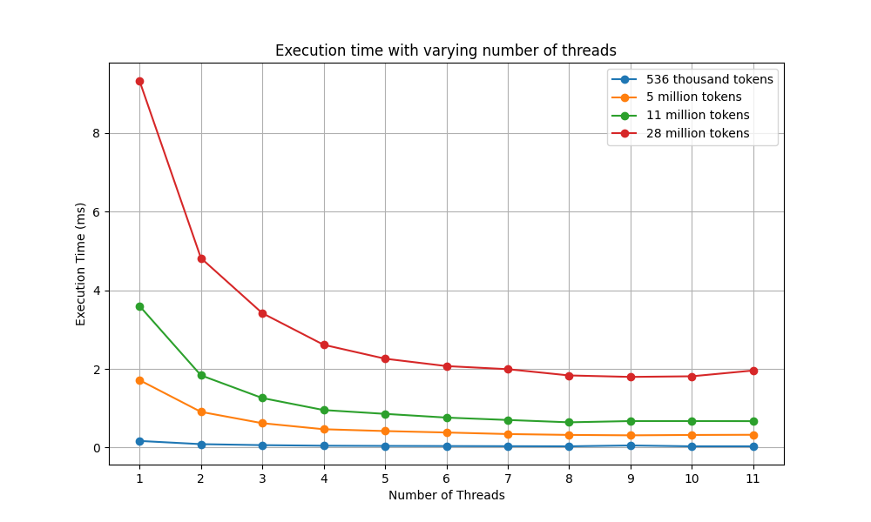
Optimization Performance: M3
M. Gemelli – F. Nocella

Slide 18
Total Time with 1 thread: ≈ 9ms Total Time with 8 threads: ≈ 2ms
Optimized version
Execution time Ryzen 5:
Total Time with 1 thread: ≈ 200ms Total Time with 6 threads: ≈ 40ms
Execution time M3:
M. Gemelli – F. Nocella

Slide 19
Optimized
Ryzen
Throughput at 6 Threads
≈ 1.000.000.000 tokens/sec
M3
Throughput at 8 Threads
≈ 16.000.000.000 tokens/sec
M. Gemelli – F. Nocella

Slide 20
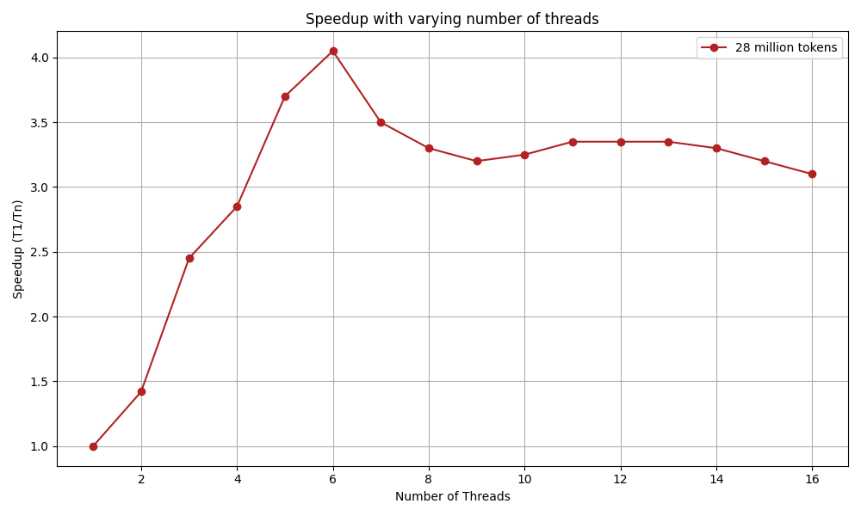
Speedup: Ryzen
M. Gemelli – F. Nocella

Slide 21
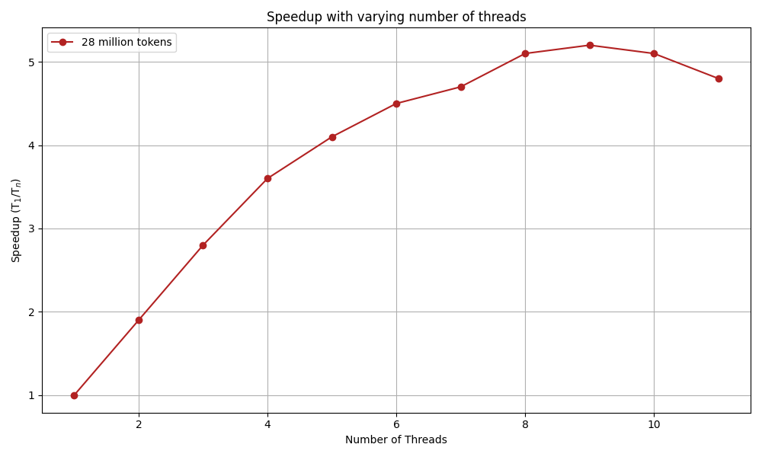
Speedup: M3
M. Gemelli – F. Nocella

Slide 22
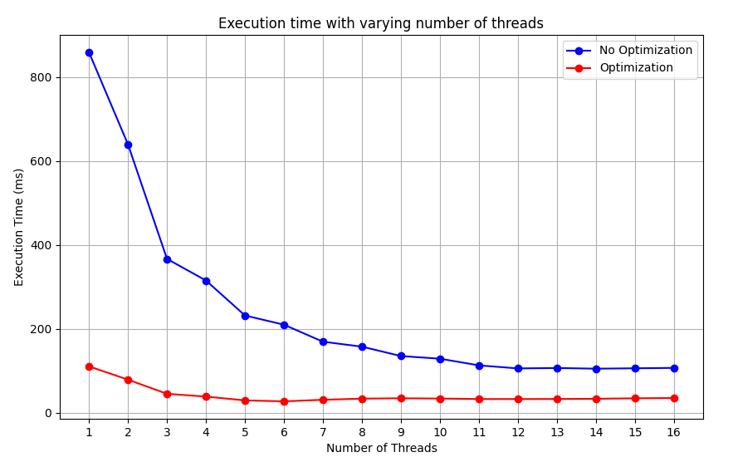
Performance Recap: Ryzen
From ≈ 250.000.000 tokens/sec
Throughput x4
to ≈ 1.000.000.000 tokens/sec
M. Gemelli – F. Nocella

Slide 23
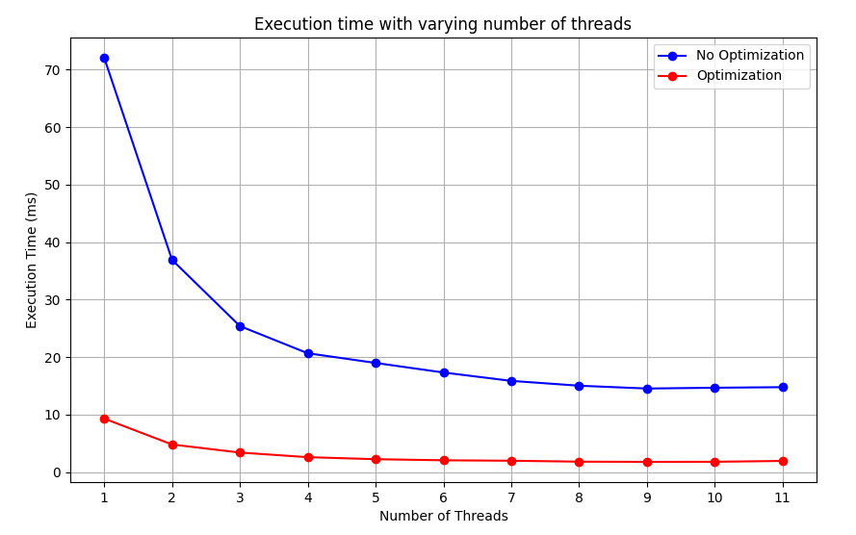
Performance Recap: M3
From ≈ 2.000.000.000 tokens/sec
Throughput x8
to ≈ 16.000.000.000 tokens/sec
M. Gemelli – F. Nocella

