Slide 1


Master’s Degree in Artificial Intelligence and Data Engineering
Multi Layer Perceptron
for
Classification
Academic Year 2024/2025
M. Gemelli – F. Nocella

Slide 2
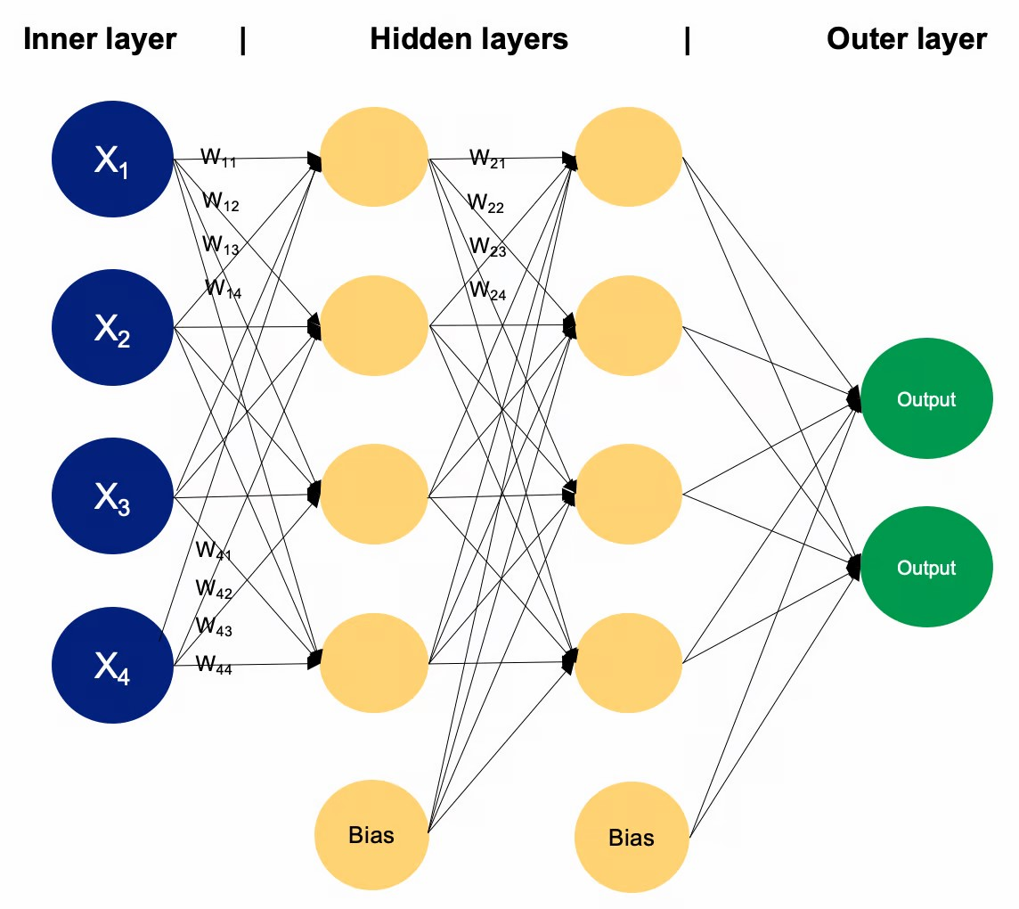
MLP
A multi-layer perceptron (MLP) is a type of artificial neural network consisting of multiple layers of neurons.
M. Gemelli – F. Nocella

Slide 3
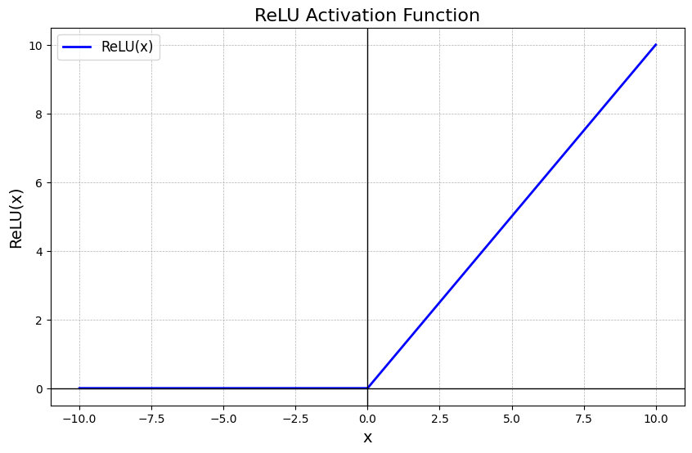
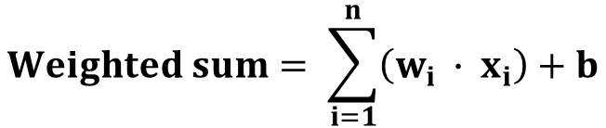

Software Architecture
Operations involved:
Linear layer:
$$Weighted sum= \sum_{i=1}^{n}{\left(w_{i} ∙ x_{i}\right)+b}$$
Activation function (ReLU):
$$f\left(x\right)=max⁡(0, x)$$
M. Gemelli – F. Nocella

Slide 4
Case Study: Classification 1/2
X: input data (matrix organization)
B rows: number of records (batch size)
512 columns: number of input features
1 Hidden layer
512 input features
2048 output fetaures
Output layer
2048 input features
100 output features (number of classes)
M. Gemelli – F. Nocella

Slide 5
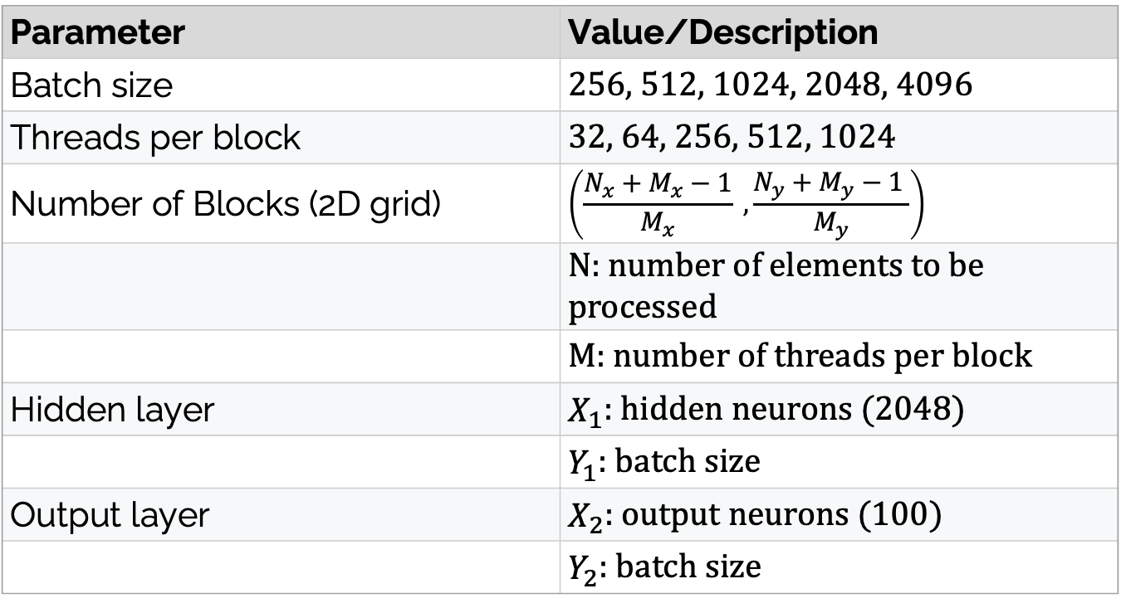
Case Study: Classification 2/2
Parameter | Value/Description
Batch size | 256, 512, 1024, 2048, 4096
Threads per block | 32, 64, 256, 512, 1024
Number of Blocks (2D grid) | $$\left(\frac{N_{x}+M_{x}−1}{M_{x}} ,\frac{N_{y}+M_{y}−1 }{M_{y}}\right)$$
 | N: number of elements to be processed
 | M: number of threads per block
Hidden layer | $X_{1}$: hidden neurons (2048)
 | $Y_{1}$: batch size
Output layer | $X_{2}$: output neurons (100)
 | $Y_{2}$: batch size
M. Gemelli – F. Nocella

Slide 6
Hardware
Versione 572.61
NVIDIA GeForce GTX 1650
Memory
Memory Size: 4GB
Memory Type: GDDR6
Memory Bus: 128 bit
Bandwidth: 192.03 GB/s
Render Config
Shading Units: 896
Streaming Multiprocessor (SM): 14
L1 Cache: 64 KB (per SM)
L2 Cache: 1024 KB
M. Gemelli – F. Nocella

Slide 7
Goals
Optimize a MLP's performance.
Maximize hardware resource utilization (GPU).
Optimize algorithm for GPU processing
Maximize throughput
M. Gemelli – F. Nocella

Slide 8
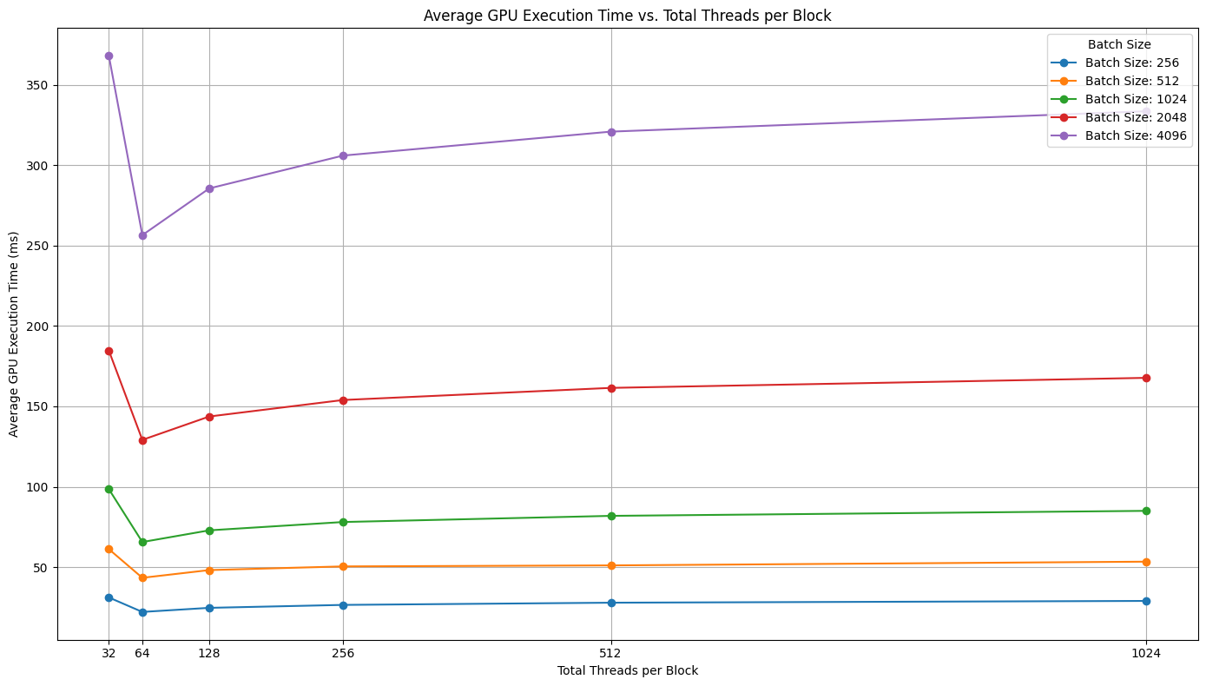
Initial version: Avg. Exec. Time
M. Gemelli – F. Nocella

Slide 9
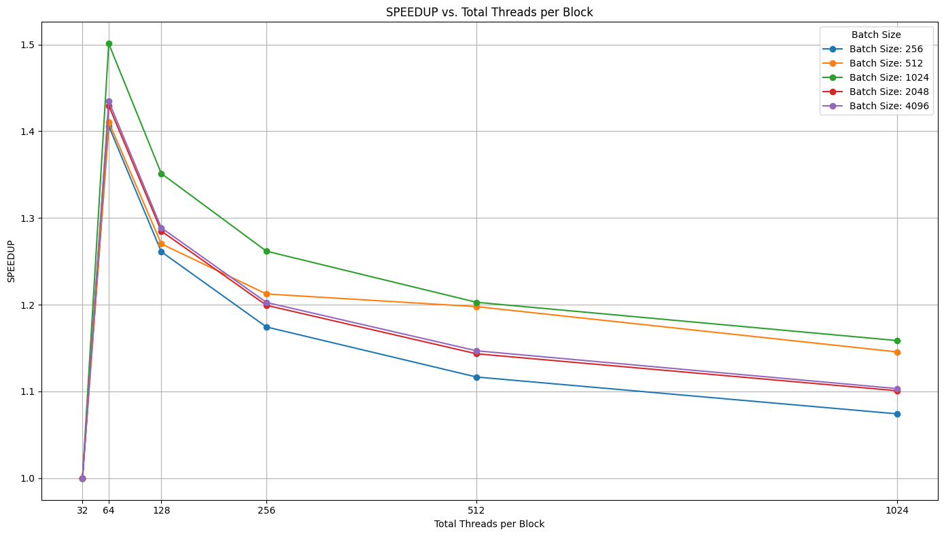
Initial version: Speed-up
M. Gemelli – F. Nocella

Slide 10
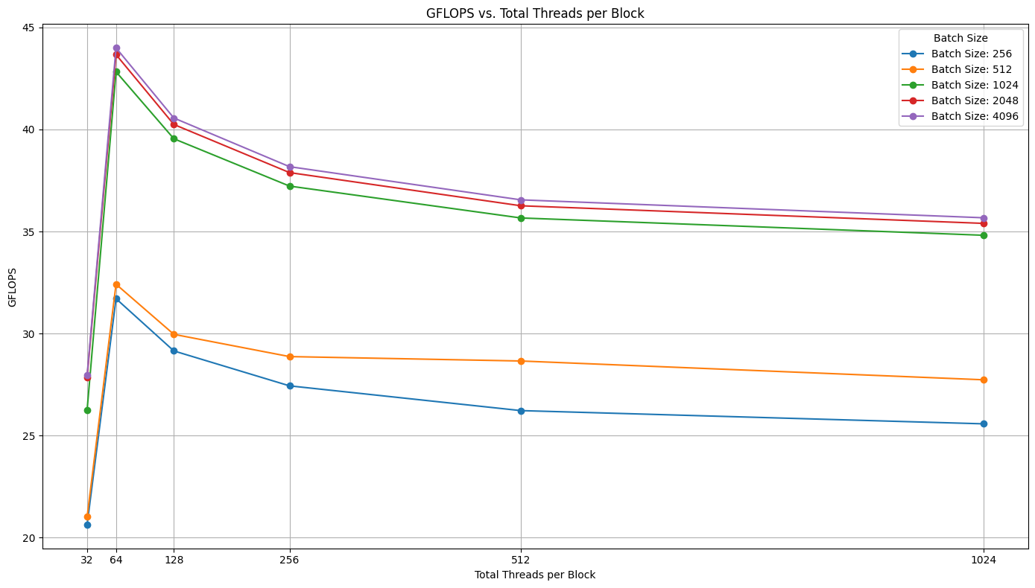
Initial version: GFLOPs
M. Gemelli – F. Nocella

Slide 11
Summary
Ideal number of threads per block: 64
Avg. Exec. Time (ms) with a batch size of 4096 records: ~250 ms
Speed-up (with respect to 32 threads per block): ~1.5
GFLOPs with a batch size of 4096 records: ~45
M. Gemelli – F. Nocella

Slide 12
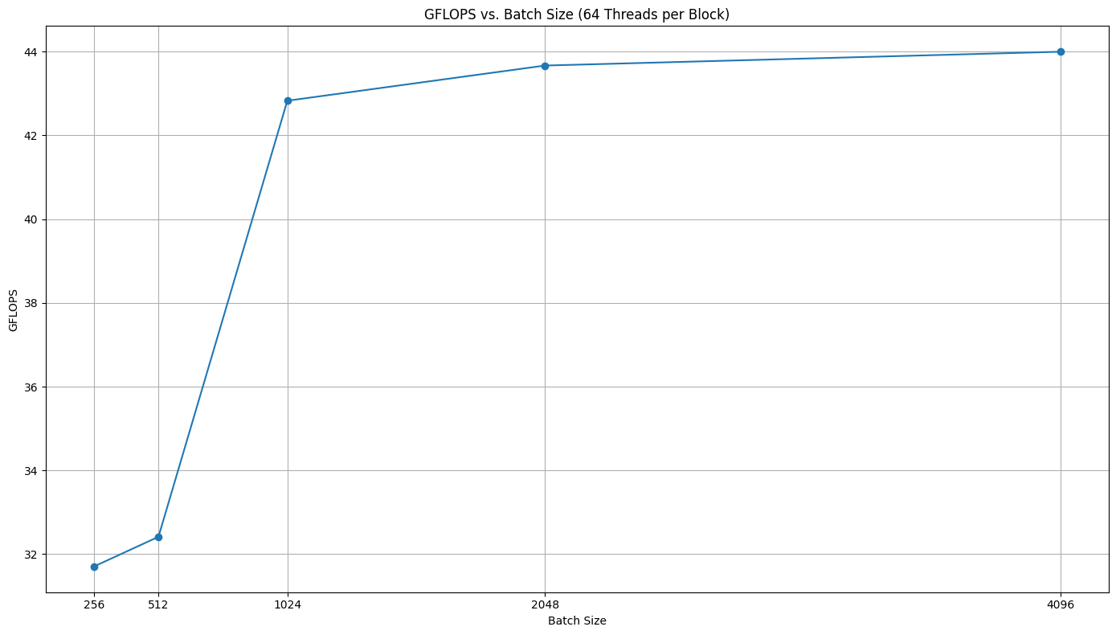
Initial version: Batch scaling
M. Gemelli – F. Nocella

Slide 13

Profiling tool
M. Gemelli – F. Nocella

Slide 14
Issues
* 64 threads per block & batch size of 4096
M. Gemelli – F. Nocella

Slide 15

Issues
* 256 threads per block & batch size of 4096
M. Gemelli – F. Nocella

Slide 16
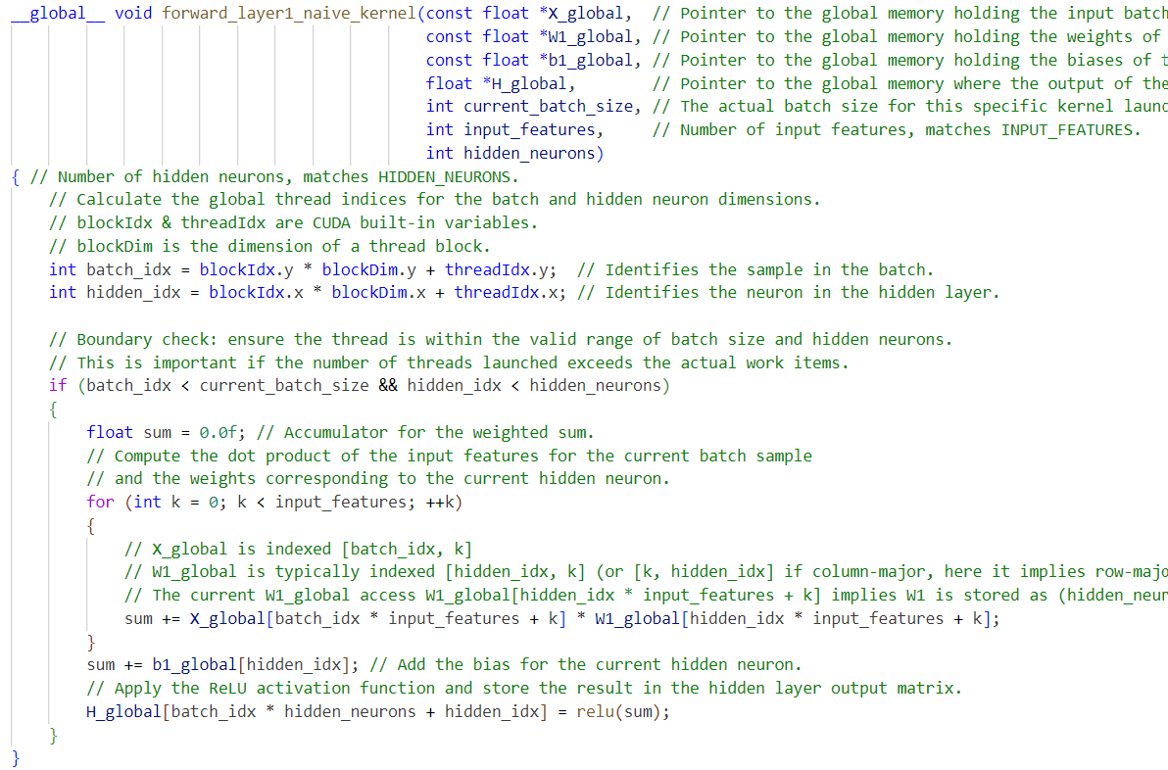
M. Gemelli – F. Nocella

Slide 17
Optimization: cuBLAS
What it is: cuBLAS is NVIDIA's high-performance library for Basic Linear Algebra Subprograms (BLAS), specifically optimized for GPUs.
Core Function: It provides a rich set of routines for vector and matrix operations (e.g., dot products, matrix-vector multiplication, matrix-matrix multiplication).
Primary Goal: To accelerate linear algebra computations significantly by leveraging the massive parallel processing power of NVIDIA GPUs.
M. Gemelli – F. Nocella

Slide 18
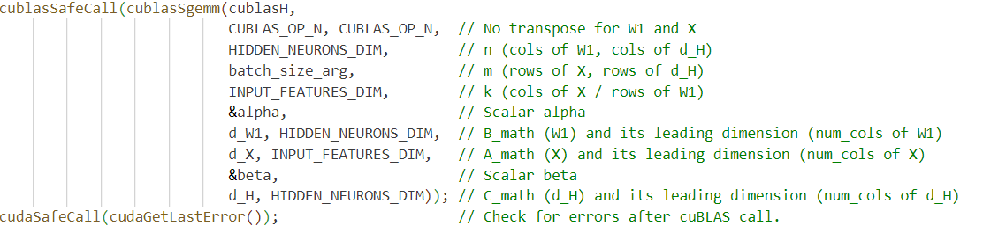
cuBLAS kernel
M. Gemelli – F. Nocella

Slide 19
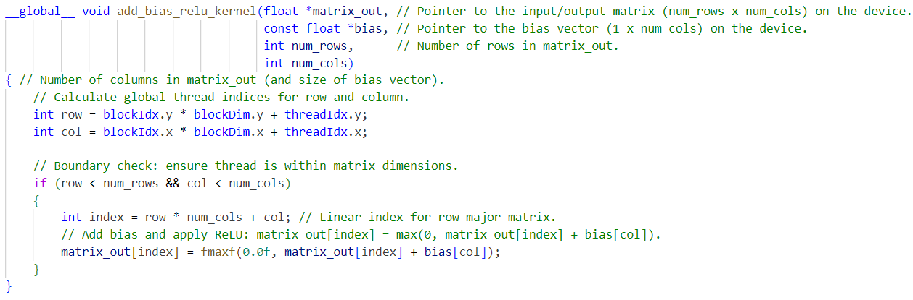
Custom ReLU & bias kernel
M. Gemelli – F. Nocella

Slide 20
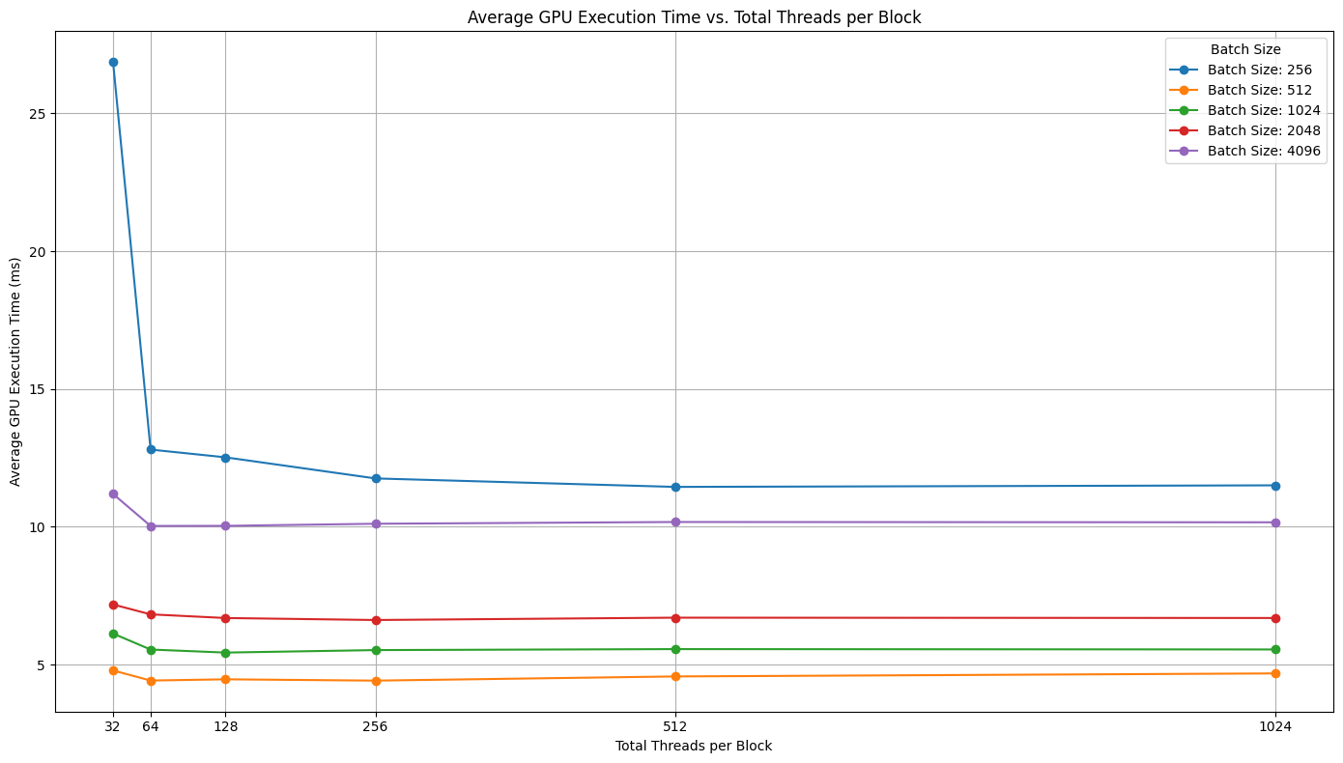
Opt. version: Avg. Exec. Time
M. Gemelli – F. Nocella

Slide 21
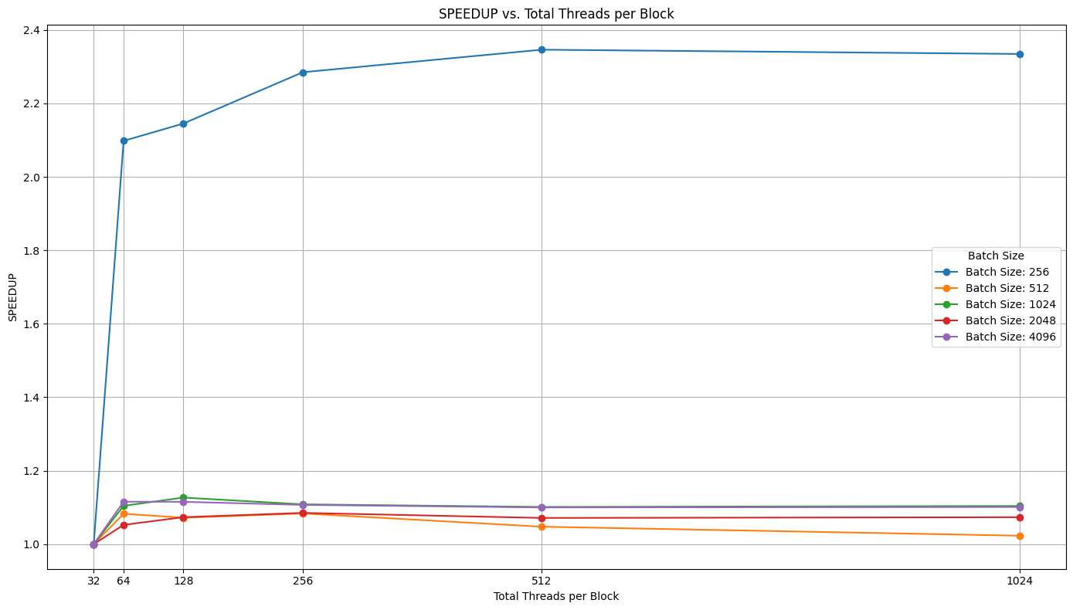
Opt. version: Speed-up
M. Gemelli – F. Nocella

Slide 22
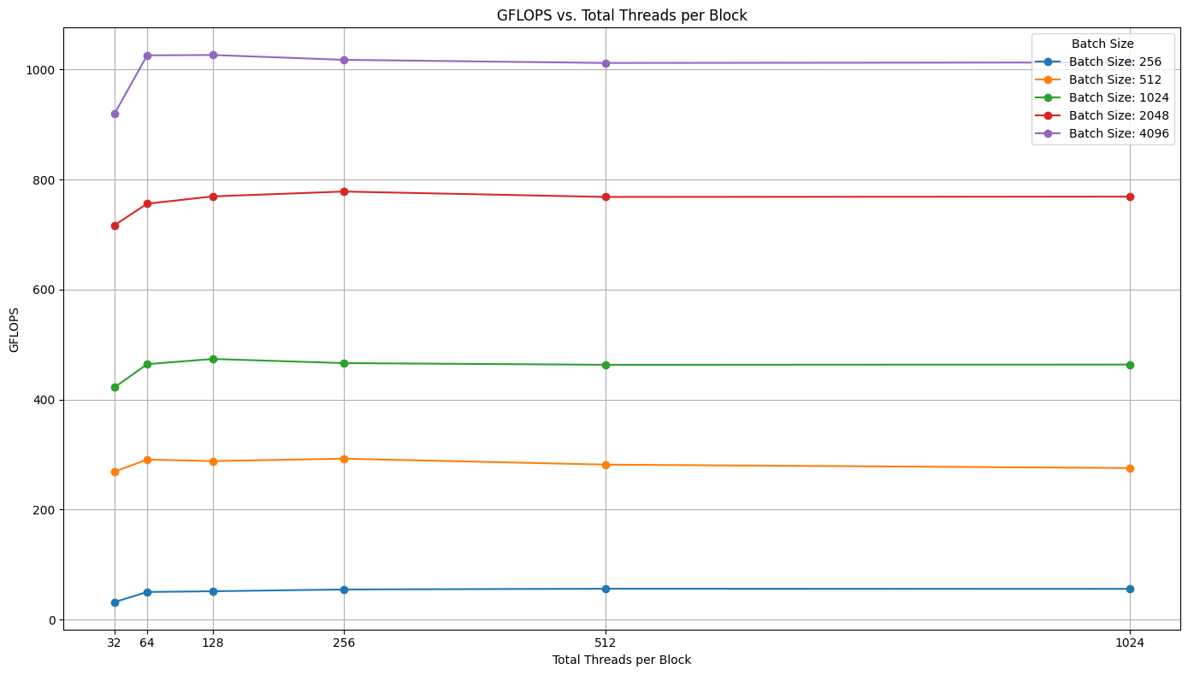
Opt. version: GFLOPs
M. Gemelli – F. Nocella

Slide 23
Summary
Ideal number of threads per block: 64
Avg. Exec. Time (ms) with a batch size of 4096 records: ~10 ms
Speed-up (with respect to 32 threads per block): ~1.2
GFLOPs with a batch size of 4096 records: > 1000
M. Gemelli – F. Nocella

Slide 24
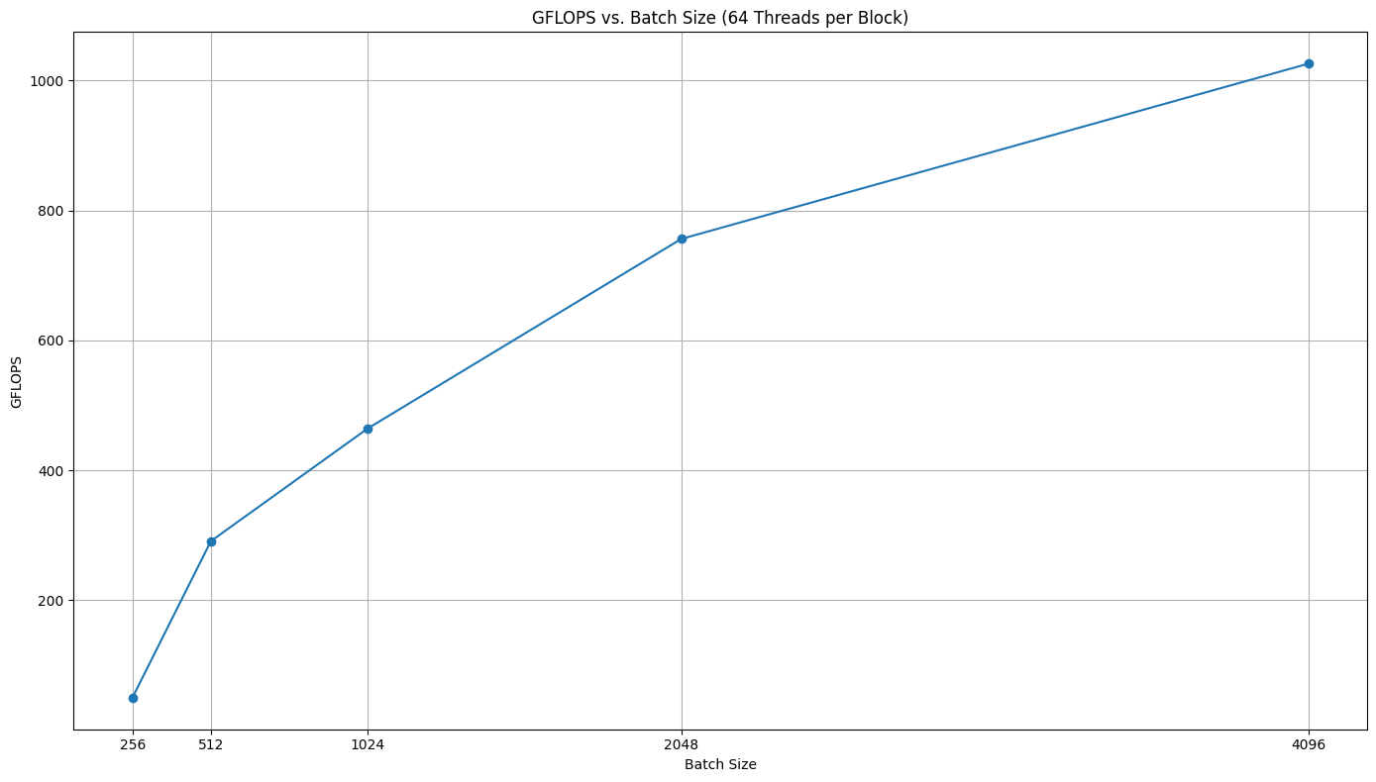
Opt. version: Batch scaling
M. Gemelli – F. Nocella

Slide 25
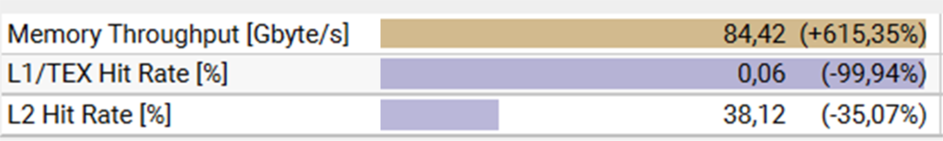
Comparison with old version
M. Gemelli – F. Nocella

Slide 26
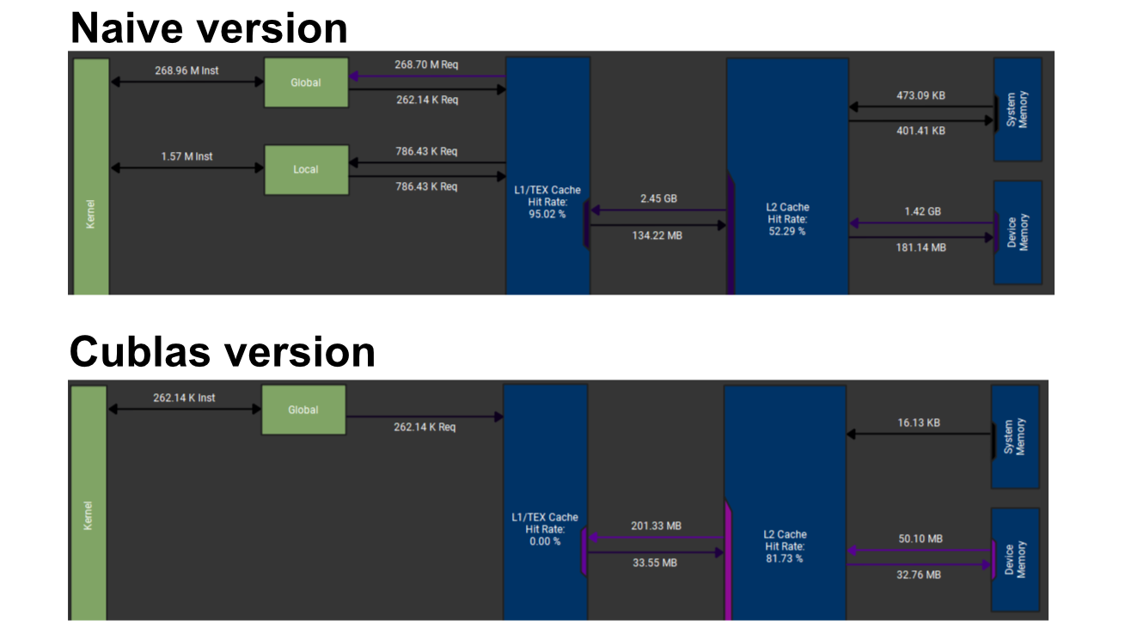
M. Gemelli – F. Nocella

Slide 27
Conclusion
Metric | Result
Execution Time (Duration in ms) | Approximately 25 times faster (from 250ms to ~10ms)
Computational Throughput (GFLOPS) | Increased by over 22 times (from ~44 to >1000)
Scaling with batch size | Optimized performance scales effectively with increasing batch size up to 4096, whereas the initial version stabilized at batch size of 1024.
*Results related to 64 threads per block & batch size of 4096
M. Gemelli – F. Nocella

