Slide 1
ThreadPoolExecutor线程池
架构部 20180823

Slide 2
ThreadPoolExecutor线程池内幕和使用方式
1、踩过的那些坑
2、线程池类的结构图
3、关键组件与初始化
4、线程启动时机
5、工作原理总结
6、常用的线程池

Slide 3
踩过的坑
public void investBatch(List<TXXDTO> tran, ThreadPoolExecutor pool) throws InterruptedException{
int poolCount = 20; /** 线程数 */
for(int index=0;index < dataSize;){
if(pool.getActiveCount() < poolCount){
TransTask task = new TransTask();
pool.execute(task);//省略index控制
}
Thread.sleep(100);
}
}
Notes:
贷款业务拓扑图

Slide 4
踩过的坑
public void investBatch(List<TXXDTO> tran, ThreadPoolExecutor pool) throws InterruptedException{
for(int index=0;index < dataSize;){
TransTask task = new TransTask();
pool.execute(task);//省略index控制
}
}
Notes:
贷款业务拓扑图

Slide 5
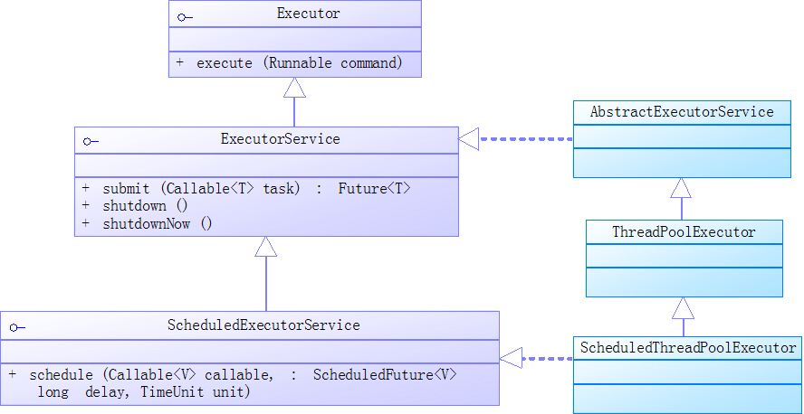
线程池类的结构图
Notes:
向前AppServer业务拓扑图

Slide 6
线程池构造方法
public ThreadPoolExecutor(int corePoolSize, int maximumPoolSize, long keepAliveTime, TimeUnit unit, BlockingQueue<Runnable> workQueue, ThreadFactory threadFactory, RejectedExecutionHandler handler) { ... ... this.corePoolSize = corePoolSize; this.maximumPoolSize = maximumPoolSize; this.workQueue = workQueue; this.keepAliveTime = unit.toNanos(keepAliveTime); this.threadFactory = threadFactory; this.handler = handler; }
//核心池的大小
//线程池最大线程数
//待执行的任务阻塞队列
//回收线程的等待时长
//线程工厂
//拒绝处理任务时的策略
Notes:
贷款业务拓扑图

Slide 7
private final class Worker extends AbstractQueuedSynchronizer implements Runnable {
final Thread thread;
Runnable firstTask;
Worker(Runnable firstTask) { setState(-1); this.firstTask = firstTask; this.thread = getThreadFactory().newThread(this); }
public void run() { runWorker(this); }
}
Notes:
贷款业务拓扑图

Slide 8
private volatile int corePoolSize;
private volatile int maximumPoolSize;
private volatile long keepAliveTime;
private final BlockingQueue<Runnable> workQueue;
private volatile ThreadFactory threadFactory;
private volatile RejectedExecutionHandler handler;
private final HashSet<Worker> workers = new HashSet<Worker>();
Notes:
贷款业务拓扑图

Slide 9
public static class CallerRunsPolicy implements RejectedExecutionHandler { public CallerRunsPolicy() { } public void rejectedExecution(Runnable r, ThreadPoolExecutor e) { if (!e.isShutdown()) { r.run(); } } }
由调用线程处理该任务
Notes:
贷款业务拓扑图

Slide 10
public static class AbortPolicy implements RejectedExecutionHandler { public AbortPolicy() { } public void rejectedExecution(Runnable r, ThreadPoolExecutor e) { throw new RejectedExecutionException("Task " + r.toString() + " rejected from " + e.toString()); } }
丢弃任务并抛出RejectedExecutionException异常
Notes:
贷款业务拓扑图

Slide 11
public static class DiscardPolicy implements RejectedExecutionHandler { public DiscardPolicy() { } public void rejectedExecution(Runnable r, ThreadPoolExecutor e) { } }
丢弃任务，但是不抛出异常
Notes:
贷款业务拓扑图

Slide 12
public static class DiscardOldestPolicy implements RejectedExecutionHandler { public DiscardOldestPolicy() { } public void rejectedExecution(Runnable r, ThreadPoolExecutor e) { if (!e.isShutdown()) { e.getQueue().poll(); e.execute(r); } } } }
丢弃队列最前面的任务，然后重新尝试执行任务（重复此过程）
Notes:
贷款业务拓扑图

Slide 13
public void execute(Runnable command) { int c = ctl.get(); if (workerCountOf(c) < corePoolSize) { if (addWorker(command, true)) return; c = ctl.get(); } if (isRunning(c) && workQueue.offer(command)) { int recheck = ctl.get(); if (! isRunning(recheck) && remove(command)) reject(command); else if (workerCountOf(recheck) == 0) addWorker(null, false); } else if (!addWorker(command, false)) reject(command); }
Notes:
/* * Proceed in 3 steps: * * 1. If fewer than corePoolSize threads are running, try to * start a new thread with the given command as its first * task. The call to addWorker atomically checks runState and * workerCount, and so prevents false alarms that would add * threads when it shouldn't, by returning false. * * 2. If a task can be successfully queued, then we still need * to double-check whether we should have added a thread * (because existing ones died since last checking) or that * the pool shut down since entry into this method. So we * recheck state and if necessary roll back the enqueuing if * stopped, or start a new thread if there are none. * * 3. If we cannot queue task, then we try to add a new * thread. If it fails, we know we are shut down or saturated * and so reject the task. */

Slide 14
private boolean addWorker(Runnable firstTask, boolean core) { //…基于CAS+死循环实现的关于线程池状态，线程数量的校验与更新逻辑… try { w = new Worker(firstTask); final Thread t = w.thread;
//加锁之后仍旧是判断线程池状态等一些校验逻辑。 //… … workers.add(w); workerAdded = true; if (workerAdded) { t.start(); workerStarted = true; } }
return workerStarted; }
Notes:
addWorker方法主要做的工作就是新建一个Woker线程，加入到woker集合中，然后启动该线程，那么接下来的重点就是Woker类的run方法了

Slide 15
final void runWorker(Worker w) {
Runnable task = w.firstTask;
try {
while (task != null || (task = getTask()) != null) {
try {
task.run();
} catch (Throwable x) {
thrown = x; throw new Error(x);
}
}
} finally {
processWorkerExit(w, completedAbruptly);
}
}
Notes:
贷款业务拓扑图

Slide 16
private final HashSet<Worker> workers = new HashSet<Worker>();
Notes:
贷款业务拓扑图

Slide 17
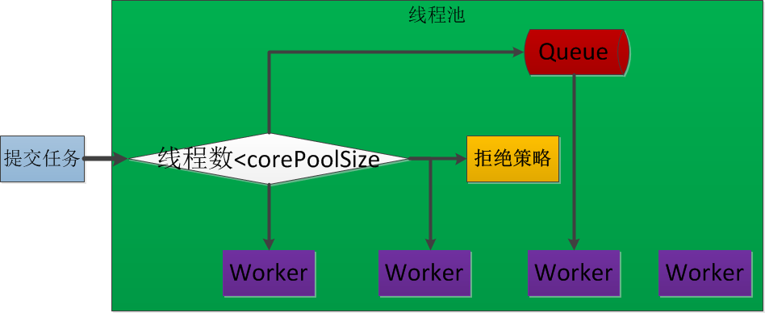
Notes:
贷款业务拓扑图

Slide 18
单线程线程池
public static ExecutorService newSingleThreadExecutor() { return new FinalizableDelegatedExecutorService (new ThreadPoolExecutor(1, 1, 0L, TimeUnit.MILLISECONDS, new LinkedBlockingQueue<Runnable>())); }
Notes:
贷款业务拓扑图

Slide 19
定长的线程池
public static ExecutorService newFixedThreadPool(int nThreads) { return new ThreadPoolExecutor(nThreads, nThreads, 0L, TimeUnit.MILLISECONDS, new LinkedBlockingQueue<Runnable>()); }
Notes:
贷款业务拓扑图

Slide 20
可缓存的线程池
public static ExecutorService newCachedThreadPool() { return new ThreadPoolExecutor(0, Integer.MAX_VALUE, 60L, TimeUnit.SECONDS, new SynchronousQueue<Runnable>()); }
Notes:
贷款业务拓扑图

Slide 21
周期性执行任务的线程池
public static ScheduledExecutorService newScheduledThreadPool(int corePoolSize) { return new ScheduledThreadPoolExecutor(corePoolSize); }
Notes:
贷款业务拓扑图

Slide 22
private final HashSet<Worker> workers = new HashSet<Worker>();
Notes:
贷款业务拓扑图

Slide 23
private final HashSet<Worker> workers = new HashSet<Worker>();
Notes:
贷款业务拓扑图

Slide 24
private final HashSet<Worker> workers = new HashSet<Worker>();
Notes:
贷款业务拓扑图

