Slide 1
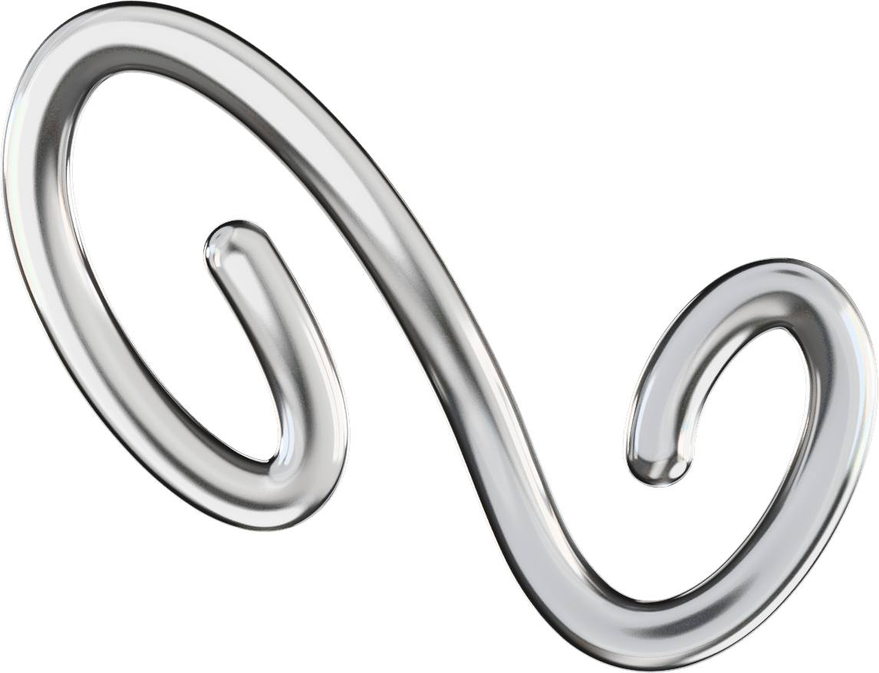
Author:
Francisco Sandoval Hernández
Word-Level ASL Recognition
from Hand Landmarks
Tutor:
Dr. Moisés Martínez Muñoz
Notes:
Quitar presented
Todo titulo en negrita
Nombre moises

Slide 2
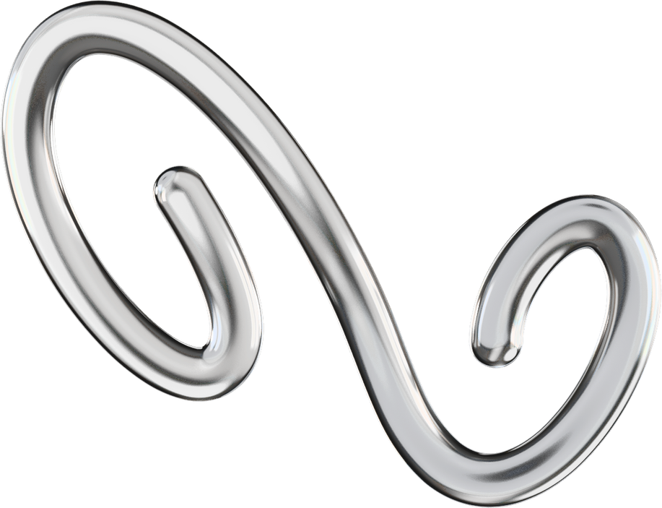
Agenda Overview
01
Introduction
02
Goals
03
Work Plan
Architecture
05
Experimental Approach
04
06
Results
07
Ethical Analysis
08
Conclusion
Notes:
05 technical research
06 evaluation

Slide 3

Introduction
THE PROBLEM
Sign languages are natural languages with their own visual-spatial structure, not simple gesture codes. Their meaning emerges from hand shape, motion, orientation, location, and timing.
WHY IS IT HARD?
The same sign varies across signers, viewpoints, execution speeds, and recording conditions, limiting the reach of every accessibility tool that depends on it.
01
Notes:
La solucion no vuelva a decir el problema, simplemente decir "construir herramienta movil.."

Slide 4

Goals
MAIN GOAL
Design, implement, and experimentally validate a research prototype for word-level American Sign Language (ASL) recognition from short video clips, using hand-landmark representations and temporal neural models.
RESEARCH HYPOTHESIS
Can hand-landmark sequences provide enough information for a temporal model to classify short ASL video clips into word glosses?
02
Notes:
HACER HIPOTESIS MAS GRANDE
METER GIF DE SIGNO

Slide 5
Specific Goals
SO1
S02
S03
Analyse the technical and scientific background of SLR.
Define a landmark-based data representation for ASL clips.
Compare candidate temporal architectures under matched conditions.
S04
S05
S06
Validate the winner model with statistically meaningful protocols.
Verify generalisation through cross-dataset and vocabulary scaling.
Build a runtime prototype and evaluate the ethical implications.
S07
EXTRA BEYOND RESEARCH SCOPE
Deploy a fully functional mobile prototype with real-time ASL recognition.
03

Slide 6
Work Plan
WORK PACKAGES
JANUARY
FEBRUARY
MARCH
APRIL
MAY
Project Framing
Hand Detection (pivot)
Landmark Baseline
Vocabulary Scaling & Ethics
Mobile Prototype
Modular Refactor
Documentation
Pivot
MVP
04
Notes:
MVP NO SUBMISSION
SUBDIVIDIDA EN DOS
DEMUESTRA TU TRABAJO LOS TIEMPOS DE VERDAD

Slide 7
Work Plan
WORK PACKAGES
JANUARY
FEBRUARY
MARCH
APRIL
MAY
Project Framing
Hand Detection (pivot)
Landmark Baseline
Vocabulary Scaling & Ethics
Mobile Prototype
Modular Refactor
Documentation
Pivot
MVP
05
Notes:
MVP NO SUBMISSION
SUBDIVIDIDA EN DOS
DEMUESTRA TU TRABAJO LOS TIEMPOS DE VERDAD

Slide 8
Architecture
Training Architecture
Inference Architecture
06

Slide 9
Training
Architecture
Data Ingestion
Feature Extraction
Model Training
model.pt
WLASL / MS-ASL
MediaPipe Hands
GRU + Attention
Experiment Manifests
YAML Configs / Git / Metrics / Confusion Matrices
07
Notes:
PONER COMO EN INFERENCE PERO UNA IMAGEN ESTATICA
MOVERLA UN POCO Y PONER MODEL REGESTRY DONDE EL BEST MODEL PT

Slide 10
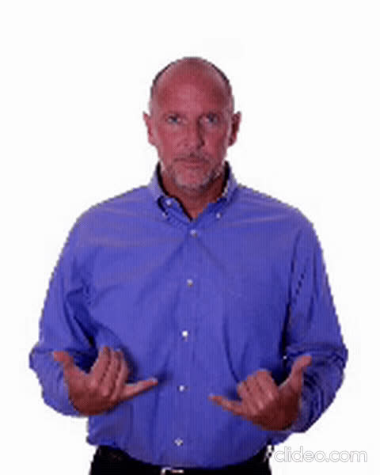
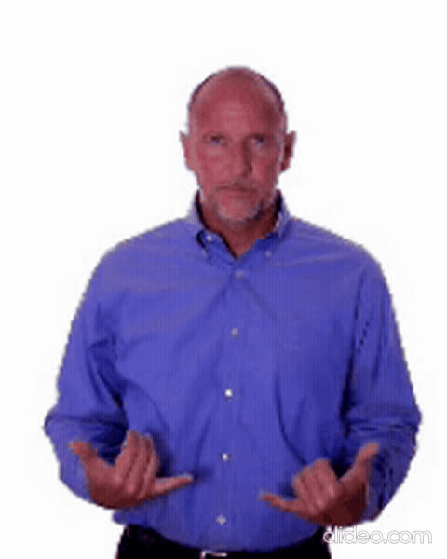
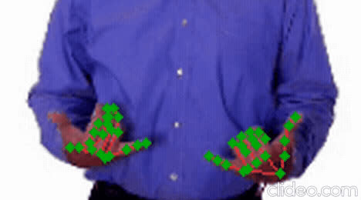
Inference
Architecture
Mobile Client
FastAPI
Server
MediaPipe
Hands
GRU + Attention
Expo &
React Native
Uvicorn
21 key
points/frame
Model
Top-K Prediction
“no” 0.87 / “before” 0.06 / “cool” 0.03
08
Notes:
HACER TAMAÑO DE TODO IGUAL
PONER LO QUE HE ENSEÑADO AL PRINCIPIO EN CADA FASE DE VERDAD QUE SEA VEA UN VIDEO, LOS FRAMES Y DEMAS
LUCIR ESPECIFICOS

Slide 11
RESEARCH QUESTION
Can hand-landmark sequences provide enough information for a temporal model to classify short ASL video clips into word glosses?
EXPERIMENTAL APPROACH
01
02
03
DATASET PREPARATION
ARCHITECTURE SELECTION
SEQUENCE SWEEP
MediaPipe 21 keypoints
GRU + Attention
64 frames / stability
04
05
06
WLASL30 VALIDATION
CROSS DATASET
VOCABULARY SCALING
5-Fold CV + multi-seed
MS-ASL50 generalisation
WLASL 30 → 1500
09

Slide 12
EXPERIMENTAL RESULTS - DETAILED
Results
EXPERIMENT / CONDITION
SETUP
TOP-1 (%)
TOP-5 (%)
NOTE
02 ARCHITECTURE SELECTION (WLASL30, multi-seed)
LSTM
landmark-based
41.18
67.65
baseline recurrent
GRU
landmark-based
38.24
76.47
plain recurrent
GRU + Features
hand-engineered
47.06
79.41
enriched input
GRU + Attention
temporal attention
58.82
91.18
WINNER
Transformer
self-attention
50.00
73.53
underfits low-data
04 STATISTICAL VALIDATION (WLASL30 Winner)
5-Fold CV
WLASL100 → 30
63.85 ± 4.50
86.46 ± 2.04
headline number
Multi-seed
fixed split / 3 seeds
58.82 ± 2.94
78.43 ± 4.49
stability check
05 CROSS-DATASET GENERALISATION (no architectural changes)
WLASL30
30 classes / 34 test
58.82 ± 2.94
78.43 ± 4.49
baseline
MS-ASL50
50 classes / 236 test
70.20 ± 2.89
90.54 ± 0.89
σ ≈ WLASL30 σ
06 VOCABULARY SCALING (WLASL, single seed)
100 classes
795 train
44.70
70.45
−14 pp vs 30
300 classes
1,974 train
28.61
59.72
log-linear regime
700 classes
3,879 train
19.57
42.66
instability threshold
1000 classes
5,122 train
11.19
31.24
−47 pp vs 30
1500 classes
6,864 train 4.6 vid/class
9.76
28.23
data starvation
Experiments 01 (preparation) and 03 (sequence sweep, σ=0.93pp selected 64 frames) summarised in setup..
key results
10
Notes:
PONER EN NEGRITA LAS QUE HAN GANADO

Slide 13
EXPERIMENTAL RESULTS - DETAILED
Results
EXPERIMENT / CONDITION
SETUP
TOP-1 (%)
TOP-5 (%)
NOTE
02 ARCHITECTURE SELECTION (WLASL30, multi-seed)
LSTM
landmark-based
41.18
67.65
baseline recurrent
GRU
landmark-based
38.24
76.47
plain recurrent
GRU + Features
hand-engineered
47.06
79.41
enriched input
GRU + Attention
temporal attention
58.82
91.18
WINNER
Transformer
self-attention
50.00
73.53
underfits low-data
04 STATISTICAL VALIDATION (WLASL30 Winner)
5-Fold CV
WLASL100 → 30
63.85 ± 4.50
86.46 ± 2.04
headline number
Multi-seed
fixed split / 3 seeds
58.82 ± 2.94
78.43 ± 4.49
stability check
05 CROSS-DATASET GENERALISATION (no architectural changes)
WLASL30
30 classes / 34 test
58.82 ± 2.94
78.43 ± 4.49
baseline
MS-ASL50
50 classes / 236 test
70.20 ± 2.89
90.54 ± 0.89
σ ≈ WLASL30 σ
06 VOCABULARY SCALING (WLASL, single seed)
100 classes
795 train
44.70
70.45
−14 pp vs 30
300 classes
1,974 train
28.61
59.72
log-linear regime
700 classes
3,879 train
19.57
42.66
instability threshold
1000 classes
5,122 train
11.19
31.24
−47 pp vs 30
1500 classes
6,864 train 4.6 vid/class
9.76
28.23
data starvation
Experiments 01 (preparation) and 03 (sequence sweep, σ=0.93pp selected 64 frames) summarised in setup..
key results
11
Notes:
PONER EN NEGRITA LAS QUE HAN GANADO

Slide 14
EXPERIMENTAL RESULTS - DETAILED
Results
EXPERIMENT / CONDITION
SETUP
TOP-1 (%)
TOP-5 (%)
NOTE
02 ARCHITECTURE SELECTION (WLASL30, multi-seed)
LSTM
landmark-based
41.18
67.65
baseline recurrent
GRU
landmark-based
38.24
76.47
plain recurrent
GRU + Features
hand-engineered
47.06
79.41
enriched input
GRU + Attention
temporal attention
58.82
91.18
WINNER
Transformer
self-attention
50.00
73.53
underfits low-data
04 STATISTICAL VALIDATION (WLASL30 Winner)
5-Fold CV
WLASL100 → 30
63.85 ± 4.50
86.46 ± 2.04
headline number
Multi-seed
fixed split / 3 seeds
58.82 ± 2.94
78.43 ± 4.49
stability check
05 CROSS-DATASET GENERALISATION (no architectural changes)
WLASL30
30 classes / 34 test
58.82 ± 2.94
78.43 ± 4.49
baseline
MS-ASL50
50 classes / 236 test
70.20 ± 2.89
90.54 ± 0.89
σ ≈ WLASL30 σ
06 VOCABULARY SCALING (WLASL, single seed)
100 classes
795 train
44.70
70.45
−14 pp vs 30
300 classes
1,974 train
28.61
59.72
log-linear regime
700 classes
3,879 train
19.57
42.66
instability threshold
1000 classes
5,122 train
11.19
31.24
−47 pp vs 30
1500 classes
6,864 train 4.6 vid/class
9.76
28.23
data starvation
Experiments 01 (preparation) and 03 (sequence sweep, σ=0.93pp selected 64 frames) summarised in setup..
key results
12
Notes:
PONER EN NEGRITA LAS QUE HAN GANADO

Slide 15
EXPERIMENTAL RESULTS - DETAILED
Results
EXPERIMENT / CONDITION
SETUP
TOP-1 (%)
TOP-5 (%)
NOTE
02 ARCHITECTURE SELECTION (WLASL30, multi-seed)
LSTM
landmark-based
41.18
67.65
baseline recurrent
GRU
landmark-based
38.24
76.47
plain recurrent
GRU + Features
hand-engineered
47.06
79.41
enriched input
GRU + Attention
temporal attention
58.82
91.18
WINNER
Transformer
self-attention
50.00
73.53
underfits low-data
04 STATISTICAL VALIDATION (WLASL30 Winner)
5-Fold CV
WLASL100 → 30
63.85 ± 4.50
86.46 ± 2.04
headline number
Multi-seed
fixed split / 3 seeds
58.82 ± 2.94
78.43 ± 4.49
stability check
05 CROSS-DATASET GENERALISATION (no architectural changes)
WLASL30
30 classes / 34 test
58.82 ± 2.94
78.43 ± 4.49
baseline
MS-ASL50
50 classes / 236 test
70.20 ± 2.89
90.54 ± 0.89
σ ≈ WLASL30 σ
06 VOCABULARY SCALING (WLASL, single seed)
100 classes
795 train
44.70
70.45
−14 pp vs 30
300 classes
1,974 train
28.61
59.72
log-linear regime
700 classes
3,879 train
19.57
42.66
instability threshold
1000 classes
5,122 train
11.19
31.24
−47 pp vs 30
1500 classes
6,864 train 4.6 vid/class
9.76
28.23
data starvation
Experiments 01 (preparation) and 03 (sequence sweep, σ=0.93pp selected 64 frames) summarised in setup..
key results
13
Notes:
PONER EN NEGRITA LAS QUE HAN GANADO

Slide 16
EXPERIMENTAL RESULTS - DETAILED
Results
EXPERIMENT / CONDITION
SETUP
TOP-1 (%)
TOP-5 (%)
NOTE
02 ARCHITECTURE SELECTION (WLASL30, multi-seed)
LSTM
landmark-based
41.18
67.65
baseline recurrent
GRU
landmark-based
38.24
76.47
plain recurrent
GRU + Features
hand-engineered
47.06
79.41
enriched input
GRU + Attention
temporal attention
58.82
91.18
WINNER
Transformer
self-attention
50.00
73.53
underfits low-data
04 STATISTICAL VALIDATION (WLASL30 Winner)
5-Fold CV
WLASL100 → 30
63.85 ± 4.50
86.46 ± 2.04
headline number
Multi-seed
fixed split / 3 seeds
58.82 ± 2.94
78.43 ± 4.49
stability check
05 CROSS-DATASET GENERALISATION (no architectural changes)
WLASL30
30 classes / 34 test
58.82 ± 2.94
78.43 ± 4.49
baseline
MS-ASL50
50 classes / 236 test
70.20 ± 2.89
90.54 ± 0.89
σ ≈ WLASL30 σ
06 VOCABULARY SCALING (WLASL, single seed)
100 classes
795 train
44.70
70.45
−14 pp vs 30
300 classes
1,974 train
28.61
59.72
log-linear regime
700 classes
3,879 train
19.57
42.66
instability threshold
1000 classes
5,122 train
11.19
31.24
−47 pp vs 30
1500 classes
6,864 train 4.6 vid/class
9.76
28.23
data starvation
Experiments 01 (preparation) and 03 (sequence sweep, σ=0.93pp selected 64 frames) summarised in setup..
key results
14
Notes:
PONER EN NEGRITA LAS QUE HAN GANADO

Slide 17
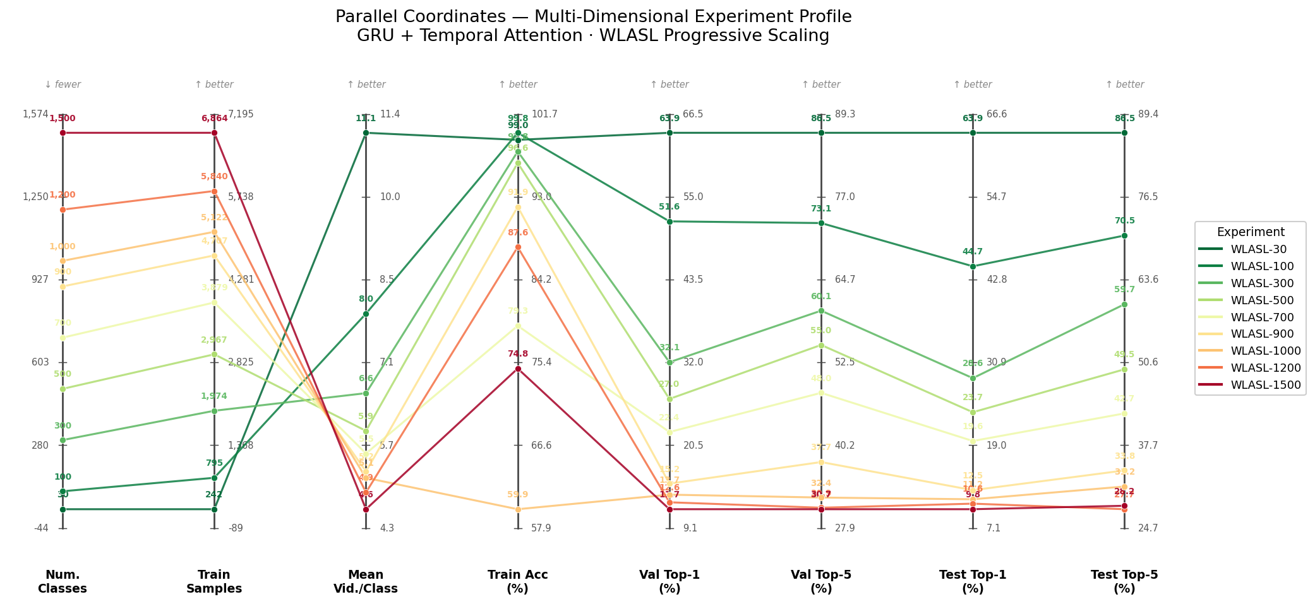
Results
15

Slide 18
USER STUDY GOOGLE FORMS
Qualitative
Validation
SignToText real users feedback
N=15 participants | 5min survey | Likert + open-ended
USABILITY DIMENSIONS (1–5 LIKERT)
NET PROMOTER SCORE
First impression
4.2
+40
UI clarity
4.0
(industry good: +30 to +50)
Result comprehension
3.7
Perceived speed
4.3
Perceived utility
4.5
MAIN FRICTION
Attention map and processing stats confused users without context
TOP-VALUED FEATURES (% MENTIONS)
  Top-K alternatives with confidence 87%
  Automatic text-to-speech 73%
  Multiple model selection 60%
16
Notes:
COJER LAS MISMAS DIMENSIONES QUE YA HE EXPLICADO EN TECHNICAL DEVELOPMENT

Slide 19
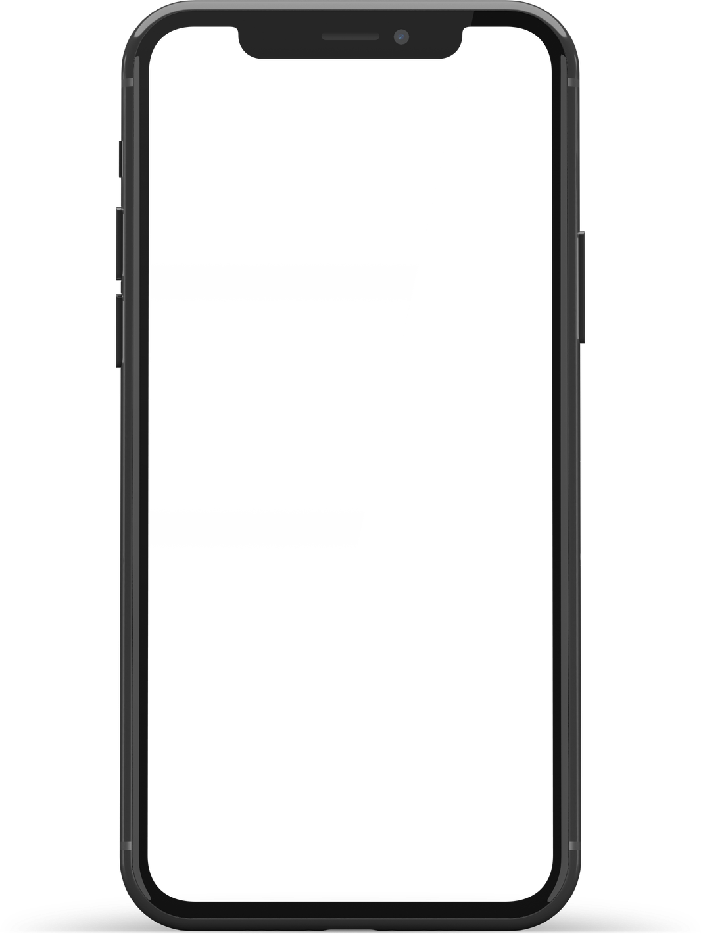
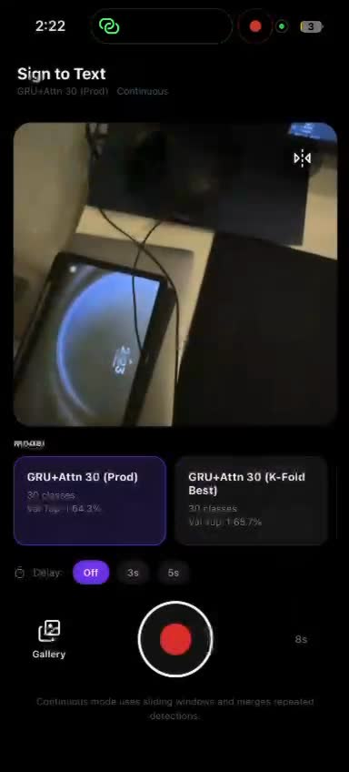
DEMO
17

Slide 20
FRAMEWORK
Ethical
Analysis
Google’s AI Principles
26 metrics | 7 principles | scored 0 / 5 / 10
SCORES BY PRINCIPLE
OVERALL
P6 Scientific Excellence
10
7.6
P3 Safety
8.8
/ 10
P1 Socially Beneficial
8.3
P4 Accountability
8.3
P7 Principled Availability
6.7
WEAKEST POINT
P2 Avoid Unfair Bias
6.3
Privacy in inference: raw frames on server
P5 Privacy
5
Key insight: MediaPipe landmarks as input originally a technical decision, propagate positive effects across P2 (bias), P5 (privacy) and P7 (misuse). One choice, three ethical wins.
18
Notes:
HACER MAS GRANDE LA CAJA NARANJA

Slide 21
Conclusions
ANSWERING THE RESEARCH QUESTION
“Can hand-landmark sequences provide enough information for a temporal model to classify short ASL video clips into word glosses?”
YES
Within the tested vocabulary scale, with reproducible stability across two ASL benchmarks ethically grounded.
GENERAL GOAL
Design, implement, and experimentally validate a research prototype for word-level ASL recognition from short video clips, using hand-landmark representations and temporal neural models.
19

Slide 22

CONCLUSIONS
Specific Goals
SO1
S02
S03
Technical background analysed
Landmark representation defined
5 architectures compared
State of the Art chapter
~69% WLASL ~84% MS-ASL50
GRU + Attention winner
S04
S05
S06
Statistical validation
Cross-dataset + scaling
Prototype + ethics
63.85% ± 4.50% 5-Fold CV
MS-ASL50 70.20% WLASL 30→1500
Mobile + FastAPI 7.6/10 ethics
S07
EXTRA DELIVERED
Real-time mobile app deployed
Expo + React Native & FastAPI backend / production-ready
20

Slide 23
FROM THIS RESEARCH TO
Next Steps
three frontiers worth pursuing
Beyond word-level & continuous translation
01
Move from isolated glosses to full ASL sentences, the open frontier of sign language recognition.
TECHNICAL
Cross-lingual sign transfer
02
Transfer the landmark-based pipeline from ASL to LSE, BSL, and beyond, since hand geometry is universal, vocabularies are not.
SCIENTIFIC
Privacy-first edge deployment
03
Move the entire pipeline on-device so only landmarks ever leave the phone, closing the privacy gap identified in the ethical analysis.
APPLIED
21
Notes:
METER:
COMPARARME CON LOS OTROS MODELOS EN UN ENTORNO QUE LOS OTROS MODELOS SE PUEDAN EJECUTAR, GPUS MAS GRANDES
EN LA DE TECHNICAL METER LO DE MINIATURIZAR

Slide 24
Author:
Francisco Sandoval Hernández
Thank You

