Slide 1
Location Analysis for Opening a Café in Buenos AIres
Applied Data Science Capstone
IBM Data Science Professional Certification

Slide 2
Problem
The project will focus on answering the following question:
Which neighborhoods could be the best options to opening a new café in Buenos Aires?

Slide 3
Data and Sources
* Population of each Neighborhood (Statistics and Census - City of Buenos Aires)
* Average Family Income per Neighborhood (Statistics and Census - City of Buenos Aires)
* Number of Café in each Neighborhood (Foursquare API)

Slide 4
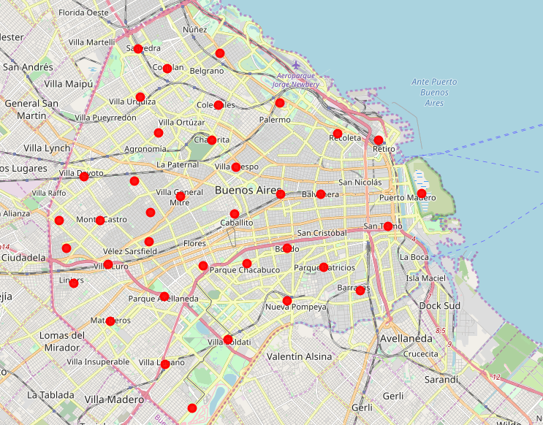
Map of Neighborhoods in Ciudad de Buenos Aires

Slide 5
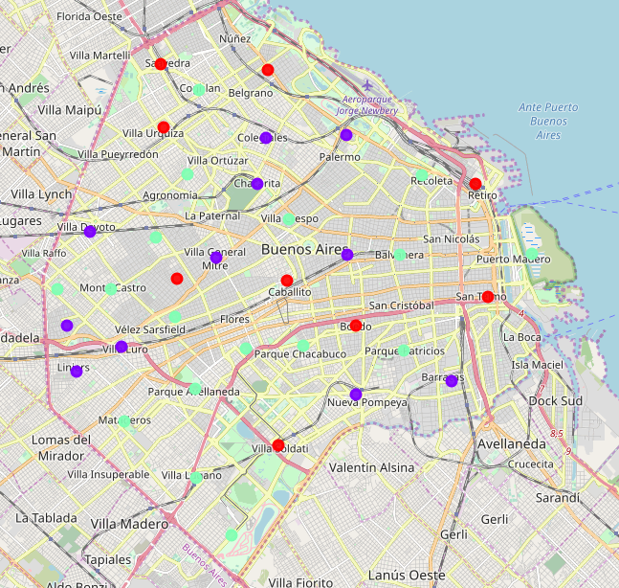
Clusters from Data

Slide 6
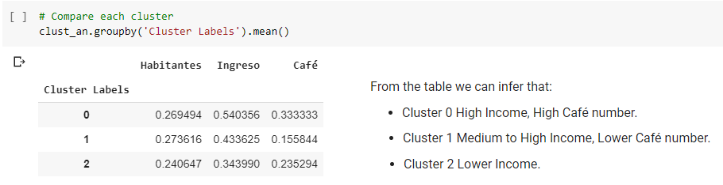
Cluster Analysis

Slide 7
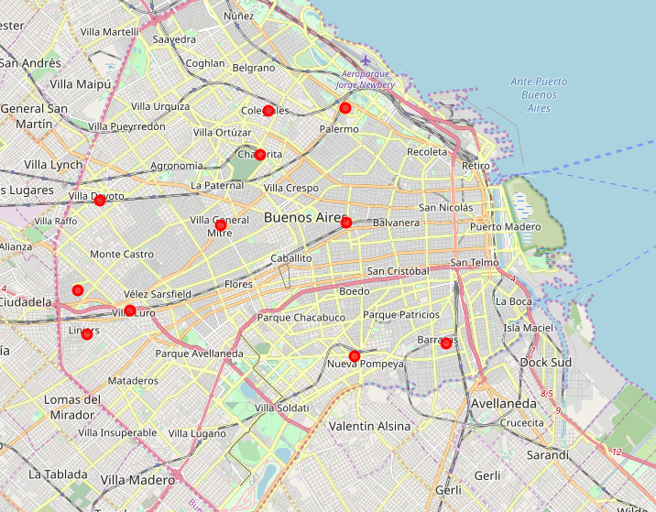
Selected Cluster

Slide 8
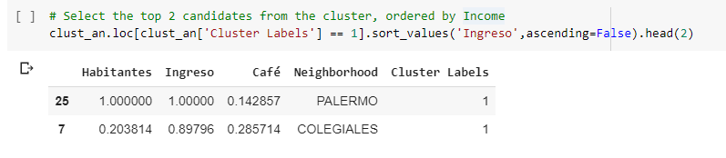
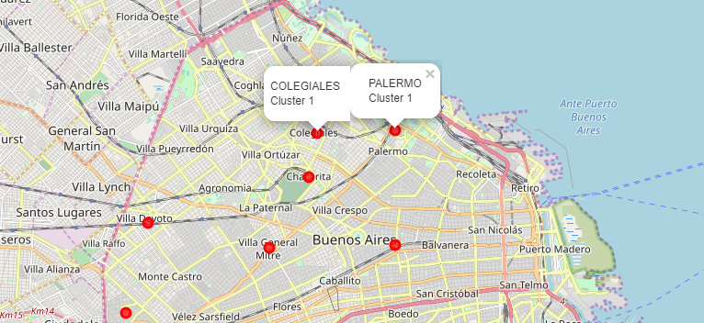
Further Analysis

Slide 9
Conclusion
The suggested location to open a Café based on the collected data and analysis would be Palermo or Colegiales

