Slide 1




Camera calibration
B.S.C.S. Franci Suni Lopez
B.S.C.S. Joel Gallegos Guillen

Slide 2
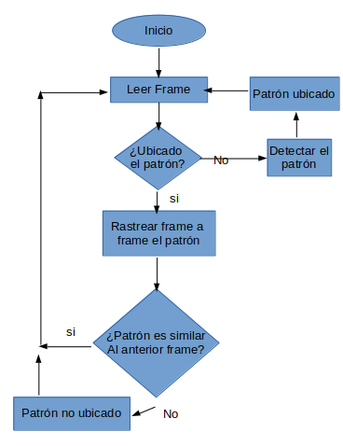
Steps

Slide 3
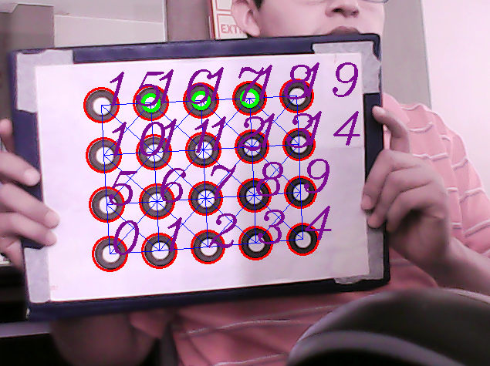
Improvements

Slide 4
Results: Reprojection Error
Calibration pattern: | Life Camera | PS3 Camera
Chessboard | 0.4177 | 0.4492
Asymmetric circles | 0.5392 | 0.3707
Rings | 0.30908 | 0.3858

Slide 5
Results: Intrinsic parameters
Calibration pattern | Life camera | PS3 camera
Chessboard | fx:4.0765380600964778e+02 fy:4.0765380600964778e+02 cx:320 cy:180 | fx:1.0328634161047403e+03 fy:1.0328634161047403e+03 cx:320 cy:240
Asymmetric circles | fx:6.0090198699826578e+02 fy:6.0090198699826578e+02 cx:320 cy:180 | fx:1.0186647088753891e+03 fy:1.0186647088753891e+03 cx:320 cy:240

Slide 6
Results: Intrinsic parameters
Rings | fx:5.1085980880453388e+02 fy:5.1085980880453388e+02 cx:320 cy:180 | fx:9.3986789376560171e+02 fy:9.3986789376560171e+02 cx:320 cy:240

Slide 7
Conclusion:
We got 0.3 of Reprojection error for both cameras.

Slide 8
Videos

Slide 9
Thanks!
¿Questions?

