Slide 1

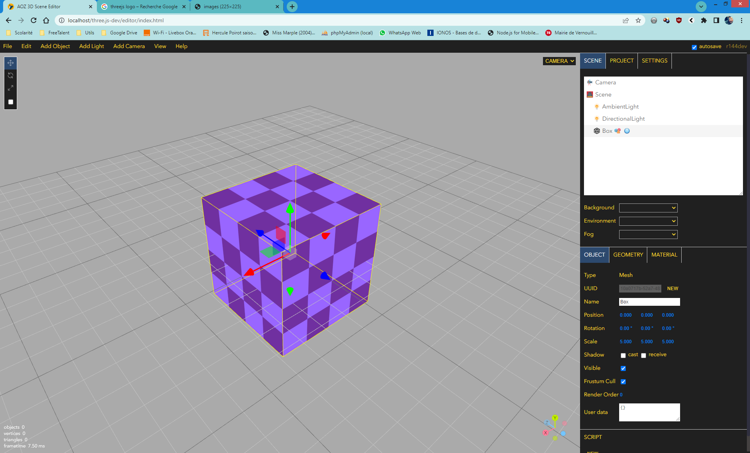

3D SCENE
Editor
Powered by

Slide 2


