Slide 1
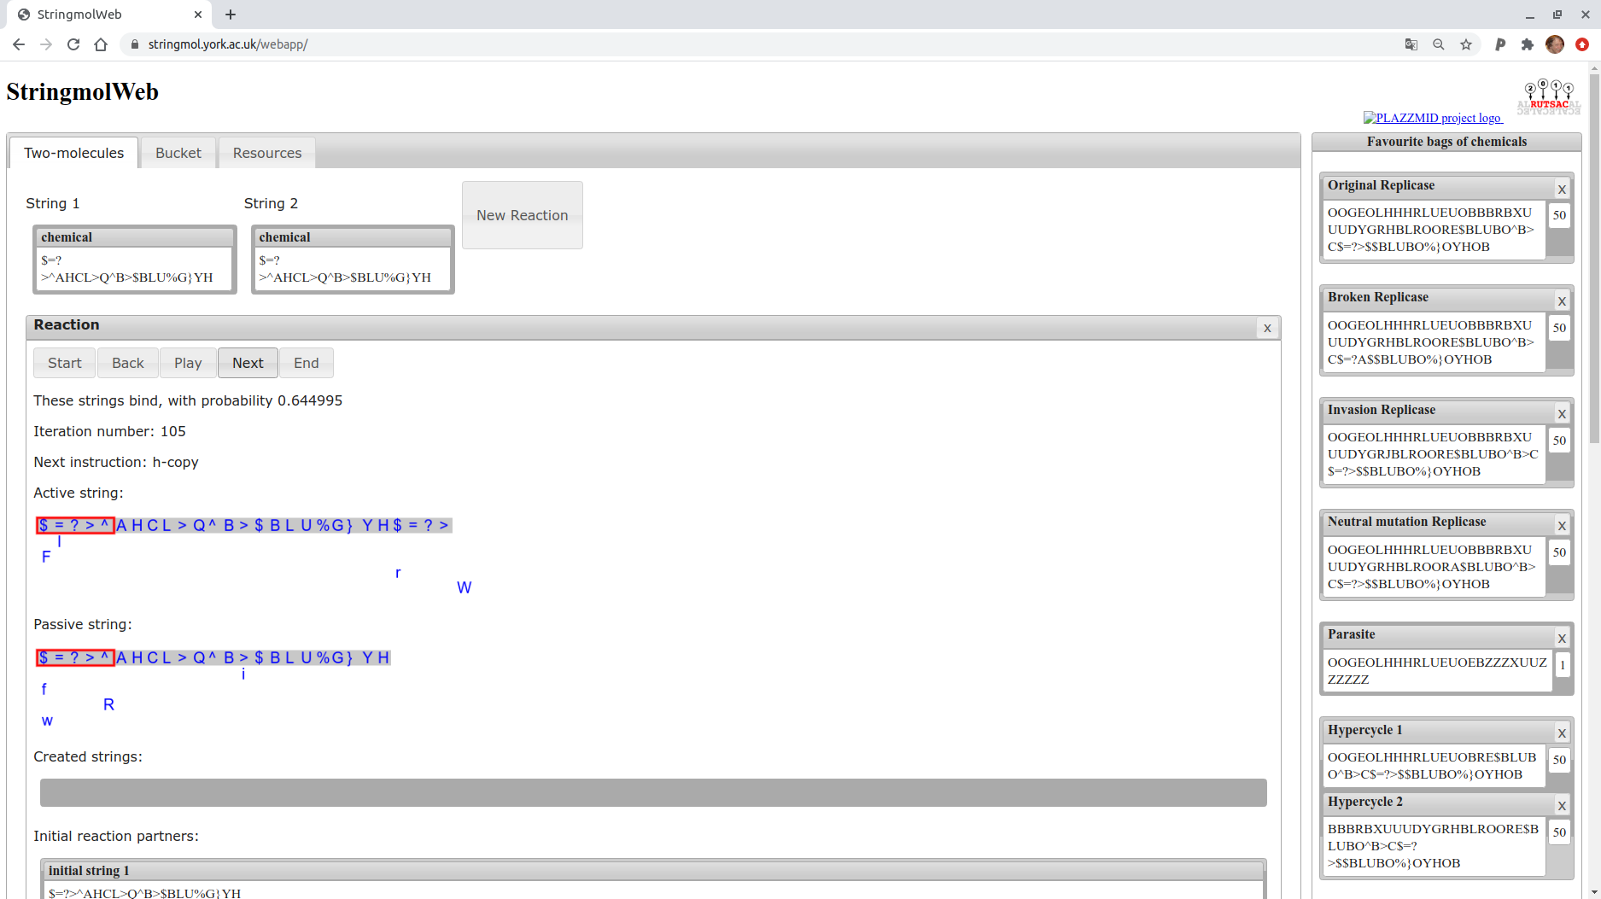
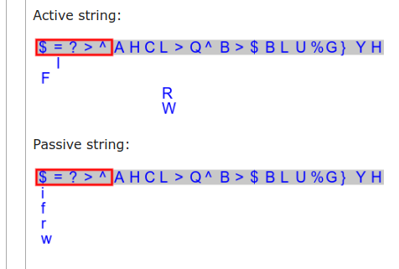
Copy operator functions
Append during
replication
Overwrite during
self-scan

Slide 2
If “R” and “W” are on
The same molecule...
Copying proceeds ad infinitum

