Slide 1
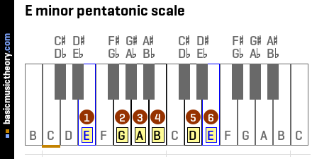
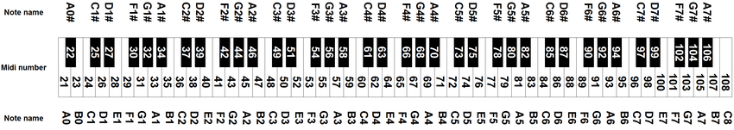
MIDI NOTES: 21,23,26,28,31,33,35,38,40,43,45,47,50,52,55,57,59,62,64,67,69,71,74,76,79,81,83,86,88,91,93,95,98,100,103,105,107

Slide 2
Random pattern workflow
MIDI mode
Generate new random pattern
Like it?
Store to EEPROM
Boot
SERIAL mode
print_serial
Stored pattern
From EEPROM

