Slide 1
Evolvable Shape Seeds:
Progress at York
Simon Hickinbotham
sjh518@york.ac.uk

Slide 2
Summary
Algorithm for ‘growing’ a set of seed genes
Strengths and weaknesses
Novelty search
Novelty search within SmartMaaS

Slide 3
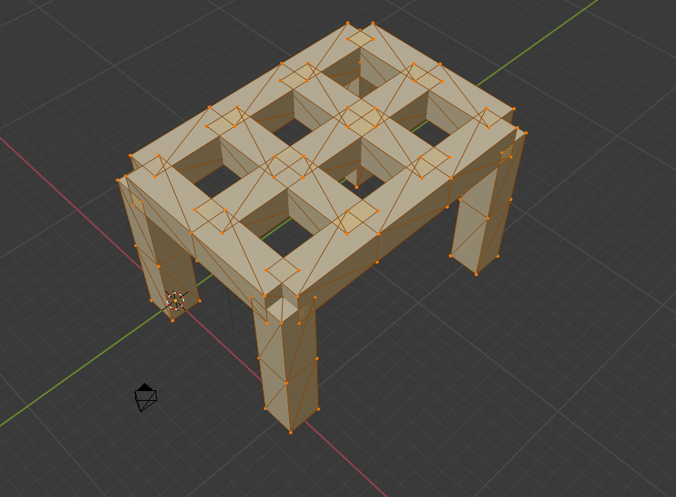
Target Shape

Slide 4
Gene Set
gene01 <- sgene("Cross section","Square",status = T,start=-40,stop=40,dom=1)
gene02 <- sgene("Length", 5,status = T,start=-40,stop= 40,dom= 1)
gene03 <- sgene("Diameter", 1,status = T,start=-40,stop= 40,dom= 0)
gene04 <- sgene("X_1X", 0,status = T,start= 0,stop= 1,dom=50)
gene05 <- sgene("Y_1Y", 0,status = T,start= 0,stop= 1,dom=50)
gene06 <- sgene("Z_1Z", 1,status = T,start= 0,stop= 5,dom=50)
gene16 <- sgene("T1_2X", 1,status = T,start= 0,stop= 5,dom=48)
gene17 <- sgene("T2_2Y", 1,status = T,start= 0,stop= 10,dom=48)
gene18 <- sgene("T1_2Z", 0,status = T,start= 0,stop= 15,dom=48)
gene19 <- sgene("T3_2X", 1,status = T,start= 0,stop= 1,dom=47)
gene20 <- sgene("T3_2Y", 0,status = T,start= 15,stop= 16,dom=47)
gene21 <- sgene("T3_2Z", -1,status = T,start= 6,stop= 10,dom=47)
gene22 <- sgene("T4_2X", 0,status = T,start= 10,stop= 11,dom=46)
gene23 <- sgene("T4_2Y", 1,status = T,start= 0,stop= 4,dom=46)
gene24 <- sgene("T4_2Z", -1,status = T,start= 6,stop= 10,dom=46)
gene25 <- sgene("T5_2X", 0,status = T,start= 10,stop= 11,dom=45)
gene26 <- sgene("T5_2Y", 1,status = T,start= 4,stop= 14,dom=45)
gene27 <- sgene("T5_2Z", 0,status = T,start= 6,stop= 10,dom=45)
gene28 <- sgene("T6_2X", 1,status = T,start= 5,stop= 9,dom=44)
gene29 <- sgene("T6_2Y", 0,status = T,start= 11,stop= 15,dom=44)
gene30 <- sgene("T6_2Z", 0,status = T,start= 6,stop= 10,dom=44)
gene31 <- sgene("L3_2X", 0,status = T,start= 0,stop=100,dom=43)
gene32 <- sgene("L3_2Y", 0,status = T,start= 0,stop= 15,dom=43)
gene33 <- sgene("L3_2Z", -1,status = T,start= 1,stop= 12,dom=43)
gene34 <- sgene("L4_2X", 0,status = T,start= 10,stop= 11,dom=51)
gene35 <- sgene("L4_2Y", 0,status = T,start=15,stop= 16,dom=51)
gene36 <- sgene("L4_2Z", -1,status = T,start= 1,stop= 10,dom=51)

Slide 5
Processing pseudocode
genetostlfile4 <- function(fn="shape.stl",genes,pos=spos(0,0,0),runlim=1000)
iterations <- 0
while (TRUE)
posnext <- NULL
for(pp in 1:nrow(pos))
shape <- getshape(pos[pp,],genes)
domval <- domInZone(pos[pp,],genes)
if(domval)
dirs <- genes[genes$dom == domval & dirs$valtyp!=0,]
for(dd in 1:nrow(dirs))
direction <- get_direction(dirs)
posnext <- addposition(dirs[dd],shape,direction,posnext)
drawCStoSTL(pos[pp,],shape,direction)
if(is.null(posnext) | iterations++ > runlim)
break
pos <- posnext

Slide 6
Seed Genes
No need for active "status flag" in this version
Dominance effects - branching *has* to be at same level. Not sure if this is a problem yet!
Novelty search as a means of measuring the "expressive power" of an encoding

Slide 7
Strengths & weaknesses
Very flexible *and readable*
Compatible with engineering platforms?
Arbitrary start/stop points
Not particularly compact?
X,Y,Z zones are only loosely joined
*Gradient* aspects loosely implemented via 'zoning'
*Grammar* aspects in a combination of dominance/ gene triplets

Slide 8
Novelty Search
Allows us to explore what's possible without a particular target design – evaluate the ‘genotype’ before the ‘phenotype’
Use Novely as a proxy for a fitness function
Easy to extend as more data (types) become(s) available to us

Slide 9
Novelty Search – in practice
Initiate an empty list L of novel states
Generate an initial popuation by mutating a seed (include 1 instance of the unmutated seed)
For each new individual,
  gather statistics about the final object
  Add all the new states to L
  Determine which are the 'most novel' seeds
  Replace the ‘least novel’ individuals with mutations of the ‘most novel’
Repeat until no new novel states are found (or limit)

Slide 10
Metrics:
Currently limited by software:
  X,Y,Z direction; X,Y,Z mean; nIterations; nPoints
In future:
  Load bearing capability; Material Used; etc.

Slide 11
Model vs manufacture
Decide whether to model or manufacture based on the degree of novelty
Manufacture the ‘centroids’ of all the novel solutions – model the rest

Slide 12
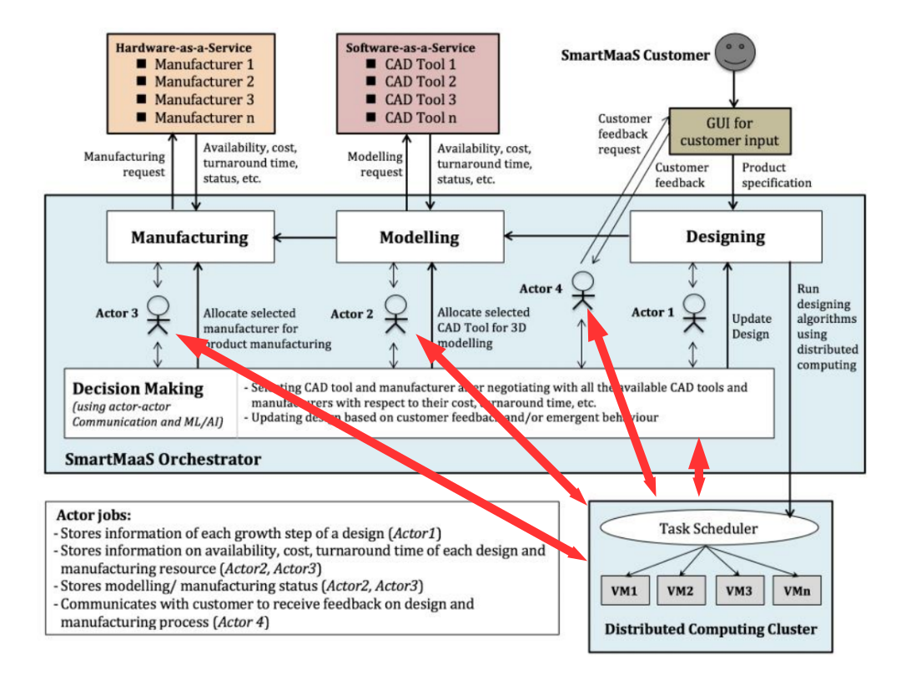
Evolution as Task Scheduler

Slide 13
Evolvable Shape Seeds:
Progress at York
Simon Hickinbotham
sjh518@york.ac.uk

