Slide 1
State of the project
FranČesko Kalvas
Guram Mikaberidze

Slide 2
Main results
Chat GPT: we find path dependence, but not bistability
Numeric Simulation: for replication of phenomena like ‘Black Pete’ we need to employ concept of boundary/ uncertainty/ latitude of acceptance from Hegselmann-Krause model
Numeric Simulation: polarization and replication of ‘Black Pete’ scenario are mainly given by macro level factors: communication rate, folding point and memorizing/ forgetting. From the micro level factors, boundary is the most powerful. But it doesn’t matter whether this factor is constant over the whole population or is normally distributed

Slide 3
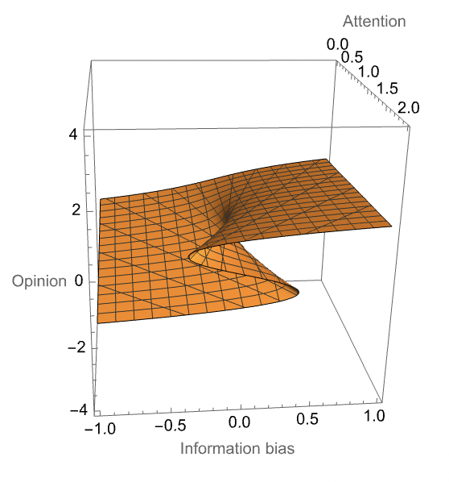
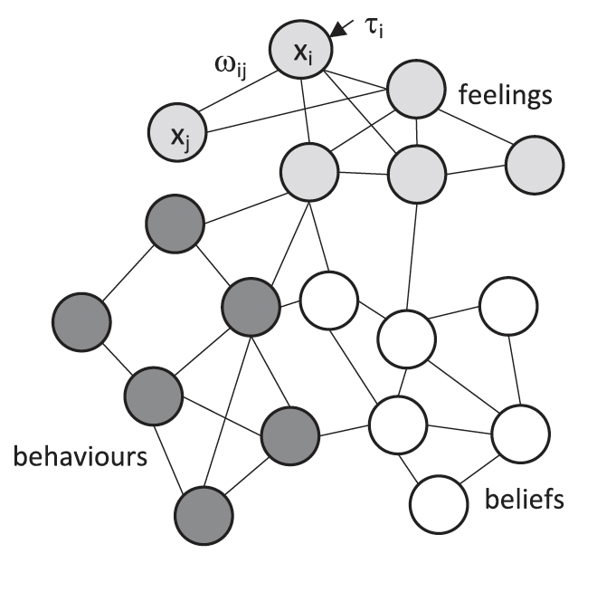
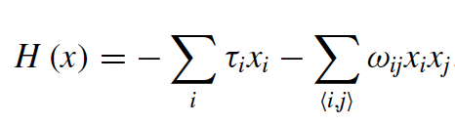
Cusp catastrophe in opinion dynamics : Ising of opinion
Binary aspects: Feelings, behaviours, and beliefs determine person’s opinion on a topic.
Cognitive bias: Connected aspects tend to align if attention is high.
External field: Each aspect is influenced by other people.
Binary node state (feelings, behaviors, beliefs)
Node interactions
External influences
Temperature→Inverse attention External field→Information bias Magnetization→Opinion
van der Maas, Han LJ, Jonas Dalege, and Lourens Waldorp. "The polarization within and across individuals: The hierarchical Ising opinion model." Journal of complex networks 8, no. 2 (2020): cnaa010.

Slide 4
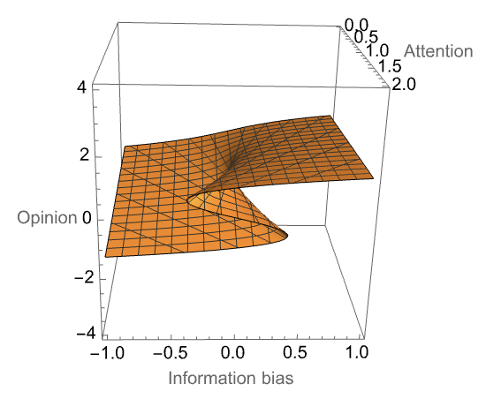
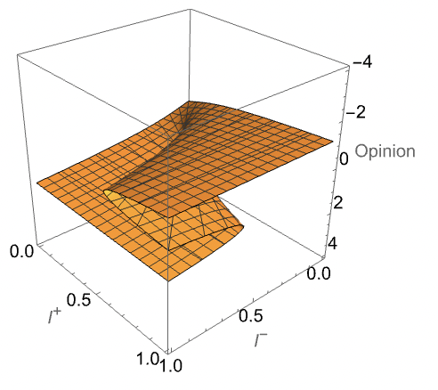
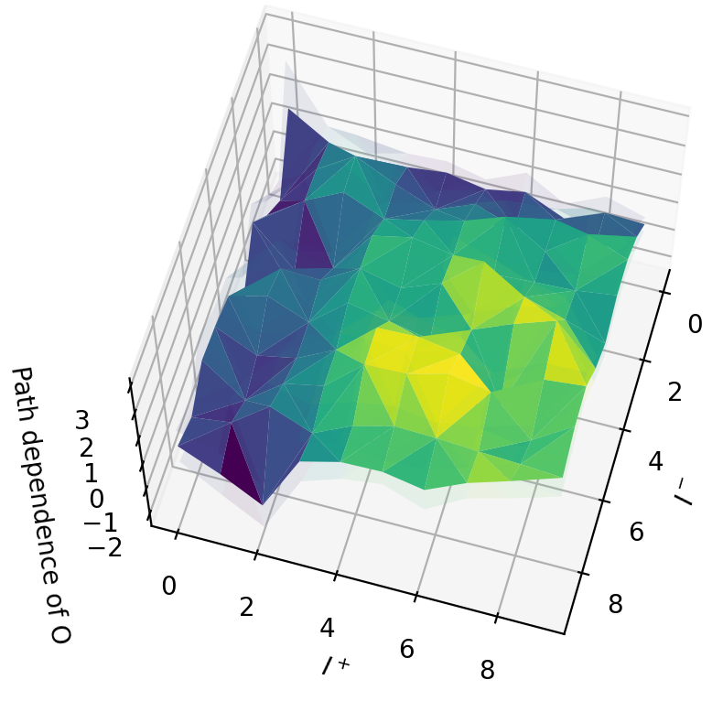
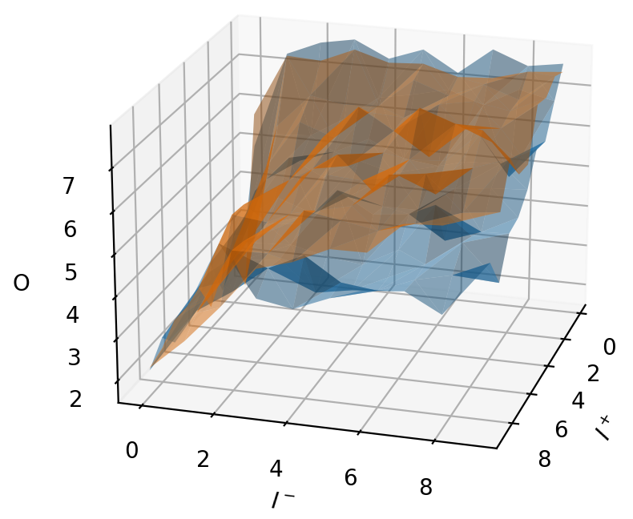
Simplification and experiments
More symmetry → fewer parameters → happier life
Info. bias
Negative info
rotate
Positive info
Attention
Path dependence in ChatGPT
But no bistability (sparse network Ising)
positive info first
negative info first

Slide 5
ChatGPT results
We find hysteresis (path dependence)
positive info first
negative info first

Slide 6
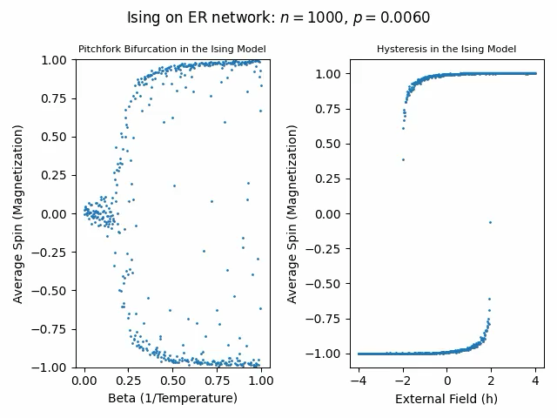
ChatGPT results
We didn’t find bistability
This is similar to Ising model on a very sparse network

Slide 7
ChatGPT
The information used for the ChatGPT experiments
GOOD = [
"Dave Smith has volunteered at a local homeless shelter a few times in the past.",
"Dave Smith has shown some potential for leadership skills in minor projects at work.",
"Dave Smith enjoys playing music as a hobby and occasionally performs at casual gatherings.",
"Dave Smith maintains an acceptable academic performance, meeting the basic requirements of his studies.",
"Dave Smith occasionally participates in community clean-up drives to contribute to a cleaner environment.",
"Dave Smith has offered occasional advice to individuals when available.",
"Dave Smith is willing to lend an ear and provide support to friends and family when possible.",
"Dave Smith sometimes donates to charitable organizations, showing occasional support for causes he cares about.",
"Dave Smith cooperates with his team at work, fulfilling his responsibilities adequately.",
"Dave Smith has an interest in cooking and occasionally prepares meals for friends and family to enjoy."
]
BAD = [
"Dave Smith has frequently been late to meetings, causing significant inconvenience to colleagues and disrupting the schedule.",
"Dave Smith consistently interrupts others during conversations, often disregarding their thoughts and opinions.",
"Dave Smith has accumulated numerous traffic citations for various offenses, including reckless driving and running red lights.",
"Dave Smith frequently procrastinates, often resulting in rushed and subpar submissions of assignments or tasks.",
"Dave Smith struggles to control anger in stressful situations, leading to frequent outbursts and confrontations.",
"Dave Smith habitually exaggerates his achievements and experiences when sharing stories, often distorting the truth.",
"Dave Smith has a history of borrowing items from friends and acquaintances without returning them or acknowledging the act.",
"Dave Smith lives in a consistently disorganized and cluttered personal space, making it difficult to maintain order.",
"Dave Smith frequently cancels plans on short notice, displaying a lack of consideration for others' time and commitments.",
"Dave Smith regularly ignores or forgets to respond to text messages and emails, causing communication gaps and misunderstandings."
]

Slide 8
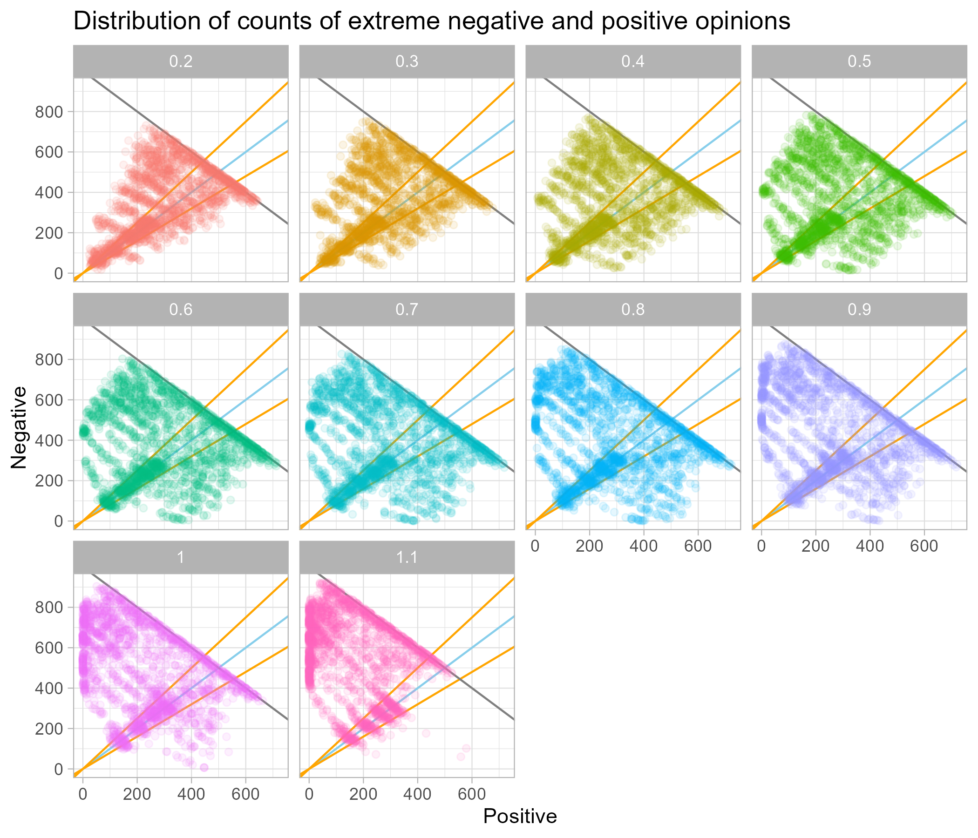
Latitude of acceptance

